Slide 1
Algorithms for Computing Variants of the Longest Common Subsequence Problem
M. S. Rahman and C. S. Iliopoulos
ISAAC 2006, LNCS 4288,
pp. 399-408, 2006
Date: Aug. 13, 2008
Introducer: Hsing-Yen Ann

Slide 2
Abstract
The longest common subsequence (LCS) problem is one of the classical and well-studied problems in computer science. The computation of the LCS is a frequent task in DNA sequence analysis, and has applications to genetics and molecular biology. In this paper we define new variants, introducing the notion of gap-constraints in LCS problem and present efficient algorithms to solve them.

Slide 3
Some Variants of LCS Problem
In this paper, following variants are defined:
  Fixed gap LCS
  Elastic gap LCS
  Rigid fixed gap LCS
  Rigid elastic gap LCS
  Elastic (可伸縮的), Rigid (嚴格的)

Slide 4
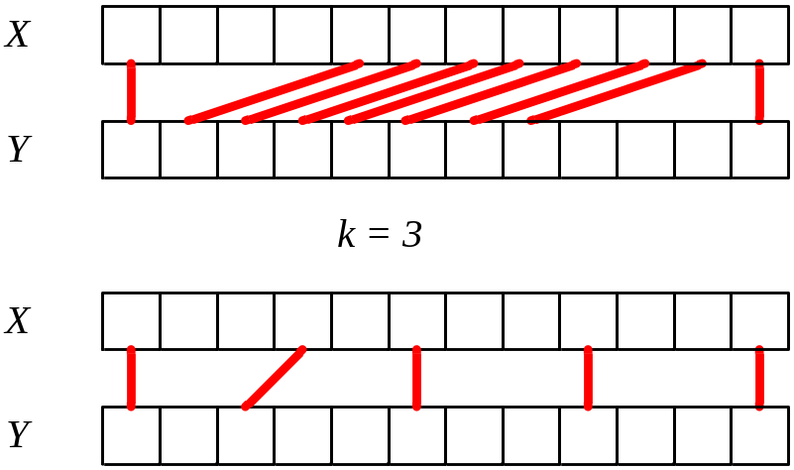
Fixed Gap LCS Problem (1/2)
Input
  Strings X and Y
  Integer k
Output
  The LCS constrained by k, where the distance between two consecutive matches is less than or equal to k.

Slide 5

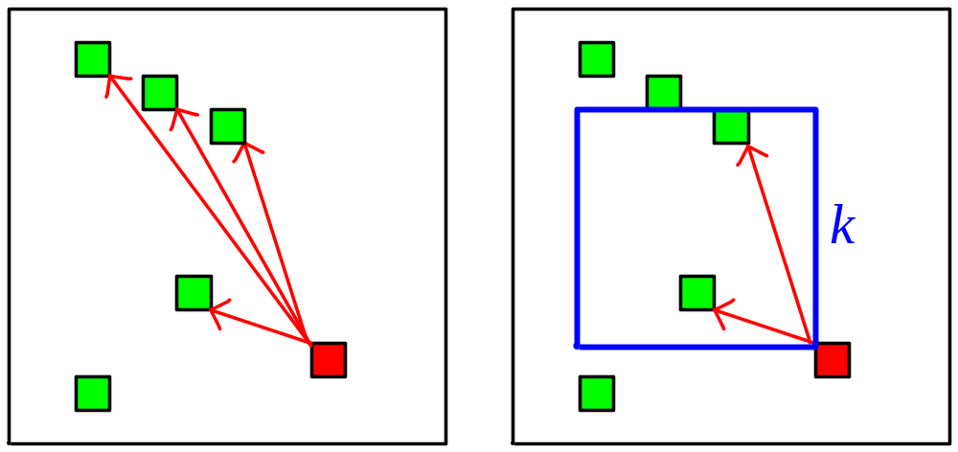
Fixed Gap LCS Problem (2/2)

Slide 6
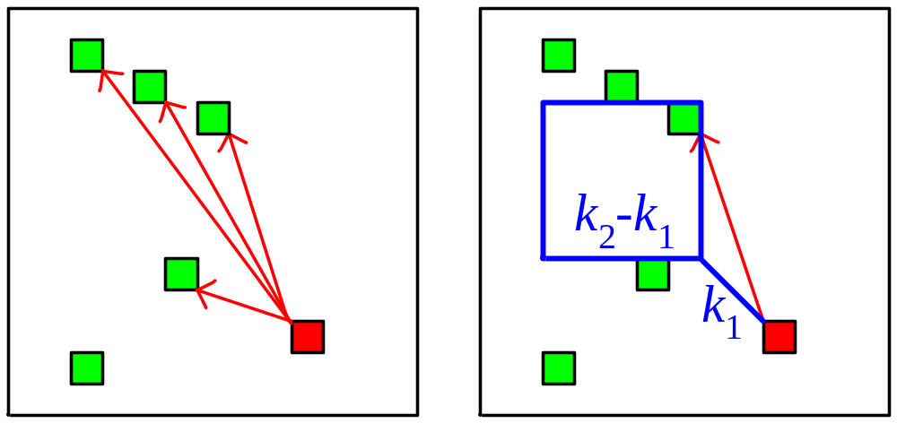
Elastic Gap LCS Problem
Given strings X and Y and integers k₁ and k₂
General problem of fixed gap LCS problem

Slide 7
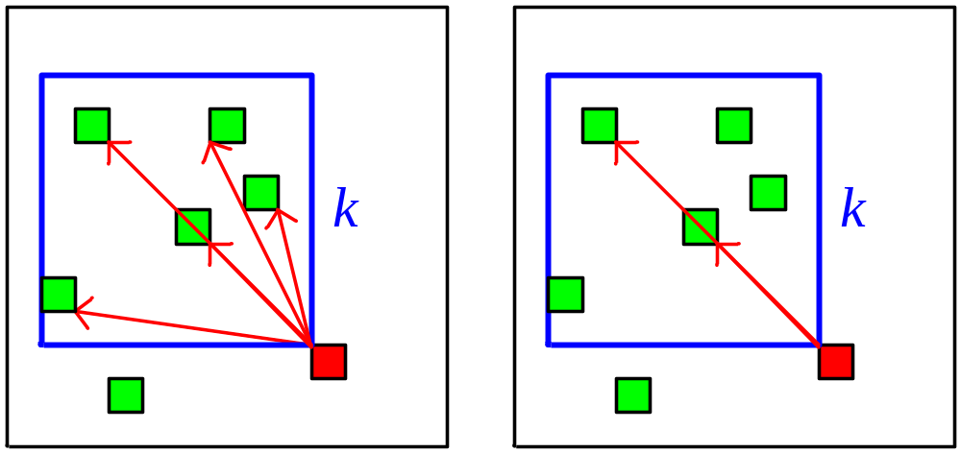
Rigid Fixed Gap LCS Problem
Rigid: distance in X and distance in Y are the same for each two consecutive matches (dx = dy)

Slide 8
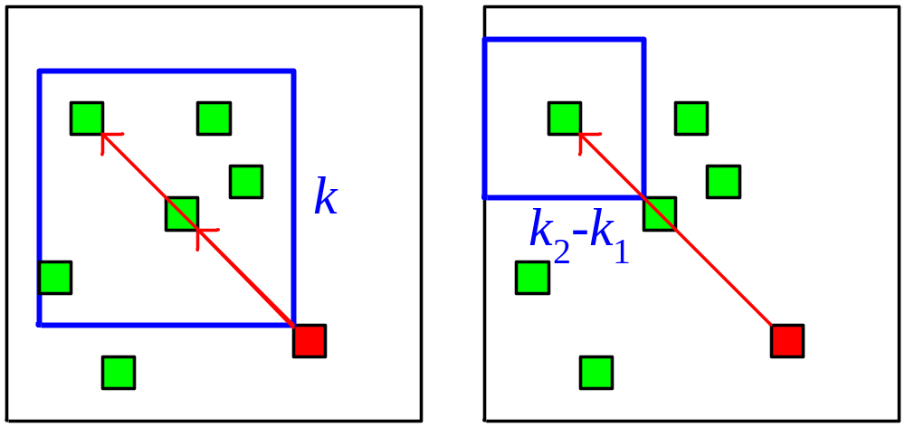
Rigid Elastic Gap LCS Problem
General problem of rigid fixed gap LCS

Slide 9
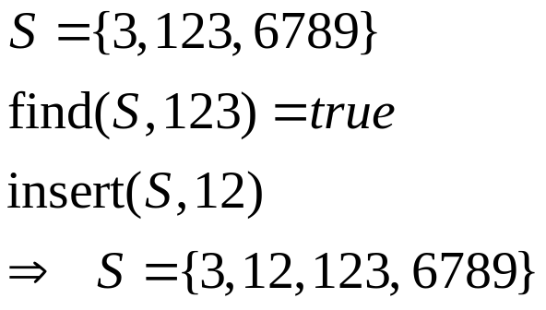
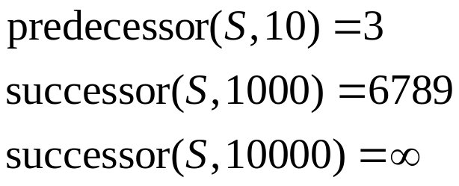
van Emde Boas (vEB) Tree
A magic data structure which maintains a sorted set within range [1..U] and provides the following
O(log log U)-time operations in worst case.
  Insertion, deletion, find, predecessor, successor
  O(U) space is initialized before it to be used.

Slide 10



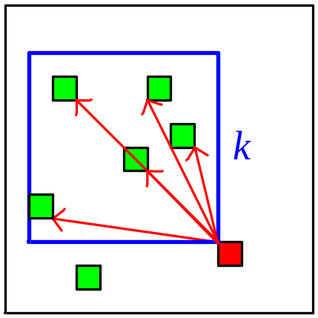
Algorithm 1 for Fixed Gap LCS
Hunt-Szymanski-like brute force method
Ordering the matched pairs by sorting
Ordering the matched pairs by vEB tree!?
Total time:

Slide 11
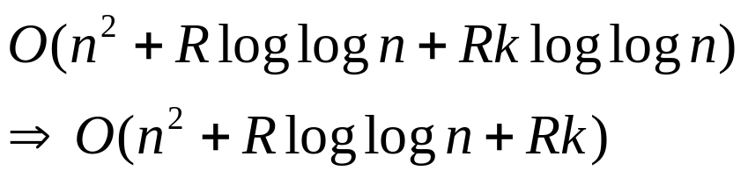
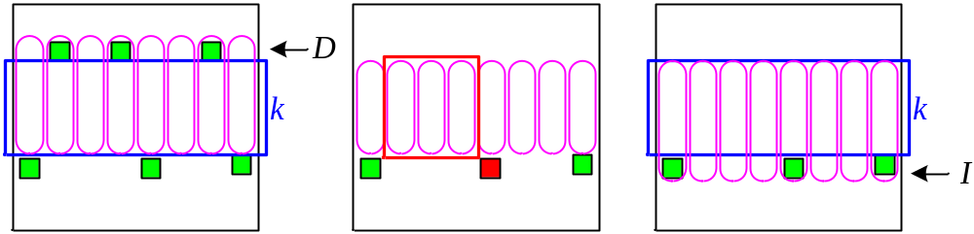
Algorithm 2 for Fixed Gap LCS
Using n vEB trees to find the maximum in the k²-square
For each row, maintain the Insert List and Delete List
Total time:
Find max only when
the vEB is inserted!

Slide 12
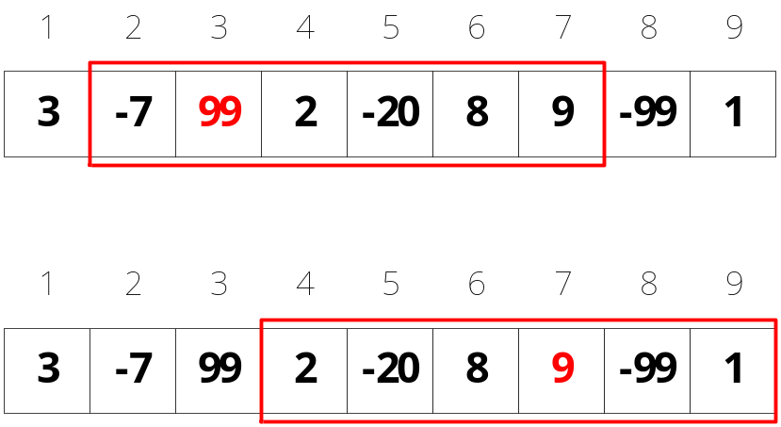
Range Maximum Query (RMQ)
Given an array A and a range [i, j], find the maximum in the range [i, j]
Can be solved in O(n) preprocessing time and O(1) query time.

Slide 13

Algorithm 3 for Fixed Gap LCS
Find the maximum in the k²-square by RMQ
Total time:

Slide 14
Conclusions
Fixed gap LCS can be solved in time and O(n²) space.
Elastic gap LCS can be solved by similar strategy.
Rigid fixed/elastic gap LCS can be solved by Hunt-Szymanski-like brute force method.
The advantage algorithm for rigid fixed gap LCS shown in this paper is incorrect. (Counterexample exists!)

