Slide 1
A Fast Clustering Algorithm Based on Pruning Unnecessary Distance Computations in DBSCAN for High-Dimensional Data
Yewang Chen(陈叶旺) , Shengyu Tang(汤盛宇) , Nizar Bouguila
Cheng Wang(王成) , Jixiang Du(杜吉祥) , HaiLin Li(李海林)
Pattern Recognition 83 (2018) 375-387
Presenter：Kuan-Lin Lai
Date: 2019 / 01 / 22

Slide 2
Abstract(1/2)
Clustering is an important technique to deal with large scale data which are explosively created in internet. Most data are high-dimensional with a lot of noise, which brings great challenges to retrieval, classification and understanding. No current existing approach is “optimal” for large scale data. For example, DBSCAN requires O(n²) time, Fast-DBSCAN only works well in 2 dimensions, and ρ-Approximate DBSCAN runs in O(n) expected time which needs dimension D to be a relative small constant for the linear running time to hold. However, we prove theoretically and experimentally that ρ-Approximate DBSCAN degenerates to an O(n²) algorithm in very high dimension such that 2^{D} > > n.

Slide 3
Abstract(2/2)
In this paper, we propose a novel local neighborhood searching technique, and apply it to improve DBSCAN, named as NQ-DBSCAN, such that a large number of unnecessary distance computations can be effectively reduced. Theoretical analysis and experimental results show that NQ-DBSCAN averagely runs in O(n∗log(n)) with the help of indexing technique, and the best case is O(n) if proper parameters are used, which makes it suitable for many realtime data.

Slide 4
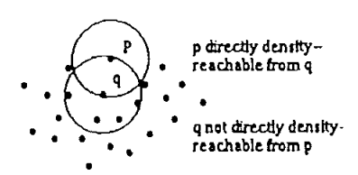

Some definitions
core point: $\left|N_{ε}\right.(p\left.)\right|≥MinPts$
directly density-reachable: p is directly density-reachable from a point q with respect to $ε$ and MinPts if p ∈ N (q) and q is a core point.

Slide 5
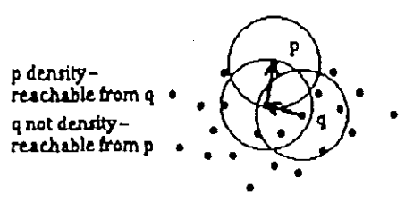
Some definitions
density-reachable: p is density-reachable from a point q with respect to and MinPts if there is a chain of points p₁, p₂, ..., p_{n}, with p₁ = q and p_{n} = p such that p_{i+1} is directly density-reachable from p_{i}.

Slide 6
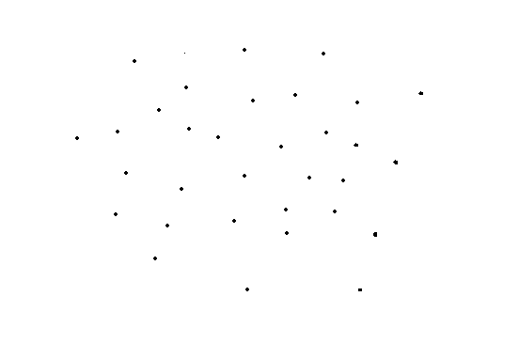
DBSCAN: MinPts=6

Slide 7
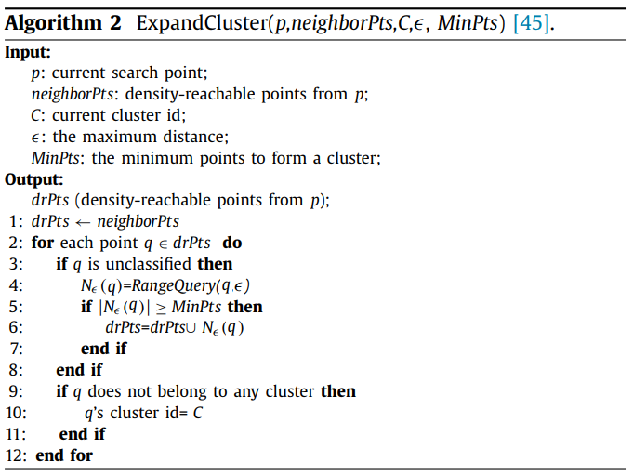
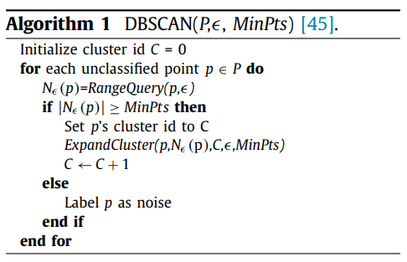
DBSCAN

Slide 8
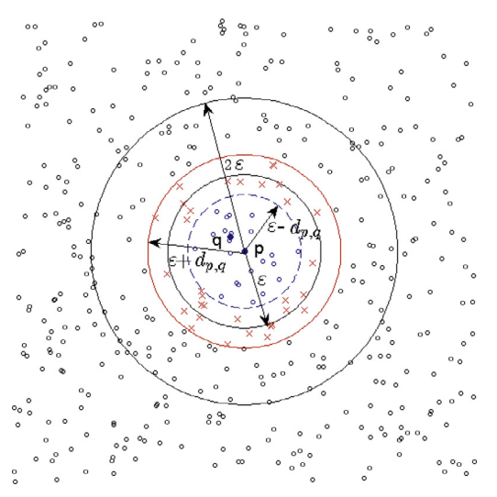
NQ-DBSCAN

Slide 9

NQ-DBSCAN
(1) If $d_{p,(MinPts)}$ ≤$ε$, then p is a core point. (2) p is a non-core point if $d_{p,(i)}$ > $ε$, where 1 ≤ i ≤ MinPts.
b = p(2)
a = p(1)
c = p(3)
p
d_{p,c} = d_{p,(3)}

Slide 10
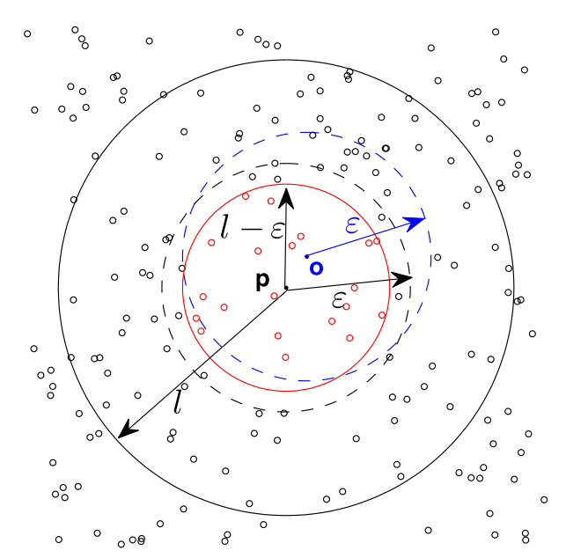

NQ-DBSCAN
Let p ∈ P, if |$N_{2ε}$(p)| < MinPts, then ∀q ∈ $N_{ε}$(p) is non-core point.
Let p ∈ P , and $d_{p,(MinPts)}$ = l, if l > $ε$ then ∀ o ∈ O, o is a non-core point, where O = {o|$d_{o,p}$< l − $ε$}.

Slide 11
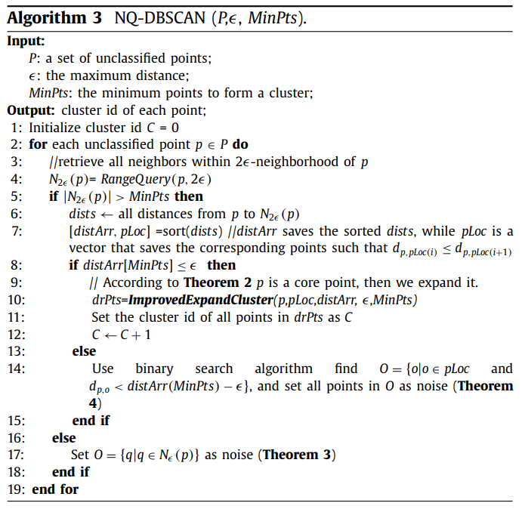
NQ-DBSCAN

Slide 12

NQ-DBSCAN
$If d_{p,m}<ε−d_{p,q}, then m∈N_{ε}\left(q\right)$
$If d_{p,m}> ε+d_{p,q}, then m\text{∉ }N_{ε}\left(q\right)$
Let p, q ∈ P, and N₂$ε$(p) is already obtained, in order to get N$ε$(q), the searching range is p_{(L)}, p_{(L+1)}, ..., p_{(U-1)}, p_{(U)}, where L, U satisfy d_{p,p(L−1)} < $ε$− d_{p,q} < d_{p,p(L)} d_{p,p(U)} <$ε$+ d_{p,q} < d_{p,p(U+1)} .

Slide 13
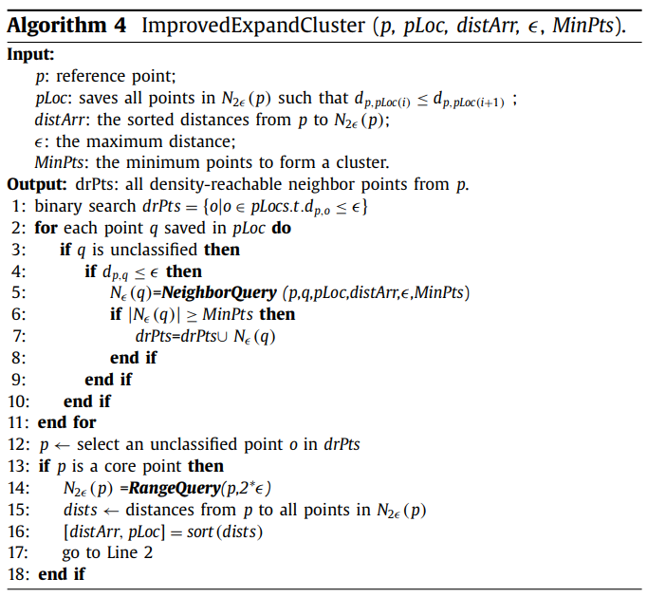
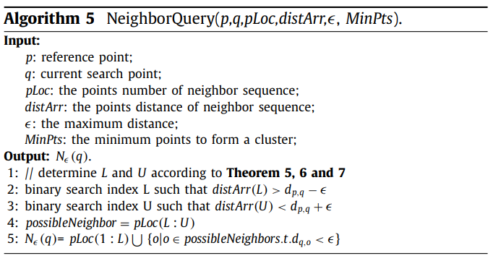
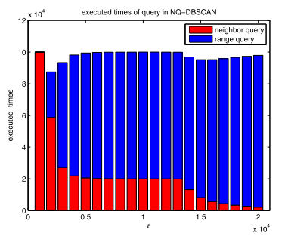
NQ-DBSCAN

Slide 14
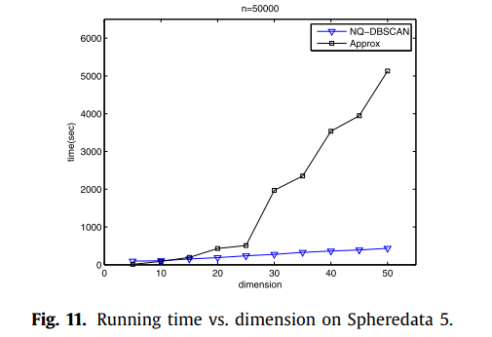
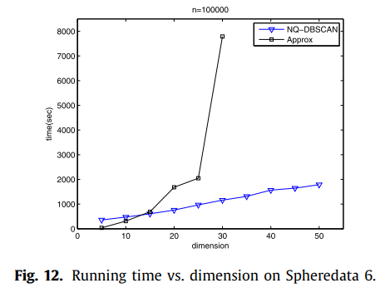
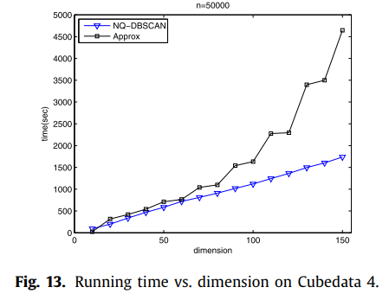
Experiments

Slide 15
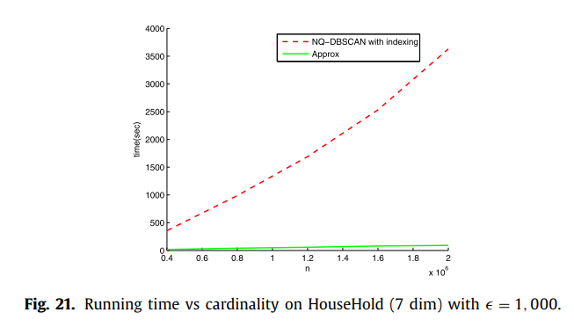
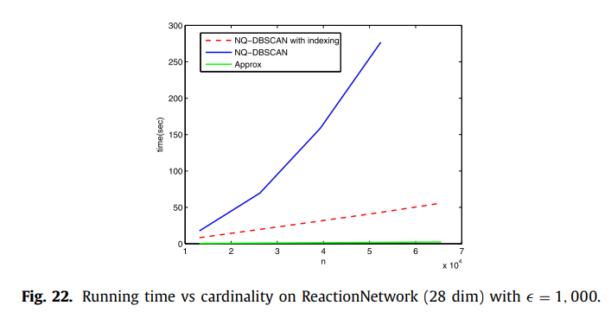
Experiments

Slide 16
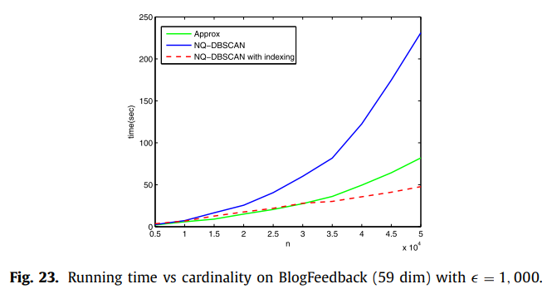
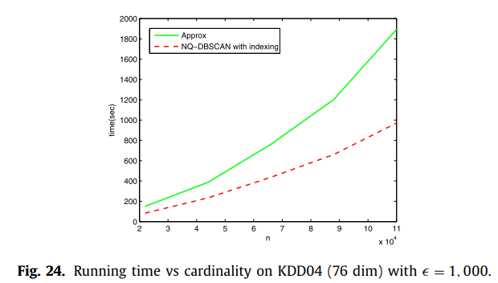
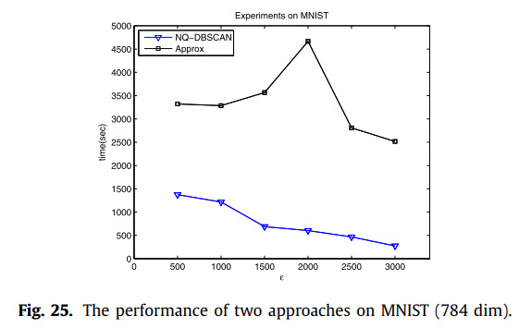
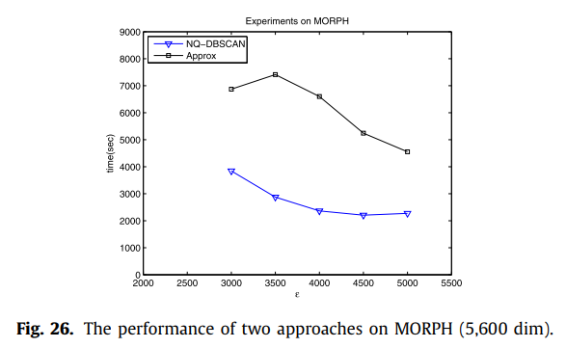
Experiments

