Slide 1
Classification of fMRI data using Dynamic Time Warping based functional connectivity analysis
Regina Meszlényi, Ladislav Peska, Viktor Gál, Zoltán Vidnyánszky, Krisztian Buza
24th European Signal Processing Conference (EUSIPCO),2016, Pages 245 – 249, Budapest, Hungary
Speaker: Jheng-Yan Lyu
Date: 2019.01.22

Slide 2
Abstract (1/2)
The synchronized spontaneous low frequency fluctuations of the BOLD signal, as captured by functional MRI measurements, is known to represent the functional connections of different brain areas. The aforementioned MRI measurements result in high-dimensional time series, the dimensions of which correspond to the activity of different brain regions. Recently we have shown that Dynamic Time Warping (DTW) distance can be used as a similarity measure between BOLD signals of brain regions as an alternative of the traditionally used correlation coefficient. We have characterized the new metric’s stability in multiple measurements, and between subjects in homogenous groups.

Slide 3
Abstract (2/2)
In this paper we investigated the DTW metric’s sensitivity and demonstrated that DTW-based models outperform correlation-based models in resting-state fMRI data classification tasks. Additionally, we show that functional connectivity networks resulting from DTW-based models as compared to the correlation-based models are more stable and sensitive to differences between healthy subjects and patient groups.

Slide 4

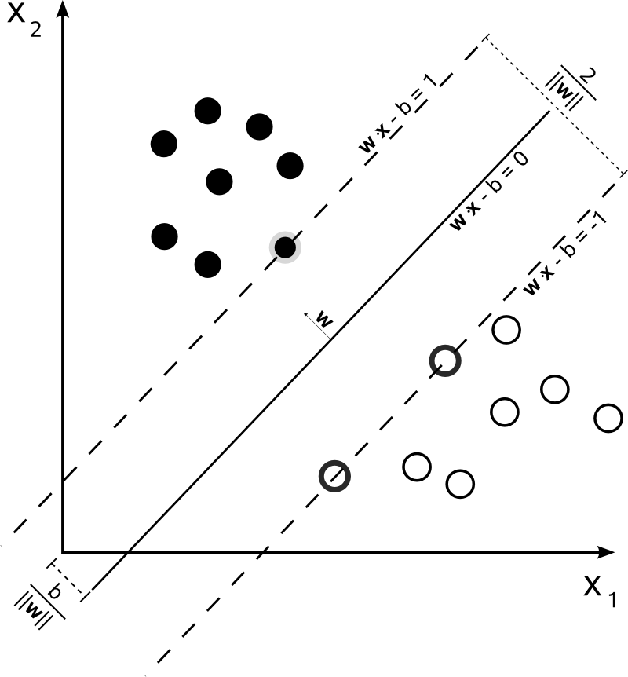
Classifiers
SVM:
SVM objective is to find optimal hyperplane 𝑥𝑇𝛽+𝛽0=0, separating training examples of the both classes:
subject to ∀𝑖: 𝜉𝑖≥0,𝑦𝑖(𝑥𝑖𝑇𝛽+𝛽0)≥1−𝜉𝑖

Slide 5
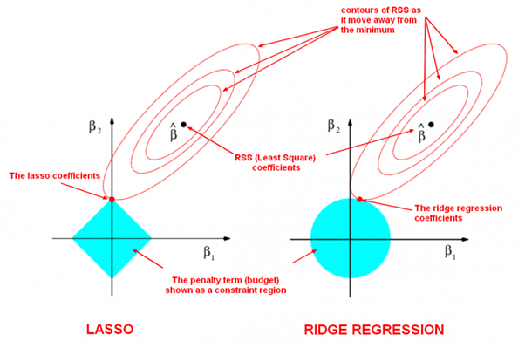

Classifiers
LASSO regression:
The LASSO’s objective is to find the parameter vector 𝜃⃑ that minimizes the sum of squared errors and the regularization term:

Slide 6
Correlation Based Method
Correlation Based Method:
The idea of the correlation of parts of one image with parts of the next (in order to find image flow) has been used more often as part of flow estimating algorithms than as a single method in its own right.

Slide 7
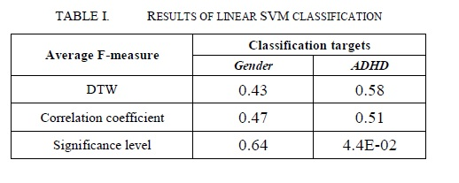
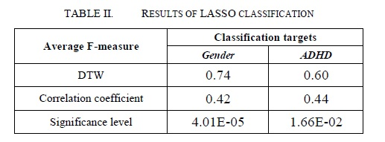
Results

Slide 8
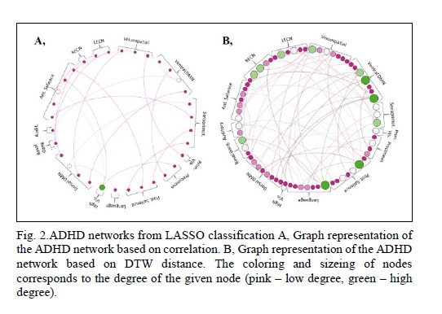
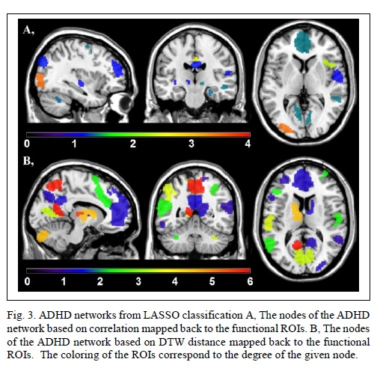
Results

Slide 9
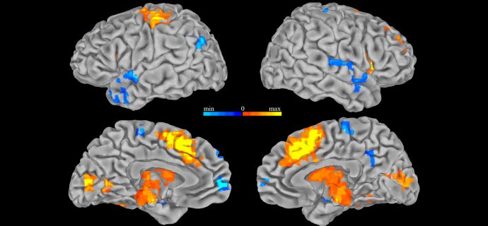
functional Magnetic Resonance Imaging(FMRI)
d

