Slide 1
On Multiple Longest Common Subsequence and Common Motifs with Gaps (Extended Abstract)
Suri Dipannita Sayeed, M. Sohel Rahman, and Atif Rahman
Proceedings of the 12th Workshop on Algorithms and Computation (WALCOM 2018), Dhaka, Bangladesh, March 3-5, 2018.
Presenter: Guo-Fong Huang
Date: Mar. 5, 2019

Slide 2
Abstract
Motif finding is the problem of identifying recurring patterns in sequences. It has been widely studied and several variants have been proposed. Here, we address the problem of finding common motifs with gaps that are present in all strings of a finite set. We prove that the problem is NP-hard by reducing the multiple longest common subsequence (MLCS) problem to it. We also provide a branch and bound algorithm for MLCS and show how the algorithm can be extended to give an algorithm for finding common motifs with gaps after common factors that occur in all the strings have been identified.

Slide 3
Preliminaries: Common Motifs with Gaps
A set of strings S = {S₁, S₂, .., S_{d}}
Alphabet Σ = {A, C, G, T}
Two integers p,q, where 1 ≤ p ≤ q ≤ min(|S_{j} | : j ∈ {1,...,d})
For example:
common motifs, p=1, q=2
S₁ = ACAAAACACAAA
S₂ = ACACCAACCACA
S₃ = CACAAACCACCA
optimization version: maximum common words
decision version: give m, find whether there is a common motif with gaps with ≥ m factors.

Slide 4
Preliminaries: Multiple Longest Common Subsequence
A set of strings S = {S₁, S₂, .., S_{d}}
S₁ = informatics
S₂ = bioinformatics
S₃ = proteomics
optimization version: find longest common subsequecne in S
decision version: give m, find whether there is a m length solution of MLCS in S.

Slide 5
Complexity of Common Motifs with Gaps
Complexity of Common Motifs with Gaps
MLCS ≤_{P} CMG
001 010 011 100
010 001 011 100
001 011 010 100
AAC G ACA G ACC G CAA
ACA T AAC T ACC T CAA
AAC T ACC T ACA T CAA
abcd
bacd
acbd
1234
2134
1324
⇒
⇒
⇒
p = ⌈ log |Σ|⌉

Slide 6
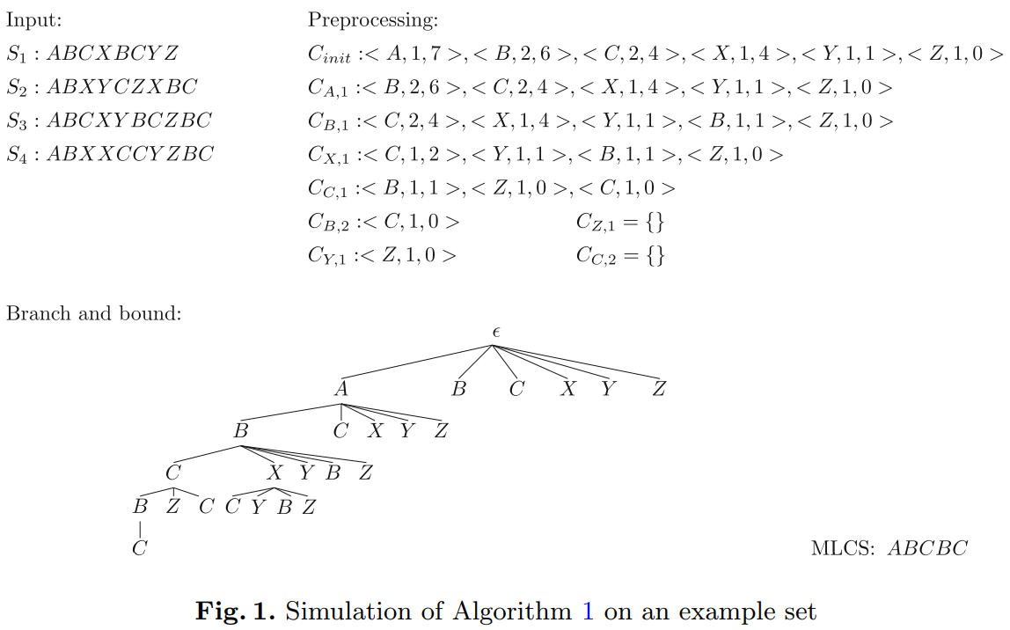

A Branch and Bound Algorithm for MLCS Problem
X=AGCGTGC Y=CTACGCG
Z=GCACGCT
longest common suffix:
$$ε\left(i,j\right)>0 iff lcs\left(n−i+1,j,Z,Y\right)≥j−i+1$$

Slide 7
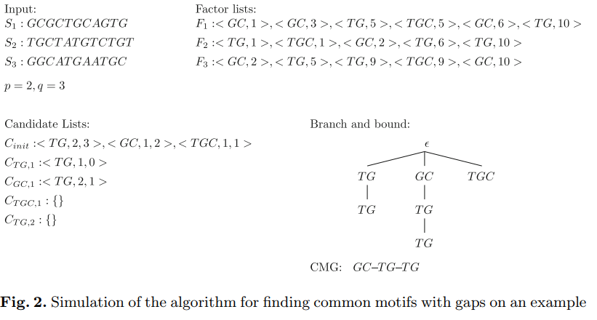
A Branch and Bound Algorithm for CMG Problem
X=AGCGTGC Y=CTACGCG
Z=GCACGCT
longest common suffix:
$$ε\left(i,j\right)>0 iff lcs\left(n−i+1,j,Z,Y\right)≥j−i+1$$

