Slide 1
Segmentation of Time Series in Improving Dynamic Time Warping
Ruizhe Ma, Azim Ahmadzadeh, Soukaina Filali Boubrahimi, Rafal A. Angryk
Proceeding of IEEE International Conference on Big Data
Seattle, WA, USA, 10-13 Dec. 2018
Presenter: Shan-Ru Liu
Date: March 5, 2019

Slide 2
Abstract (1/2)
Since its introduction to the computer science community, the Dynamic Time Warping (DTW) algorithm has demonstrated good performance with time series data. While this elastic measure is known for its effectiveness with time series sequence comparisons, the possibility of pathological warping paths weakens the algorithms potential considerably. Techniques centering on pruning off impossible mappings or lowering data dimensions such as windowing, slope weighting, step pattern, and approximation have been proposed over the years to reduce the possibility of pathological warping paths with Dynamic Time Warping. However, because the current DTW improvement techniques are mostly global methods, they are either limited in effect or limit the warping path excessively.

Slide 3
Abstract (2/2)
We believe segmenting time series at significant feature points will alleviate some of the pathological warpings, and at the same time allowing us to obtain more intuitive warpings. Our heuristic approaches the problem from the human perspective of sequence comparison: by identifying global similarity before local similarities. We use easily identifiable peaks as the significant feature. The final distance is the DTW distance sum of all segments of time series. In this paper, we explore the impact of different peak identification parameters on Dynamic Time Warping and demonstrate how segmentation can help to avoid pathological warpings.

Slide 4
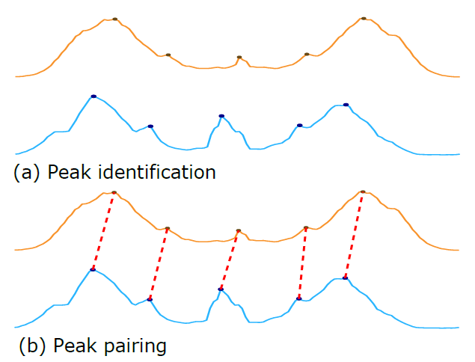
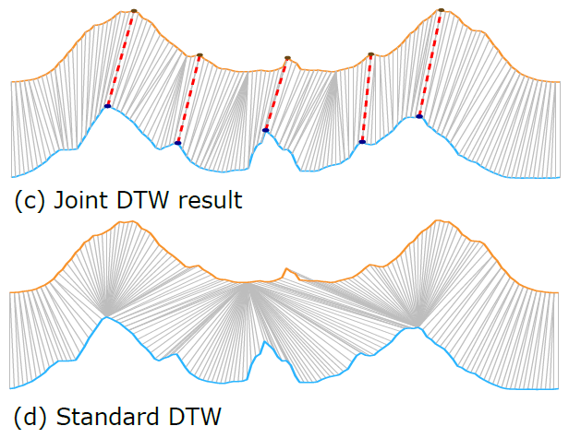
Segmentation of Time Series

Slide 5
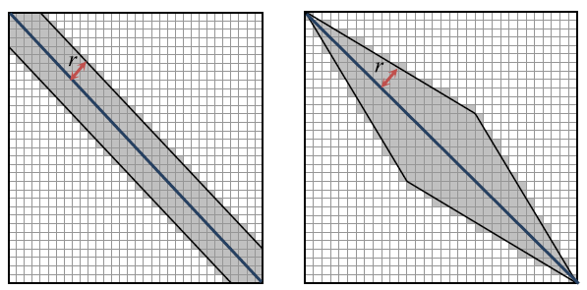
DTW
Global Warping Constraints:
Sakoe-Chiba band, Itakura parallelogram
Lower Bounding:
LB_Kim, LB_Yi, LB_Keogh

Slide 6
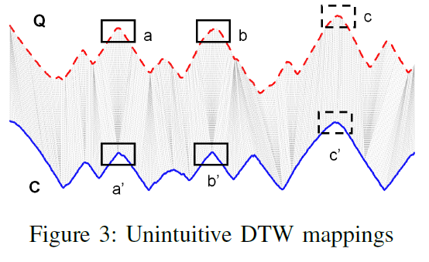
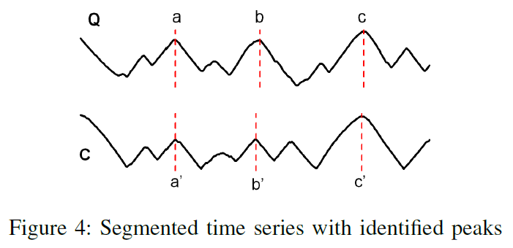
Time Series Segmentation

Slide 7
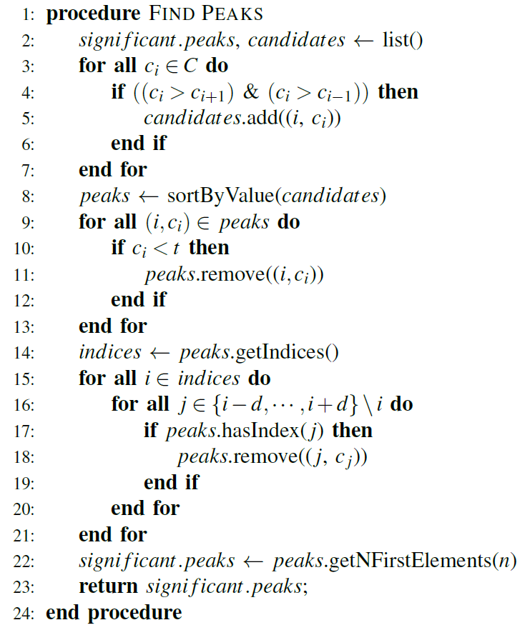
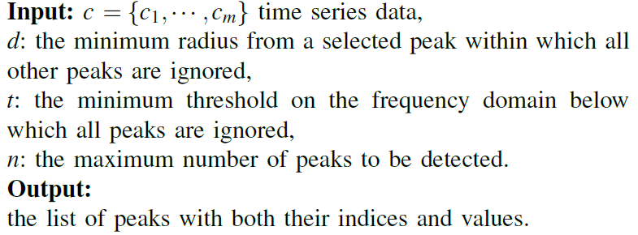
Time Series Peak Selection

Slide 8
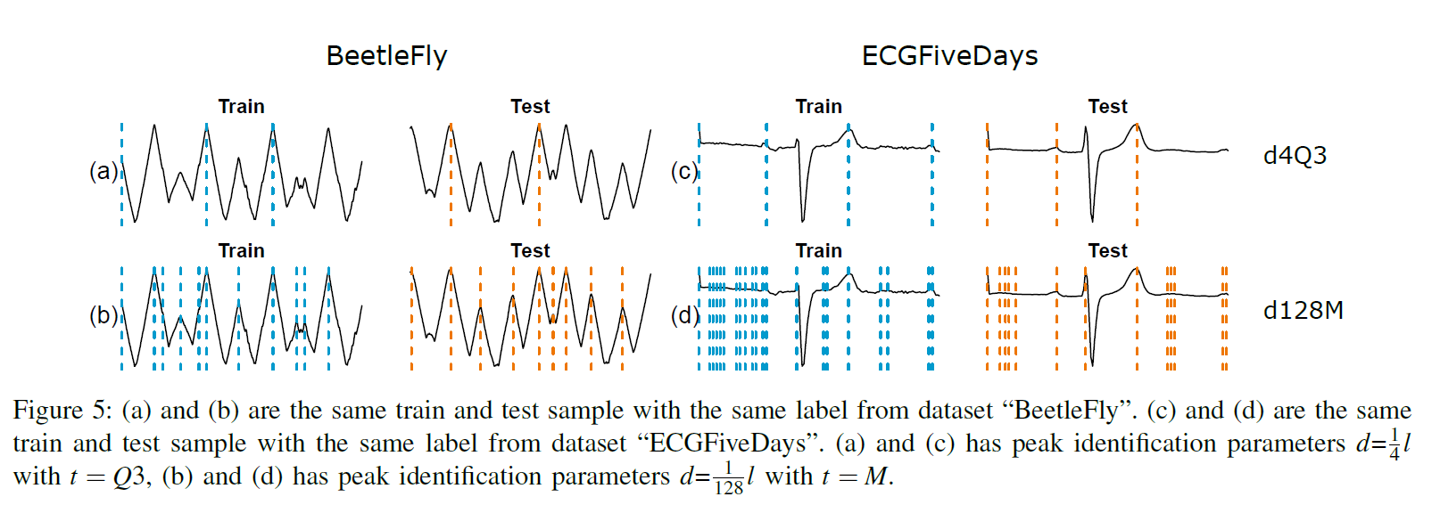
Results (1/3)
Q1: the first quartile
M: median
Q3: the third quartile

Slide 9
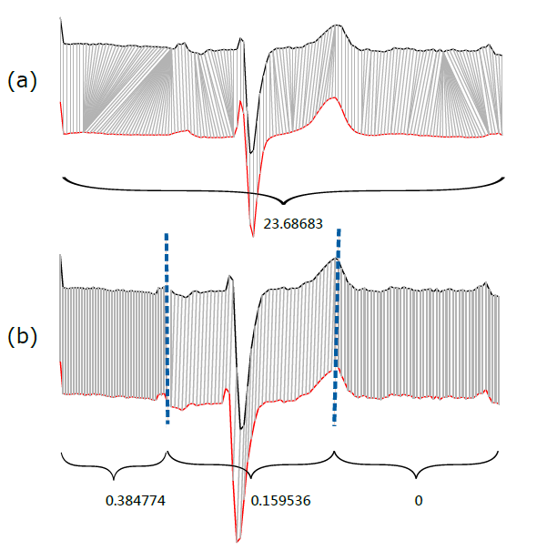
Results (2/3)

Slide 10
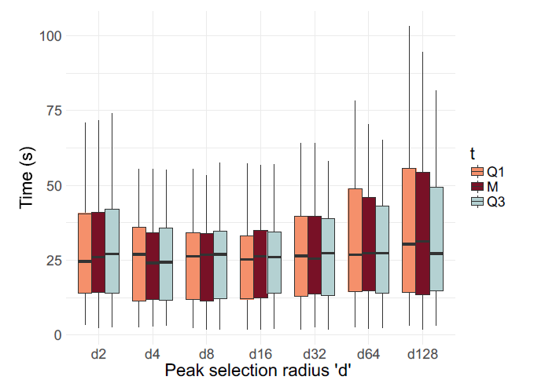
Results (3/3)
Q1: the first quartile
M: median
Q3: the third quartile

