Slide 1
Voronoi-Based K Nearest Neighbor Search for Spatial Network Databases
Mohammad Kolahdouzan and Cyrus Shahabi
Proceedings of the 30th VLDB Conference,
Toronto, Canada, 2004
Presenter: Ke-Xin Zhu
Date: 2019/03/05
Notes:
https://www.google.com.tw/maps/place/%E5%8A%A0%E6%8B%BF%E5%A4%A7%E5%AE%89%E5%A4%A7%E7%95%A5%E5%A4%9A%E5%80%AB%E5%A4%9A/@43.6570403,-79.4609327,11z/data=!3m1!4b1!4m5!3m4!1s0x89d4cb90d7c63ba5:0x323555502ab4c477!8m2!3d43.653226!4d-79.3831843?hl=zh-TW
https://www.researchgate.net/scientific-contributions/8269618_Mohammad_R_Kolahdouzan

Slide 2
Abstract (1/2)
A frequent type of query in spatial networks (e.g., road networks) is to find the K nearest neighbors (KNN) of a given query object. With these networks, the distances between objects depend on their network connectivity and it is computationally expensive to compute the distances (e.g., shortest paths) between objects. In this paper, we propose a novel approach to efficiently and accurately evaluate KNN queries in spatial network databases using first order Voronoi diagram.This approach is based on partitioning a large network to small Voronoi regions, and then pre-computing distances both within and across the regions.

Slide 3
Abstract (2/2)
By localizing the pre-computation within the regions, we save on both storage and computation and by performing across-the-network computation for only the border points of the neighboring regions, we avoid global pre-computation be- tween every node-pair. Our empirical experiments with several real-world data sets show that our proposed solution outperforms approaches that are based on on-line distance computation by up to one order of magnitude, and provides a factor of four improvement in the selectivity of the filter step as compared to the index-based approaches.

Slide 4
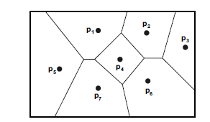
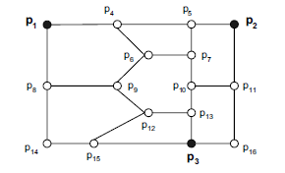
1.INTRODUCTION
KNN in SDB(spatial databases.)：
Given spatial objects (or points of interest), and a query point, find the K closest objects.
KNN in SNDB(spatial network databases):
Depend on the connectivity of the network rather than the objects’ locations.

Slide 5
1.INTRODUCTION
Voronoi-based Network Nearest Neighbor (VN³):
(1) Partition large network into smaller/more manageable regions;
(2) Pre-compute the intra and inter distances for each cell;
(3) Find the first NN by contain(q);
(4) Find next NNs within the adjacent cells ;
(5) Compute the actual network distance.
Compare with INE(Incremental Network Expansion).

Slide 6

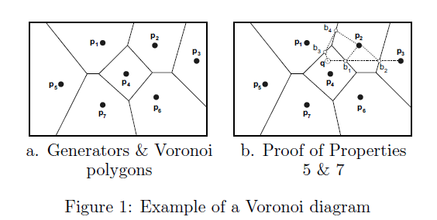
2.Background: Voronoi Diagram
Definition:

Slide 7
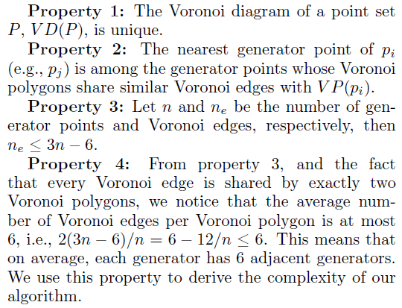
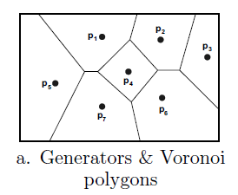
2.Background: Voronoi Diagram
Properties:

Slide 8
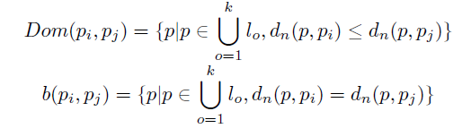
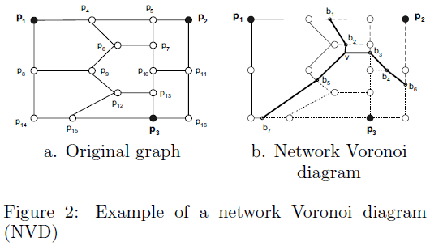

2.Background: Voronoi Diagram
Network Voronoi Diagram:

Slide 9
3. Voronoi-Based Network Nearest Neighbor: VN³
VN³ :
(1) Find the first NN;
(2) Filter process;
(3) Refinement process;
(4) Invoked (2)(3) k times.
Store components:
(1) Save-1: Pre-calculation of the solution space;
(2) Save-2: Utilization of an index structure;
(3) Save-3: Pre-computation of the exact distances for small portion of data.

Slide 10

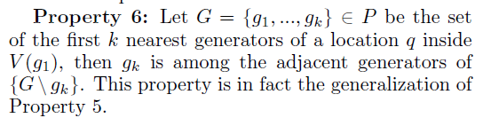
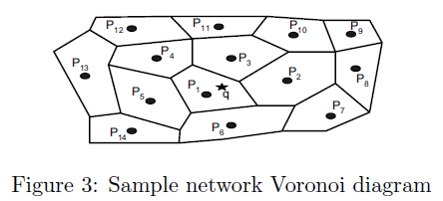
3.1 VN³ Filter Step
P1-> C = {P2, P3, P4, P5, P6} -> P3 -> C = {P2, P4, P5, P6, P10, P11, P12}.
Size: O(K).
Disk Block Accesses: O(K + log(n)).

Slide 11


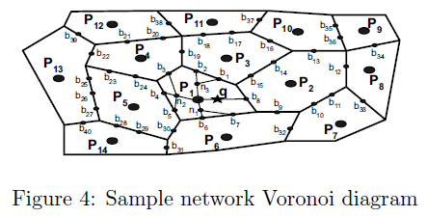
3.2 VN³ Refinement Step
P2B: Generator to border;
Q2B: Query to border;
B2B: Border to border.
Save-3.1: P2B.

Slide 12
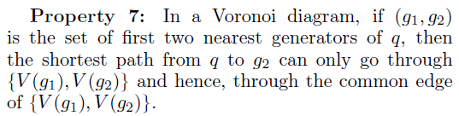
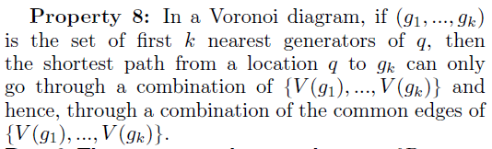

3.2 VN³ Refinement Step
Border to Border Computations:
Save-3.3;
NVP(P1): {b1, ..., b8};
NVP(P3): {b1, b2, b14, ..., b19}.

Slide 13
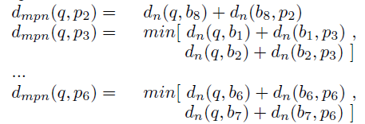

3.2 VN³ Refinement Step
minimum possible network distances, d_{mpn}:
d_{mpn}(q, pi) ≥ dn(q, pi);
Assume that p2 is 2nd NN, pi ∈(p3, p4, p5, p6, p7, p8, p10);

Slide 14
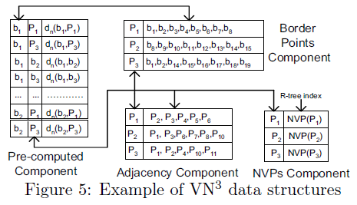
3.3 VN³ Storage Schema

Slide 15
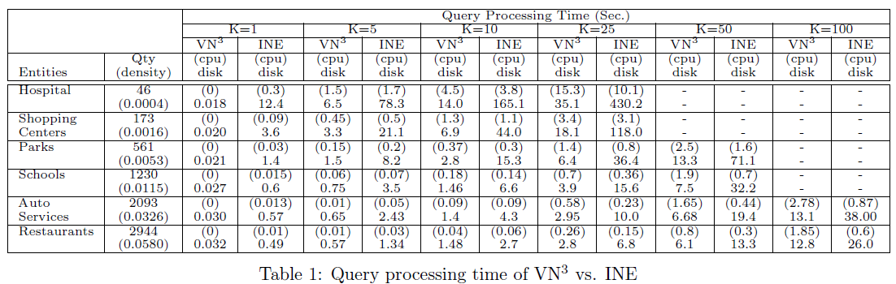
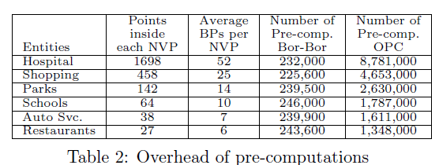
4 Performance Evaluation

Slide 16
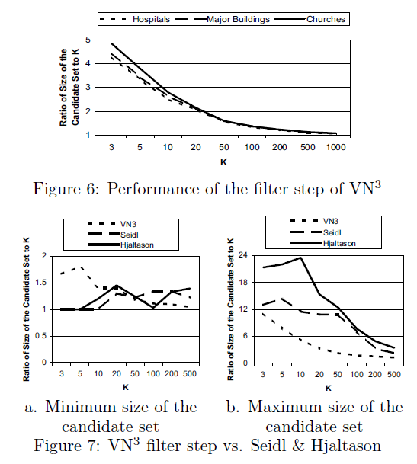
4 Performance Evaluation

