Slide 1
Protein structure alignment beyond spatial proximity
Sheng Wang, Jianzhu Ma, Jian Peng, and Jinbo Xu
Scientific Reports, 3 : 1448, (2013)
Presenter : Feng-Yang Tsai
Date:Sep. 10, 2019.

Slide 2
Abstract(1/2)
Protein structure alignment is a fundamental problem in computational structure biology. Many programs have been developed for automatic protein structure alignment, but most of them align two protein structures purely based upon geometric similarity without considering evolutionary and functional relationship. As such, these programs may generate structure alignments which are not very biologically meaningful from the evolutionary perspective. This paper presents a novel method DeepAlign for automatic pairwise protein structure alignment. DeepAlign aligns two protein structures using not only spatial proximity of equivalent residues (after rigid-body superposition), but also evolutionary relationship and hydrogen-bonding similarity.

Slide 3
Abstract(2/2)
Experimental results show that DeepAlign can generate structure alignments much more consistent with manually-curated alignments than other automatic tools especially when proteins under consideration are remote homologs. These results imply that in addition to geometric similarity, evolutionary information and hydrogen-bonding similarity are essential to aligning two protein structures.

Slide 4
Design a scoring function
local structure similarity
evolutionary and functional information
angular similarity for hydrogen bonding
Employ a fast and efficient search algorithm
from highly similar local structures pair (SFP)
recruit new SFPs that satisfies spatial constrains
final refine the alignment within a bound

Slide 5
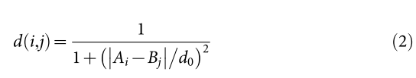
Scoring Function
local similarity
global similarity
CLESUM is the local structure substitution matrix;
BLOSUM is the amino acid substitution matrix;
v(i,j) measures the angular similarity using three vectors;
d(i,j) measures the spatial proximity of two aligned residues.

Slide 6
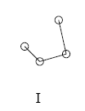

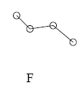
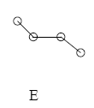






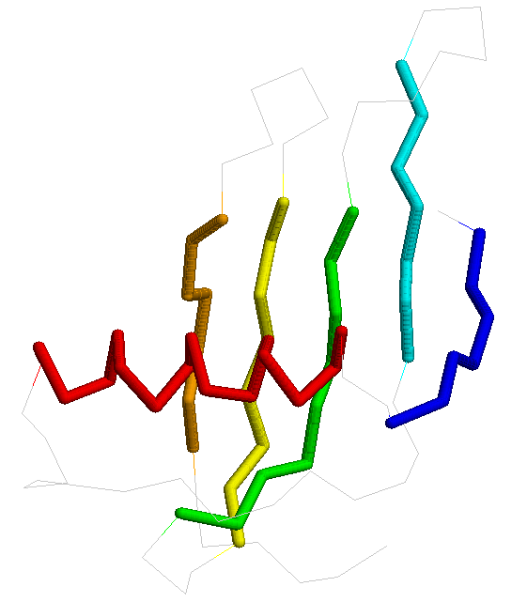
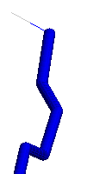
The transformation from 3D structure to 1D CLE strings
alpha
i-2
(A)
θ
i-1
τ
beta
i
θ’
i+1
(B)
RRFEDECCGAIHHHHHHHHHHHHHHHOMICQEECBLDFQNBFEEEEFEQNNGCP
LDDEEEDEEENOGCEDEEEEEEPKKOGFEDPLDEQBGCCR
S Wang, WM Zheng, “CLePAPS: Fast Pair Alignment of Protein Structures Based on Conformational Letters.” JBCB, 2008
coil

Slide 7
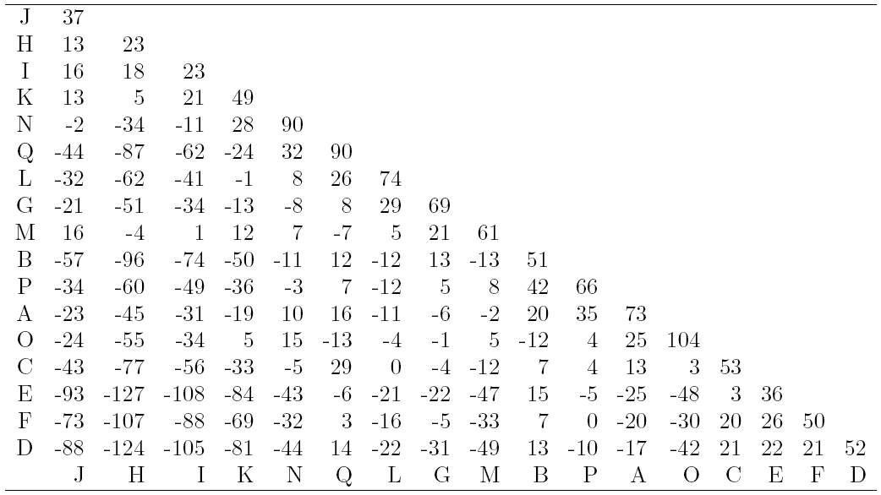
CLESUM : Conformational Letter Substitution Matrix
evolutionary
+ geometric

Slide 8
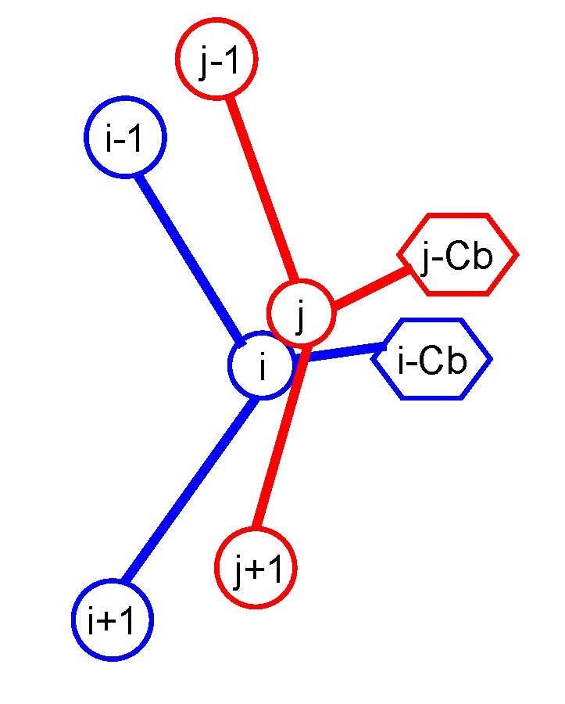
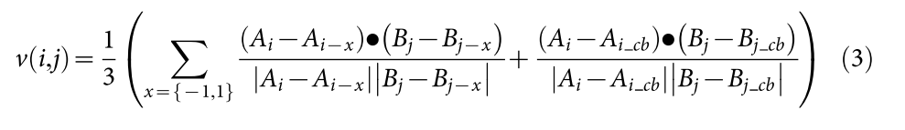
Using three vector's deviation for angular similarity
The three vectors used in the vector-score v(i,j).

Slide 9
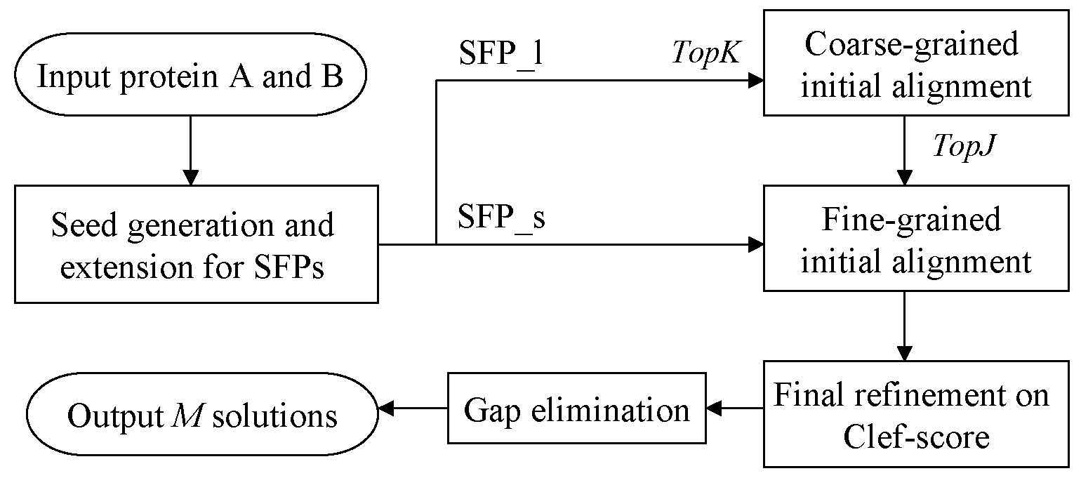
The DeepAlign algorithm flowchart
SFP_long
SFP_short
Sort both SFP lists
DeepAlign-score
1. SFP stands for Similar Fragment Pair, using

Slide 10
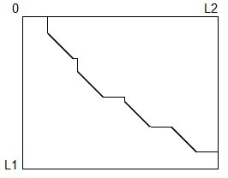
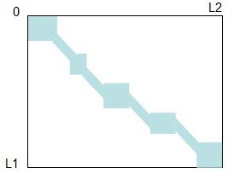
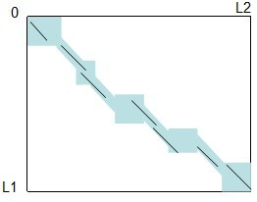
Final refinement on DeepAlign-score only in bounded area
(1) refined fine-grained alignment
(2) bounded area upon the alignment
(3) dynamic programming to find a path
with maximal DeepAlign-score within
bounded area

Slide 11
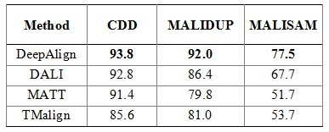
Result on manually-curated data
CDD (Conserved Domain Database): contains 3591 conserved domain structure alignments.
MALUDUP: contains 241 alignments for homologous domains originated from internal duplication.
MALISAM: contains 130 alignments for structurally analogous motifs in proteins.

Slide 12


Result on discrimination data
We use SABmark to test the ability of identifying distant homologs (super-family) and structural analogs (fold) among those negative data (with no structural similarity)
super-family
fold

