Slide 1
Frequent Pattern Mining with Non-overlapping Inversions
Da-Jung Cho, Yo-Sub Han, and Hwee Kim Proceedings of International Conference on Language and Automata Theory and Applications (LATA), Nice, France, March 2-6, 2015, pp. 121-132
Speaker: Kuan-Lin Lai
Date: Oct. 29, 2019

Slide 2
Abstract
Frequent pattern mining is widely used in bioinformatics since frequent patterns in bio sequences often correspond to residues conserved during evolution. In bio sequence analysis, non-overlapping inversions are well-studied because of their practical properties for local sequence comparisons. We consider the problem of finding frequent patterns in a bio sequence with respect to non-overlapping inversions, and design efficient algorithms.

Slide 3
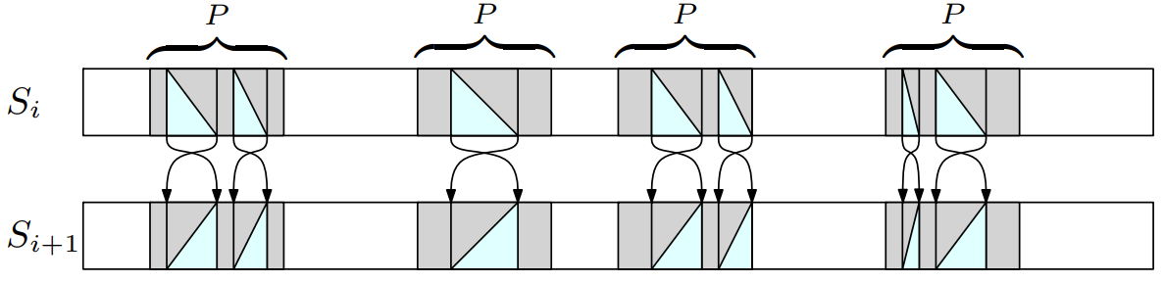

Inversion v.s. Reversal
$T$ = AGCTAGCTAG
reversal($T$): GATCGATCGA
inversion($T$): CTAGCTAGCT

Slide 4

Frequent Pattern Mining with Non-overlapping Reversal
EX: $T$ = AGCTAGCTAG m = 4 r = 3 …
Find all pattern $P$ with length m s.t. $Occ(T, P)≥r$ TCGA: 7
A | G | C | T | A | G | C | T | A | G
T | C | G | A
 | T | C | G | A
 |  | T | C | G | A
 |  |  | T | C | G | A

Slide 5
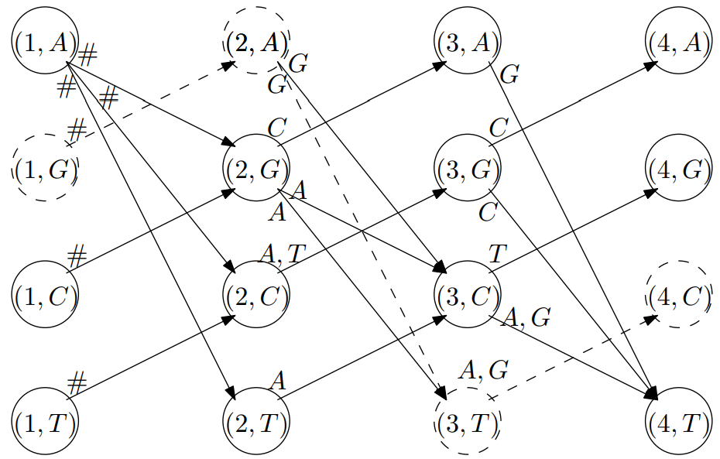
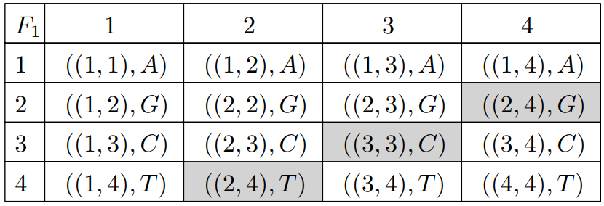
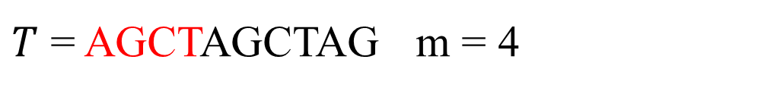
Construct Reversal Graph
$T$ = AGCTAGCTAG m = 4

Slide 6
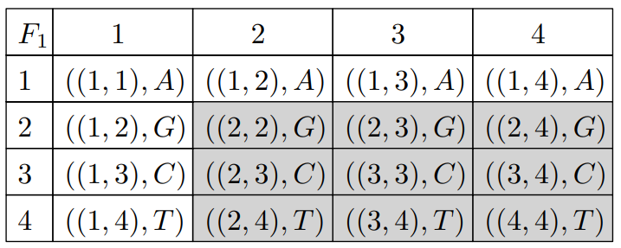
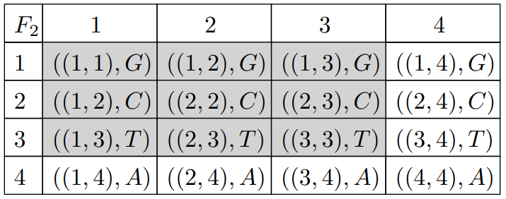
Construct Fast Reversal Graph

Slide 7
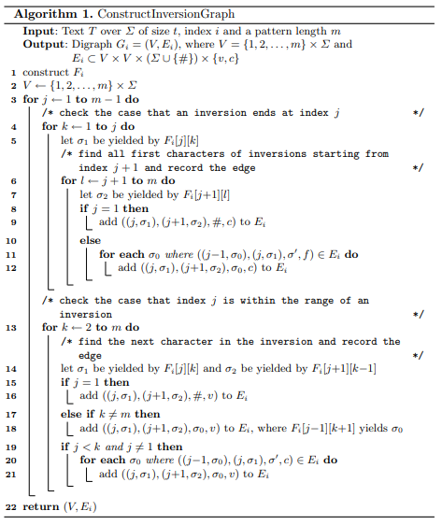
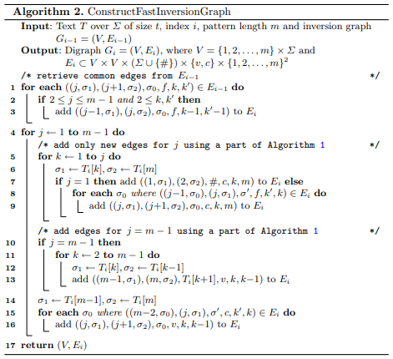

Slide 8
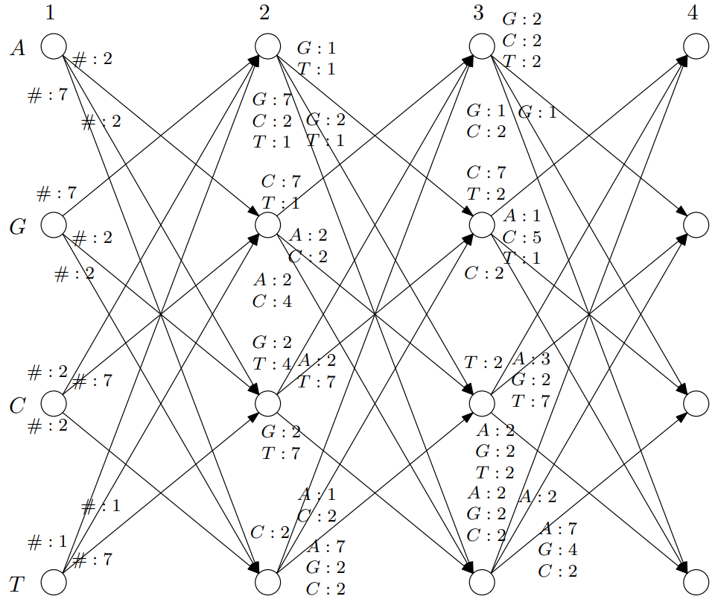
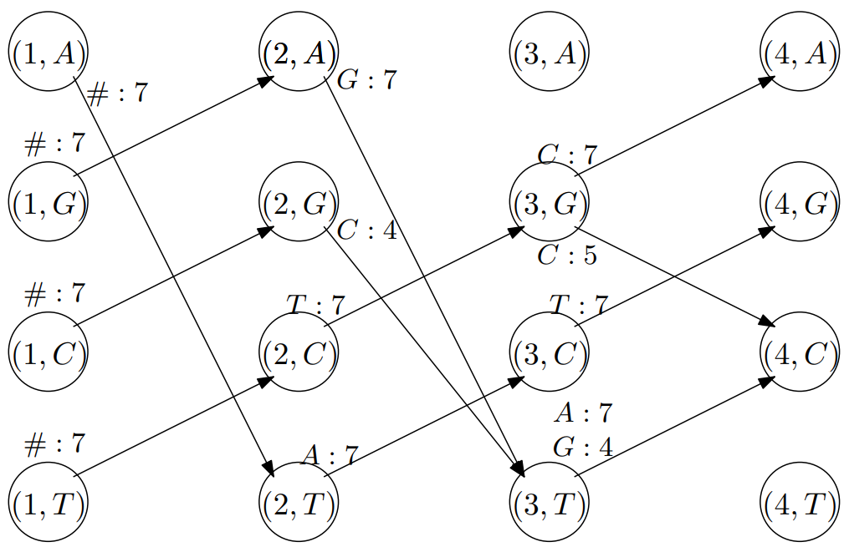
Reduce Accumulated Reversal Graph

