Slide 1
Minimum Common String Partition Revisited
Haitao Jiang, Binhai Zhu, Daming Zhu, and Hong Zhu
International Workshop on Frontiers in Algorithmics
FAW, Wuhan, China, 11-13 August 2010, pp. 45-52
Presenter: Yuan-Hsiu Tsai
Date: Oct. 22, 2019

Slide 2
Abstract
Minimum Common String Partition (MCSP) has drawn much attention due to its application in genome rearrangement. In this paper, we investigate three variants of MCSP: MCSP^{c} , which requires that there are at most c symbols in the alphabet; d-MCSP, which requires the occurrence of each symbol to be bounded by d; and x-balance MCSP, which requires the length of blocks not being x away from the average length. We show that MCSP^{c} is NP-hard when c ≥ 2. As for d-MCSP, we present an FPT algorithm which runs in O∗((d!)k) time. As it is still unknown whether an FPT algorithm only parameterized on k exists for the general case of MCSP, we also devise an FPT algorithm for the special case x-balance MCSP parameterized on both k and x.

Slide 3
Introduction
MCSP (Minimum Common String Partition) :
There are two string X and Y, they must have some condition: 1.the length of X and Y are same. 2.X and Y have the same alphabet 3.the number of any letter in X is same in Y
Then MCSP will partition X and Y such that they will have the same substring set, but the same set in X could not in same position of Y

Slide 4
Introduction
MCSP example there are two string
X = beabcdb
Y = abdbebc
MCSP(X,Y) =>partition of X=(b,e,ab,c,db)
=>partition of Y=(ab,db,e,b,c)
➔X and Y have same substring set, X can be transform to Y

Slide 5
Introduction
We will introduce three MCSP deform
d-MCSP: any letter at most occur d times.
MCSP^{c}: the alphabet at most c size
x-balance MCSP: if the number of partition is k, the length of every block is from (n/k –x) to (n/k +x)

Slide 6
Hardness for MCSP^{c}
1. MCSP² is NP-complete. using 3-PARTITION is NP-complete reduce to MCSP²
2. MCSP^{c} is NP-complete for c ≧ 2.

Slide 7
What is 3-Partition?
Input ：
Question：Can A be partitioned into n disjoint sets S₁, S₂,…,S_{n} such that, for 1≦i ≦n,

Slide 8
Let
Example : n=1, B=5

Slide 9
Example : n=1, B=5
Claim: any block in the common string partition has the form
Why not have ?

Slide 10
Example : n=1, B=5
Why not Y = 00,00,01,1³, 1⁴, 1⁴ ?
If every block of the form 0^{B} in Y is matched to exactly three blocks of the form 0^{ai},
Which means it is a yes 3-PARTITION instance

Slide 11
What is duo
X = beabcdb =>(b,e,ab,c,db)
Y = abdbebc =>(ab,db,e,b,c)
duo of X =(be, ea, ab, bc, cd, db)
duo of Y =(ab, bd, db, be, eb, bc)
Specific duo is (be,ab,bc,db)

Slide 12
On d-MCSP
Lemma 1.
Each duo appears the same number of times in X and Y in the common partition. X = abcdaabb =>(ab,cd,aabb)
Y = aabbcbab =>(aabb,cb,ab)
in aabb partition ,duo of aabb is (aa,ab,bb)

Slide 13
On d-MCSP
Lemma
2. If each duo appears the same number of times in a partition of X and a partition of Y , then two matches are conflict if and only if the specific duos are continuous in one string and not continuous in the other. X = abcdaabb => (a,bcd,aa,bb) Y = bcdabbaa => (bcd,a,bb,aa)

Slide 14
On d-MCSP
Lemma
3. Given a pair of partition π = (P,Q) for X and Y , if all specific duos are matched and all matches are not conflict then π is a common partition. X = abcdefg => (abcd,efg) Y = efgabcd => (efg,abcd) duo of X=(ab,bc,cd,de,ef,fg) duo of Y=(ef,fg,ga,ab,bc,cd) specific duo=(ab,bc,cd,ef,fg)

Slide 15
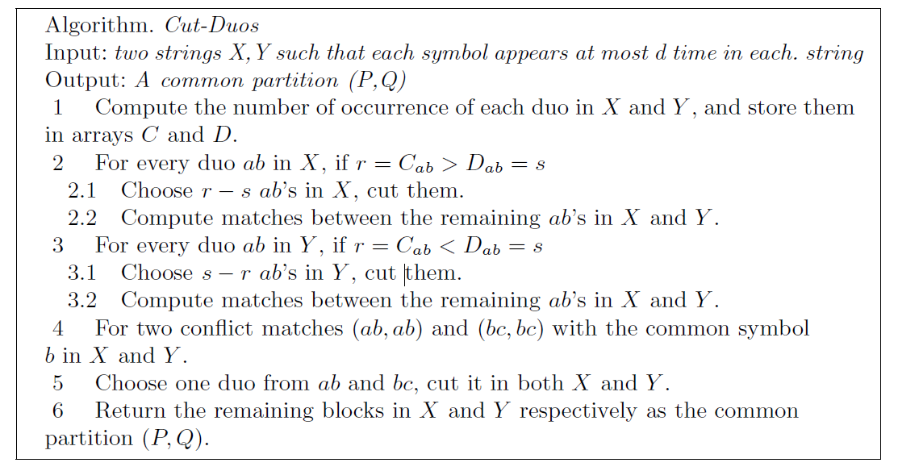
On d-MCSP
Theorem Algorithm Cut-Duos runs in O((d!)^{k}) time.

Slide 16
X=abcdfbc
Y=bcdfbac Specify duo of X,Y : (bc,cd,df,fb)

Slide 17
X=abcdfbc
Y=bcdfbac X=abcdf
Y=bcdfbac
Specify duo of X,Y : (bc,cd,df,fb)

Slide 18
X=a_dfbc
Y=_dfbac specify duo of X,Y is (bc,cd,df,fb) bc is using so next to compare <cd> but <cd> is over, so next to compare <df>

Slide 19
X=a_dfbc
Y=dfbac compare <df> , since times of duo <df> in X,Y is same , so <df> is match
Specify duo of X,Y : (bc,cd,df,fb)

Slide 20
X=a_bc
Y=bac
specify duo of X,Y(bc,cd,df,fb) are using so remain of X and Y are not match, partition !! X=> (a,b,c) Y=> (b,a,c) input the match duos
X => (a,bc,df,b,c) Y => (bc,df,b,a,c)

Slide 21
So we can get partition X=abcdfbc => (a,bc,df,b,c)
Y=bcdfbac => (bc,df,b,a,c)

Slide 22
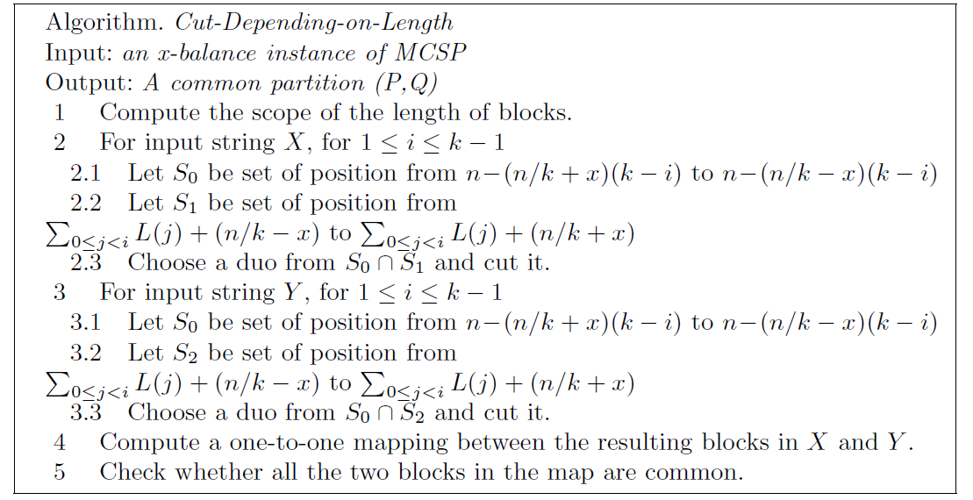
On x-Balance MCSP
Theorem Algorithm Cut-Depending-on-Length runs in O((2x)^{k} k!n) time.

Slide 23
Concluding Remarks
Prove MCSP^{c} is NP-complete when c ≧ 2.
devise FPT algorithm for d-MCSP and x-balance MCSP since original MCSP problem is difficult to solve with an FPT algorithm only on the parameter k.

