Slide 1
Occam's Razor
Anselm Blumer, Andrzej Ehrenfeucht, David Haussler, Manfred K.Warmuth
Information Processing Letters
Volume 24, Issue 6, 6 April 1987, Pages 377-380
Presenter: KeXin Zhu
Date: 2019/10/29
Notes:
IPL:
https://www.letpub.com.cn/index.php?journalid=3565&page=journalapp&view=detail
https://www.sciencedirect.com/journal/information-processing-letters
Location：
https://www.google.com.tw/maps/place/%E7%BE%8E%E5%9C%8B%E9%BA%BB%E8%96%A9%E8%AB%B8%E5%A1%9E%E5%B7%9E/@42.0365786,-72.2439164,9z/data=!3m1!4b1!4m5!3m4!1s0x89e3656de973bffd:0x45c6d03655830d1c!8m2!3d42.4072107!4d-71.3824374?hl=zh-TW
Tufts University：
https://zh.wikipedia.org/zh-tw/%E5%A1%94%E5%A4%AB%E8%8C%A8%E5%A4%A7%E5%AD%B8

Slide 2
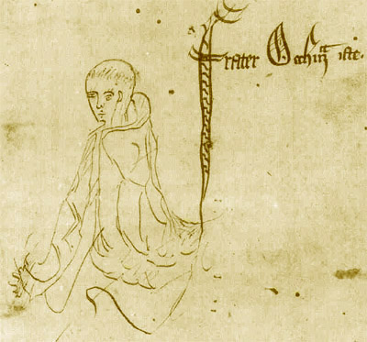
Abstract
We show that a polynomial learning algorithm, as defined by Valiant (1984), is obtained whenever there exists a polynomial-time method of producing, for any sequence of observations, a nearly minimum hypothesis that is consistent with these observations.

Slide 3
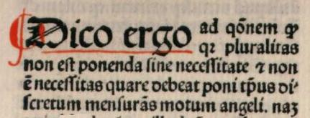
1 Introduction
William of Ockham, the 14th-century English philosopher：
Pluralitasnon est ponenda sine necessitate.
Plurality must not be posited without necessity.
如非必要，不可假定多元.
Modern Rendering:
Entities should not be multiplied without necessity.
It is vain to do with more what can be done with less.
An explanation of the facts should be no more complicated than necessary.
Among competing hypotheses, favor the simplest one.
Notes:
奧卡姆剃刀：
https://zh.wikipedia.org/zh-tw/%E5%A5%A5%E5%8D%A1%E5%A7%86%E5%89%83%E5%88%80
American Scientist：
https://zh.wikipedia.org/zh-tw/%E7%BE%8E%E5%9B%BD%E7%A7%91%E5%AD%A6%E5%AE%B6
http://findit.lib.nsysu.edu.tw:3210/nsysu/journalsearch?param_pattern_value=

Slide 4
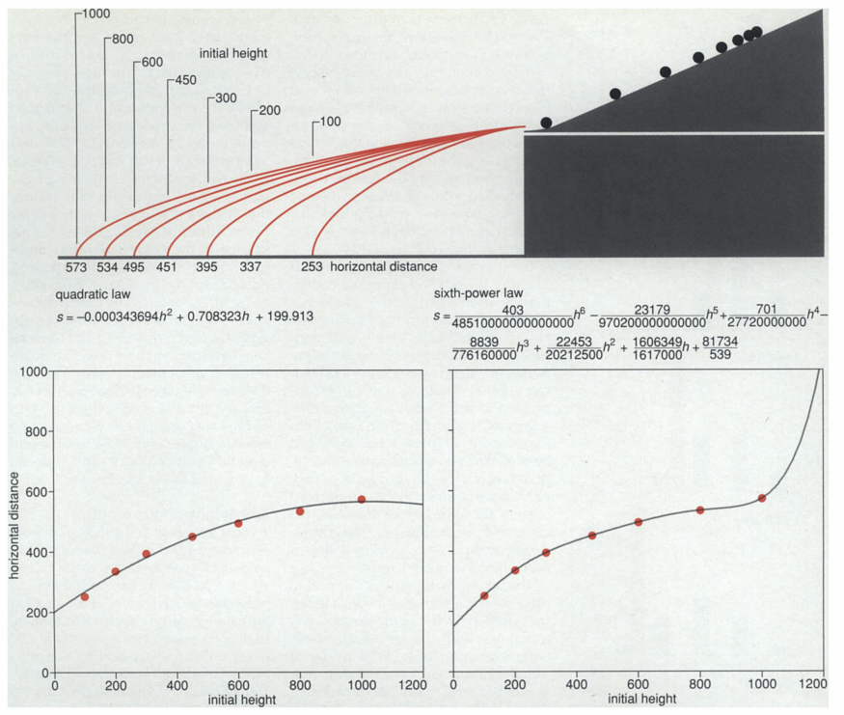
2 Example-Galileo's Problem
Free fall：
Notes:
自由落體：
https://zh.wikipedia.org/zh-tw/%E8%87%AA%E7%94%B1%E8%90%BD%E9%AB%94

Slide 5
3 The Razor applied
Problem of learning:
Hypothesis class H: Map from input space X to output space Y.
Goal:
Function: f in H;
Given：
(1) Observation: Point x in X, with the value f(x) in Y.
(2) Sample: A sequence of m observations.
Learning algorithm:
Recovering f, or at least approximates f, from a sample of f.

Slide 6

3 The Razor applied
Polynomial learnability :
Given f in H of r hypotheses, any h with error larger than ε, the probability consistent with a m-sample of f of size m is less than (1 – ε)^{m}r.
Lower Bound of m:
H is polynomial learnable if there exists a learning algorithm for H and a minimal sample size m(ε, σ, n).

Slide 7
3 The Razor applied
Occam-algorithm(polynomial learning algorithm) :
An Occam-algorithm for H with constant parameters c >1 and 0 < a < 1 is a learning algorithm that:
(1) produces a hypothesis of complexity at most n^{c}mª when given a sample of size m of any function in H of complexity at most n, and
(2) runs in time polynomial in the length of the sample.

Slide 8

3 The Razor applied
Occam algorithm for polynomial learnability.:
Given observations of any function in H of complexity at most n, an Occam-algorithm with parameters c >1 and 0 < a < 1 produces a hypothesis of error at most ε with probability at least 1- σ using sample size polynomial in n, 1/ε, and 1/σ, independent of the function and of the probability distribution.
The sample size required is:

Slide 9
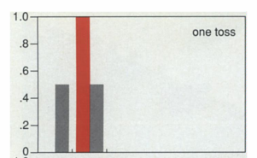
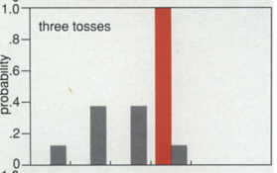
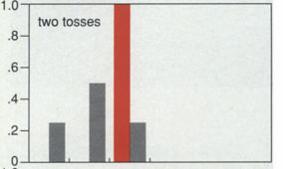
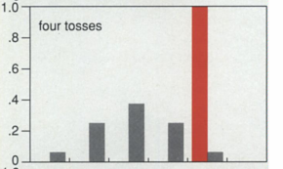
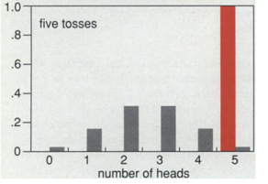
4 Example-To Catch a Cheat
Two-headed coin:

Slide 10
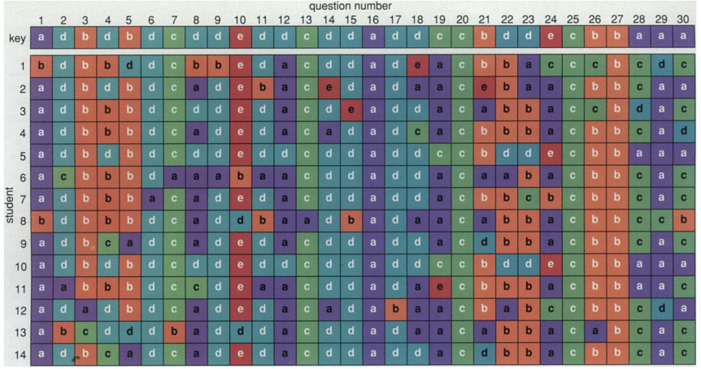
4 Example-To Catch a Cheat
Detecting plagiarism :

Slide 11
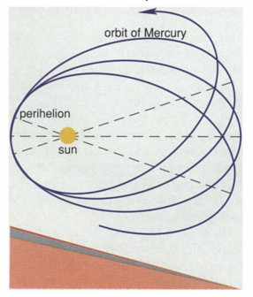
5 Example-Planetary Puzzle
Anomaly in the orbit of Mercury :
Vulcan
Sun rings
Oblate sun
Fudged Newtonian law
Einstein's general theory of relativity
Notes:
火神星：
https://zh.wikipedia.org/zh-tw/%E7%A5%9D%E8%9E%8D%E6%98%9F
廣義相對論：
https://pansci.asia/archives/135105

Slide 12
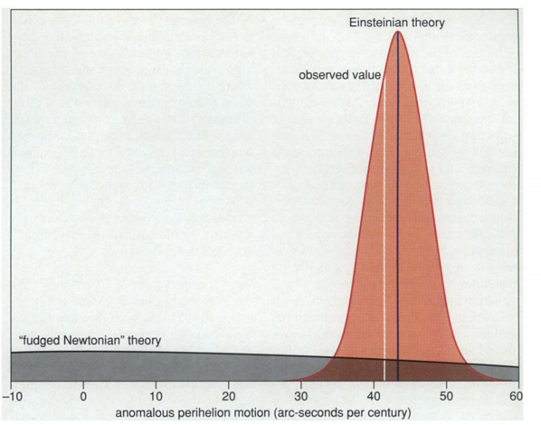
5 Example-Planetary Puzzle
Theory of relativity VS. Fudged Newtonian:
Notes:
火神星：
https://zh.wikipedia.org/zh-tw/%E7%A5%9D%E8%9E%8D%E6%98%9F
廣義相對論：
https://pansci.asia/archives/135105

Slide 13
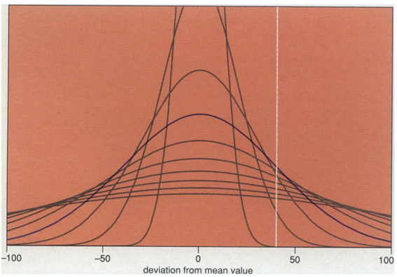
5 Example-Planetary Puzzle
Theory of relativity VS. Fudged Newtonian:
Notes:
火神星：
https://zh.wikipedia.org/zh-tw/%E7%A5%9D%E8%9E%8D%E6%98%9F
廣義相對論：
https://pansci.asia/archives/135105

Slide 14
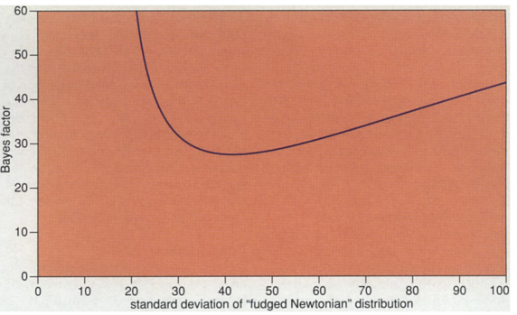
5 Example-Planetary Puzzle
Theory of relativity VS. Fudged Newtonian:
Notes:
火神星：
https://zh.wikipedia.org/zh-tw/%E7%A5%9D%E8%9E%8D%E6%98%9F
廣義相對論：
https://pansci.asia/archives/135105

Slide 15
6 Conclusion
Conclusion:
The real value of a scientific explanation lies not in its ability to explain events past, but in predicting events that have yet to occur.
Choose hypothesis that are consistent with the sample and have minimum complexity.
Reducing polynomial learnability to the problem of finding Occam-algorithms.
Notes:
火神星：
https://zh.wikipedia.org/zh-tw/%E7%A5%9D%E8%9E%8D%E6%98%9F
廣義相對論：
https://pansci.asia/archives/135105

