Slide 1
A Lossless Image Compression Technique Using Generic Peano Pattern Mask Tree
Mohammad Kabir Hossain, Shams MImam, Khondker Shajadul Hasan , William Perrizo
Proceedings of 11th International Conference on Computer
and Information Technology (ICCIT 2008)
Bangladesh, Khulna, 25-27 December, 2008
Presenter: Yuan-Hsiu Tsai
Date: Dec. 24, 2019

Slide 2
Abstract(1/2)
Digital Image processing has become ubiquitous in our daily life and the demands to produce and process images are ever increasing. Large amounts of space are required to store these images. Image compression techniques are in high demand as they allow reduction in this storage space. The basis for image compression, as is for most other compression techniques, is to remove redundant and unimportant data. Lossless image compression techniques retain the original information in compact form and do not introduce any errors when decompressed.

Slide 3
Abstract(2/2)
In this paper, we discuss such a lossless technique using a data structure that we name "Generic Peano Pattern Mask Tree". It is an improvement over a previously discussed Lossless Image compression technique - "Peano Pattern Mask Tree". Both these structures are based on the data structure - Peano Mask Tree.

Slide 4
Introduction
1. Peano Count Tree (P-tree)
2. Peano Mask Tree (PM-tree)
3. Peano Pattern Mask Tree (PPM-tree)
4. Generic Peano Pattern Mask Tree (GPPM-tree)

Slide 5
Introduction
Peano Count Tree(P-tree):
Peano Count Tree (P-tree) is a lossless, compressed,and data-mining ready data structure.

Slide 6
Introduction
Peano Count Tree(P-tree):
11001011 01001001 11111010 01111010 11111111 11110111 11111110 11110110

Slide 7
Introduction
Peano Count Tree(P-tree):
11001011 01001001 11111010 01111010 11111111 11110111 11111110 11110110

Slide 8
Introduction
Peano Count Tree(P-tree):
11001011 01001001 11111010 01111010 11111111 11110111 11111110 11110110

Slide 9
Introduction
Peano Count Tree(P-tree):
11001011 01001001 11111010 01111010 11111111 11110111 11111110 11110110

Slide 10
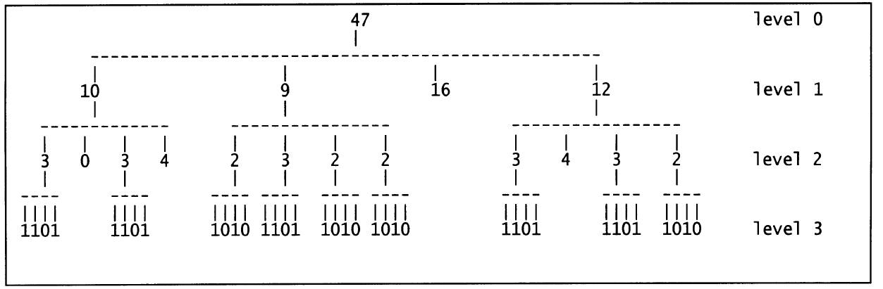
Introduction
Peano Count Tree(P-tree):
Notes:
全0 和全1就會停止了， 否則會一職 recursive到 全部都只有1或0

Slide 11
Introduction
Peano Mask Tree(PM-tree):
It use three value logic to represent pure-1,pure-0 and mix

Slide 12
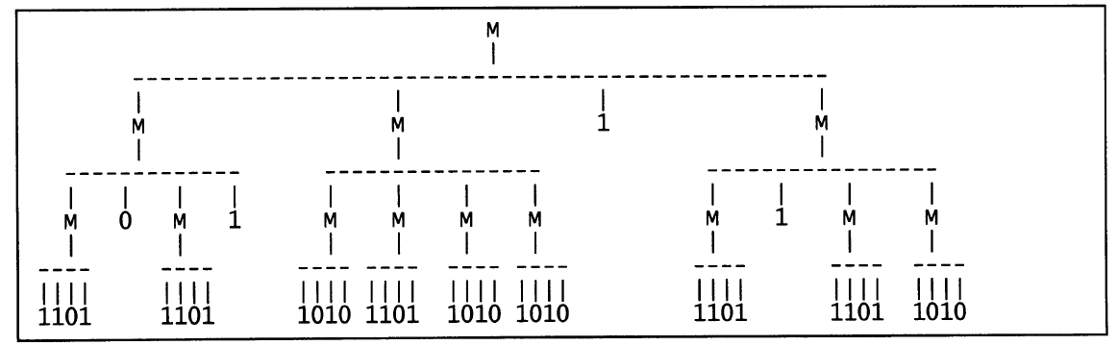
Introduction
Peano Mask Tree(PM-tree):

Slide 13
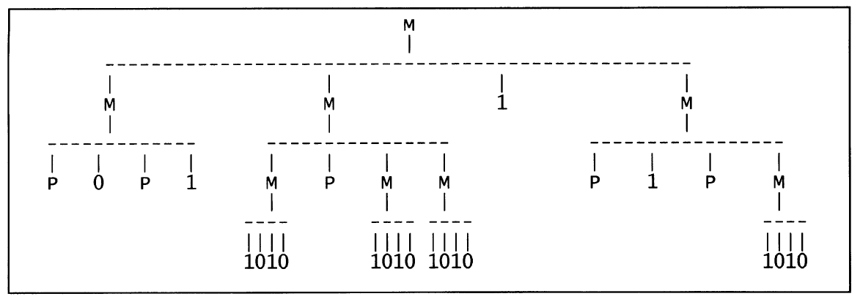
Introduction
Peano Pattern Mask Tree(PPM-tree):

Slide 14
Introduction
Disadvantage of PPM-Tree:
Pure-0 and pure-1 are rare.
Image share the same bit values with a low probability

Slide 15
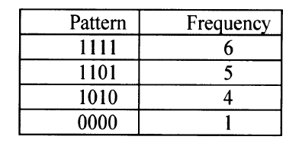
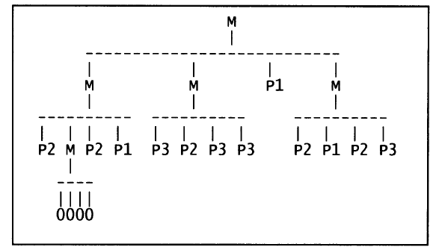
Introduction
Generic Peano Pattern Mask Tree(GPPM-tree):

Slide 16
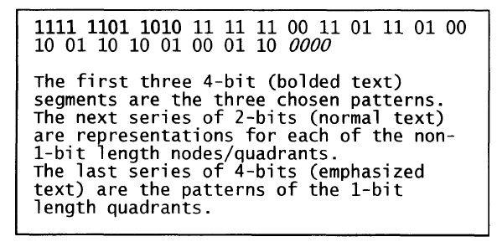
Structure of GPPM-tree

Slide 17
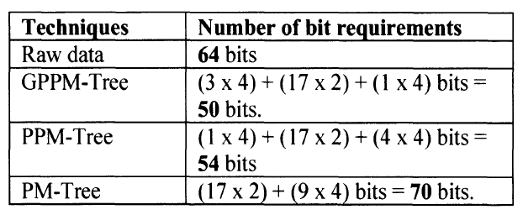
Compare of Compression

Slide 18
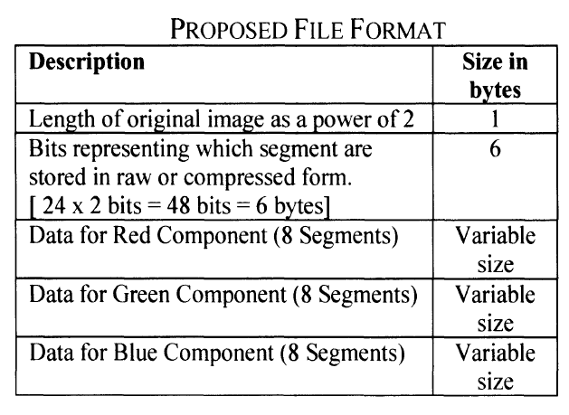
Structure of use in 24-BMP image

Slide 19
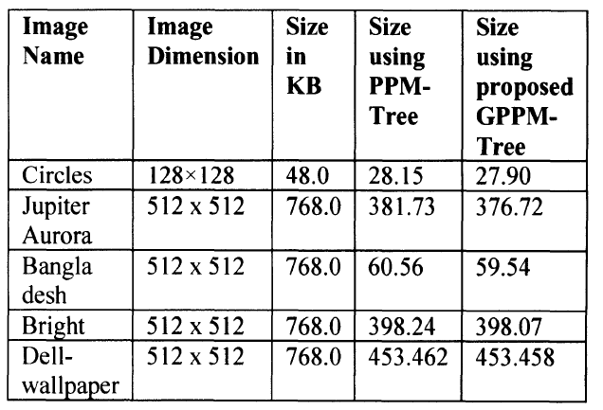
Experiments

