Slide 1
A recommendation approach for programming online judges supported by data preprocessing techniques
Raciel Yera, Luis Martínez
Applied Intelligence 47(2): 277-290, 2017.
Presenter: KeXin Zhu
Date: 2019/12/22
Notes:
University of Camagüey：
https://en.wikipedia.org/wiki/University_of_Camag%C3%Bcey
Camagüey:
https://en.wikipedia.org/wiki/Camag%C3%Bcey
Location：
https://www.google.com.tw/maps/place/%E5%8F%A4%E5%B7%B4%E5%8D%A1%E9%A6%AC%E5%9C%AD/@21.3863648,-77.9323774,13z/data=!3m1!4b1!4m5!3m4!1s0x8ed3806e370b5943:0x397a32d27d15f527!8m2!3d21.3926035!4d-77.9053182?hl=zh-TW

Slide 2
Abstract
The use of programming online judges (POJ) to support students acquiring programming skills is common nowadays because this type of software contains a large collection of programming exercises to be solved by students. A POJ not only provides exercises but also automates the code compilation and its evaluation process. A common problem that students face when using POJ is information overload, as choosing the right problem to solve can be quite frustrating due to the large number of problems offered. The integration of current POJs into e-learning systems such as Intelligent Tutoring Systems (ITSs) is hard because of the lack of necessary information in ITSs.

Slide 3
Abstract
Hence, the aim of this paper is to support students with the information overload problem by using a collaborative filtering recommendation approach that filters out programming problems suitable for students’ programming skills. It uses an enriched user-problem matrix that implies a better student role representation, facilitating the computation of closer neighborhoods and hence a more accurate recommendation. Additionally a novel data preprocessing step that manages anomalous users’ behaviors that could affect the recommendation generation is also integrated in the recommendation process. A case study is carried out on a POJ real dataset showing that the proposal outperforms other previous approaches.

Slide 4
1 Introduction to POJ
1. University of Valladolid Online Judge(UVA) ( 1700+ problems ):
https://uhunt.onlinejudge.org/
2. Peking University Online Judge ( 3000+ problems ):
http://poj.org/
3. Caribbean Online Judge( 3400+ problems ):
http://coj.uci.cu/
4. SPOJ Online Judge( 6800+ problems ):
http://www.spoj.com/
5. Timus Online Judge( 1100+ problems ):
http://acm.timus.ru/
6. Code Forces( 5600+ problems ):
https://codeforces.com/
Notes:
https://zh.wikipedia.org/wiki/%E5%9C%A8%E7%BA%BF%E8%AF%84%E6%B5%8B%E7%B3%BB%E7%BB%9F#cite_note-6

Slide 5
1 Introduction to POJ
Typical interaction sequence on POJ:
(1) Select a problem.
(2) Write code.
(3) Upload source code .
(4) Judge the solution is correct or not.
If not, classifies the failure mainly in Wrong Answer, Time limited exceeded or Runtime Error.

Slide 6
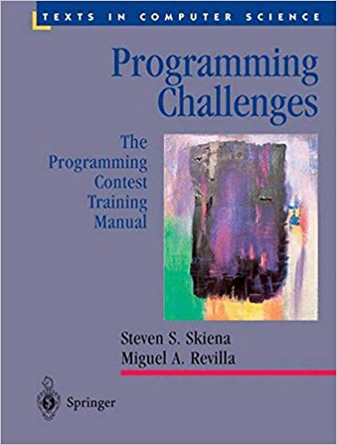
1 Introduction to POJ
The most important categories of failure:
Wrong Answer.
Incorrect answer to secret test case.
Compile Error.
Can’t compile the code submitted.
Runtime Error.
The program fails during.
Presentation Error.
Outputs are correct, but not in the specified format.
Time Limit Exceeded.
More than established time to process all the inputs.
Notes:
Skiena, S., & Revilla, M. (2003). Programming challenges. Springer-Verlag.

Slide 7
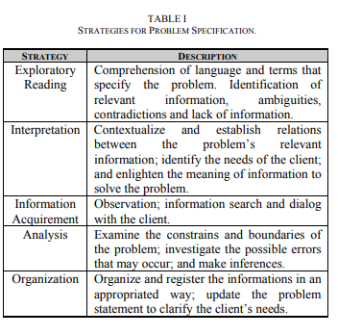
1 Introduction to POJ
Ill-Defined Problems：
We call as an ill-defined problem the one whose description is not complete and may contain ambiguities, contradictions, lack of information or even present irrelevant one.
Notes:
Mendonça, A., et al. (2009). Difficulties in solving ill-defined problems: A case study with introductory computer programming students. 2009 39th IEEE Frontiers in Education Conference, IEEE.

Slide 8
1 Introduction to POJ
Problem Difficulty Mechanism：
Lines of code;
Repetition structures used in the solution;
Selection structures;
Edges in a graph that represents the algorithm;
Edges in a graph that represent repetition structures in the algorithm;
Height of a tree, with each sub-block of internally nested code representing a node;
Number of topics involved in the problem.
Notes:
Francisco, R. E. and A. P. Ambrosio (2015). Mining an Online Judge System to Support Introductory Computer Programming Teaching. EDM (Workshops).

Slide 9
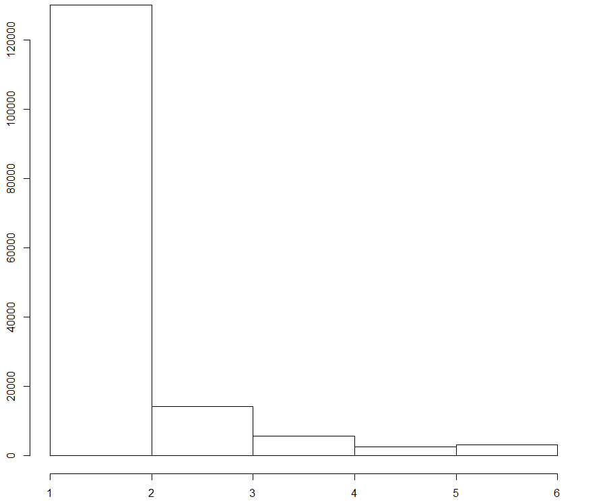
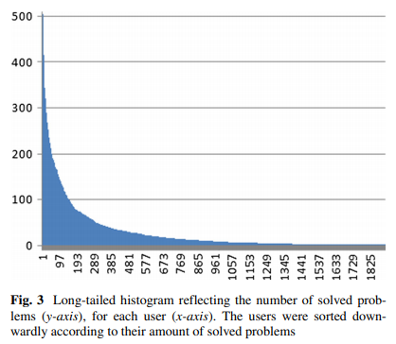
1 Introduction to POJ
Information overload：
Caribbean Online Judge( 3400+ problems ): SPOJ Online Judge( 6800+ problems ):

Slide 10
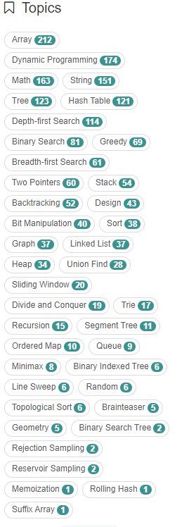
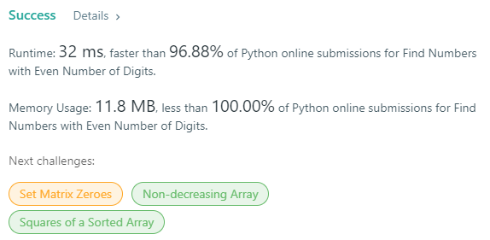
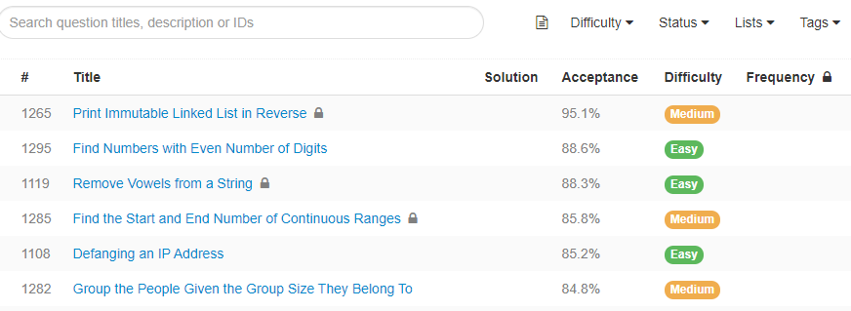
2 Recommender Systems
Recommender Systems on LeetCode：
Notes:
https://leetcode.com/problemset/all/

Slide 11
2 Recommender Systems
The main classification of recommenders：
1.Content-based: Features of the user preferences.
2.Collaborative filtering:
2.1 Neighborhood:
2.1.1 Item-based.
2.1.2 User-based.
2.2 Latent Factor:
2.2.1 SVD
2.2.2 ALS
3. Popular-based
4.Hybrids
Notes:
https://www.rdocumentation.org/packages/recommenderlab/versions/0.2-5

Slide 12
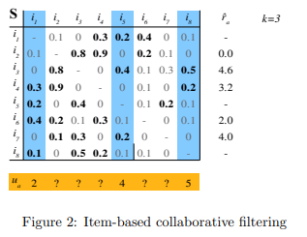
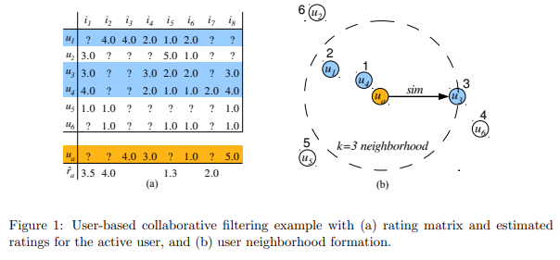
2 Recommender Systems
Collaborative filtering ：
Notes:
Michael Hahsler (2016). recommenderlab: A Framework for Developing and Testing Recommendation Algorithms, R package. https://CRAN.R-project.org/package=recommenderlab

Slide 13
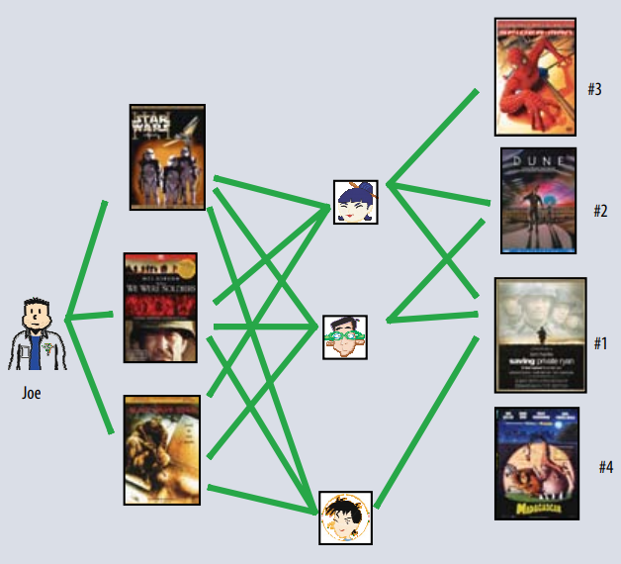
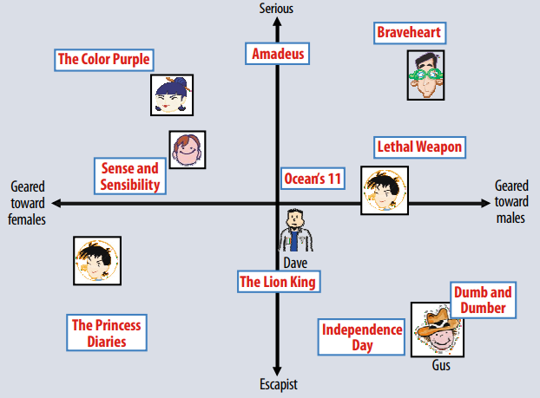
2 Recommender Systems
Latent Factor ：
Notes:
Koren, Y., et al. (2009). "Matrix factorization techniques for recommender systems." Computer(8): 30-37.

Slide 14
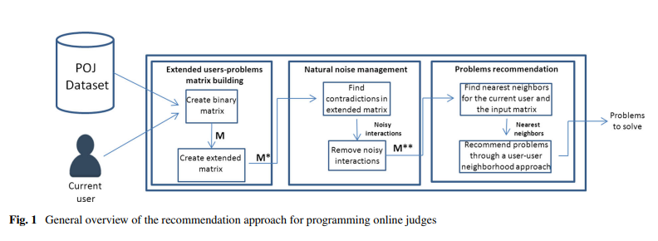
3 Recommender Systems for POJ
General overview of the approach：

Slide 15
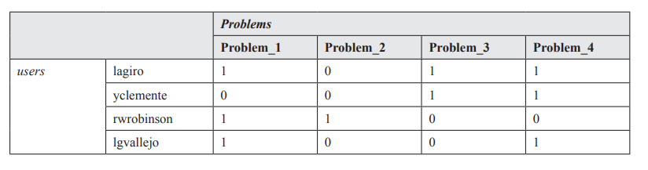
3 Recommender Systems for POJ
Users vs problems matrix：

Slide 16
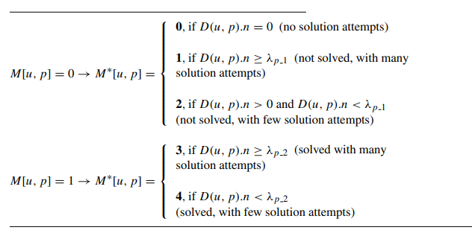
3 Recommender Systems for POJ
user-problem interaction extended matrix M∗：

Slide 17
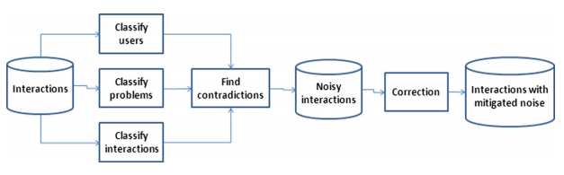
3 Recommender Systems for POJ
Preprocessing natural noise：
Users’ tendencies:
1. Precise user: Solve most of the problems quickly.
2. Imprecise user: Have many failed solution attempts.
3. Variable user: Varies between the two categories.
Problems’ tendencies:
1. Easy problem: users need only a few failed solution attempts.
2. Difficult problem: users need several previous failed solution attempts.
3. Variable problem: varies between the two categories.

Slide 18
3 Recommender Systems for POJ
Experimental study：

Slide 19
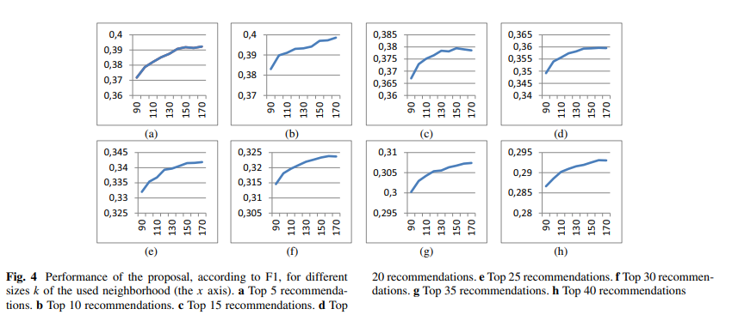
3 Recommender Systems for POJ
Experimental study ：

Slide 20
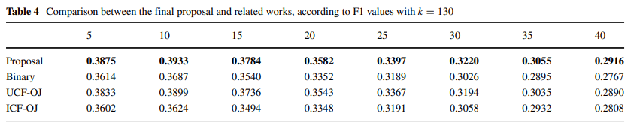
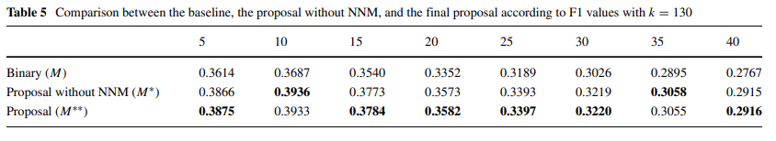
3 Recommender Systems for POJ
Experimental study ：

Slide 21
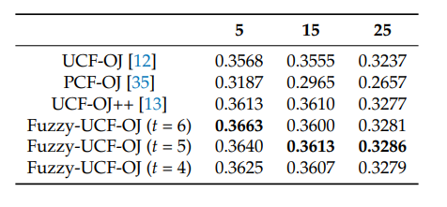
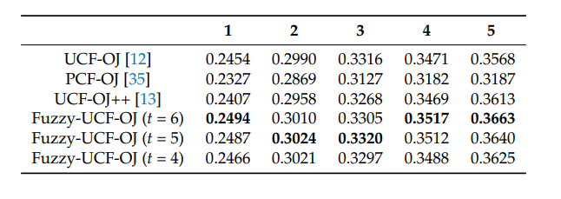
3 Recommender Systems for POJ
Experimental study ：
Notes:
Yera Toledo, R., et al. (2018). A recommender system for programming online judges using fuzzy information modeling. Informatics, Multidisciplinary Digital Publishing Institute.

Slide 22
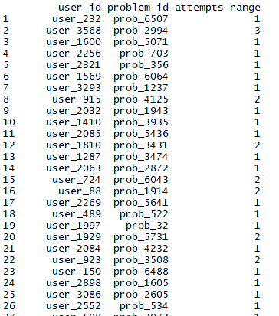
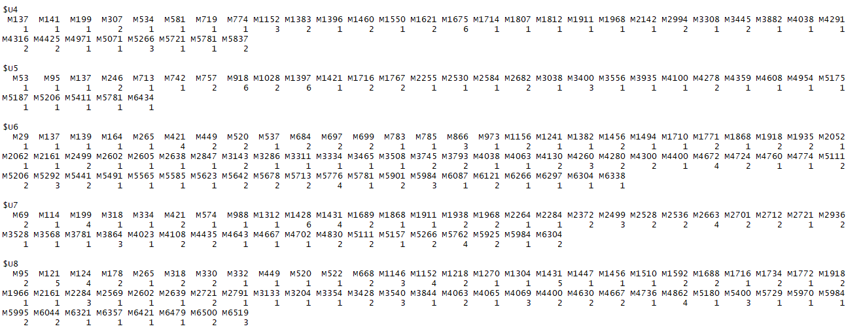
4 Experimental study
Data Transform：
Notes:
https://www.kaggle.com/ashishvaya/recommendation-engine

Slide 23
4 Experimental study
histogram：

Slide 24
4 Experimental study
UBCF：

Slide 25
4 Experimental study
Compare：

Slide 26
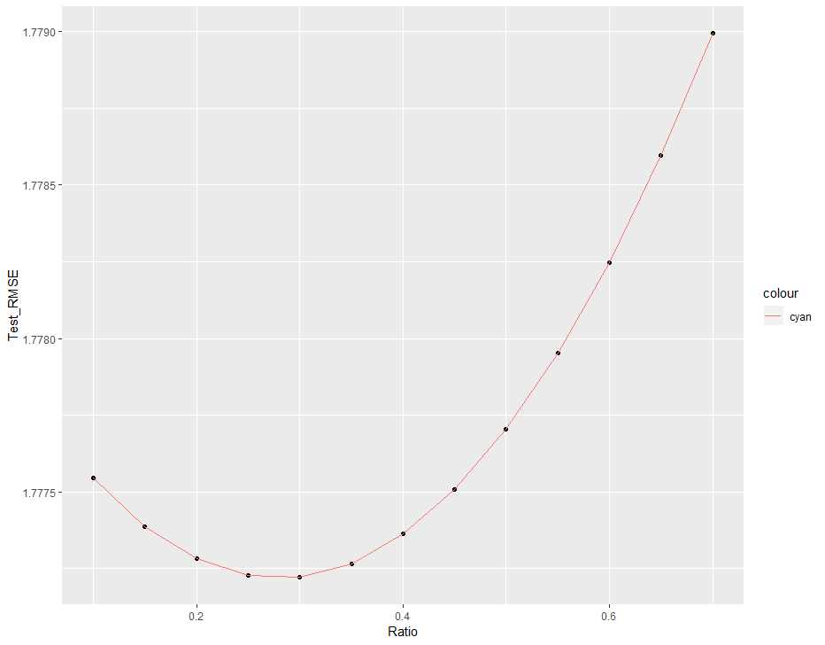
4 Experimental study
RMSE：

Slide 27
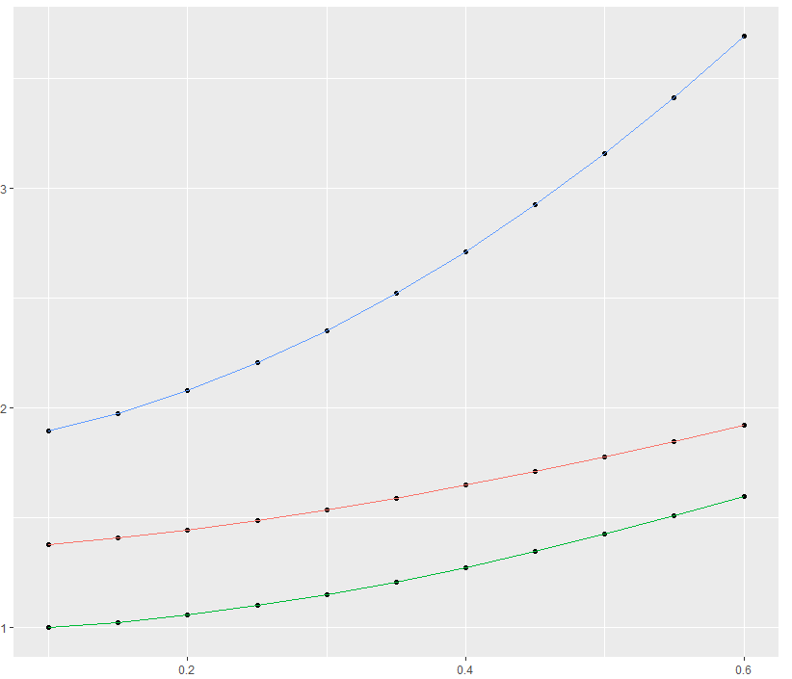
4 Experimental study
RMSE(红色)/MSE(蓝色)/MAE(绿色)：

