Slide 1
Some Biological Sequence Metrics
M. S. WATERMAN, T. F. SMITH, W. A. BEYER
Advances in Mathematics Volume 20, Issue 3, June 1976, Pages 367–387
Presenter: Huang-Ting Chang
Date:115/11/07

Slide 2
Abstract
Some new metrics are introduced to measure the distance between biological sequences, such as amino acid sequences or nucleotide sequences. These metrics generalize a metric of Sellers, who considered only single deletions, mutations, and insertions. The present metrics allow, for example, multiple deletions and insertions and single mutations.

Slide 3
They also allow computation of the distance among more than two sequences. Algorithms for computing the values of the metrics are given which also compute best alignments. The connection with the information theory approach of Reichert, Cohen, and Wong is discussed.

Slide 4
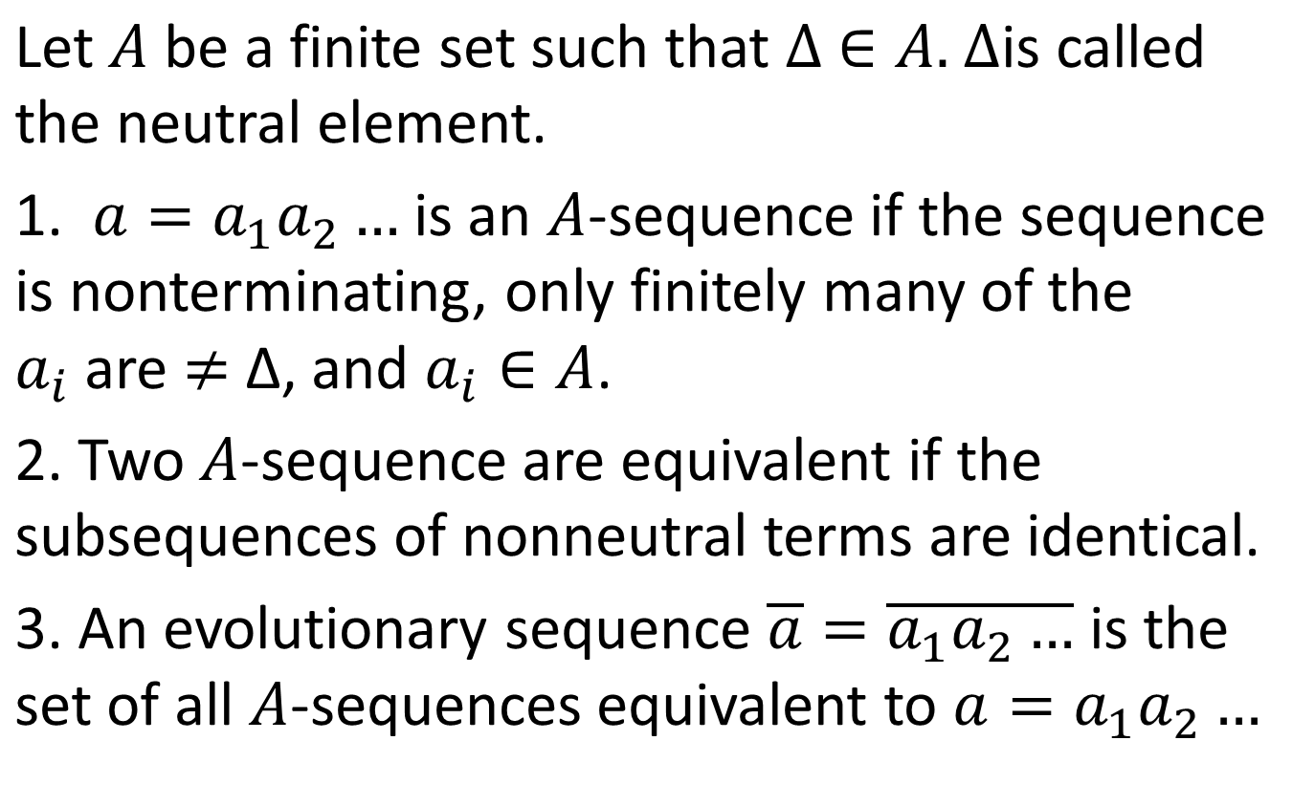
T-metric

Slide 5
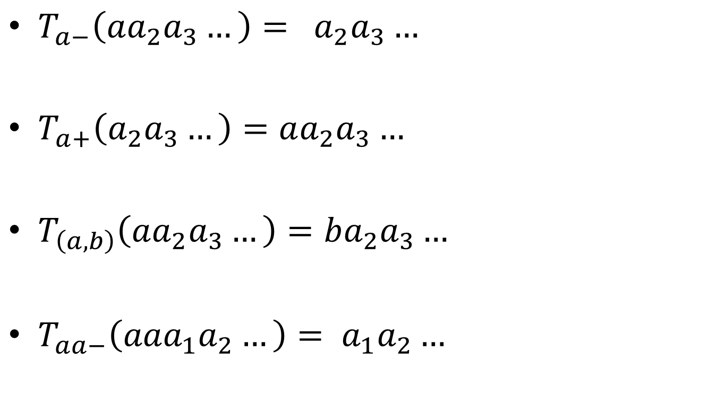

Slide 6
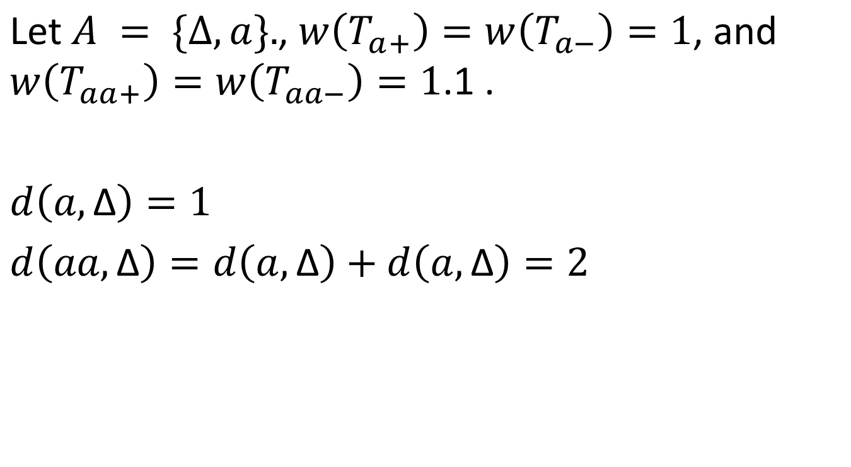
Example

Slide 7
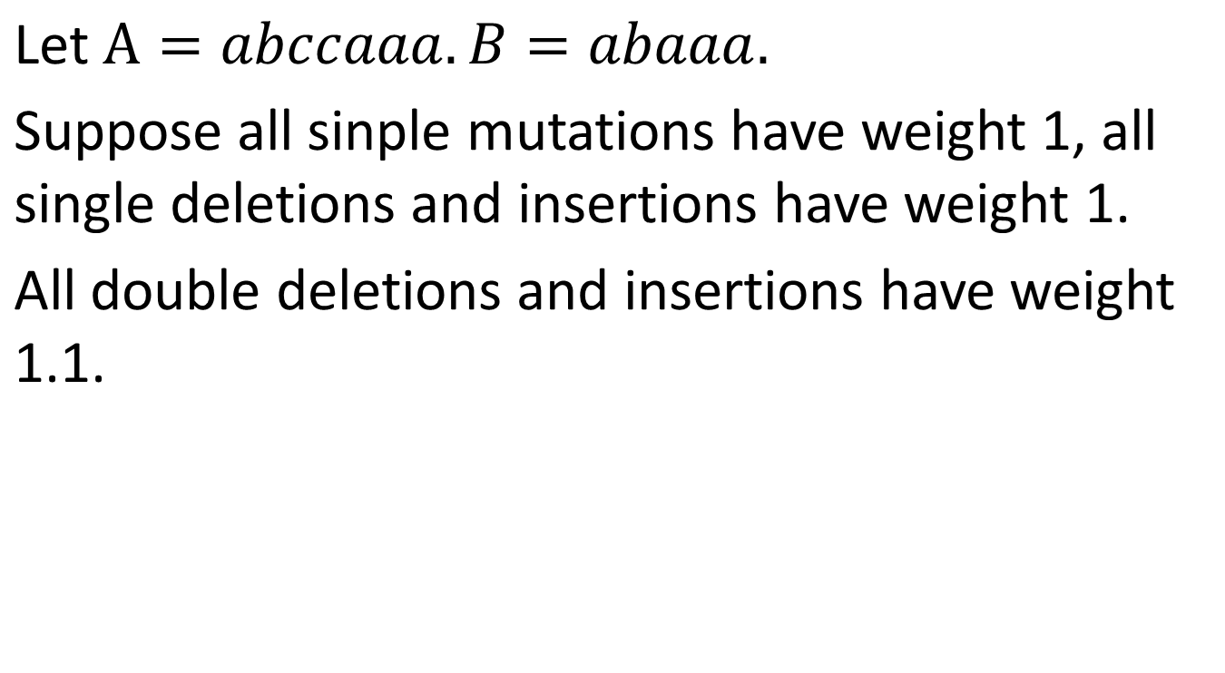

Slide 8
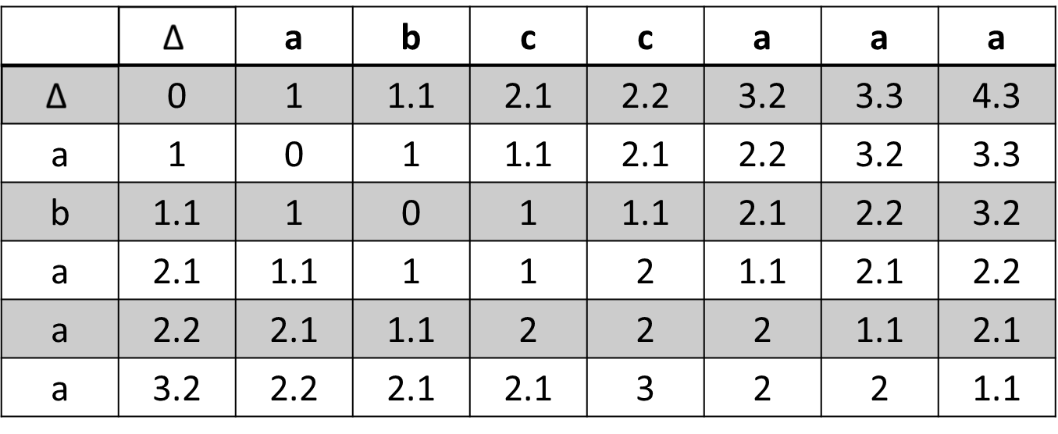
Double Deletion and Insertion Distance Calculation

Slide 9
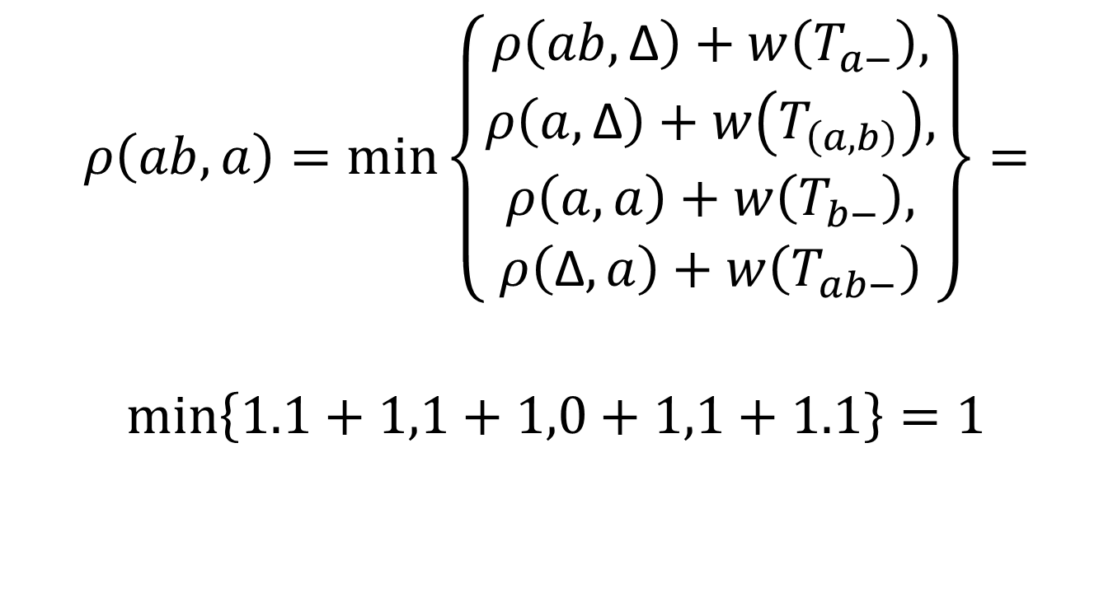

Slide 10
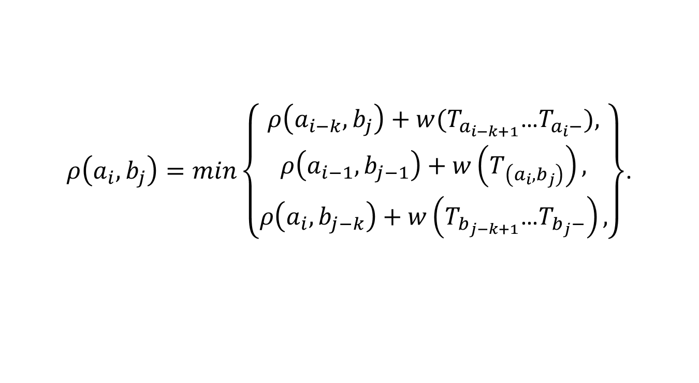
Equation

Slide 11
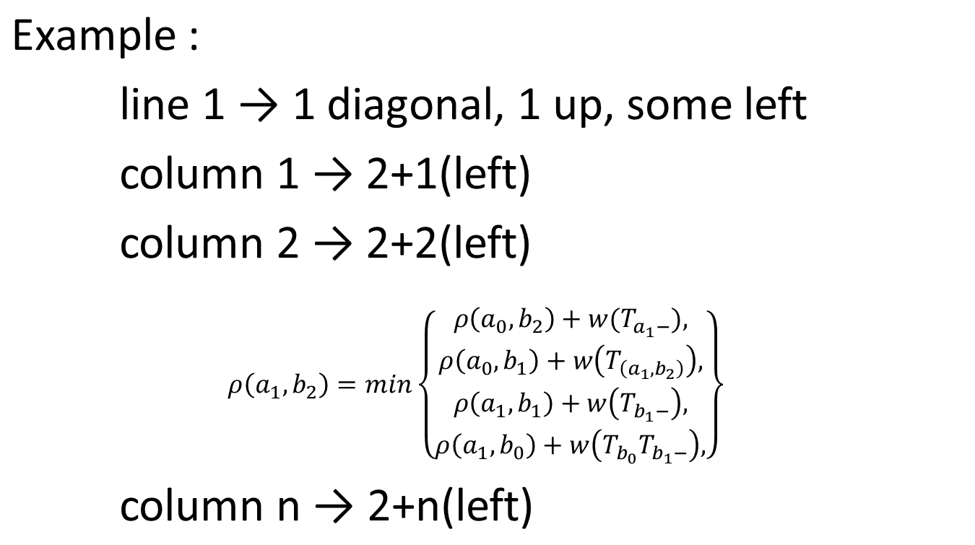
Time Complexity

Slide 12
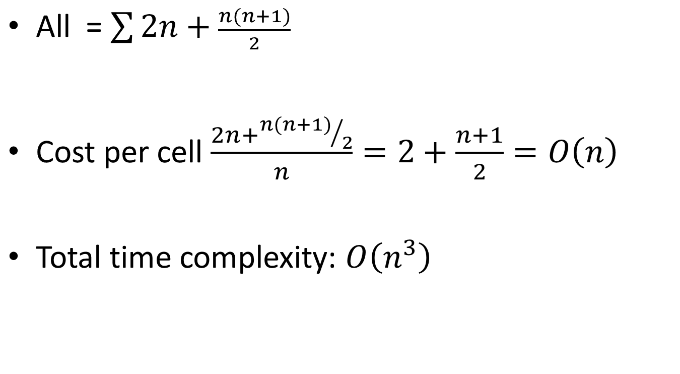

Slide 13
An Improved Algorithm for Matching Biological Sequences
OSAMU GOTOH
Journal of molecular biology, Vol. 162, No. 3. (15 December 1982), Pages 705-708
Presenter: Huang-Ting Chang
Date:115/11/07

Slide 14
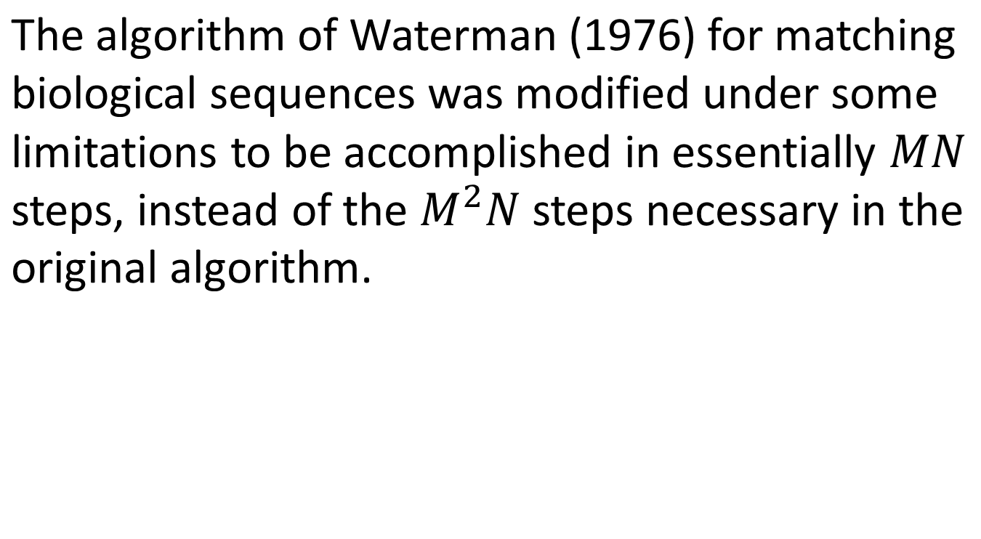
Abstract

Slide 15
The limitations do not seriously reduce the generality of the original method, and the present method is available for most practical uses. The algorithm can be executed on a small computer with a limited capacity of core memory.

Slide 16
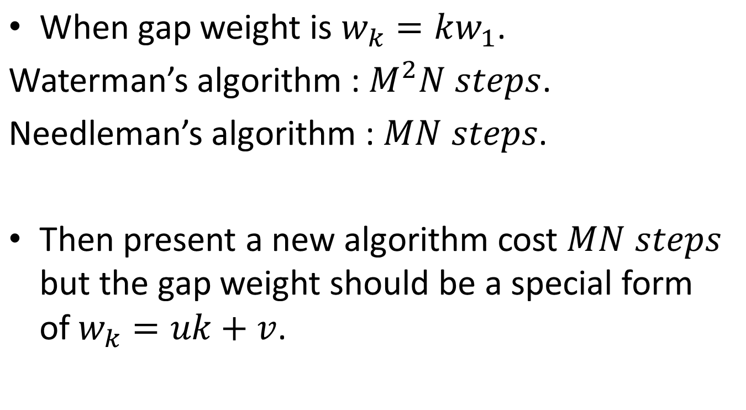

Slide 17
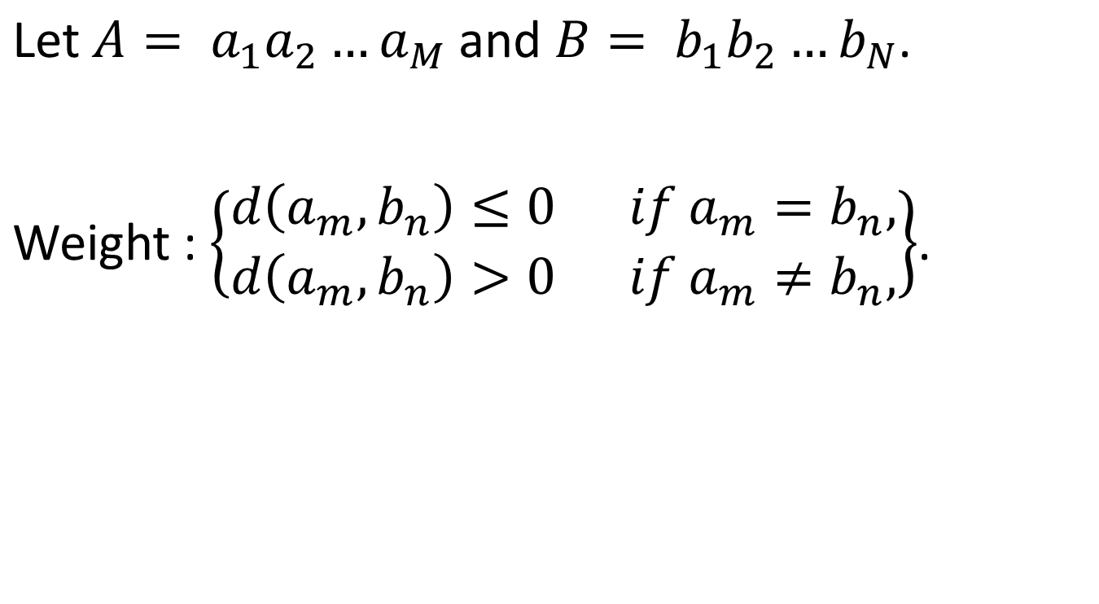
Algorithm

Slide 18
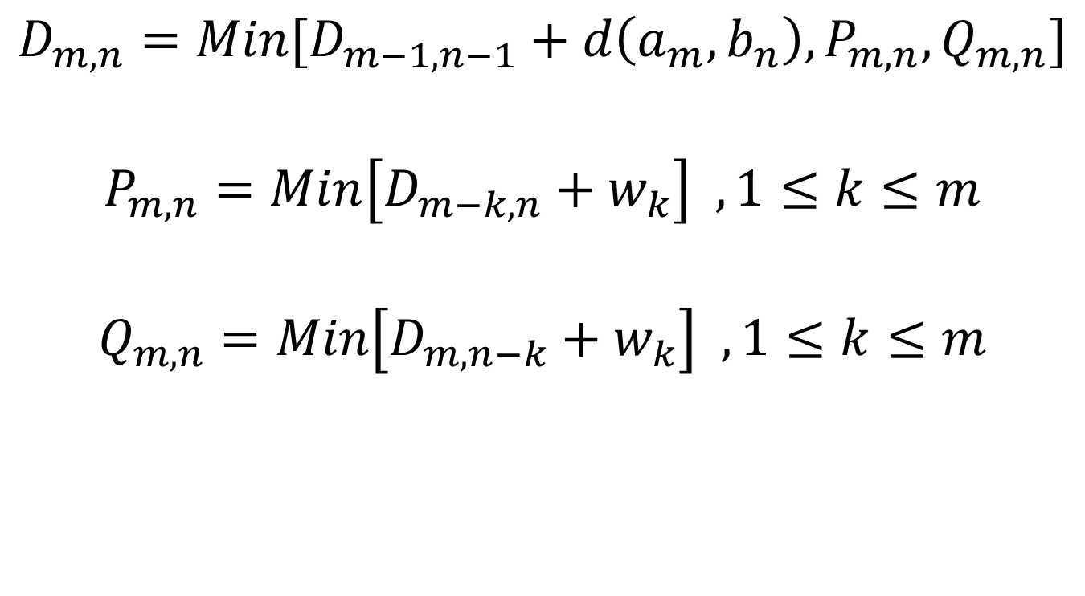

Slide 19
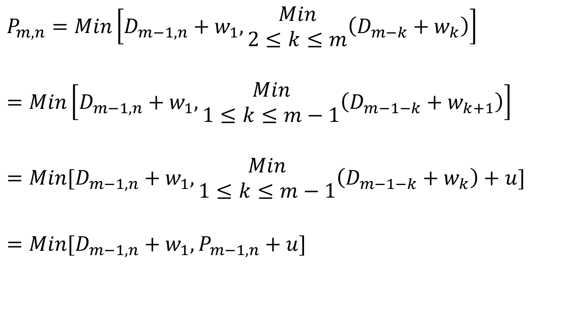

Slide 20
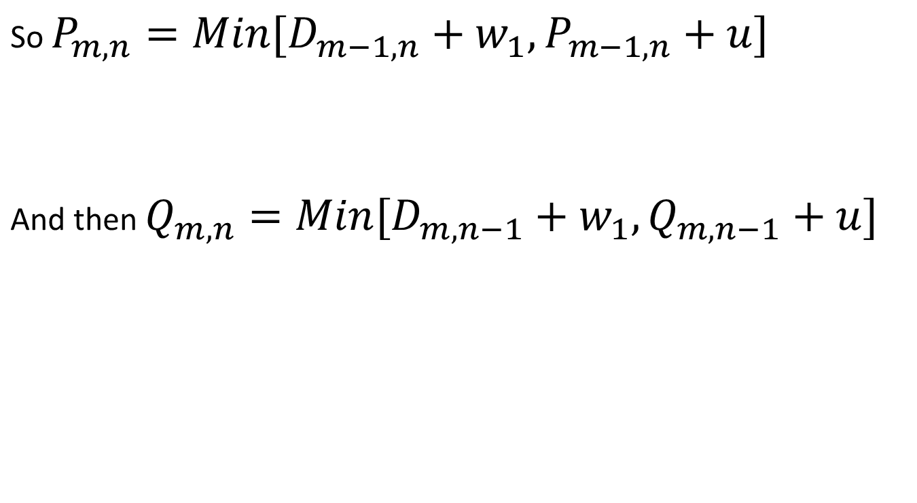

Slide 21
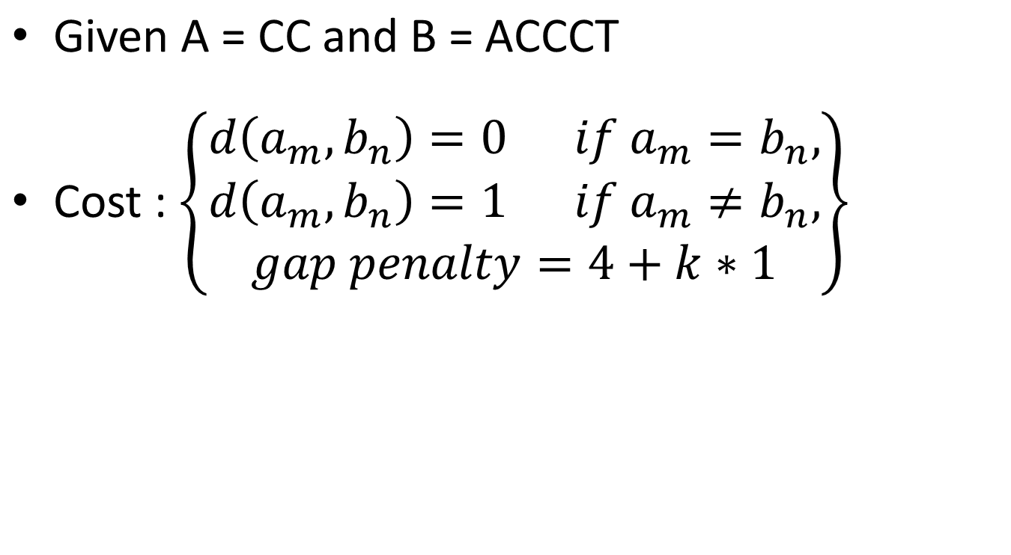
Example

Slide 22

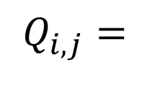

 | ∆ | A | C | C | T
∆ | 0 | 5 | 6 | 7 | 8
C | 5 | 1 | 5 | 6 | 8
C | 6 | 6 | 1 | 5 | 7
 | ∆ | A | C | C | T
∆ | 0 | - | - | - | -
C | ∞ | 10 | 6 | 7 | 8
C | ∞ | 11 | 11 | 6 | 7
 | ∆ | A | C | C | T
∆ | 0 | ∞ | ∞ | ∞ | ∞
C | - | 10 | 11 | 12 | 13
C | - | 6 | 10 | 11 | 13

Slide 23
OPTIMAL SEQUENCE ALIGNMENT USING AFFINE GAP COSTS
STEPHAN F. Altschul, Bruce W. Erickson
Bulletin of Mathematical Biology 1986, Volume 48, Issue 5-6 page 603-616
Presenter: Huang-Ting Chang
Date:115/11/07

Slide 24
Abstract
When comparing two biological sequences, it is often desirable for a gap to be assigned a cost not directly proportional to its length. If affine gap costs are employed, in other words if opening a gap costs v and each null in the gap costs u, the algorithm of Gotoh (1982,J. molec. Biol. 162, 705) finds the minimum cost of aligning two sequences in order MN steps.

Slide 25
Gotoh's algorithm attempts to find only one from among possibly many optimal (minimum-cost) alignments, but does not always succeed. This paper provides an example for which this part of Gotoh's algorithm fails and describes an algorithm that finds all and only the optimal alignments.

Slide 26
This modification of Gotoh's algorithm still requires order MN steps. A more precise form of path graph than previously used is needed to represent accurately all optimal alignments for affine gap costs.

Slide 27
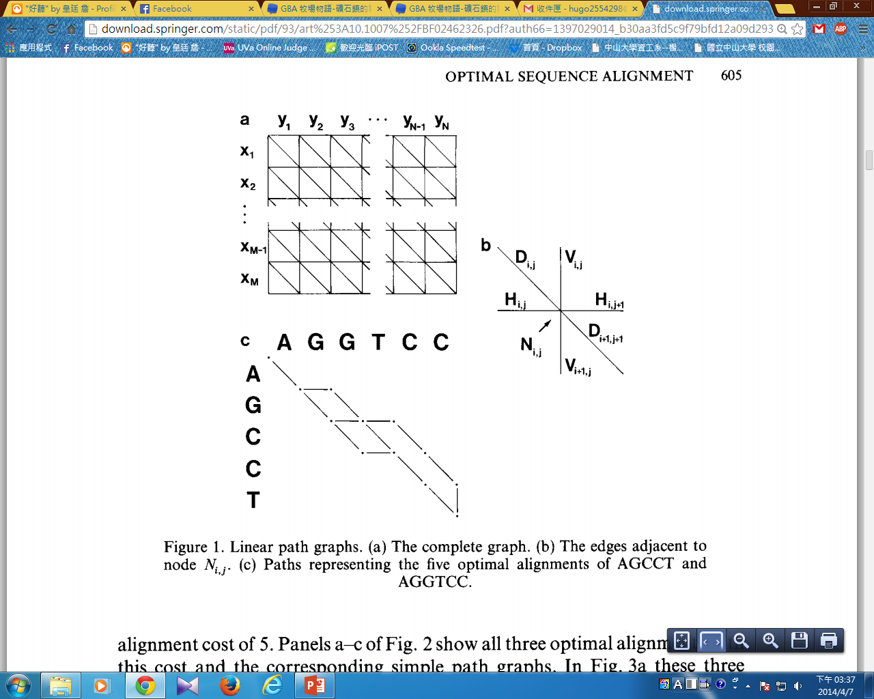


Slide 28
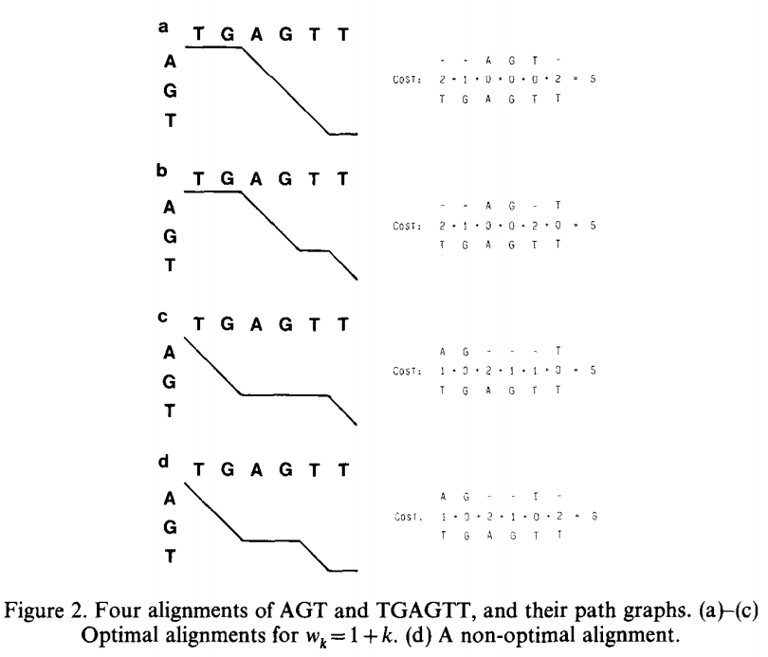

Slide 29
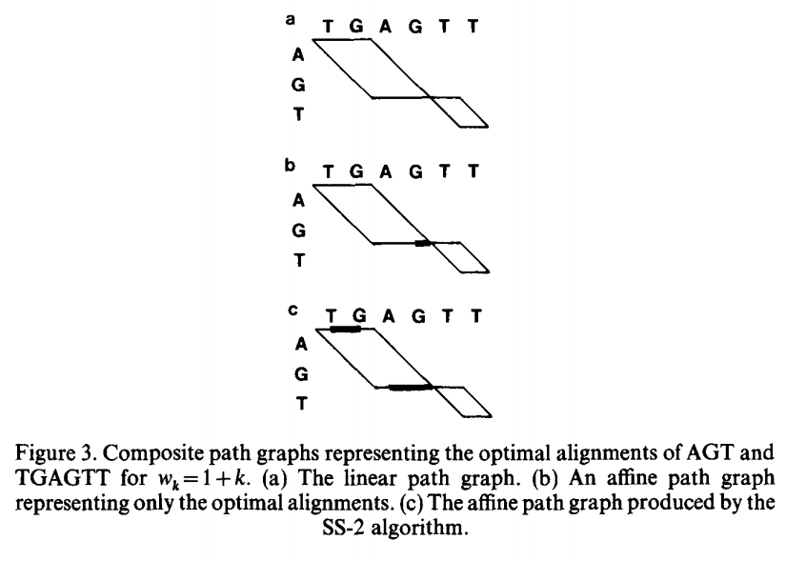

Slide 30
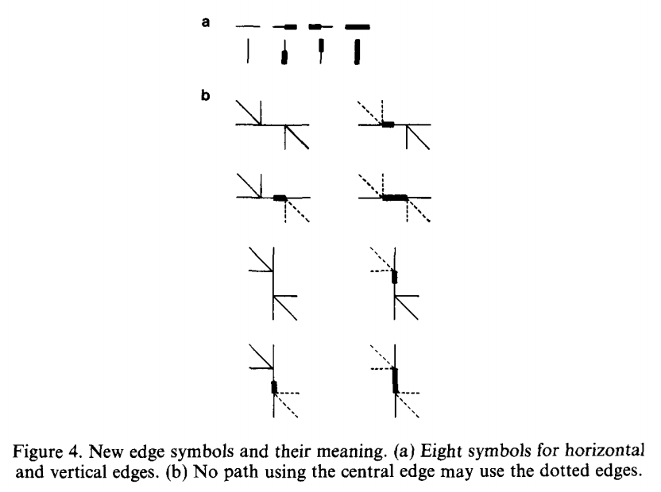

Slide 31
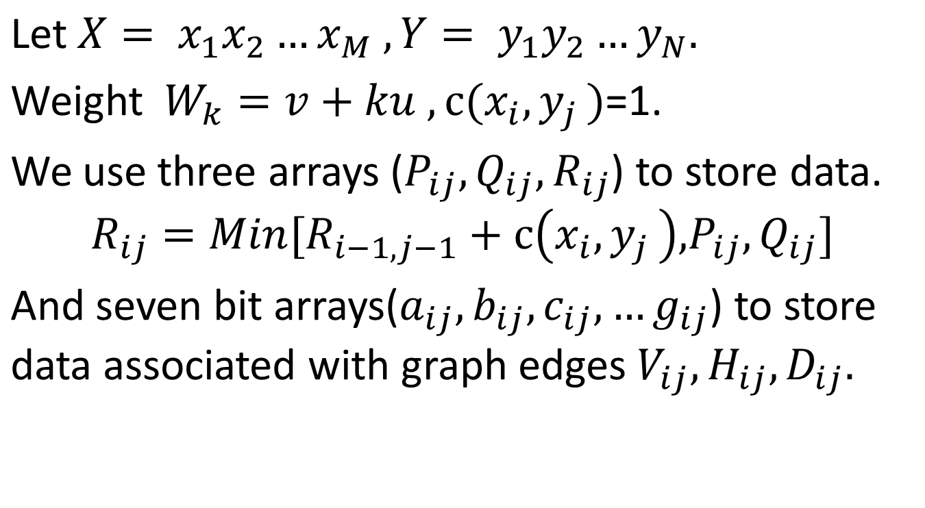
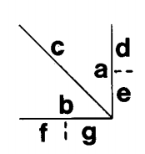
SS-2 Algorithm

Slide 32
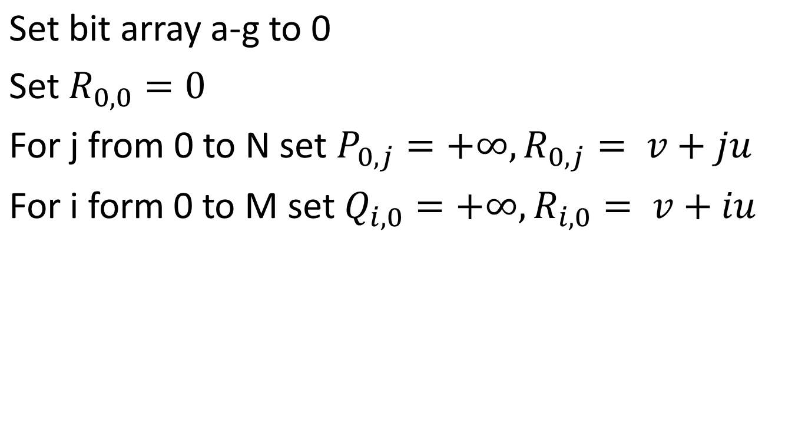
Step 1 initialization

Slide 33
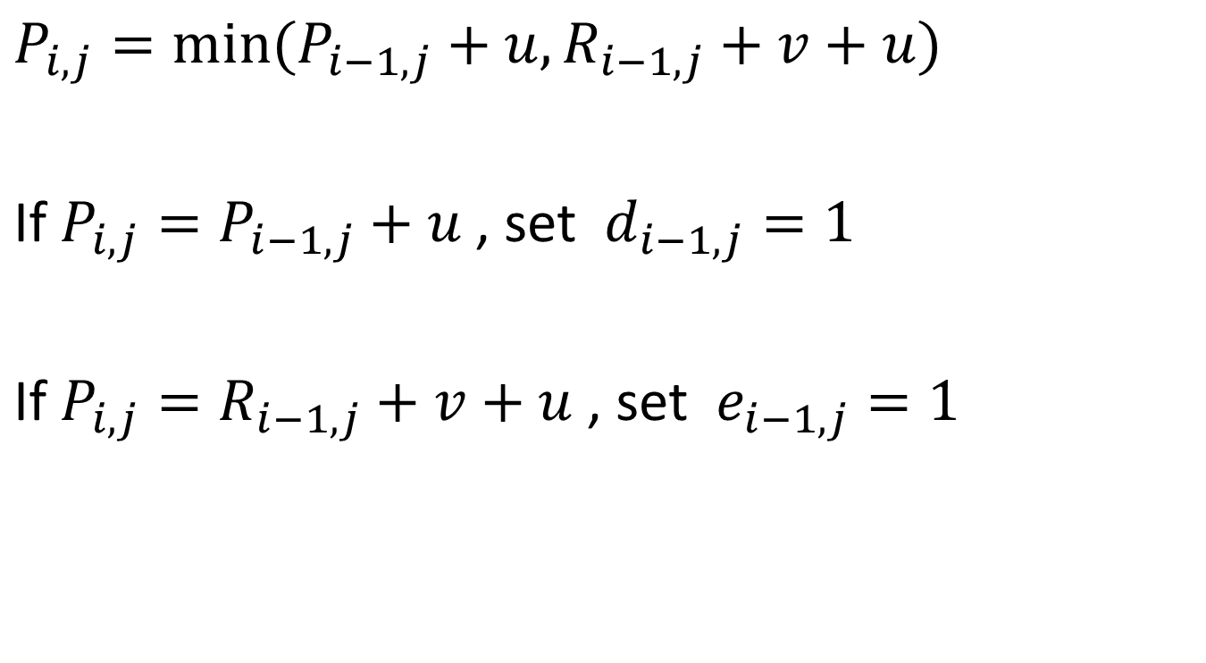
Step 2-7 Cost assignment

Slide 34
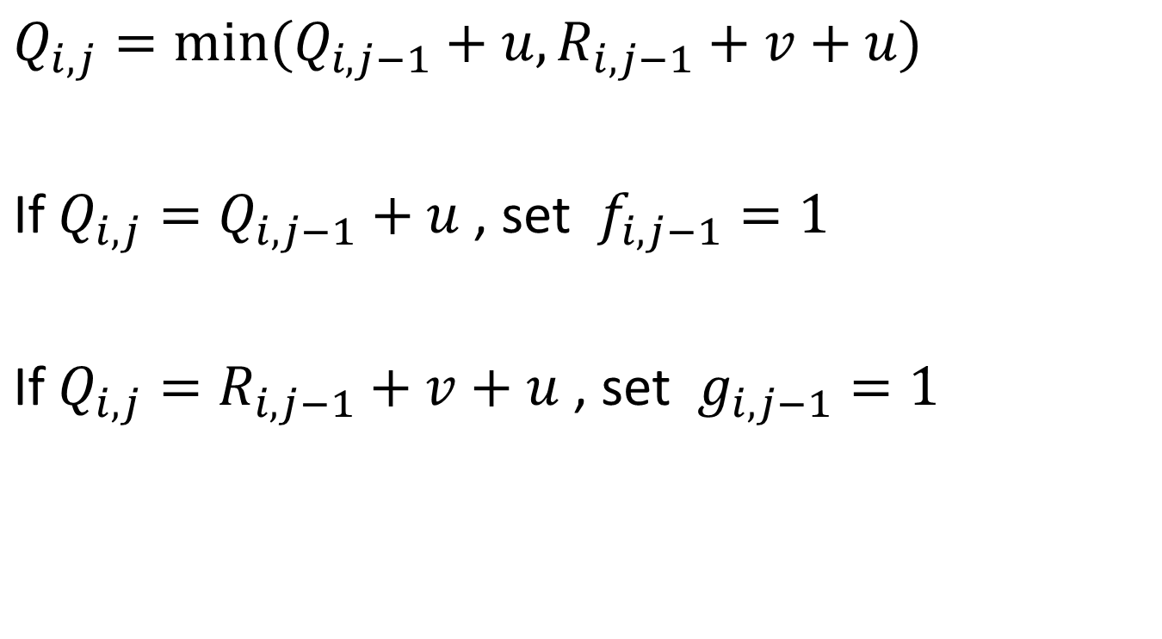

Slide 35
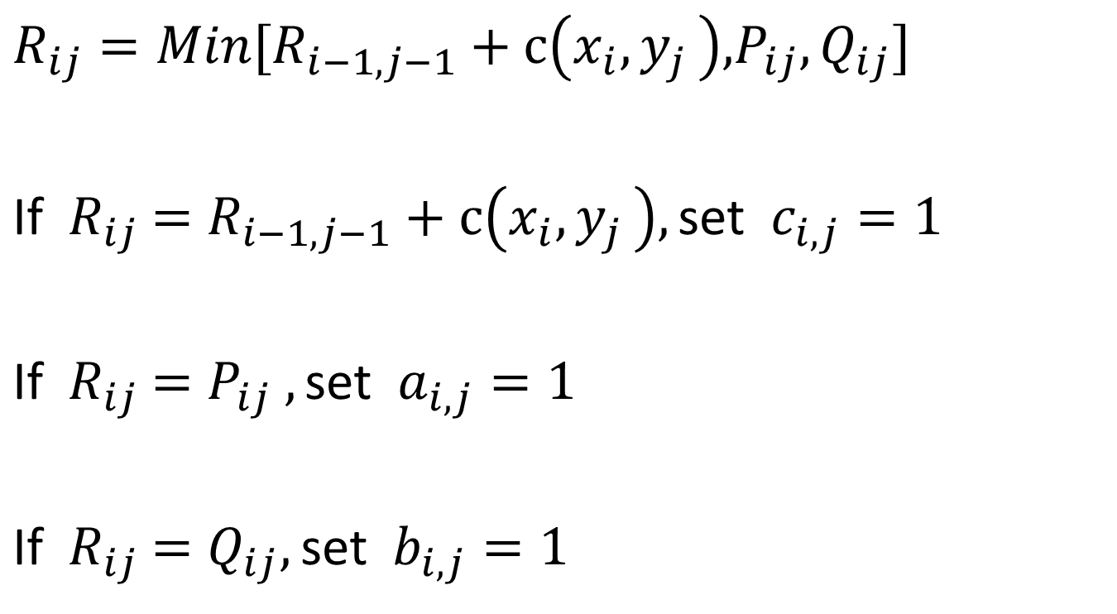

Slide 36
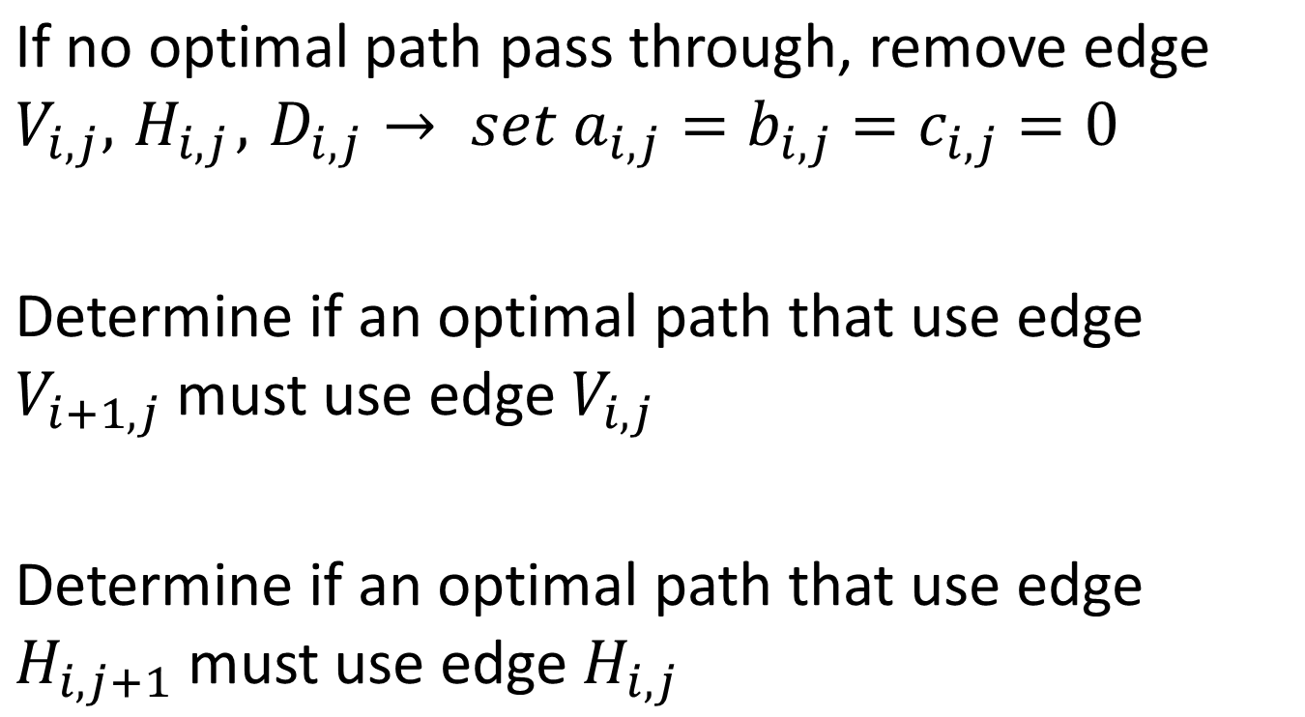
Step 8-11 Edge assignment

Slide 37
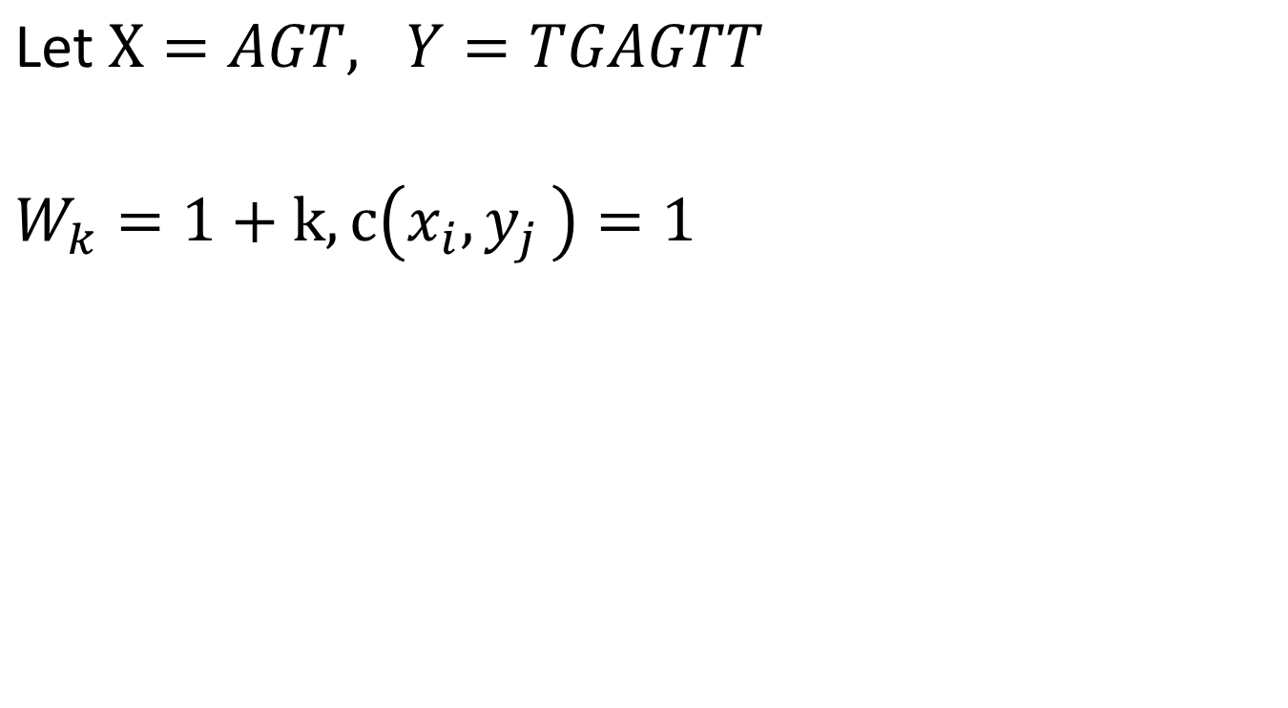
Example

Slide 38



 | ∆ | T | G | A | G | T | T
∆ | 0 | 2 | 3 | 4 | 5 | 6 | 7
A | 2 | 1 | 3 | 3 | 5 | 6 | 7
G | 3 | 3 | 1 | 3 | 3 | 5 | 6
T | 4 | 3 | 3 | 2 | 4 | 3 | 5
 | ∆ | T | G | A | G | T | T
∆ | ∞ | ∞ | ∞ | ∞ | ∞ | ∞ | ∞
A | 2 | 4 | 5 | 6 | 7 | 8 | 9
G | 3 | 3 | 5 | 5 | 7 | 8 | 9
T | 4 | 4 | 3 | 5 | 5 | 7 | 8
 | ∆ | T | G | A | G | T | T
∆ | ∞ | 2 | 3 | 4 | 5 | 6 | 7
A | ∞ | 4 | 3 | 4 | 5 | 6 | 7
G | ∞ | 5 | 5 | 3 | 4 | 5 | 6
T | ∞ | 6 | 5 | 5 | 4 | 5 | 5

Slide 39
