Slide 1
A Fast Algorithm for Computing Longest Common Subsequences of Small Alphabet Size
Chin Francis Y. L. and Poon C. K. Journal of information processing 13(4), 463-469 (Feb, 1991)
Presenter: 周展億
Date: 2014/04/08

Slide 2
Abstract
Given two strings of lengths m and n ≥ m on an alphabet of size s, the longest common subsequence (LCS) problem is to determine the longest subsequence that can be obtained by deleting zero or more symbols from either string. The first Ο(mn) algorithm was given by Hirschberg in 1975. The algorithm was later revised to Ο(ln), where l is the length of an LCS between the two strings. Another strategy given by Hunt and Szymanski takes Ο(rlogn) time, where r ≤ mn is the total number of matches between the two strings. Apostolico and Guerra combined the two approaches and derived an Ο(mlogn+dlog(mn/d)) algorithm, where d ≤ r is the number of dominant matches (minimal candidates) between the two strings. Efficient algorithms for two similar strings were devised by Nakatsu et al.[7]and Myers[61with time complexities of Ο(n(m-l)) and Ο(n(n-1)), respectively. This paper presents a new algorithm for this problem, which requires preprocessing that is nearly standard for the LCS problem and has time and space complexity of Ο(ns+min{ds,lm}) and Ο(ns+d), respectively. This algorithm is particularly efficient when s (the alphabet size) is small Different data structures are used to obtain variations of the basic algorithm that require different time and space complexities.

Slide 3
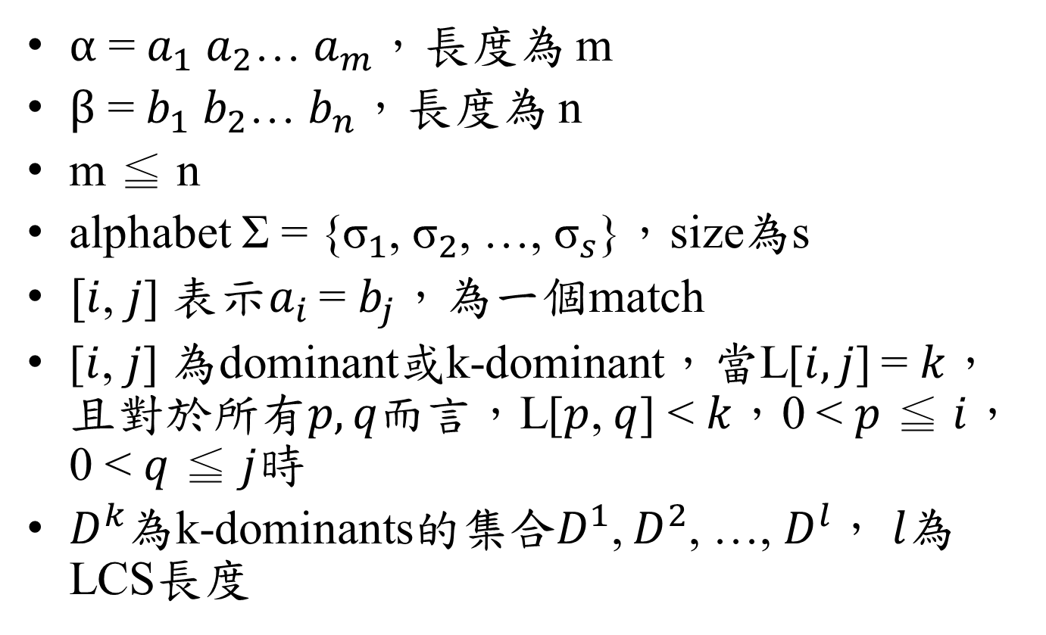
Introduction
$α$= $a_{1}$$a_{2}$…$a_{m}$，長度為 m
$β$= $b_{1}$$b_{2}$… $b_{n}$，長度為 n
m ≦ n
alphabet Σ = {${\text{σ}}_{1}$, ${\text{σ}}_{2}$, …, ${\text{σ}}_{s}$}，size為s
$[i$, $j$] 表示$a_{i}$= $b_{j}$，為一個match
[$i$, $j$] 為dominant或k-dominant，當L[$i,j$] = $k$，且對於所有$p,q而言$，L[$p$, $q$] <$k$，0 <$p$≦$i$，0 <$q$≦$j$時
$D^{k}$為k-dominants的集合$D^{1}$, $D^{2}$, …, $D^{l}$，$l$為LCS長度

Slide 4
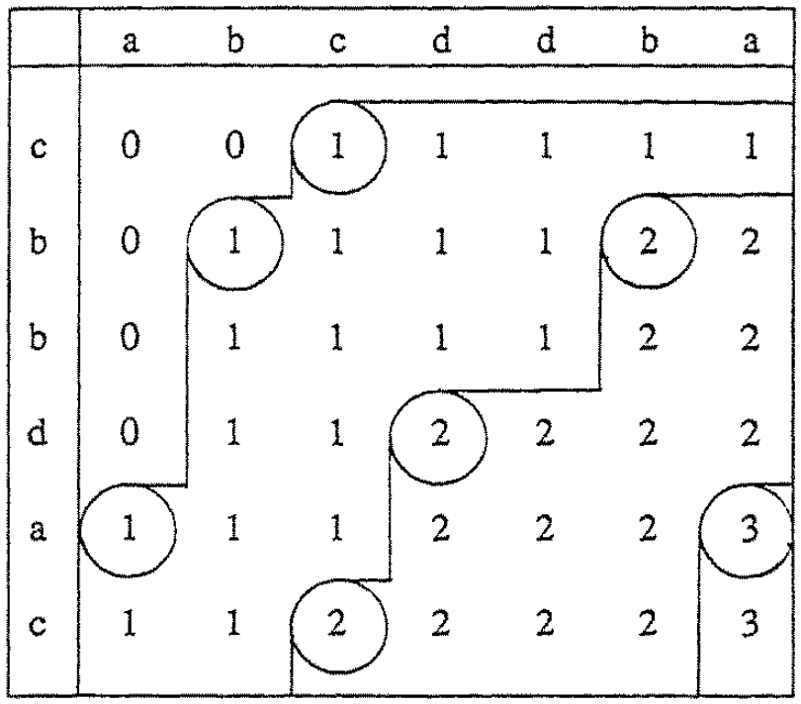
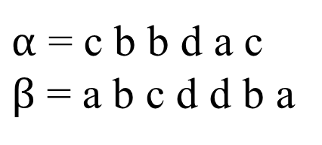
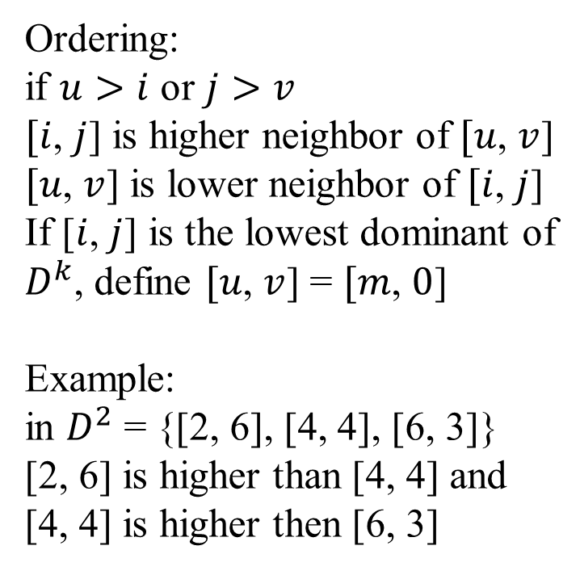
Example
$α$= c b b d a c $β$ = a b c d d b a
Ordering: if $u>i$ or $j>v$
$[i$, $j$] ishigher neighbor of $[u$, $v$]
$[u$, $v$] is lower neighbor of$[i$, $j$]
If [$i$, $j$] is the lowest dominant of $D^{k}$, define $[u$, $v$] = $[m$,$0$] Example: in $D^{2}$= {[2, 6], [4, 4], [6, 3]}
[2, 6] is higher than [4, 4] and [4, 4] is higher then [6, 3]

Slide 5
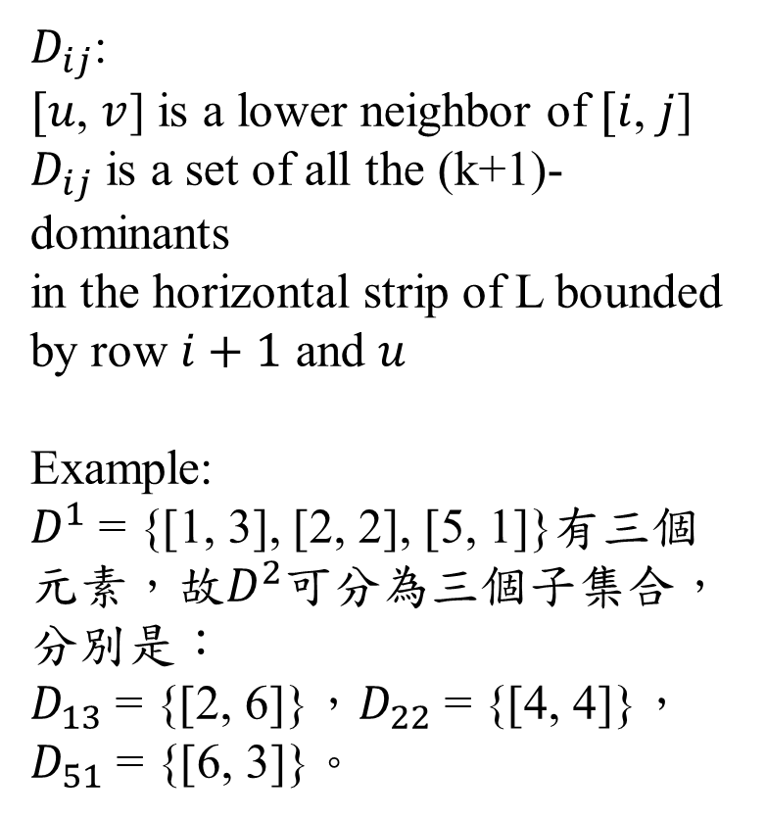
Example
$D_{ij}$: $[u$,$v$] is a lower neighbor of $[i$, $j$] $D_{ij}$is a set of all the (k+1)-dominants in the horizontal strip of L bounded by row $i+1$ and $u$ Example:
$D^{1}$= {[1, 3], [2, 2], [5, 1]}有三個元素，故$D^{2}$可分為三個子集合，分別是： $D_{13}$={[2, 6]}，$D_{22}$={[4, 4]}， $D_{51}$={[6, 3]}。
$α$= c b b d a c $β$ = a b c d d b a

Slide 6
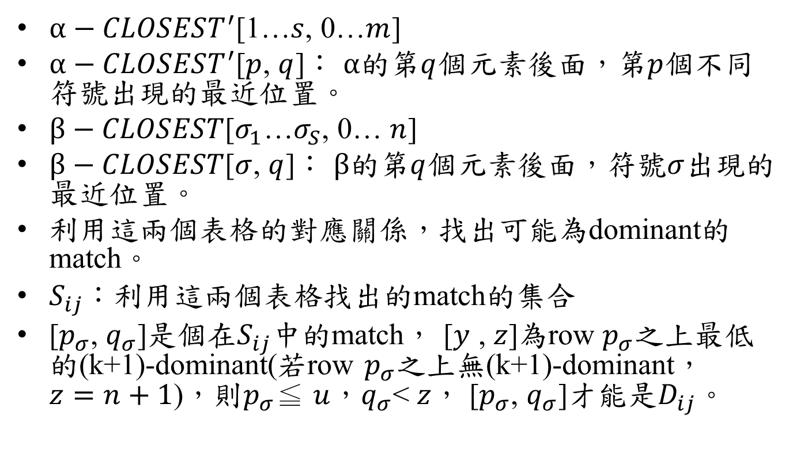
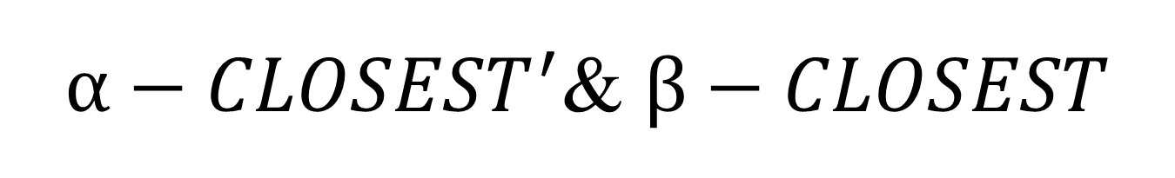
$α−CLOSEST^{′}$&$β−CLOSEST$
$α−CLOSEST^{′}$[1…$s$, 0…$m$]
$α−CLOSEST^{′}$[$p$,$q$]：$α$的第$q$個元素後面，第$p$個不同符號出現的最近位置。
$β−CLOSEST$[$σ_{1}$…$σ_{S}$, 0…$n$]
$β−CLOSEST$[$σ$, $q$]：$β$的第$q$個元素後面，符號$σ$出現的最近位置。
利用這兩個表格的對應關係，找出可能為dominant的match。
$S_{ij}$：利用這兩個表格找出的match的集合
[$p_{σ}$,$q_{σ}$]是個在$S_{ij}$中的match，[$y$ ,$z$]為row$p_{σ}$之上最低的(k+1)-dominant(若row$p_{σ}$之上無(k+1)-dominant，$z=n+1$)，則$p_{σ}$≦$u$，$q_{σ}$<$z$， [$p_{σ}$, $q_{σ}$]才能是$D_{ij}$。

Slide 7
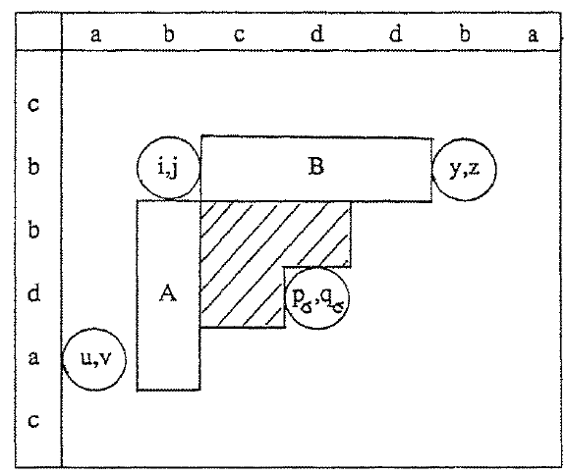

[$p_{σ}$, $q_{σ}$]

Slide 8
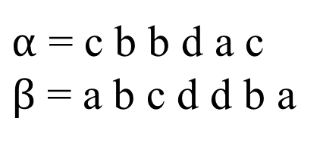
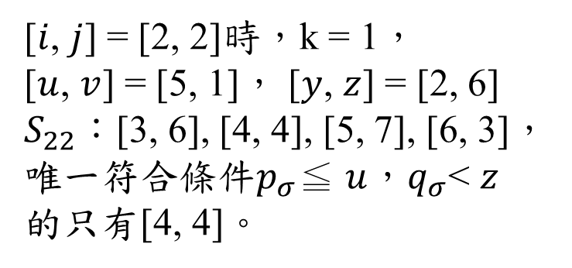
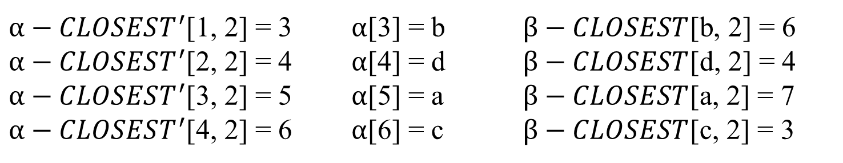
Example
$α−CLOSEST^{′}$[1, 2] = 3 $α$[3] = b $β−CLOSEST$[b, 2] = 6
$α−CLOSEST^{′}$[2, 2] = 4 $α$[4] = d $β−CLOSEST$[d, 2] = 4
$α−CLOSEST^{′}$[3, 2] = 5 $α$[5] = a $β−CLOSEST$[a, 2] = 7
$α−CLOSEST^{′}$[4, 2] = 6 $α$[6] = c $β−CLOSEST$[c, 2] = 3
$α$= c b b d a c $β$ = a b c d d b a
[$i$, $j$]=[2, 2]時，k = 1，
[$u$, $v$] = [5, 1]，[$y$, $z$] = [2, 6] $S_{22}$：[3, 6], [4, 4], [5, 7], [6, 3]， 唯一符合條件$p_{σ}$≦ $u$，$q_{σ}$<$z$ 的只有[4, 4]。

Slide 9

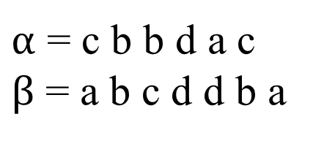


Algorithm
$α−CLOSEST^{′}$
建立$α−CLOSEST^{′}$和$β−CLOSEST$
 | 0 | 1 | 2 | 3 | 4 | 5 | 6
1 | 1 | 2 | 3 | 4 | 5 | 6 | 7
2 | 2 | 4 | 4 | 5 | 6 | 7 | 7
3 | 4 | 5 | 5 | 6 | 7 | 7 | 7
4 | 5 | 6 | 6 | 7 | 7 | 7 | 7
$$β−CLOSEST$$
$α$= c b b d a c $β$ = a b c d d b a
 | 0 | 1 | 2 | 3 | 4 | 5 | 6 | 7
a | 1 | 7 | 7 | 7 | 7 | 7 | 7 | 8
b | 2 | 2 | 6 | 6 | 6 | 6 | 8 | 8
c | 3 | 3 | 3 | 8 | 8 | 8 | 8 | 8
d | 4 | 4 | 4 | 4 | 5 | 8 | 8 | 8

Slide 10



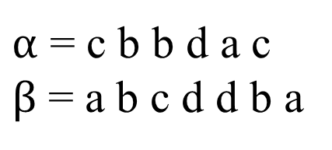
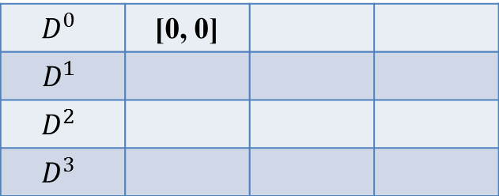
Algorithm
尋找$D_{ij}$
0 | a | b | c | d | d | b | a
c
b
b
d
a
c
$α$= c b b d a c $β$ = a b c d d b a
$$D^{0}$$ | [0, 0]
$$D^{1}$$
$$D^{2}$$
$$D^{3}$$
$α−CLOSEST^{′}$
$$β−CLOSEST$$
 | 0 | 1 | 2 | 3 | 4 | 5 | 6
1 | 1 | 2 | 3 | 4 | 5 | 6 | 7
2 | 2 | 4 | 4 | 5 | 6 | 7 | 7
3 | 4 | 5 | 5 | 6 | 7 | 7 | 7
4 | 5 | 6 | 6 | 7 | 7 | 7 | 7
 | 0 | 1 | 2 | 3 | 4 | 5 | 6 | 7
a | 1 | 7 | 7 | 7 | 7 | 7 | 7 | 8
b | 2 | 2 | 6 | 6 | 6 | 6 | 8 | 8
c | 3 | 3 | 3 | 8 | 8 | 8 | 8 | 8
d | 4 | 4 | 4 | 4 | 5 | 8 | 8 | 8

Slide 11
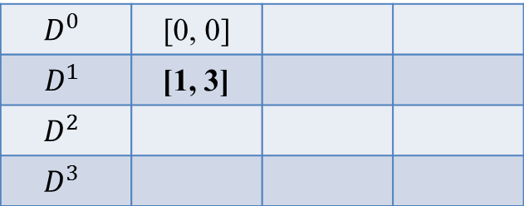
Algorithm
尋找$D_{ij}$
0 | a | b | c | d | d | b | a
c |  |  | *
b
b
d
a
c
$α$= c b b d a c $β$ = a b c d d b a
$$D^{0}$$ | [0, 0]
$$D^{1}$$ | [1, 3]
$$D^{2}$$
$$D^{3}$$
$α−CLOSEST^{′}$
$$β−CLOSEST$$
 | 0 | 1 | 2 | 3 | 4 | 5 | 6
1 | 1 | 2 | 3 | 4 | 5 | 6 | 7
2 | 2 | 4 | 4 | 5 | 6 | 7 | 7
3 | 4 | 5 | 5 | 6 | 7 | 7 | 7
4 | 5 | 6 | 6 | 7 | 7 | 7 | 7
 | 0 | 1 | 2 | 3 | 4 | 5 | 6 | 7
a | 1 | 7 | 7 | 7 | 7 | 7 | 7 | 8
b | 2 | 2 | 6 | 6 | 6 | 6 | 8 | 8
c | 3 | 3 | 3 | 8 | 8 | 8 | 8 | 8
d | 4 | 4 | 4 | 4 | 5 | 8 | 8 | 8

Slide 12
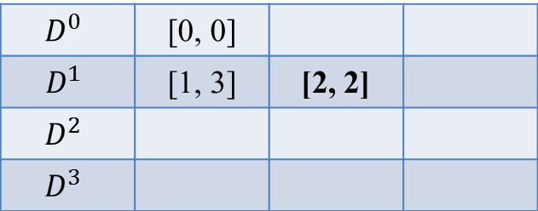
Algorithm
尋找$D_{ij}$
0 | a | b | c | d | d | b | a
c |  |  | *
b |  | *
b
d
a
c
$α$= c b b d a c $β$ = a b c d d b a
$$D^{0}$$ | [0, 0]
$$D^{1}$$ | [1, 3] | [2, 2]
$$D^{2}$$
$$D^{3}$$
$α−CLOSEST^{′}$
$$β−CLOSEST$$
 | 0 | 1 | 2 | 3 | 4 | 5 | 6
1 | 1 | 2 | 3 | 4 | 5 | 6 | 7
2 | 2 | 4 | 4 | 5 | 6 | 7 | 7
3 | 4 | 5 | 5 | 6 | 7 | 7 | 7
4 | 5 | 6 | 6 | 7 | 7 | 7 | 7
 | 0 | 1 | 2 | 3 | 4 | 5 | 6 | 7
a | 1 | 7 | 7 | 7 | 7 | 7 | 7 | 8
b | 2 | 2 | 6 | 6 | 6 | 6 | 8 | 8
c | 3 | 3 | 3 | 8 | 8 | 8 | 8 | 8
d | 4 | 4 | 4 | 4 | 5 | 8 | 8 | 8

Slide 13
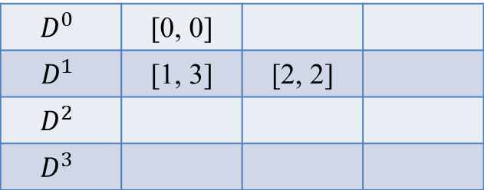
Algorithm
尋找$D_{ij}$
0 | a | b | c | d | d | b | a
c |  |  | *
b |  | *
b
d |  |  |  | *
a
c
$α$= c b b d a c $β$ = a b c d d b a
$$D^{0}$$ | [0, 0]
$$D^{1}$$ | [1, 3] | [2, 2]
$$D^{2}$$
$$D^{3}$$
$α−CLOSEST^{′}$
$$β−CLOSEST$$
 | 0 | 1 | 2 | 3 | 4 | 5 | 6
1 | 1 | 2 | 3 | 4 | 5 | 6 | 7
2 | 2 | 4 | 4 | 5 | 6 | 7 | 7
3 | 4 | 5 | 5 | 6 | 7 | 7 | 7
4 | 5 | 6 | 6 | 7 | 7 | 7 | 7
 | 0 | 1 | 2 | 3 | 4 | 5 | 6 | 7
a | 1 | 7 | 7 | 7 | 7 | 7 | 7 | 8
b | 2 | 2 | 6 | 6 | 6 | 6 | 8 | 8
c | 3 | 3 | 3 | 8 | 8 | 8 | 8 | 8
d | 4 | 4 | 4 | 4 | 5 | 8 | 8 | 8

Slide 14
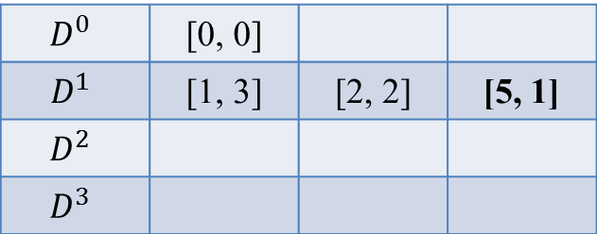
Algorithm
尋找$D_{ij}$
0 | a | b | c | d | d | b | a
c |  |  | *
b |  | *
b
d |  |  |  | *
a | *
c
$α$= c b b d a c $β$ = a b c d d b a
$$D^{0}$$ | [0, 0]
$$D^{1}$$ | [1, 3] | [2, 2] | [5, 1]
$$D^{2}$$
$$D^{3}$$
$α−CLOSEST^{′}$
$$β−CLOSEST$$
 | 0 | 1 | 2 | 3 | 4 | 5 | 6
1 | 1 | 2 | 3 | 4 | 5 | 6 | 7
2 | 2 | 4 | 4 | 5 | 6 | 7 | 7
3 | 4 | 5 | 5 | 6 | 7 | 7 | 7
4 | 5 | 6 | 6 | 7 | 7 | 7 | 7
 | 0 | 1 | 2 | 3 | 4 | 5 | 6 | 7
a | 1 | 7 | 7 | 7 | 7 | 7 | 7 | 8
b | 2 | 2 | 6 | 6 | 6 | 6 | 8 | 8
c | 3 | 3 | 3 | 8 | 8 | 8 | 8 | 8
d | 4 | 4 | 4 | 4 | 5 | 8 | 8 | 8

Slide 15
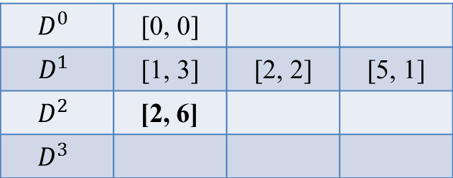
Algorithm
尋找$D_{ij}$
0 | a | b | c | d | d | b | a
c |  |  | *
b |  | * |  |  |  | *
b
d |  |  |  | *
a | * |  |  |  |  |  | *
c
$α$= c b b d a c $β$ = a b c d d b a
$$D^{0}$$ | [0, 0]
$$D^{1}$$ | [1, 3] | [2, 2] | [5, 1]
$$D^{2}$$ | [2, 6]
$$D^{3}$$
$α−CLOSEST^{′}$
$$β−CLOSEST$$
 | 0 | 1 | 2 | 3 | 4 | 5 | 6
1 | 1 | 2 | 3 | 4 | 5 | 6 | 7
2 | 2 | 4 | 4 | 5 | 6 | 7 | 7
3 | 4 | 5 | 5 | 6 | 7 | 7 | 7
4 | 5 | 6 | 6 | 7 | 7 | 7 | 7
 | 0 | 1 | 2 | 3 | 4 | 5 | 6 | 7
a | 1 | 7 | 7 | 7 | 7 | 7 | 7 | 8
b | 2 | 2 | 6 | 6 | 6 | 6 | 8 | 8
c | 3 | 3 | 3 | 8 | 8 | 8 | 8 | 8
d | 4 | 4 | 4 | 4 | 5 | 8 | 8 | 8

Slide 16
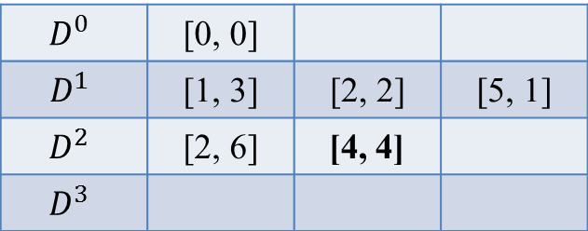
Algorithm
尋找$D_{ij}$
0 | a | b | c | d | d | b | a
c |  |  | *
b |  | * |  |  |  | *
b
d |  |  |  | *
a | * |  |  |  |  |  | *
c |  |  | *
$α$= c b b d a c $β$ = a b c d d b a
$$D^{0}$$ | [0, 0]
$$D^{1}$$ | [1, 3] | [2, 2] | [5, 1]
$$D^{2}$$ | [2, 6] | [4, 4]
$$D^{3}$$
$α−CLOSEST^{′}$
$$β−CLOSEST$$
 | 0 | 1 | 2 | 3 | 4 | 5 | 6
1 | 1 | 2 | 3 | 4 | 5 | 6 | 7
2 | 2 | 4 | 4 | 5 | 6 | 7 | 7
3 | 4 | 5 | 5 | 6 | 7 | 7 | 7
4 | 5 | 6 | 6 | 7 | 7 | 7 | 7
 | 0 | 1 | 2 | 3 | 4 | 5 | 6 | 7
a | 1 | 7 | 7 | 7 | 7 | 7 | 7 | 8
b | 2 | 2 | 6 | 6 | 6 | 6 | 8 | 8
c | 3 | 3 | 3 | 8 | 8 | 8 | 8 | 8
d | 4 | 4 | 4 | 4 | 5 | 8 | 8 | 8

Slide 17
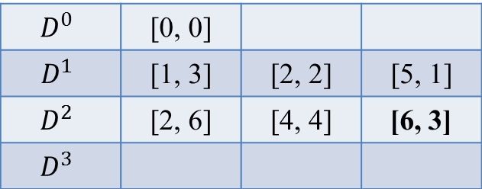
Algorithm
尋找$D_{ij}$
0 | a | b | c | d | d | b | a
c |  |  | *
b |  | * |  |  |  | *
b
d |  |  |  | *
a | * |  |  |  |  |  | *
c |  |  | *
$α$= c b b d a c $β$ = a b c d d b a
$$D^{0}$$ | [0, 0]
$$D^{1}$$ | [1, 3] | [2, 2] | [5, 1]
$$D^{2}$$ | [2, 6] | [4, 4] | [6, 3]
$$D^{3}$$
$α−CLOSEST^{′}$
$$β−CLOSEST$$
 | 0 | 1 | 2 | 3 | 4 | 5 | 6
1 | 1 | 2 | 3 | 4 | 5 | 6 | 7
2 | 2 | 4 | 4 | 5 | 6 | 7 | 7
3 | 4 | 5 | 5 | 6 | 7 | 7 | 7
4 | 5 | 6 | 6 | 7 | 7 | 7 | 7
 | 0 | 1 | 2 | 3 | 4 | 5 | 6 | 7
a | 1 | 7 | 7 | 7 | 7 | 7 | 7 | 8
b | 2 | 2 | 6 | 6 | 6 | 6 | 8 | 8
c | 3 | 3 | 3 | 8 | 8 | 8 | 8 | 8
d | 4 | 4 | 4 | 4 | 5 | 8 | 8 | 8

Slide 18
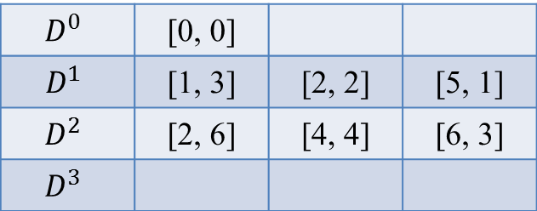
Algorithm
尋找$D_{ij}$
0 | a | b | c | d | d | b | a
c |  |  | *
b |  | * |  |  |  | *
b
d |  |  |  | *
a | * |  |  |  |  |  | *
c |  |  | *
$α$= c b b d a c $β$ = a b c d d b a
$$D^{0}$$ | [0, 0]
$$D^{1}$$ | [1, 3] | [2, 2] | [5, 1]
$$D^{2}$$ | [2, 6] | [4, 4] | [6, 3]
$$D^{3}$$
$α−CLOSEST^{′}$
$$β−CLOSEST$$
 | 0 | 1 | 2 | 3 | 4 | 5 | 6
1 | 1 | 2 | 3 | 4 | 5 | 6 | 7
2 | 2 | 4 | 4 | 5 | 6 | 7 | 7
3 | 4 | 5 | 5 | 6 | 7 | 7 | 7
4 | 5 | 6 | 6 | 7 | 7 | 7 | 7
 | 0 | 1 | 2 | 3 | 4 | 5 | 6 | 7
a | 1 | 7 | 7 | 7 | 7 | 7 | 7 | 8
b | 2 | 2 | 6 | 6 | 6 | 6 | 8 | 8
c | 3 | 3 | 3 | 8 | 8 | 8 | 8 | 8
d | 4 | 4 | 4 | 4 | 5 | 8 | 8 | 8

Slide 19

Algorithm
尋找$D_{ij}$
0 | a | b | c | d | d | b | a
c |  |  | *
b |  | * |  |  |  | *
b
d |  |  |  | *
a | * |  |  |  |  |  | *
c |  |  | *
$α$= c b b d a c $β$ = a b c d d b a
$$D^{0}$$ | [0, 0]
$$D^{1}$$ | [1, 3] | [2, 2] | [5, 1]
$$D^{2}$$ | [2, 6] | [4, 4] | [6, 3]
$$D^{3}$$ | [5, 7]
$α−CLOSEST^{′}$
$$β−CLOSEST$$
 | 0 | 1 | 2 | 3 | 4 | 5 | 6
1 | 1 | 2 | 3 | 4 | 5 | 6 | 7
2 | 2 | 4 | 4 | 5 | 6 | 7 | 7
3 | 4 | 5 | 5 | 6 | 7 | 7 | 7
4 | 5 | 6 | 6 | 7 | 7 | 7 | 7
 | 0 | 1 | 2 | 3 | 4 | 5 | 6 | 7
a | 1 | 7 | 7 | 7 | 7 | 7 | 7 | 8
b | 2 | 2 | 6 | 6 | 6 | 6 | 8 | 8
c | 3 | 3 | 3 | 8 | 8 | 8 | 8 | 8
d | 4 | 4 | 4 | 4 | 5 | 8 | 8 | 8

Slide 20

Algorithm
尋找$D_{ij}$
0 | a | b | c | d | d | b | a
c |  |  | *
b |  | * |  |  |  | *
b
d |  |  |  | *
a | * |  |  |  |  |  | *
c |  |  | *
$α$= c b b d a c $β$ = a b c d d b a
$$D^{0}$$ | [0, 0]
$$D^{1}$$ | [1, 3] | [2, 2] | [5, 1]
$$D^{2}$$ | [2, 6] | [4, 4] | [6, 3]
$$D^{3}$$ | [5, 7]
$α−CLOSEST^{′}$
$$β−CLOSEST$$
 | 0 | 1 | 2 | 3 | 4 | 5 | 6
1 | 1 | 2 | 3 | 4 | 5 | 6 | 7
2 | 2 | 4 | 4 | 5 | 6 | 7 | 7
3 | 4 | 5 | 5 | 6 | 7 | 7 | 7
4 | 5 | 6 | 6 | 7 | 7 | 7 | 7
 | 0 | 1 | 2 | 3 | 4 | 5 | 6 | 7
a | 1 | 7 | 7 | 7 | 7 | 7 | 7 | 8
b | 2 | 2 | 6 | 6 | 6 | 6 | 8 | 8
c | 3 | 3 | 3 | 8 | 8 | 8 | 8 | 8
d | 4 | 4 | 4 | 4 | 5 | 8 | 8 | 8

Slide 21
Algorithm
尋找$D_{ij}$
0 | a | b | c | d | d | b | a
c |  |  | *
b |  | * |  |  |  | *
b
d |  |  |  | *
a | * |  |  |  |  |  | *
c |  |  | *
$α$= c b b d a c $β$ = a b c d d b a
$$D^{0}$$ | [0, 0]
$$D^{1}$$ | [1, 3] | [2, 2] | [5, 1]
$$D^{2}$$ | [2, 6] | [4, 4] | [6, 3]
$$D^{3}$$ | [5, 7]
完成，LCS長度為3
$α−CLOSEST^{′}$
$$β−CLOSEST$$
 | 0 | 1 | 2 | 3 | 4 | 5 | 6
1 | 1 | 2 | 3 | 4 | 5 | 6 | 7
2 | 2 | 4 | 4 | 5 | 6 | 7 | 7
3 | 4 | 5 | 5 | 6 | 7 | 7 | 7
4 | 5 | 6 | 6 | 7 | 7 | 7 | 7
 | 0 | 1 | 2 | 3 | 4 | 5 | 6 | 7
a | 1 | 7 | 7 | 7 | 7 | 7 | 7 | 8
b | 2 | 2 | 6 | 6 | 6 | 6 | 8 | 8
c | 3 | 3 | 3 | 8 | 8 | 8 | 8 | 8
d | 4 | 4 | 4 | 4 | 5 | 8 | 8 | 8

Slide 22
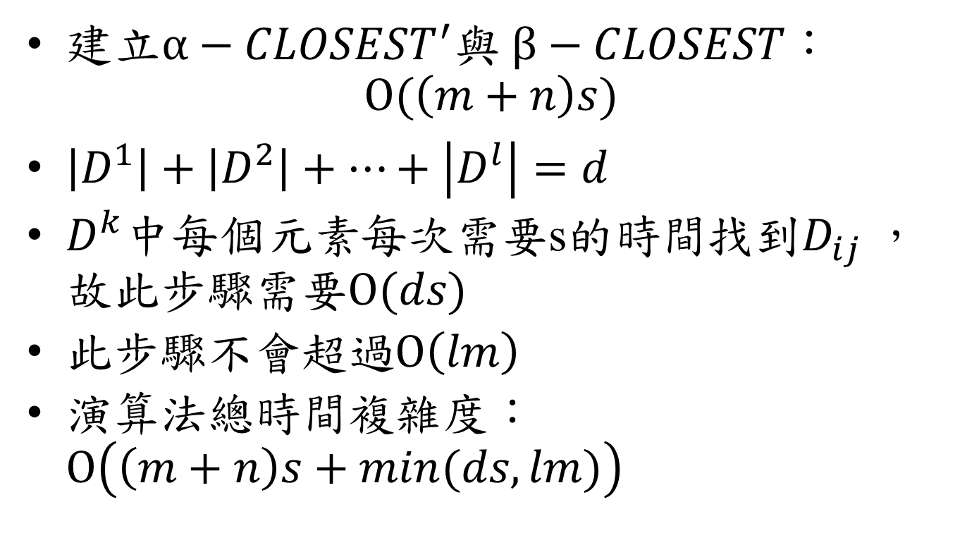
Time Complexity
建立$α−CLOSEST^{′}$與$β−CLOSEST$： $O(\left(m+n\right)s)$
$\left|D^{1}\right|+\left|D^{2}\right|+…+\left|D^{l}\right|=d$
$D^{k}$中每個元素每次需要s的時間找到$D_{ij}$，故此步驟需要$O(ds)$
此步驟不會超過$O\left(lm\right)$
演算法總時間複雜度：$O\left(\left(m+n\right)s+min(ds,lm)\right)$

