Slide 1
New Algorithms for the LCS Problem *
W.J. Hsu, M.W. Du
JOURNAL OF COMPUTER AND SYSTEM SCIENCES 29, 133-152 (1984)
Presenter:De-Sheng Jhan
2014/03/24

Slide 2
The LCS problem is to determine a longest common subsequence (LCS) of two symbol sequences. Two algorithms which improve two existing results, respectively, are resented. Let m, n be the lengths of the two input strings, with m ≦ n, p being the length of the LCS, and s being the number of distinct symbols appearing in the two strings. It is shown that the first algorithm presented requires at most O(n log s) reprocessing time and O(pm log(n/m) + pm) processing time to solve the problem. This bound is better than that of previous algorithms especially when n is much greater than m. The algorithm also exhibits desirable properties under conditions of sparse matches. The second scheme achieves essentially the same bound O(pm log(n/p) + pm) by employing efficient merging methods in the computations. It also outperforms existing algorithms designed for sparsely-matched situations. Together, the two algorithms provide interesting contrasts of different approaches to one problem; they also offer improved alternatives for actual implementation.

Slide 3
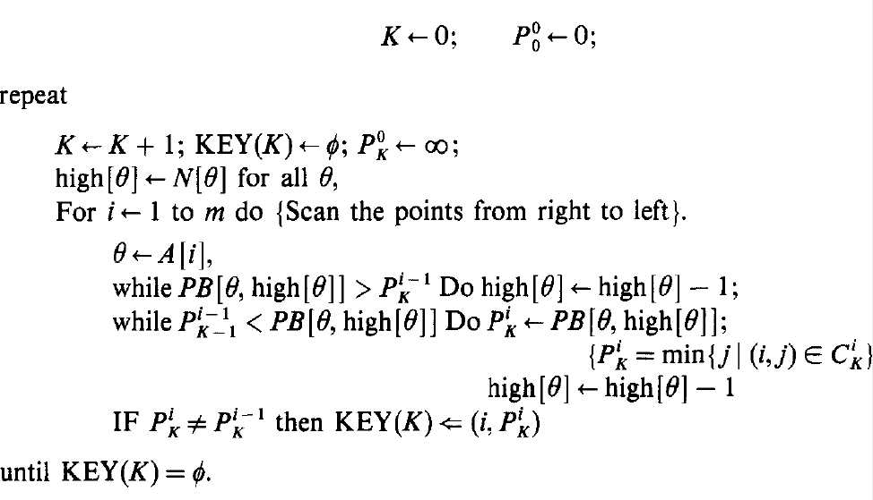
Approach 1
D. S. HIRSCHBERG, Algorithms for the longest common subsequence problem

Slide 4
A = “abcdbb” , B = “cbacbaaba”
 |  |  | c | B | a | c | b | a | a | b | a
 |  | 0 | 1 | 2 | 3 | 4 | 5 | 6 | 7 | 8 | 9
 | 0 | 0 | 0 | 0 | 0 | 0 | 0 | 0 | 0 | 0 | 0
a | 1 | 0 | 0 | 0 | 1 | 1 | 1 | 1 | 1 | 1 | 1
b | 2 | 0 | 0 | 1 | 1 | 1 | 2 | 2 | 2 | 2 | 2
c | 3 | 0 | 1 | 1 | 1 | 2 | 2 | 2 | 2 | 2 | 2
d | 4 | 0 | 1 | 1 | 1 | 2 | 2 | 2 | 2 | 2 | 2
b | 5 | 0 | 1 | 2 | 2 | 2 | 3 | 3 | 3 | 3 | 3
b | 6 | 0 | 1 | 2 | 2 | 2 | 3 | 3 | 3 | 4 | 4
 | c | b | a | c | b | a | a | b | a
a |  |  | 1 |  |  | 1 | 1 |  | 1
b |  | 1 |  |  | 2 |  |  | 2
c | 1 |  |  | 2
d
b |  | 2 |  |  | 3 |  |  | 3
b |  | 2 |  |  | 3 |  |  | 4

Slide 5
rank(i, j)
 |  |  | c | B | a | c | b | a | a | b | a
 |  | 0 | 1 | 2 | 3 | 4 | 5 | 6 | 7 | 8 | 9
 | 0 | 0 | 0 | 0 | 0 | 0 | 0 | 0 | 0 | 0 | 0
a | 1 | 0 | 0 | 0 | 1 | 1 | 1 | 1 | 1 | 1 | 1
b | 2 | 0 | 0 | 1 | 1 | 1 | 2 | 2 | 2 | 2 | 2
c | 3 | 0 | 1 | 1 | 1 | 2 | 2 | 2 | 2 | 2 | 2
d | 4 | 0 | 1 | 1 | 1 | 2 | 2 | 2 | 2 | 2 | 2
b | 5 | 0 | 1 | 2 | 2 | 2 | 3 | 3 | 3 | 3 | 3
b | 6 | 0 | 1 | 2 | 2 | 2 | 3 | 3 | 3 | 4 | 4
rank(3,4) = 2
rank(6,8) = 4

Slide 6
successor : a point P(i, j) to be a successor of another point P’(i’, j’) iff i’ < i and j’ < j , which simply means rank(i, j) ≧ rank(i’, j’)
 |  |  | c | B | a | c | b | a | a | b | a
 |  | 0 | 1 | 2 | 3 | 4 | 5 | 6 | 7 | 8 | 9
 | 0 | 0 | 0 | 0 | 0 | 0 | 0 | 0 | 0 | 0 | 0
a | 1 | 0 | 0 | 0 | 1 | 1 | 1 | 1 | 1 | 1 | 1
b | 2 | 0 | 0 | 1 | 1 | 1 | 2 | 2 | 2 | 2 | 2
c | 3 | 0 | 1 | 1 | 1 | 2 | 2 | 2 | 2 | 2 | 2
d | 4 | 0 | 1 | 1 | 1 | 2 | 2 | 2 | 2 | 2 | 2
b | 5 | 0 | 1 | 2 | 2 | 2 | 3 | 3 | 3 | 3 | 3
b | 6 | 0 | 1 | 2 | 2 | 2 | 3 | 3 | 3 | 4 | 4

Slide 7
A = “abcdbb” , B = “cbacbaaba”
if A[i] == b[j] => *
 | c | b | a | c | b | a | a | b | a
a |  |  | * |  |  | * | * |  | *
b |  | * |  |  | * |  |  | *
c | * |  |  | *
d
b |  | * |  |  | * |  |  | *
b |  | * |  |  | * |  |  | *

Slide 8
find rank = 1
 | c | b | a | c | b | a | a | b | a
a |  |  | * |  |  | * | * |  | 1
b |  | * |  |  | * |  |  | *
c | * |  |  | *
d
b |  | * |  |  | * |  |  | *
b |  | * |  |  | * |  |  | *
 | c | b | a | c | b | a | a | b | a
a |  |  | * |  |  | * | 1 |  | 1
b |  | * |  |  | * |  |  | *
c | * |  |  | *
d
b |  | * |  |  | * |  |  | *
b |  | * |  |  | * |  |  | *
：

Slide 9
find rank = 1
 | c | b | a | c | b | a | a | b | a
a |  |  | * |  |  | * | 1 |  | 1
b |  | * |  |  | * |  |  | *
c | * |  |  | *
d
b |  | * |  |  | * |  |  | *
b |  | * |  |  | * |  |  | *
 | c | b | a | c | b | a | a | b | a
a |  |  | 1 |  |  | 1 | 1 |  | 1
b |  | * |  |  | * |  |  | *
c | * |  |  | *
d
b |  | * |  |  | * |  |  | *
b |  | * |  |  | * |  |  | *

Slide 10
find rank = 1
 | c | b | a | c | b | a | a | b | a
a |  |  | 1 |  |  | 1 | 1 |  | 1
b |  | * |  |  | * |  |  | *
c | * |  |  | *
d
b |  | * |  |  | * |  |  | *
b |  | * |  |  | * |  |  | *
 | c | b | a | c | b | a | a | b | a
a |  |  | 1 |  |  | 1 | 1 |  | 1
b |  | 1 |  |  | * |  |  | *
c | * |  |  | *
d
b |  | * |  |  | * |  |  | *
b |  | * |  |  | * |  |  | *

Slide 11
find rank = 1
 | c | b | a | c | b | a | a | b | a
a |  |  | 1 |  |  | 1 | 1 |  | 1
b |  | 1 |  |  | * |  |  | *
c | 1 |  |  | *
d
b |  | * |  |  | * |  |  | *
b |  | * |  |  | * |  |  | *

Slide 12
find rank = 2
 | c | b | a | c | b | a | a | b | a
a |  |  | 1 |  |  | 1 | 1 |  | 1
b |  | 1 |  |  | * |  |  | 2
c | 1 |  |  | *
d
b |  | * |  |  | * |  |  | *
b |  | * |  |  | * |  |  | *
 | c | b | a | c | b | a | a | b | a
a |  |  | 1 |  |  | 1 | 1 |  | 1
b |  | 1 |  |  | 2 |  |  | 2
c | 1 |  |  | *
d
b |  | * |  |  | * |  |  | *
b |  | * |  |  | * |  |  | *

Slide 13
find rank = 2
 | c | b | a | c | b | a | a | b | a
a |  |  | 1 |  |  | 1 | 1 |  | 1
b |  | 1 |  |  | 2 |  |  | 2
c | 1 |  |  | 2
d
b |  | * |  |  | * |  |  | *
b |  | * |  |  | * |  |  | *
 | c | b | a | c | b | a | a | b | a
a |  |  | 1 |  |  | 1 | 1 |  | 1
b |  | 1 |  |  | 2 |  |  | 2
c | 1 |  |  | 2
d
b |  | 2 |  |  | * |  |  | *
b |  | 2 |  |  | * |  |  | *
……

Slide 14
find rank = 3 find rank = 4
 | c | b | a | c | b | a | a | b | a
a |  |  | 1 |  |  | 1 | 1 |  | 1
b |  | 1 |  |  | 2 |  |  | 2
c | 1 |  |  | 2
d
b |  | 2 |  |  | 3 |  |  | 3
b |  | 2 |  |  | 3 |  |  | *
 | c | b | a | c | b | a | a | b | a
a |  |  | 1 |  |  | 1 | 1 |  | 1
b |  | 1 |  |  | 2 |  |  | 2
c | 1 |  |  | 2
d
b |  | 2 |  |  | 3 |  |  | 3
b |  | 2 |  |  | 3 |  |  | 4

Slide 15
Improvement Approach 1
O(m² * max(1 , log(n/m)))
 |  |  | c | B | a | c | b | a | a | b | a
 |  | 0 | 1 | 2 | 3 | 4 | 5 | 6 | 7 | 8 | 9
 | 0 | 0 | 0 | 0 | 0 | 0 | 0 | 0 | 0 | 0 | 0
a | 1 | 0 | 0 | 0 | 1 | 1 | 1 | 1 | 1 | 1 | 1
b | 2 | 0 | 0 | 1 | 1 | 1 | 2 | 2 | 2 | 2 | 2
c | 3 | 0 | 1 | 1 | 1 | 2 | 2 | 2 | 2 | 2 | 2
d | 4 | 0 | 1 | 1 | 1 | 2 | 2 | 2 | 2 | 2 | 2
b | 5 | 0 | 1 | 2 | 2 | 2 | 3 | 3 | 3 | 3 | 3
b | 6 | 0 | 1 | 2 | 2 | 2 | 3 | 3 | 3 | 4 | 4
 |  |  | c | B | a | c | b | a | a | b | a
 |  | 0 | 1 | 2 | 3 | 4 | 5 | 6 | 7 | 8 | 9
 | 0 | 0 | 0 | 0 | 0 | 0 | 0 | 0 | 0 | 0 | 0
a | 1 | 0 | 0 | 0 | 1 | 1 | 1 | 1 | 1 | 1 | 1
b | 2 | 0 | 0 | 1 | 1 | 1 | 2 | 2 | 2 | 2 | 2
c | 3 | 0 | 1 | 1 | 1 | 2 | 2 | 2 | 2 | 2 | 2
d | 4 | 0 | 1 | 1 | 1 | 2 | 2 | 2 | 2 | 2 | 2
b | 5 | 0 | 1 | 2 | 2 | 2 | 3 | 3 | 3 | 3 | 3
b | 6 | 0 | 1 | 2 | 2 | 2 | 3 | 3 | 3 | 4 | 4

Slide 16
find rank = 1
 | c | b | a | c | b | a | a | b | a
a |  |  | 1 |  |  | * | * |  | *
b |  | * |  |  | * |  |  | *
c | * |  |  | *
d
b |  | * |  |  | * |  |  | *
b |  | * |  |  | * |  |  | *
 | c | b | a | c | b | a | a | b | a
a |  |  | 1 |  |  | * | * |  | *
b |  | 1 |  |  | * |  |  | *
c | * |  |  | *
d
b |  | * |  |  | * |  |  | *
b |  | * |  |  | * |  |  | *

Slide 17
find rank = 1
 | c | b | a | c | b | a | a | b | a
a |  |  | 1 |  |  | * | * |  | *
b |  | 1 |  |  | * |  |  | *
c | 1 |  |  | *
d
b |  | * |  |  | * |  |  | *
b |  | * |  |  | * |  |  | *

Slide 18
find rank = 2
 | c | b | a | c | b | a | a | b | a
a |  |  | 1 |  |  | * | * |  | *
b |  | 1 |  |  | 2 |  |  | *
c | 1 |  |  | *
d
b |  | * |  |  | * |  |  | *
b |  | * |  |  | * |  |  | *
 | c | b | a | c | b | a | a | b | a
a |  |  | 1 |  |  | * | * |  | *
b |  | 1 |  |  | 2 |  |  | *
c | 1 |  |  | 2
d
b |  | 2 |  |  | * |  |  | *
b |  | * |  |  | * |  |  | *
……

Slide 19
find rank = 3 find rank = 4
 | c | b | a | c | b | a | a | b | a
a |  |  | 1 |  |  | * | * |  | *
b |  | 1 |  |  | 2 |  |  | *
c | 1 |  |  | 2
d
b |  | 2 |  |  | 3 |  |  | *
b |  | * |  |  | * |  |  | *
 | c | b | a | c | b | a | a | b | a
a |  |  | 1 |  |  | * | * |  | *
b |  | 1 |  |  | 2 |  |  | *
c | 1 |  |  | 2
d
b |  | 2 |  |  | 3 |  |  | *
b |  | * |  |  | * |  |  | 4

Slide 20
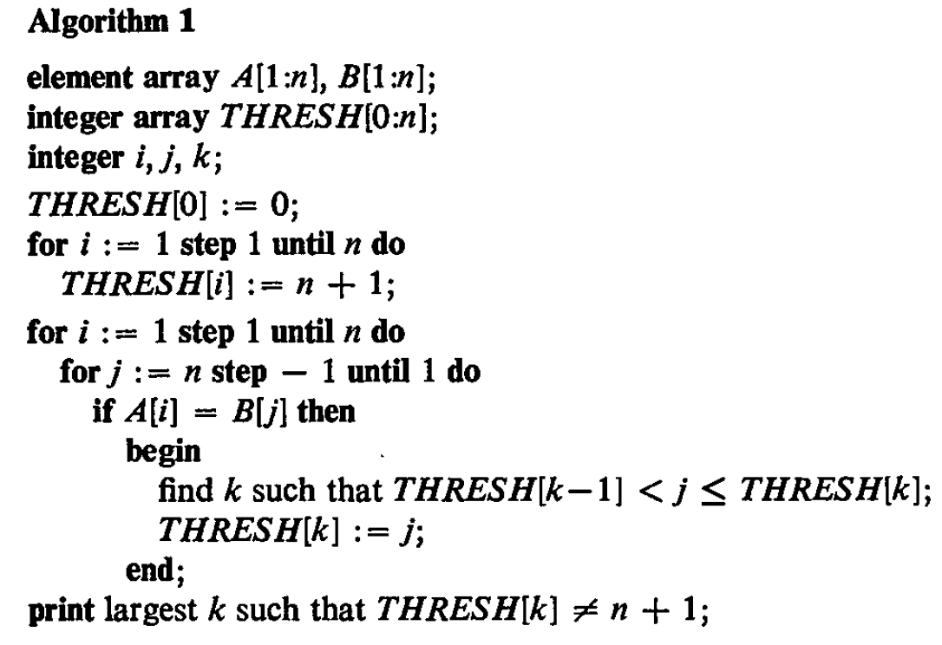
Approach 2(1/8)
A Fast Algorithm for Computing Longest Common Subsequences - Hunt and Szymanski
O(N²logn)

Slide 21
Approach 2(2/8)
A = “abcdbb” , B = “cbacbaaba”
if A[i] == b[j] => *
 | c | b | a | c | b | a | a | b | a
a |  |  | * |  |  | * | * |  | *
b |  | * |  |  | * |  |  | *
c | * |  |  | *
d
b |  | * |  |  | * |  |  | *
b |  | * |  |  | * |  |  | *

Slide 22
Approach 2(3/8)
A = “abcdbb” , B = “cbacbaaba”
n = max( |A|, |B|) = 9
Thresh[0:n]=
=
index | 0 | 1 | 2 | 3 | 4 | 5 | 6
value | 0 | n+1 | n+1 | n+1 | n+1 | n+1 | n+1
index | 0 | 1 | 2 | 3 | 4 | 5 | 6
value | 0 | 10 | 10 | 10 | 10 | 10 | 10

Slide 23
Approach 2(4/8)
index | 0 | 1 | 2 | 3 | 4 | 5 | 6
value | 0 | 10 | 10 | 10 | 10 | 10 | 10
Thresh[0:n]=
Thresh[k-1] ＜ j ≦ Thresh[k] => Thresh[k] = j

Slide 24
Approach 2(5/8)
index | 0 | 1 | 2 | 3 | 4 | 5 | 6
value | 0 | 10 | 10 | 10 | 10 | 10 | 10
index | 0 | 1 | 2 | 3 | 4 | 5 | 6
value | 0 | 9 | 10 | 10 | 10 | 10 | 10
 | c | b | a | c | b | a | a | b | a
a |  |  | * |  |  | * | * |  | 1
b |  | * |  |  | * |  |  | *
c | * |  |  | *
d
b |  | * |  |  | * |  |  | *
b |  | * |  |  | * |  |  | *
Point(i, j) = (1, 9)
Thresh[0] ＜9 ≦ Thresh[1] => Thresh[1] = 9
rank of point(1,9) = 1

Slide 25
Approach 2(6/8)
index | 0 | 1 | 2 | 3 | 4 | 5 | 6
value | 0 | 9 | 10 | 10 | 10 | 10 | 10
index | 0 | 1 | 2 | 3 | 4 | 5 | 6
value | 0 | 7 | 10 | 10 | 10 | 10 | 10
 | c | b | a | c | b | a | a | b | a
a |  |  | * |  |  | * | 1 |  | 1
b |  | * |  |  | * |  |  | *
c | * |  |  | *
d
b |  | * |  |  | * |  |  | *
b |  | * |  |  | * |  |  | *
Point(i, j) = (1, 7)
Thresh[0] ＜7 ≦ Thresh[1] => Thresh[1] = 7
rank of point(1,7) = 1

Slide 26
Approach 2(7/8)
index | 0 | 1 | 2 | 3 | 4 | 5 | 6
value | 0 | 3 | 10 | 10 | 10 | 10 | 10
index | 0 | 1 | 2 | 3 | 4 | 5 | 6
value | 0 | 3 | 8 | 10 | 10 | 10 | 10
 | c | b | a | c | b | a | a | b | a
a |  |  | 1 |  |  | 1 | 1 |  | 1
b |  | * |  |  | * |  |  | 2
c | * |  |  | *
d
b |  | * |  |  | * |  |  | *
b |  | * |  |  | * |  |  | *
Point(i, j) = (2, 8)
Thresh[1] ＜8 ≦ Thresh[2] => Thresh[2] = 8
rank of point(2,8) = 2

Slide 27
Approach 2(8/8)
index | 0 | 1 | 2 | 3 | 4 | 5 | 6
value | 0 | 1 | 2 | 5 | 8 | 10 | 10
 | c | b | a | c | b | a | a | b | a
a |  |  | 1 |  |  | 1 | 1 |  | 1
b |  | 1 |  |  | 2 |  |  | 2
c | 1 |  |  | 2
d
b |  | 2 |  |  | 3 |  |  | 3
b |  | 2 |  |  | 3 |  |  | 4
Length of LCS(A,B)=4

Slide 28
Improvement Approach 2
index | 0 | 1 | 2 | 3 | 4 | 5 | 6
value | 0 | 2 | 5 | 10 | 10 | 10 | 10
 | c | b | a | c | b | a | a | b | a
a |  |  | 1 |  |  | 1 | 1 |  | 1
b |  | 1 |  |  | 2 |  |  | 2
c | * |  |  | *
d
b |  | * |  |  | * |  |  | *
b |  | * |  |  | * |  |  | *
binary search => logn
j = 4

Slide 29
index | 0 | 1 | 2 | 3 | 4 | 5 | 6
value | 0 | 2 | 5 | 10 | 10 | 10 | 10
 | c | b | a | c | b | a | a | b | a
a |  |  | 1 |  |  | 1 | 1 |  | 1
b |  | 1 |  |  | 2 |  |  | 2
c | * |  |  | *
d
b |  | * |  |  | * |  |  | *
b |  | * |  |  | * |  |  | *
SetA{ j₁= 1 , j₂ = 4}
SetB{0 , 2 , 5 , 10, 10, 10, 10}
merging algorithms:
Hwang-Lin merge is recommended

Slide 30
A Simple Algorithm for Merging Two Disjoint Linearly Ordered Sets*
F. K. HWANG AND S. LIN
SIAM J. COMPUT. Vol. 1, No. 1, March 1972

Slide 31
Abstract
In this paper we present a new algorithm for merging two linearly ordered sets which requires substantially fewer comparisons than the commonly used tape merge or binary insertion algorithms. Bounds on the difference between the number of comparisons required by this algorithm and the information theory lower bounds are derived. Results from a computer implementation of the new algorithm are given and compared with a similar implementation of the tape merge algorithm.

Slide 32
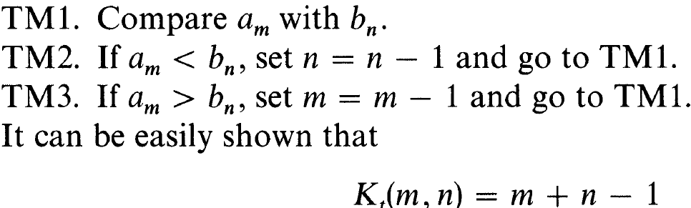
Two existing algorithms – tape merge(1/4)

Slide 33
The example of tape merge(2/4)
A : {087,503,512}
B : {61,154,170,275,426,509,612,653,677,703,
765,897,908}
512:908
output: 908

Slide 34
The example of tape merge(3/4)
A : {087,503,512}
B :{61,154,170,275,426,509,612,653,677,703,
765,897}
512:897
output: 897, 908

Slide 35
The example of tape merge(4/4)
output: 61, 087,154,170,275,426, 503,509, 512,612,653,677,703,765,897
K_{t}(3, 13) = 15

Slide 36
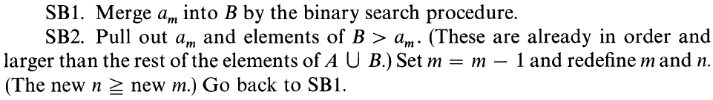

Two existing algorithms – simple binary(1/3)

Slide 37
The example of simple binary(2/3)
A : {087,503,512}
B :{61,154,170,275,426,509,612,653,677,703,
765,897,908}
512
(61,154,170,275,426,509)
612
(653,677,703,765,897,908)

Slide 38
The example of simple binary(3/3)
output: 61, 087,154,170,275,426, 503,509, 512,612,653,677,703,765,897
K_{s}(3, 13) = 12

Slide 39
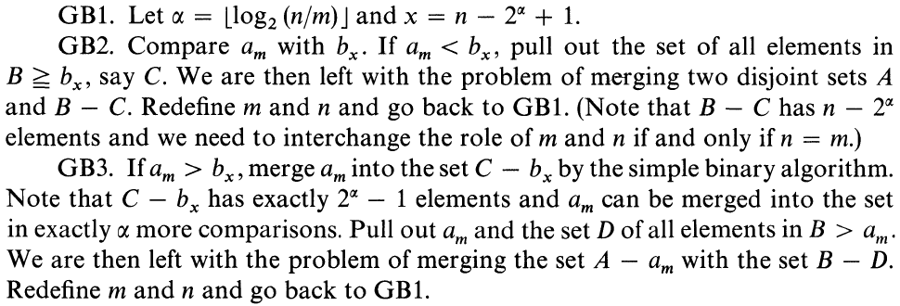
The generalized binary algorithm(1/6)

Slide 40
The generalized binary algorithm(2/6)
A : {087,503,512}
B :{61,154,170,275,426,509,612,653,677,703,
765,897,908}
Am : B_{n + 1 – 2}^{t} t =
512 < 703
output:703, 765,897,908

Slide 41
The generalized binary algorithm(3/6)
A : {087,503,512}
B :{61,154,170,275,426,509,612,653,677,}
Am : B_{n + 1 – 2}^{t} t =
512 < 653
output:653,677,703, 765,897,908

Slide 42
The generalized binary algorithm(4/6)
A : {087,503,512}
B :{61,154,170,275,426,509,612}
Am : B_{n + 1 – 2}^{t} t =
512 > 509
binary search B[7,7]
output:512,612,653,677,703, 765,897,908

Slide 43
The generalized binary algorithm(5/6)
A |  |  | B |  |  |  |  |  |  |  |  |  |  |  |  | output
087 | 503 | 512 | 061 | 154 | 170 | 275 | 426 | 509 | 612 | 653 | 677 | 703 | 765 | 897 | 908
087 | 503 | 512 | 061 | 154 | 170 | 275 | 426 | 509 | 612 | 653 | 677 |  |  |  | 703 | 765 | 897 | 908
087 | 503 | 512 | 061 | 154 | 170 | 275 | 426 | 509 | 612 |  |  |  | 653 | 677 | 703 | 765 | 897 | 908
087 | 503 | 512 | 061 | 154 | 170 | 275 | 426 | 509 | 612 |  |  |  | 653 | 677 | 703 | 765 | 897 | 908
087 | 503 |  | 061 | 154 | 170 | 275 | 426 | 509 |  |  | 512 | 612 | 653 | 677 | 703 | 765 | 897 | 908
087 | 503 |  | 061 | 154 | 170 | 275 | 426 | 509 |  |  | 512 | 612 | 653 | 677 | 703 | 765 | 897 | 908
087 |  |  | 061 | 154 | 170 | 275 | 426 |  | 503 | 509 | 512 | 612 | 653 | 677 | 703 | 765 | 897 | 908
087 |  |  | 061 |  | 154 | 170 | 275 | 426 | 503 | 509 | 512 | 612 | 653 | 677 | 703 | 765 | 897 | 908
 |  |  | 061 | 087 | 154 | 170 | 275 | 426 | 503 | 509 | 512 | 612 | 653 | 677 | 703 | 765 | 897 | 908

Slide 44
The generalized binary algorithm(6/6)
K_{g}(3, 13) = 8
K_{g}(m, n) ≈

Slide 45
index | 0 | 1 | 2 | 3 | 4 | 5 | 6
value | 0 | 2 | 5 | 10 | 10 | 10 | 10
 | c | b | a | c | b | a | a | b | a
a |  |  | 1 |  |  | 1 | 1 |  | 1
b |  | 1 |  |  | 2 |  |  | 2
c | * |  |  | *
d
b |  | * |  |  | * |  |  | *
b |  | * |  |  | * |  |  | *
merge:

Slide 46
Thank you for listening

