Slide 1

Stock Investment with Stochastic Programming
Department of Computer Science and Engineering, National Sun-Yat-sen University
Presenter: Hung-Hsin Chen (陳紘昕)
Advisor: Prof. Chang-Biau Yang (楊昌彪)
Date: Apr. 29, 2014

Slide 2
Abstract
In this paper, we propose the stochastic programming (SP) model with risk measure conditional value at risk (CVaR) for investing stocks in Taiwan stock market. In each period of investment, 200 scenarios are generated for solving SP, and the CVaR is utilized to manage the risk. The experiment interval starts from 2005/1/1 and ends on 2013/12/31, which has totally 2235 trading periods. The experimental results show that our method is able to earn positive return. We also perform superior predictive ability test to illustrate that our method can avoid the data snooping problem. Our method achieves the best annualized return 13.26%, which is higher than the buy-and-hold annualized return 12.19%.

Slide 3
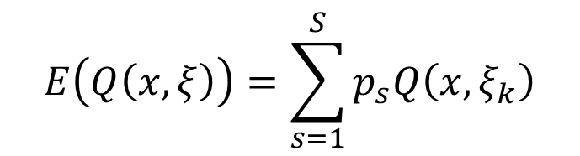
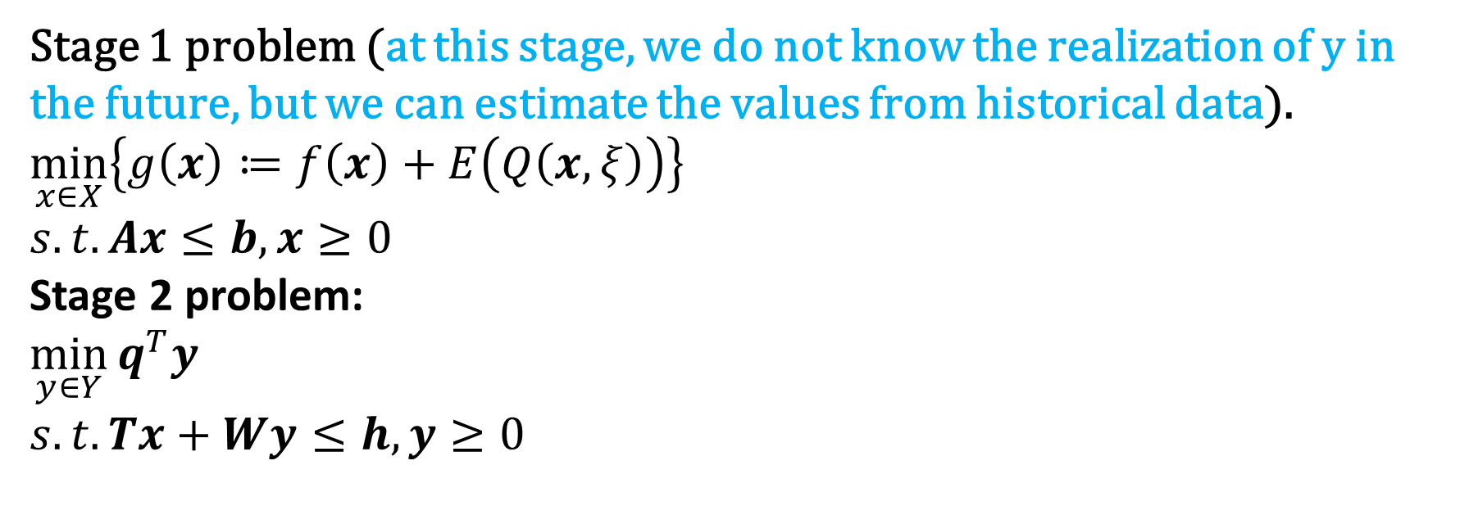
Two-stage stochastic programming (SP)
Stage 1 problem (at this stage, we do not know the realization of y in the future, but we can estimate the values from historical data).
$$\min_{x∈X}\left\{g\left(x\right)≔f\left(x\right)+E\left(Q\left(x, ξ\right)\right)\right\}$$
$$s.t. Ax≤b, x≥0$$
Stage 2 problem:
$$\min_{y∈Y}{q^{T}y}$$
$$s.t. Tx+Wy≤h, y≥0$$
$$E\left(Q\left(x,ξ\right)\right)=\sum_{s=1}^{S}{p_{s}Q\left(x, ξ_{k}\right)}$$

Slide 4
Farmer’s problem
農夫要在他的500 acres農地上種植wheat, corn與sugar beets，且必須在冬天之前做出決定。
Wheat種植成本$$150/acre, corn種植成本為$230/acre, sugar beets種植成本為$260/acre
為了cattle feed，至少必須有 200 tons (T) of wheat與240 T of corn. 這些農產品可用種植或是向wholesaler購買。
如果農產品的量超出需求時，則將農產品賣出。Wheat賣出價為$170/T, corn賣出價$150/T。但是若是量wholesaler購買時，上述兩產品為(wheat:$238/T, corn: $210/T)。
Sugar beet賣出價為$36/T, 但European Commission有限制sugar beet的產量，若超過產量時，sugar beet的賣出價只有$10/T，而農夫的產量限制為6000T.
根據經驗，農夫知道他的農地wheat產量為2.5T/acre, corn產量為3T/acre, sugar beet產量為20T/acre.

Slide 5
Decision parameters
x1: 農地種稙wheat的面積(acre)
x2: 農地種稙corn的面積(acre)
x3: 農地種稙sugar beet的面積(acre)
w1: wheat賣出量(ton)
y1: wheat買進量(ton)
w2: corn賣出量(ton)
y2: corn買進量(ton)
w3: sugar beet賣出量(ton) (at higher price)
w4: sugar beet 賣出量(ton) (at lower price)

Slide 6
Uncertainty
在上述模型中，我們只考慮單位產量(yield)的不確定性(higher or lower)。假設：
1/3的機率yield為平均值(2.5, 3, 20)。
1/3的機率yield會於平均值(2, 2.4, 16)。
1/3的機率yield高於平均值(3, 3.6, 24)。
上述每一種情形稱為一個scenario，全部scenario所形成的集合稱scenario tree。
所以此scenario tree有一個root node，三個leaf node。

Slide 7
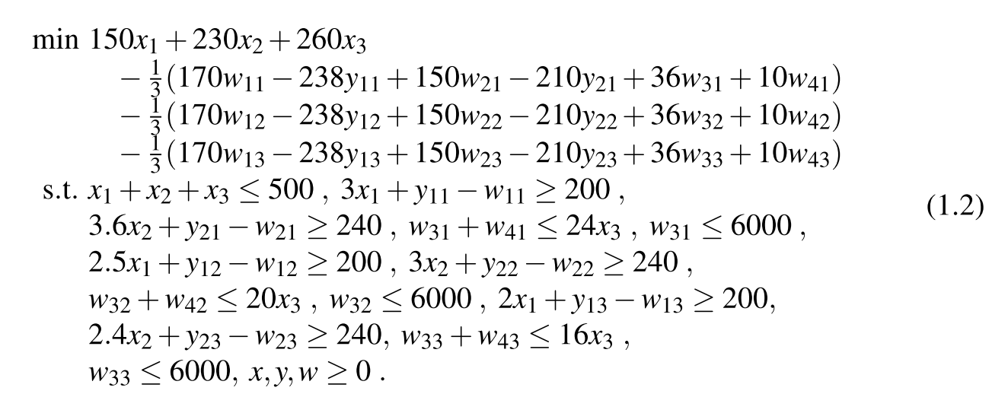
Two-stage Stochastic programming
1-stage cost
2-stage cost
2-stage constraints

Slide 8
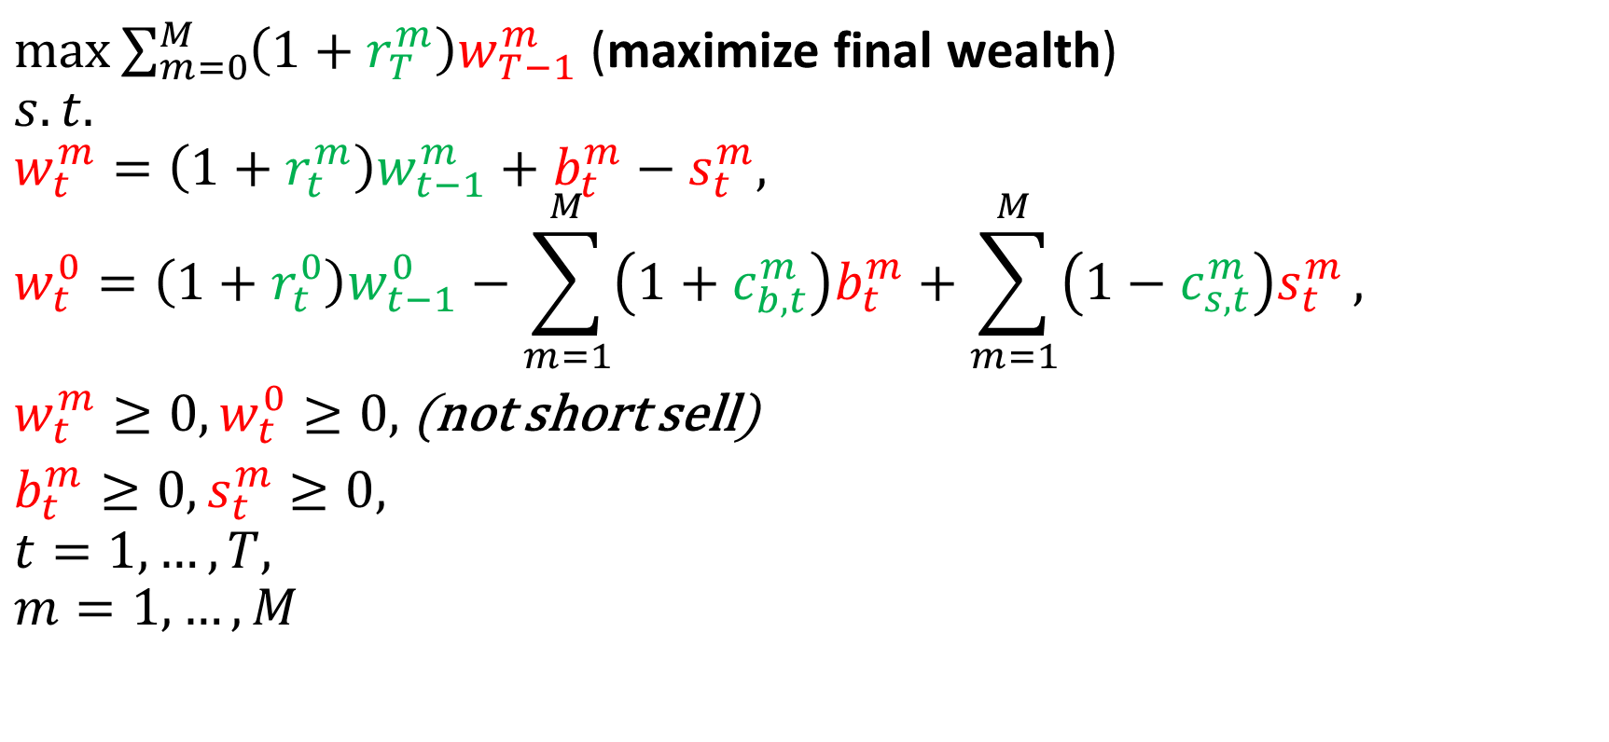
Multiperiod portfolio problem
Red: decision variables
Green: parameters
$\max{\sum_{m=0}^{M}{\left(1+r_{T}^{m}\right)w_{T−1}^{m}}}$ (maximize final wealth)
$$s.t.$$
$$w_{t}^{m}=\left(1+r_{t}^{m}\right)w_{t−1}^{m}+b_{t}^{m}−s_{t}^{m},$$
$$w_{t}^{0}=\left(1+r_{t}^{0}\right)w_{t−1}^{0}−\sum_{m=1}^{M}{\left(1+c_{b,t}^{m}\right)b_{t}^{m}}+\sum_{m=1}^{M}{\left(1−c_{s,t}^{m}\right)s_{t}^{m}},$$
$w_{t}^{m}≥0, w_{t}^{0}≥0,$(not short sell)
$b_{t}^{m}≥0, s_{t}^{m}≥0,$
$$t=1,…,T,$$
$$m=1,…,M$$

Slide 9
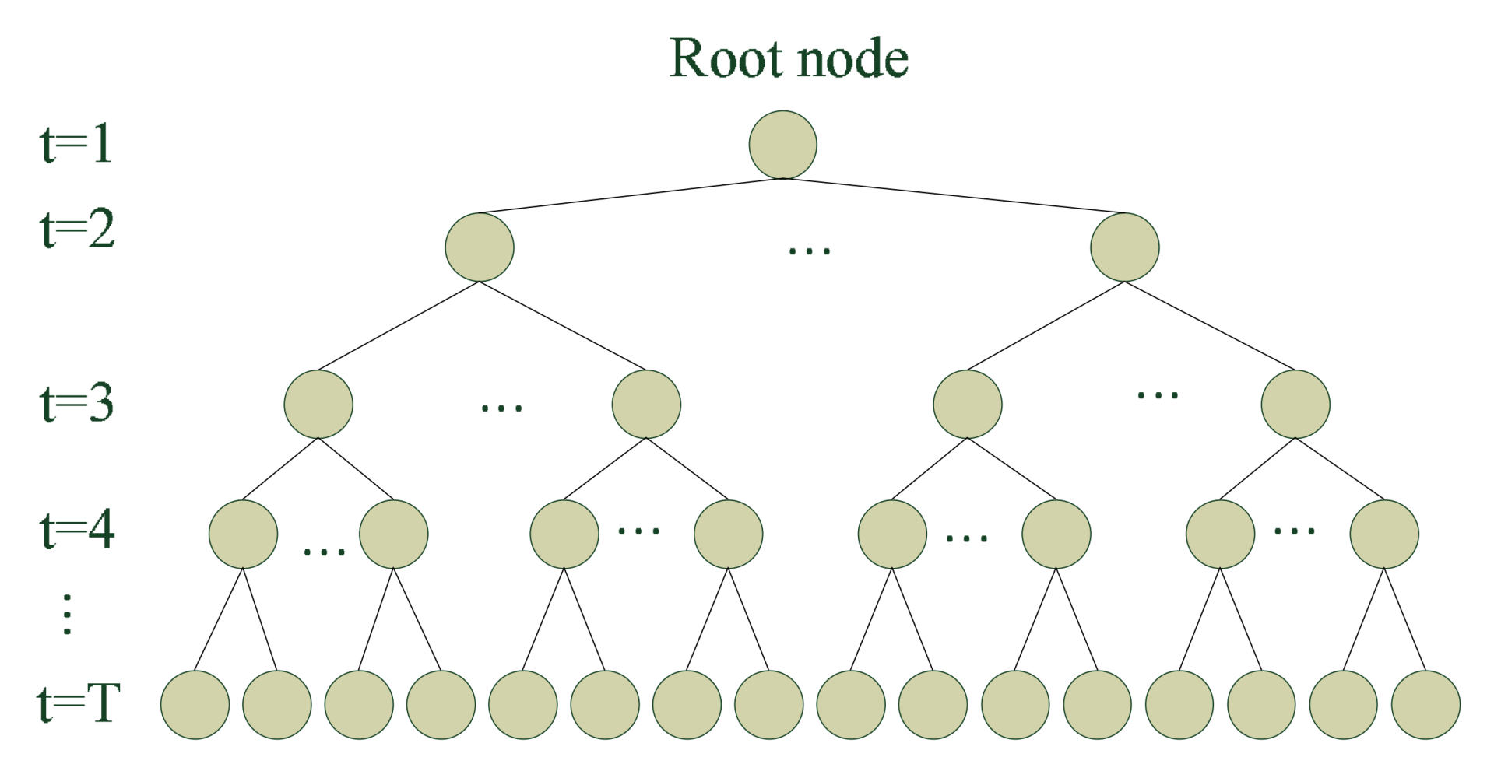
Scenario tree
Stages
Period
Scenarios;
A path from root to leaf

Slide 10
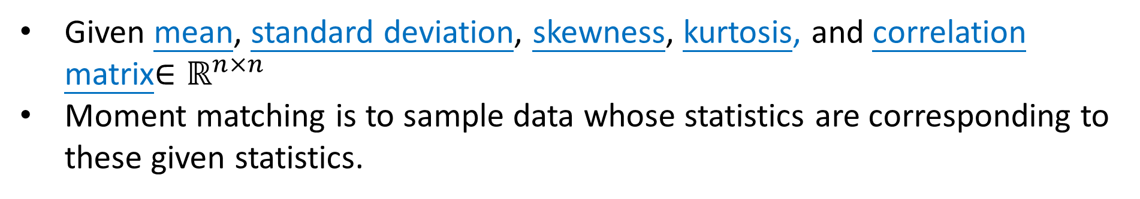
Moment matching
Easy to compute
Statistics, such as mean, standard deviation, skewness, kurtosis, correlation etc.
Data
Moment matching!!
Given mean, standard deviation, skewness, kurtosis, and correlation matrix$∈ℝ^{n×n}$
Moment matching is to sample data whose statistics are corresponding to these given statistics.

Slide 11
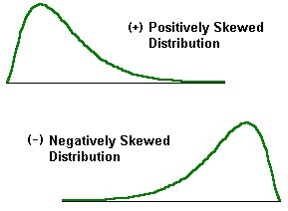
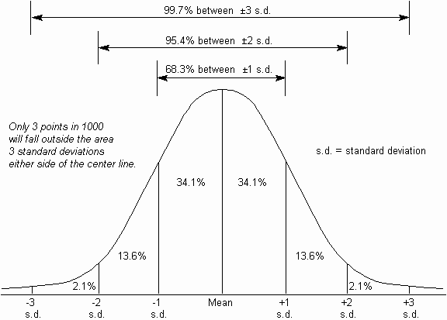
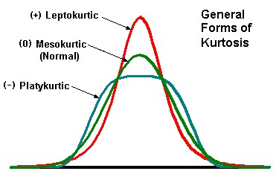

Slide 12
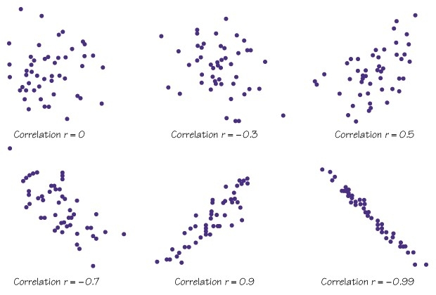

Slide 13
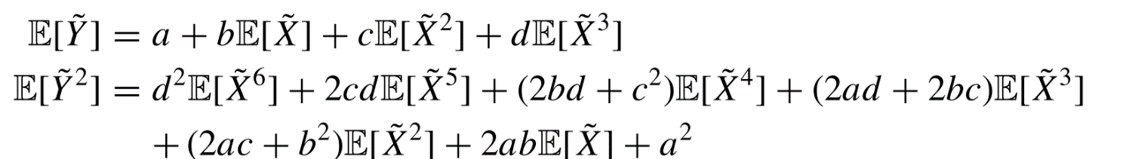
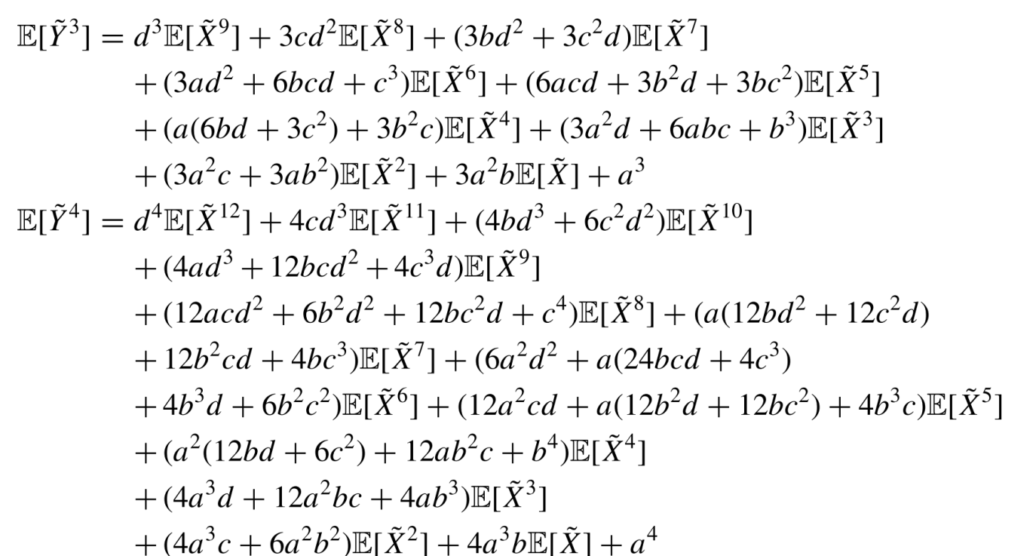

Heuristic moment matching [Hoyland et al., 2003]
1. cubic transform (correct statistics, wrong correlation)
y is the target statistics vector, x is the sample vectors
$y=a+bx+cx^{2}+dx^{3}$
Solve (or get the approximate solution) the equation using least square method to get parameters a, b, c, d.

Slide 14
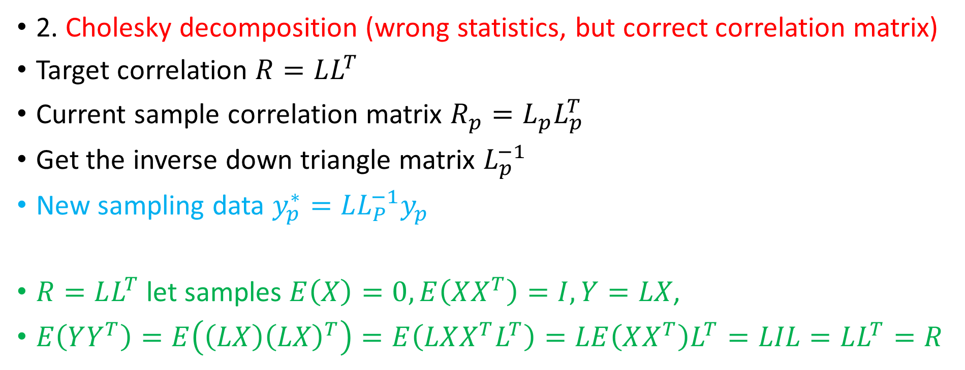
Heuristic moment matching [Hoyland et al., 2003]
2. Cholesky decomposition (wrong statistics, but correct correlation matrix)
Target correlation $R=LL^{T}$
Current sample correlation matrix $R_{p}=L_{p}L_{p}^{T}$
Get the inverse down triangle matrix $L_{p}^{−1}$
New sampling data $y_{p}^{∗}=LL_{P}^{−1}y_{p}$
$R=LL^{T}$let samples $E\left(X\right)=0, E\left(XX^{T}\right)=I, Y=LX$,
$E\left(YY^{T}\right)=E\left(\left(LX\right){\left(LX\right)}^{T}\right)=E\left(LXX^{T}L^{T}\right)=LE\left(XX^{T}\right)L^{T}=LIL=LL^{T}=R$

Slide 15
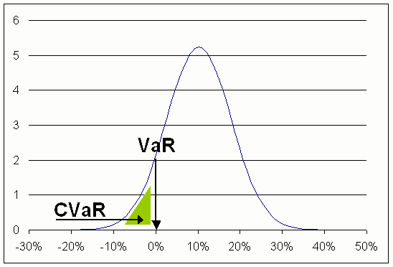
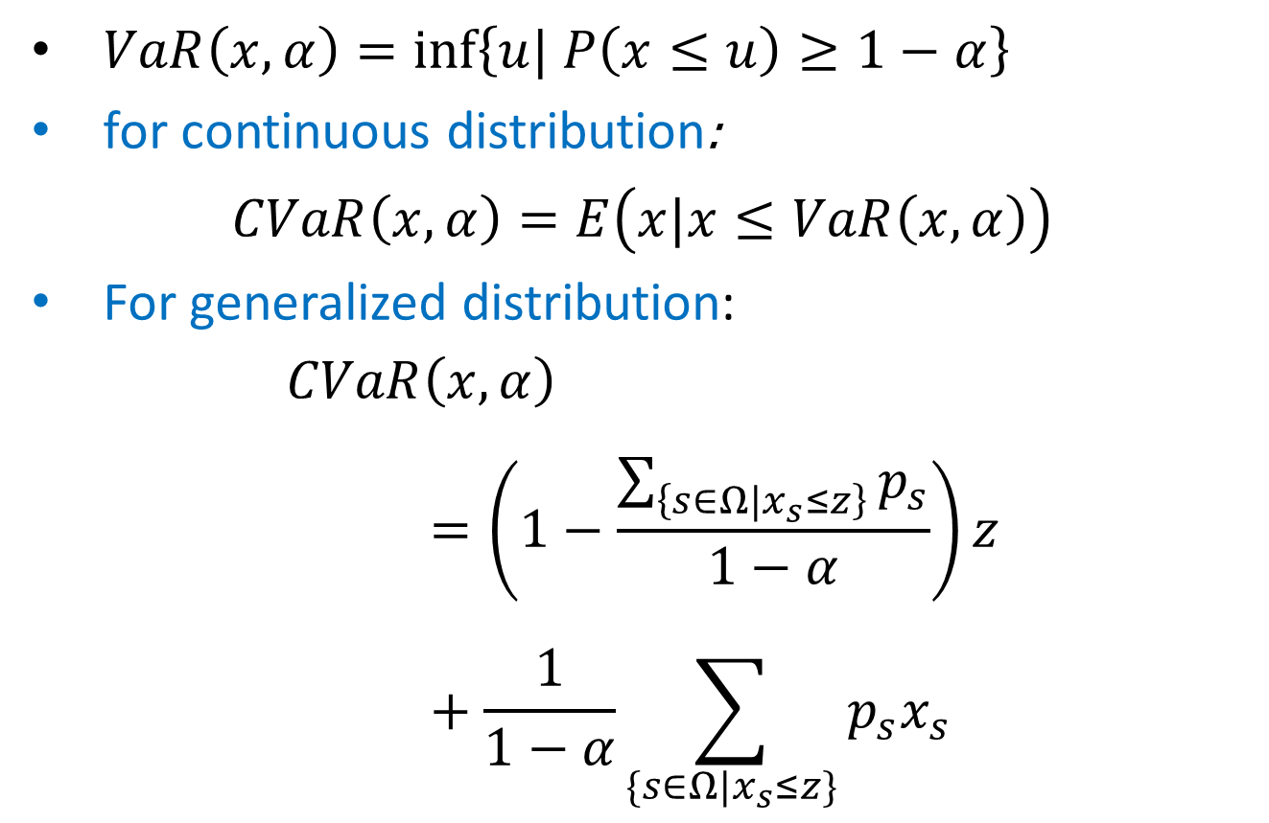
Conditional value at risk (CVaR)
$VaR\left(x,α\right)=\inf\left\{u| P\left(x≤u\right)≥1−α\right\}$
for continuous distribution: $CVaR\left(x,α\right)=E\left(x|x≤VaR\left(x,α\right)\right)$
For generalized distribution: $CVaR\left(x,α\right)=\left(1−\frac{\sum_{\left\{s∈Ω|x_{s}≤z\right\}}{p_{s}}}{1−α}\right)z+\frac{1}{1−α}\sum_{\{s∈Ω|x_{s}≤z\}}{p_{s}x_{s}}$

Slide 16
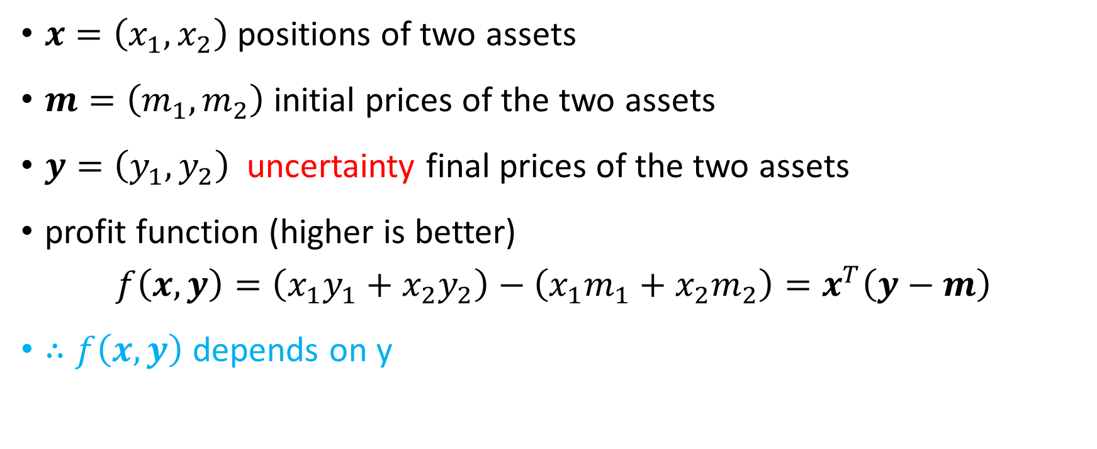
CVaR (two-asset portfolio)
$x=\left(x_{1},x_{2}\right)$positions of two assets
$m=\left(m_{1}, m_{2}\right)$initial prices of the two assets
$y=\left(y_{1}, y_{2}\right)$uncertainty final prices of the two assets
profit function (higher is better) $f\left(x, y\right)=\left(x_{1}y_{1}+x_{2}y_{2}\right)−\left(x_{1}m_{1}+x_{2}m_{2}\right)=x^{T}\left(y−m\right)$
$∴f\left(x,y\right)$depends on y

Slide 17
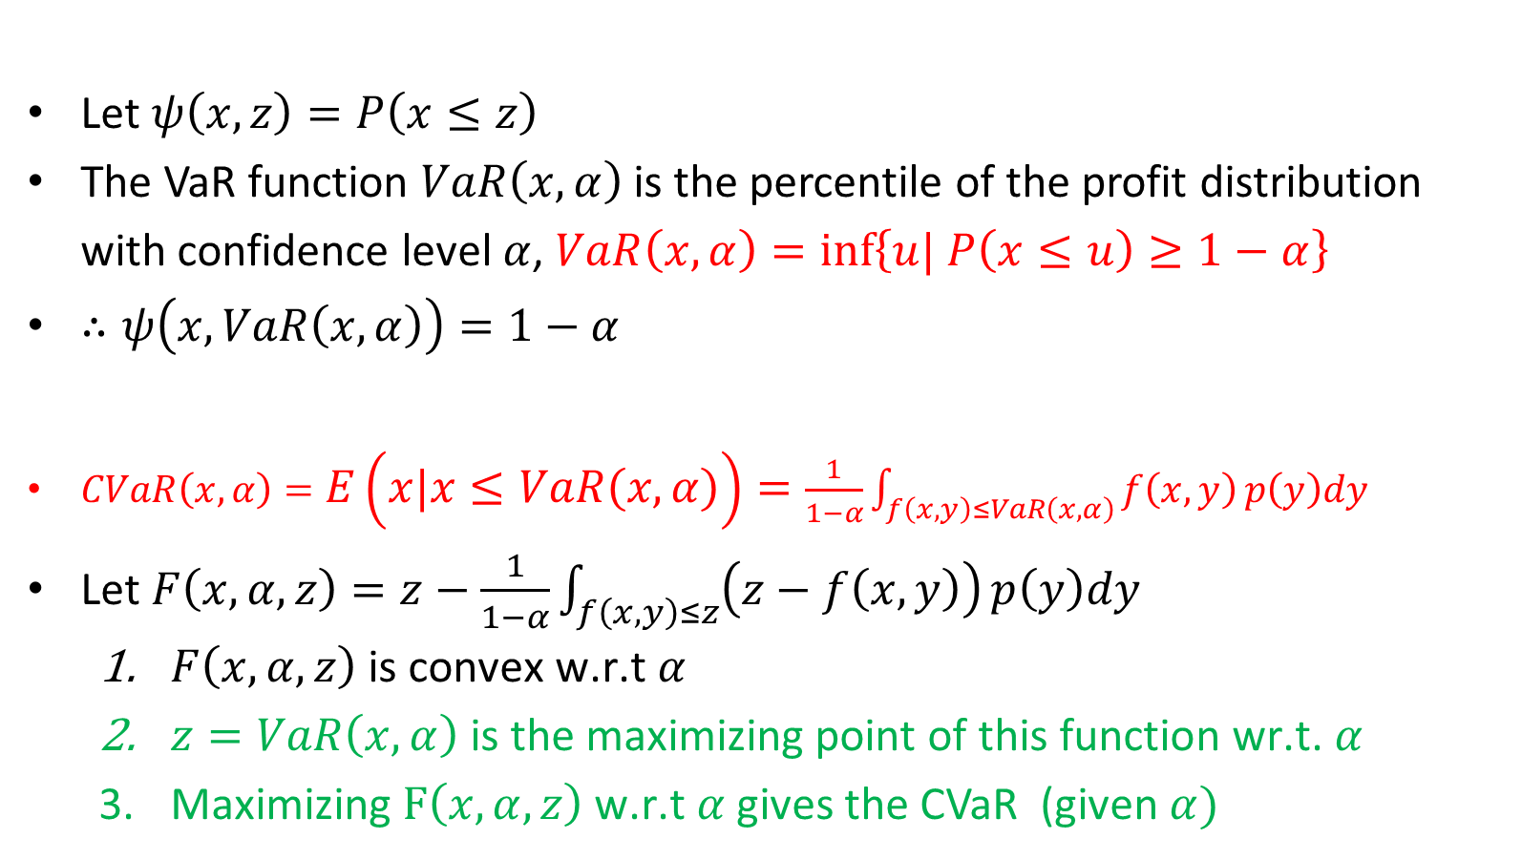
Let $ψ\left(x,z\right)=P\left(x≤z\right)$
The VaR function $VaR\left(x, α\right)$is the percentile of the profit distribution with confidence level $α$, $VaR\left(x,α\right)=\inf\left\{u| P\left(x≤u\right)≥1−α\right\}$
$∴ψ\left(x,VaR\left(x,α\right)\right)=1−α$
$CVaR\left(x,α\right)=E\left(x|x≤VaR\left(x,α\right)\right)=\frac{1}{1−α}\int_{f\left(x,y\right)≤VaR\left(x,α\right)}{f\left(x,y\right)}p\left(y\right)dy$
Let $F\left(x,α,z\right)=z−\frac{1}{1−α}\int_{f\left(x,y\right)≤z}{\left(z−f\left(x,y\right)\right)}p\left(y\right)dy$
$F\left(x,α,z\right) \text{is} \text{convex} \text{w}\text{.}\text{r}\text{.}\text{t} α$
$z=VaR\left(x,α\right) \text{is} \text{the} \text{maximizing} \text{point} \text{of} \text{this} \text{function} \text{wr}\text{.}\text{t}\text{. }α$
$\text{Maximizing} F\left(x,α,z\right) \text{w}\text{.}\text{r}\text{.}\text{t} α$ gives the CVaR (given $α)$

Slide 18

CVaR with finite scenarios
$$y_{s}=\max\left(0, z−x_{s}\right),$$
$$z−\sum_{s∈Ω}{p_{s}y_{s}}=\left(1−\frac{\sum_{\left\{s∈Ω|x_{s}≤z\right\}}{p_{s}}}{1−α}\right)z+\frac{1}{1−α}\sum_{\{s∈Ω|x_{s}≤z\}}{p_{s}x_{s}}$$
(P) $\max{z−\frac{1}{1−α}\sum_{s=1}^{S}{p_{s}y_{s}}}$
$$s.t.$$
$$x_{s}∈X, z∈ℝ$$
$$y_{s}≥z−x_{s},$$
$$y_{s}≥0,$$
$$s=1,…,S$$
The optimal solution of P is the CVaR of the distribution.
The z in the optimal solution is corresponding to the VaR of the distribution.

Slide 19
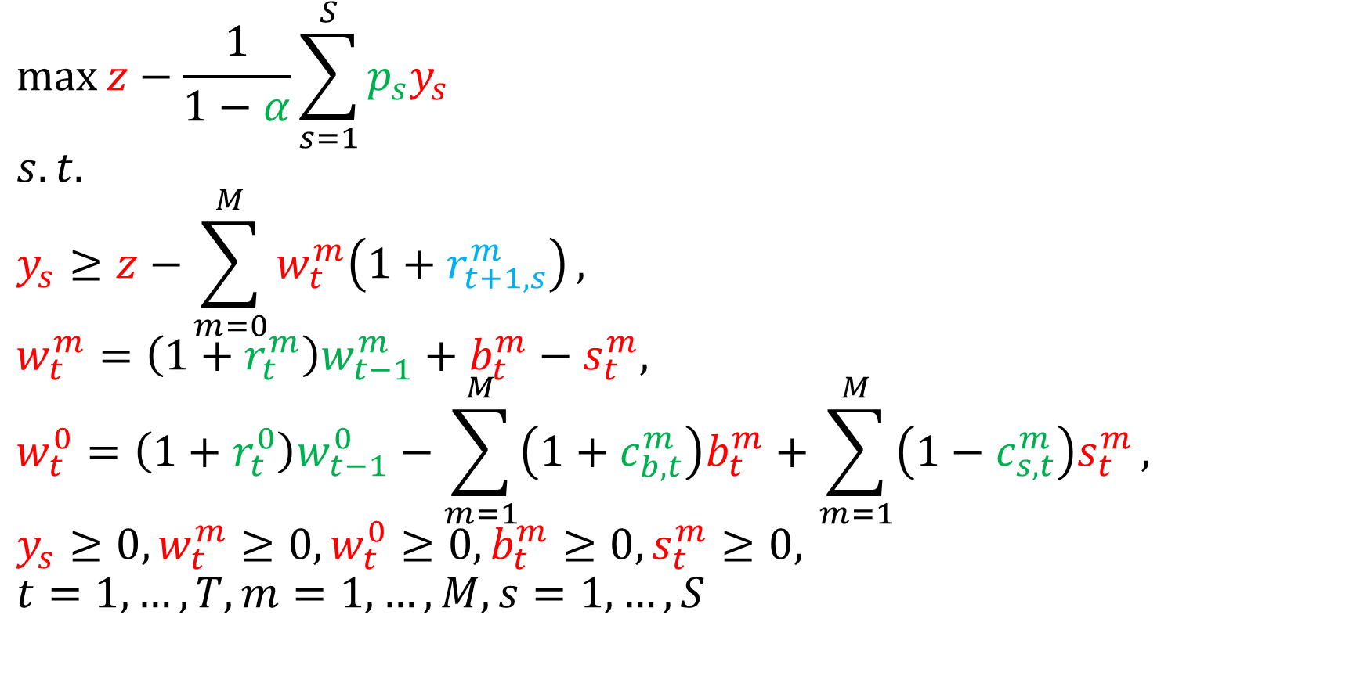
Our model
Red: decision variables
Green: parameters
Blue: scenarios (sampling)
$$\max{z−\frac{1}{1−α}\sum_{s=1}^{S}{p_{s}y_{s}}}$$
$$s.t.$$
$$y_{s}≥z−\sum_{m=0}^{M}{w_{t}^{m}\left(1+r_{t+1,s}^{m}\right)},$$
$$w_{t}^{m}=\left(1+r_{t}^{m}\right)w_{t−1}^{m}+b_{t}^{m}−s_{t}^{m},$$
$$w_{t}^{0}=\left(1+r_{t}^{0}\right)w_{t−1}^{0}−\sum_{m=1}^{M}{\left(1+c_{b,t}^{m}\right)b_{t}^{m}}+\sum_{m=1}^{M}{\left(1−c_{s,t}^{m}\right)s_{t}^{m}},$$
$$y_{s}≥0, w_{t}^{m}≥0, w_{t}^{0}≥0, b_{t}^{m}≥0, s_{t}^{m}≥0,$$
$$t=1,…,T, m=1,…,M, s=1,…,S$$
Given the confidence level α of CVaR, to decide the buying and selling of each stock in all periods.

Slide 20
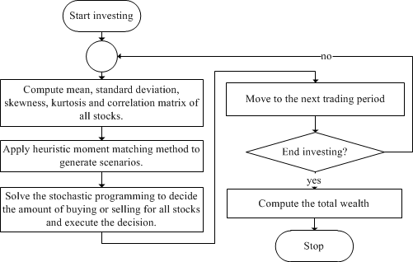
Flowchart of our method

Slide 21
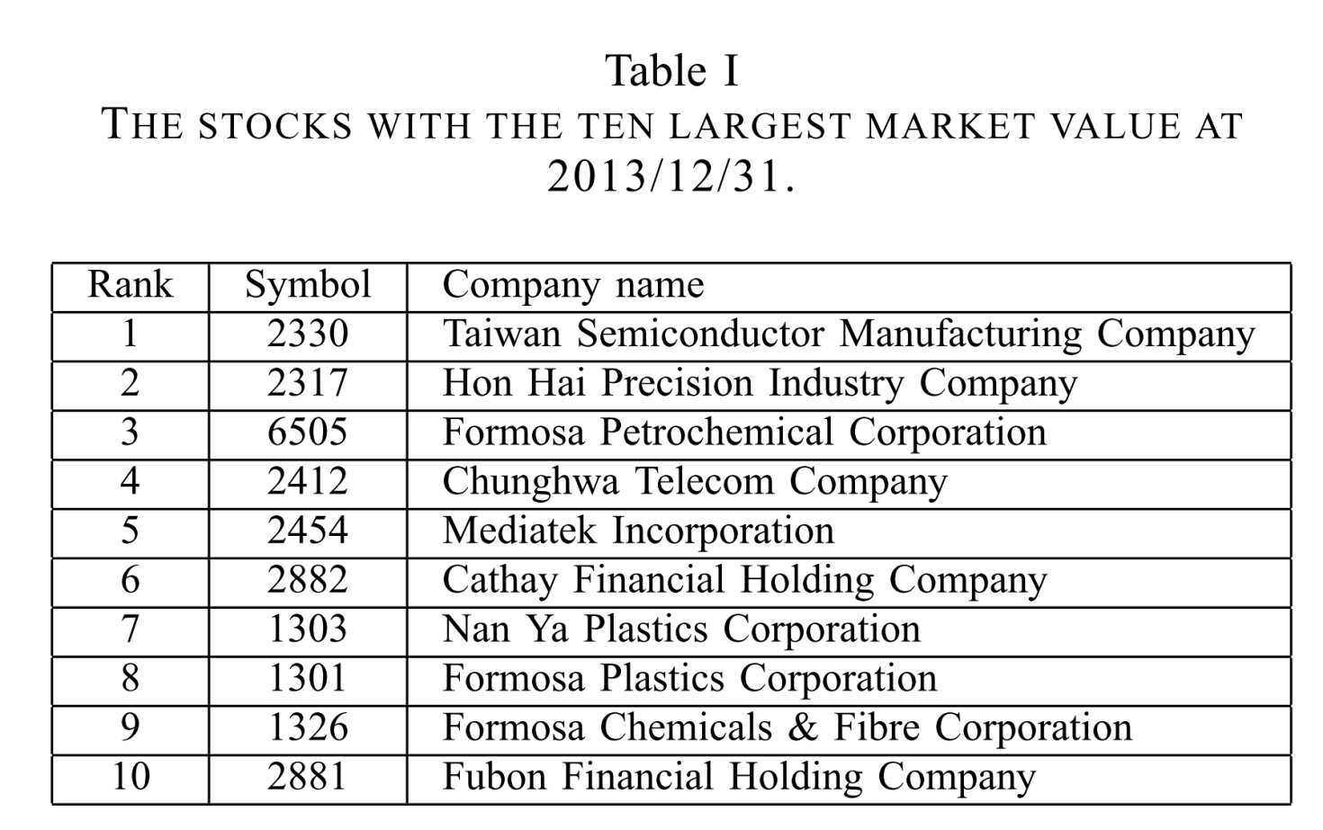

Experiments
Experiment interval: 2005/1/1 ~ 2013/12/21, 2235 trading periods.
Stocks with ten largest market value at 2013/12/31.
Parameters:
S=200 scenarios
Buying and selling transaction fee $c_{b,t}^{m}=0.1425\%$, $c_{s,t}^{m}=0.4425\%$
Riskfree return: $r_{t}^{0}=0$
Variables of our model:
Portfolio size n = {5, 10}
Past periods h= {10, 20, …, 80}
Confidence level $α=\{0.5, 0.55, …,0.9, 0.99\}$
Totally 2*8*11=176 trails

Slide 22
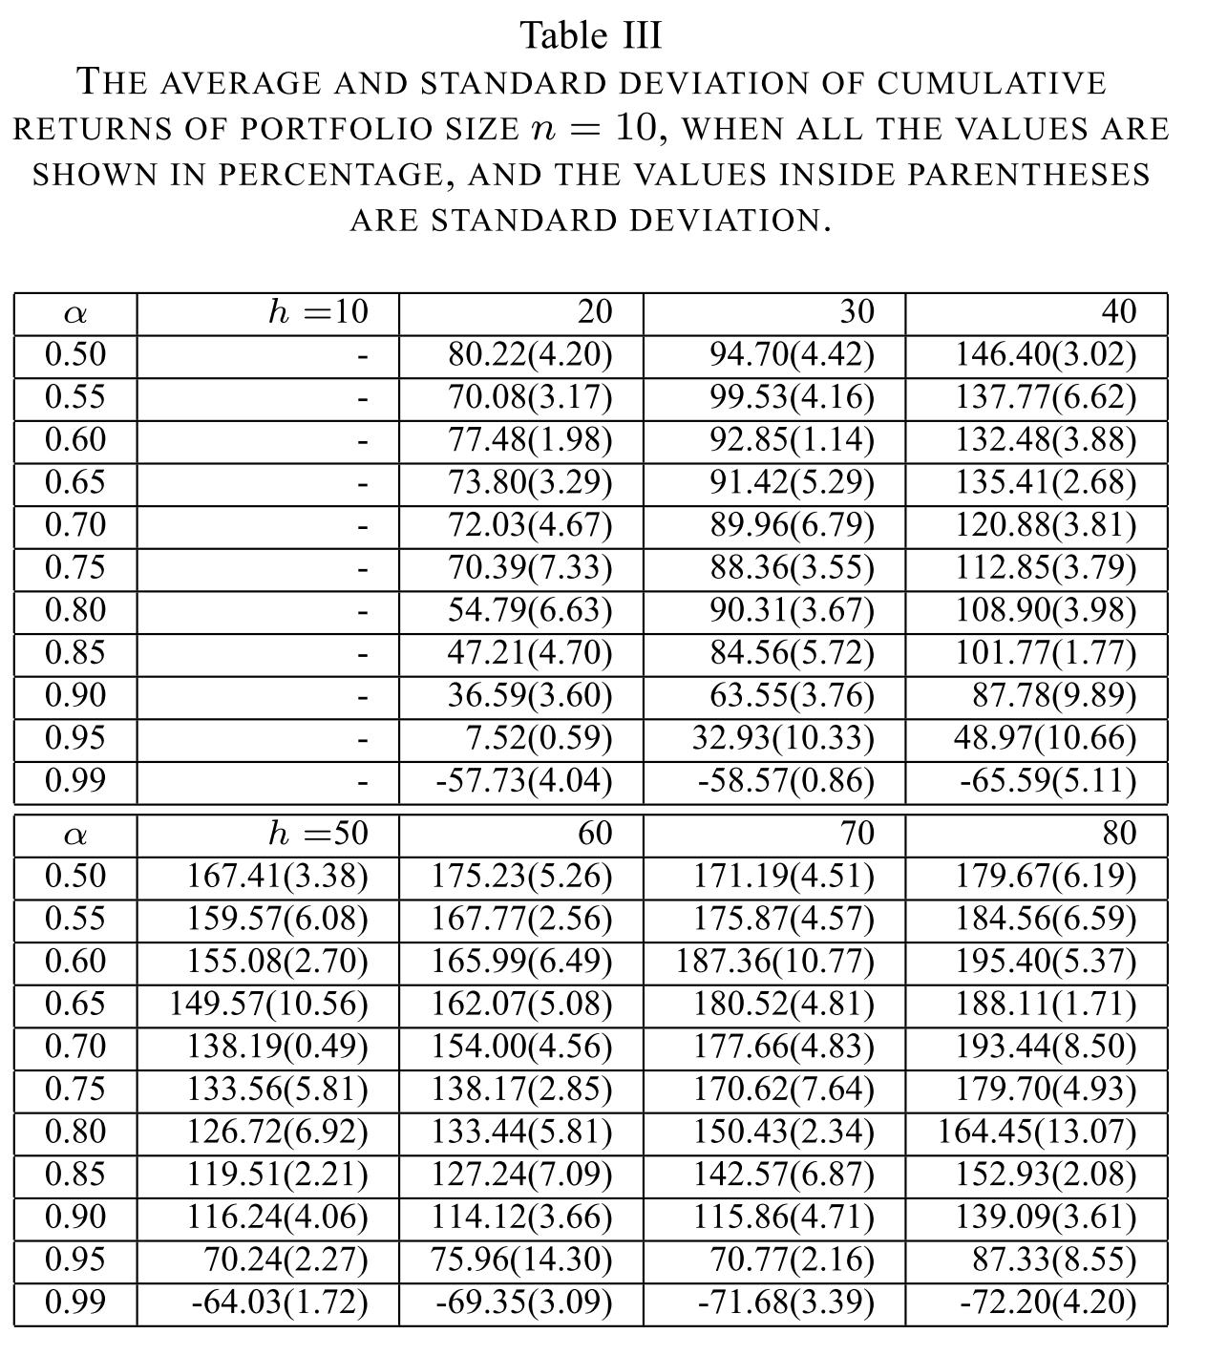
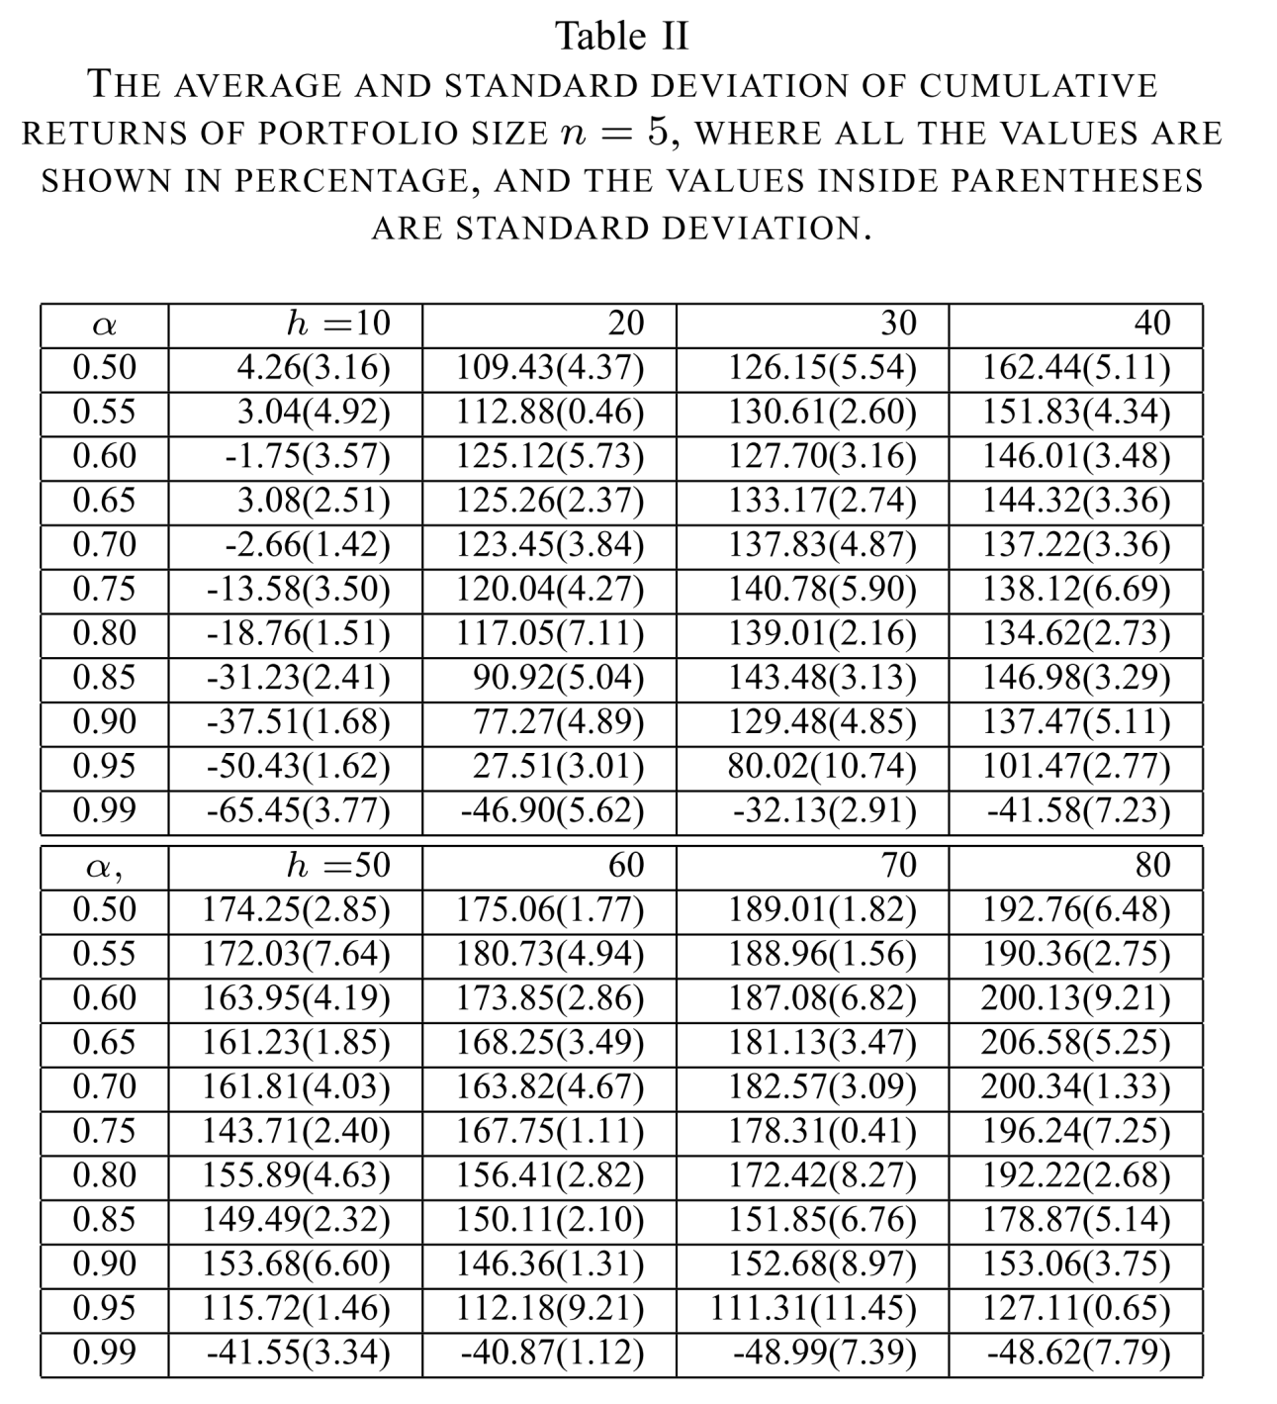
Experiment results

Slide 23
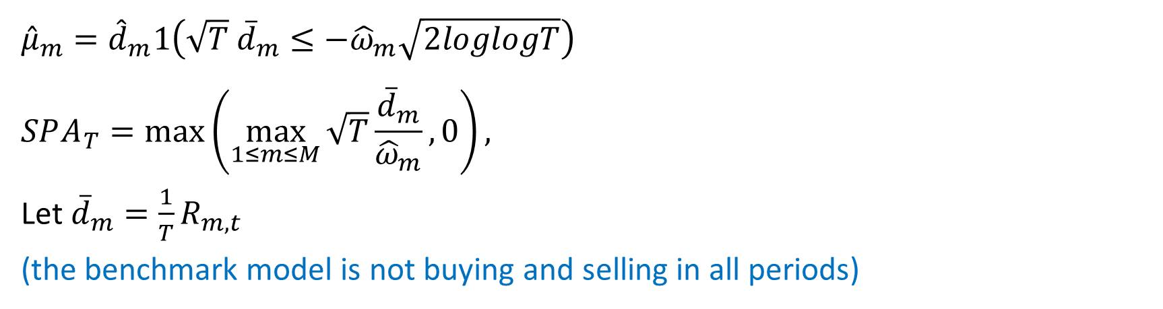

Superior predictive ability (SPA) test
Null hypothesis:
$H_{0}^{m}:μ_{m}≤0, where 1≤m≤M$
(all models are not able to beat the benchmark model)
$${\hat{μ}}_{m}={\hat{d}}_{m}1\left(\sqrt{T} {\overline{d}}_{m}≤−{\hat{ω}}_{m}\sqrt{2loglogT}\right)$$
$$SPA_{T}=\max\left(\max_{1≤m≤M}{\sqrt{T}}\frac{{\overline{d}}_{m}}{{\hat{ω}}_{m}},0\right),$$
Let ${\overline{d}}_{m}=\frac{1}{T}R_{m,t}$
(the benchmark model is not buying and selling in all periods)

Slide 24
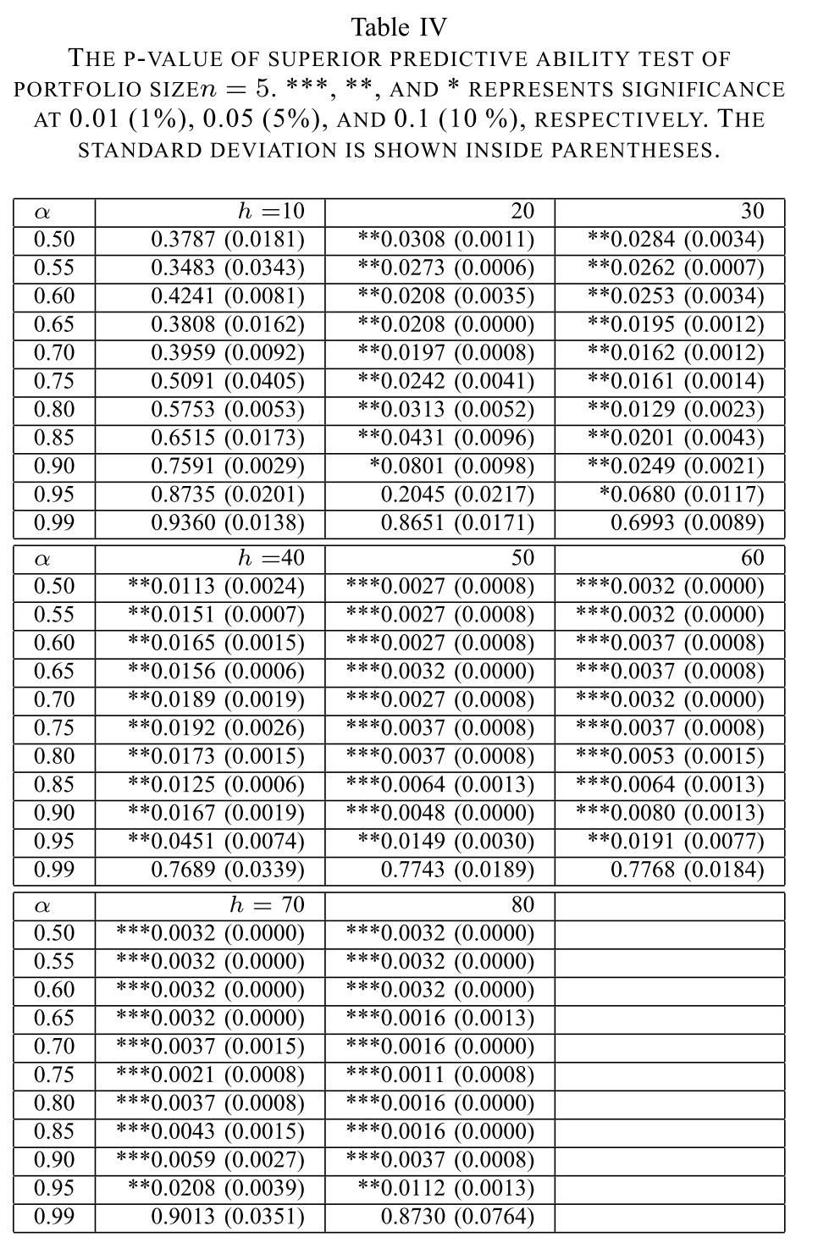

Slide 25
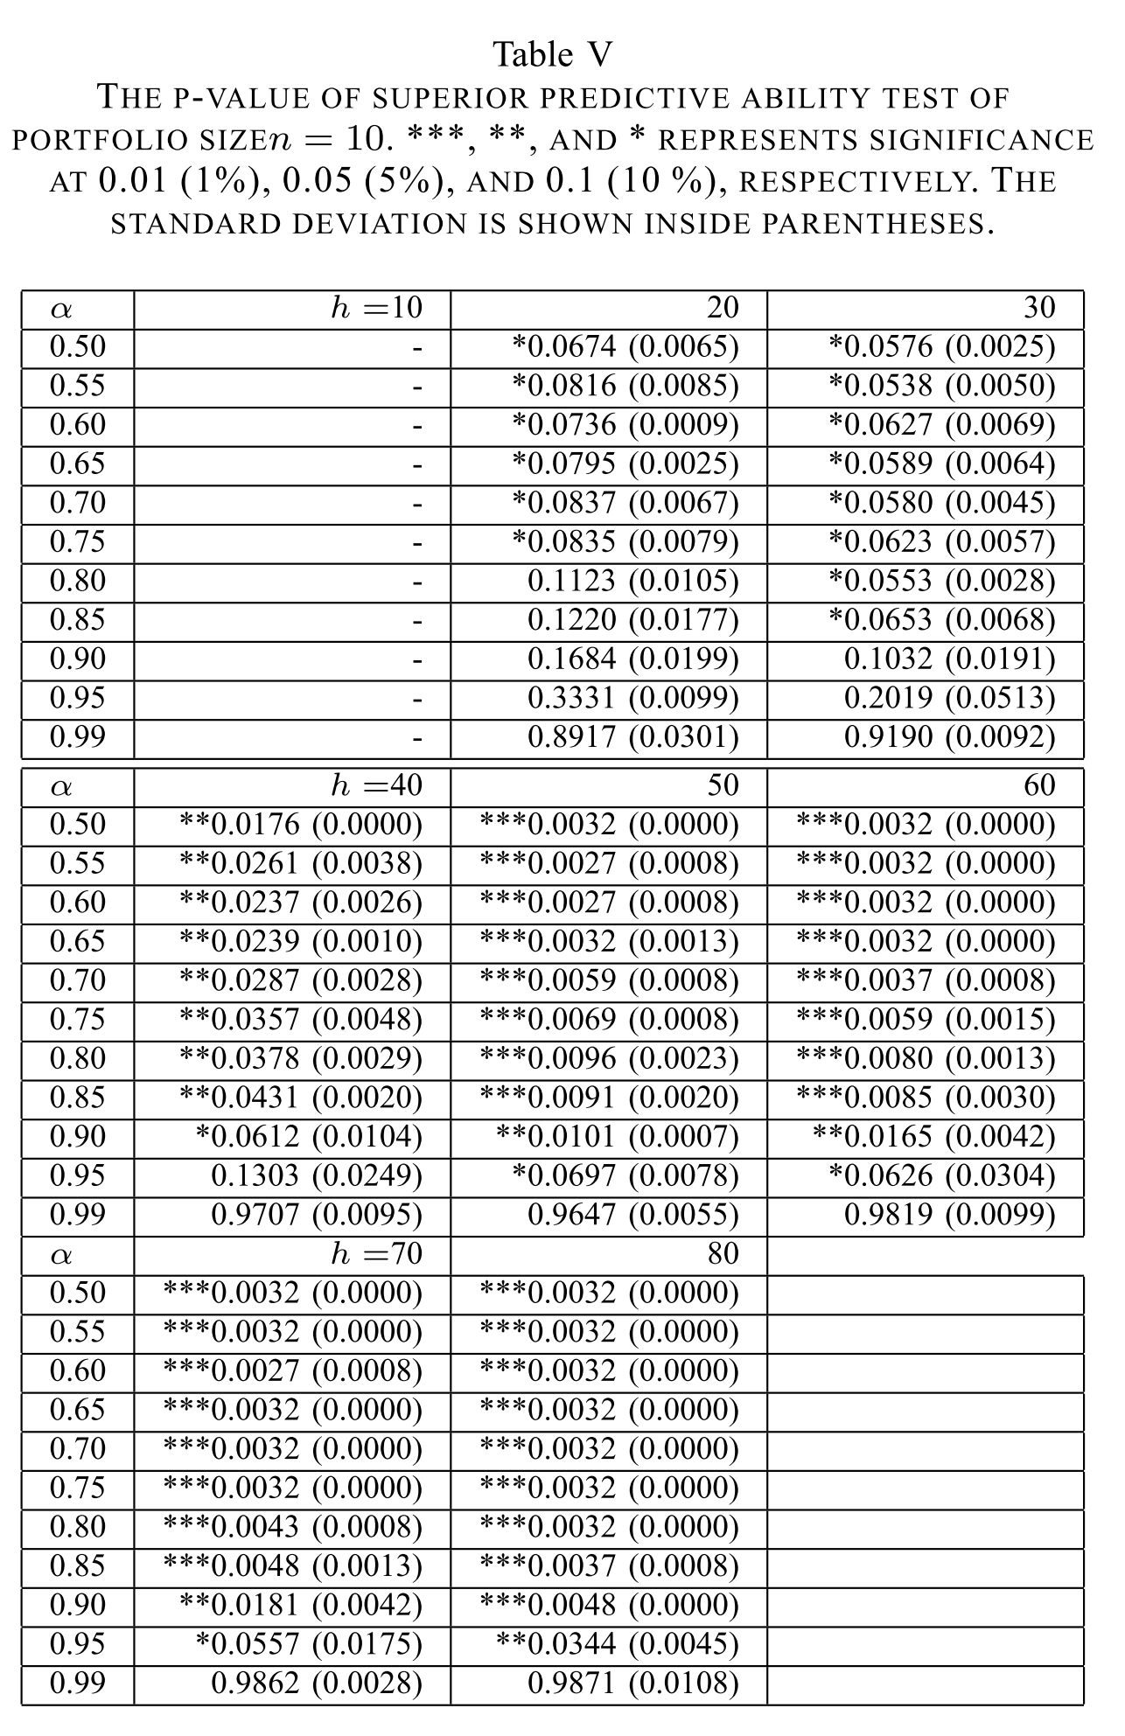

Slide 26
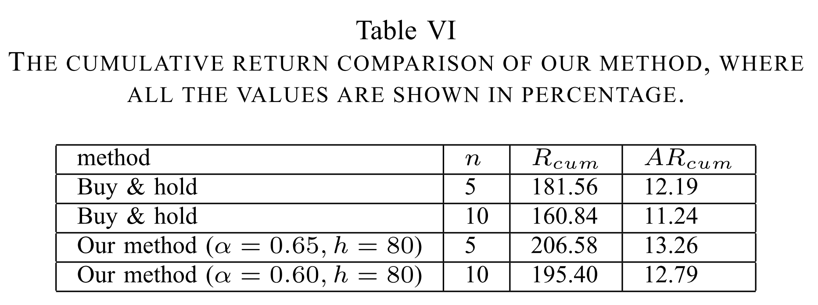
Comparisons

Slide 27
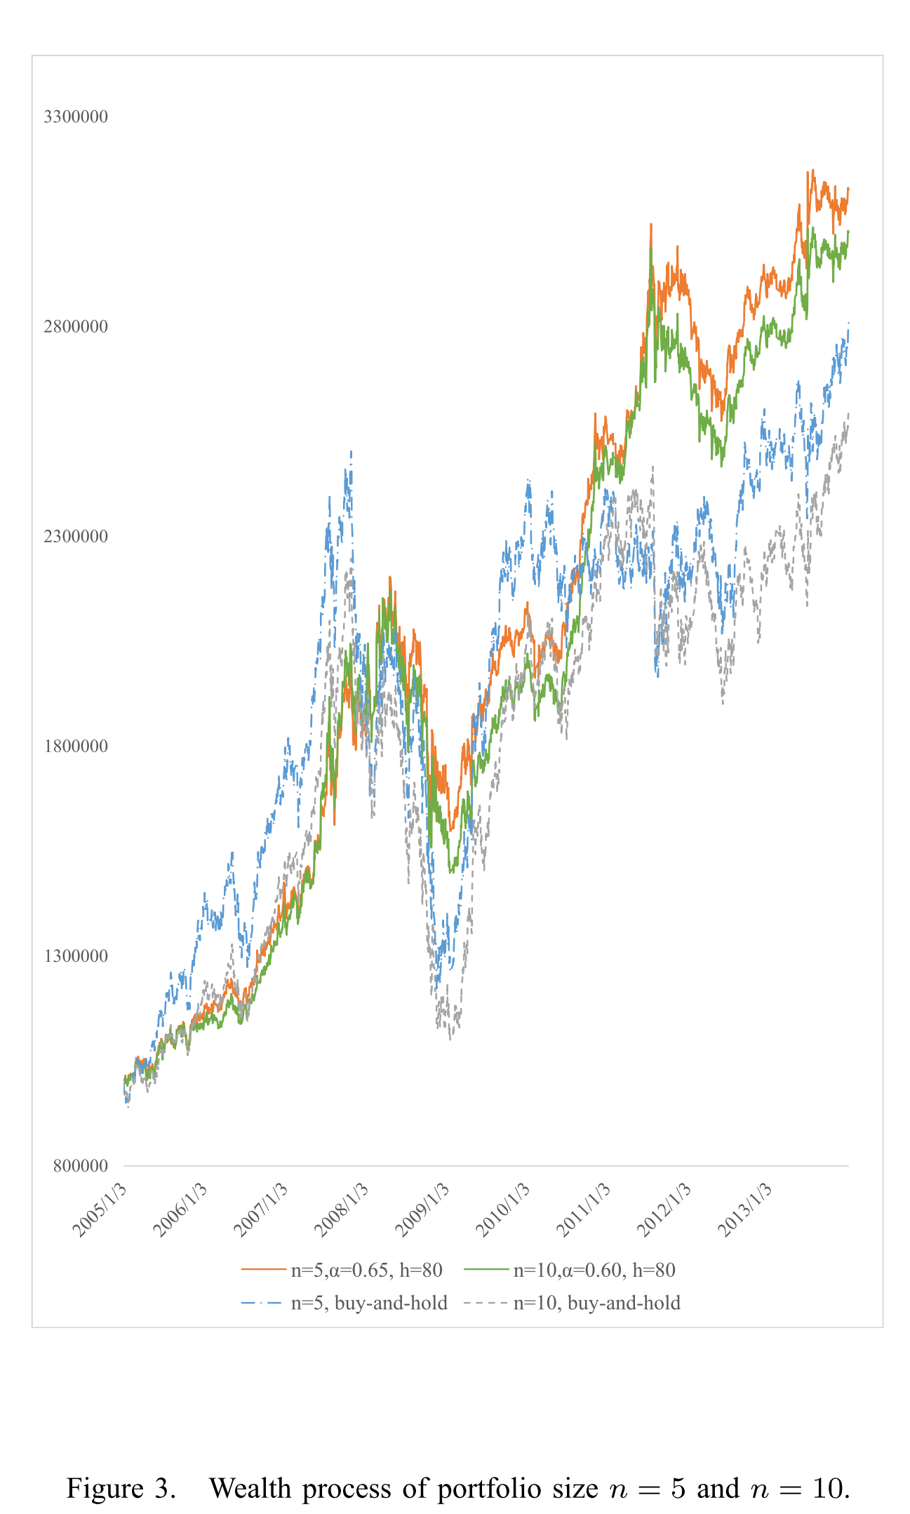

Slide 28
Conclusions and future work
Our method consists two phases:
Generating scenarios of joint returns of period t+1
Solving the stochastic programing to get optimal amount of buying and selling
It is worth finding more precise way to generating scenarios.
To modify the stochastic programming to close the real investment.

Slide 29

Thanks for your listening!

