Slide 1
Fast and Simple Computation of All Longest Common Subsequences
Ronald I. Greenberg
March 2011
Presenter: Huang-Ting Chan
Date:2014/10/7

Slide 2
Abstract
This paper shows that a simple algorithm produces the all-prefixes-LCSs-graph in O(mn) time for two input sequences of size m and n.
Given any prefix p of the first input sequence and any prefix q of the second input sequence, all longest common subsequences (LCSs) of p and q can be generated in time proportional to the output size, once the all-prefixes-LCSs-graph has been constructed.

Slide 3
The problem can be solved in the context of generating all the distinct character strings that represent an LCS or in the context of generating all ways of embedding an LCS in the two input strings.

Slide 4
Introduction
Canonical embedding:
Starting from the beginning of the LCS,is assigned matching positions in both sequences as small as possible.
Anticanonical embedding:
The matching positions are chosen as large as possible

Slide 5
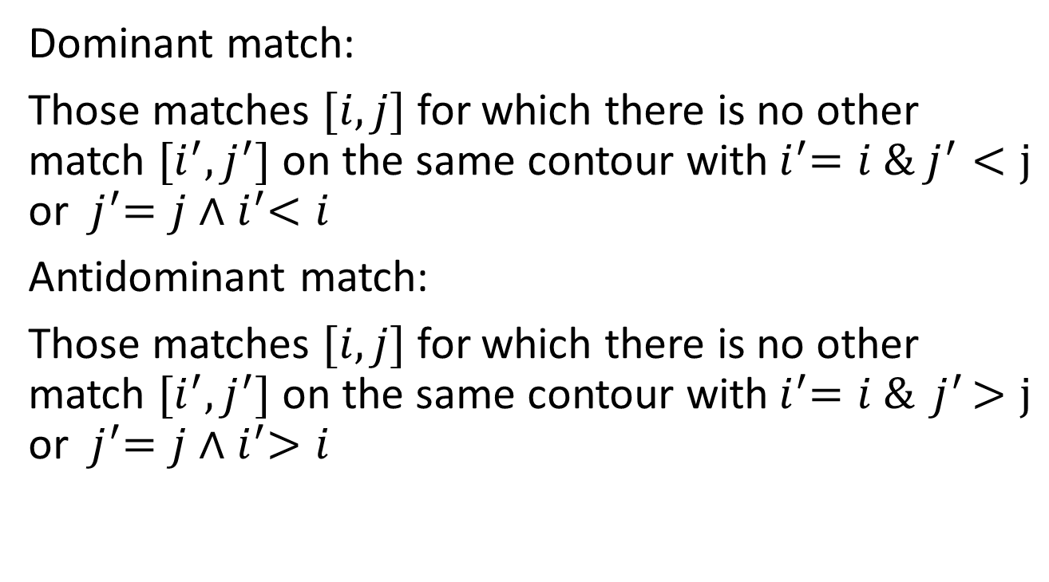
Dominant match:
Those matches $[i,j]$ for which there is no other match $[i^{′},j^{′}]$ on the same contour with${ i}^{′}=i {\& j}^{′}<j$ or ${ j}^{′}=j∧{ i}^{′}<i$
Antidominant match:
Those matches $[i,j]$ for which there is no other match $[i^{′},j^{′}]$ on the same contour with${ i}^{′}=i \&{ j}^{′}>j$ or ${ j}^{′}=j∧{ i}^{′}>i$

Slide 6
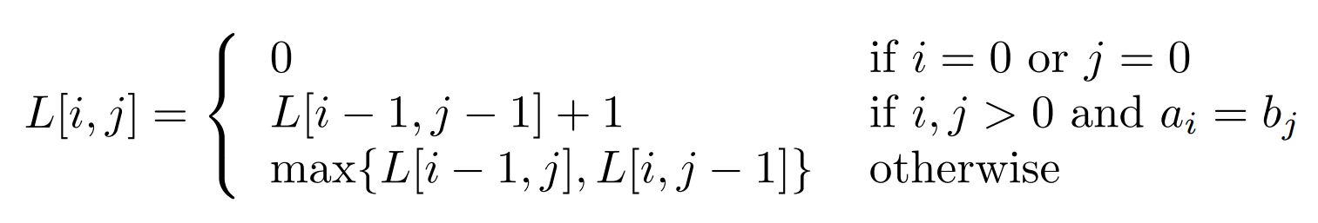

$A_{i}$ to represent the prefix $a_{1}a_{2}a_{3}…a_{i}$ of A
When $a_{i}=b_{j}⇒$ match
When $a_{i}≠b_{j}⇒$ clash

Slide 7
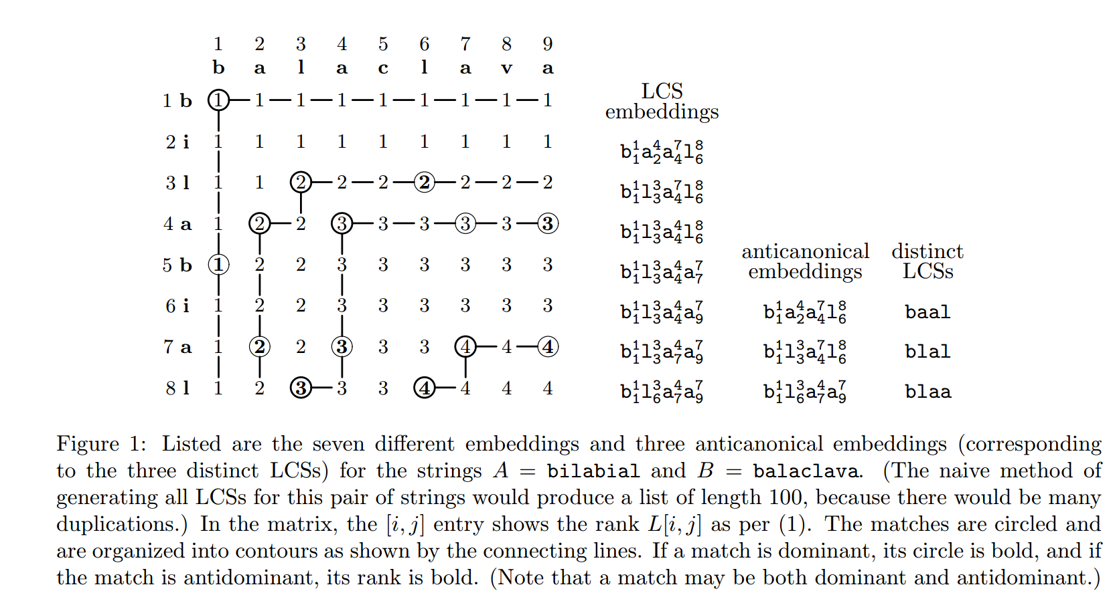

Slide 8
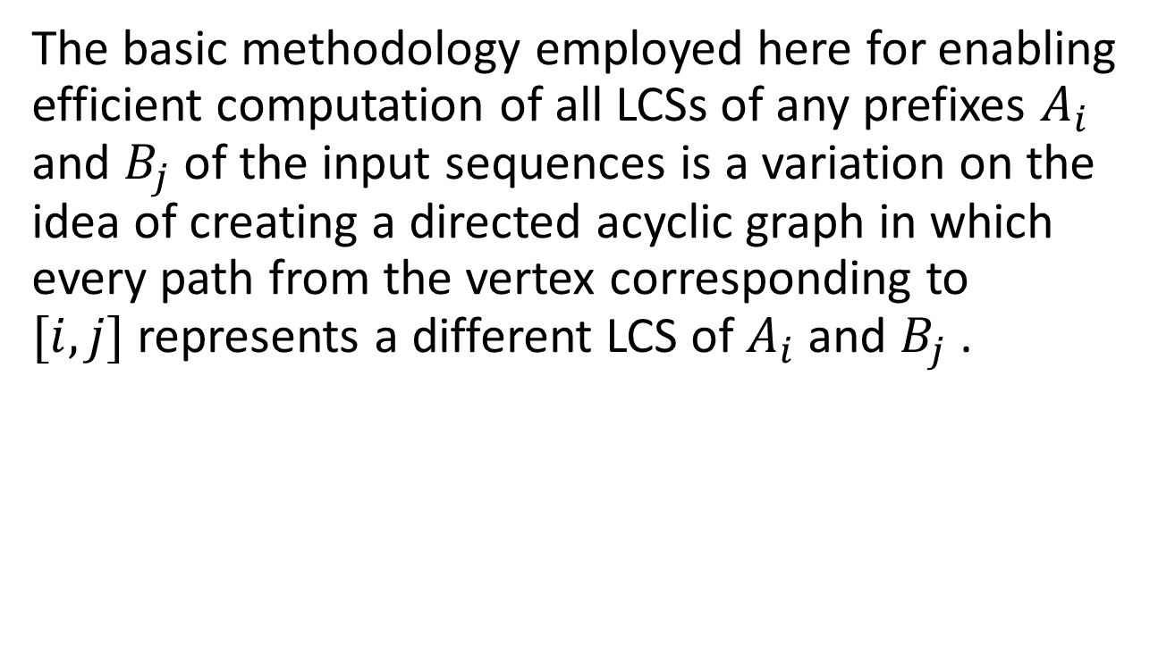
Find all distinct LCS
The basic methodology employed here for enabling efficient computation of all LCSs of any prefixes $A_{i}$ and $B_{j}$ of the input sequences is a variation on the idea of creating a directed acyclic graph in which every path from the vertex corresponding to $[i, j]$represents a different LCS of $A_{i}$ and $B_{j}$ .

Slide 9
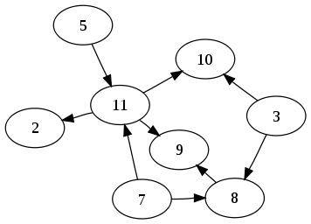

Slide 10
Rick’s compact representation of all LCS embeddings in A and B, the LCSs-graph, may be defined as follows.
Find the transitive closure of the naive graph
Remove all but those vertices that are matches belonging to some LCS
Remove all edges except those connecting a retained vertex to a retained vertex of next lower rank.

Slide 11
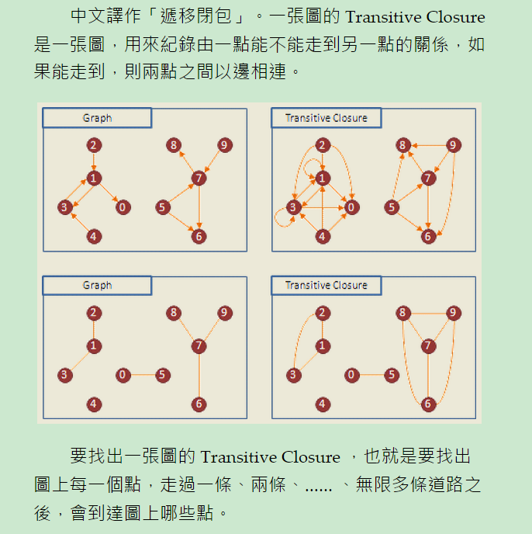

Slide 12
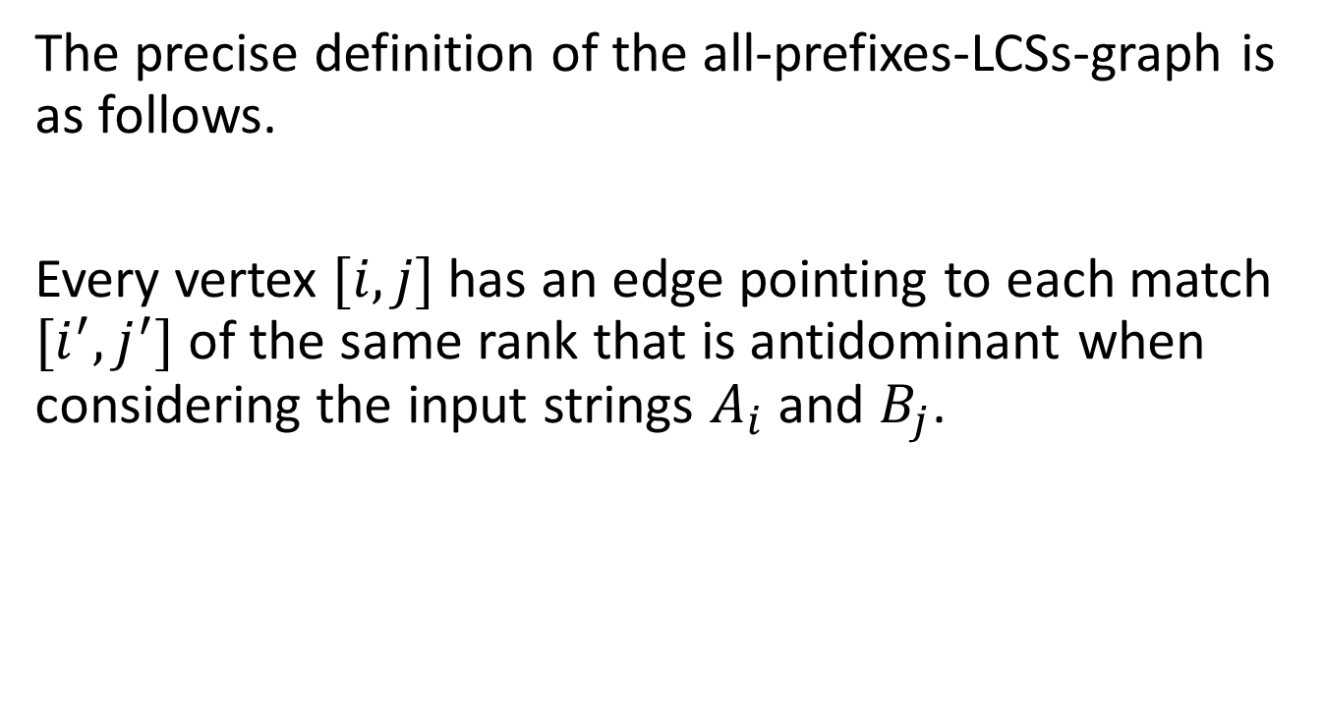
The precise definition of the all-prefixes-LCSs-graph is as follows.
Every vertex $[i, j]$has an edge pointing to each match $[i^{′},j^{′}]$ of the same rank that is antidominant when considering the input strings $A_{i}$ and $B_{j}$.

Slide 13

Theorem 1
Considering all paths from [i, j] in the all-prefixes-LCSs-graph provides a one-to-one correspondence with distinct LCSs of $A_{i}$ and $B_{j}$.

Slide 14
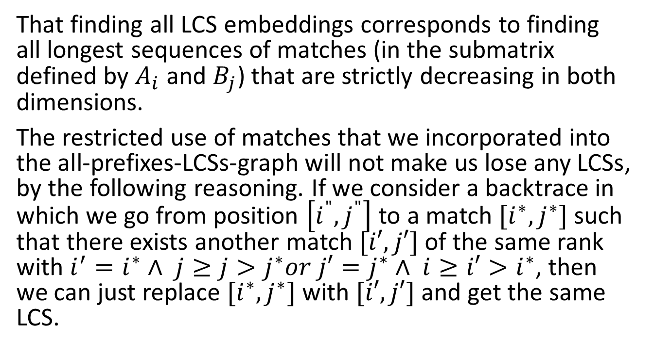
That finding all LCS embeddings corresponds to finding all longest sequences of matches (in the submatrix defined by $A_{i}$ and $B_{j}$) that are strictly decreasing in both dimensions.
The restricted use of matches that we incorporated into the all-prefixes-LCSs-graph will not make us lose any LCSs, by the following reasoning. If we consider a backtrace in which we go from position $\left[i^{"},j^{"}\right]$ to a match $[i^{∗},j^{∗}]$such that there exists another match $[i′, j′]$of the same rank with $i^{′}=i^{∗}∧ j≥j>j^{∗}or j′=j^{∗}∧ i≥i′>i^{∗}$, then we can just replace $[i^{∗},j^{∗}]$with $[i′, j′]$and get the same LCS.

Slide 15
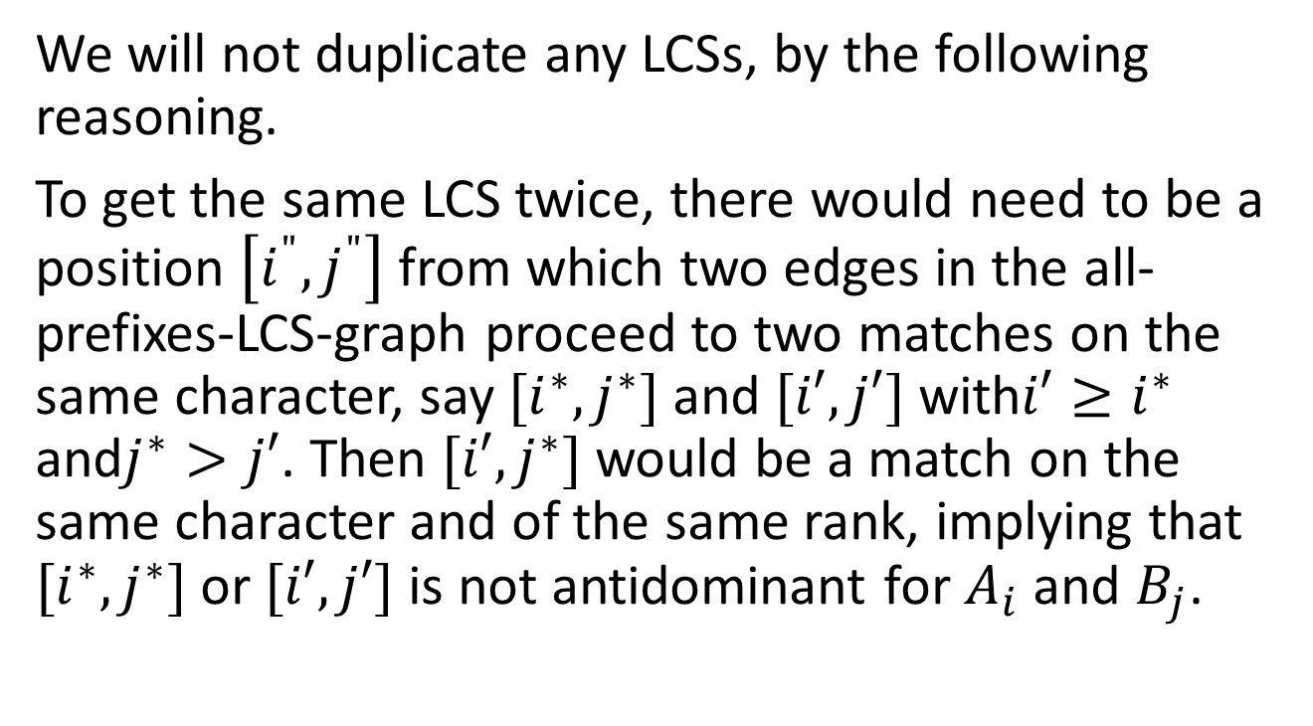
We will not duplicate any LCSs, by the following reasoning.
To get the same LCS twice, there would need to be a position $\left[i^{"},j^{"}\right]$ from which two edges in the all-prefixes-LCS-graph proceed to two matches on the same character, say $[i^{∗},j^{∗}]$and $[i′, j′]$with$i′≥i^{∗}$ and$j^{∗}>j′$. Then $[i′,j^{∗}]$would be a match on the same character and of the same rank, implying that $[i^{∗},j^{∗}]$or $[i′, j′]$is not antidominant for $A_{i}$ and $B_{j}$.

Slide 16
Now, each adjacency list in the all-prefixes-LCSs-graph can be thought of as being based upon a linked list of the antidominant matches along one of the contours; let us call such a linked list a contour list.

Slide 17
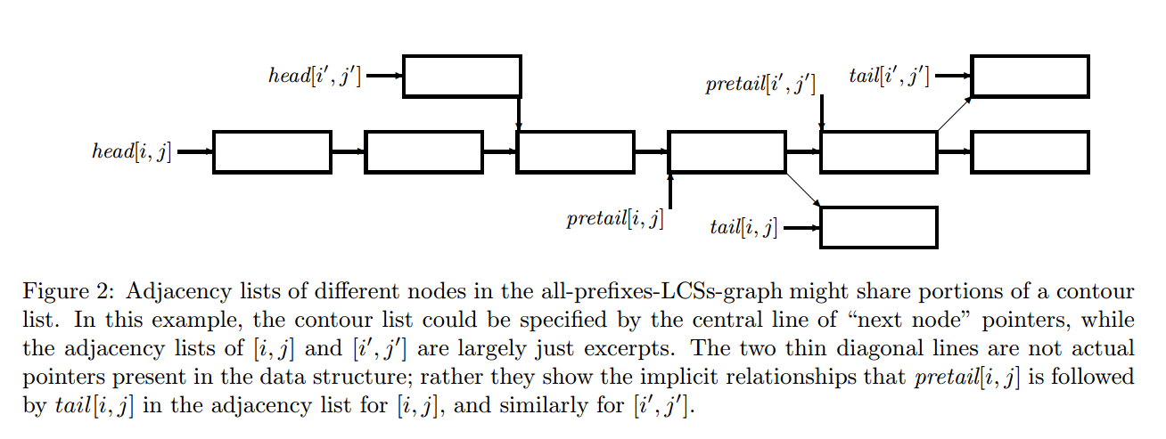

Slide 18
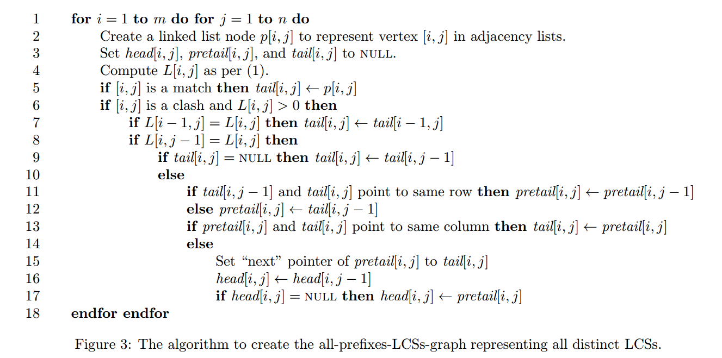

Slide 19
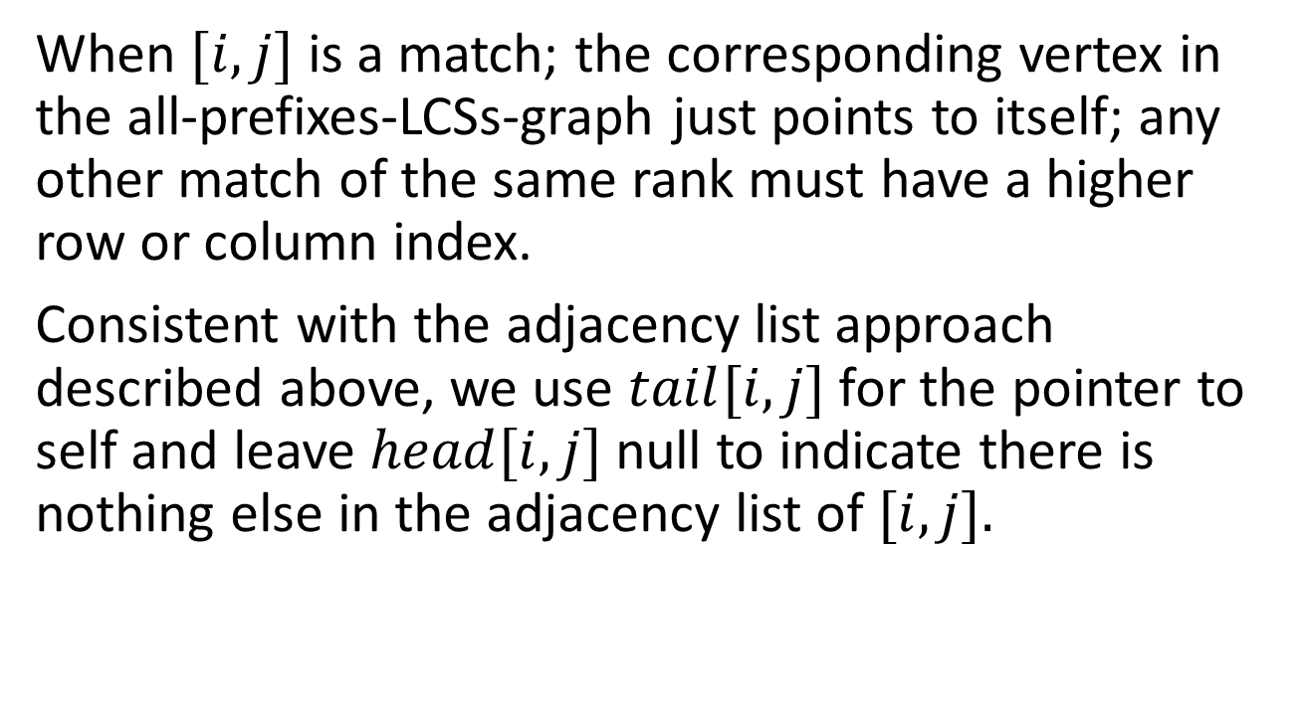
When $[i, j]$ is a match; the corresponding vertex in the all-prefixes-LCSs-graph just points to itself; any other match of the same rank must have a higher row or column index.
Consistent with the adjacency list approach described above, we use $tail[i, j]$for the pointer to self and leave $head[i, j]$null to indicate there is nothing else in the adjacency list of $[i, j].$

Slide 21
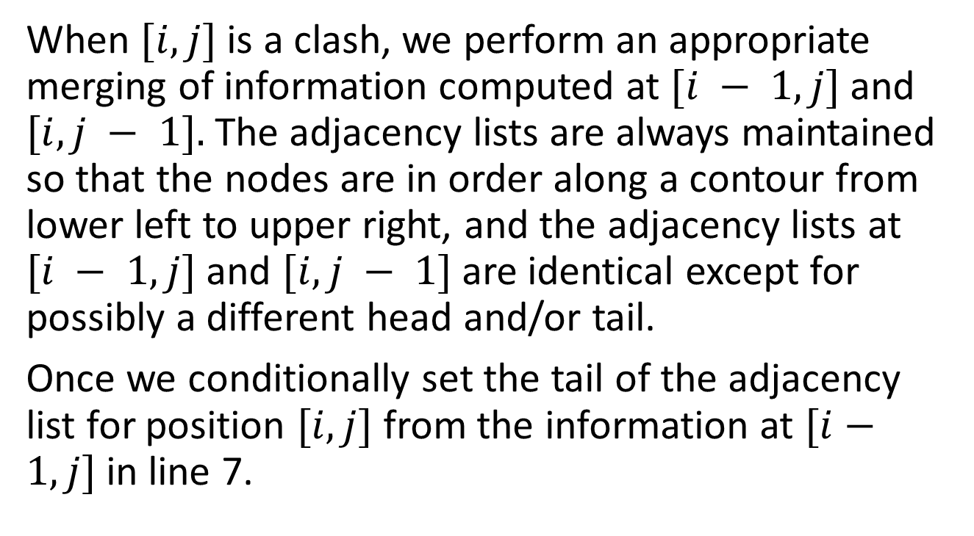
When $[i, j]$is a clash, we perform an appropriate merging of information computed at $[i − 1, j]$and $[i, j − 1].$The adjacency lists are always maintained so that the nodes are in order along a contour from lower left to upper right, and the adjacency lists at $[i − 1, j]$and $[i, j − 1]$are identical except for possibly a different head and/or tail.
Once we conditionally set the tail of the adjacency list for position $[i, j]$from the information at $[i−1, j]$in line 7.

Slide 22

If a null $tail[i, j]$was obtained by looking at position $[i − 1, j],$then the adjacency list for $[i, j]$contains at most one node; in that case $tail[i, j]$is copied from position $[i, j − 1],$and our work is done.

Slide 24
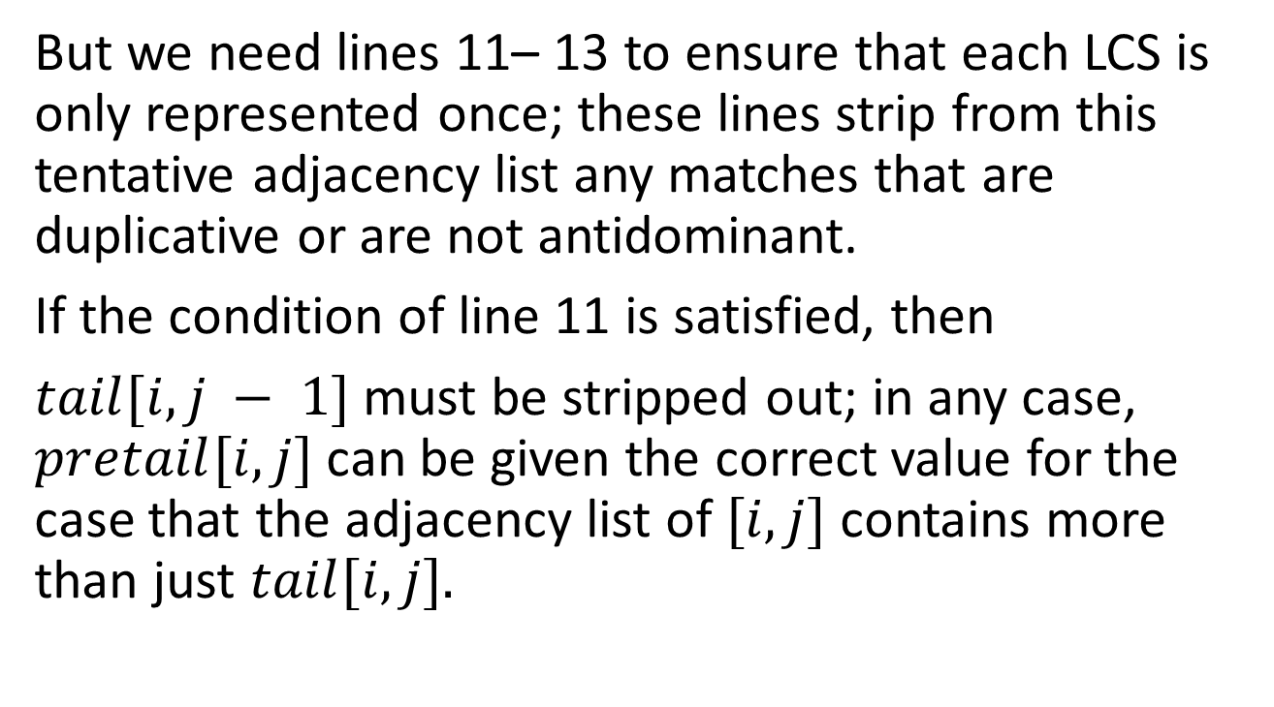
But we need lines 11– 13 to ensure that each LCS is only represented once; these lines strip from this tentative adjacency list any matches that are duplicative or are not antidominant.
If the condition of line 11 is satisfied, then
$tail[i, j − 1]$must be stripped out; in any case, $pretail[i, j]$can be given the correct value for the case that the adjacency list of $[i, j]$contains more than just $tail[i, j].$

Slide 25
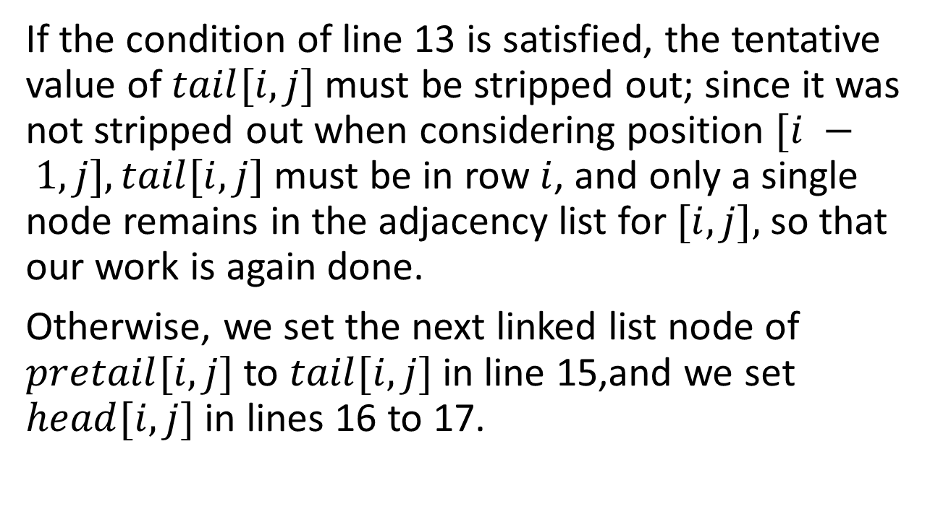
If the condition of line 13 is satisfied, the tentative value of $tail[i, j]$must be stripped out; since it was not stripped out when considering position $[i − 1, j], tail[i, j]$must be in row $i$, and only a single node remains in the adjacency list for $[i, j],$so that our work is again done.
Otherwise, we set the next linked list node of $pretail[i, j]$to $tail[i, j]$in line 15,and we set $head[i, j]$ in lines 16 to 17.

Slide 26
 | b | a | l | a
b | 1 | 1 | 1 | 1
i | 1 | 1 | 1 | 1
l | 1 | 1 | 2 | 2
a | 1 | 2 | 2 | 3

Slide 27
 | b | c | l | a
b | 1 | 1 | 1 | 1
i | 1 | 1 | 1 | 1
l | 1 | 1 | 2 | 2
c | 1 | 2 | 2 | 2

Slide 28
 | b | c | l | a
b | 1 | 1 | 1 | 1
a | 1 | 1 | 1 | 2
l | 1 | 1 | 2 | 2
c | 1 | 2 | 2 | 2

Slide 29
Find all LCS embeddings
If we wish to find all LCS embeddings, without duplicating the same embedding, but including multiple embeddings of the same LCS

Slide 30
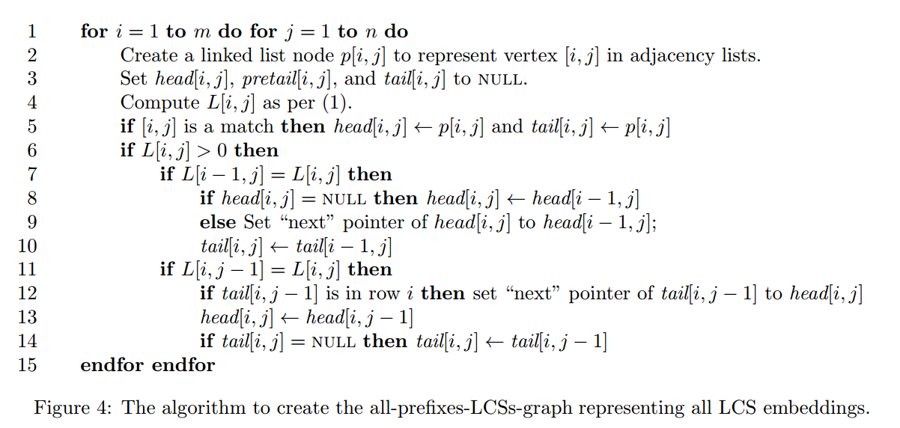

Slide 31
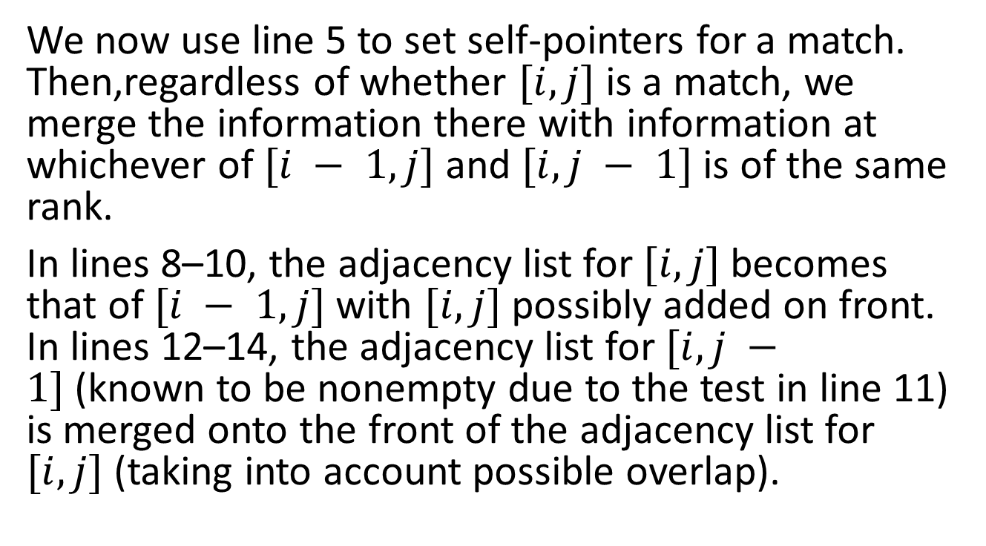
We now use line 5 to set self-pointers for a match. Then,regardless of whether $[i, j]$is a match, we merge the information there with information at whichever of $[i − 1, j]$and $[i, j − 1]$is of the same rank.
In lines 8–10, the adjacency list for $[i, j]$becomes that of $[i − 1, j]$with $[i, j]$possibly added on front. In lines 12–14, the adjacency list for $[i, j −1]$(known to be nonempty due to the test in line 11) is merged onto the front of the adjacency list for $[i, j]$(taking into account possible overlap).

Slide 32
 | b | a | l | a
b | 1 | 1 | 1 | 1
i | 1 | 1 | 1 | 1
l | 1 | 1 | 2 | 2
a | 1 | 2 | 2 | 3

Slide 33
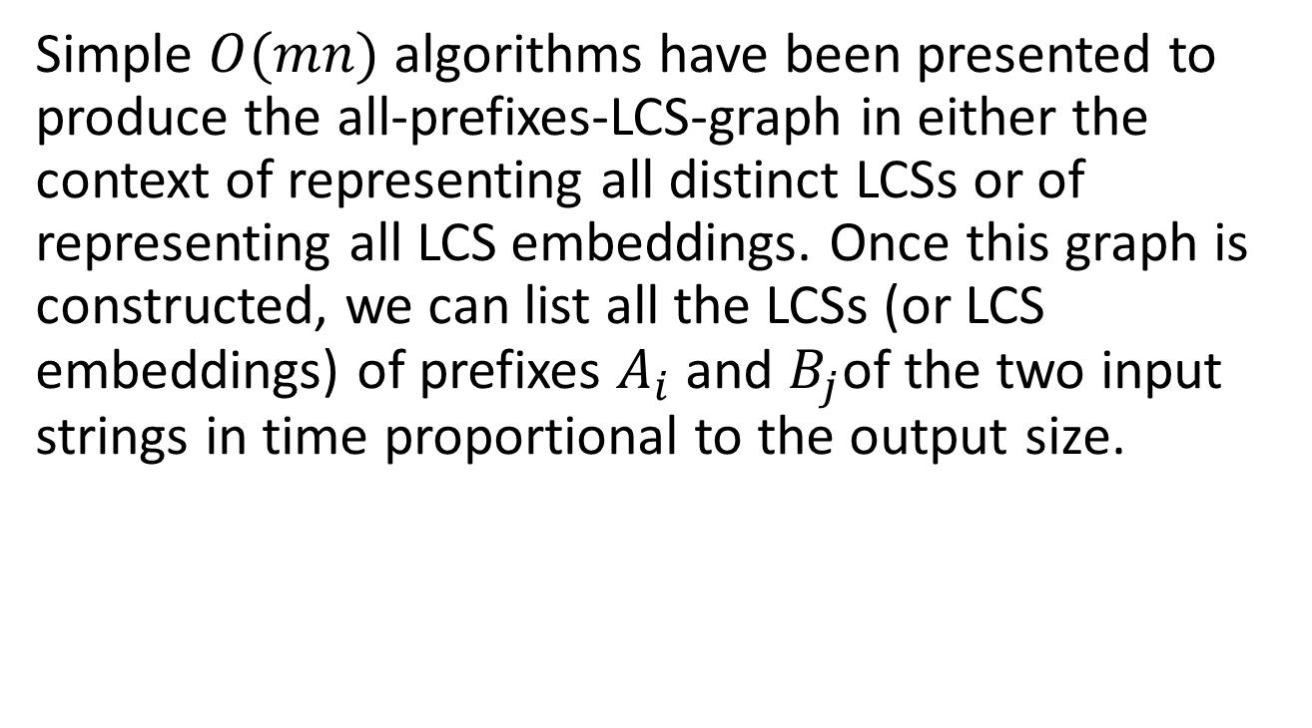
Conclusion
Simple $O(mn)$algorithms have been presented to produce the all-prefixes-LCS-graph in either the context of representing all distinct LCSs or of representing all LCS embeddings. Once this graph is constructed, we can list all the LCSs (or LCS embeddings) of prefixes $A_{i}$ and $B_{j}$of the two input strings in time proportional to the output size.

