Slide 1
Bit-Parallel Algorithm for the Constrained Longest Common Subsequence Problem
Sebastian Deorowicz∗
Fundamenta Informaticae 99 (2010) 409–433 409
DOI 10.3233/FI-2010-256
Presenter:De-Sheng Jhan
2014/10/07

Slide 2
Abstract
The problem of finding a constrained longest common subsequence (CLCS) for the sequences A and B with respect to the sequence P was introduced recently. Its goal is to find a longest subsequence C of A and B such that P is a subsequence of C. Most of the algorithms solving the CLCS problem are based on dynamic programming. Bit-parallelism is a technique of using single bits in a machine word for concurrent computation. We propose the first bit-parallel algorithm computing a CLCS and/or its length which outperforms the other known algorithms in terms of speed.

Slide 3
LCS
A = a₁a₂…a_{n} = ABAADACBAABC , n = 12
B = b₁b₂…b_{m} = CBCBDAADCDBA, m = 12
C = LCS(A, B) = B A A D C B A , | C | = 7

Slide 4
CLCS
A = a₁a₂…a_{n} = ABAADACBAABC , n = 12
B = b₁b₂…b_{m} = CBCBDAADCDBA, m = 12
C = LCS(A, B) = B A A D C B A, | C | = 7
P = p₁p₂…p_{r} = CBB, r = 3
P is not a subsequence of C

Slide 5
CLCS
A = a₁a₂…a_{n} = ABAADACBAABC , n = 12
B = b₁b₂…b_{m} = CBCBDAADCDBA, m = 12
P = CBB
C = CLCS(A, B) = B C B A A B, | C | = 6

Slide 6
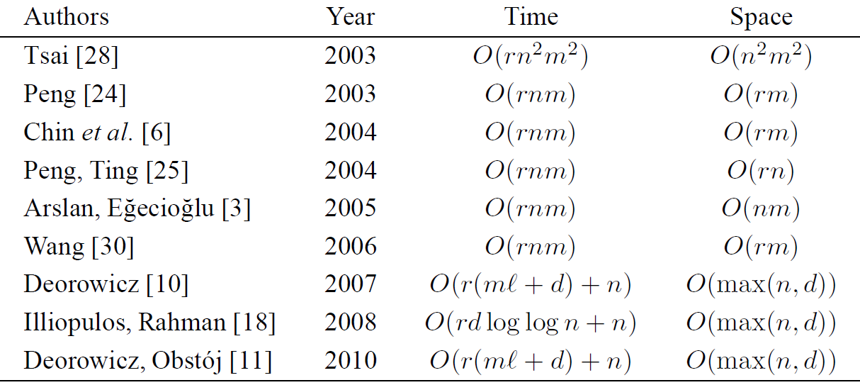
Existing Algorithms for the CLCS Problem

Slide 7
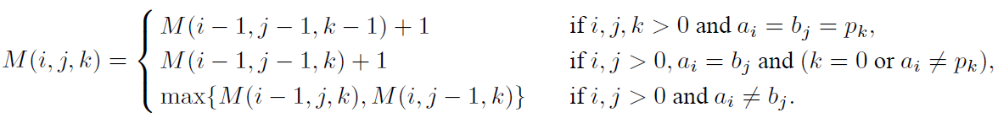
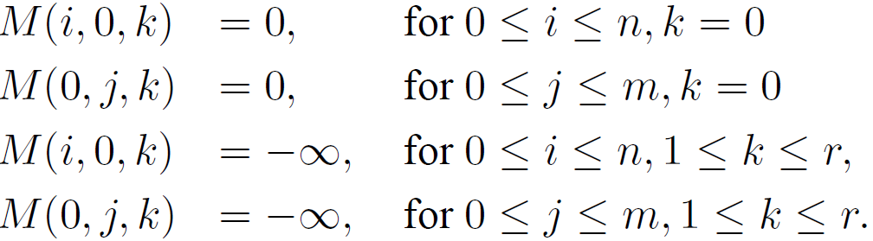
Chin et al.
O( rmn )
A_{i} = b_{j} = p_{k} : strong match
A_{i} = b_{j} ≠ p_{k} : weak match

Slide 8
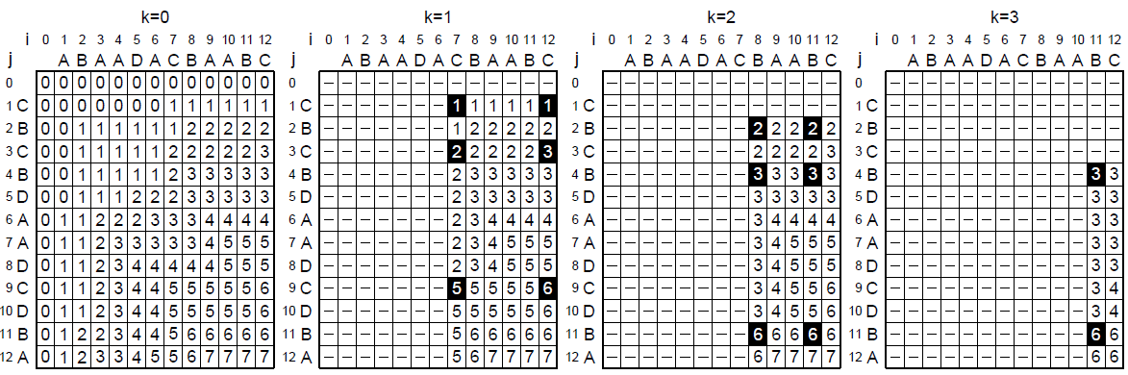
A = ABAADACBAABC
B = CBCBDAADCDBA
P = CBB

Slide 9
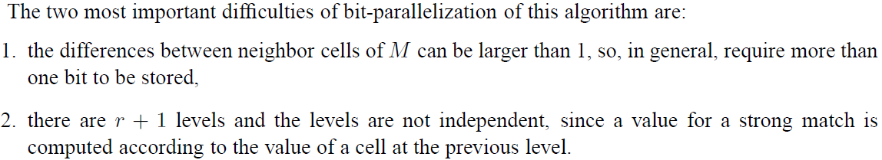
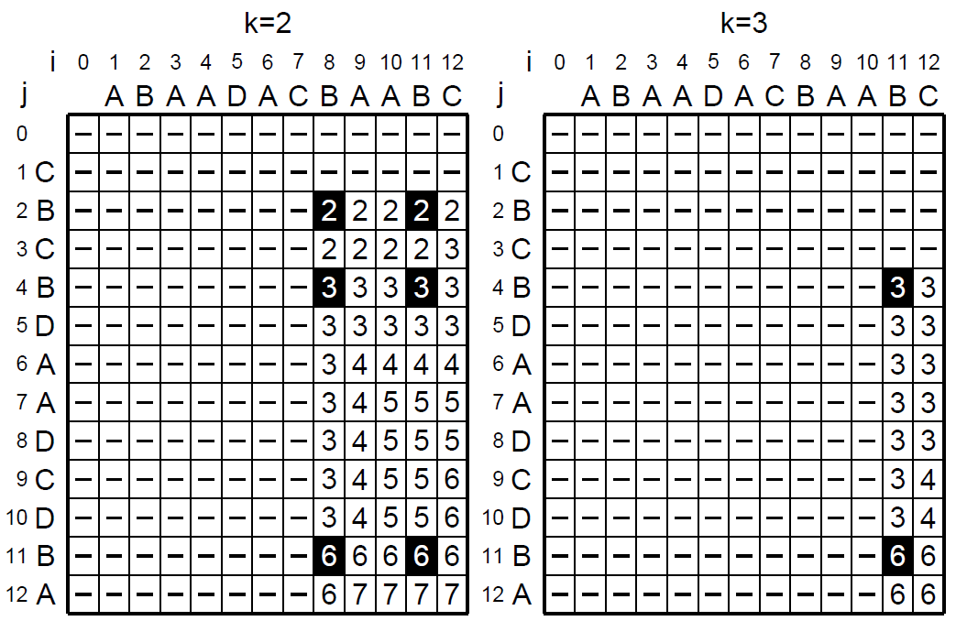
Bit-Parallel Strip Algorithm

Slide 10
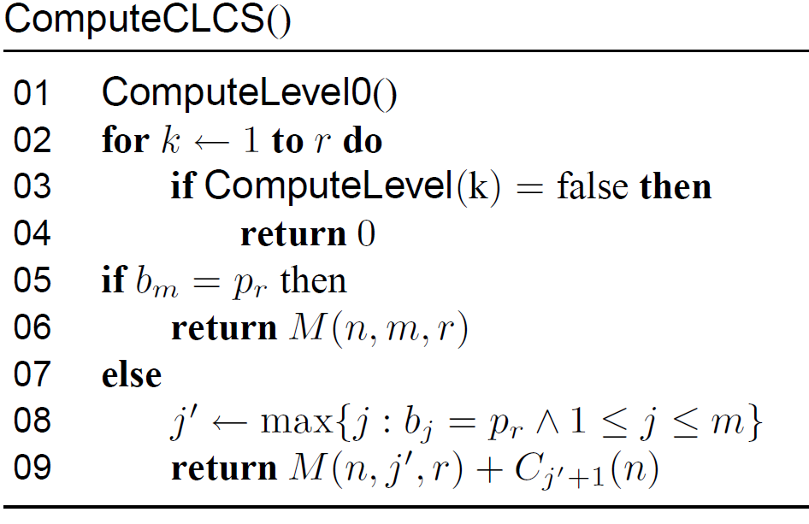
Bit-Parallel Strip Algorithm

Slide 11
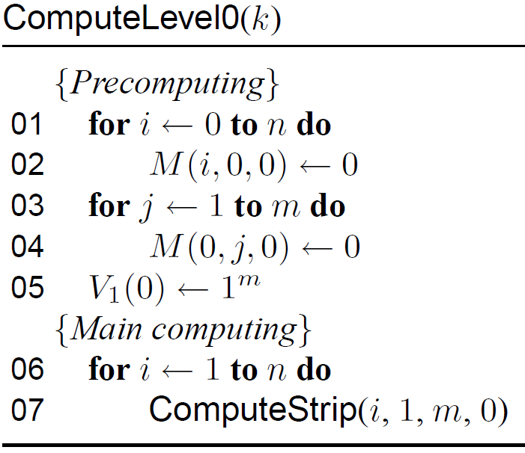
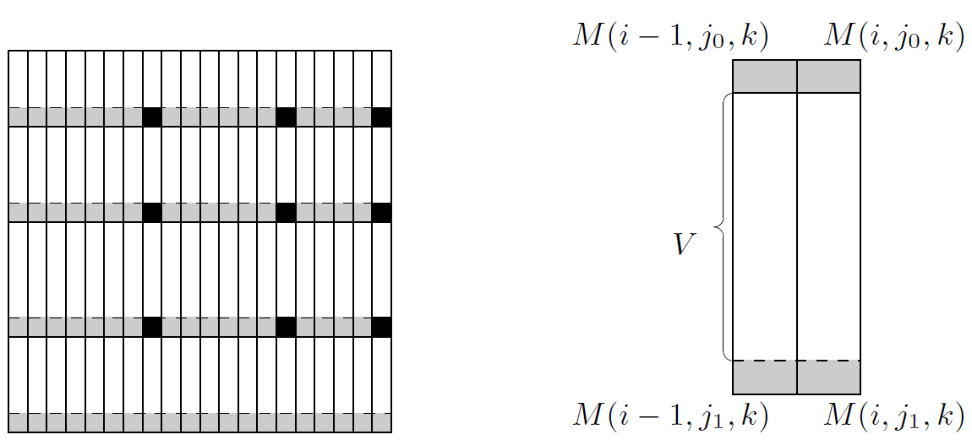
index | V₁(0)
1 | 1
2 | 1
3 | 1
4 | 1
5 | 1
6 | 1
7 | 1
8 | 1
9 | 1
10 | 1
11 | 1
12 | 1

Slide 12
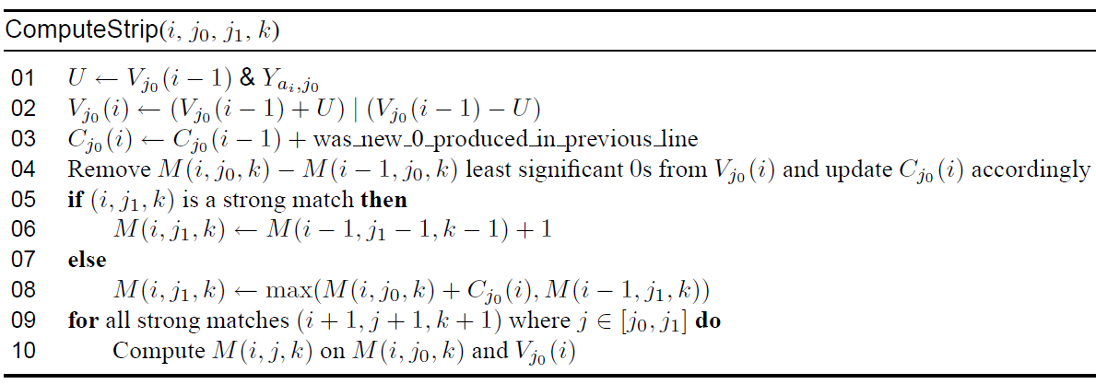
Y_{ai}
 | A | B | C | D
C | 0 | 0 | 1 | 0
B | 0 | 1 | 0 | 0
C | 0 | 0 | 1 | 0
B | 0 | 1 | 0 | 0
D | 0 | 0 | 0 | 1
A | 1 | 0 | 0 | 0
A | 1 | 0 | 0 | 0
D | 0 | 0 | 0 | 1
C | 0 | 0 | 1 | 0
D | 0 | 0 | 0 | 1
B | 0 | 1 | 0 | 0
A | 1 | 0 | 0 | 0

Slide 13
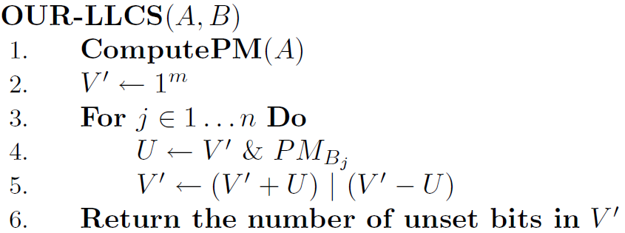
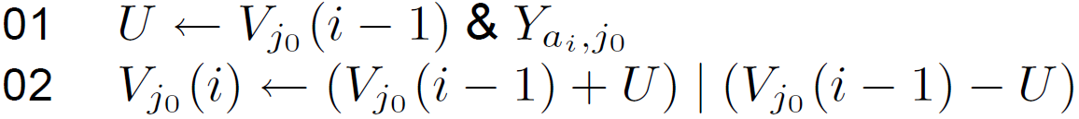

Slide 14
 | i | 0 | 1 | 2 | 3 | 4 | 5 | 6 | 7 | 8 | 9 | 10 | 11 | 12
j |  |  | A | B | A | A | D | A | C | B | A | A | B | C
0
1 | C | 1 | 1
2 | B | 1 | 1
3 | C | 1 | 1
4 | B | 1 | 1
5 | D | 1 | 1
6 | A | 1 | 0
7 | A | 1 | 1
8 | D | 1 | 1
9 | C | 1 | 1
10 | D | 1 | 1
11 | B | 1 | 1
12 | A | 1 | 1
V₁(0)
1
1
1
1
1
1
1
1
1
1
1
1
Y_{A}
0
0
0
0
0
1
1
0
0
0
0
1
_{V(0)+U}
1
1
1
1
1
0
1
0
0
0
0
1
_{V(0)-U}
1
1
1
1
1
0
0
1
1
1
1
0
V₁(1)
1
1
1
1
1
0
1
1
1
1
1
1
_{U}
0
0
0
0
0
1
1
0
0
0
0
1

Slide 16
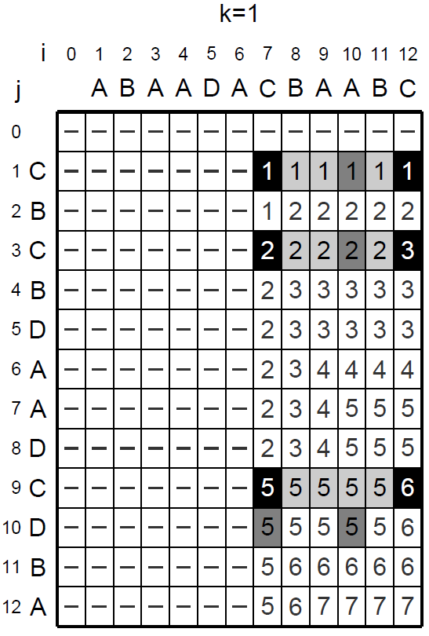
 | i | 0 | 1 | 2 | 3 | 4 | 5 | 6 | 7 | 8 | 9 | 10 | 11 | 12
j |  |  | A | B | A | A | D | A | C | B | A | A | B | C
0
1 | C | 1 | 1 | 1 | 1 | 1 | 1 | 1
2 | B | 1 | 1 | 0 | 0 | 0 | 0 | 0
3 | C | 1 | 1 | 1 | 1 | 1 | 1 | 1
4 | B | 1 | 1 | 1 | 1 | 1 | 1 | 1
5 | D | 1 | 1 | 1 | 1 | 1 | 0 | 0
6 | A | 1 | 0 | 1 | 0 | 0 | 1 | 0
7 | A | 1 | 1 | 1 | 1 | 0 | 0 | 1
8 | D | 1 | 1 | 1 | 1 | 1 | 0 | 0
9 | C | 1 | 1 | 1 | 1 | 1 | 1 | 1
10 | D | 1 | 1 | 1 | 1 | 1 | 1 | 1
11 | B | 1 | 1 | 0 | 1 | 1 | 1 | 1
12 | A | 1 | 1 | 1 | 0 | 1 | 1 | 0
M(6,0,0) = 0
M(6,2,0) = ?
M(6,2,0) = M(6,0,0) + 1 = 1
M(6,8,0) = ?
M(6,8,0) = M(6,0,0) + 4 = 4

Slide 17
K = 0
 | i | 0 | 1 | 2 | 3 | 4 | 5 | 6 | 7 | 8 | 9 | 10 | 11 | 12
j |  |  | A | B | A | A | D | A | C | B | A | A | B | C
0
1 | C | 1 | 1 | 1 | 1 | 1 | 1 | 1 | 0 | 0 | 0 | 0 | 0 | 0
2 | B | 1 | 1 | 0 | 0 | 0 | 0 | 0 | 1 | 0 | 0 | 0 | 0 | 0
3 | C | 1 | 1 | 1 | 1 | 1 | 1 | 1 | 0 | 1 | 1 | 1 | 1 | 0
4 | B | 1 | 1 | 1 | 1 | 1 | 1 | 1 | 1 | 0 | 0 | 0 | 0 | 1
5 | D | 1 | 1 | 1 | 1 | 1 | 0 | 0 | 1 | 1 | 1 | 1 | 1 | 1
6 | A | 1 | 0 | 1 | 0 | 0 | 1 | 0 | 0 | 1 | 0 | 0 | 0 | 0
7 | A | 1 | 1 | 1 | 1 | 0 | 0 | 1 | 1 | 1 | 1 | 0 | 0 | 0
8 | D | 1 | 1 | 1 | 1 | 1 | 0 | 0 | 0 | 0 | 1 | 1 | 1 | 1
9 | C | 1 | 1 | 1 | 1 | 1 | 1 | 1 | 0 | 0 | 0 | 1 | 1 | 0
10 | D | 1 | 1 | 1 | 1 | 1 | 1 | 1 | 1 | 1 | 1 | 1 | 1 | 1
11 | B | 1 | 1 | 0 | 1 | 1 | 1 | 1 | 1 | 0 | 0 | 0 | 0 | 1
12 | A | 1 | 1 | 1 | 0 | 1 | 1 | 0 | 1 | 1 | 0 | 0 | 0 | 0

Slide 19
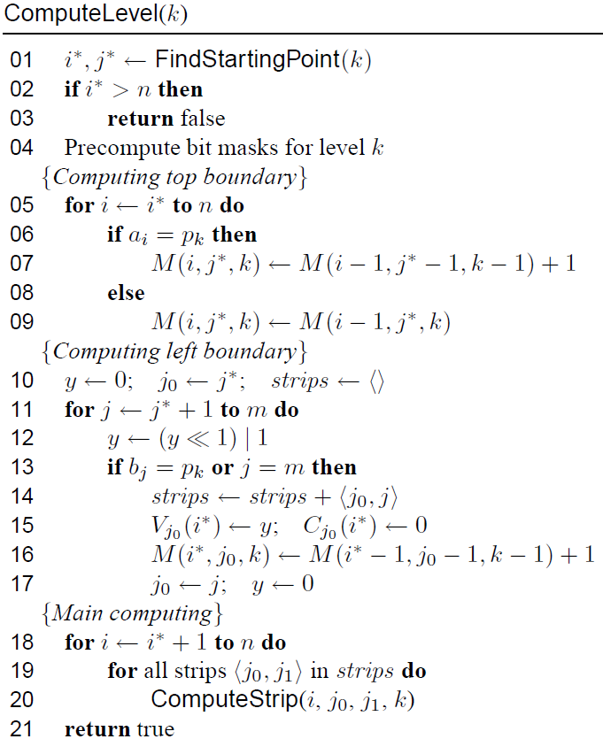

Slide 20
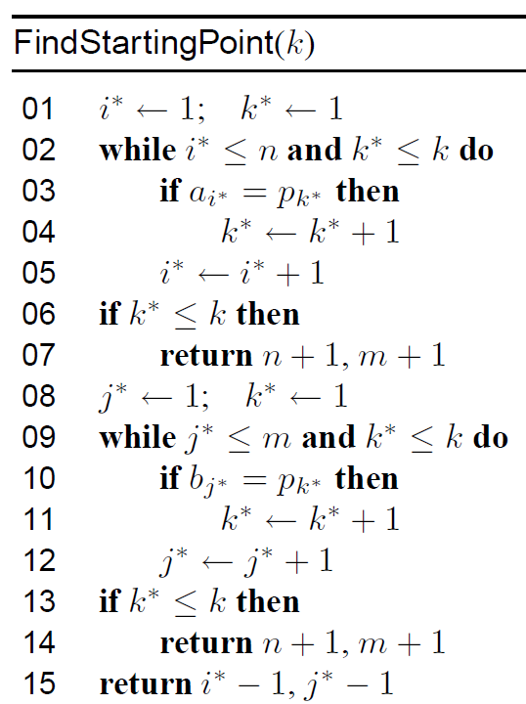
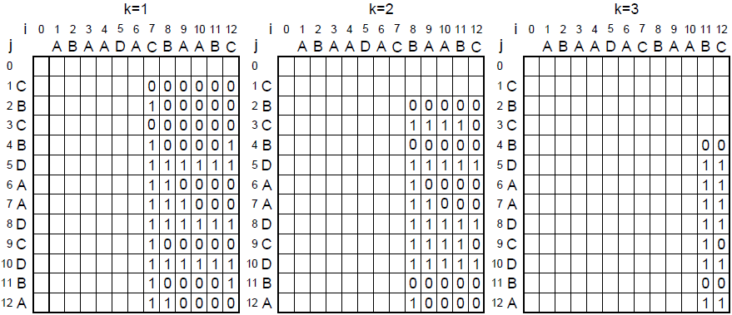

Slide 22
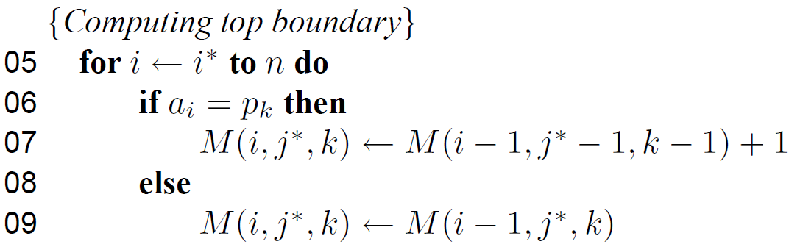
K = 1
 | i | 0 | 1 | 2 | 3 | 4 | 5 | 6 | 7 | 8 | 9 | 10 | 11 | 12
j |  |  | A | B | A | A | D | A | C | B | A | A | B | C
0
1 | C
2 | B
3 | C
4 | B
5 | D
6 | A
7 | A
8 | D
9 | C
10 | D
11 | B
12 | A
M(7,1,1) = M(6,0,0) + 1
= 1
M(8,1,1) = M(7,1,1)=1
.
.
.
M(12,1,1) = M(11,0,0)+1
= 1

Slide 23
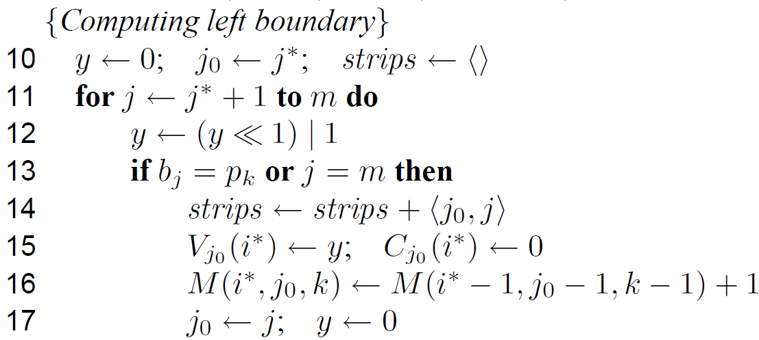
K = 1
 | i | 0 | 1 | 2 | 3 | 4 | 5 | 6 | 7 | 8 | 9 | 10 | 11 | 12
j |  |  | A | B | A | A | D | A | C | B | A | A | B | C
0
1 | C |  |  |  |  |  |  | 1
2 | B |  |  |  |  |  |  | 1
3 | C |  |  |  |  |  |  | 1
4 | B |  |  |  |  |  |  | 1
5 | D |  |  |  |  |  |  | 1
6 | A |  |  |  |  |  |  | 1
7 | A |  |  |  |  |  |  | 1
8 | D |  |  |  |  |  |  | 1
9 | C |  |  |  |  |  |  | 1
10 | D |  |  |  |  |  |  | 1
11 | B |  |  |  |  |  |  | 1
12 | A |  |  |  |  |  |  | 1
strips = {〈1,3〉, 〈3,9〉,
〈9,12〉}
M(7,1,1) = M(6,0,0) + 1 = 1
M(7,3,1) = M(6,2,0) + 1 = 2
M(7,9,1) = M(6,8,0) + 1 = 5

Slide 24
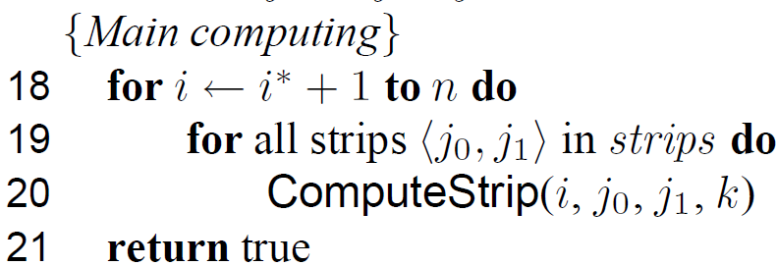

Slide 25
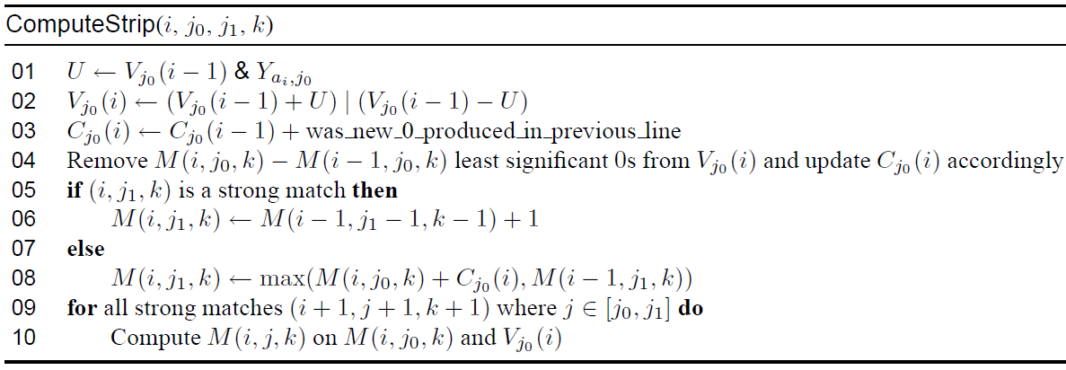
K = 1
 | i | 0 | 1 | 2 | 3 | 4 | 5 | 6 | 7 | 8 | 9 | 10 | 11 | 12
j |  |  | A | B | A | A | D | A | C | B | A | A | B | C
0
1 | C |  |  |  |  |  |  | 1 | 0
2 | B |  |  |  |  |  |  | 1 | 1
3 | C |  |  |  |  |  |  | 1
4 | B |  |  |  |  |  |  | 1
5 | D |  |  |  |  |  |  | 1
6 | A |  |  |  |  |  |  | 1
7 | A |  |  |  |  |  |  | 1
8 | D |  |  |  |  |  |  | 1
9 | C |  |  |  |  |  |  | 1
10 | D |  |  |  |  |  |  | 1
11 | B |  |  |  |  |  |  | 1
12 | A |  |  |  |  |  |  | 1
1
1
V₁(6) =
C₁(6) = 0
V₁(7) =
C₁(7) = 0
0
1

Slide 26
K = 1
 | i | 0 | 1 | 2 | 3 | 4 | 5 | 6 | 7 | 8 | 9 | 10 | 11 | 12
j |  |  | A | B | A | A | D | A | C | B | A | A | B | C
0
1 | C |  |  |  |  |  |  | 1 | 0
2 | B |  |  |  |  |  |  | 1 | 1
3 | C |  |  |  |  |  |  | 1
4 | B |  |  |  |  |  |  | 1
5 | D |  |  |  |  |  |  | 1
6 | A |  |  |  |  |  |  | 1
7 | A |  |  |  |  |  |  | 1
8 | D |  |  |  |  |  |  | 1
9 | C |  |  |  |  |  |  | 1
10 | D |  |  |  |  |  |  | 1
11 | B |  |  |  |  |  |  | 1
12 | A |  |  |  |  |  |  | 1

Slide 27
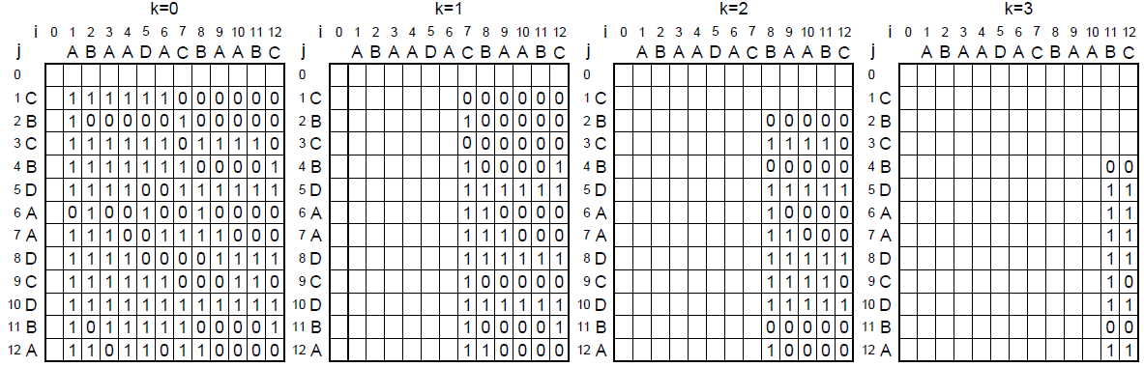

Slide 28
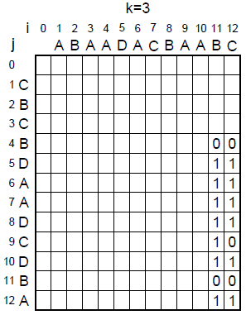
M(12,12,3) = M(12,11,3) + 0
= 6

Slide 29
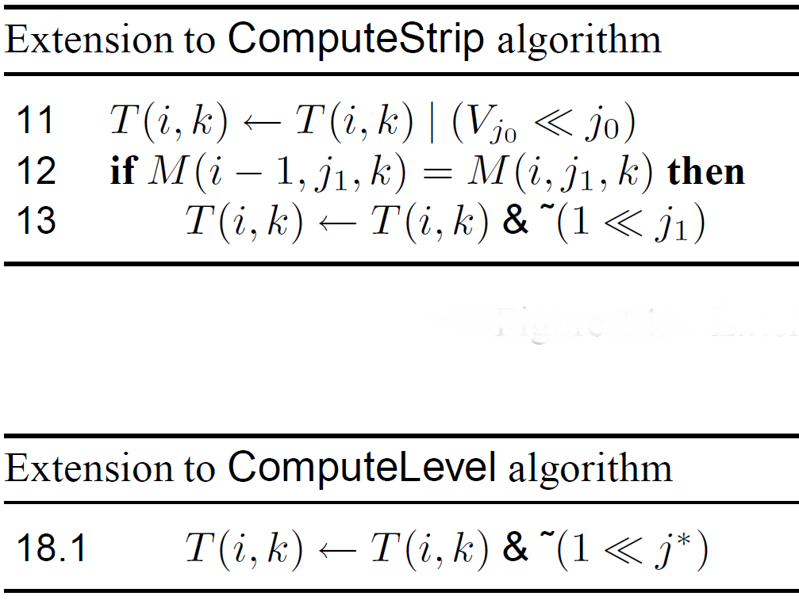
Obtaining a Requested Sequence

Slide 30
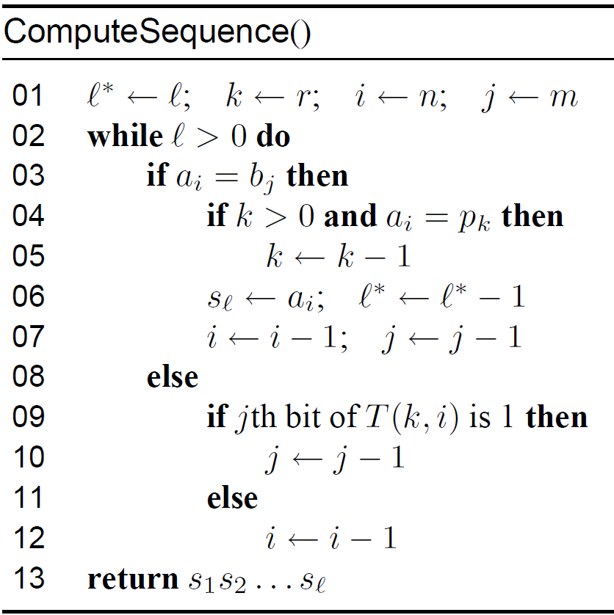
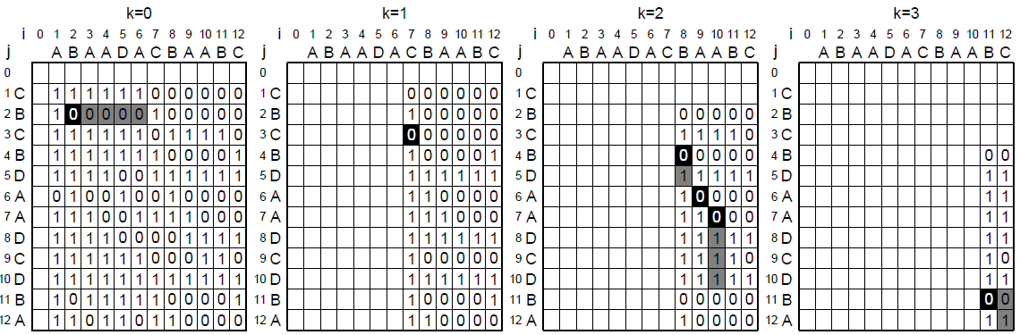

Slide 31
Complexity Analysis
Worst-case : O(rnm)
Average-case : O(rmn/σ + rn⌈m/w⌉)

Slide 32
Experimental Results
In all situations, the times were obtained as medians of 501 executions on a computer equipped with AMD Phenom II X4 810 CPU(2.6GHz real CPU clock) with w = 64.

Slide 33
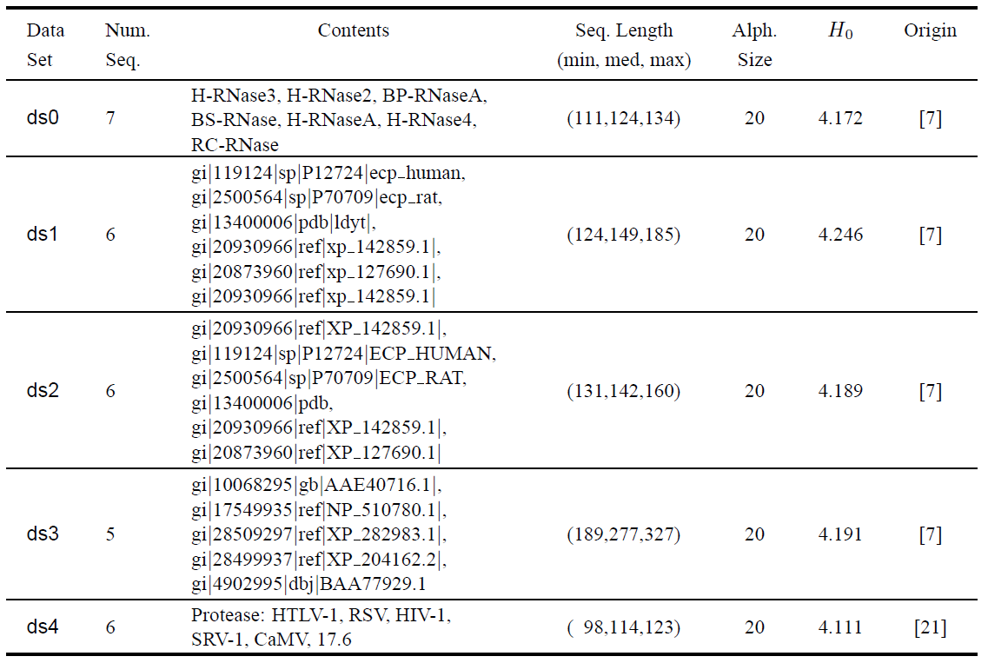

Slide 34
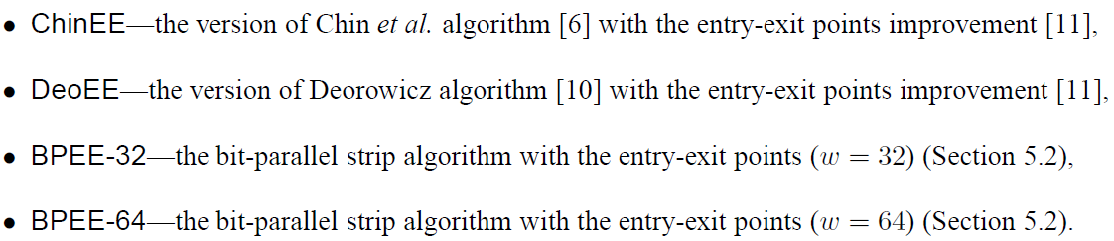

Slide 35
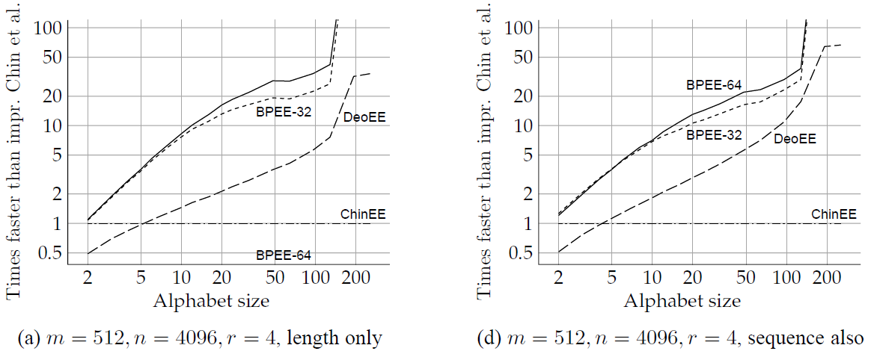

Slide 36
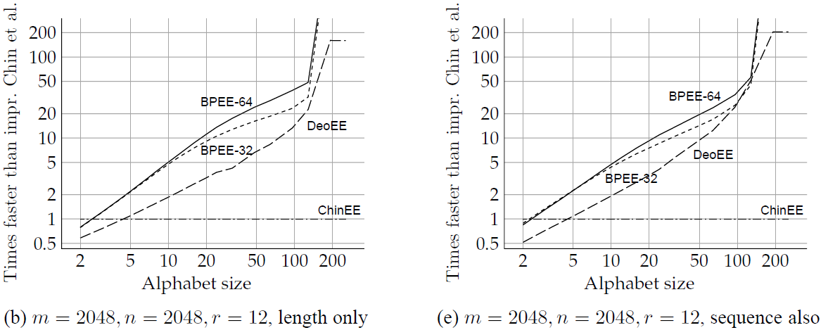

Slide 37
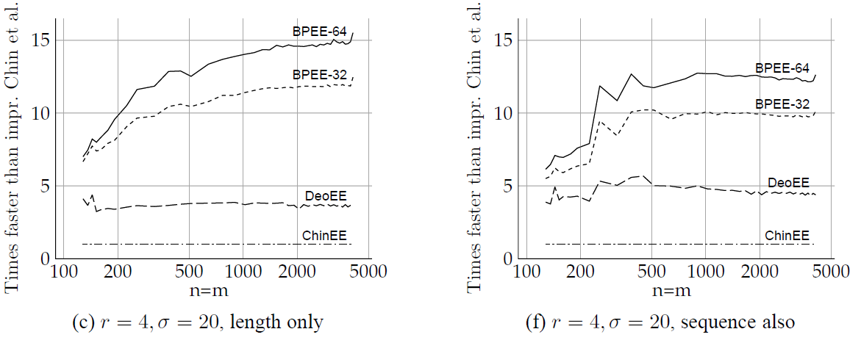

Slide 38
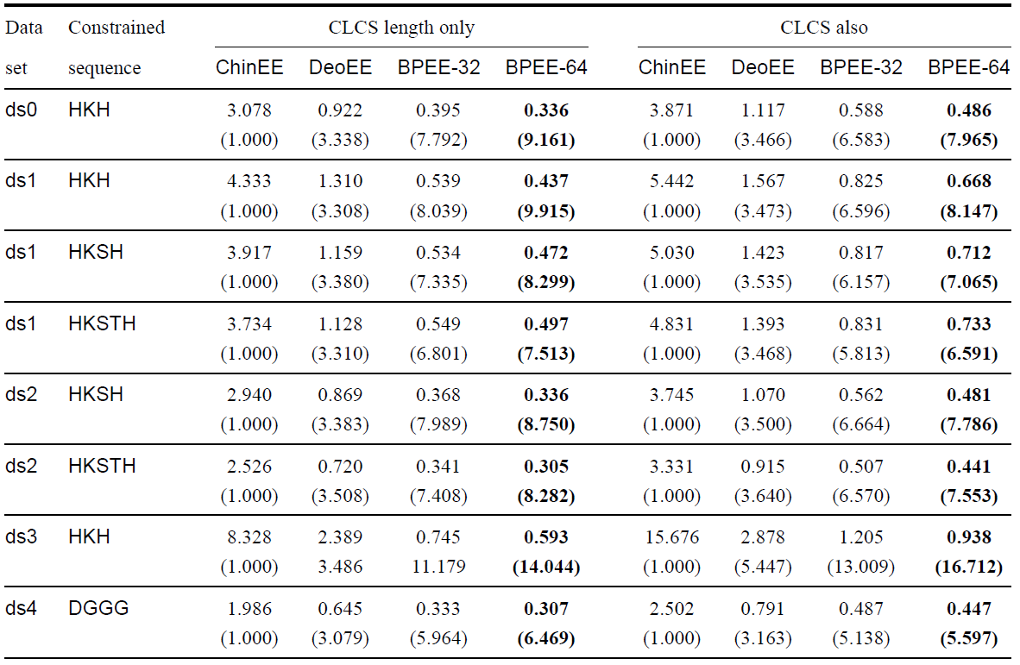

Slide 39
Thanks for listening

