Slide 1
Application of Reinforcement Learning to the Card Game Wizard
J. C. Backhus, H. Nonaka, T. Yoshikawa and M. Sugimoto,
2013 IEEE 2nd Global Conference on Consumer Electronics (at Tokyo, Japan), 2013
Presenter: Yu-Yen Chu
Date: Sep. 5, 2023

Slide 2
Abstract
This article proposes an application using a reinforcement learning (RL) approach to the card game Wizard. The aim is to create a computer player that is able to learn a winning strategy for the game by himself. Wizard is a partially observable competitive multiplayer game that consists of two game phases, forecasting and trick playing. The biggest challenges in creating a strong player are dealing with multiple rounds which have a different grade of imperfection and the decision on the forecast at the beginning of every game round.

Slide 3
Abstract (Cont.)
We introduce an RL approach to the problem by adopting an existing RL algorithm to the playing phase of the game and by implementing an evaluator of the player’s hand card using a Multi-Player-Perceptron to conduct the forecast. The results of our experiments show that the player is able to improve his playing strategy through learning. At the beginning the performance of the learning agent is very bad due to the bad forecasting behavior, but he is able to improve his performance over a few training episodes from 0% won games to approximately 25.68% won games in an experiment with 4 players. Therefore he plays equally strong as his opponents and even outperforms one of them.

Slide 4
Wizard (card game)
a trick-taking card game
every player plays one card per round
60 cards
52 normal cards (4 suits, each suit has card number 1 to 13, 13 > 12 > … > 1)
4 Wizards (biggest card)
4 Jesters (smallest card)
3 to 6 players (4 players in this paper, so 15 rounds)
bidding(predicting)
Each player predicts the # of tricks he/she can get.
Start from dealer’s left player, follows clockwise, ends with dealer.
If prediction is correct, +(20 + 10 * # of tricks taken) points;
otherwise, -(10 * difference between # of tricks predicted and taken) points.

Slide 5
Wizard (card game)
playing
First round starts from dealer’s left player.
The winner of previous round is next round’s first player.
For each round:
If first card is a normal card, then rest of players have to play a normal card with same suit (if he/she has) or Wizard or Jester.
If first card is a Wizard, then rest of players can play any cards, but the first Wizard is seen as biggest.
If first card is a Jester, the first normal card been played is the suit that the rest of players have to follow if they play a normal card (Wizard or Jester can be played).
If first card is Jester and second card is Wizard, then all cards can be followed.
(If all four cards are Jesters in same round, the first Jester is the biggest.)

Slide 6
Model
In playing section, a state evaluator to choose an action.
multi-layer perceptron(MLP) + reinforcement learning
= deep reinforcement learning (NN + RL)
neural network: state as input, action as output
use reward and gradient descent to train NN(state evaluator)
features
# of Wizards, # of Jesters
# of cards of trump suit stronger/weaker than the strongest card in current trick
# of cards of other first/second/third suit
# of tricks still need to be won
trump color
bit sequence for the playing order

Slide 7
Model
three opponents’ agent action predictors
features
# of cards of first suit stronger/weaker than the strongest card in current trick
# of cards of second suit stronger/weaker than the strongest card in current trick
# of cards of third suit stronger/weaker than the strongest card in current trick
# of cards of fourth suit stronger/weaker than the strongest card in current trick
# of Wizards/Jesters
if the strongest card in current trick is Wizard or not
# of tricks still need to be won
bit sequence for the playing order

Slide 8
Model
In predicting section, a MLP(NN) is trained with RL to predict winning tricks in a round.
features
# of Wizards/Jesters
# of cards of trump suit bigger than 10/bigger than 6/equal to or smaller than 6
# of cards of other suits bigger than 10/bigger than 6/equal to or smaller than 6
trump color
if plays first card or not
rule-based method + MLP & RL method of whole game’s prediction
Both methods are tested in each round.
In a 4-player game, rule-based method performs better in first 8 round; MLP & RL method performs better in the latter.

Slide 9
Experiment & Result
In an experiment:
20 test runs
10 learning phases and 11 evaluating phases per run
500 games per learning phase
400 games per evaluating phase
100 card distributions are created and 4 different dealers in evaluating phase

Slide 10
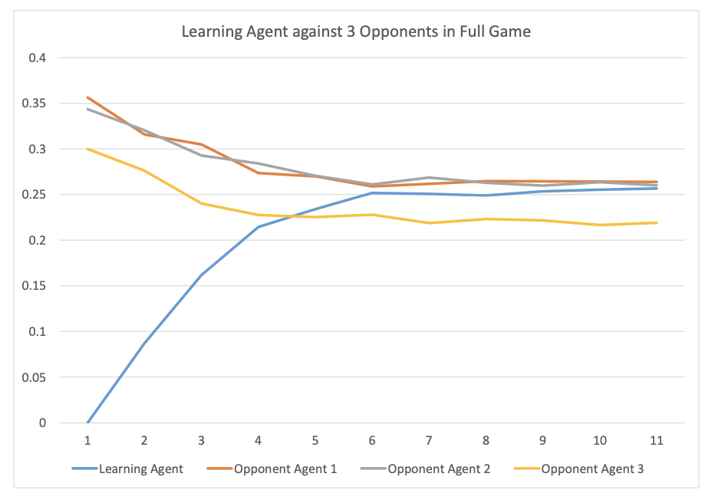
Experiment & Result
the percentage of won games in 11 evaluating phases
Learning agent is trained, other three agents are rule-based.

Slide 11
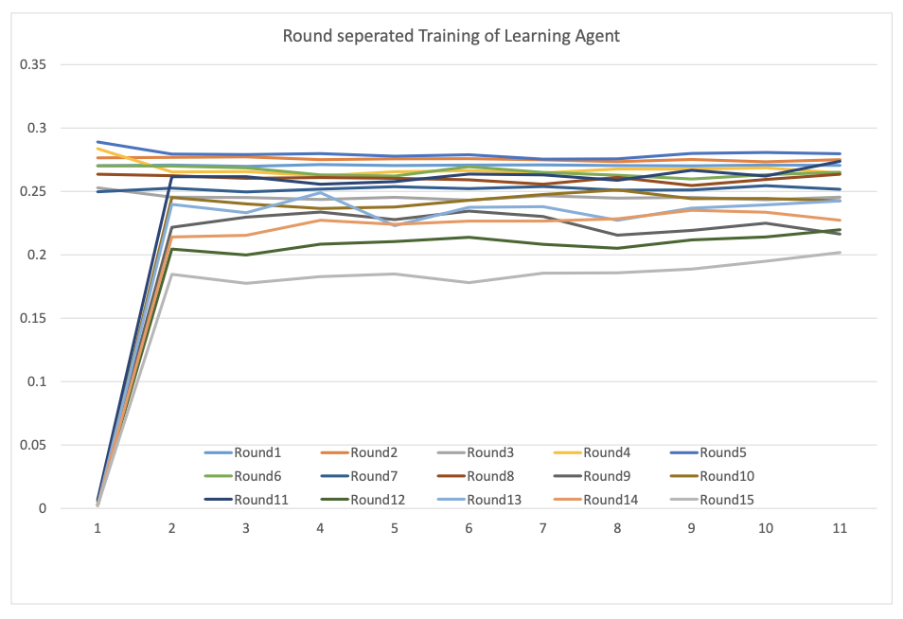
Experiment & Result
the percentage of won games in each round by learning agent.
Each game round is played separately.

