Slide 1
Research on path planning method of forging handling robot based on combined strategy
Kunju Shi, Peng Wu, Mingshuai Liu. 2021 IEEE International Conference on Power Electronics, Computer Applications (ICPECA). Shenyang, China.
Presenter: Yu-Chen Lin
Date: Sept. 5, 2023

Slide 2
Abstract
In the robot navigation module, autonomous path planning is at the core, and the path planning control strategy is the key factor. Traditional robot path planning algorithms generally have some inherent defects, and they cannot seamlessly integrate local and global path planning methods, resulting in low efficiency. This paper proposes a combination strategy of local and global path planning algorithms. In the global algorithm, the potential field ant colony algorithm is adopted. Before the robot starts, it will plan a relatively optimal path on the specified electronic map, which solves the problems of premature convergence and low efficiency of the traditional ant colony algorithm; in terms of local algorithms The improved artificial potential field method is adopted, which carries out real-time path planning for the unknown environment, and solves the problems of local minima and unreachable targets in the traditional potential field method. In this paper, the proposed improved method is simulated and analyzed, and the results show that the proposed control method is feasible.

Slide 3
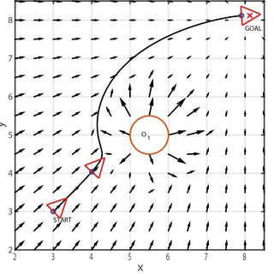
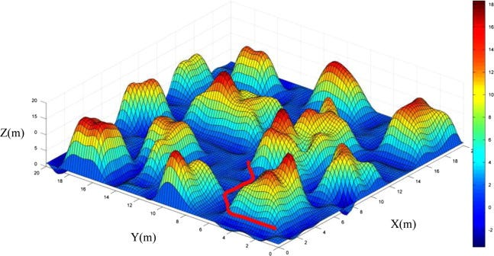
Artificial Potential Field Method

Slide 4

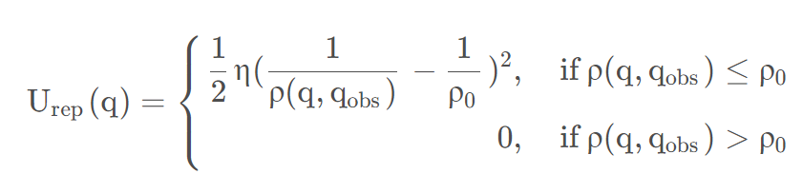
Gravitation field
Repulsive field

Slide 5
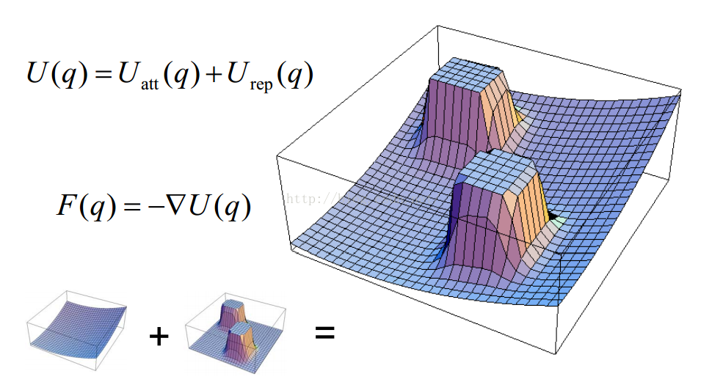

Slide 6
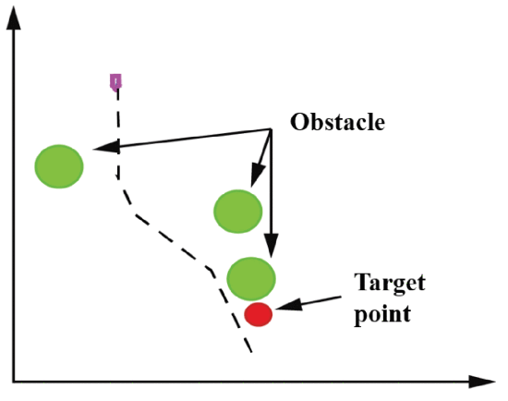

Slide 7
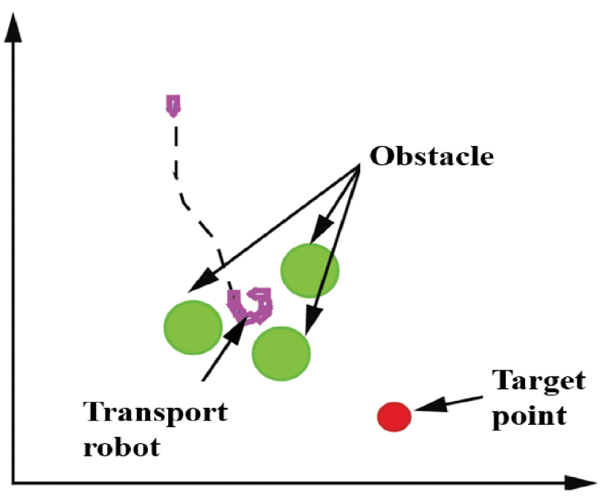

Slide 8
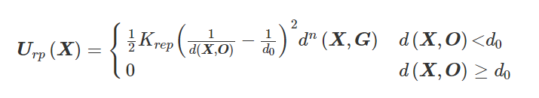





Artificial Potential Field Method Based On Obstacle Boundary Detection

Slide 9
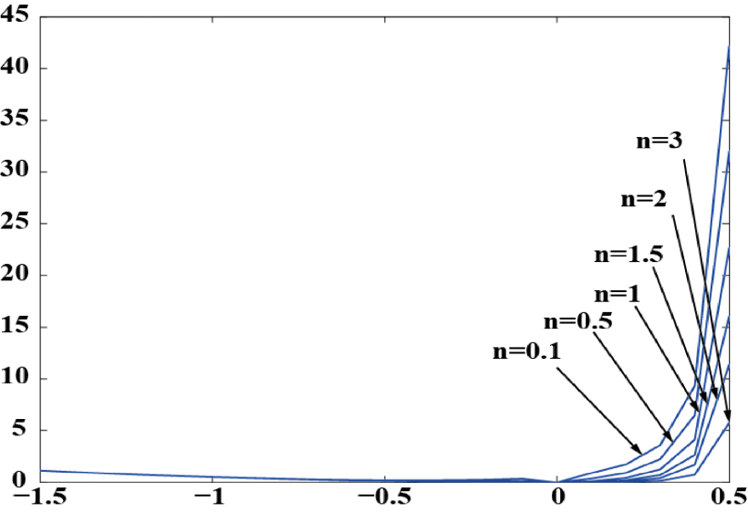
Simulation Analysis and Experiment

Slide 10
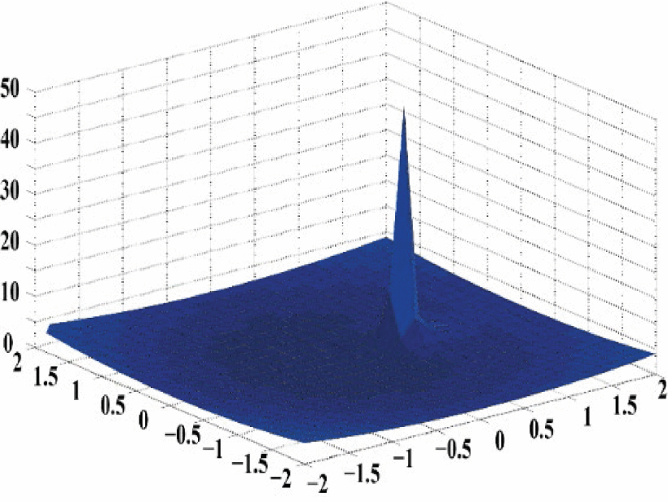

Slide 11
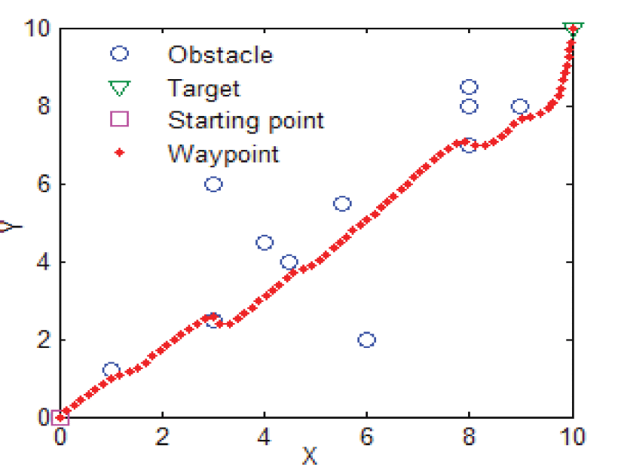
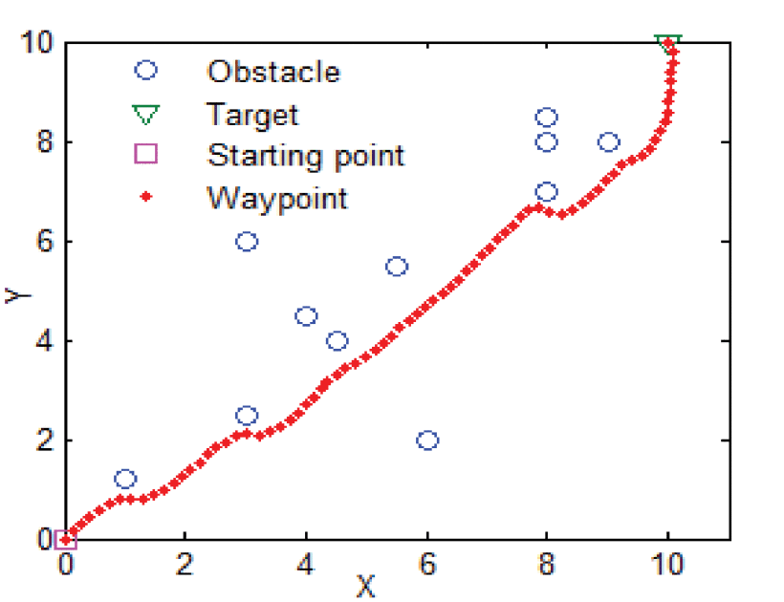
Simulation Analysis of Potential Field Ant Colony Algorithm

Slide 12
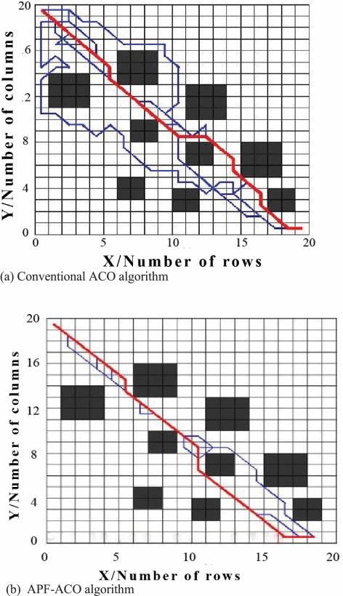

Slide 13
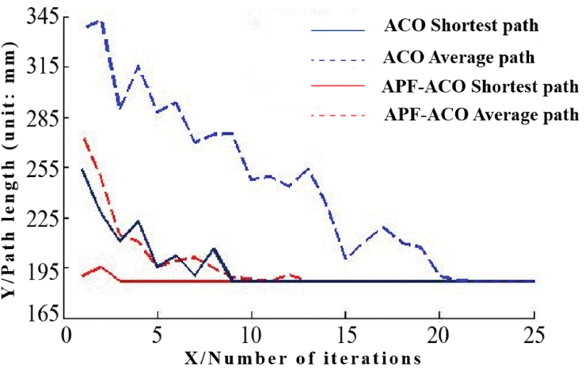

Slide 14
Conclusion
The improved artificial potential field method is better than the traditional algorithm.
It can effectively solve the ubiquitous target unreachable and local minimum.

