Slide 1
Palindromic trees for a sliding window and its applications
Takuya Mieno, Kiichi Watanabe, Yuto Nakashima, Shunsuke Inenaga, Hideo Bannai, Masayuki Takeda
Information Processing Letters, Volume 173, January 2022
Presenter: Shih-Hong Li
Date: Sept. 5, 2023

Slide 2
Abstract (1/2)
The palindromic tree (a.k.a. eertree) for a string S of length n is a tree-like data structure that represents the set of all distinct palindromic substrings of S, using O(n) space [Rubinchik and Shur, 2018]. It is known that, when S is over an alphabet of size σ and is given in an online manner, then the palindromic tree of S can be constructed in O(n log σ) time with O(n) space. In this paper, we consider the sliding window version of the problem: For a sliding window of length at most d, we present two versions of an algorithm which maintains the palindromic tree of size O(d) for every sliding window S[i.. j] over S, where 1 ≤ j − i + 1 ≤ d

Slide 3
Abstract (2/2)
The first version works in O(n log σ ) time with O(d) space where σ ≤ d is the maximum number of distinct characters in the windows, and the second one works in O(n + dσ) time with (d + 2)σ + O(d) space. We also show how our algorithms can be applied to efficient computation of minimal unique palindromic substrings (MUPS) and minimal absent palindromic words (MAPW) for a sliding window.

Slide 4
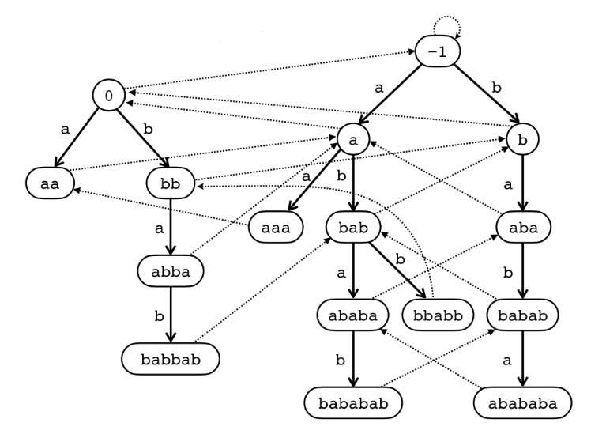
Palindromic tree(Eertree)
S=aaababababbabb
Solid Line = Edges
Dashed Line = Suffix Link
Notes:
當(u,v)有edge相連時代表 len(u) + 2 = len(v)

Slide 5
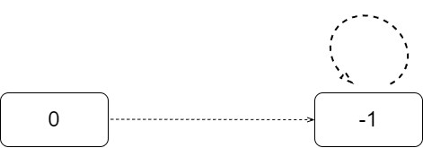
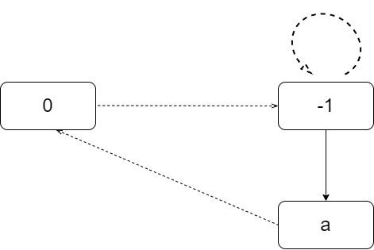
Build Eertree
Initial
Insert "a" in S=aaababababbabb

Slide 6
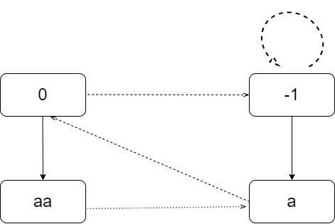
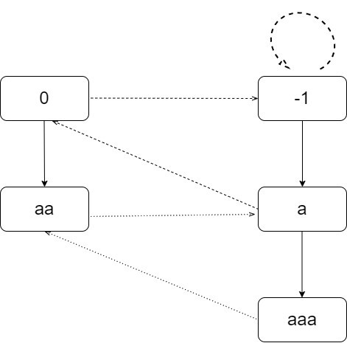
Build Eertree
Insert "a" in S=aaababababbabb​
​
Insert "a" in S=aaababababbabb​
​

Slide 7
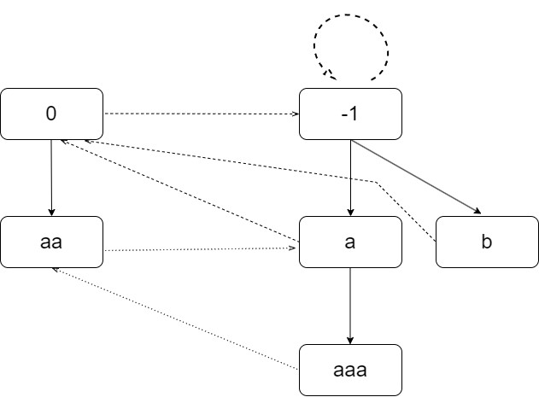
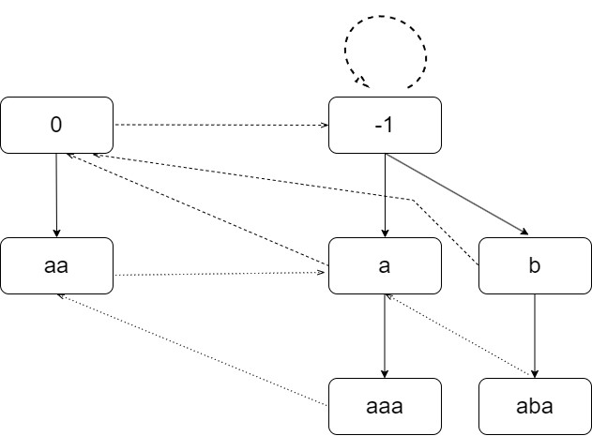
Build Eertree
Insert "b" in S=aaababababbabb​
​
Insert "a" in S=aaababababbabb​
​

Slide 8
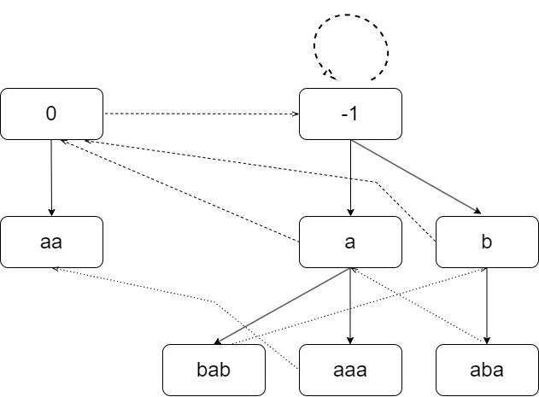
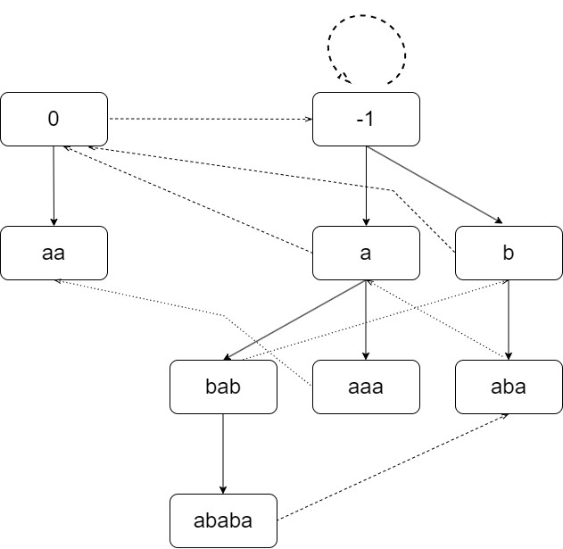
Build Eertree
Insert "b" in S=aaababababbabb​
​
Insert "a" in S=aaababababbabb​
​

Slide 9
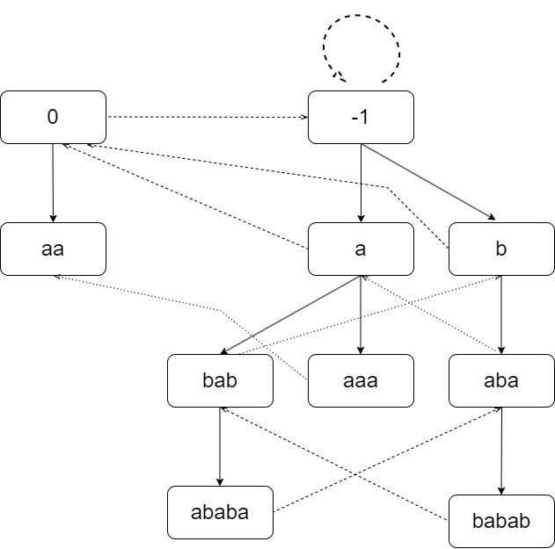
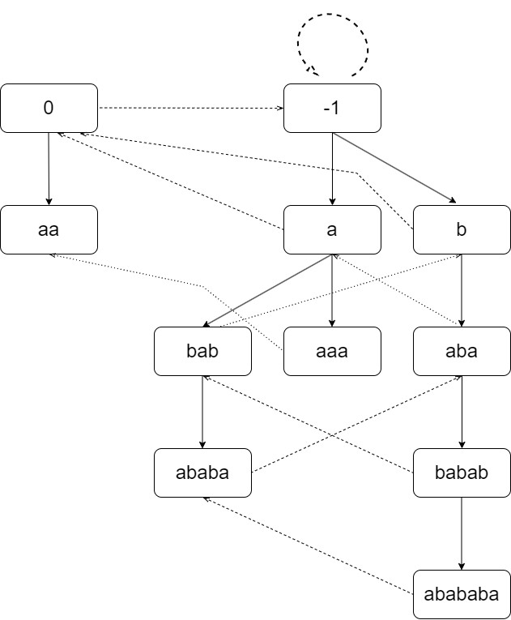
Build Eertree
Insert "b" in S=aaababababbabb​
​
Insert "a" in S=aaababababbabb​
​

Slide 10
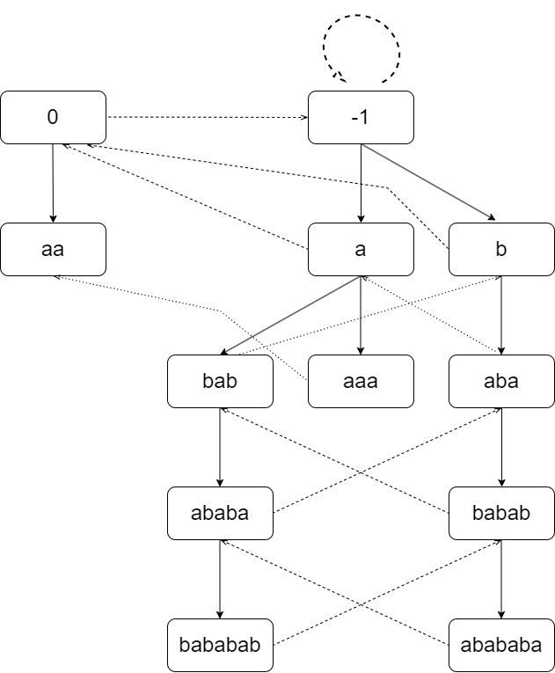
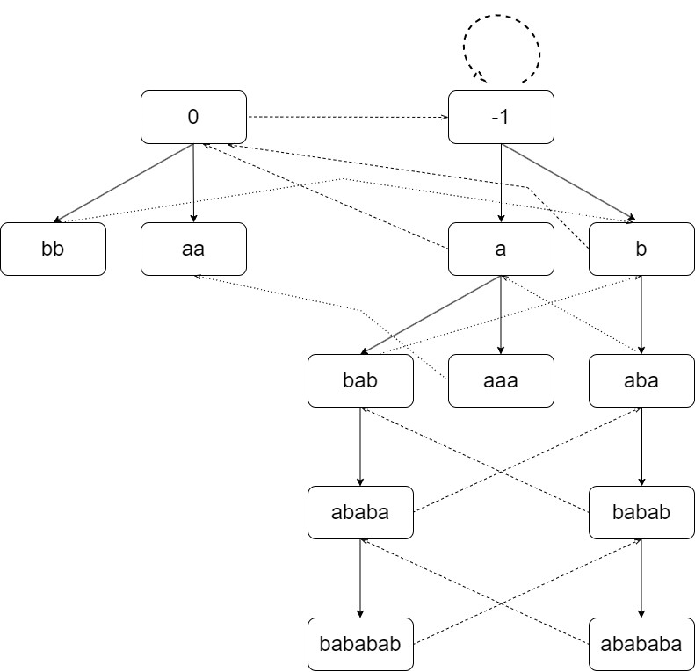
Build Eertree
Insert "b" in S=aaababababbabb​
​
Insert "b" in S=aaababababbabb​
​

Slide 11
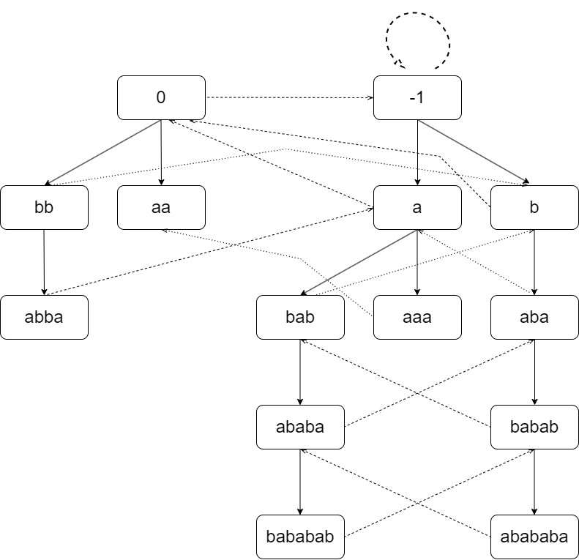
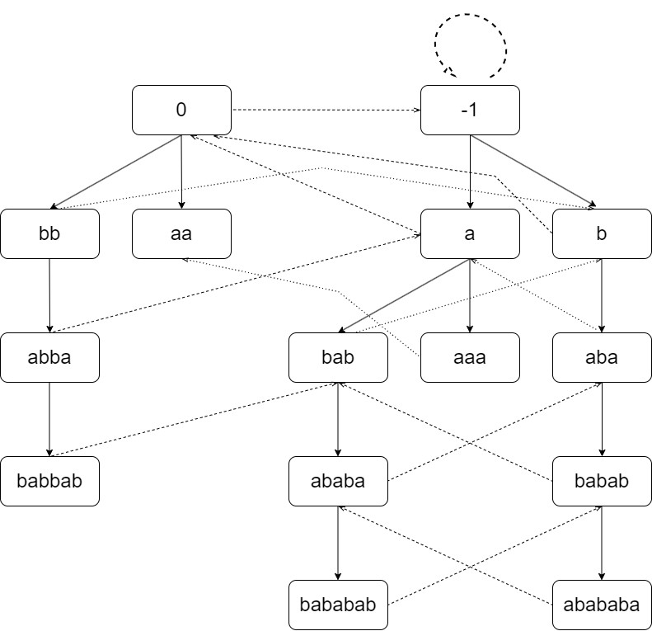
Build Eertree
Insert "a" in S=aaababababbabb​
​
Insert "b" in S=aaababababbabb​
​

Slide 12
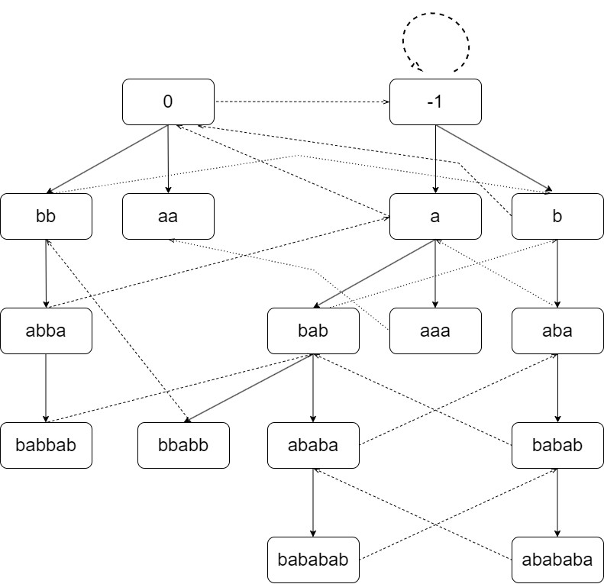
Build Eertree
Insert "b" in S=aaababababbabb​
​
Time complexity: O(n log σ)
Space: O(n)
n=len(S)
σ=general ordered alphabet

Slide 13
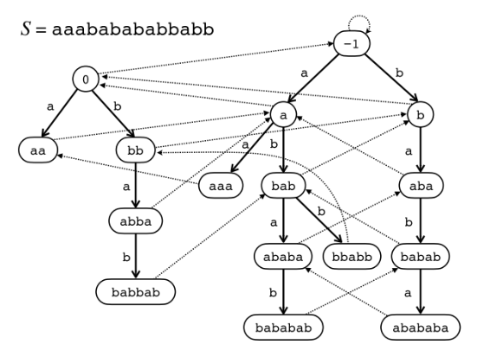
Auxiliary data structures for detecting the node to be deleted
prefPal[0..d-1]:a cyclic array of size d such that prefPal[i_{t} mod d] stores the node which corresponds to the longest palindromic prefix of the window S[i_{t}.. j_{t}] at each time t.
e.g.
prefPal[13]="aaa"

Slide 14
Combinatorial properties on palindromes for a sliding window
A node p in eertree(S[i − 1.. j − 1]) to be removed when the leftmost character S[i − 1] is deleted from S[i−1.. j−1] if only if
1.pal(p) is unique in S[i−1.. j−1]
2.pal(p) = lpp(S[i −1.. j−1])
3.p is a leaf node
Notes:
pal()該節點的最長回文子序列
lpp() longest palidrome prefix 最長回文前墜

Slide 15
Determining uniqueness of a palindrome
rm_{i,j}(v) = the starting position of the rightmost occurrence of pal(v) in S[i.. j]
srm_{i,j}(v) = the starting position of the second rightmost occurrence of pal(v) in S[i.. j] if such a position exists, and otherwise, srm_{i,j}(v) = −1.
BegPair_{i,j}(v) = if inSL(v) = 0:
BegPair_{i,j}(v).first = rm_{i,j}(v)
BegPair_{i,j}(v).second = srm_{i,j}(v)
Else: -1

Slide 16
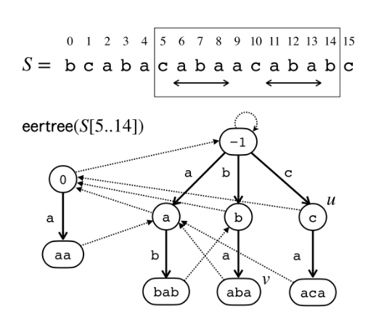
Example for Begpair_{i,j}
rm_{5,14}(u)=10 , srm_{5,14}(u)=5
BegPair_{5,14}(u)=(10,5)
rm_{5,14}(v)=11 , srm_{5,14}(v)=6
BegPair_{5,14}(v)=(11,6)

Slide 17
Eertree for a sliding window
Step1: given the eertree of S[i−1.. j−1] ,compute the eertree of S[i.. j − 1] (deleting the leftmost character)
Step2:compute the eertree of S[i.. j] (appending a character).

Slide 18
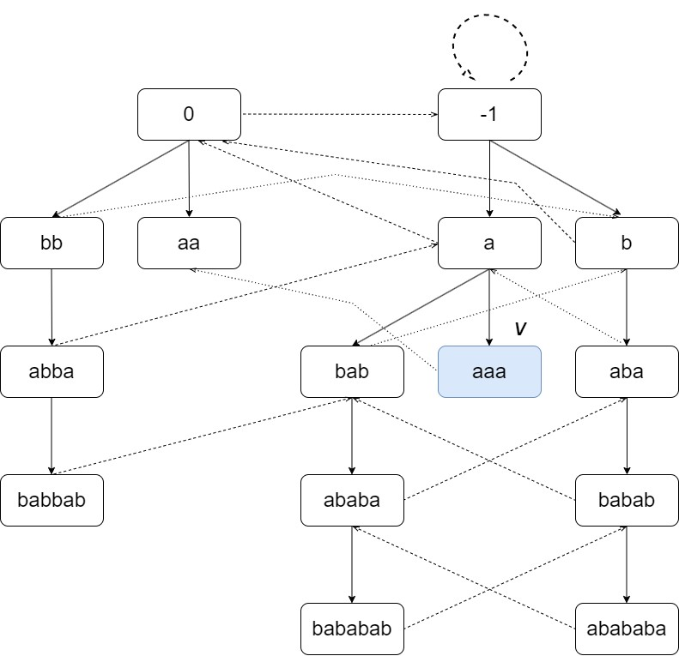
Eertree for a sliding window: step1(delete S[0])
0 | 1 | 2 | 3 | 4 | 5 | 6 | 7 | 8 | 9
a | a | a | b | a | b | a | b | a | b
10 | 11 | 12 | 13
b | a | b | b
Window=12,prePal[12] = "aaa"
Delete node(v):
prePal[12]=pal(v)="aaa"
begpair_{0,12}(v)=(0,-1)
begpair_{0,12}(v).second=-1<i-1
InSL(v)=0
Update begpair()

Slide 19
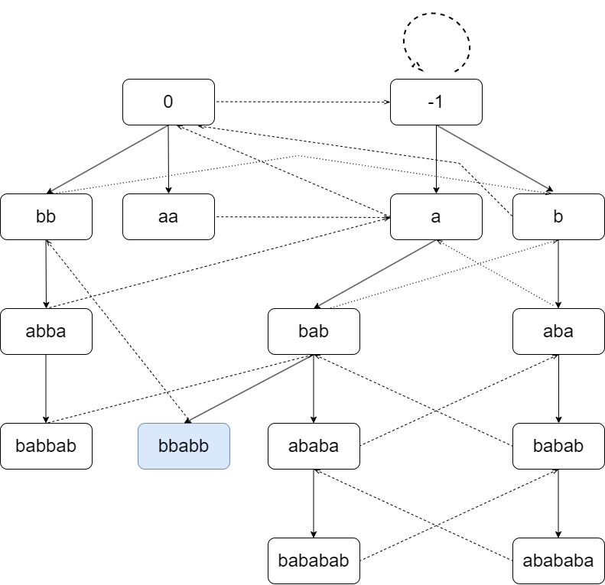
Eertree for a sliding window: step2(append S[13])
0 | 1 | 2 | 3 | 4 | 5 | 6 | 7 | 8 | 9
a | a | a | b | a | b | a | b | a | b
10 | 11 | 12 | 13
b | a | b | b
Window=12,prePal[12] = "aa"
Add "b" in eertree
Update begpair()

Slide 20
Eertree for a sliding window
Time complexity : O(nlog σ')
deleting the leftmost character = O(log σ')
appending a character = O(log σ')
Update begpair = O(1)
Space : O(d')+d where d'≤d is the maximum number of distinct palindromes in all windows

Slide 21
Applications of eertrees for a sliding window
Minimal unique palindromic substrings for a sliding window(MUPS):
a node v in eertree(S) ,such that pal(v) = w, pal(v) is unique in S and pal(u) is repeating in S, where u is the parent of v
e.g. :
S=aaababababbabb
S[9..13]=bbabb is unique(pal(v).begpair.srm=-1) and S[10..12]=bab is repeating in S
Time complexity = O(n log σ')
Space = O(d)
Notes:
MUPS= 最小唯一迴文子字串。

Slide 22
Applications of eertrees for a sliding window
Minimal absent palindromic words for a sliding window(MAPW):
w is a palindrome, w does not occur in S and w[1..|w|−2] occurs in S
e.g. :
S = aaababababbabb
w = aabbaa,w[1..|w|-2]=abba occurs in S at position 8
Time complexity = O(n + dσ)
Space = O(dσ)

Slide 23
Thanks

