Slide 1
A fast algorithm for order-preserving pattern matching
Sukhyeun Cho, Joong Chae Na, Kunsoo Park, Jeong Seop Sim,
Information Processing Letters (2015), pp. 397-402
Presenter: Wen-Wen Liao
Date: Sept. 12, 2023
Notes:
特拉維夫市以色列

Slide 2
Abstract
Given a text T and a pattern P, the order-preserving pattern matching (OPPM) problem is to find all substrings in T which have the same relative orders as P. The OPPM has been studied in the fields of finding some patterns affected by relative orders, not by their absolute values. In this paper, we present a method of deciding the order-isomorphism between two strings even when there are same characters. Then, we show that the bad character rule of the Horspool algorithm for generic pattern matching problems can be applied to the OPPM problem and we present a space-efficient algorithm for computing shift tables for text search. Finally, we combine our bad character rule with the KMP-based algorithm to improve the worst-case running time. We give experimental results to show that our algorithm is about 2 to 6 times faster than the KMP-based algorithm in reasonable cases.

Slide 3
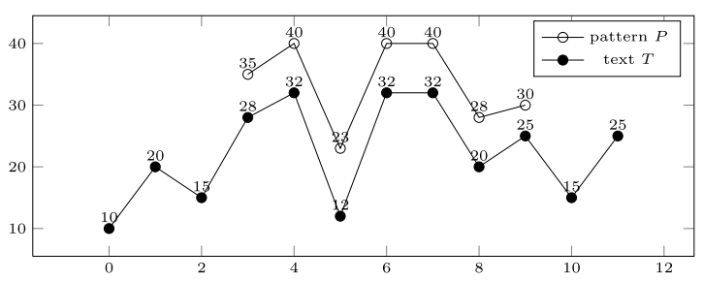
Order preserving pattern matching
P = (35, 40, 23, 40, 40, 28, 30)
T = (10, 20, 15, 28, 32, 12, 32, 32, 20, 25, 15, 25)
T’ = (28, 32, 12, 32, 32, 20, 25)

Slide 4
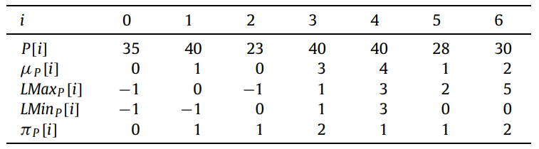


Order preserving pattern matching
$μ_{P}[i]$: prefix table, 比P[i]小的數量
${LMax}_{P}[i]$:Predecessor (prefix裡比不比P[i]大中最大的)
${LMin}_{P}[i]$:Sucessor (prefix裡比不比P[i]小中最小的)
$π_{P}[i]$: failure function
$x≈y$
$x\left[i\right]≤x\left[j\right]⇔y\left[i\right]≤y\left[j\right]$
$μ_{x}=μ_{y}$

Slide 5




Horspool algorithm
P = cbcac
T = abcbcsdfibaccbcac
pattern後移位數 = 沒有匹配的pattern位置 - 沒有匹配的pattern上一次出現的位置
shift table
a | b | c | else
1 | 3 | 2 | 5
a | b | c | b | c | s | d | f | i | b | a | c | c | b | c | a | a
c | b | c | a | c
 |  | c | b | c | a | c
 |  |  |  |  |  |  | c | b | c | a | c
 |  |  |  |  |  |  |  | c | b | c | a | c
 |  |  |  |  |  |  |  |  | c | b | c | a | c
 |  |  |  |  |  |  |  |  |  |  |  | c | b | c | a | c

Slide 6
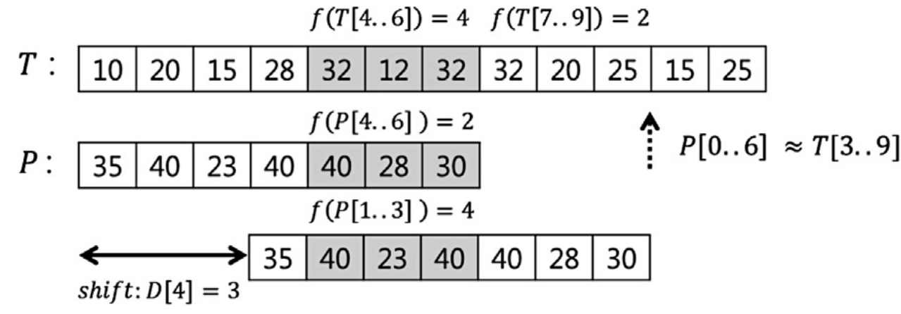
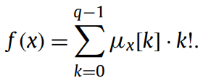

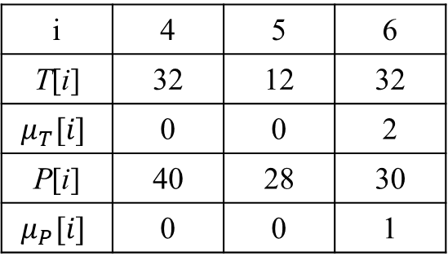

q-grams
i | 4 | 5 | 6
T[i] | 32 | 12 | 32
$$μ_{T}[i]$$ | 0 | 0 | 2
P[i] | 40 | 28 | 30
$$μ_{P}[i]$$ | 0 | 0 | 1
P = (35, 40, 23, 40, 40, 28, 30)
T = (10, 20, 15, 28, 32, 12, 32, 32, 20, 25, 15, 25)
Ex. 3-grams
fingerprint
f(T[4..6]) = 0*0! + 0*1! + 2*2! = 4
f(P[4..6]) = 0*0! + 0*1! + 1*2! = 2

Slide 7

q-grams
P = (35, 40, 23, 40, 40, 28, 30)
T = (10, 20, 15, 28, 32, 12, 32, 32, 20, 25, 15, 25)
Ex. 3-grams
shift
$$D\left[f(x)\right]=min⁡(m−q+1, m−{Lmax}_{p})$$
$D[f\left(T[4..6\right])]=D[4]=min(7−3+1, 7−4)=3$

Slide 8
Time complexity
Preprocessing
Location tables
O(mlogm)
Prefix table
O(mqlogq)
Shift table
O(q! + mqlogq)
Compare
O(nm+nqlogq)
Sum
O(nm+nq+q!)

Slide 9
Improving the worst-case complexity
Combined with KMP algorithm
Time complexity
Preprocessing
O(q! + mqlogq + mlogm)
Horspool algorithm
O(nqlogq)
KMP algorithm
O(n + mlogm)
Sum
O((m + n) q + q!)

Slide 10
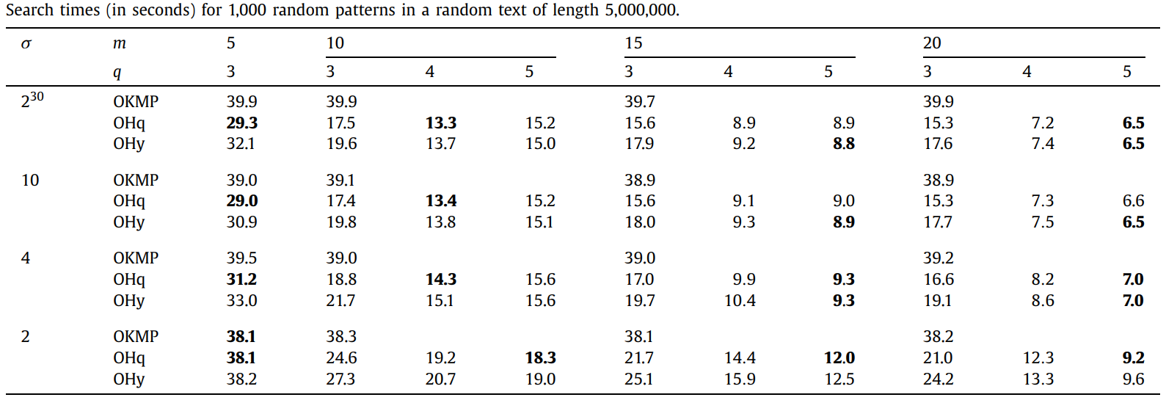
Experimental result

