Slide 1
Stock Prediction Based on Genetic Algorithm Feature Selection and Long Short-Term Memory Neural Network
SHILE CHEN(陳詩樂), CHANGJUN ZHOU(周昌軍)
IEEE Access, Volume 9, 24 December 2020, Page : 9066 - 9072
Presenter : Jing-Xiang.Yang
Data : SEP.8,2023

Slide 2
ABSTRACT(1/2)
In the financial market, there are a large number of indicators used to describe the change of stock price, which provides a good data basis for our stock price forecast. Different stocks are affected by different factors due to their different industry types and regions. Therefore, it is very important to find a multi factor combination suitable for a particular stock to predict the price of the stock. This paper proposes to use Genetic Algorithm(GA) for feature selection and develop an optimized Long Short-Term Memory(LSTM) neural network stock prediction model.

Slide 3
ABSTRACT(2/2)
Firstly, we use the GA to obtain a factors importance ranking. Then, the optimal combination of factors is obtained from this ranking with the method of trial and error. Finally, we use the combination of optimal factors and LSTM model for stock prediction. Thorough empirical studies based upon the China construction bank dataset and the CSI 300 stock dataset demonstrate that the GA-LSTM model can outperform all baseline models for time series prediction.

Slide 4
Paper Proposed Method
DataSet
China construction bank ( 2490 pieces of historical data )
CSI 300(滬深300) (January 1, 2010 to April 1, 2020)
Use 40 stock factor as feature candidate

Slide 5
Paper Proposed Method
WorkFlow
Stage1
Stage2
top 40, 30, 20, 10 and 5 factors were taken as input features of the LSTM model
Use GA to sort importance of factor
Optimal factor combination is determined !

Slide 6
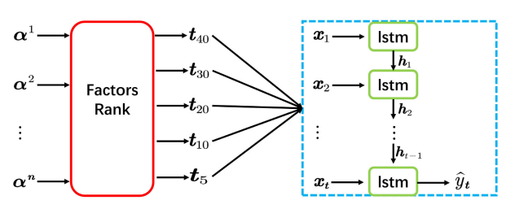
Stock Factor
Predict Output

Slide 7
GA Procedure
Initial Population
Fitness Compulation
Selection
Crossover & Mutation
N
Terminate
Y
Optimal Population

Slide 8
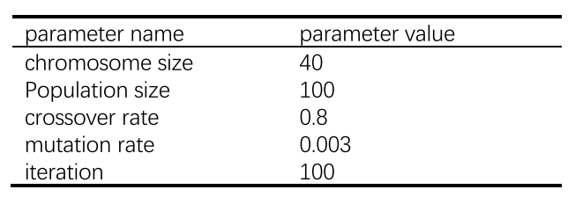
Parameters of GA

Slide 9
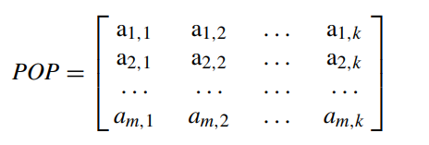
m : 100
k : 40
Chromosome

Slide 10
Each gene represents different stock-related factors
Gene is represented as binary form (0/1)
OSC MASS UDL DKK EMA MACD SMA OBV DIF1 …… AMO
0 1 1 0 1 0 1 0 0 1
chromosome

Slide 11
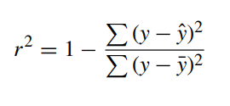
Fitness Function
Determination coefficient
y : label value
ȳ : average value
ŷ : predicted value
Range of r2 is [0, 1]

Slide 12
Selection
Taking roulette method
Multi-point intersection (80% crossover between each chromosome)
Crossover
Mutation
Every gene is altered with a small probability(0.003)

Slide 13
After 100 iterations
Caculate the frequency of each factor in the population
Obtain a factors importance ranking
OSC MASS UDL DKK
0 1 1 0
0 1 0 1
0 1 1 0
R4 R1 R2 R3

Slide 14
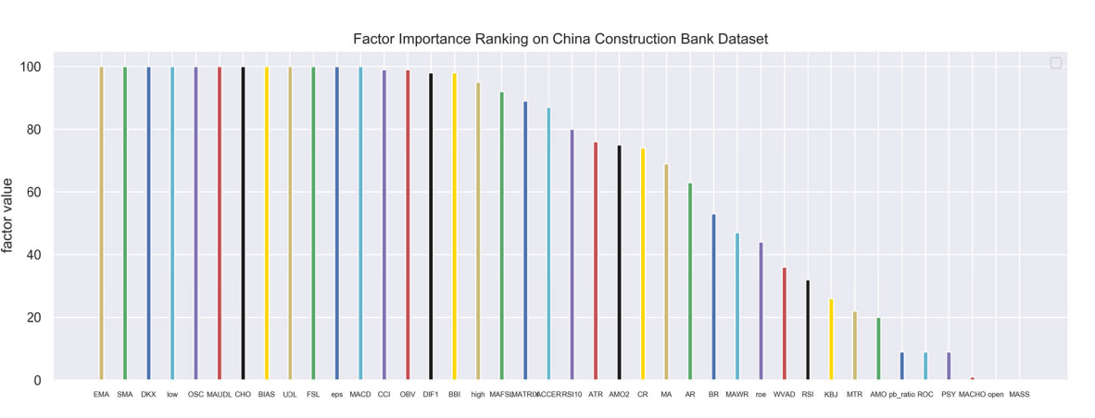

Slide 15
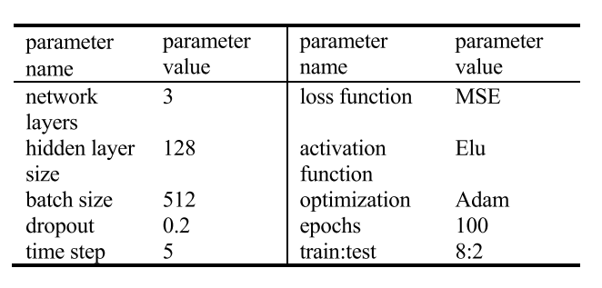
Parameters of LSTM

Slide 16
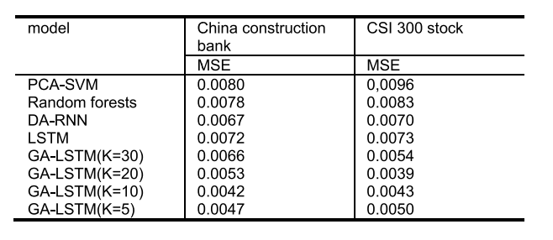
The LSTM network time step is set to 5
Trial and error to obtain optimal combination of factors
(K5, K10, K20, K30)

Slide 17
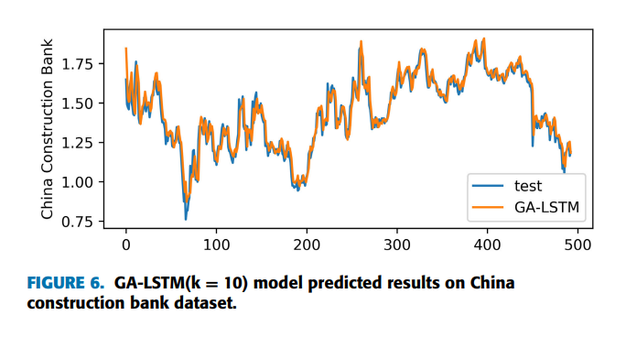
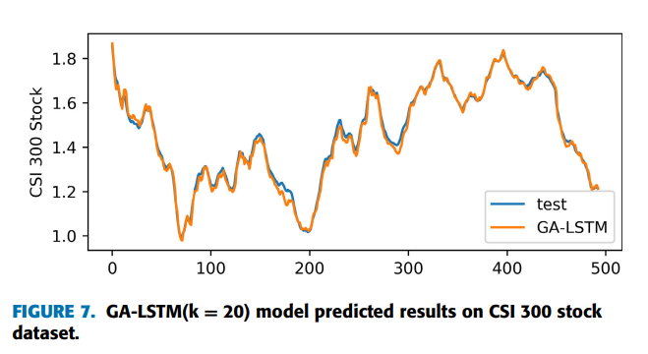

Slide 18
Thanks

