Slide 1
Longest Increasing Subsequence Computation over Streaming Sequences
Youhuan Li, Lei Zou, Huaming Zhang, and Dongyan Zhao
IEEE Transactions on Knowledge and Data Engineering,
vol. 30, no. 6, June 2018
Presenter: Zhi-Cheng Shen
Date: Sept. 12, 2023

Slide 2
Abstract
In this paper, we propose a data structure, a quadruple neighbor list (QN-list, for short), to support real time queries of all longest increasing subsequence (LIS) and LIS with constraints over sequential data streams. The QN-List built by our algorithm requires O(w) space, where w is the time window size. The running time for building the initial QN-List takes O(wlogw) time. Applying the QN-List, insertion of the new item takes O(logw) time and deletion of the first item takes O(w) time. To the best of our knowledge, this is the first work to support both LIS enumeration and LIS with constraints computation by using a single uniform data structure for real time sequential data streams. Our method outperforms the state-of-the-art methods in both time and space cost, not only theoretically, but also empirically.

Slide 3
Neighbors
left neighbor ln(a_{i}): ln(a_{i}) = a_{j} if a_{j} is the nearest item before a_{i} such that RL(a_{i}) = RL(a_{j})
right neighbor rn(a_{i}): rn(a_{i}) = a_{j} if a_{j} is the nearest item after a_{i} such that RL(a_{i}) = RL(a_{j})
up neighbor un(a_{i}): un(a_{i}) = a_{j} if a_{j} is the nearest item before a_{i} such that RL(a_{j}) = RL(a_{i}) - 1.
down neighbor dn(a_{i}): dn(a_{i}) = a_{j} if a_{j} is the nearest item before a_{i} such that RL(a_{j}) = RL(a_{i}) + 1.

Slide 4
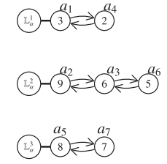
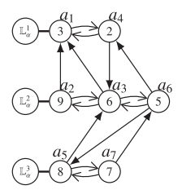
Data Structure
Horizontal lists
QN-List

Slide 5
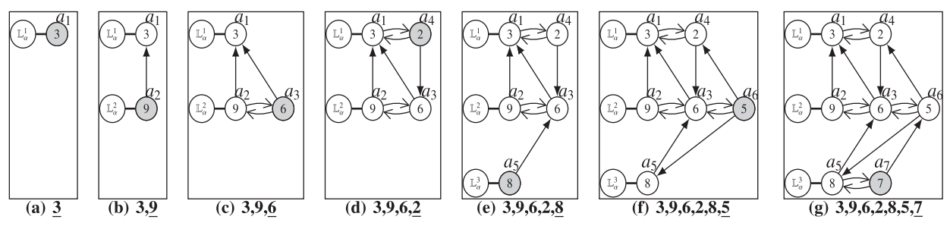
L_{α} Construction

Slide 6

k-Hop Up Neighbor

Slide 7
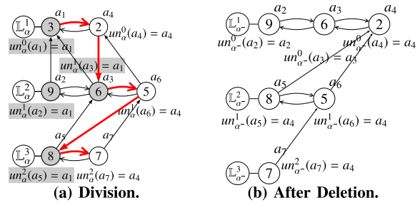
Horizontal Update

Slide 8
Smart Division
If Right(L_{α}^{t}) = NULL => all below lists are set to be the left part.
If Right(L_{α}^{t}) != NULL and HEAD(Right(L_{α}^{t}) ) is a_{k}:
if dn(a_{k}) does not exist => L_{α}^{t+1} is empty at the time when a_{k} is inserted into L_{α}^{t} => the t-hop up neighbor of each item in L_{α}^{t+1} cannot be a₁
if dn(a_{k}) exists => dn(a_{k}) and items at its left side come before a_{k} and their up neighbors can only be at the left side of a_{k} => the t-hop up neighbor of dn(a_{k}) or items on the left of dn(a_{k}) must be a₁

Slide 9
Vertical Update
when we promote Left(L_{α}^{t} )to the above level, we need to change their up neighbors but not down neighbors.
While, Right(L_{α}^{t} ) is still in the same level after the horizontal update. We need to change their down neighbors but not up neighbors.

Slide 10
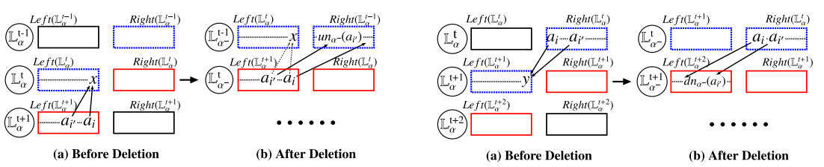

Slide 11
Find a_{i’}
If dn(x) != NULL, then a_{i’} is exactly rn(dn(x)); otherwise, a_{i’} is HEAD(L_{α}^{RL(ai)})

Slide 12
Left:
finding the rightmost item whose position is before a_{i’} in sequence a₋.
Right:
finding the rightmost item whose position is before a_{i’} in sequence a₋.

Slide 13
Time complexity
Construction QN list: O(wlogw)
Insert: O(logw)
Delete: O(w)

