Slide 1
A dynamic programming solution to a generalized LCS problem
Lei Wang, Xiaodong Wang, Yingjie Wu, Daxin Zhu
Information Processing Letters 113 (2013) 723–728
Presenter: Wen-Yu Chang
Date: Sept. 19, 2023

Slide 2
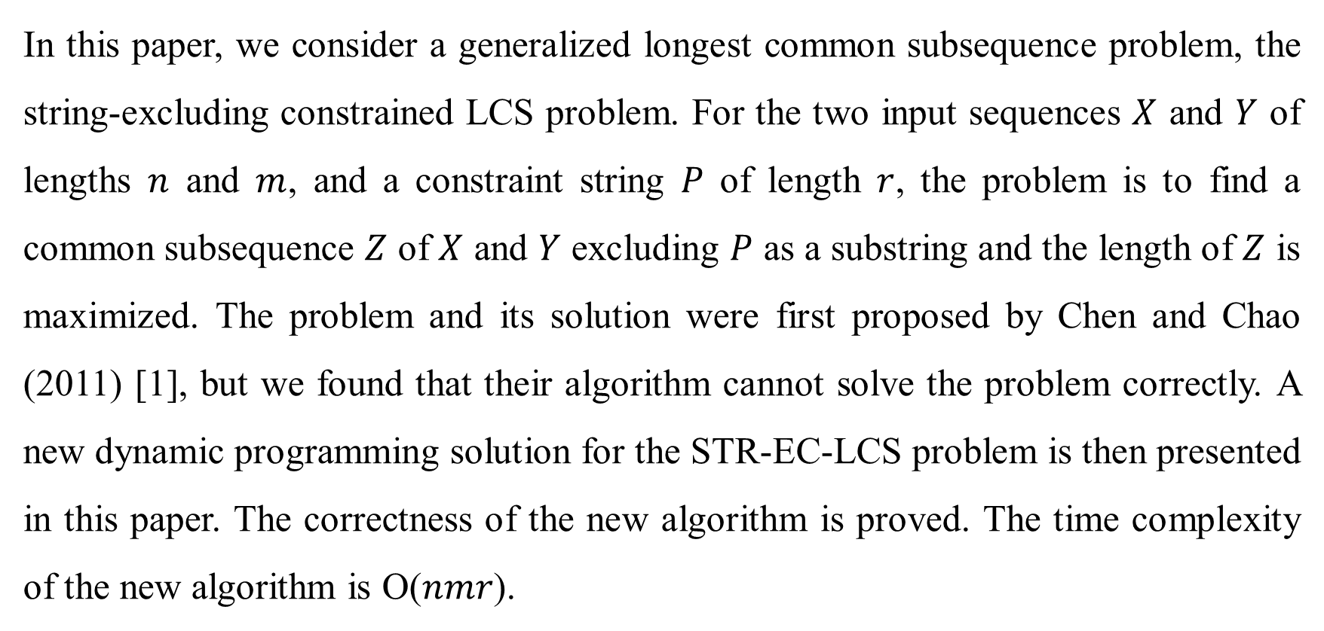
Abstract
In this paper, we consider a generalized longest common subsequence problem, the string-excluding constrained LCS problem. For the two input sequences $X$ and $Y$ of lengths $n$ and $m$, and a constraint string $P$ of length $r$, the problem is to find a common subsequence $Z$ of $X$ and $Y$ excluding $P$ as a substring and the length of $Z$ is maximized. The problem and its solution were first proposed by Chen and Chao (2011) [1], but we found that their algorithm cannot solve the problem correctly. A new dynamic programming solution for the STR-EC-LCS problem is then presented in this paper. The correctness of the new algorithm is proved. The time complexity of the new algorithm is O($nmr$).

Slide 3

String-Exclusion-LCS(STR-EC-LCS)
$X=$ abababa
$Y=$aabab
$P=$ aa
LCS($X, Y$) = aabab
STR-EC-LCS($X, Y, P$) = abab

Slide 4
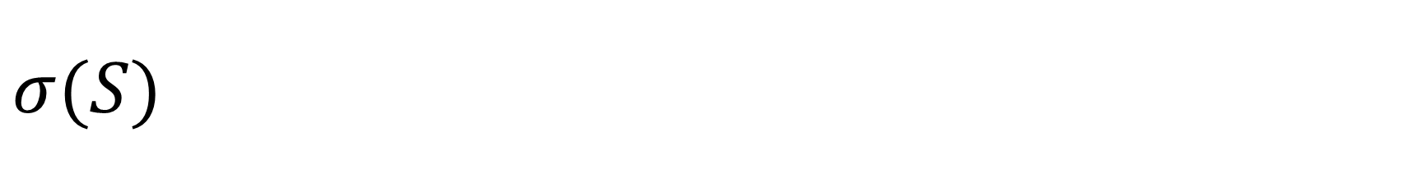

$$σ(S)$$
The length of the longest suffix of S that is also a prefix of P.
$S=$ aabaaab
$P=$ aaba
$σ\left(S\right)=3$

Slide 5

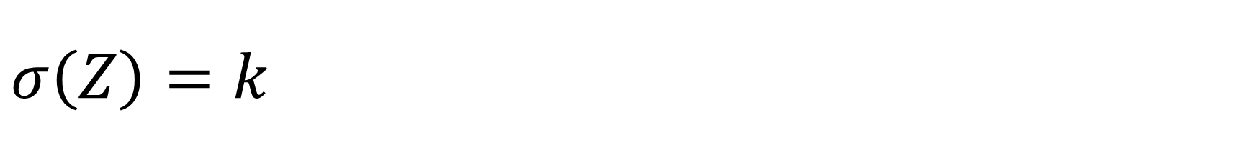

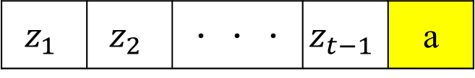
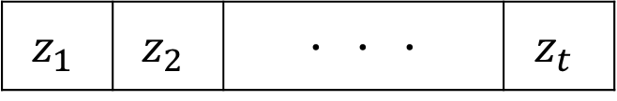



$$σ\left(Z\right)=k$$
$k=$ 0
$k=$ 1
$$Z$$
$$z_{1}$$ | $$z_{2}$$ | ．．． | $$z_{t}$$
$$P$$
a | a
$$Z$$
$$z_{1}$$ | $$z_{2}$$ | ．．． | $$z_{t−1}$$ | a
$$P$$
a | a

Slide 6

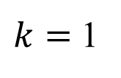
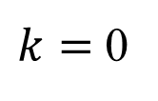
The Algorithm
$k=$ 0
$k=$ 1
$x_{i}=y_{j}$
 |  | a | a | b | a | b
 | 0 | 0 | 0 | 0 | 0 | 0
a | 0
b | 0
a | 0
b | 0
a | 0
b | 0
a | 0
 |  | a | a | b | a | b
 | 0 | 0 | 0 | 0 | 0 | 0
a | 0
b | 0
a | 0
b | 0
a | 0
b | 0
a | 0
…
a | a
… | a
a | a

Slide 7



The Algorithm
$k=$ 0
$k=$ 1
$x_{i}=y_{j}$
 |  | a | a | b | a | b
 | 0 | 0 | 0 | 0 | 0 | 0
a | 0 | 0
b | 0
a | 0
b | 0
a | 0
b | 0
a | 0
 |  | a | a | b | a | b
 | 0 | 0 | 0 | 0 | 0 | 0
a | 0 | 1
b | 0
a | 0
b | 0
a | 0
b | 0
a | 0
… | a
$$σ(Z)=1$$
a | a
… | a | a
$$σ(Z)=2≠1$$
a | a
$Z_{k=1}=a$

Slide 8


The Algorithm
$k=$ 0
$k=$ 1
$x_{i}≠y_{j}$
 |  | a | a | b | a | b
 | 0 | 0 | 0 | 0 | 0 | 0
a | 0 | 0 | 0 | 0
b | 0
a | 0
b | 0
a | 0
b | 0
a | 0
 |  | a | a | b | a | b
 | 0 | 0 | 0 | 0 | 0 | 0
a | 0 | 1 | 1 | 1
b | 0
a | 0
b | 0
a | 0
b | 0
a | 0
$Z_{k=1}=a$

Slide 9

The Algorithm
$k=$ 0
$k=$ 1
$x_{i}=y_{j}$
 |  | a | a | b | a | b
 | 0 | 0 | 0 | 0 | 0 | 0
a | 0 | 0 | 0 | 0 | 0 | 0
b | 0 | 0 | 0
a | 0
b | 0
a | 0
b | 0
a | 0
 |  | a | a | b | a | b
 | 0 | 0 | 0 | 0 | 0 | 0
a | 0 | 1 | 1 | 1 | 1 | 1
b | 0 | 1 | 1
a | 0
b | 0
a | 0
b | 0
a | 0
…
a | a
… | a
a | a
$Z_{k=1}=a$

Slide 10




The Algorithm
$k=$ 0
$k=$ 1
$x_{i}=y_{j}$
 |  | a | a | b | a | b
 | 0 | 0 | 0 | 0 | 0 | 0
a | 0 | 0 | 0 | 0 | 0 | 0
b | 0 | 0 | 0 | 2
a | 0
b | 0
a | 0
b | 0
a | 0
 |  | a | a | b | a | b
 | 0 | 0 | 0 | 0 | 0 | 0
a | 0 | 1 | 1 | 1 | 1 | 1
b | 0 | 1 | 1
a | 0
b | 0
a | 0
b | 0
a | 0
… | b
$$σ(Z)=0$$
a | a
… | a | b
$$σ(Z)=0$$
a | a
$Z_{k=0}=ab$
$Z_{k=1}=a$

Slide 11

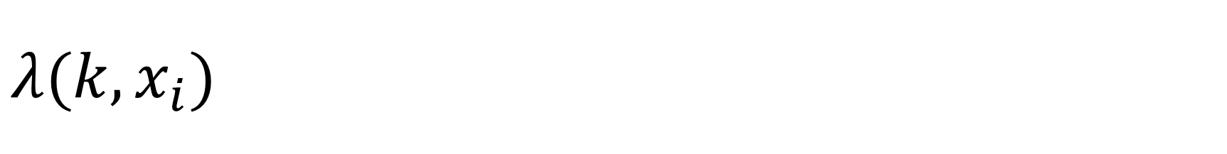




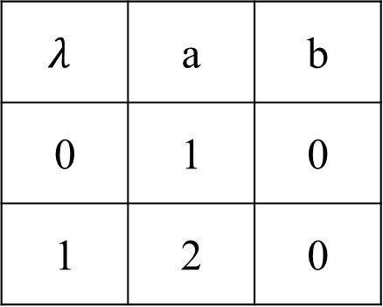

$$λ(k, x_{i})$$
$$x_{i}$$
$$λ$$ | a | b
0 | 1 | 0
1 | 2 | 0
… | a
… | b
$$σ(Z)=1$$
$$σ(Z)=0$$
a | a
a | a
$$k$$
… | a | a
… | a | b
$$σ(Z)=2$$
$$σ(Z)=0$$
a | a
a | a

Slide 12

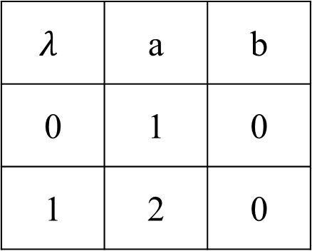
The Modified Algorithm
$k=$ 0
$k=$ 1
 |  | a | a | b | a | b
 | 0 | 0 | 0 | 0 | 0 | 0
a | 0 | 0 | 0 | 0 | 0 | 0
b | 0 | 0 | 0 | 2 | 2 | 2
a | 0 | 0 | 0 | 2 | 2
b | 0
a | 0
b | 0
a | 0
 |  | a | a | b | a | b
 | 0 | 0 | 0 | 0 | 0 | 0
a | 0 | 1 | 1 | 1 | 1 | 1
b | 0 | 1 | 1 | 1 | 1 | 1
a | 0 | 1 | 1 | 1 | 3
b | 0
a | 0
b | 0
a | 0
$$λ$$ | a | b
0 | 1 | 0
1 | 2 | 0
$Z_{k=0}=ab$
$Z_{k=1}=aba$

Slide 13

The Modified Algorithm
$k=$ 0
$k=$ 1
 |  | a | a | b | a | b
 | 0 | 0 | 0 | 0 | 0 | 0
a | 0 | 0 | 0 | 0 | 0 | 0
b | 0 | 0 | 0 | 2 | 2 | 2
a | 0 | 0 | 0 | 2 | 2 | 2
b | 0 | 0 | 0 | 2 | 2 | 4
a | 0
b | 0
a | 0
 |  | a | a | b | a | b
 | 0 | 0 | 0 | 0 | 0 | 0
a | 0 | 1 | 1 | 1 | 1 | 1
b | 0 | 1 | 1 | 1 | 1 | 1
a | 0 | 1 | 1 | 1 | 3 | 3
b | 0 | 1 | 1 | 1 | 3
a | 0
b | 0
a | 0
$$λ$$ | a | b
0 | 1 | 0
1 | 2 | 0
$Z_{k=0}=abab$
$Z_{k=1}=aba$

Slide 14

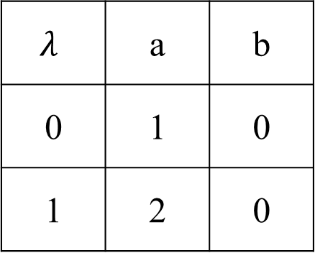
The Modified Algorithm
$k=$ 0
$k=$ 1
 |  | a | a | b | a | b
 | 0 | 0 | 0 | 0 | 0 | 0
a | 0 | 0 | 0 | 0 | 0 | 0
b | 0 | 0 | 0 | 2 | 2 | 2
a | 0 | 0 | 0 | 2 | 2 | 2
b | 0 | 0 | 0 | 2 | 2 | 4
a | 0 | 0 | 0 | 2 | 2 | 4
b | 0 | 0 | 0 | 2 | 2 | 4
a | 0 | 0 | 0 | 2 | 2 | 4
 |  | a | a | b | a | b
 | 0 | 0 | 0 | 0 | 0 | 0
a | 0 | 1 | 1 | 1 | 1 | 1
b | 0 | 1 | 1 | 1 | 1 | 1
a | 0 | 1 | 1 | 1 | 3 | 3
b | 0 | 1 | 1 | 1 | 3 | 3
a | 0 | 1 | 1 | 1 | 3 | 3
b | 0 | 1 | 1 | 1 | 3 | 3
a | 0 | 1 | 1 | 1 | 3 | 3
$$λ$$ | a | b
0 | 1 | 0
1 | 2 | 0
STR-EC-LCS($X, Y, P$) = abab

Slide 15

Time Complexity
O($nmr$)
Preprocessing time: O($r|Σ|$)

