Slide 1
Maze Exploration Algorithm for Small Mobile Platforms
Ł Bienias, K Szczepański, P Duch
Image Processing & Communications, vol. 21, no. 3, pp.15-26
Presenter: Guan-Jie Chen
Date: Sept. 19, 2023

Slide 2
Abstract
An algorithm that enables efficient maze exploration is presented in the paper. The algorithm involves two phases: first the whole maze is explored in an ordered way and then, the shortest possible way out is determined. The algorithm has been derived in a way that combines main advantages of the two known labirynth-exploration algorithms: "Wall follower" and "Trémaux’s algorithm".

Slide 3
Abstract (cont.)
The algorithm has been tested using an autonomous vehicle, controlled by Arduino UNO, with two DC engines, ultrasonic sensors and gyroscope. It has been shown that the proposed approach provides a few crucial advantages with respect to already known solutions.

Slide 4
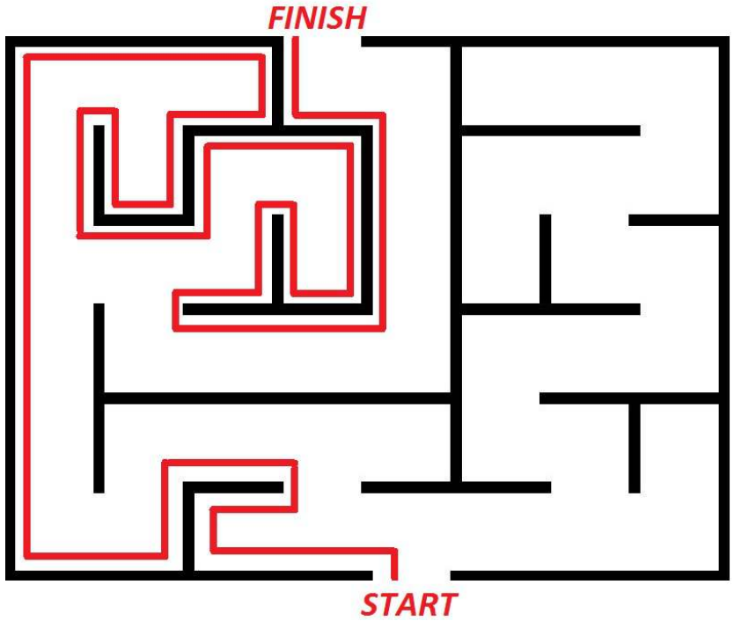
Left / Right Wall Follower

Slide 5
Left / Right Wall Follower (cont.)
The maze is traversed in an ordered way
It does not always guarantee that the way out will be found
 | End
Start

Slide 6
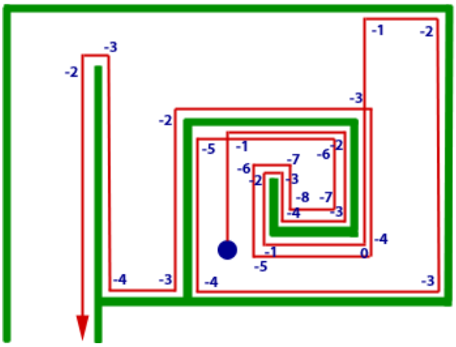
Pledge Algorithm

Slide 7
Pledge Algorithm (cont.)
It is a modified version of "Left Wall Follower" algorithm
It can find a way from any point inside to an outer exit of any finite two-dimensional maze, regardless of the initial position of the solver

Slide 8
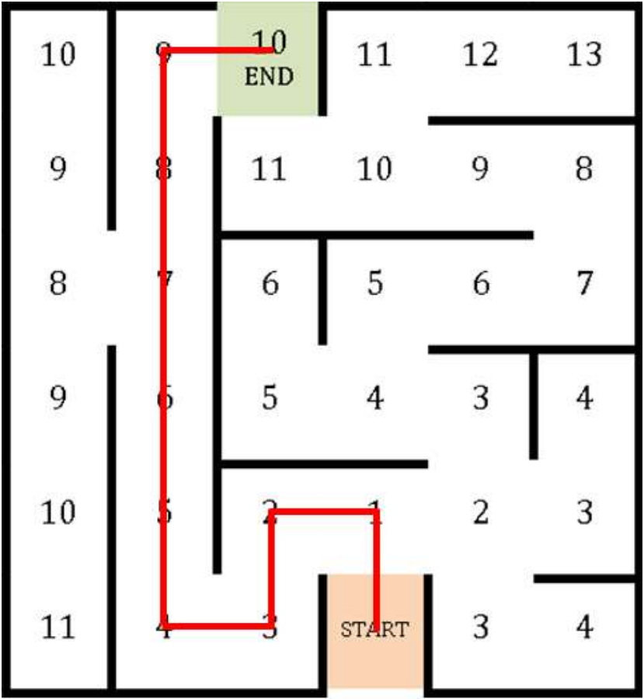
Flood Fill Algorithm

Slide 9
Flood Fill Algorithm (cont.)
It not only finds all possible solutions, but also indicates the best one and ensures exploration of the whole maze
It requires knowledge of the structure of the maze before entering into it

Slide 10
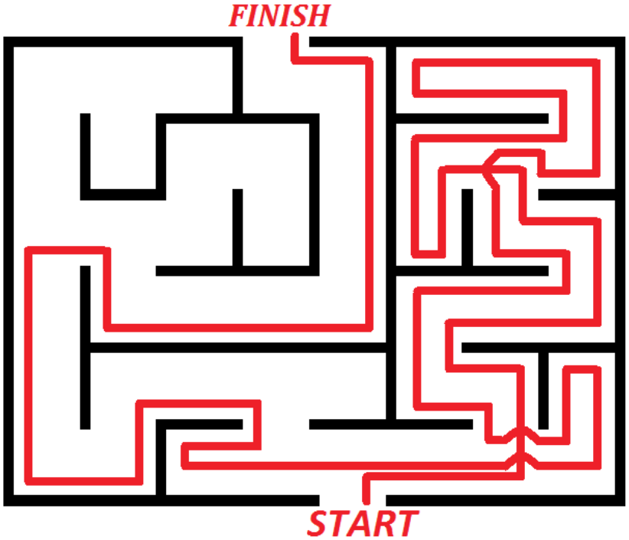
Trémaux’s Algorithm

Slide 11
Trémaux’s Algorithm (cont.)
Three types of passages can be distinguished:
Empty, which means that the passage wasn’t explored yet
Marked once, pointing that the path was visited exactly once
Marked twice, meaning that traveller was going that way and was forced to turn back, which indicates the wrong path

Slide 12
Trémaux’s Algorithm (cont.)
The logic assumes random choice of direction, which should be followed in case of more than one free passage going out of one junction
There is a possibility that not whole maze will be traversed, which in turn may result in missing the shortest paths to the same exit

Slide 13
Proposed Algorithm
Provides a complete maze mapping
Produces information for generation of shortest paths to exit
The proposed algorithm combines "Left Wall Follower" and "Trémaux’s algorithm" to meets two objectives

Slide 14
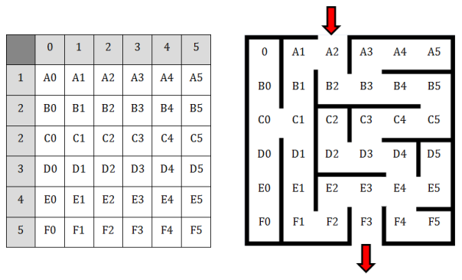
Proposed Algorithm (cont.)

Slide 15
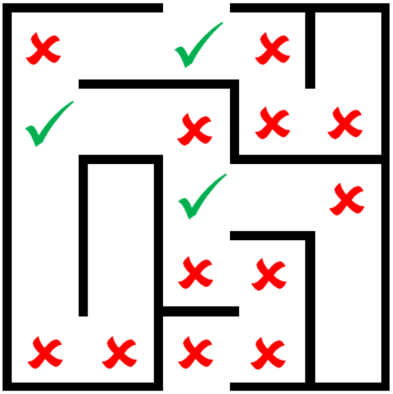
Proposed Algorithm (cont.)
Maze with marked turns, which would be stored on the stack

Slide 16
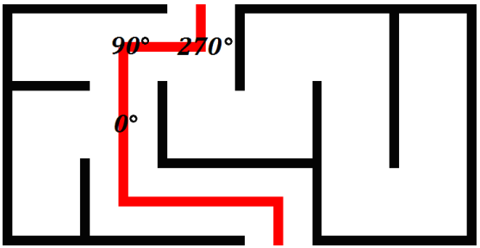
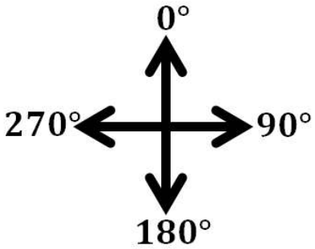
Proposed Algorithm (cont.)

Slide 17
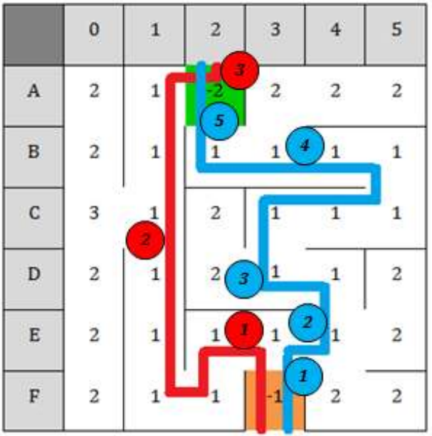
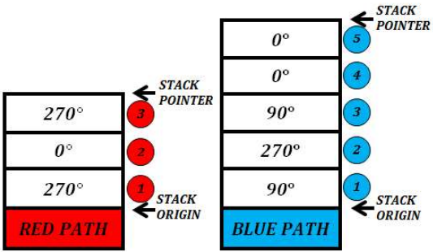
Proposed Algorithm (cont.)

Slide 18
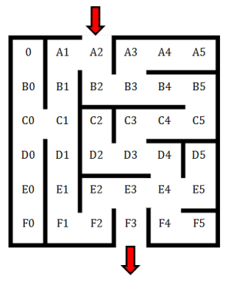
Proposed Algorithm (cont.)
0 | 0 | 0 | 0 | 0 | 0
0 | 0 | 0 | 0 | 0 | 0
0 | 0 | 0 | 0 | 0 | 0
0 | 0 | 0 | 0 | 0 | 0
0 | 0 | 0 | 0 | 0 | 0
0 | 0 | 0 | 0 | 0 | 0

Slide 19
Proposed Algorithm (cont.)
0 | 0 | -1 | 2 | 2 | 2
0 | 0 | 1 | - | 1 | 1
0 | 0 | 0 | 0 | 0 | 0
0 | 0 | 0 | 0 | 0 | 0
0 | 0 | 0 | 0 | 0 | 0
0 | 0 | 0 | 0 | 0 | 0

Slide 20
Proposed Algorithm (cont.)
0 | 0 | -1 | 2 | 2 | 2
0 | 0 | 1 | - | 1 | 1
0 | 0 | 0 | 1 | 1 | 1
0 | 0 | 0 | - | 1 | 2
0 | 0 | 0 | - | - | 2
0 | 0 | 0 | -2 | 2 | 2

Slide 21
Proposed Algorithm (cont.)
2 | 1 | -1 | 2 | 2 | 2
2 | 1 | 1 | - | 1 | 1
- | - | 0 | 1 | 1 | 1
2 | 1 | 0 | - | 1 | 2
2 | 1 | 1 | - | - | 2
2 | 1 | 1 | -2 | 2 | 2

Slide 22
Proposed Algorithm (cont.)
當2D array沒有0: Done
當traverse回到起點
Stack為空: Done
Stack尚有資料: 存在從終點回到起點的路徑
把stack中的資料順序顛倒，再加180◦

Slide 23
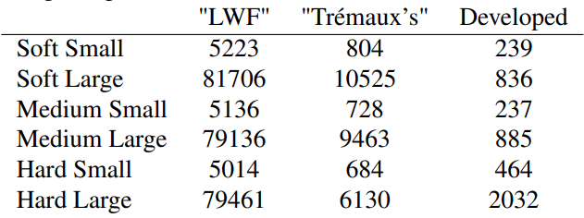
Result
Length of paths

Slide 24
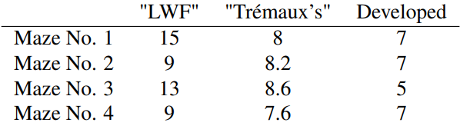
Result (cont.)
Length of paths (average)

Slide 25
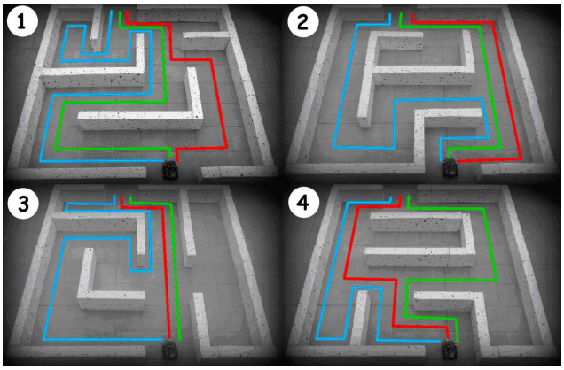
Result (cont.)
——— Left Wall Follower
——— Trémaux’s algorithm
——— Developed algorithm

Slide 26
Thanks for your patience

