Slide 1
Learning to bid in bridge
Asaf Amit and Shaul Markovitch Machine Learning, 63, 287-327, 2006.
Presenter: Yun-An Chen
Date: Sept. 19, 2023

Slide 2
Abstract
Bridge bidding is considered to be one of the most difficult problems for game- playing programs. It involves four agents rather than two, including a cooperative agent. In addition, the partial observability of the game makes it impossible to predict the outcome of each action. In this paper we present a new decision-making algorithm that is capable of overcoming these problems. The algorithm allows models to be used for both opponent agents and partners, while utilizing a novel model-based Monte Carlo sampling method to overcome the problem of hidden information.

Slide 3
Abstract(cont.)
The paper also presents a learning framework that uses the above decision-making algorithm for co-training of partners. The agents refine their selection strategies during training and continuously exchange their refined strategies. The refinement is based on inductive learning applied to examples accumulated for classes of states with conflicting actions. The algorithm was empirically evaluated on a set of bridge deals. The pair of agents that co-trained significantly improved their bidding performance to a level surpassing that of the current state-of-the-art bidding algorithm.

Slide 4
Problems in bridge bidding
Each call can carry one or more of the following meanings:
1. Suggesting an optional contract.
2. Exchanging information between partners.
3. Interfering with opponents.

Slide 5
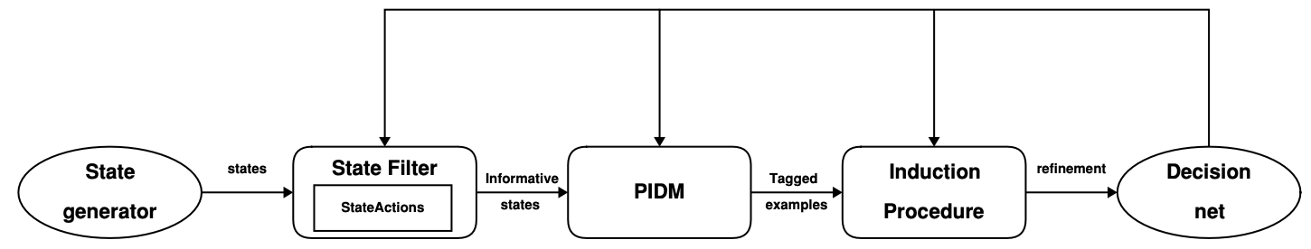
Learning process
Partial Information Decision Making

Slide 6
State of the auction stage
The distribution of cards between the four players (the deal)
The current sequence of calls for the auction
The identity of the dealer
The vulnerability of each of the pairs
The bidding system of both pairs

Slide 7
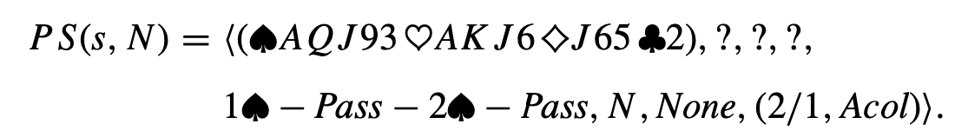
Partial state
the distribution of cards between the four players (the deal)
bidding systems
the current sequence of calls for the auction
dealer
vulnerability

Slide 8
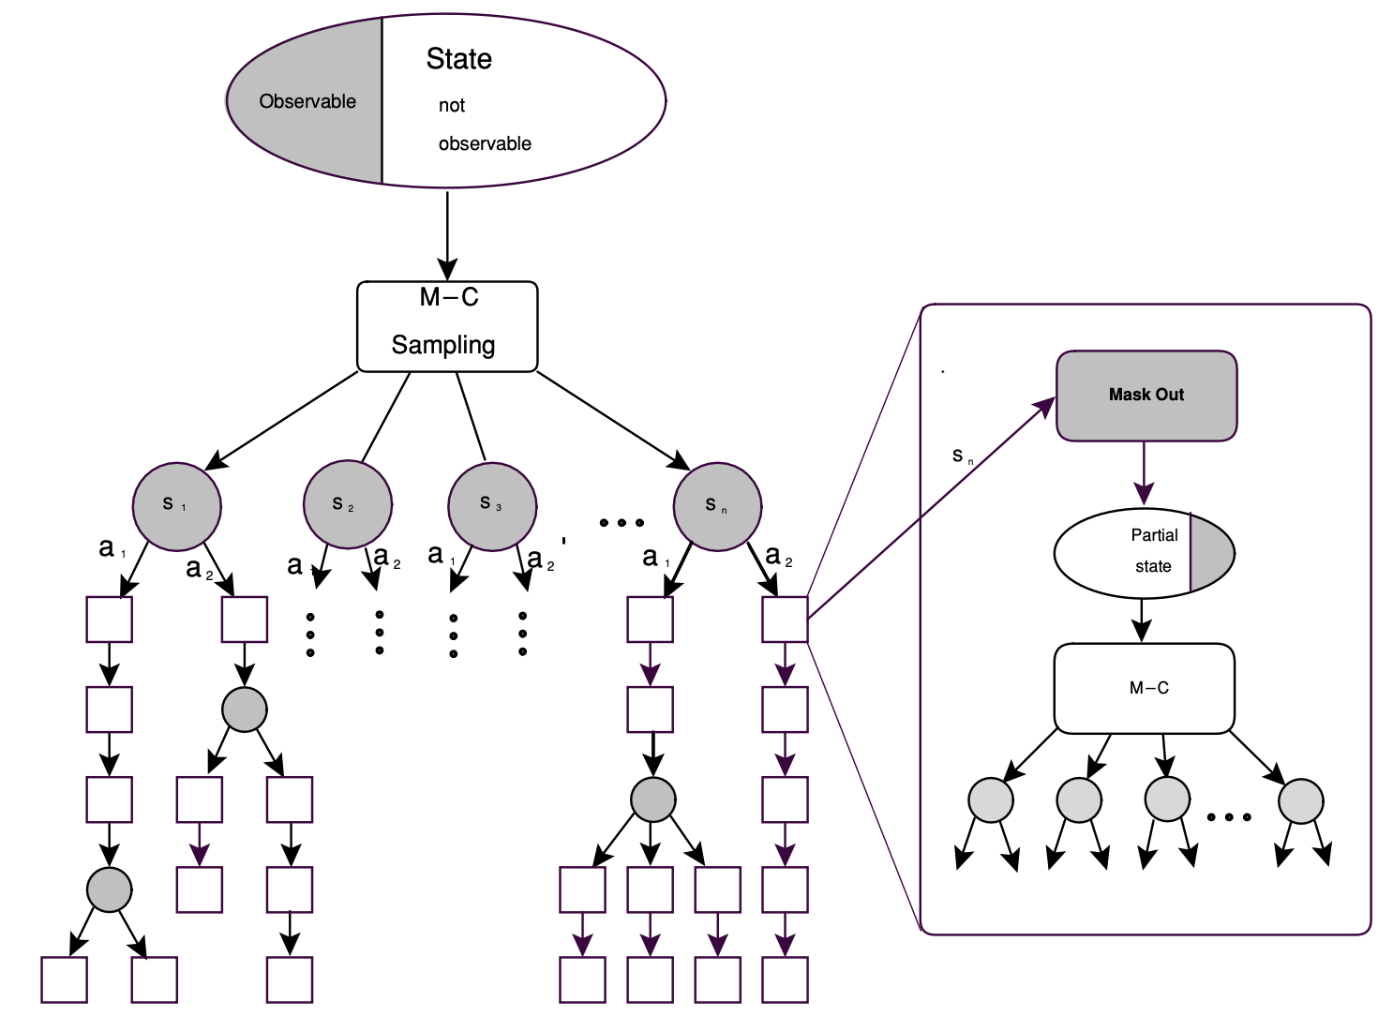
PIDM
If the pair can take 11 tricks with hearts as the trump suit, the function will return +200 for a 2 ♡ contract ,+450 for a 4 ♡ contract, and –50 for a 6 ♡ contract.

Slide 9
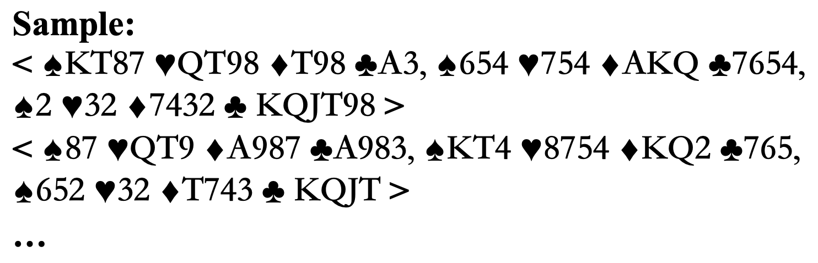
State

Slide 10
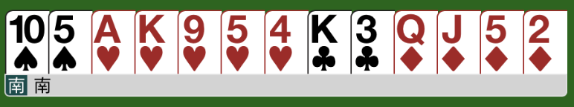
Bidding rule
HCP = 13
SUITLEN_{S} = 2, SUITLEN_{H} = 5, SUITLEN_{D} = 4, SUITLEN_{C} = 2

Slide 11
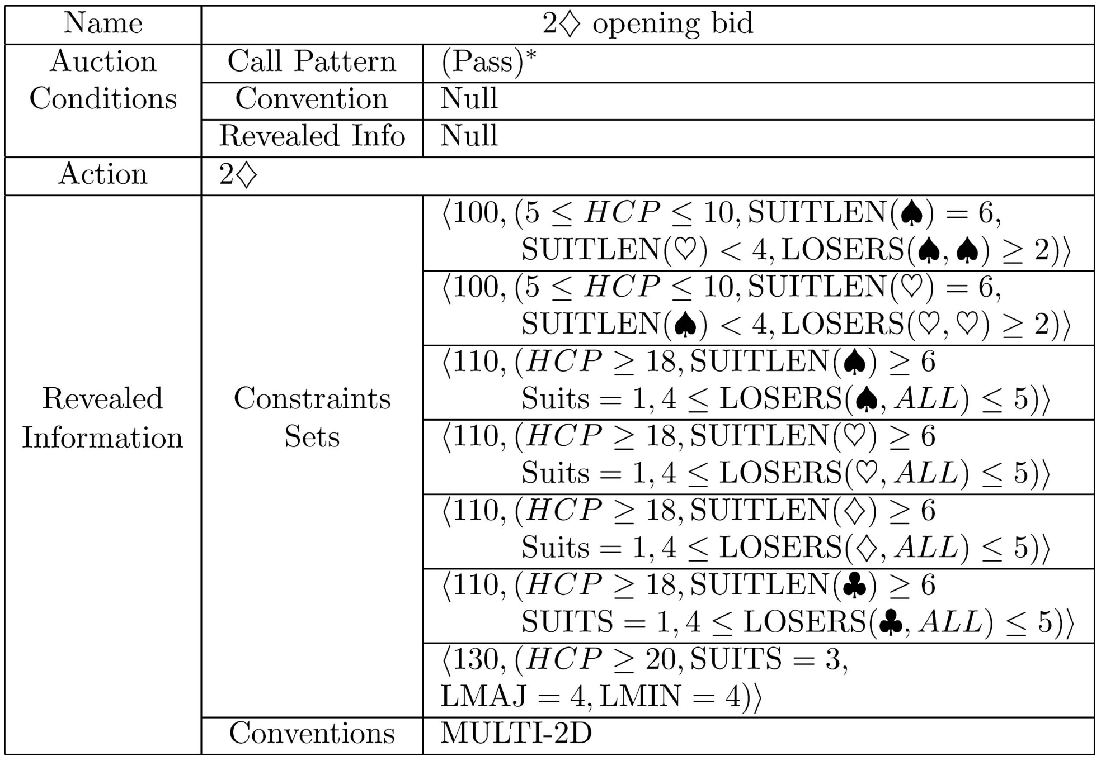
Positive bidding rule

Slide 12
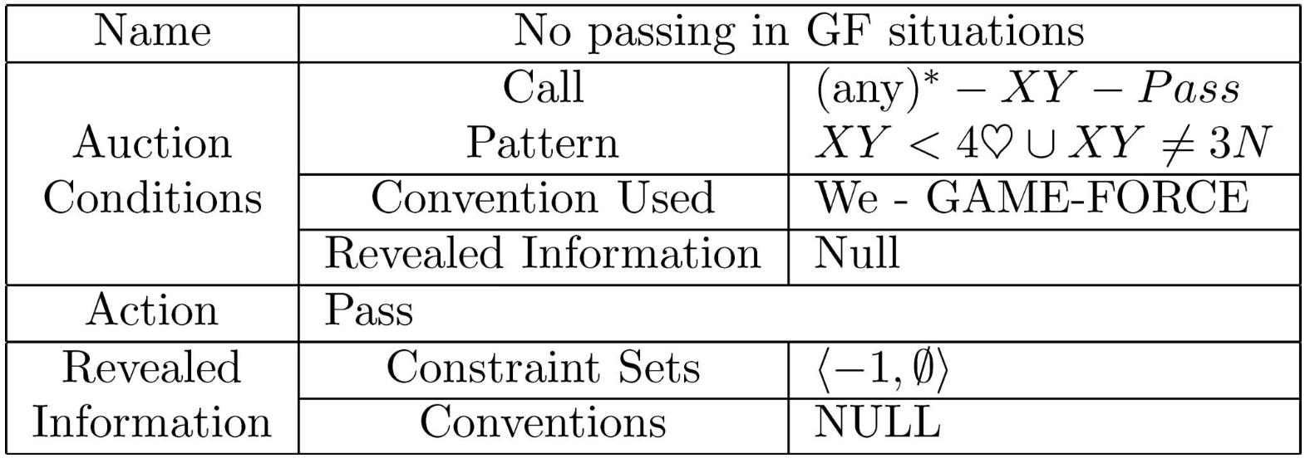
Negative bidding rule

Slide 13
Hand attributes
High cards
Distribution
Quality of the suits
Quality of the hand

Slide 14
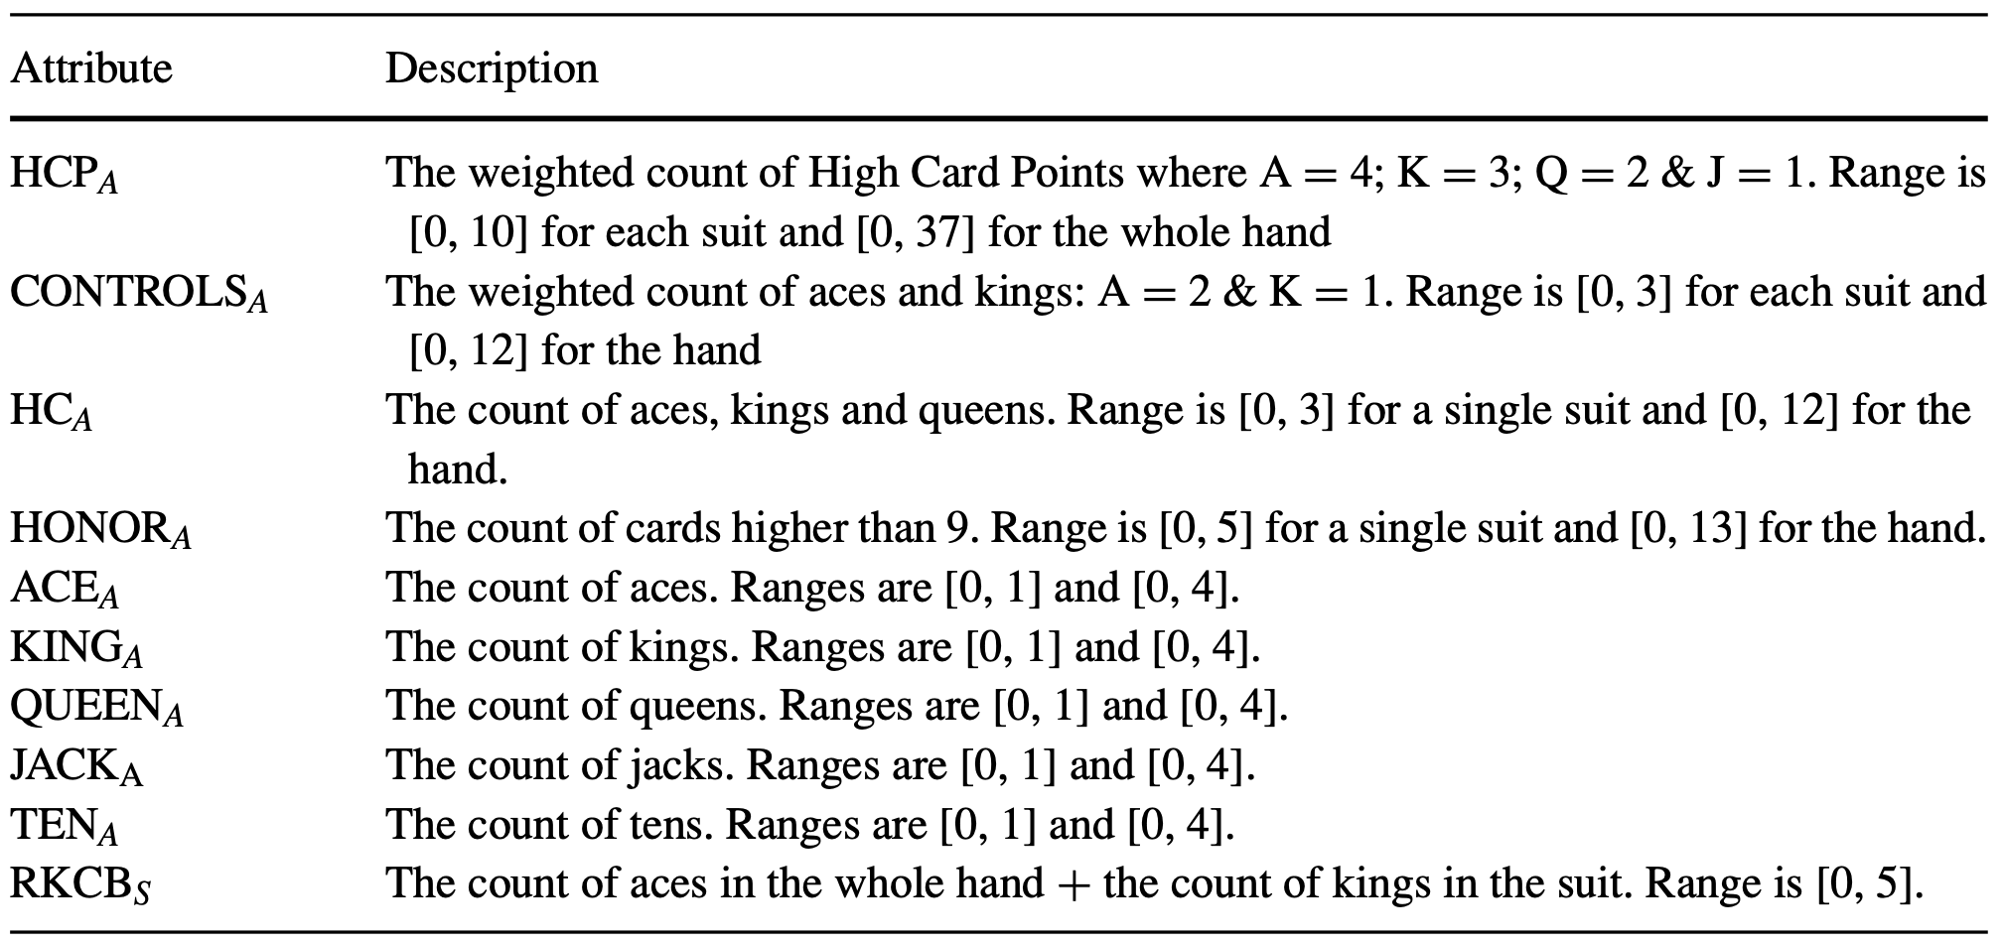
Hand attributes – High cards

Slide 15
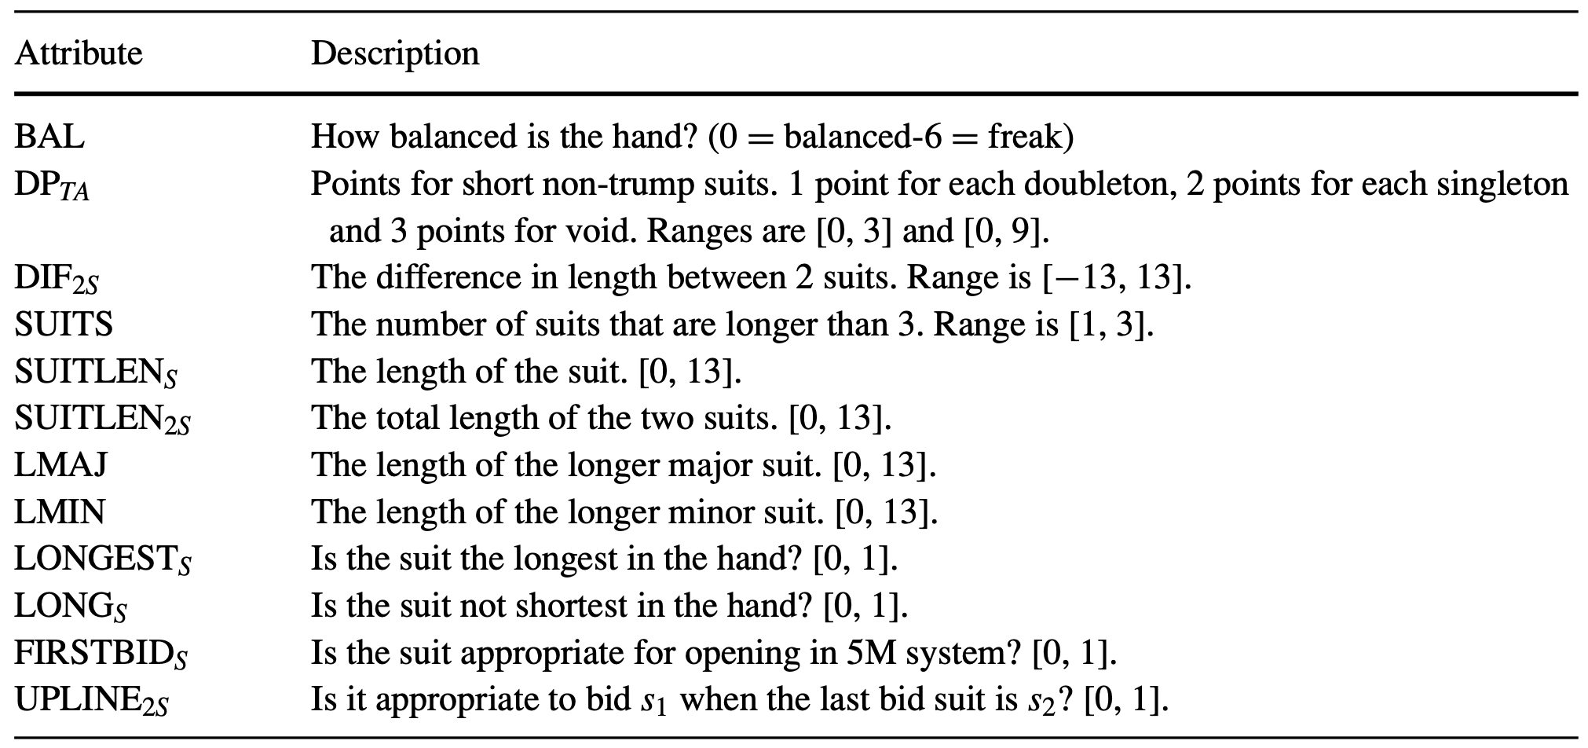
Hand attributes – Distribution

Slide 16
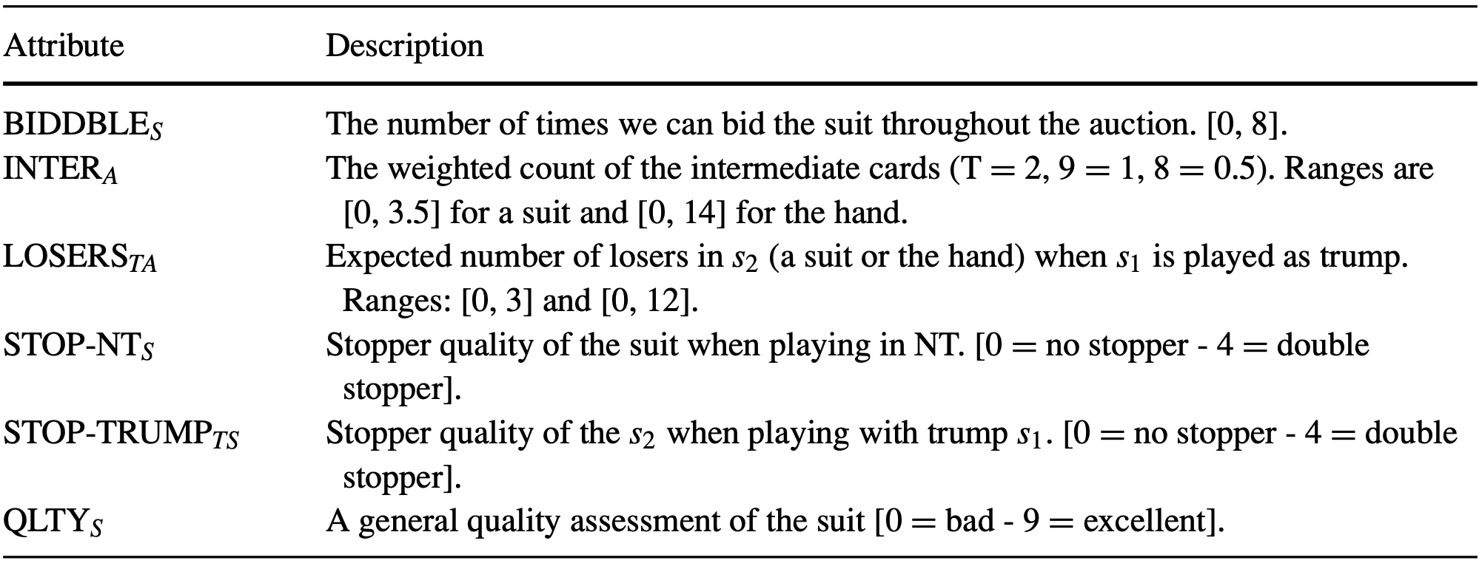
Hand attributes – Quality of the suits

Slide 17
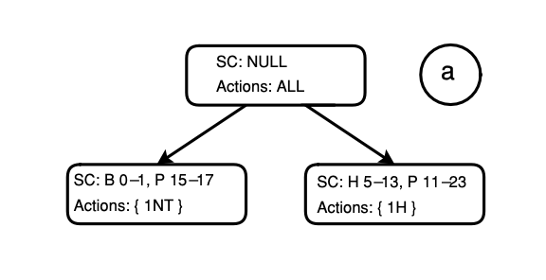
Induction Procedure (conflict)
1. If the hand is balanced and HCP is between 15 and 17, then bid 1NT.
2. If HCP is between 11 and 23 and the hand contains at least 5 hearts, then bid 1H.

Slide 18
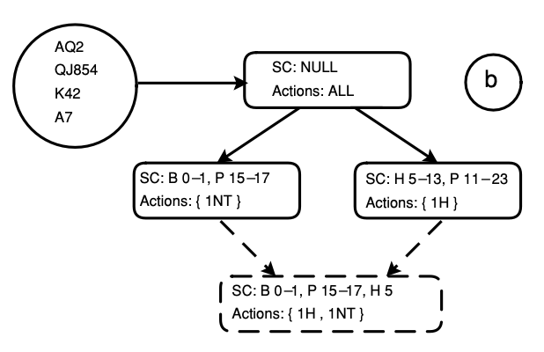
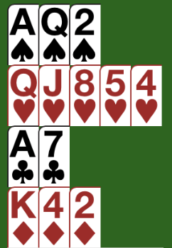
Induction Procedure

Slide 19
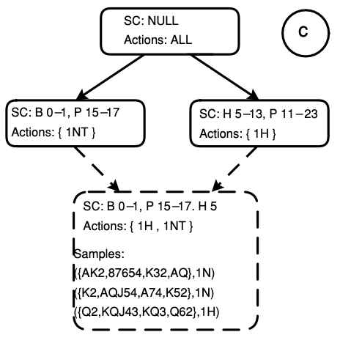
Induction Procedure

Slide 20
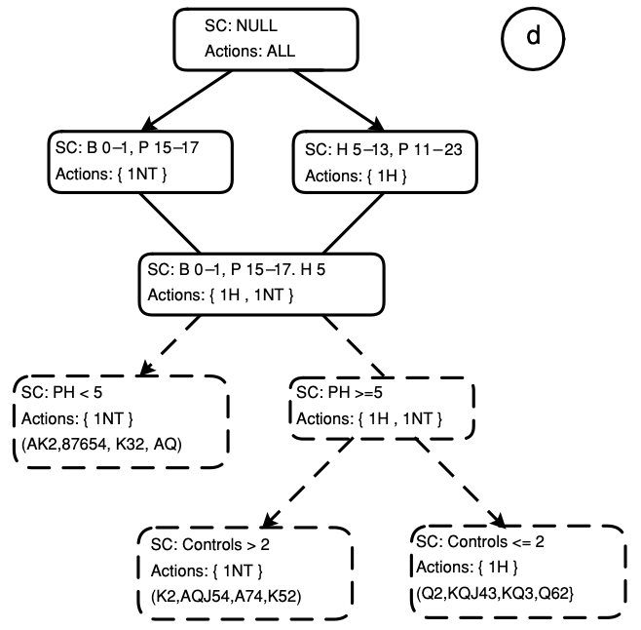
Induction Procedure

Slide 21
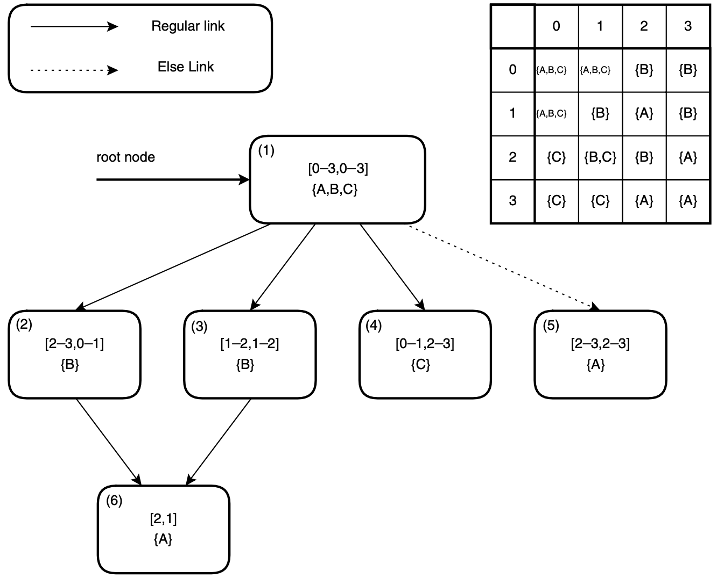
Decision net
[f₁, f₂]
world states: [f₁, f₂]
The state [0, 2] has the only most specific node (4) and therefore {C} will be returned.
The state [1, 2] has two most specific nodes—(3) and (4). Therefore, the algorithm will return {B, C}.

Slide 22
Experimental results
2000 random deals
Stopped the learning session after 100 decision nets were refined
5 seconds for each tagging process and a sample size of 10
Initial bidding system contains about 2000 rules

Slide 23
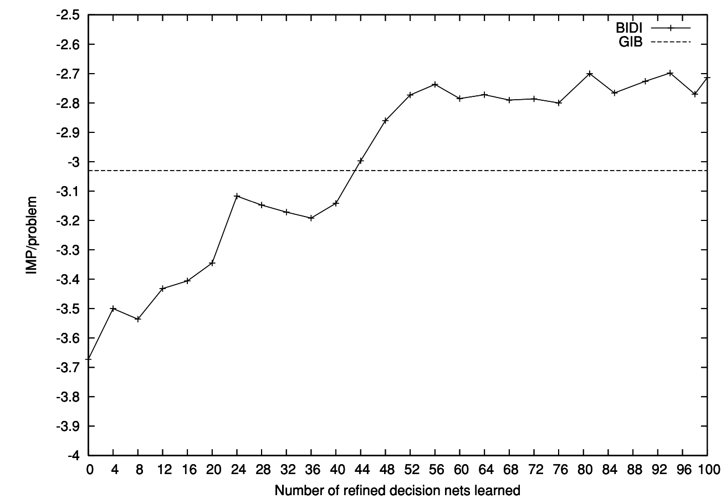
Experimental results

Slide 24
Experimental results
We tested the performance of BIDI after learning with the performance of GIB by conducting a match of 48 boards.
The results of the match were 103 IMPs to BIDI versus 84 IMPs to GIB, which is equivalent to 0.4 IMP/board.

