Slide 1
Reinforcement Learning in Card Game Environments Using Monte Carlo Methods and Artificial Neural Networks
Omer Baykal, Ferda Nur Alpaslan,
4th International Conference on Computer Science and Engineering (at Samsun, Turkey), 2019
Presenter: Yu-Yen Chu
Date: Sept. 27, 2023

Slide 2
Abstract
Artificial intelligence has wide range of application areas and games are one of the important ones. There are many applications of artificial intelligence methods in game environments. It is very common for game environments to include intelligent agents. Having intelligent agents makes a game more entertaining and challenging for its players. Reinforcement learning methods can be applied to develop artificial intelligence agents that learn to play a game by themselves without any supervision and can play it at a high level of expertize.

Slide 3
Abstract (Cont.)
Supervised learning methods, on the other hand, can be applied to develop agents that play a game by imitating the supervisor players. The purpose of this study is to develop self-learning agents for a card game, namely Batak, using reinforcement learning combined with supervised learning. Batak is a trick-taking card game popular in Turkey. Results of the study reveal that the developed agents are better at gameplaying and similar at bidding compared to some rule based Batak playing agents.

Slide 4
Batak (card game)
a trick-taking card game
52 cards
4 suits (spade, heart, diamond, club)
card rank relationship: A > K > Q > J > 10 > 9 > 8 > … > 2
spade as trump (trump is higher than other three suits)
4 players (everyone has 13 cards, and one card is played per round)
bidding
Each player predicts # of tricks he/she can get.
If # of predicted tricks is 0, score = 50/-50 when # of winning tricks is/isn’t 0.
If # of winning tricks >= # of predicted tricks,
score = 10 * (# of predicted tricks) + (# of winning tricks - # of predicted tricks).
Otherwise, score = -10 * (# of predicted tricks).

Slide 5
Batak (card game)
playing
The winner of previous round is next round’s first player.
For each round:
If a non-trump card is led, the following card has to be “same suit, higher rank” → “same suit, lower rank” → “trump suit” → “any other cards”.
If a non-trump card is led and a trump card is played in same round, the following cards has to be “same suit” → “trump suit, higher rank than highest trump rank” → “trump suit, lower rank than highest rank” → “any other cards”.
A trump card cannot be lead.
The card with highest rank wins the trick.
13 times were played per game, and the player with highest total score wins.

Slide 6
Model
bidding agent
neural network & supervised learning
Using # of tricks wins after a game as label.
input: own cards
output: predicted winning tricks
playing agent
Monte Carlo reinforcement learning (state-value function estimation)
Train a neural network to estimate state value.
input: game state
output: state value
2 types: win more & win less.

Slide 7
Model
game state representation
Use 52 one hot vectors with length 5 to represent a game state.
Each vector represents a card.
[1 0 0 0 0]: the player owns the card.
[0 1 0 0 0]: another player owns the card.
[0 0 1 0 0]: the card is played in current round and is owned by the player.
[0 0 0 1 0]: the card is played in current round and is owned by another player.
[0 0 0 0 1]: the card was played in previous rounds.

Slide 8
Experiment
train bidding agent
Data: gameplaying results from 4 trained playing agents (type of win more).
Evaluate performance after some of 10,000 games, and 1,000 games were simulated.
train playing agents
Type of win more: state value = # of winning tricks per game / 13.
Type of win less: state value = 1 - # of winning tricks per game / 13.
Increase data by switching suits of heart, diamond, and club, since only suit of spade is the trump. Therefore, 6(= 3!) similar data can use to train neural network with only 1 gameplay simulation.
Evaluate performance after every 10,000 games, and 1,000 games were simulated.
Compete with 3 rule-based agents.

Slide 9
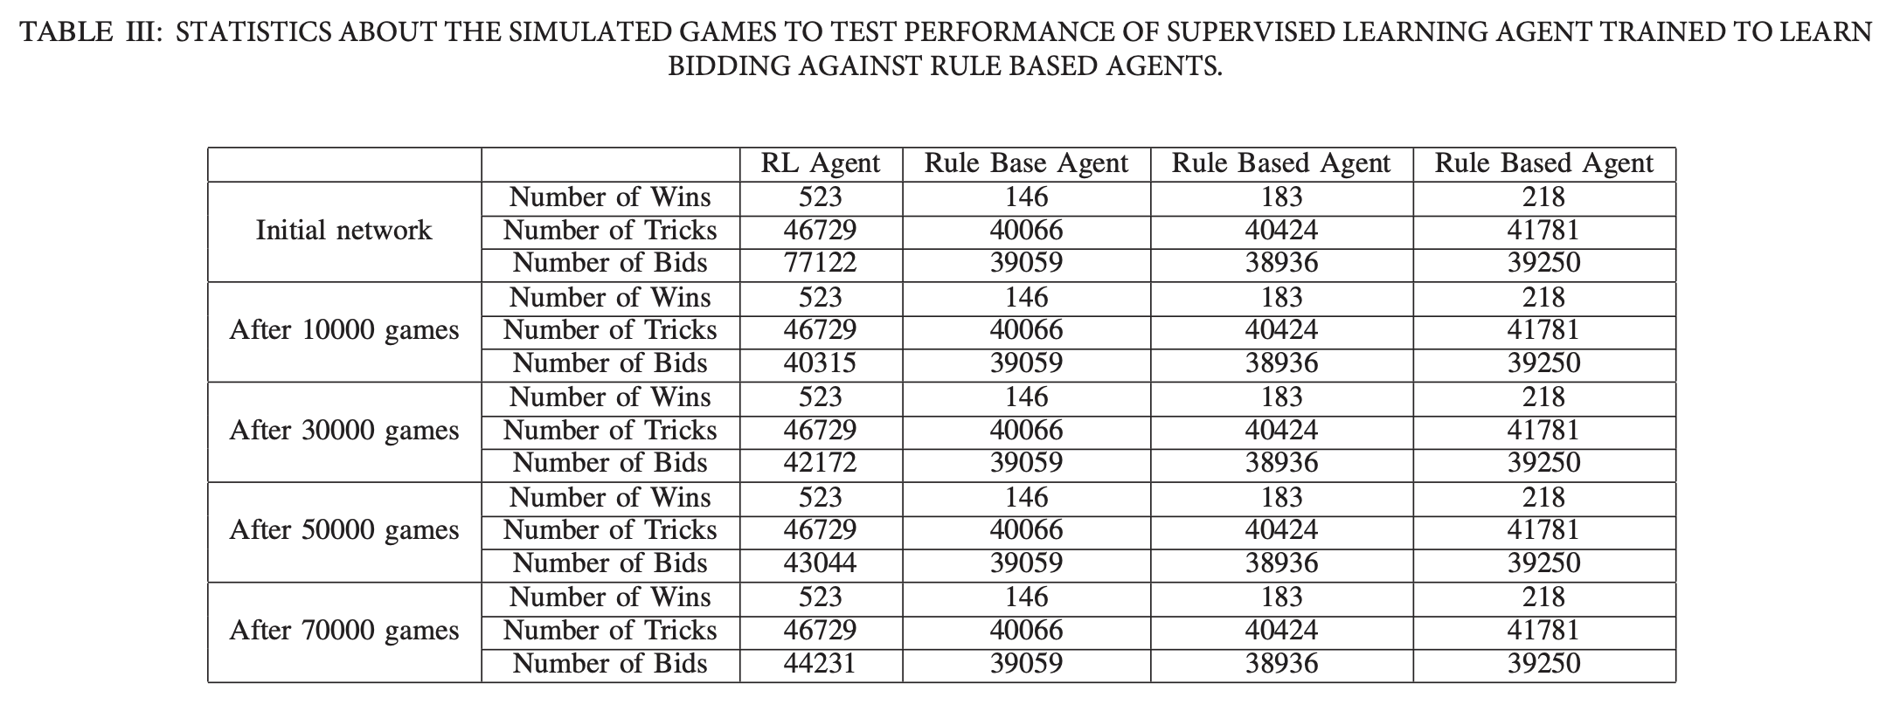

Slide 10
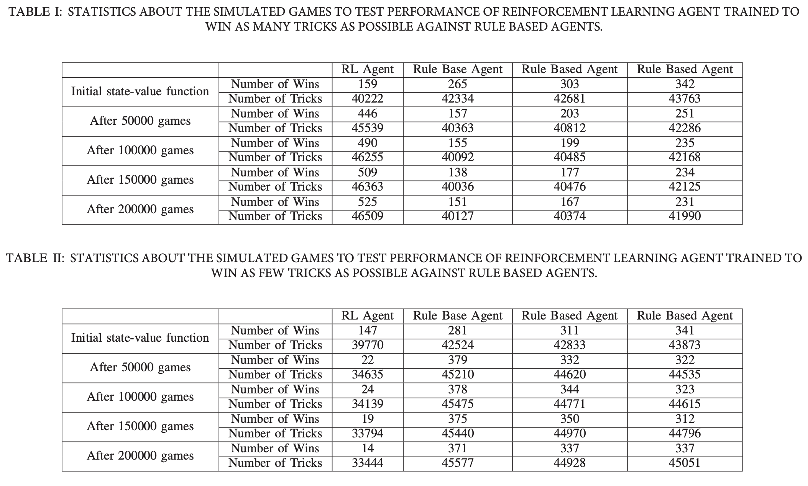

Slide 11
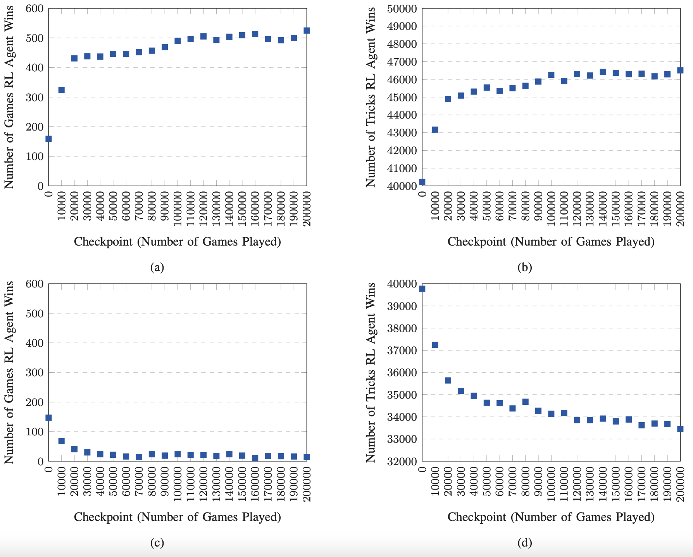
Result
Type of win more: (a), (b)
Type of win less: (c), (d)

