Slide 1
Ant clustering algorithm with K-harmonic means clustering
Hua Jiang, Shenghe Yi,
Jing Li, Fengqin Yang, Xin Hu
Expert Systems with Applications 37 (2010) 8679–8684
報告者:方鈞毅
日期: 2013/08/26

Slide 2
Abstract
Clustering is an unsupervised learning procedure and there is no a prior knowledge of data distribution. It organizes a set of objects/data into similar groups called clusters, and the objects within one cluster are highly similar and dissimilar with the objects in other clusters. The classic K-means algorithm (KM) is the most popular clustering algorithm for its easy implementation and fast working. But KM is very sensitive to initialization, the better centers we choose, the better results we get. Also, it is easily trapped in local optimal.

Slide 3
Abstract
The K-harmonic means algorithm (KHM) is less sensitive to the initialization than the KM algorithm. The Ant clustering algorithm (ACA) can avoid trapping in local optimal solution. In this paper, we will propose a new clustering algorithm using the Ant clustering algorithm with K-harmonic means clustering (ACAKHM). The experiment results on three well-known data sets like Iris and two other artiﬁcial data sets indicate the superiority of the ACAKHM algorithm. At last the performance of the ACAKHM algorithm is compared with the ACA and the KHM algorithm.

Slide 4
Clustering
Clustering的分類，given n objects
Hierarchical clustering
初始的n個objects視為n個clustering作合併(由下往上)
由一開的宇集合作分裂(由上往下)
Partitional clustering
是先給予欲分群的群數(k)，利用疊代的方式直到所有物件都被加入。

Slide 5
Hard Partitional
其中滿足
沒有空群
所有的物件都被加入
每個物件只屬於一種cluster
但實際上一個物件可能屬於多個cluster, 於是發展了Fuzzy Clustering

Slide 6

Fuzzy Clustering
與hard partitional不同的是
An object belong to all clusters with a degree
m(c_{j} /x_{i})
代表object x_{i} 屬於cluster j的程度
m(c_{j} /x_{i})滿足
1.每個物件總共有1.0的分數去分給所有的clusters。
2.每個cluster所得到分數不能超過N 。

Slide 7
K-means(KM)
Steps:
1.隨機指派k筆資料為k個群集中心。
2.計算每個資料 對應到最短距離的群中心並將該點加入該群組。
3.計算加入新資料點後的新的群集中心(重心)。
重複2.3.直到群集成員不再變動。

Slide 8
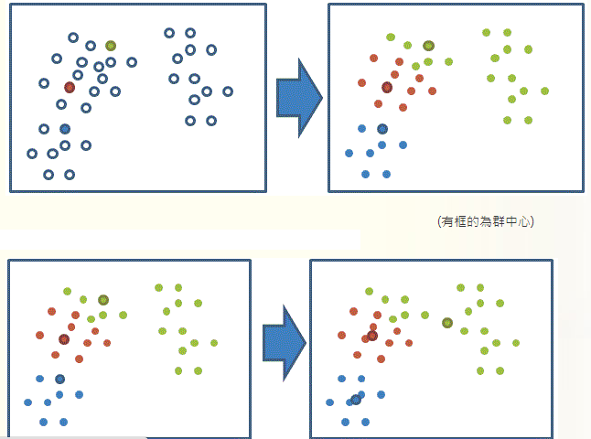

Slide 9
K-harmonic Means(KHM)
The difference between KM and KHM is that the KM algorithm gives equal weight to all of the data points and the KHM algorithm every time gives dynamic weight to each data point with a harmonic average.

Slide 10
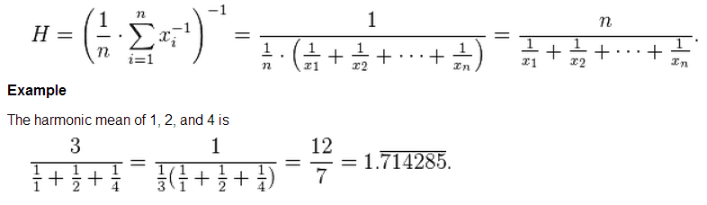
Harmonic Means

Slide 11
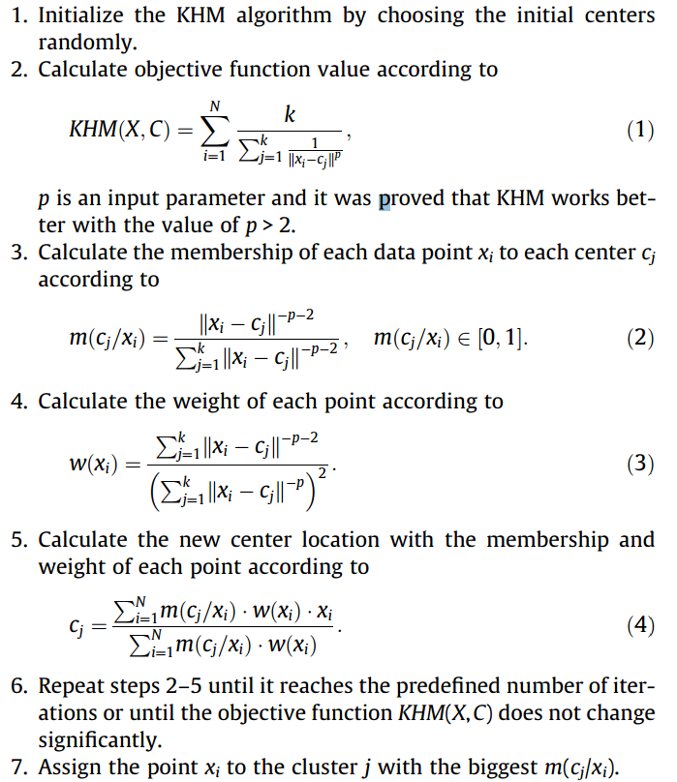

Slide 12
Ant Clustering Algorithm(ACA)
模擬螞蟻的行為
在圖上隨意的散布了一些物件。
初始給予數隻螞蟻(隨機分布)。
螞蟻會在圖上恣意奔跑。
若螞蟻持有物件時，有一定的機率下物件(P_{drop})
若螞蟻沒有持有物件時，有一定的機率拾取物件(P_{pick})。
持有(掉落)的機率與附近物件的密度成反比(正比)
計算堆疊的中心點。

Slide 13
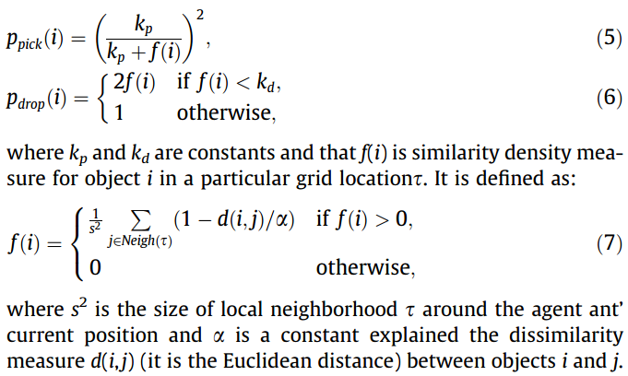
Ant Clustering Algorithm(ACA)

Slide 14
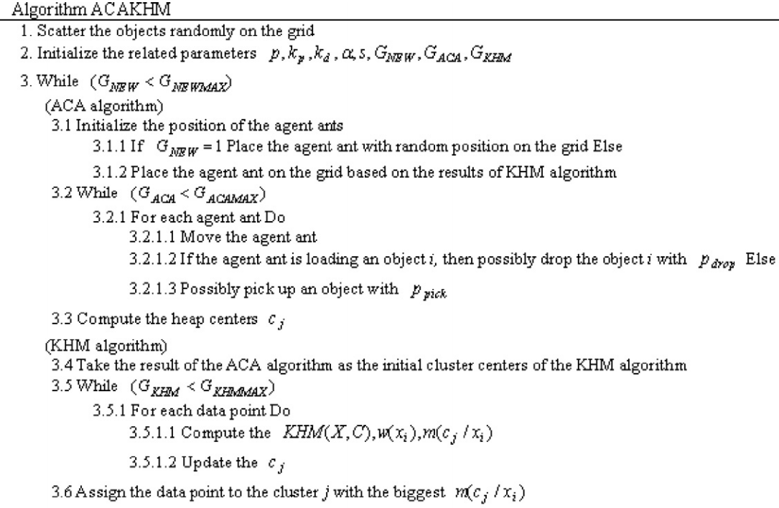
Ant clustering algorithm with K-harmonic means clustering

Slide 15
Experimental Results
KM，KHM為objective function，其值愈小代表分群的品質愈佳。
F-Measure值愈大( ≦ 1)，代表分群的演算法愈佳。
利用precision p(i,j) = n_{ij} / n_{j}
recall r(i,j) = n_{ij} / n_{i}
其中n_{ij}為屬於class i 而被分類到cluster j 的筆數
n_{i} , n_{j} 分別表示class i 與cluster j的資料筆數

Slide 16
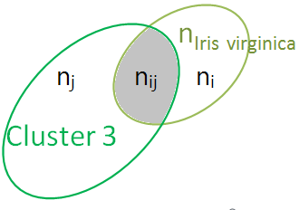
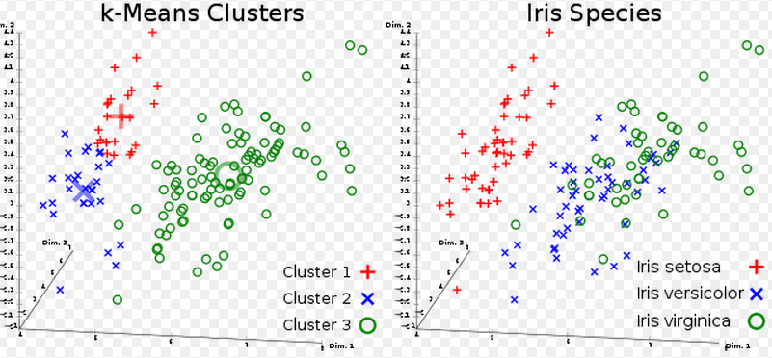
F-Measure
p(i,j) = n_{ij} / n_{j}
r(i,j) = n_{ij} / n_{i}

Slide 17
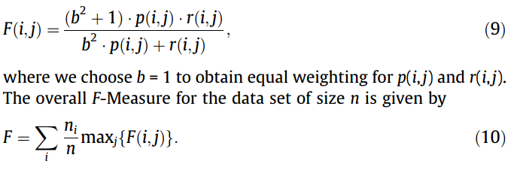
F-Measure
b = 1時，F(i,j) = 2p*r/(p+r) = 2/(r⁻¹ +p⁻¹) =
2n_{ij} /(n_{i} + n_{j})
又n_{i} ≧ n_{ij} , n_{j} ≧ n_{ij}
所以 2n_{ij} /( n_{i} + n_{j} ) ≦ 2n_{ij} /( n_{ij} + n_{ij} ) = 1
F(i,j) = 1時表示,完全預測正確 n_{i} = n_{j} = n_{ij}

Slide 18
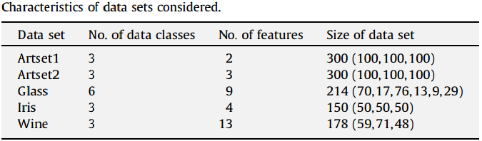
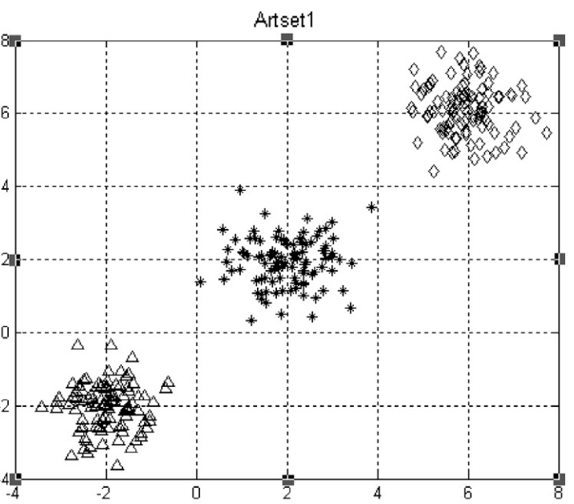
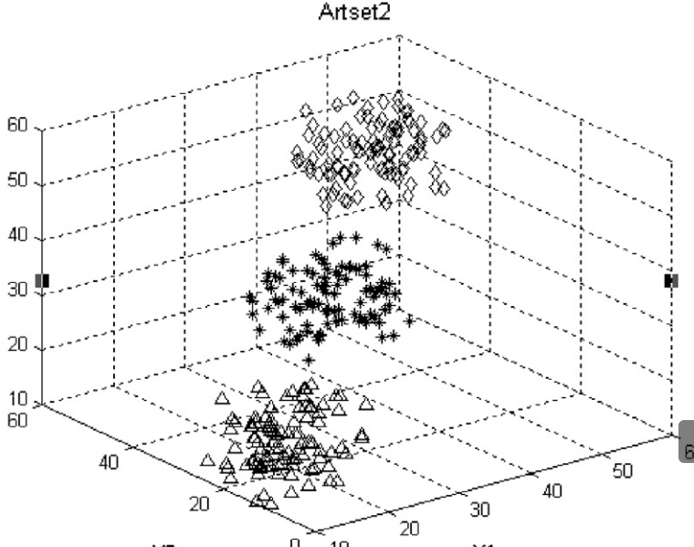
Experimental Results

Slide 19
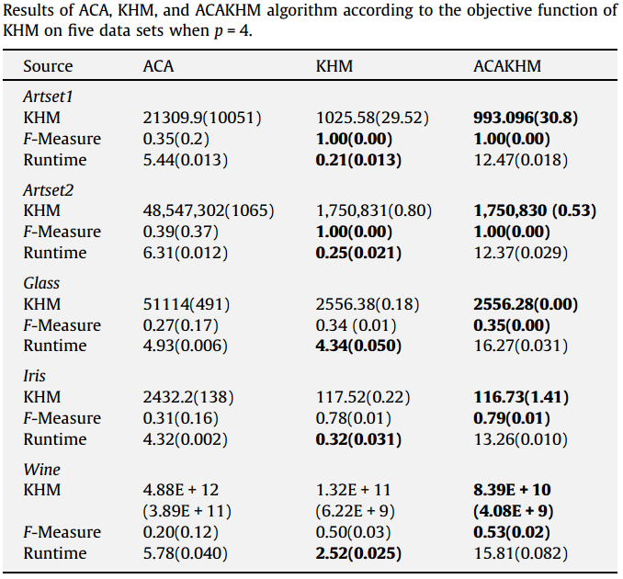
10runs ，括號內為十次數據的標準差

Slide 20
