Slide 1
Predicting drug-target interactions using restricted
Boltzmann machines
Yuhao Wang and Jianyang Zeng
Bioinformatics 2012, Vol. 29, pp. i126-i134

Slide 2
Abstract
Motivation: In silico prediction of drug-target interactions plays an important role toward identifying and developing new uses of existing or abandoned drugs. Network-based approaches have recently become a popular tool for discovering new drug-target interactions (DTIs). Unfortunately, most of these network-based approaches can only predict binary interactions between drugs and targets, and information about different types of interactions has not been well exploited for DTI prediction in previous studies. On the other hand, incorporating additional information about drug-target relationships or drug modes of action can improve prediction of DTIs. Furthermore, the predicted types of DTIs can broaden our understanding about the molecular basis of drug action.

Slide 3
Abstract
Results: We propose a first machine learning approach to integrate multiple types of DTIs and predict unknown drug-target relationships or drug modes of action. We cast the new DTI prediction problem into a two-layer graphical model, called restricted Boltzmann machine, and apply a practical learning algorithm to train our model and make pre- dictions. Tests on two public databases show that our restricted Boltzmann machine model can effectively capture the latent features of a DTI network and achieve excellent performance on predicting different types of DTIs, with the area under precision-recall curve up to 89.6.

Slide 4
Abstract
Results (Cont'd): In addition, we demonstrate that integrating multiple types of DTIs can significantly outperform other predictions either by simply mixing multiple types of interactions without distinction or using only a single interaction type. Further tests show that our approach can infer a high fraction of novel DTIs that has been validated by known experiments in the literature or other databases. These results indicate that our approach can have highly practical relevance to DTI predic- tion and drug repositioning, and hence advance the drug discovery process.

Slide 5
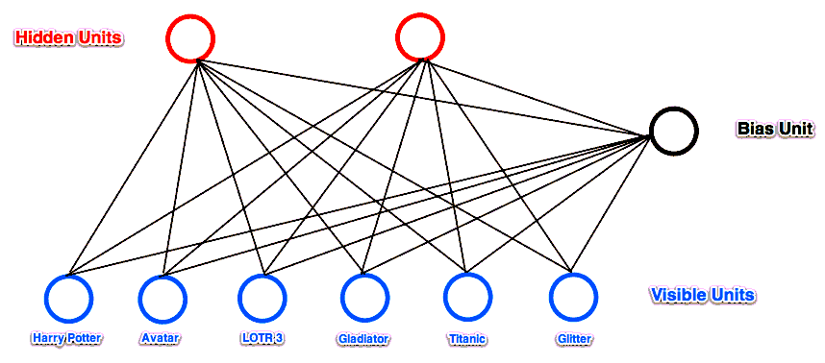
Restricted Boltzmann Machines (RBM)
A Restricted Boltzmann Machine is a stochastic neural network consisting of:
One layer of visible units (users’ movie preferences whose states we know and set);
One layer of hidden units (the latent factors we try to learn);
A bias unit (whose state is always on, and is a way of adjusting for the different inherent popularities of each movie).
http://blog.echen.me/2011/07/18/introduction-to-restricted-boltzmann-machines/

Slide 6

Restricted Boltzmann Machines (RBM)
Training data:
Alice: (Harry Potter = 1, Avatar = 1, LOTR 3 = 1, Gladiator = 0, Titanic = 0, Glitter = 0). Big SF/fantasy fan.
Bob: (Harry Potter = 1, Avatar = 0, LOTR 3 = 1, Gladiator = 0, Titanic = 0, Glitter = 0). SF/fantasy fan, but doesn't like Avatar.
Carol: (Harry Potter = 1, Avatar = 1, LOTR 3 = 1, Gladiator = 0, Titanic = 0, Glitter = 0). Big SF/fantasy fan.
David: (Harry Potter = 0, Avatar = 0, LOTR 3 = 1, Gladiator = 1, Titanic = 1, Glitter = 0). Big Oscar winners fan.
Eric: (Harry Potter = 0, Avatar = 0, LOTR 3 = 1, Gladiator = 1, Titanic = 1, Glitter = 0). Oscar winners fan, except for Titanic.
Fred: (Harry Potter = 0, Avatar = 0, LOTR 3 = 1, Gladiator = 1, Titanic = 1, Glitter = 0). Big Oscar winners fan.
The network learned the following weights:
Bias Unit Hidden 1 Hidden 2
Bias Unit -0.7342946 , 1.62413413, 0.38261796
Harry Potter -8.28013449, 3.46336899, 1.25647695
Avatar -5.63172297, 1.22485789, -0.54704988
LOTR 3 3.18821331, 4.19419496, 4.19278116
Gladiator 7.97049391, -2.81753116, -1.68188448
Titanic 4.37201403, -7.3249733 , -0.68051480
Glitter -3.57746822, -3.10724491, -3.89272309
http://blog.echen.me/2011/07/18/introduction-to-restricted-boltzmann-machines/

Slide 7


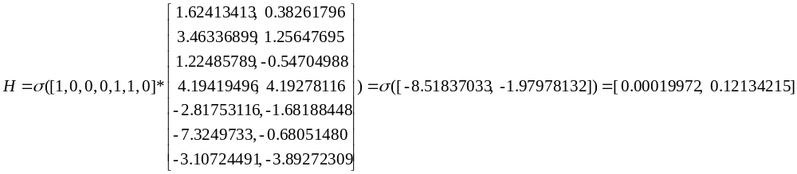
The network learned the following weights:
Bias Unit Hidden 1 Hidden 2
Bias Unit -0.7342946 , 1.62413413, 0.38261796
Harry Potter -8.28013449, 3.46336899, 1.25647695
Avatar -5.63172297, 1.22485789, -0.54704988
LOTR 3 3.18821331, 4.19419496, 4.19278116
Gladiator 7.97049391, -2.81753116, -1.68188448
Titanic 4.37201403, -7.3249733 , -0.68051480
Glitter -3.57746822, -3.10724491, -3.89272309
visible -> hidden
Assuming visible = [0,0,0,1,1,0]
Notes:
from rbm import *
r = RBM(num_visible = 6, num_hidden = 2)
r.weights = np. array([[-0.7342946 , 1.62413413, 0.38261796],
[-8.28013449, 3.46336899, 1.25647695],
[-5.63172297, 1.22485789, -0.54704988],
[ 3.18821331, 4.19419496, 4.19278116],
[ 7.97049391, -2.81753116, -1.68188448],
[ 4.37201403, -7.3249733 , -0.6805148 ],
[-3.57746822, -3.10724491, -3.89272309]])
data=np.array([[1,0,0,0,1,1,0]])
hidden_activations = np.dot(data, r.weights)
hidden_probs = r._logistic(hidden_activations) [:,1:]

Slide 8

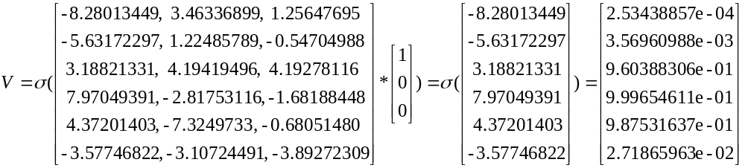
The network learned the following weights:
Bias Unit Hidden 1 Hidden 2
Bias Unit -0.7342946 , 1.62413413, 0.38261796
Harry Potter -8.28013449, 3.46336899, 1.25647695
Avatar -5.63172297, 1.22485789, -0.54704988
LOTR 3 3.18821331, 4.19419496, 4.19278116
Gladiator 7.97049391, -2.81753116, -1.68188448
Titanic 4.37201403, -7.3249733 , -0.68051480
Glitter -3.57746822, -3.10724491, -3.89272309
hidden -> visible
Assuming hidden = [0,0]
Notes:
from rbm import *
r = RBM(num_visible = 6, num_hidden = 2)
r.weights = np. array([[-0.7342946 , 1.62413413, 0.38261796],
[-8.28013449, 3.46336899, 1.25647695],
[-5.63172297, 1.22485789, -0.54704988],
[ 3.18821331, 4.19419496, 4.19278116],
[ 7.97049391, -2.81753116, -1.68188448],
[ 4.37201403, -7.3249733 , -0.6805148 ],
[-3.57746822, -3.10724491, -3.89272309]])
data=np.array([[1,0,0]])
visible_probs = r._logistic(np.dot(r.weights[1:,:],data.T))

Slide 9
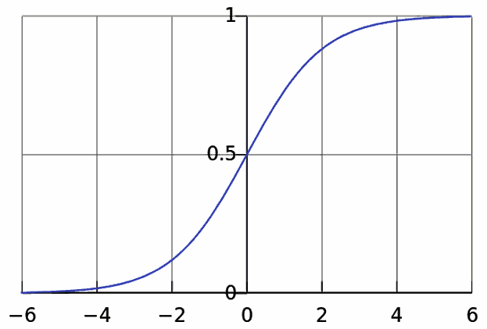
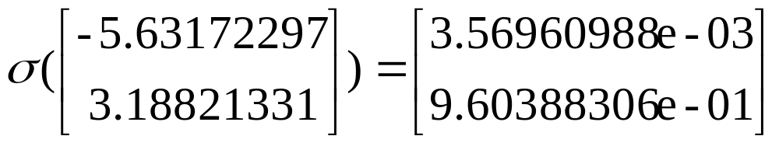
http://en.wikipedia.org/wiki/File:Logistic-curve.svg

Slide 10
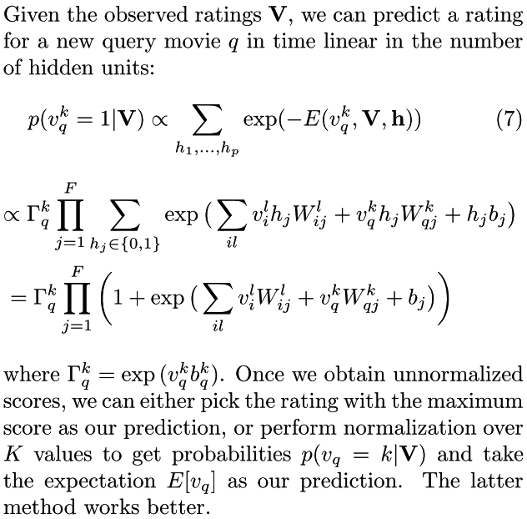
RBM prediction
Ruslan Salakhutdinov et al., "Restricted Boltzmann Machines for Collaborative Filtering"

Slide 11
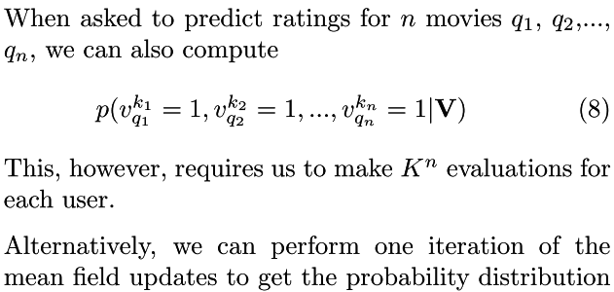
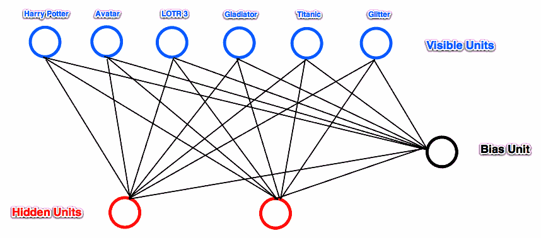
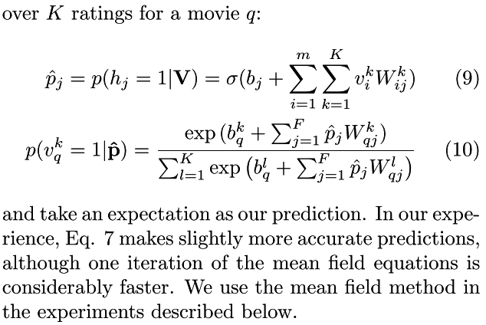
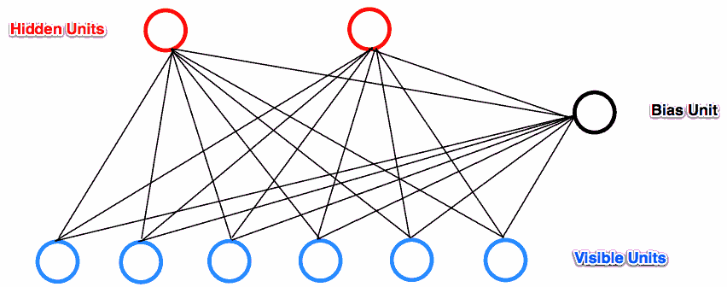
RBM prediction
Ruslan Salakhutdinov et al., "Restricted Boltzmann Machines for Collaborative Filtering"

Slide 12
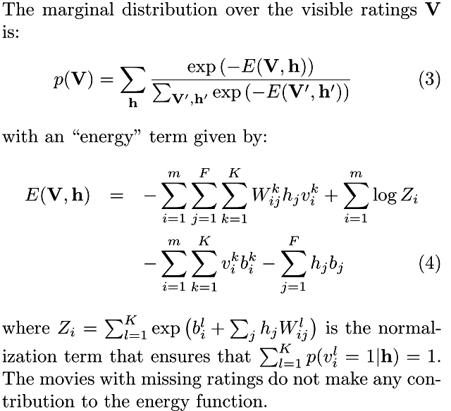
RBM learning
Ruslan Salakhutdinov et al., "Restricted Boltzmann Machines for Collaborative Filtering"

Slide 13
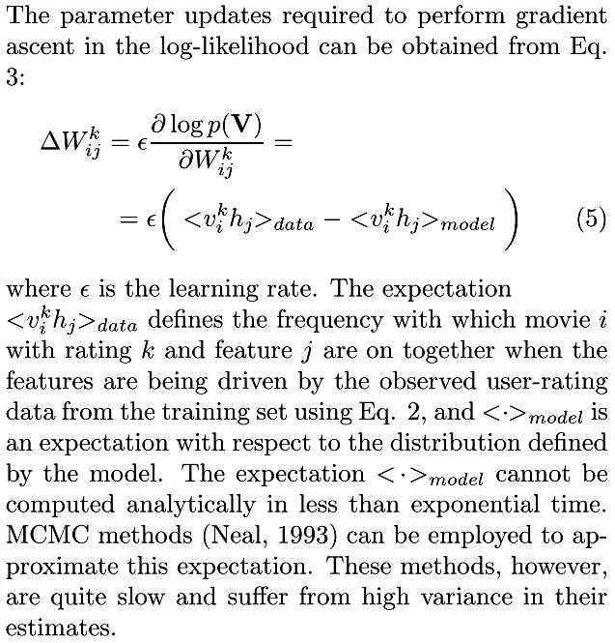
RBM learning
Ruslan Salakhutdinov et al., "Restricted Boltzmann Machines for Collaborative Filtering"

Slide 14
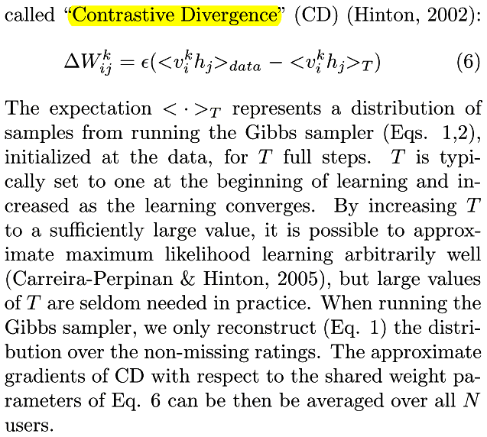
RBM learning
Ruslan Salakhutdinov et al., "Restricted Boltzmann Machines for Collaborative Filtering"

Slide 15
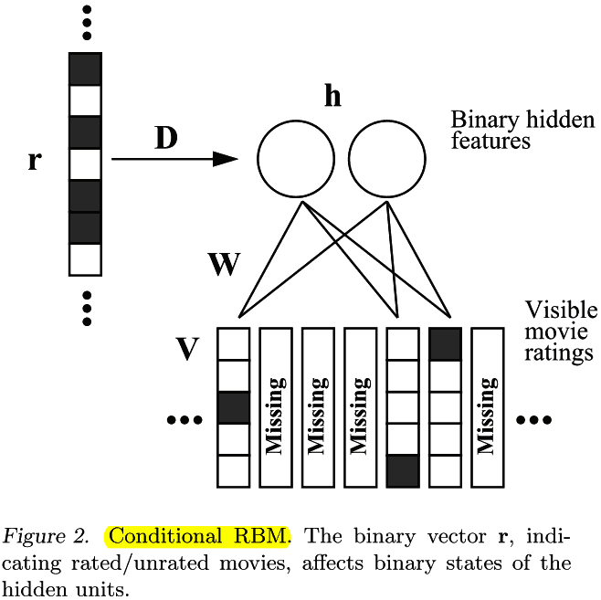
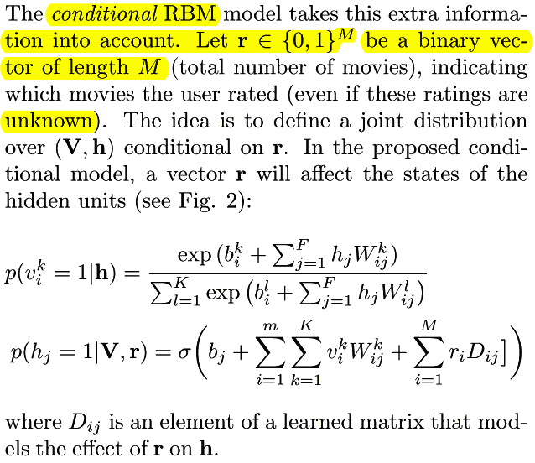
Conditional RBM (CRBM)
Ruslan Salakhutdinov et al., "Restricted Boltzmann Machines for Collaborative Filtering"

Slide 16
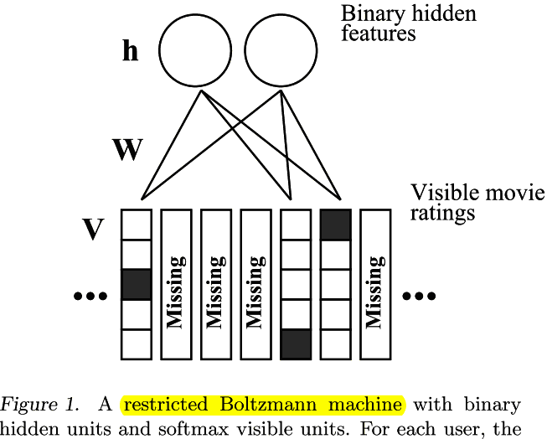

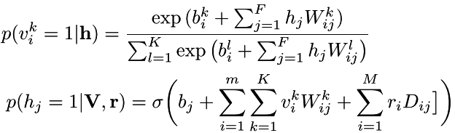

Conditional RBM (CRBM)
Ruslan Salakhutdinov et al., "Restricted Boltzmann Machines for Collaborative Filtering"

Slide 17
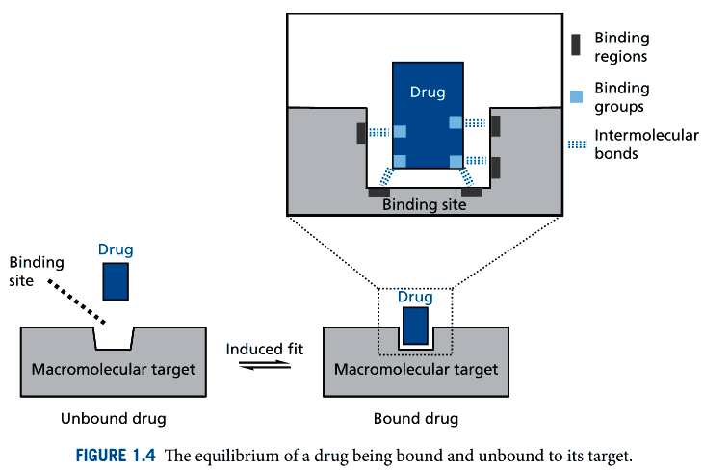
Drug-target interaction (DTI)
http://fds.oup.com/www.oup.com/pdf/13/9780199234479_chapter1.pdf

Slide 18
Drug-target pairs can be described by different relationships, such as direct and indirect interactions. A direct interaction is usually caused by protein-ligand[配體; 配基] binding, whereas an indirect interaction can be induced by the changed expression level of a protein or active metabolites produced by a drug.
In addition, DTIs can be annotated with different drug modes of action: binding, activation and inhibition.

Slide 19
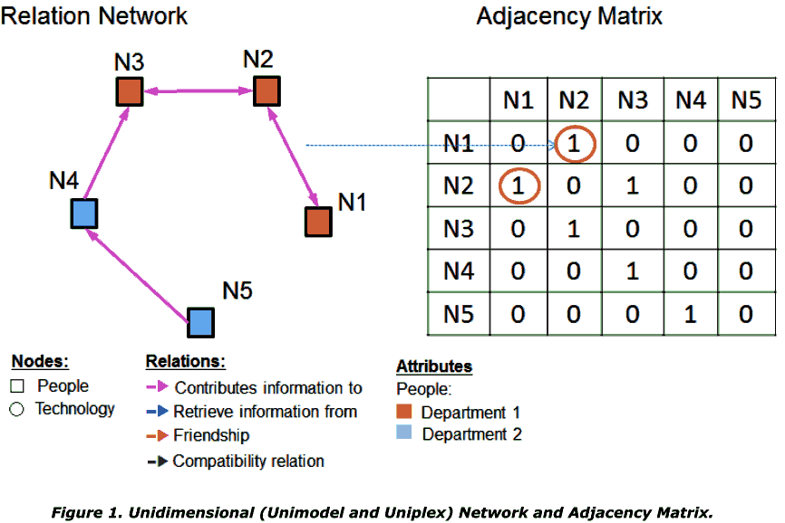
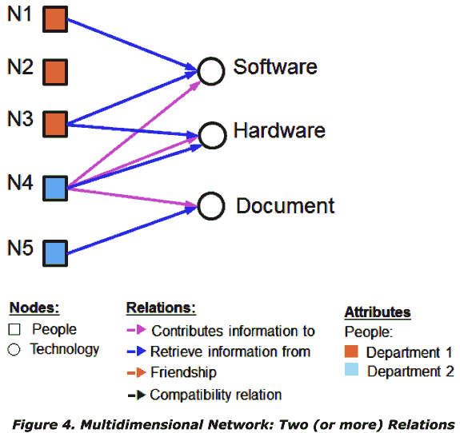
Type of network data
NOSHIR S. CONTRACTOR et al., "Multidimensional Networks and the Dynamics of Sociomateriality: Bringing Technology Inside the Network "

Slide 20
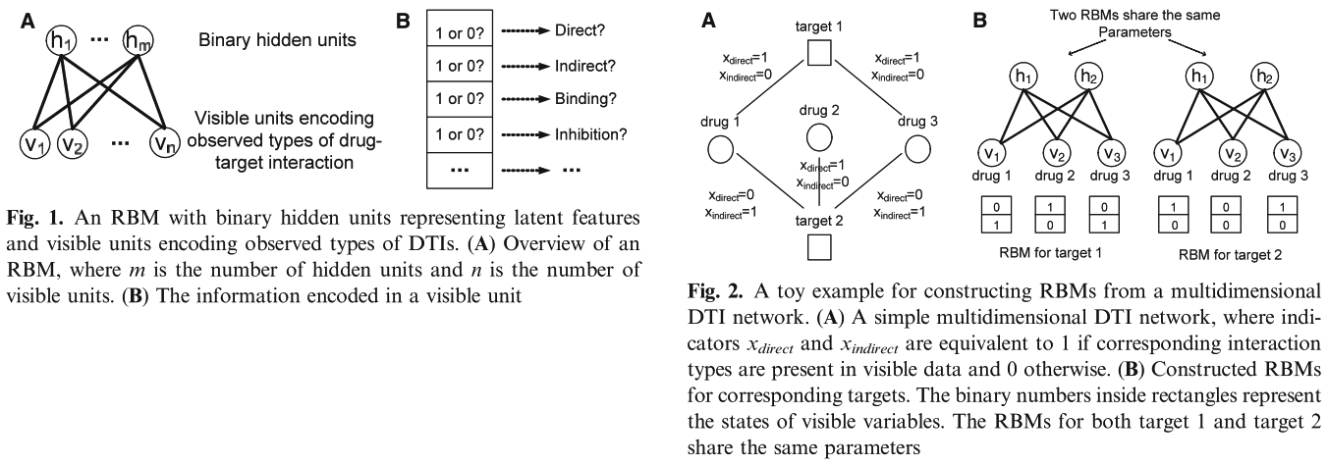
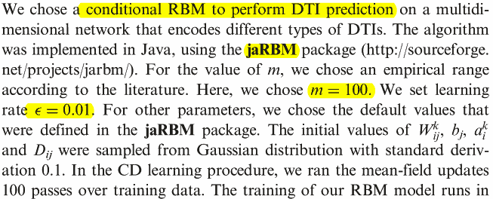
DTIs as Multidimensional Network

Slide 21
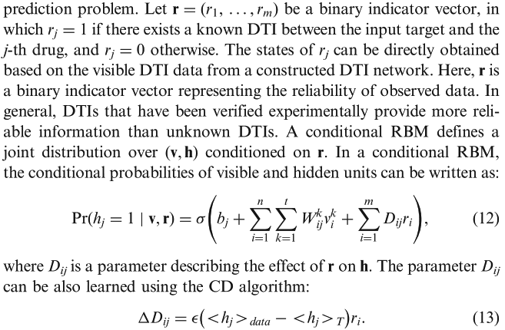
DTI prediction with CRBM

Slide 22
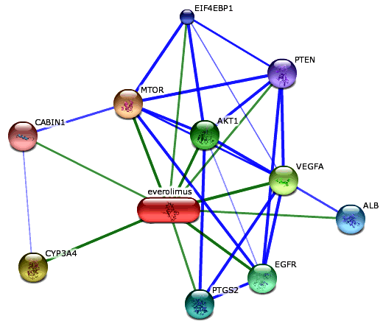
Datasets
MATADOR
  http://matador.embl.de/
STITCH
  http://stitch.embl.de/
The confidence view. Stronger associations are represented by thicker lines. Protein-protein interactions are shown in blue, chemical-protein interactions in green and interactions between chemicals in red.
Experiments are conducted in 10-fold cross-validation.
http://stitch.embl.de/cgi/show_network_section.pl

Slide 23
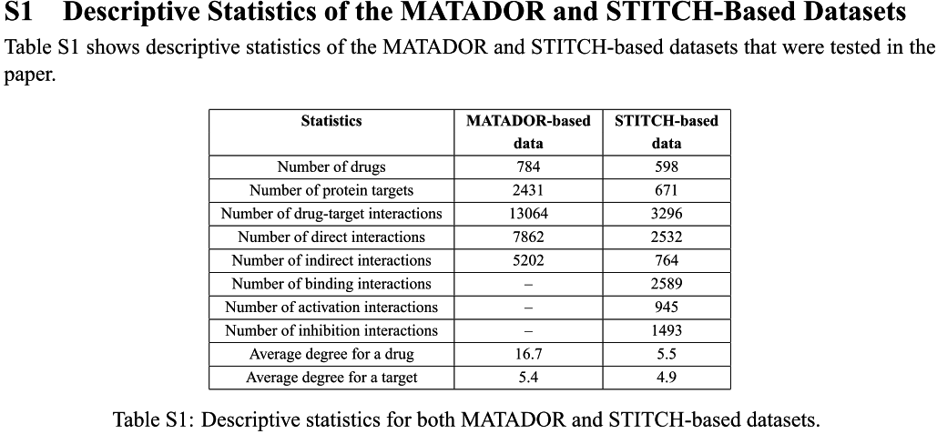
Datasets

Slide 24
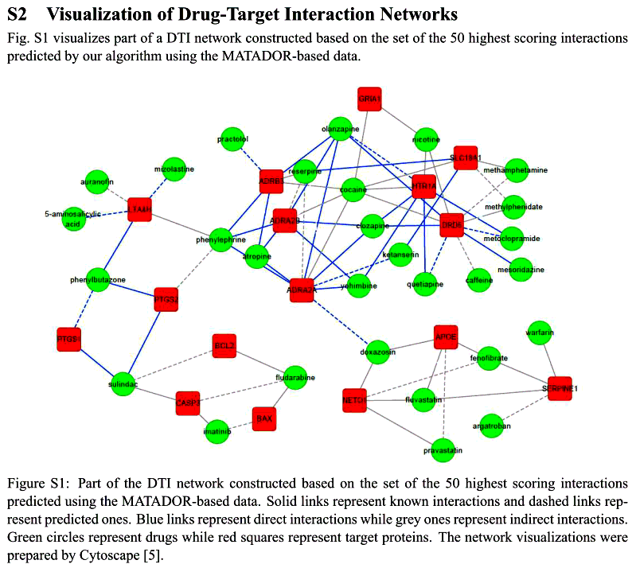
Datasets

Slide 25
Evaluation methods
AUC (Area under ROC curve)
AUPR (Area under precisiom and recall curve)

Slide 26
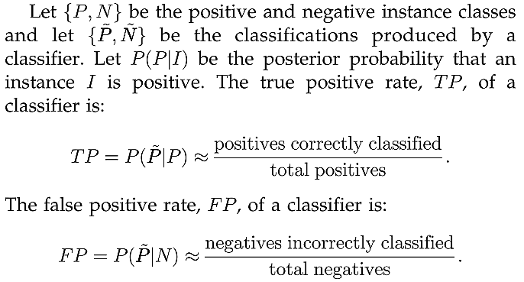
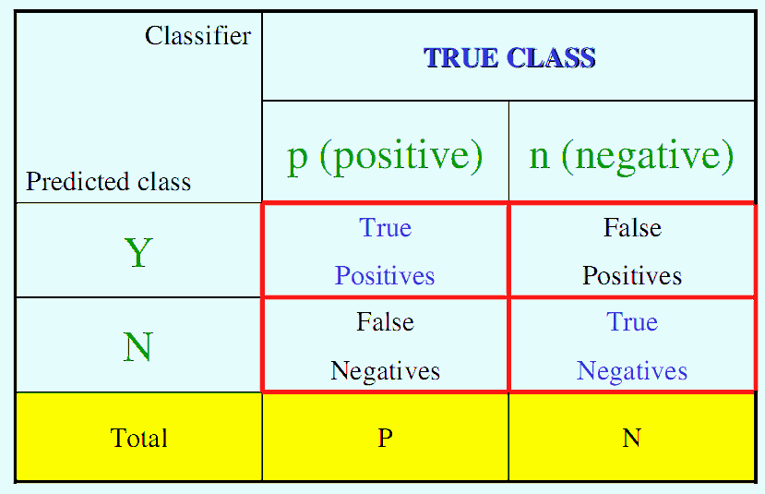
http://www.anaesthetist.com/mnm/stats/roc/Findex.htm

Slide 27
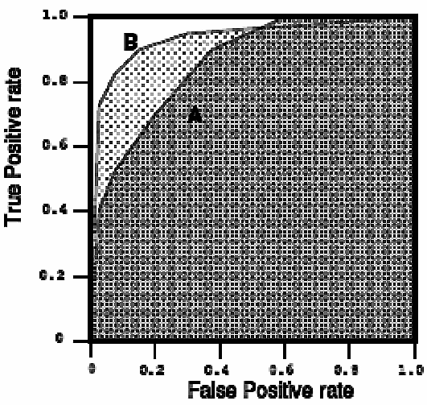
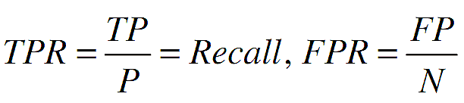
Receiver Operating Characteristic (ROC)
AUC
http://www.anaesthetist.com/mnm/stats/roc/Findex.htm

Slide 28

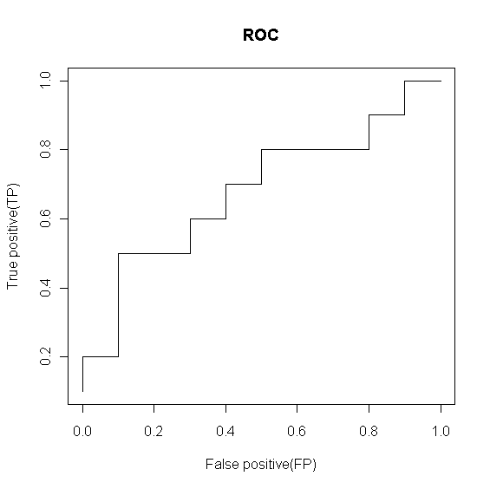
Receiver Operating Characteristic (ROC)
Use thresholds to create ROC curve
Score Class
------------------
0.9 P
0.8 P
0.7 N
0.6 P
0.55 P
0.54 P
0.53 N
0.52 N
0.51 P
0.505 N
0.4 P
0.39 N
0.38 P
0.37 N
0.36 N
0.35 N
0.34 P
0.33 N
0.30 P
0.1 N
threshold=0.900000
N P
N 10 9
P 0* 1*
TP FP
0.1 0.0
------------------
threshold=0.800000
N P
N 10 8
P 0* 2*
TP FP
0.2 0.0
------------------
threshold=0.300000
N P
N 1 0
P 9* 10*
TP FP
1.0 0.9
http://www.anaesthetist.com/mnm/stats/roc/Findex.htm
Notes:
d1 = c(0.9, 0.8, 0.7, 0.6, 0.55, 0.54, 0.53, 0.52, 0.51, 0.505, 0.4, 0.39, 0.38, 0.37, 0.36, 0.35, 0.34, 0.33, 0.3, 0.1)
d2 = c(2, 2, 1, 2, 2, 2, 1, 1, 2, 1, 2, 1, 2, 1, 1, 1, 2, 1, 2, 1)
tb = data.frame(Score=d1,Class=c('N','P')[d2])
#tb <- read.table('roct.txt',header=T)
tn <- table(tb[,2]); x<- NULL
for(thr in tb[,1]){
print(sprintf('threshold=%f',thr),quote=F)
print(ttb <- table(ifelse(tb[,1]>=thr,"P","N"),tb[,2]))
dttb <- c(ttb['P','P'],ttb['P','N'])
x <- rbind(x, dttb/tn); dttbxy <- dttb/tn; names(dttbxy) <- c('TP','FP')
print(dttbxy)
}
plot(x[,2],x[,1],xlab='False positive(FP)',ylab='True positive(TP)',type='l',main='ROC')
#計算ROC與AUC值
#http://rocr.bioinf.mpi-sb.mpg.de/
compute_unnormalized_roc_curve <- function (predictions, labels)
{
#Obtained from the ROCR package!
labels = factor(labels)
pos.label <- levels(labels)[2]
neg.label <- levels(labels)[1]
pred.order <- order(predictions, decreasing = TRUE)
predictions.sorted <- predictions[pred.order]
tp <- cumsum(labels[pred.order] == pos.label)
fp <- cumsum(labels[pred.order] == neg.label)
dups <- rev(duplicated(rev(predictions.sorted)))
tp <- c(0, tp[!dups]) / sum(labels==pos.label)
fp <- c(0, fp[!dups]) / sum(labels==neg.label)
cutoffs <- c(Inf, predictions.sorted[!dups])
len = length(tp)
auc = sum((tp[1:(len-1)] + tp[2:len]) * (fp[2:len] - fp[1:(len-1)])) / 2
return(list(cutoffs = cutoffs, fpr = fp, tpr = tp, auc = auc))
}
compute_unnormalized_roc_curve(d1,d2)
rtb=data.frame(tb,rank=paste(rank(d1),sapply(d2,function(d) ifelse(d=='2','*','')),sep=''))
S0=sum(rank(d1)[d2==2])
n0=n1=10
(A=(123-10*(10+1)/2)/(10*10))

Slide 29
Area under ROC
$fpr
0.0 0.0 0.0 0.1 0.1 0.1 0.1 0.2 0.3 0.3 0.4 0.4 0.5 0.5 0.6 0.7 0.8 0.8 0.9 0.9 1.0
$tpr
0.0 0.1 0.2 0.2 0.3 0.4 0.5 0.5 0.5 0.6 0.6 0.7 0.7 0.8 0.8 0.8 0.8 0.9 0.9 1.0 1.0
0.1*0.2+0.2*0.5+0.1*0.6+0.1*0.7+0.3*0.8+0.1*0.9+0.1*1.0 = 0.68

Slide 30
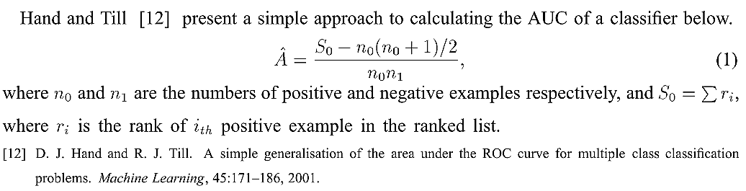
Area under ROC
Score Class rank
1 0.900 P 20*
2 0.800 P 19*
3 0.700 N 18
4 0.600 P 17*
5 0.550 P 16*
6 0.540 P 15*
7 0.530 N 14
8 0.520 N 13
9 0.510 P 12*
10 0.505 N 11
11 0.400 P 10*
12 0.390 N 9
13 0.380 P 8*
14 0.370 N 7
15 0.360 N 6
16 0.350 N 5
17 0.340 P 4*
18 0.330 N 3
19 0.300 P 2*
20 0.100 N 1
S0=20+19+17+16+15+12+10+8+4+2=123
n0=n1=10
A=(123-10*(10+1)/2)/(10*10)=0.68
Jin Huang et al., " Using AUC and Accuracy in Evaluating Learning Algorithms "

Slide 31
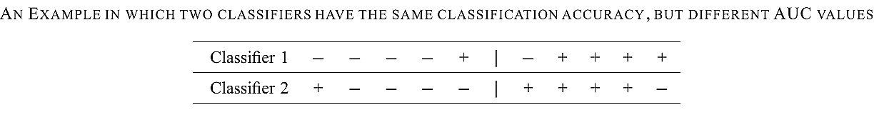
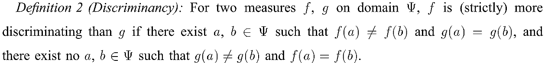
AUC vs. Accuracy
Accuracy: Both 80%
AUC:
Classifier1: ((5+7+8+9+10)-5*6/2)/(5*5)=24/25, Better!
Classifier2: ((1+6+7+8+9)-5*6/2)/(5*5)=16/25
We say Classifier1 is better!
Jin Huang et al., " Using AUC and Accuracy in Evaluating Learning Algorithms "

Slide 32
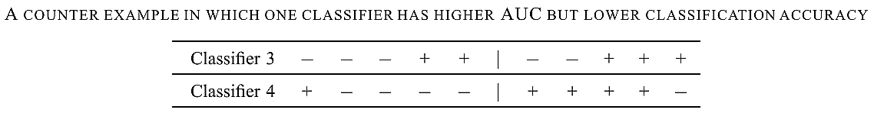
AUC vs. Accuracy
Accuracy:
Classifier1: (3+3)/10=0.6
Classifier2: (4+4)/10=0.8 , Better!
AUC:
Classifier1: ((4+5+8+9+10)-5*6/2)/(5*5)=21/25, Better!
Classifier2: ((1+6+7+8+9)-5*6/2)/(5*5)=16/25
We can not say which classifier is better!
Jin Huang et al., " Using AUC and Accuracy in Evaluating Learning Algorithms "

Slide 33
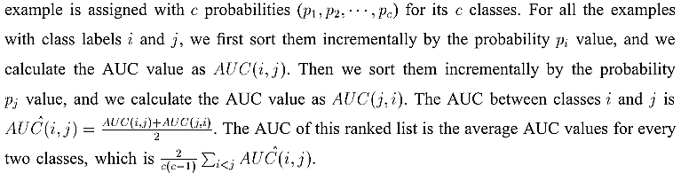
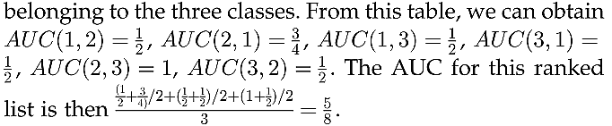
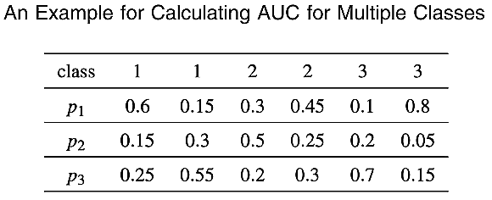
Multiclass AUC
Jin Huang et al., " Using AUC and Accuracy in Evaluating Learning Algorithms "

Slide 34
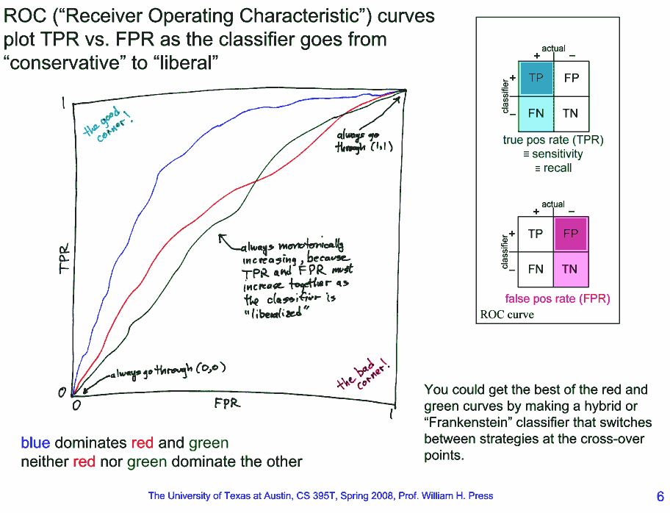

Slide 35
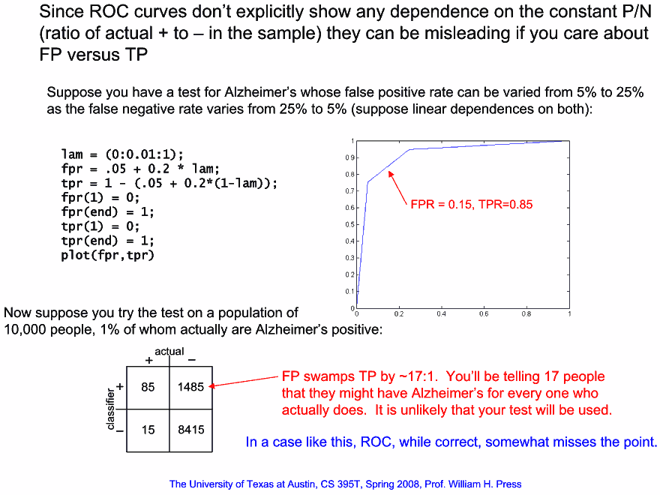

Slide 36
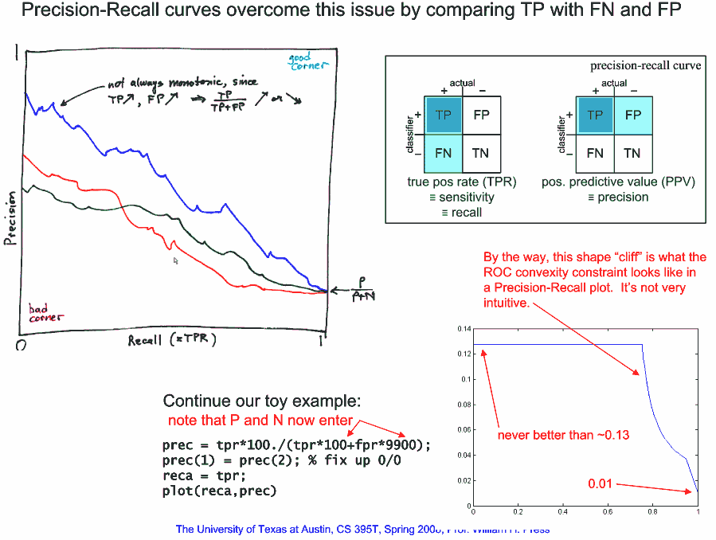

Slide 37
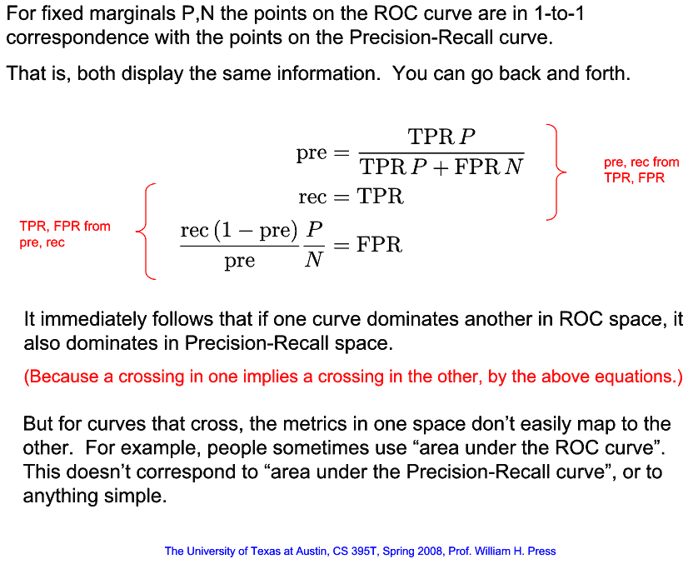

Slide 38
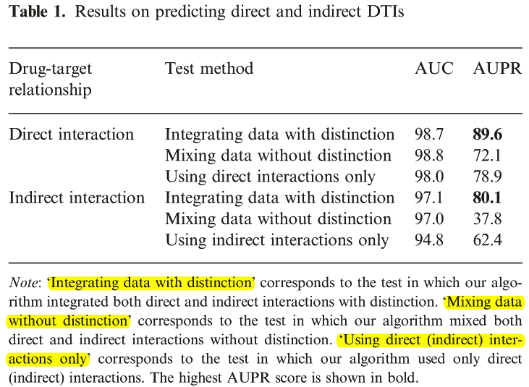
Predicting direct and indirect DTIs

Slide 39
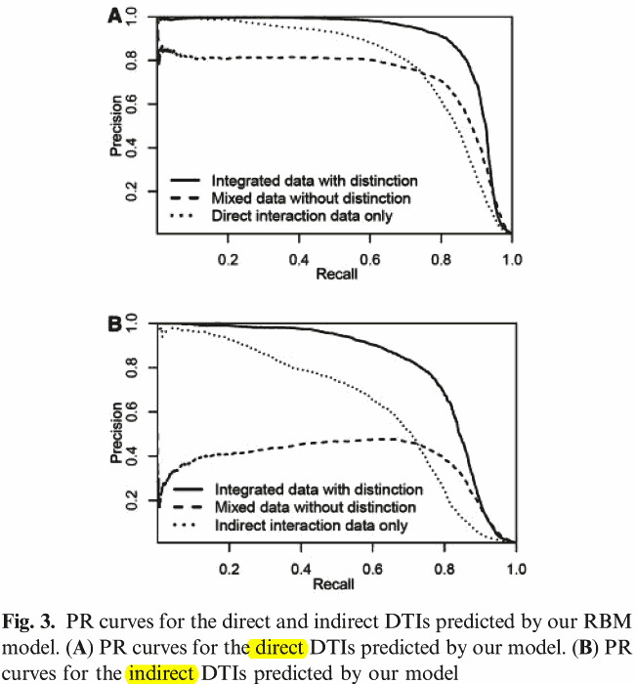

Slide 40
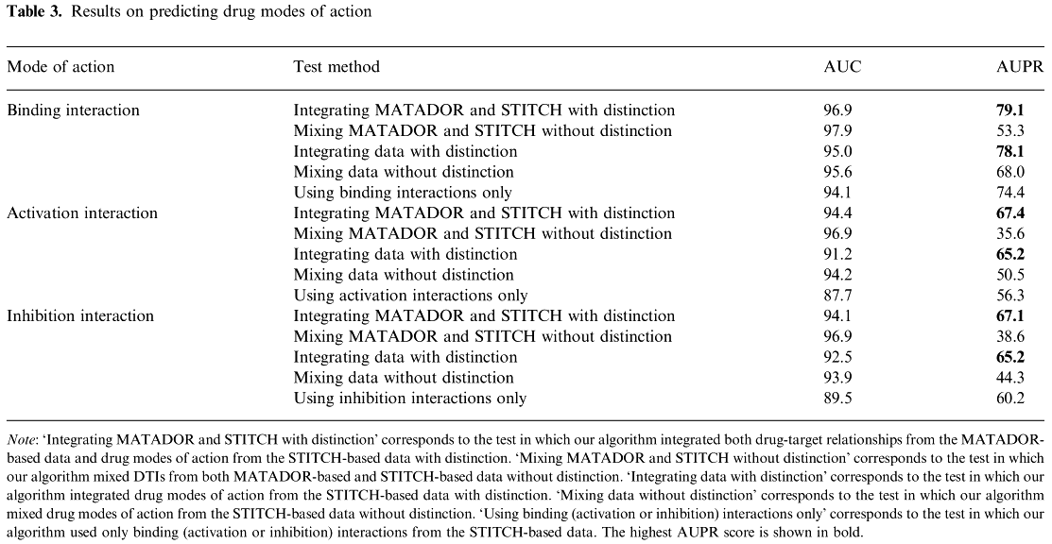
Predicting drug modes of action

Slide 41
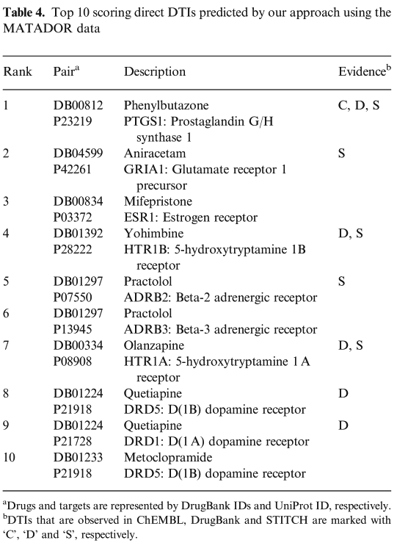
New predictions
These results on new predictions indicated that the proposed RBM model is practically useful in predicting novel DTIs and can have potential applications in drug repositioning.

Slide 42
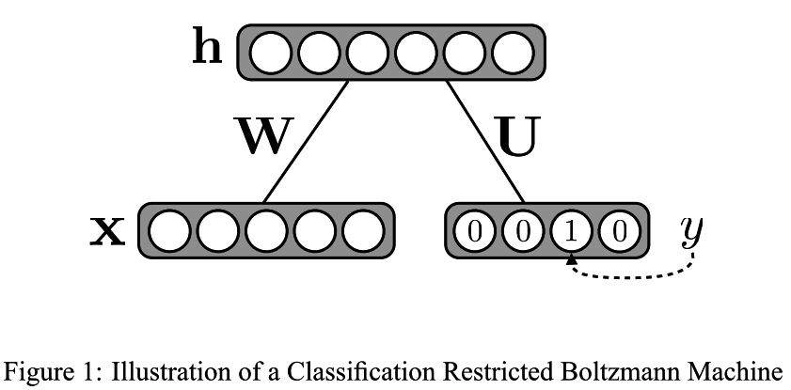
Classiﬁcation RBM (ClassRBM)

Slide 43
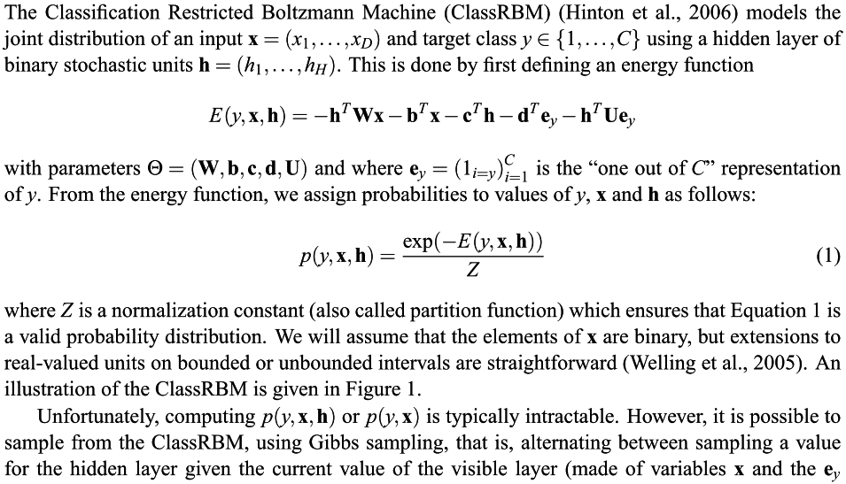

Slide 44
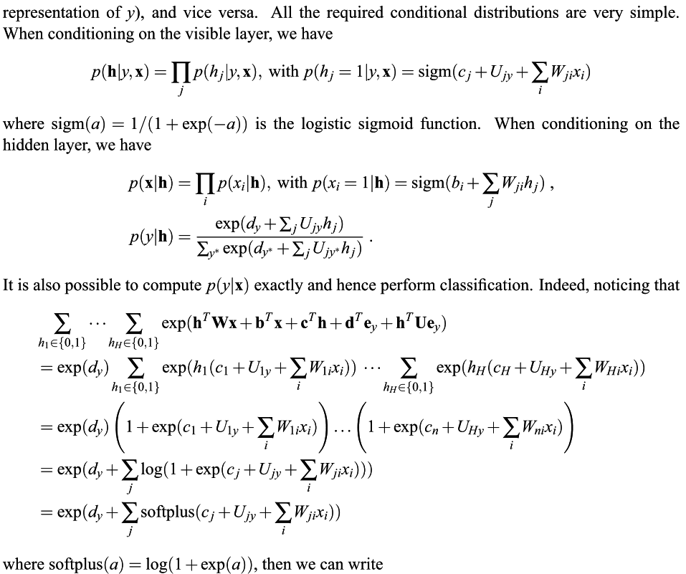

Slide 45
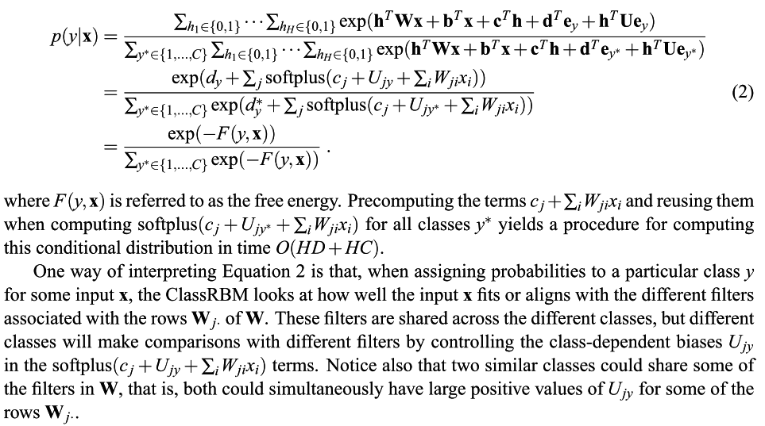

Slide 46

ClassRBM vs. Neural Networks
http://hephaestusaudio.com/delphi/2008/11/20/neural-networks-for-audio/

