Slide 1
Forecasting Enrollment Model Based on First-Order Fuzzy Time Series
Melike Sah and Konstantin Y.Degtiarev, MIEEE
World Academy of Science, Engineering and Technology 1 2007
Date: Aug. 27, 2013
許竣傑

Slide 2
Abstract
This paper proposes a novel improvement of forecasting approach based on using time-invariant fuzzy time series. In contrast to traditional forecasting methods, fuzzy time series can be also applied to problems, in which historical data are linguistic values. It is shown that proposed time-invariant method improves the performance of forecasting process. Further, the effect of using different number of fuzzy sets is tested as well. As with the most of cited papers, historical enrollment of the University of Alabama is used in this study to illustrate the forecasting process. Subsequently, the performance of the proposed method is compared with existing fuzzy time series time-invariant models based on forecasting accuracy. It reveals a certain performance superiority of the proposed method over methods described in the literature.

Slide 3
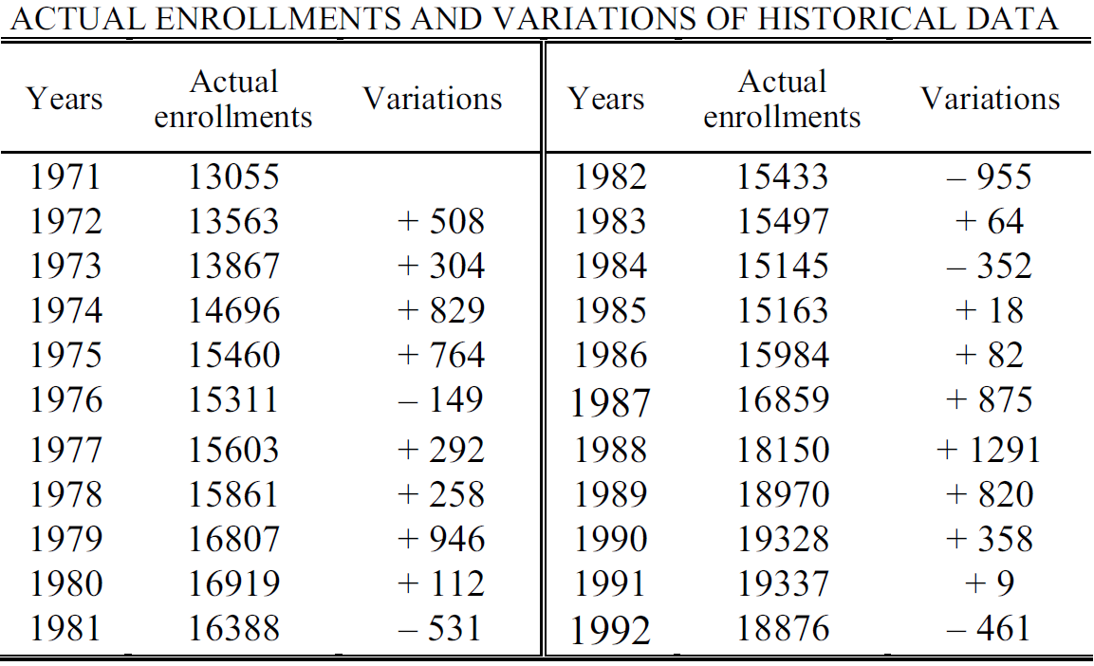




Forecasting
Step 1: U=[$V_{min}−V_{1},V_{max}+V_{2}$]
$$V_{min}=−955,V_{max}=1291$$
$$V_{1}=45,V_{2}=109$$
$U=[$-1000,1400]

Slide 4

Forecasting
Step 2
U=[-1000,1400]
$u_{1}=\left[−1000,−600\right]$
$u_{2}=\left[−600,−200\right]$
$u_{3}=\left[−200,200\right]$
$u_{4}=[200,600]$
$u_{5}=\left[600,1000\right]$
$u_{6}=[1000,1400]$

Slide 5
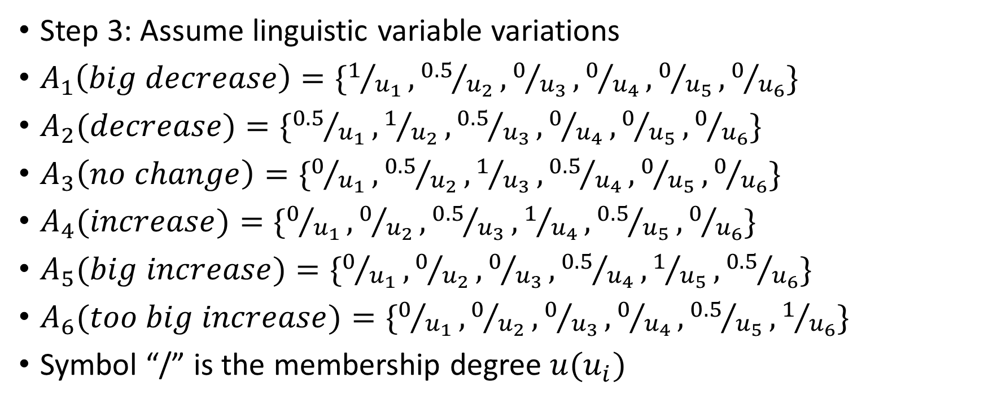
Forecasting
Step 3: Assume linguistic variable variations
$A_{1}\left(big decrease\right)=\{1/{u_{1}},{0.5}/{u_{2}},0/{u_{3}},0/{u_{4}},0/{u_{5}},0/{u_{6}}\}$
$A_{2}(decrease)=\{{0.5}/{u_{1}},1/{u_{2}},{0.5}/{u_{3}},0/{u_{4}},0/{u_{5}},0/{u_{6}}\}$
$A_{3}\left(no change\right)=\{0/{u_{1}},{0.5}/{u_{2}},1/{u_{3}},{0.5}/{u_{4}},0/{u_{5}},0/{u_{6}}\}$
$A_{4}(increase)=\{0/{u_{1}},0/{u_{2}},{0.5}/{u_{3}},1/{u_{4}},{0.5}/{u_{5}},0/{u_{6}}\}$
$A_{5}(big increase)=\{0/{u_{1}},0/{u_{2}},0/{u_{3}},{0.5}/{u_{4}},1/{u_{5}},{0.5}/{u_{6}}\}$
$A_{6}(too big increase)=\{0/{u_{1}},0/{u_{2}},0/{u_{3}},0/{u_{4}},{0.5}/{u_{5}},1/{u_{6}}\}$
Symbol “/” is the membership degree $u(u_{i})$

Slide 6
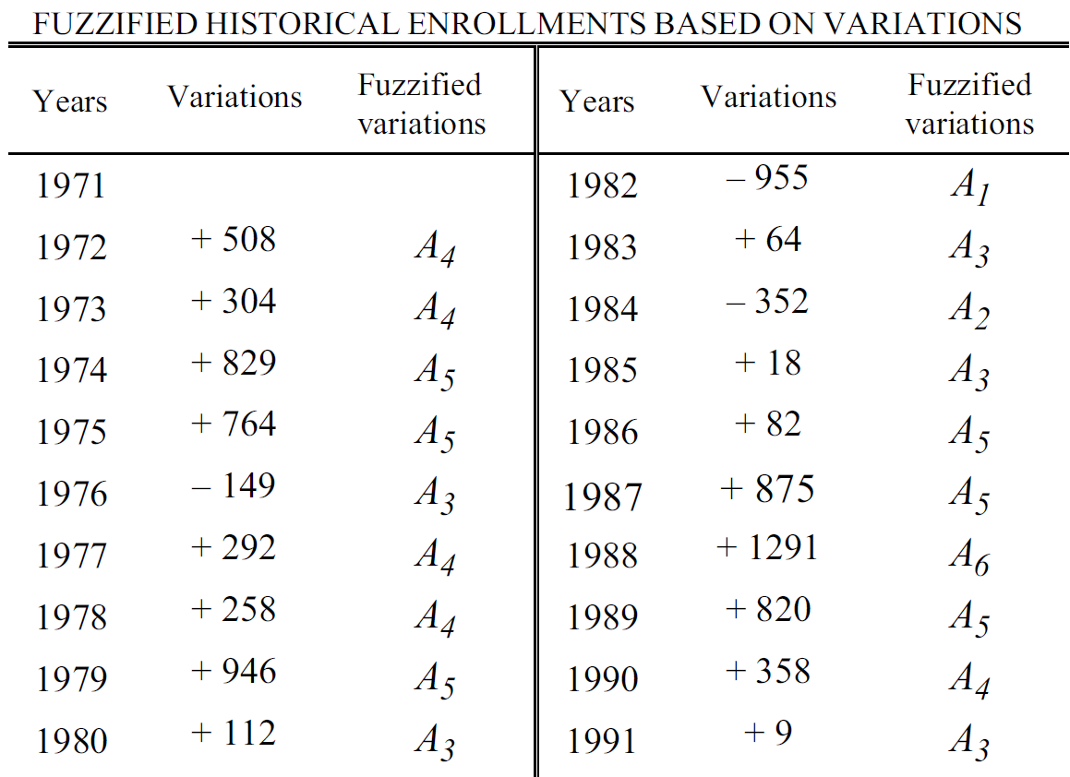
Forecasting
Step 4: find fuzzy set

Slide 7
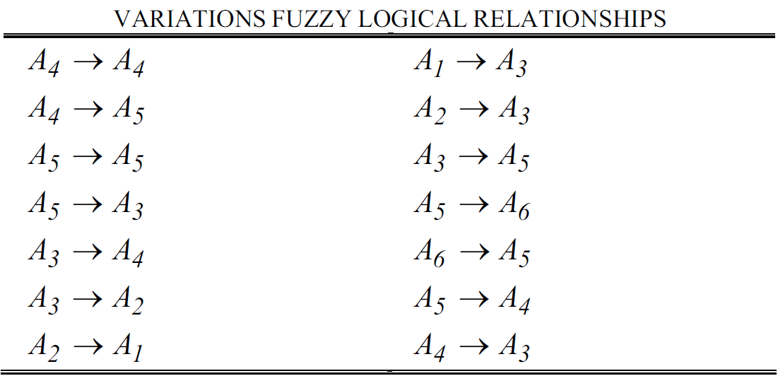
Forecasting
Step 5: Determine first-order relation

Slide 8
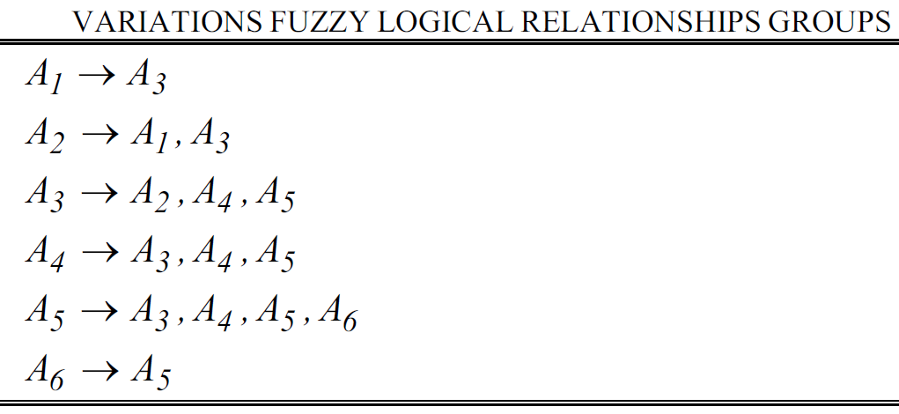
Forecasting
Step 6: Combine fuzzy
relationships

Slide 9
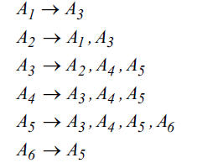
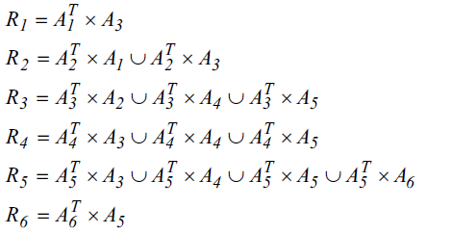



Forecasting
$R_{2}=A_{2}^{T}×A_{1}⋃A_{2}^{T}×A_{3}$
0.5
1
0.5
0
0
0
F
$$×$$
1 | 0.5 | 0 | 0 | 0 | 0
0.5 | 0.5 | 0 | 0 | 0 | 0
1 | 0.5 | 0 | 0 | 0 | 0
0.5 | 0.5 | 0 | 0 | 0 | 0
0 | 0 | 0 | 0 | 0 | 0
0 | 0 | 0 | 0 | 0 | 0
0 | 0 | 0 | 0 | 0 | 0
$$=$$

Slide 10


Forecasting
0 | 0.5 | 0.5 | 0.5 | 0 | 0
0 | 0.5 | 1 | 0.5 | 0 | 0
0 | 0.5 | 0.5 | 0.5 | 0 | 0
0 | 0 | 0 | 0 | 0 | 0
0 | 0 | 0 | 0 | 0 | 0
0 | 0 | 0 | 0 | 0 | 0
$A_{2}^{T}×A_{3}$ =
$R_{2}$=
0.5 | 0.5 | 0 | 0 | 0 | 0
1 | 0.5 | 0 | 0 | 0 | 0
0.5 | 0.5 | 0 | 0 | 0 | 0
0 | 0 | 0 | 0 | 0 | 0
0 | 0 | 0 | 0 | 0 | 0
0 | 0 | 0 | 0 | 0 | 0
0 | 0.5 | 0.5 | 0.5 | 0 | 0
0 | 0.5 | 1 | 0.5 | 0 | 0
0 | 0.5 | 0.5 | 0.5 | 0 | 0
0 | 0 | 0 | 0 | 0 | 0
0 | 0 | 0 | 0 | 0 | 0
0 | 0 | 0 | 0 | 0 | 0
0.5 | 0.5 | 0.5 | 0.5 | 0 | 0
1 | 0.5 | 1 | 0.5 | 0 | 0
0.5 | 0.5 | 0.5 | 0.5 | 0 | 0
0 | 0 | 0 | 0 | 0 | 0
0 | 0 | 0 | 0 | 0 | 0
0 | 0 | 0 | 0 | 0 | 0
$$⋃$$
=

Slide 11
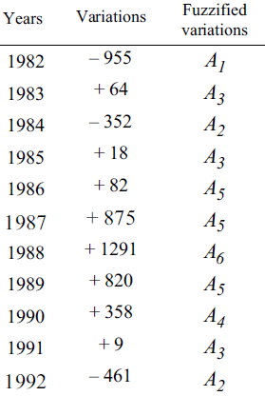





Forecasting
Step 7: $A_{i}=A_{i−1}∘R_{i}$
0.5 | 0.5 | 0.5 | 0.5 | 0 | 0
1 | 0.5 | 1 | 0.5 | 0 | 0
0.5 | 0.5 | 0.5 | 0.5 | 0 | 0
0 | 0 | 0 | 0 | 0 | 0
0 | 0 | 0 | 0 | 0 | 0
0 | 0 | 0 | 0 | 0 | 0
$$f(1993)=A_{2}∘R_{2}$$
=
0.5 | 1 | 0.5 | 0 | 0 | 0
$$∘$$
=
1 | 0.5 | 1 | 0.5 | 0 | 0
1
0.5
$$u_{1}$$
…
$$u_{6}$$
-800
0
1200
Notes:
http://green.kyu.edu.tw/gt/file/file2/ef3b56dac5704f958fb77b6be3291f0c.pdf

Slide 12
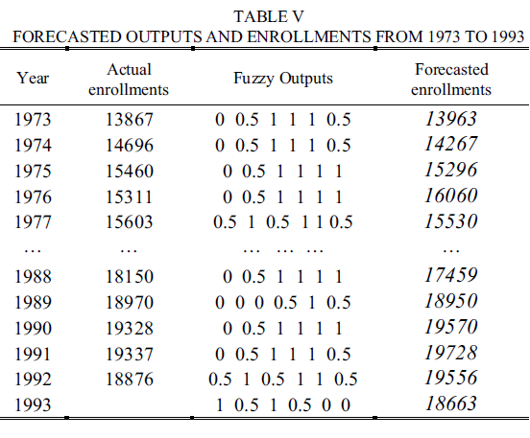
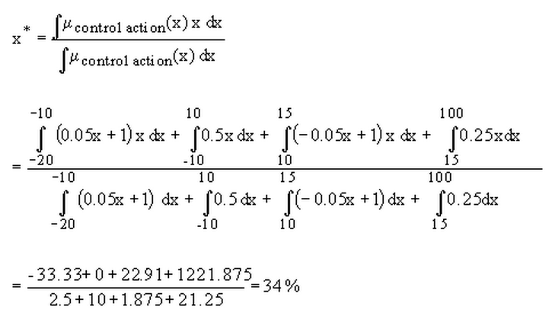
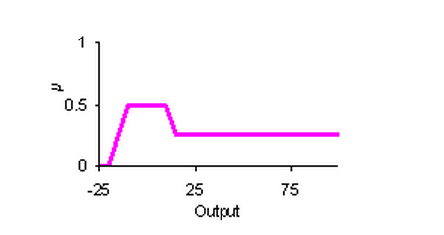
Forecasting
Step 8: Defuzzification
centroid method:

Slide 13
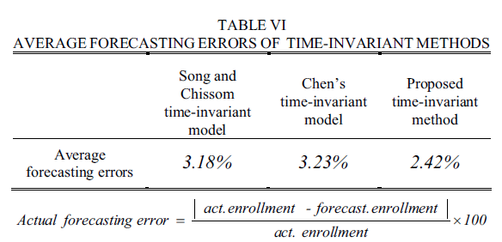
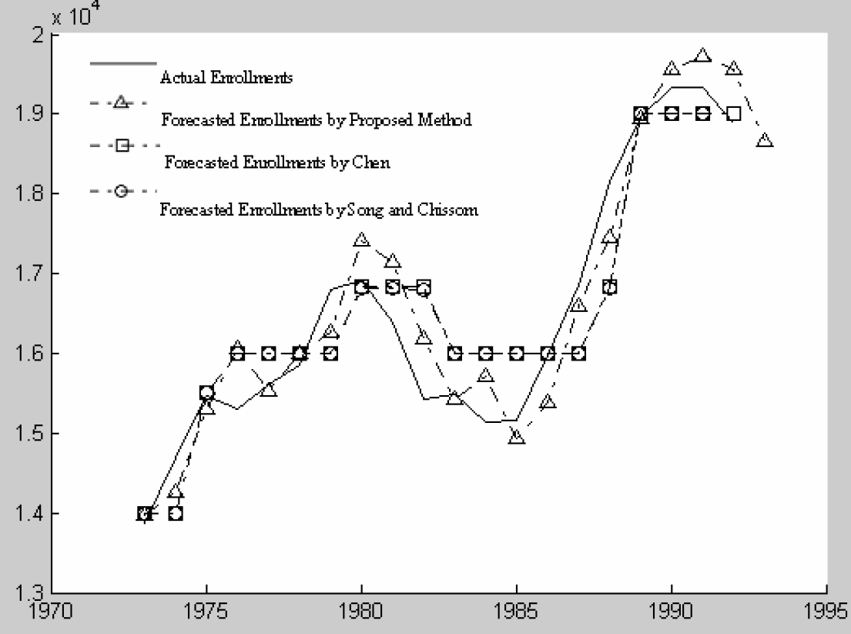
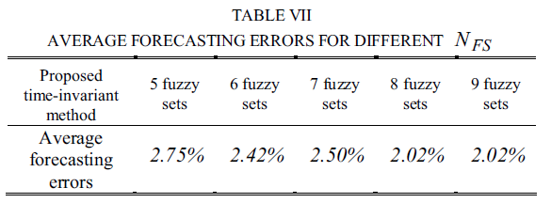
Discussion

Slide 14
Thank you !!

