Slide 1
Overview OF Multicarrier CDMA
Shinsuke Hara, Osaka University
Ramjee Prasad, Delft University of Technology
IEEE Communications Magazine December 1997
Reporter : Cing-Yao Chen 2013/9/10

Slide 2
ABSTRACT
The authors present an overview of new multiple access schemes based on a combination of code division and multicarrier techniques, such as multicarrier code-division multiple access (MC-CDMA), multicarrier direct sequence CDMA (multicarrier DS-CDMA), and multitone CDMA (MT-CDMA)

Slide 3
?DMA
TDMA
Time-division multiple access
FDMA
Frequency-division multiple access
CDMA
Code-division multiple access
DS-
Direct sequence
FH-
Frequency hopping

Slide 4
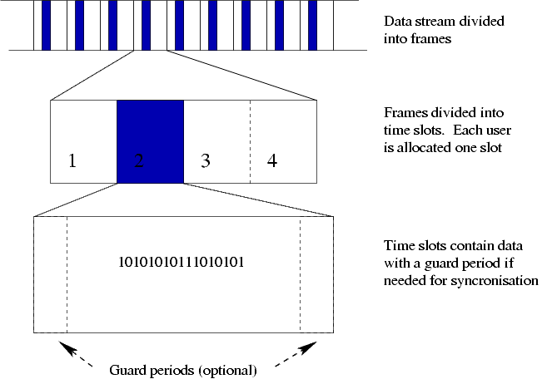
TDMA
TDMA
Time-division multiple access
FDMA
Frequency-division multiple access
CDMA
Code-division multiple access
DS-
Direct sequence
FH-
Frequency hopping

Slide 5
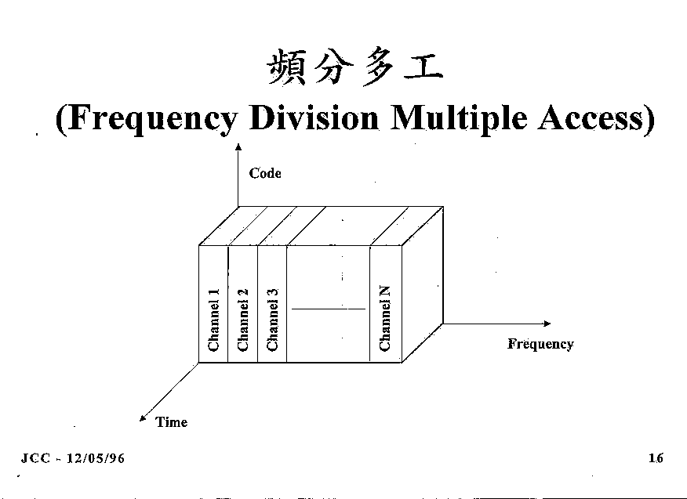
FDMA
TDMA
Time-division multiple access
FDMA
Frequency-division multiple access
CDMA
Code-division multiple access
DS-
Direct sequence
FH-
Frequency hopping

Slide 6
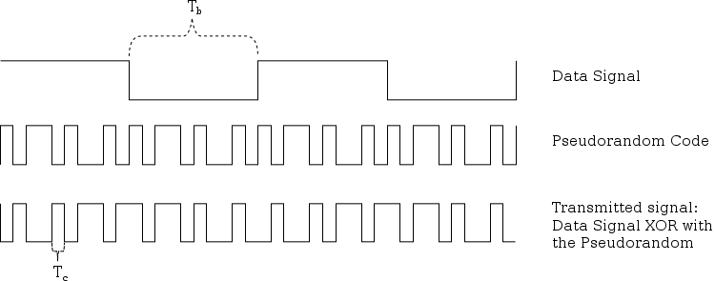
CDMA
TDMA
Time-division multiple access
FDMA
Frequency-division multiple access
CDMA
Code-division multiple access
DS-
Direct sequence
FH-
Frequency hopping

Slide 7
DS-CDMA

Slide 8
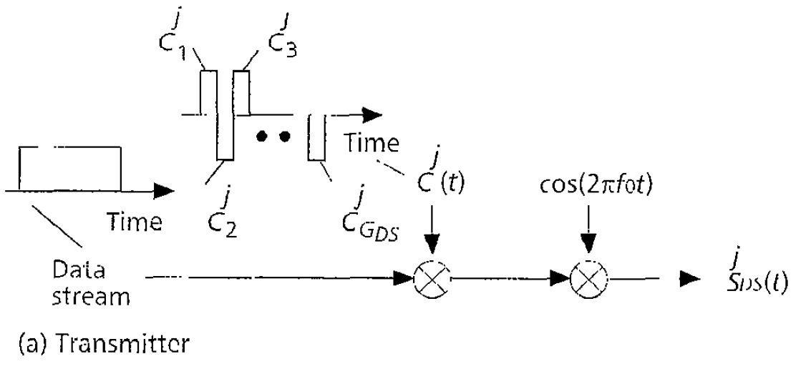
DS-CDMA

Slide 9
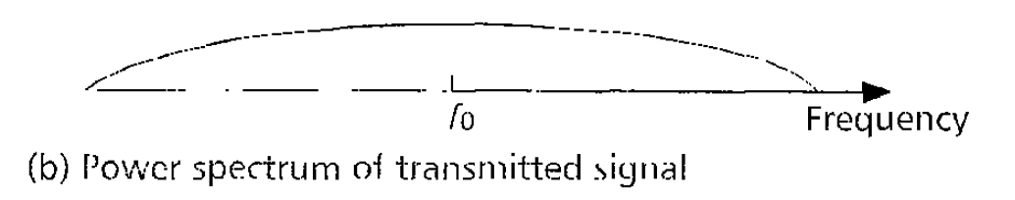
DS-CDMA

Slide 10
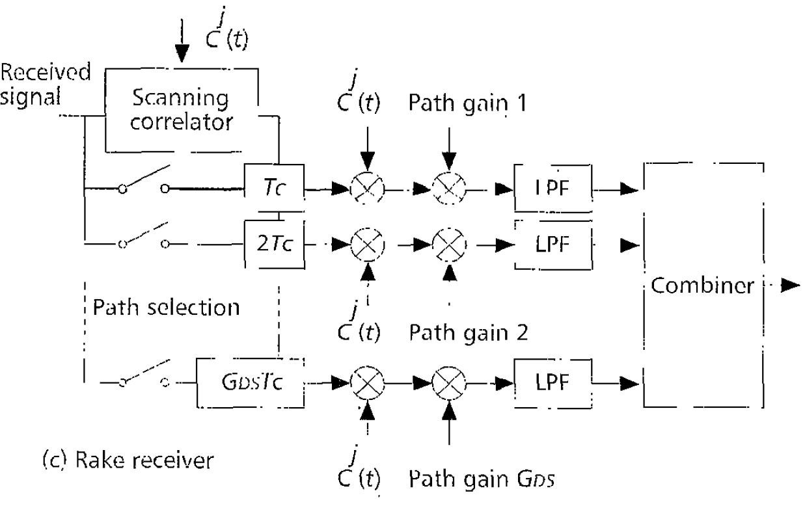
DS-CDMA

Slide 11
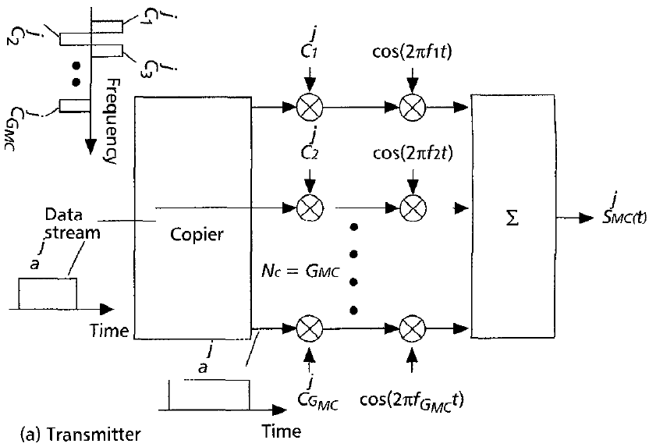
MC-CDMA

Slide 12
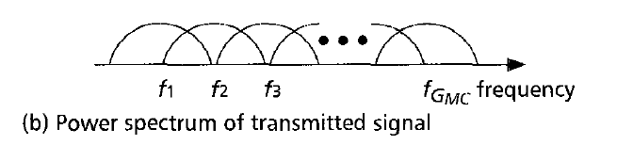
MC-CDMA

Slide 13
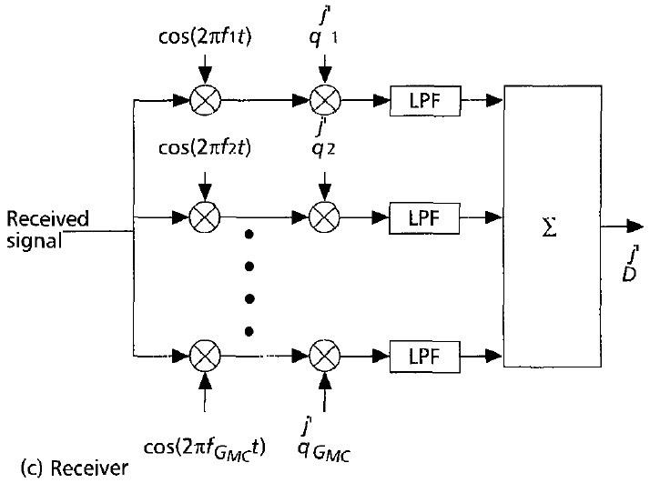
MC-CDMA

Slide 14
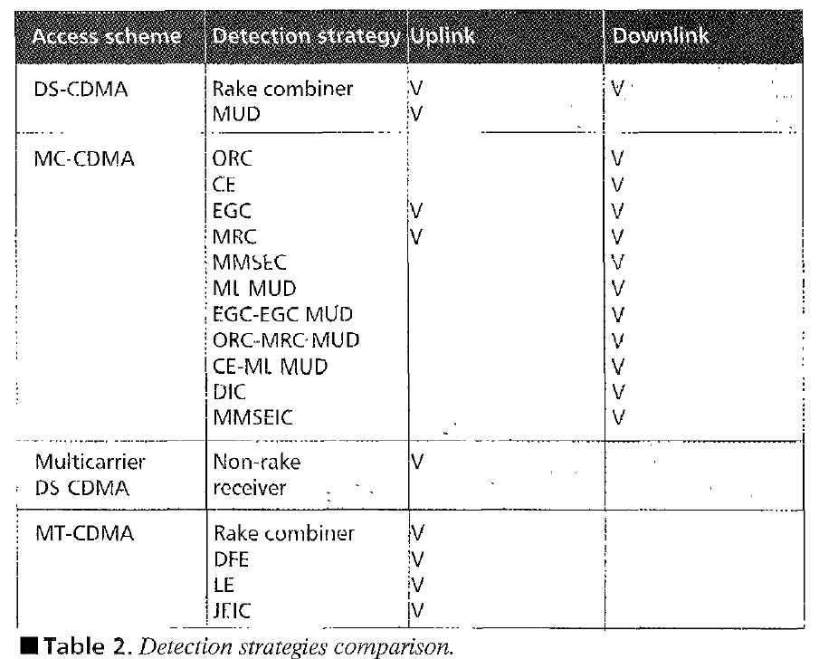
Detection strategies comparison.

Slide 15
CONCLuSIONS
This article reviews the Multi-Carrier-based CDMA schemes such as MC-CDMA, Multicarrier DS-CDMA and Multitone CDMA, and discusses their advantages and disadvantages, with a normal DS-CDMA scheme. Computer simulation results have shown that the MC-CDMA scheme with MMSEC is a promising protocol in a 2-path frequency selective slow Rayleigh fading channel.
However, more detailed discussions and analyses using different multipath delay profiles are required.

