Slide 1
An Introduction to the Conjugate gradient method without the agonizing pain
Jonathan Richard Shewchuk
Technical Report, 1994
Sept. 10, 2013
Hung-Hsin Chen (陳紘昕)

Slide 2
Abstract (1/2)
The Conjugate Gradient Method is the most prominent iterative method for solving sparse systems of linear equations. Unfortunately, many textbook treatments of the topic are written with neither illustrations nor intuition, and their victims can be found to this day babbling senselessly in the corners of dusty libraries. For this reason, a deep, geometric understanding of the method has been reserved for the elite brilliant few who have painstakingly decoded the mumblings of their forebears. Nevertheless, the Conjugate Gradient Method is a composite of simple, elegant ideas that almost anyone can understand. Of course, a reader as intelligent as yourself will learn them almost effortlessly.

Slide 3
Abstract (2/2)
The idea of quadratic forms is introduced and used to derive the methods of Steepest Descent, Conjugate Directions, and Conjugate Gradients. Eigenvectors are explained and used to examine the convergence of the Jacobi Method, Steepest Descent, and Conjugate Gradients. Other topics include preconditioning and the nonlinear Conjugate Gradient Method. I have taken pains to make this article easy to read. Sixty-six illustrations are provided. Dense prose is avoided. Concepts are explained in several different ways. Most equations are coupled with an intuitive interpretation.

Slide 4
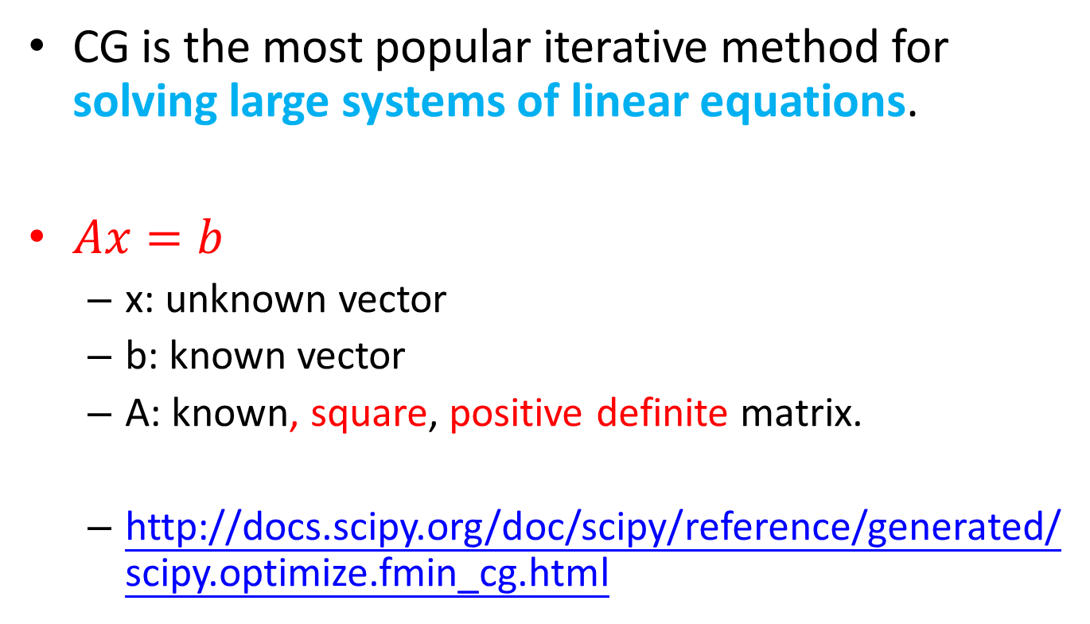
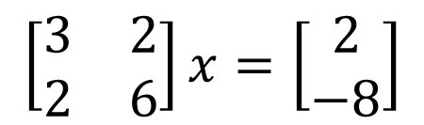
Conjugate gradient (CG)
CG is the most popular iterative method for solving large systems of linear equations.
$Ax=b$
x: unknown vector
b: known vector
A: known, square, positive definite matrix.
http://docs.scipy.org/doc/scipy/reference/generated/scipy.optimize.fmin_cg.html
$$\left[\begin{matrix}3 & 2 \\ 2 & 6\end{matrix}\right]x=\left[\begin{matrix}2 \\ −8\end{matrix}\right]$$

Slide 5
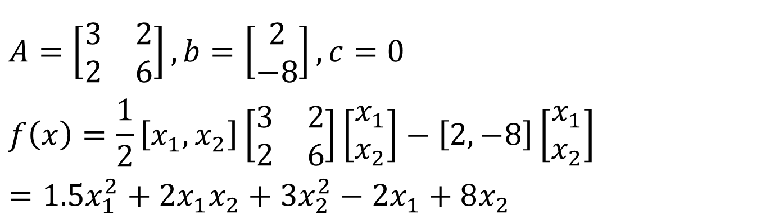
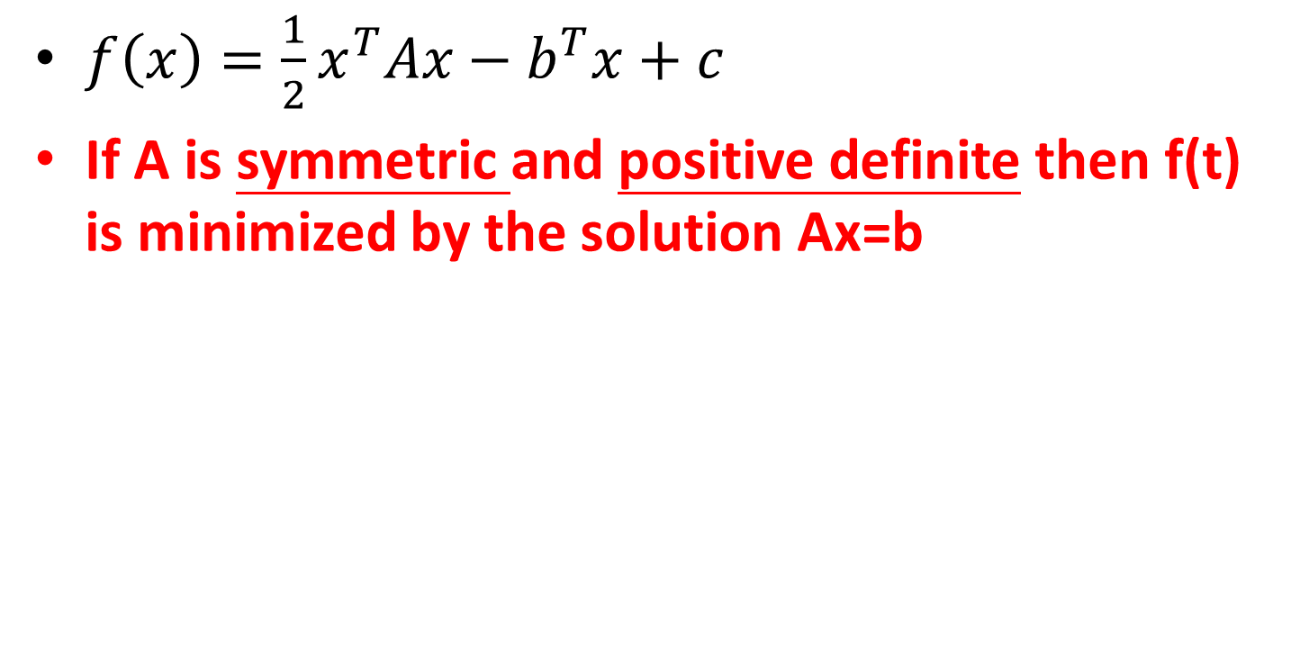
Quadratic form
$f\left(x\right)=\frac{1}{2}x^{T}Ax−b^{T}x+c$
If A is symmetric and positive definite then f(t) is minimized by the solution Ax=b
$$A=\left[\begin{matrix}3 & 2 \\ 2 & 6\end{matrix}\right], b=\left[\begin{matrix}2 \\ −8\end{matrix}\right], c=0$$
$$f\left(x\right)=\frac{1}{2}\left[x_{1},x_{2}\right]\left[\begin{matrix}3 & 2 \\ 2 & 6\end{matrix}\right]\left[\begin{matrix}x_{1} \\ x_{2}\end{matrix}\right]−\left[2,−8\right]\left[\begin{matrix}x_{1} \\ x_{2}\end{matrix}\right]=1.5x_{1}^{2}+2x_{1}x_{2}+3x_{2}^{2}−2x_{1}+8x_{2}$$

Slide 6
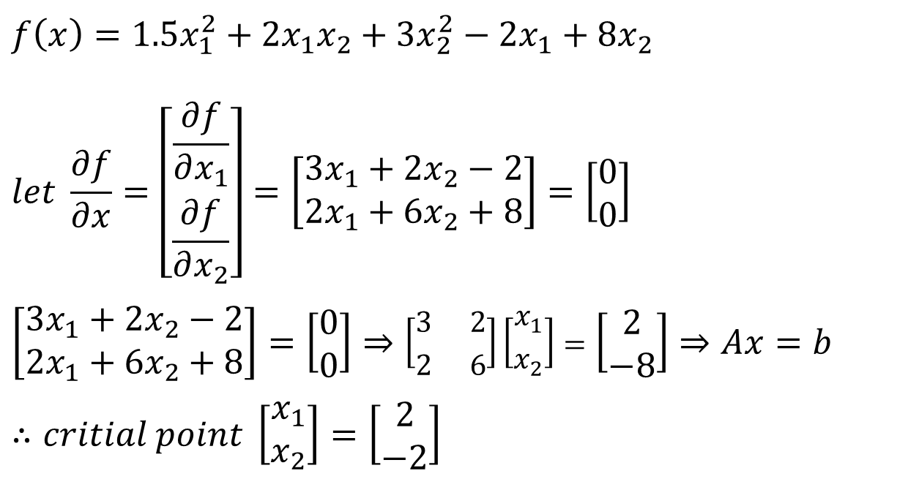
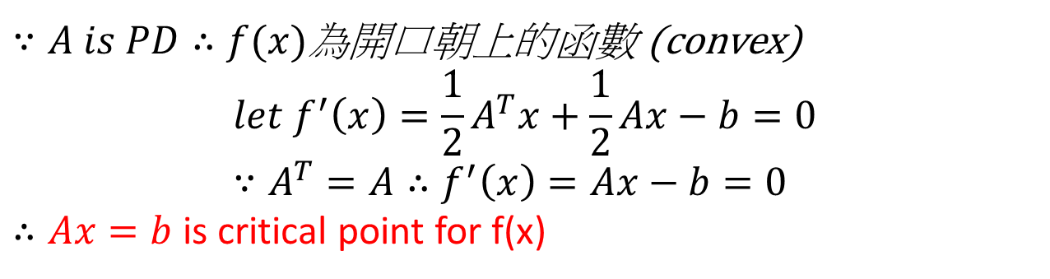
$∵A is PD∴f(x)$為開口朝上的函數 (convex)
$$let f^{′}\left(x\right)=\frac{1}{2}A^{T}x+\frac{1}{2}Ax−b=0 \\ ∵A^{T}=A∴f^{′}\left(x\right)=Ax−b=0$$ $∴Ax=b$ is critical point for f(x)
$$f\left(x\right)=1.5x_{1}^{2}+2x_{1}x_{2}+3x_{2}^{2}−2x_{1}+8x_{2}$$
$$let \frac{∂f}{∂x}=\left[\begin{matrix}\frac{∂f}{∂x_{1}} \\ \frac{∂f}{∂x_{2}}\end{matrix}\right]=\left[\begin{matrix}3x_{1}+2x_{2}−2 \\ 2x_{1}+6x_{2}+8\end{matrix}\right]=\left[\begin{matrix}0 \\ 0\end{matrix}\right]$$
$$\left[\begin{matrix}3x_{1}+2x_{2}−2 \\ 2x_{1}+6x_{2}+8\end{matrix}\right]=\left[\begin{matrix}0 \\ 0\end{matrix}\right]⇒\left[\begin{matrix}3 & 2 \\ 2 & 6\end{matrix}\right]\left[\begin{matrix}x_{1} \\ x_{2}\end{matrix}\right]=\left[\begin{matrix}2 \\ −8\end{matrix}\right]⇒Ax=b$$
$$∴critial point \left[\begin{matrix}x_{1} \\ x_{2}\end{matrix}\right]=\left[\begin{matrix}2 \\ −2\end{matrix}\right]$$

Slide 7
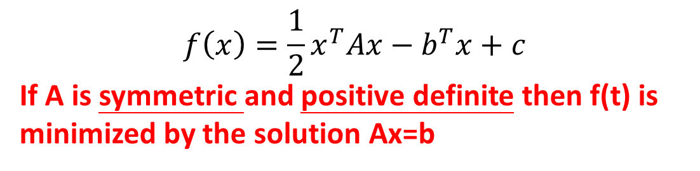
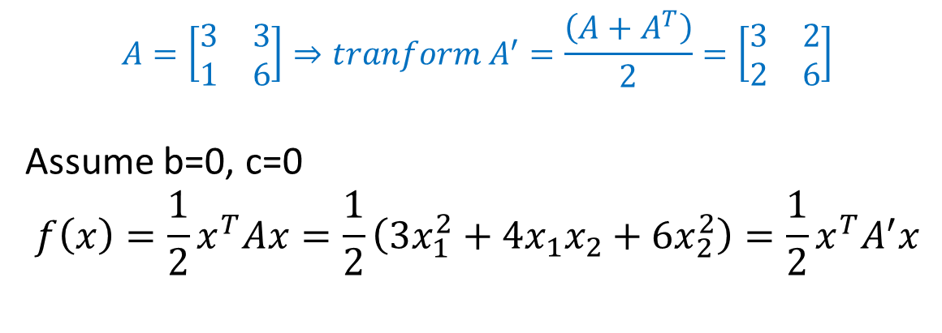
If matrix A is not symmetric
$$f\left(x\right)=\frac{1}{2}x^{T}Ax−b^{T}x+c$$
If A is symmetric and positive definite then f(t) is minimized by the solution Ax=b
$$A=\left[\begin{matrix}3 & 3 \\ 1 & 6\end{matrix}\right]⇒tranform A^{′}=\frac{\left(A+A^{T}\right)}{2}=\left[\begin{matrix}3 & 2 \\ 2 & 6\end{matrix}\right]$$
Assume b=0, c=0
$$f\left(x\right)=\frac{1}{2}x^{T}Ax=\frac{1}{2}\left(3x_{1}^{2}+4x_{1}x_{2}+6x_{2}^{2}\right)=\frac{1}{2}x^{T}A^{′}x$$

Slide 8
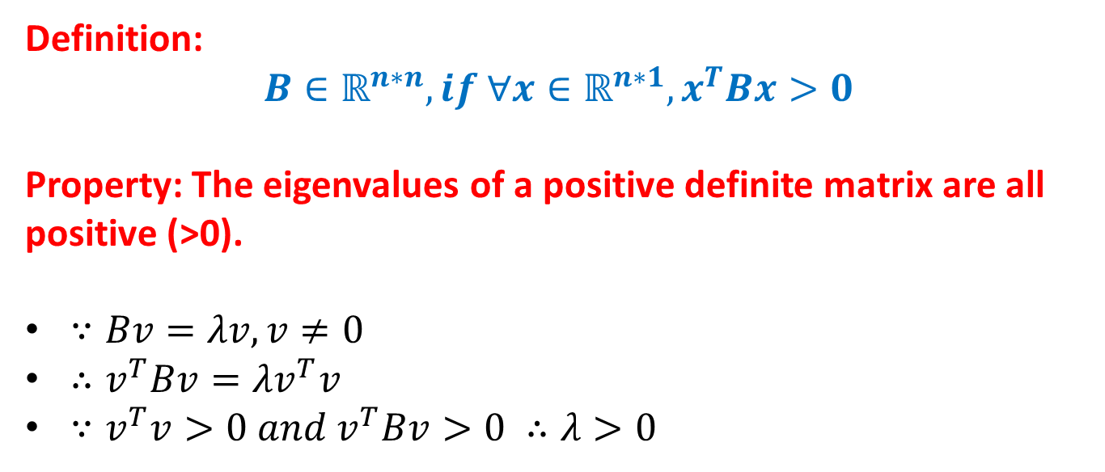
Positive definite matrix
Definition:
$$B∈ℝ^{n∗n}, if ∀x∈ℝ^{n∗1}, x^{T}Bx>0$$
Property: The eigenvalues of a positive definite matrix are all positive (>0).
$∵Bv=λv, v≠0$
$∴v^{T}Bv=λv^{T}v$
$∵v^{T}v>0 and v^{T}Bv>0 ∴λ>0$

Slide 9
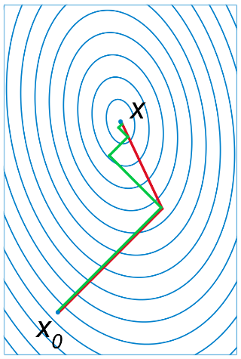
Advantage of the CG
X: optimal solution
X₀: initial search pint
Green path: gradient descent
Red path: conjugate gradient

Slide 10
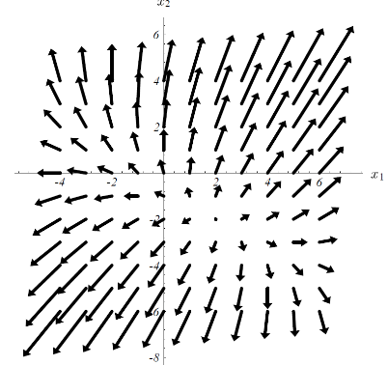
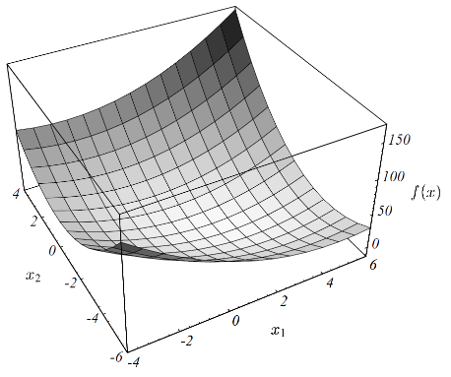
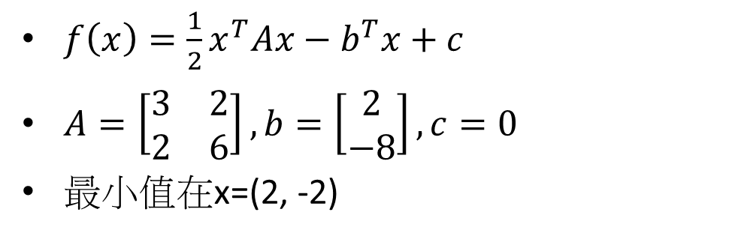
$f\left(x\right)=\frac{1}{2}x^{T}Ax−b^{T}x+c$
$A=\left[\begin{matrix}3 & 2 \\ 2 & 6\end{matrix}\right], b=\left[\begin{matrix}2 \\ −8\end{matrix}\right], c=0$
最小值在x=(2, -2)

Slide 11
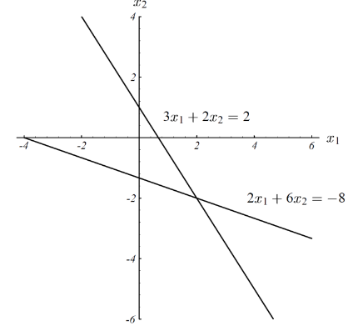
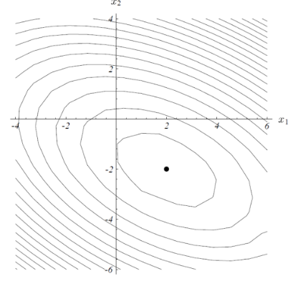
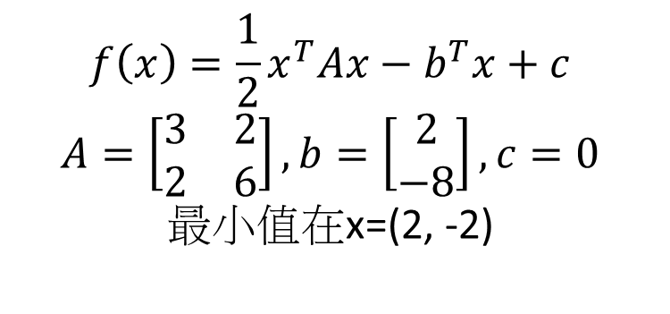
$$f\left(x\right)=\frac{1}{2}x^{T}Ax−b^{T}x+c$$
$$A=\left[\begin{matrix}3 & 2 \\ 2 & 6\end{matrix}\right], b=\left[\begin{matrix}2 \\ −8\end{matrix}\right], c=0$$
最小值在x=(2, -2)

Slide 12
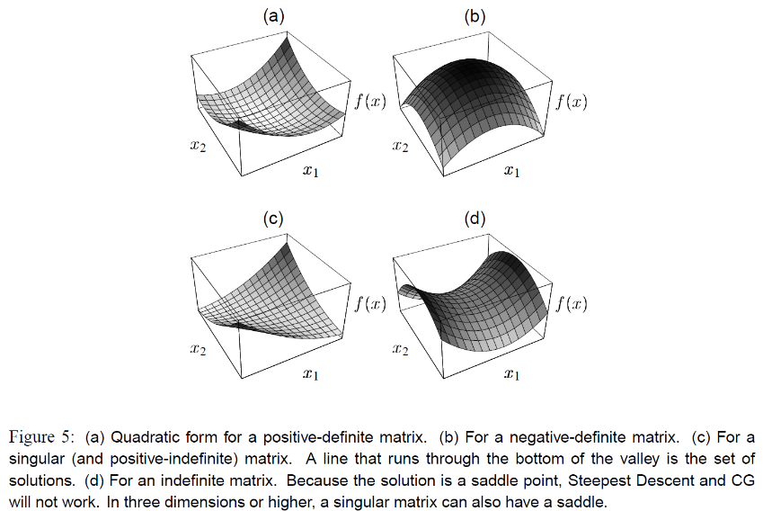
Quadratic form for different matrix
PD, 開口朝上
存在最小值
ND, 開口朝下
存在最大值
Singular and PI
Set of solutions

Slide 13
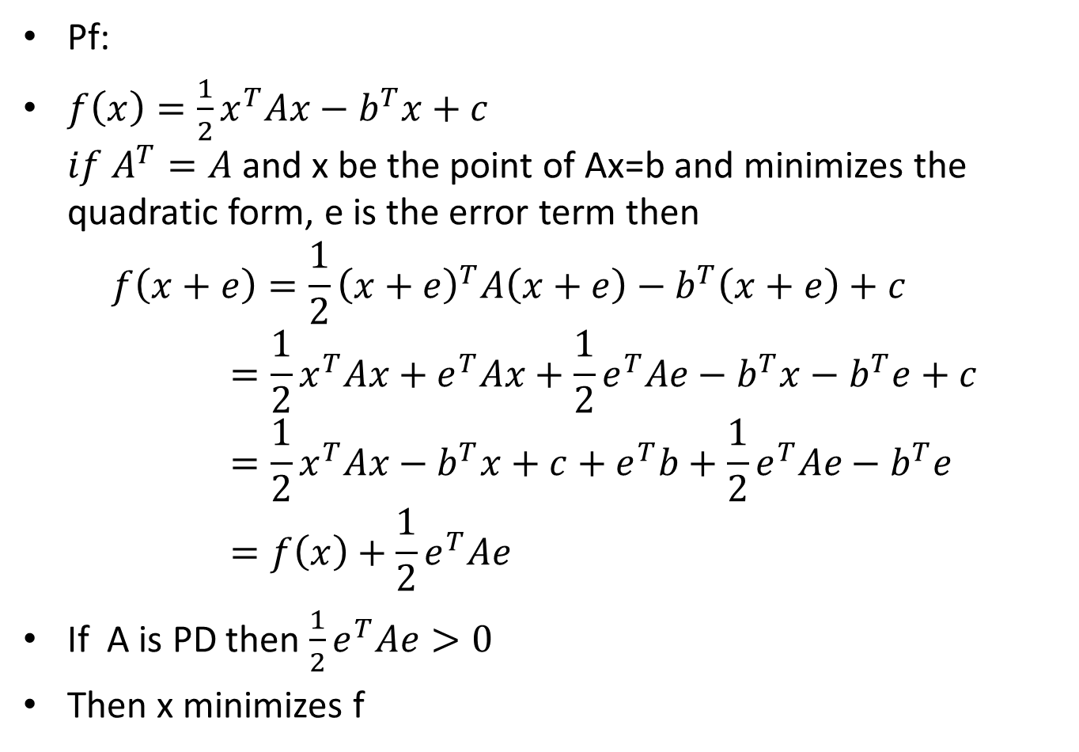
The solution to Ax=b minimizes the quadratic form
Pf:
$f\left(x\right)=\frac{1}{2}x^{T}Ax−b^{T}x+c$ $if A^{T}=A$ and x be the point of Ax=b and minimizes the quadratic form, e is the error term then $f\left(x+e\right)=\frac{1}{2}{\left(x+e\right)}^{T}A\left(x+e\right)−b^{T}\left(x+e\right)+c=\frac{1}{2}x^{T}Ax+e^{T}Ax+\frac{1}{2}e^{T}Ae−b^{T}x−b^{T}e+c=\frac{1}{2}x^{T}Ax−b^{T}x+c+e^{T}b+\frac{1}{2}e^{T}Ae−b^{T}e=f\left(x\right)+\frac{1}{2}e^{T}Ae$
If A is PD then $\frac{1}{2}e^{T}Ae>0$
Then x minimizes f

Slide 14
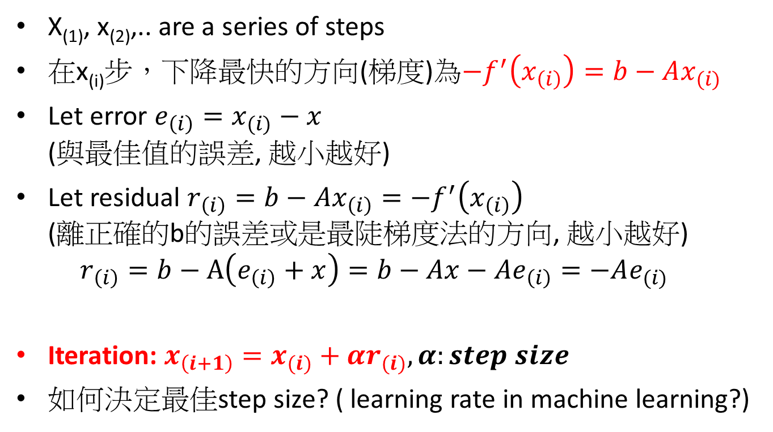
Steepest gradient descent (SGD)
X₍₁₎, x₍₂₎,.. are a series of steps
在x_{(i)}步，下降最快的方向(梯度)為$−f^{′}\left(x_{\left(i\right)}\right)=b−Ax_{(i)}$
Let error $e_{\left(i\right)}=x_{(i)}−x$ (與最佳值的誤差, 越小越好)
Let residual $r_{\left(i\right)}=b−Ax_{\left(i\right)}=−f^{′}\left(x_{\left(i\right)}\right)$ (離正確的b的誤差或是最陡梯度法的方向, 越小越好) $r_{\left(i\right)}=b−A\left(e_{\left(i\right)}+x\right)=b−Ax−Ae_{\left(i\right)}=−Ae_{(i)}$
Iteration: $x_{\left(i+1\right)}=x_{(i)}+αr_{(i)}, α:step size$
如何決定最佳step size? ( learning rate in machine learning?)

Slide 15
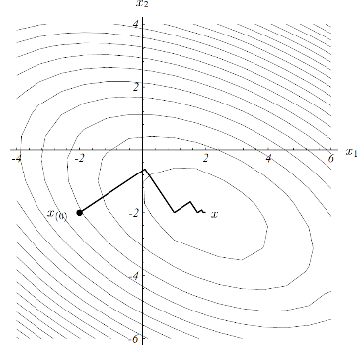
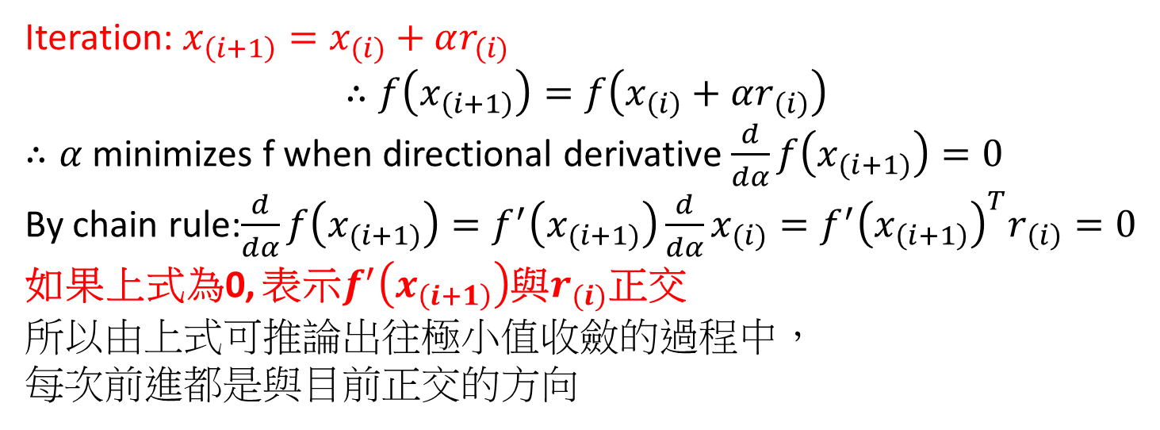
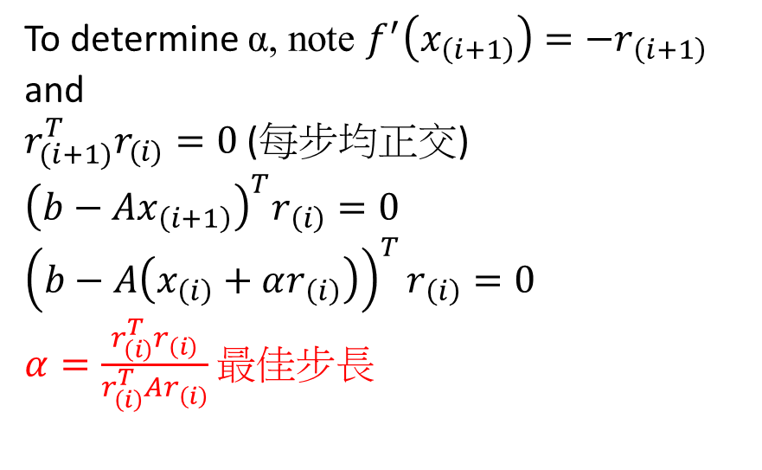
Iteration: $x_{\left(i+1\right)}=x_{(i)}+αr_{(i)}$
$$∴f\left(x_{\left(i+1\right)}\right)=f\left(x_{\left(i\right)}+αr_{\left(i\right)}\right)$$
$∴α$minimizes f when directional derivative $\frac{d}{dα}f\left(x_{(i+1)}\right)=0$
By chain rule:$\frac{d}{dα}f\left(x_{(i+1)}\right)=f^{′}\left(x_{(i+1)}\right)\frac{d}{dα}x_{(i)}=f^{′}{\left(x_{\left(i+1\right)}\right)}^{T}r_{\left(i\right)}=0$
如果上式為0, 表示$f^{′}\left(x_{\left(i+1\right)}\right)$與$r_{(i)}$正交
所以由上式可推論出往極小值收斂的過程中，
每次前進都是與目前正交的方向
To determine α, note $f^{′}\left(x_{\left(i+1\right)}\right)=−r_{\left(i+1\right)}$and
$r_{(i+1)}^{T}r_{(i)}=0$(每步均正交)
$${\left(b−Ax_{\left(i+1\right)}\right)}^{T}r_{\left(i\right)}=0$$
$${\left(b−A\left(x_{\left(i\right)}+αr_{\left(i\right)}\right)\right)}^{T}r_{\left(i\right)}=0$$
$α=\frac{r_{\left(i\right)}^{T}r_{\left(i\right)}}{r_{\left(i\right)}^{T}Ar_{\left(i\right)}}$ 最佳步長
Zigzag path

Slide 16
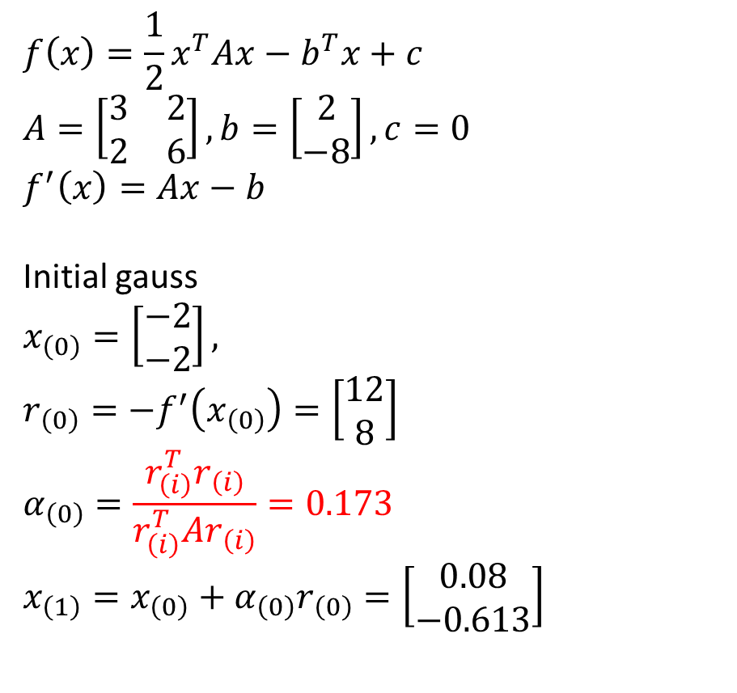
SGD example
$$f\left(x\right)=\frac{1}{2}x^{T}Ax−b^{T}x+c$$
$$A=\left[\begin{matrix}3 & 2 \\ 2 & 6\end{matrix}\right], b=\left[\begin{matrix}2 \\ −8\end{matrix}\right], c=0$$
$$f^{′}\left(x\right)=Ax−b$$
Initial gauss
$$x_{\left(0\right)}=\left[\begin{matrix}−2 \\ −2\end{matrix}\right],$$
$$r_{\left(0\right)}=−f^{′}\left(x_{\left(0\right)}\right)=\left[\begin{matrix}12 \\ 8\end{matrix}\right]$$
$$α_{\left(0\right)}=\frac{r_{\left(i\right)}^{T}r_{\left(i\right)}}{r_{\left(i\right)}^{T}Ar_{\left(i\right)}}=0.173$$
$$x_{\left(1\right)}=x_{\left(0\right)}+α_{\left(0\right)}r_{\left(0\right)}=\left[\begin{matrix}0.08 \\ −0.613\end{matrix}\right]$$

Slide 17
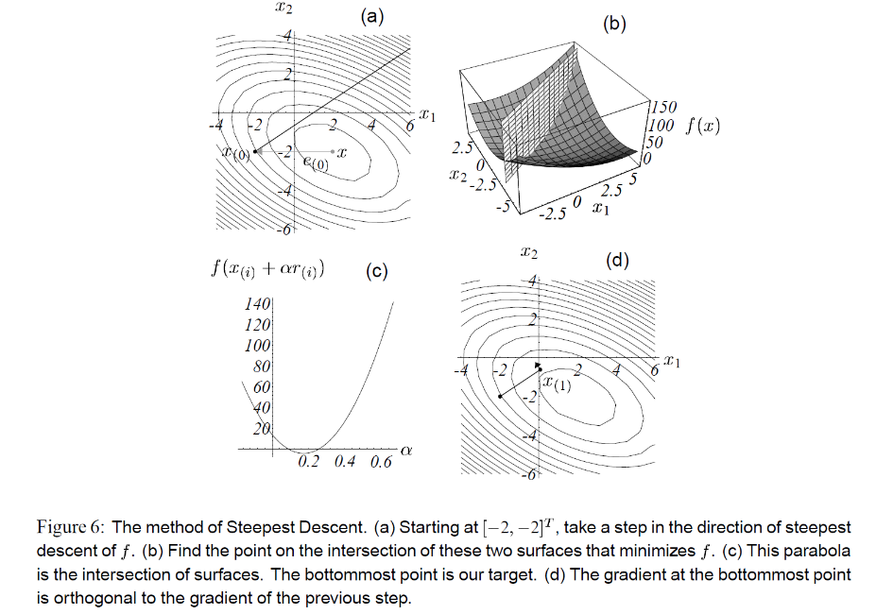

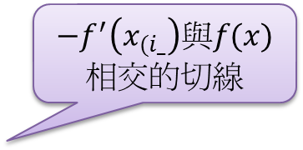
由(-2, -2)開始，實線的方向為$−f^{′}\left(−2, −2\right)$
$−f^{′}\left(x_{(i_}\right)與f(x)$相交的切線

Slide 18
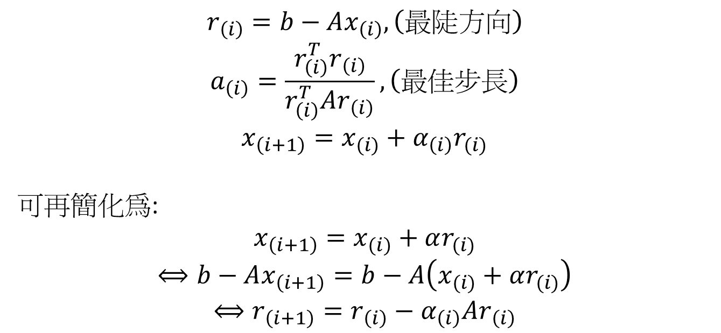
Steepest descent algorithm
$$r_{\left(i\right)}=b−Ax_{\left(i\right)}, \left(最陡方向\right)$$
$$a_{\left(i\right)}=\frac{r_{\left(i\right)}^{T}r_{\left(i\right)}}{r_{\left(i\right)}^{T}Ar_{\left(i\right)}},\left(最佳步長\right)$$
$$x_{\left(i+1\right)}=x_{(i)}+α_{\left(i\right)}r_{(i)}$$
可再簡化為:
$$x_{\left(i+1\right)}=x_{(i)}+αr_{(i)}$$
$$⟺b−Ax_{\left(i+1\right)}=b−A\left(x_{(i)}+αr_{(i)}\right)$$
$$⟺r_{\left(i+1\right)}=r_{\left(i\right)}−α_{\left(i\right)}Ar_{\left(i\right)}$$

Slide 19
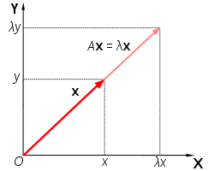
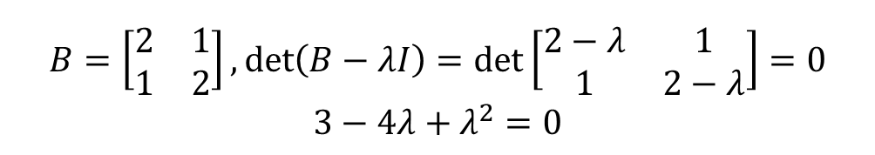
Eigenvector and eigenvalue
Vector x is eigenvector of matrix B, x!=0 if:
Bx = λx
λ is eigenvalue of matrix B
$$B=\left[\begin{matrix}2 & 1 \\ 1 & 2\end{matrix}\right],\det\left(B−λI\right)=\det\left[\begin{matrix}2−λ & 1 \\ 1 & 2−λ\end{matrix}\right]=0$$
$$3−4λ+λ^{2}=0$$
λ=3 or 1, 可再求出對應的eigenvector各為[1, 1]與[-1, 1]

Slide 20
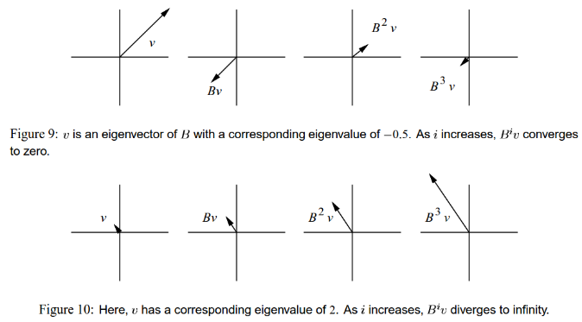

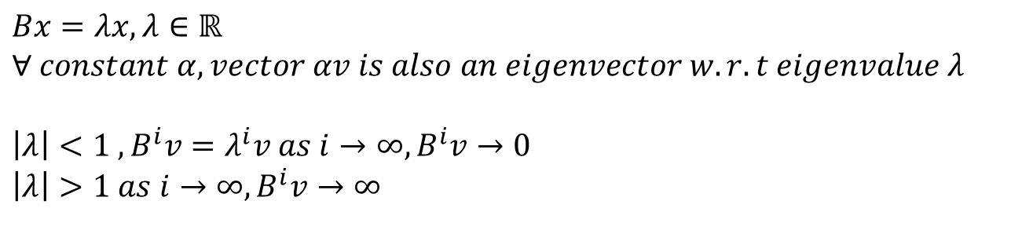

Eigenvector & eigenvalue
$$Bx=λx, λ∈ℝ$$
$$∀ constant α, vector αv is also an eigenvector w.r.t eigenvalue λ$$
$$\left|λ\right|<1 , B^{i}v=λ^{i}v as i→∞, B^{i}v→0$$
$$\left|λ\right|>1 as i→∞, B^{i}v→∞$$
$$λ=−0.5$$
$$λ=2$$

Slide 21
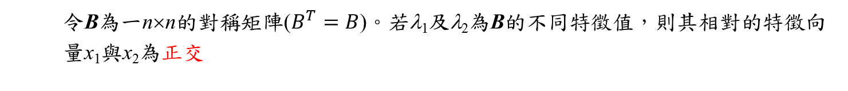
Symmetric matrix
令B為一n×n的對稱矩陣($B^{T}=B$)。若λ₁及λ₂為B的不同特徵值，則其相對的特徵向量x₁與x₂為正交

Slide 22
Symmetric matrix
A real n×n matrix B is symmetric if and only if there is an orthonormal basis of R consisting of eigenvectors for B.
所以對稱矩陣B的eigenvector必定L.I.，且有n個不同的eigenvalues
如果B apply to a non-eigenvector x時，則Bx可拆解成B之eigenvector的線性組合

Slide 23
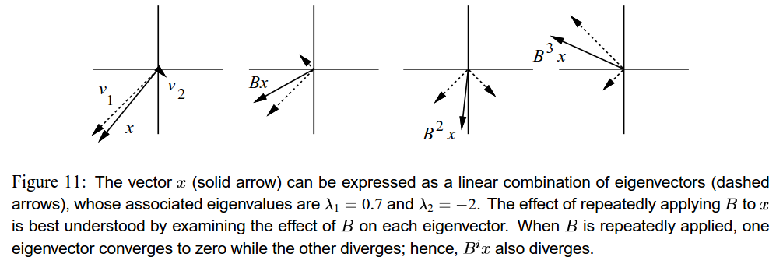
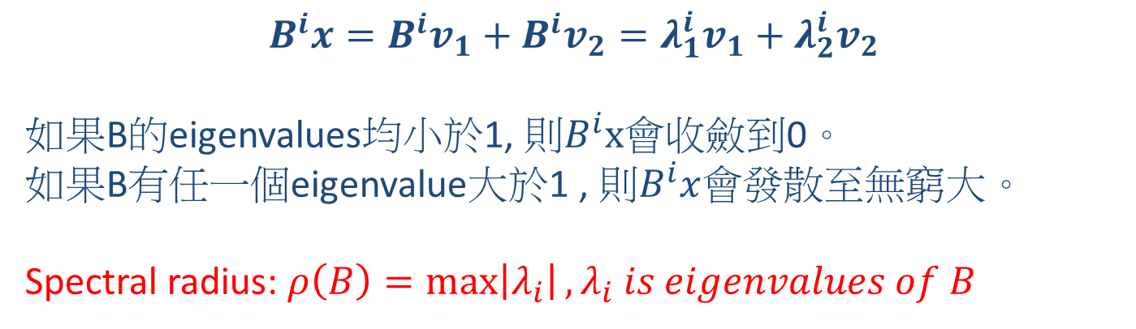
$$B^{i}x=B^{i}v_{1}+B^{i}v_{2}=λ_{1}^{i}v_{1}+λ_{2}^{i}v_{2}$$
如果B的eigenvalues均小於1, 則$B^{i}x$會收斂到0。
如果B有任一個eigenvalue大於1 , 則$B^{i}x$會發散至無窮大。
Spectral radius: $ρ\left(B\right)=\max\left|λ_{i}\right|, λ_{i} is eigenvalues of B$

Slide 24
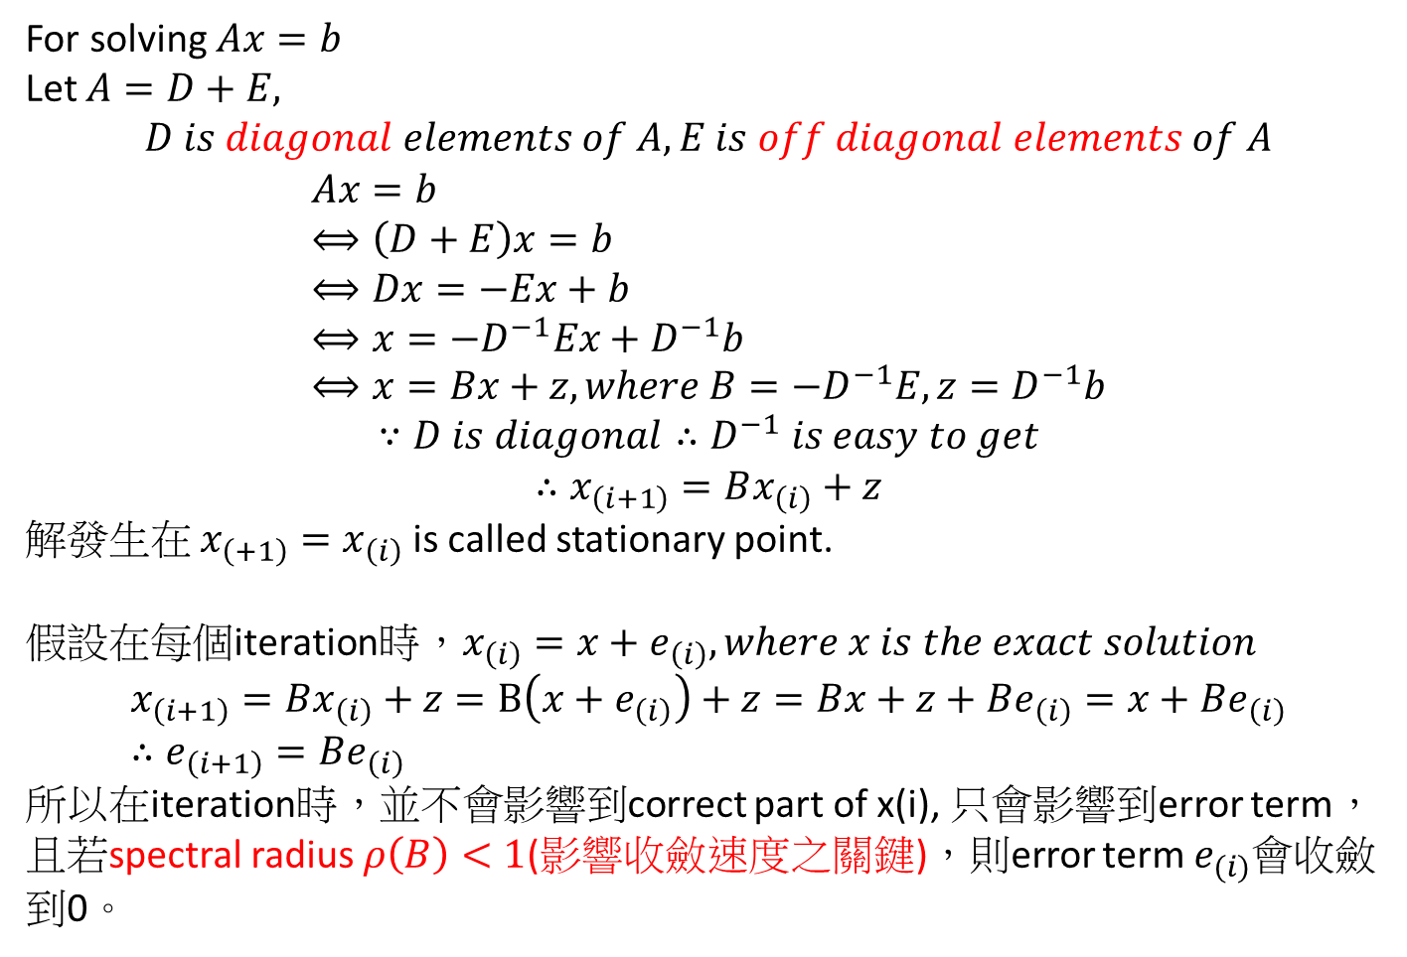
Jacobi iterations
For solving $Ax=b$
Let $A=D+E,$ $$D is diagonal elements of A, E is off diagonal elements of A$$
$$Ax=b \\ ⟺\left(D+E\right)x=b \\ ⟺Dx=−Ex+b \\ ⟺x=−D^{−1}Ex+D^{−1}b \\ ⟺x=Bx+z, where B=−D^{−1}E, z=D^{−1}b$$
$$∵D is diagonal∴D^{−1} is easy to get$$
$$∴x_{\left(i+1\right)}=Bx_{\left(i\right)}+z$$
解發生在 $x_{\left(+1\right)}=x_{\left(i\right)}$is called stationary point.
假設在每個iteration時，$x_{\left(i\right)}=x+e_{\left(i\right)}, where x is the exact solution$
$$x_{\left(i+1\right)}=Bx_{\left(i\right)}+z=B\left(x+e_{\left(i\right)}\right)+z=Bx+z+Be_{\left(i\right)}=x+Be_{\left(i\right)} \\ ∴e_{\left(i+1\right)}=Be_{\left(i\right)}$$
所以在iteration時，並不會影響到correct part of x(i), 只會影響到error term，且若spectral radius $ρ\left(B\right)<1$(影響收斂速度之關鍵)，則error term $e_{(i)}$會收斂到0。

Slide 25
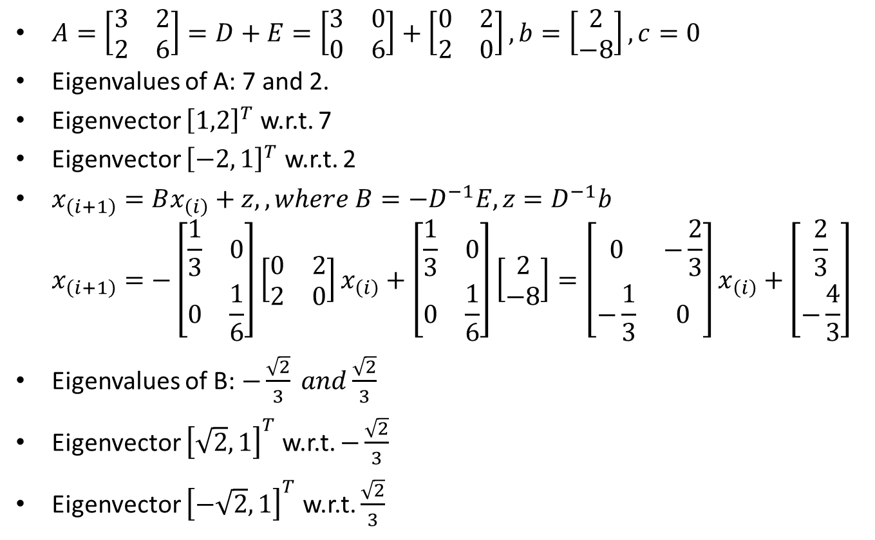
Jacobi iterations example
$A=\left[\begin{matrix}3 & 2 \\ 2 & 6\end{matrix}\right]=D+E=\left[\begin{matrix}3 & 0 \\ 0 & 6\end{matrix}\right]+\left[\begin{matrix}0 & 2 \\ 2 & 0\end{matrix}\right],b=\left[\begin{matrix}2 \\ −8\end{matrix}\right], c=0$
Eigenvalues of A: 7 and 2.
Eigenvector ${\left[1,2\right]}^{T}$ w.r.t. 7
Eigenvector ${\left[−2, 1\right]}^{T}$ w.r.t. 2
$x_{\left(i+1\right)}=Bx_{\left(i\right)}+z, , where B=−D^{−1}E, z=D^{−1}b$ $x_{\left(i+1\right)}=−\left[\begin{matrix}\frac{1}{3} & 0 \\ 0 & \frac{1}{6}\end{matrix}\right]\left[\begin{matrix}0 & 2 \\ 2 & 0\end{matrix}\right]x_{\left(i\right)}+\left[\begin{matrix}\frac{1}{3} & 0 \\ 0 & \frac{1}{6}\end{matrix}\right]\left[\begin{matrix}2 \\ −8\end{matrix}\right]=\left[\begin{matrix}0 & −\frac{2}{3} \\ −\frac{1}{3} & 0\end{matrix}\right]x_{\left(i\right)}+\left[\begin{matrix}\frac{2}{3} \\ −\frac{4}{3}\end{matrix}\right]$
Eigenvalues of B: $−\frac{\sqrt{2}}{3} and\frac{\sqrt{2}}{3}$
Eigenvector ${\left[\sqrt{2}, 1\right]}^{T}$ w.r.t. $−\frac{\sqrt{2}}{3}$
Eigenvector ${\left[−\sqrt{2},1\right]}^{T}$ w.r.t. $\frac{\sqrt{2}}{3}$

Slide 26
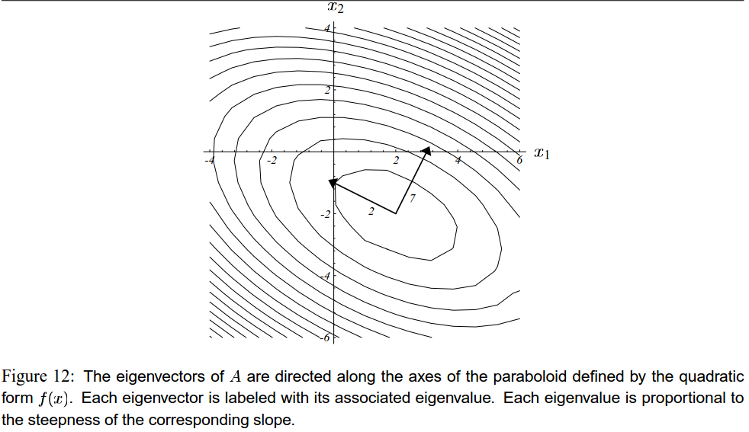


Eigenvalues of A: 7 and 2.
Eigenvector ${\left[1,2\right]}^{T}$ w.r.t. 7
Eigenvector ${\left[−2, 1\right]}^{T}$ w.r.t. 2
$$A=\left[\begin{matrix}3 & 2 \\ 2 & 6\end{matrix}\right]$$
Eigenvectors正交
Eigenvectors指向橢圓的兩軸
eigenvalue較大的eigenvector的方向較陡

Slide 27
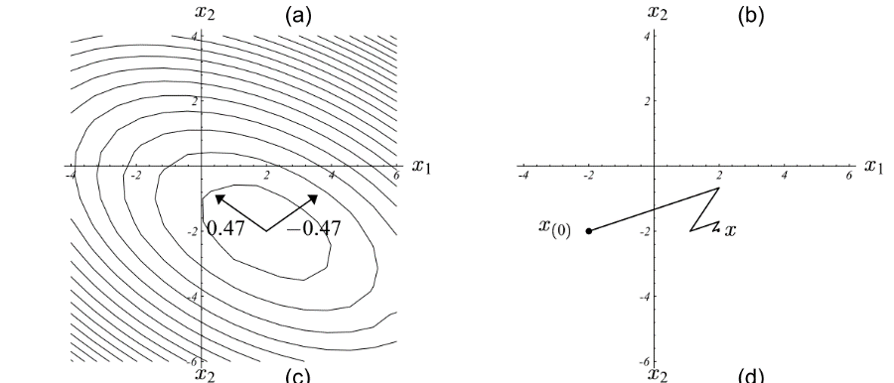

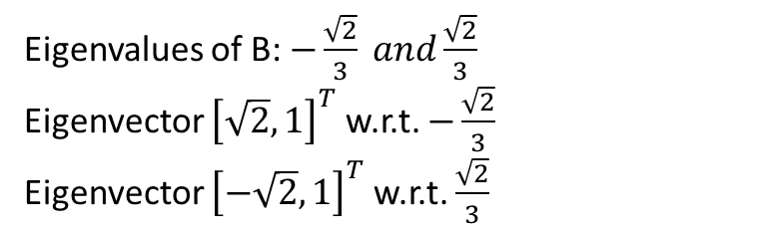
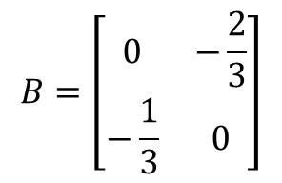
Eigenvalues of B: $−\frac{\sqrt{2}}{3} and\frac{\sqrt{2}}{3}$
Eigenvector ${\left[\sqrt{2}, 1\right]}^{T}$ w.r.t. $−\frac{\sqrt{2}}{3}$
Eigenvector ${\left[−\sqrt{2},1\right]}^{T}$ w.r.t. $\frac{\sqrt{2}}{3}$
與A的eigenvectors的方向不同
Eigenvectors不指向橢圓的兩軸
x前進的方向不正交
$$B=\left[\begin{matrix}0 & −\frac{2}{3} \\ −\frac{1}{3} & 0\end{matrix}\right]$$

Slide 28
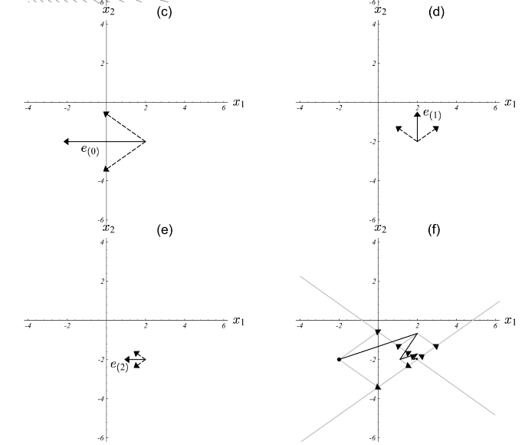
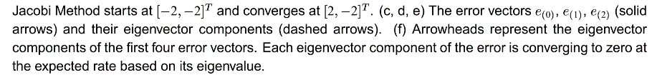
實線為error term
虛線為eigenvectors
Error term因為B之eigenvalues的關系會逐漸漸收斂至0

Slide 29
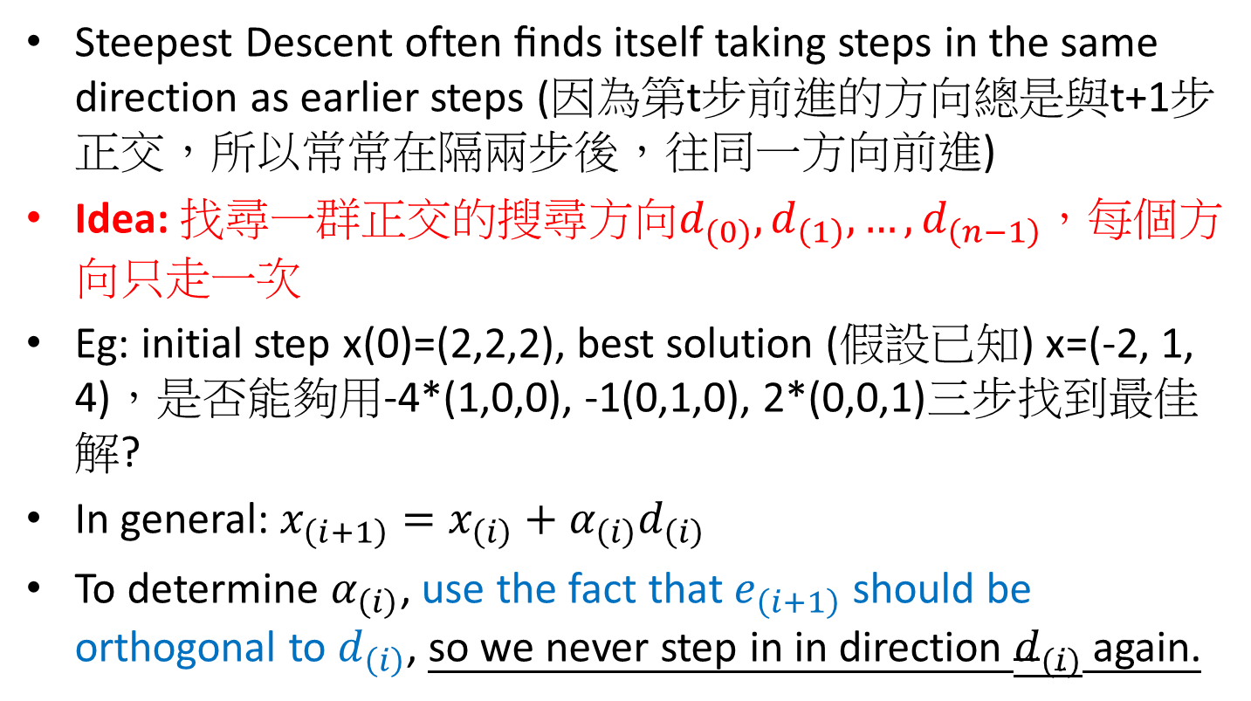
The method of Conjugate directions
Steepest Descent often ﬁnds itself taking steps in the same direction as earlier steps (因為第t步前進的方向總是與t+1步正交，所以常常在隔兩步後，往同一方向前進)
Idea:找尋一群正交的搜尋方向$d_{(0)}, d_{\left(1\right)},…,d_{\left(n−1\right)}$，每個方向只走一次
Eg: initial step x(0)=(2,2,2), best solution (假設已知) x=(-2, 1, 4)，是否能夠用-4*(1,0,0), -1(0,1,0), 2*(0,0,1)三步找到最佳解?
In general: $x_{\left(i+1\right)}=x_{\left(i\right)}+α_{\left(i\right)}d_{\left(i\right)}$
To determine $α_{\left(i\right)}$, use the fact that $e_{\left(i+1\right)}$ should be orthogonal to $d_{\left(i\right)}$, so we never step in in direction $d_{(i)}$ again.

Slide 30
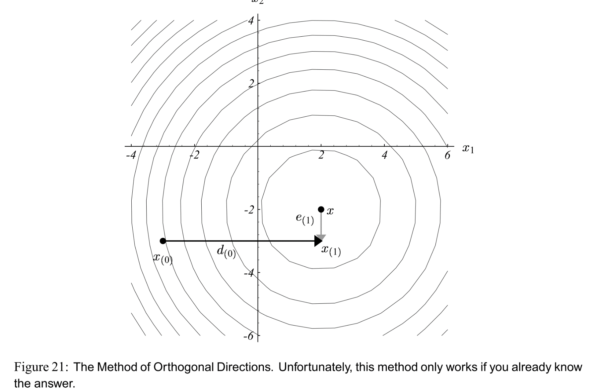
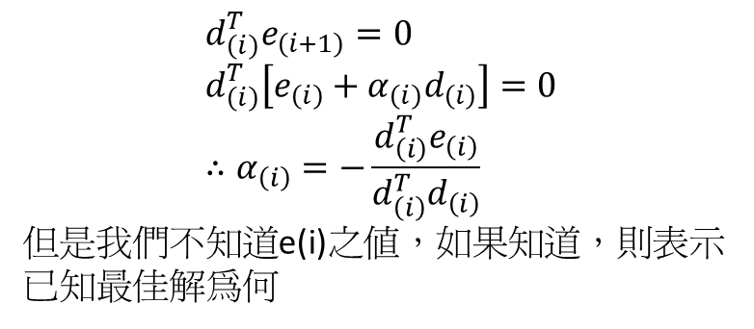
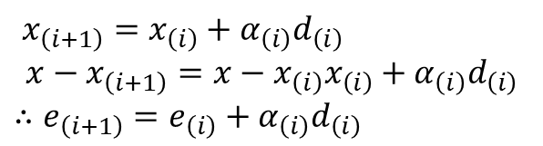
$$d_{\left(i\right)}^{T}e_{\left(i+1\right)}=0 \\ d_{\left(i\right)}^{T}\left[e_{\left(i\right)}+α_{\left(i\right)}d_{\left(i\right)}\right]=0 \\ ∴α_{\left(i\right)}=−\frac{d_{\left(i\right)}^{T}e_{\left(i\right)}}{d_{\left(i\right)}^{T}d_{\left(i\right)}}$$
但是我們不知道e(i)之值，如果知道，則表示已知最佳解為何
$x_{\left(i+1\right)}=x_{\left(i\right)}+α_{\left(i\right)}d_{\left(i\right)}$
$$x−x_{\left(i+1\right)}=x−x_{\left(i\right)}x_{\left(i\right)}+α_{\left(i\right)}d_{\left(i\right)}$$
$$∴e_{\left(i+1\right)}=e_{\left(i\right)}+α_{\left(i\right)}d_{\left(i\right)}$$

Slide 31
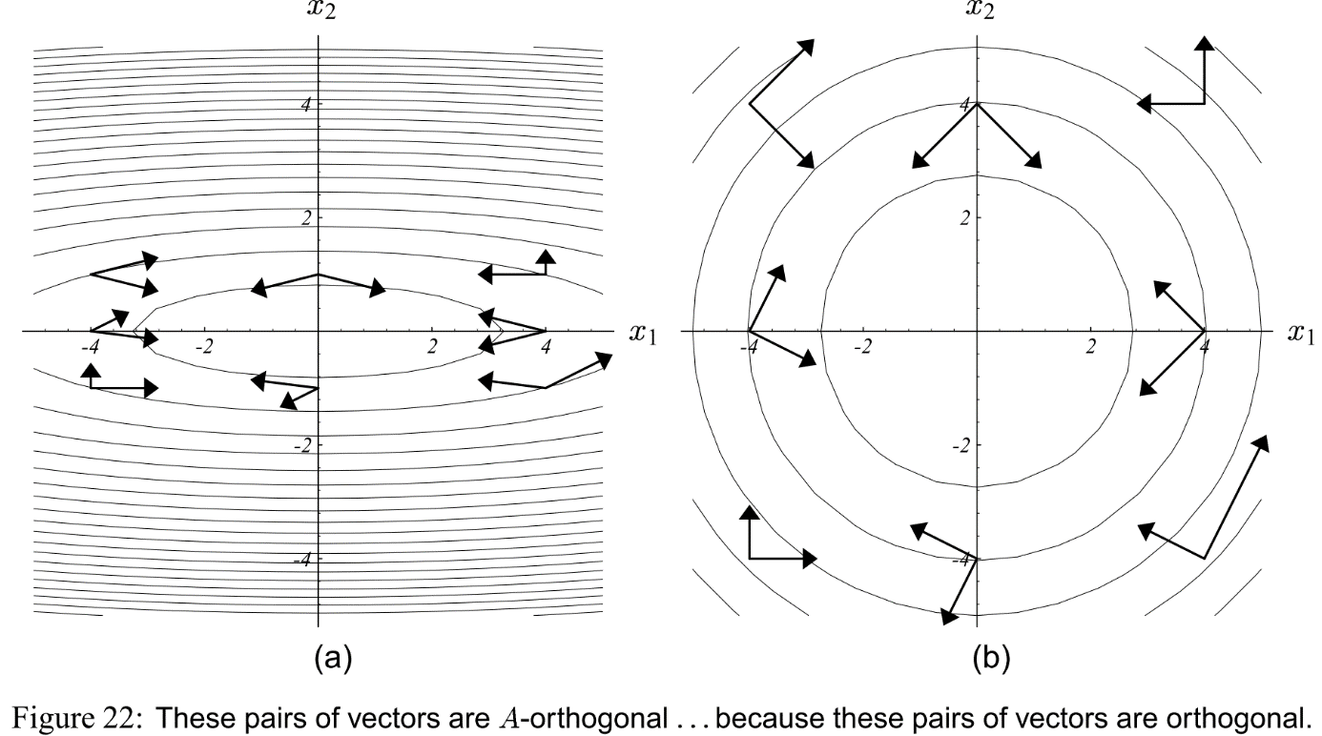

A-orthogonal
因為找尋orthogonal的方向不可行，改用A-orthogonal。
Two vectors $d_{\left(i\right)} and d_{\left(j\right)}$are A-orthogonal or conjugate if $d_{\left(i\right)}^{T}Ad_{\left(j\right)}=0$
可想成兩個向量經矩陣A線性轉換後才會正交。

Slide 32
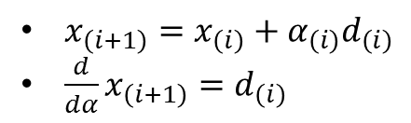
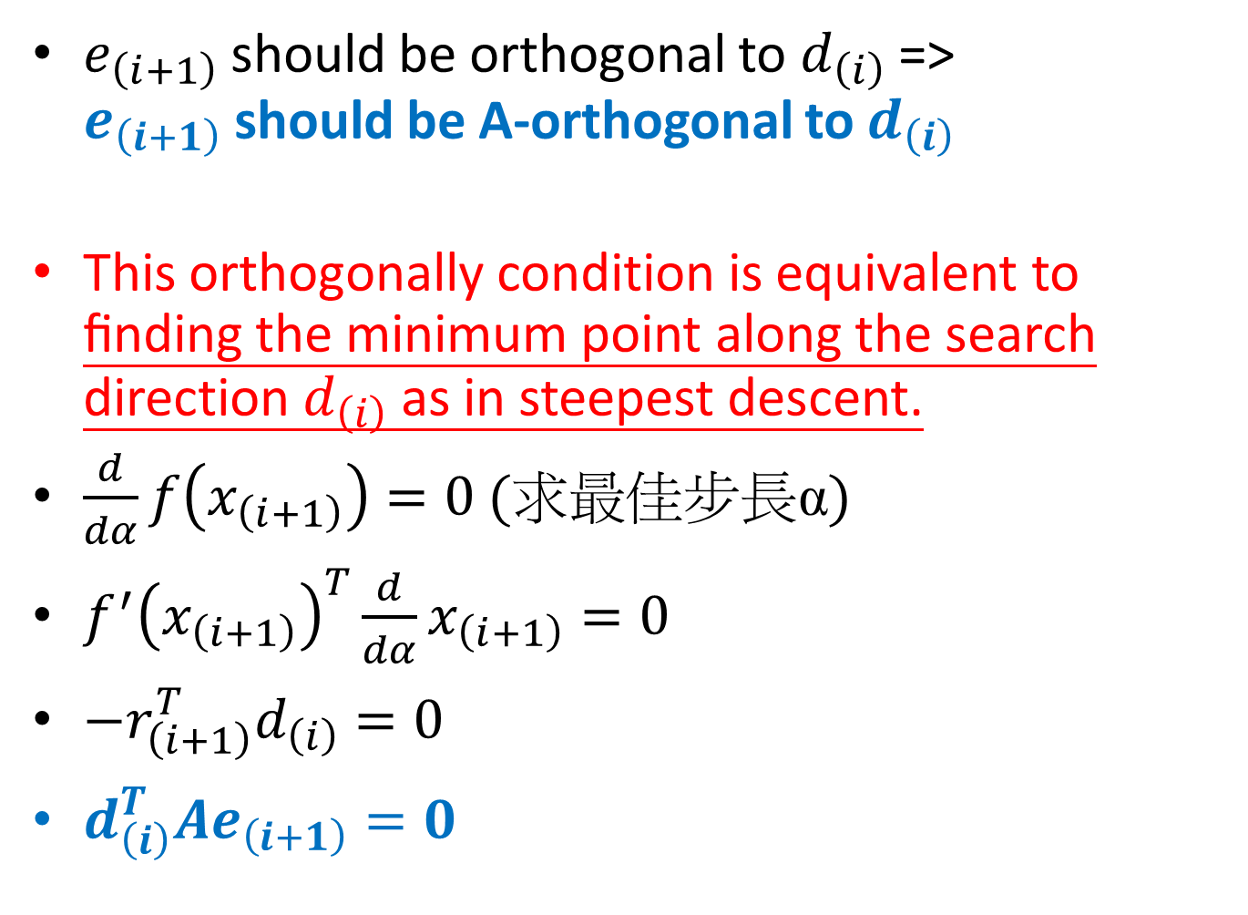
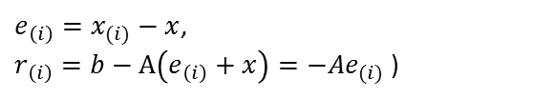


$e_{\left(i+1\right)}$ should be orthogonal to $d_{\left(i\right)}$=> $e_{\left(i+1\right)}$ should be A-orthogonal to $d_{\left(i\right)}$
This orthogonally condition is equivalent to ﬁnding the minimum point along the search direction $d_{\left(i\right)}$ as in steepest descent.
$\frac{d}{dα}f\left(x_{\left(i+1\right)}\right)=0$(求最佳步長α)
$f^{′}{\left(x_{\left(i+1\right)}\right)}^{T}\frac{d}{dα}x_{\left(i+1\right)}=0$
$−r_{\left(i+1\right)}^{T}d_{\left(i\right)}=0$
$d_{\left(i\right)}^{T}Ae_{\left(i+1\right)}=0$
$e_{\left(i\right)}=x_{(i)}−x$,
$r_{\left(i\right)}=b−A\left(e_{\left(i\right)}+x\right)=−Ae_{(i)}$)
$x_{\left(i+1\right)}=x_{\left(i\right)}+α_{\left(i\right)}d_{\left(i\right)}$
$\frac{d}{dα}x_{\left(i+1\right)}=d_{\left(i\right)}$
$f\left(x\right)=\frac{1}{2}x^{T}Ax−b^{T}x+c$
$r_{\left(i+1\right)}=b−Ax_{\left(i+1\right)}=−f^{′}\left(x_{(i+1)}\right)$
$r_{\left(i\right)}=b−A\left(e_{\left(i\right)}+x\right)=b−Ax−Ae_{\left(i\right)}=−Ae_{(i)}$

Slide 33



$d_{\left(i\right)}^{T}e_{\left(i+1\right)}=0⇒d_{\left(i\right)}^{T}\left(e_{\left(i\right)}+α_{\left(i\right)}d_{\left(i\right)}\right)⇒α_{\left(i\right)}=−\frac{d_{\left(i\right)}^{T}Ae_{\left(i\right)}}{d_{\left(i\right)}^{T}Ad_{\left(i\right)}}=\frac{d_{\left(i\right)}^{T}r_{\left(i\right)}}{d_{\left(i\right)}^{T}Ad_{\left(i\right)}}$
$e_{\left(i\right)}=x_{(i)}−x$,
$r_{\left(i\right)}=b−A\left(e_{\left(i\right)}+x\right)=−Ae_{(i)}$)
e(1) is A-orthogonal to d(0)
e(0)為d(0)與e(1)的合成向量

Slide 34

Convergence of CG
假設在n steps後得到optimal solution x
$e_{(0)}=\sum_{j=0}^{n−1}{δ_{j}d_{\left(j\right)}}$
$d_{\left(k\right)}^{T}Ae_{(0)}=\sum_{j=0}^{n−1}{δ_{j}d_{\left(k\right)}^{T}Ad_{\left(j\right)}}$
$d_{\left(k\right)}^{T}Ae_{(0)}$=$δ_{k}d_{\left(k\right)}^{T}Ad_{\left(k\right)}$ (by A-orthogonality of d vectors)
$δ_{k}$=$\frac{d_{\left(k\right)}^{T}Ae_{(0)}}{d_{\left(k\right)}^{T}Ad_{\left(k\right)}}=\frac{d_{\left(k\right)}^{T}A\left(e_{\left(0\right)}+\sum_{i=0}^{k−1}{α_{\left(i\right)}d_{\left(i\right)}}\right)}{d_{\left(k\right)}^{T}Ad_{\left(k\right)}}=\frac{d_{\left(k\right)}^{T}Ae_{(k)}}{d_{\left(k\right)}^{T}Ad_{\left(k\right)}}$

Slide 35

$δ_{k}=\frac{d_{\left(k\right)}^{T}Ae_{(k)}}{d_{\left(k\right)}^{T}Ad_{\left(k\right)}}$
$α_{\left(i\right)}=−\frac{d_{\left(i\right)}^{T}Ae_{\left(i\right)}}{d_{\left(i\right)}^{T}Ad_{\left(i\right)}}$
Therefore $α_{\left(i\right)}=−δ_{\left(i\right)}$
$∴e_{\left(i\right)}=e_{\left(0\right)}+\sum_{j=0}^{i−1}{α_{\left(j\right)}d_{\left(j\right)}}=\sum_{j=0}^{n−1}{δ_{\left(j\right)}d_{\left(j\right)}}−\sum_{j=0}^{i−1}{δ_{\left(j\right)}d_{\left(j\right)}}=\sum_{j=i}^{n−1}{δ_{\left(j\right)}d_{\left(j\right)}}$
所以在n steps後, error term $e_{\left(n\right)}=0$

Slide 36

Gram-Schmidt conjugation
在知道search direction的特性後，現在需要找出search direction $\left\{d_{\left(i\right)}\right\}$之值，假設現在有 n個linear independent vectors $u_{0}, u_{1},⋯u_{n−1}$(但未彼此正交或共軛正交)
Let $d_{\left(0\right)}=u_{0} and ∀i>0$
$$d_{\left(i\right)}=u_{i}+\sum_{k=0}^{i−1}{β_{ik}d_{\left(k\right)}}, whereβ_{ik} are defined for i>k$$
$d_{\left(0\right)}=u_{0}$
$d_{\left(1\right)}=u_{1}−conjproj_{d_{\left(0\right)}}\left(u_{1}\right)$
$d_{\left(2\right)}=u_{2}−conjproj_{d_{\left(0\right)}}\left(u_{2}\right)−conjproj_{d_{\left(1\right)}}\left(u_{2}\right)$
$d_{\left(i\right)}=u_{i}−\sum_{k=1}^{i−1}{conjproj_{d_{\left(k\right)}}\left(u_{i}\right)}$

Slide 37


u₁可拆解成u* (與u₀共軛正交)與u⁺
$$d_{\left(i\right)}=u_{i}+\sum_{k=0}^{i−1}{β_{ik}d_{\left(k\right)}} \\ d_{\left(i\right)}^{T}Ad_{\left(j\right)}=u_{i}^{T}Ad_{\left(j\right)}+\sum_{k=0}^{i−1}{β_{ik}d_{\left(k\right)}^{T}Ad_{\left(j\right)}}$$
$0=u_{i}^{T}Ad_{\left(j\right)}+β_{ij}d_{\left(j\right)}^{T}Ad_{\left(j\right)}$$, i>j \left(∵A−orthogonal \right)$
$$β_{ij}=−\frac{u_{i}^{T}Ad_{\left(j\right)}}{d_{\left(j\right)}^{T}Ad_{\left(j\right)}}$$

Slide 38

CG algorithm
$d_{\left(0\right)}=r_{\left(0\right)}=b−Ax_{\left(0\right)}$ $\left(初始方向=negative gradient\right)$
$α_{\left(i\right)}=\frac{r_{\left(i\right)}^{T}r_{\left(i\right)}}{d_{\left(i\right)}^{T}Ad_{\left(i\right)}}\left(最佳步長\right)$
$x_{\left(i+1\right)}=x_{\left(i\right)}+α_{\left(i\right)}d_{\left(i\right)}$
$r_{\left(i+1\right)}=r_{\left(i\right)}−α_{\left(i\right)}Ad_{\left(i\right)}$
$β_{\left(i+1\right)}=\frac{r_{\left(i+1\right)}^{T}r_{\left(i+1\right)}}{r_{\left(i\right)}^{T}r_{\left(i\right)}}$
$d_{\left(i+1\right)}=r_{\left(i+1\right)}+β_{\left(i+1\right)}d_{\left(i\right)} \left(下一個前進方向\right)$

Slide 39

Nonlinear CG
Key points:
The step size $α$ is determined by linear search
Different choice for $β$
The residual : $r_{\left(i\right)}=−f^{′}\left(x_{\left(i\right)}\right) ∀ i$
Fletcher Reeves formula:
$$β_{\left(i+1\right)}^{FR}=\frac{r_{\left(i+1\right)}^{T}r_{\left(i+1\right)}}{r_{\left(i\right)}^{T}r_{\left(i\right)}}$$
Polak-Ribere formula (scipy use this one):
$$β_{\left(i+1\right)}^{PR}=\frac{r_{\left(i+1\right)}^{T}\left(r_{\left(i+1\right)}−r_{\left(i\right)}\right)}{r_{\left(i\right)}^{T}r_{\left(i\right)}}$$

Slide 40


Outline of nonlinear CG

Slide 41


Slide 42


Slide 43

Thanks for your listening!

