Slide 1
Combining multiple clusterings using similarity graph Pattern Recognition vol. 44 pp.694–703 (2011)
Selim Mimaroglu, Ertunc Erdil
Department of Computer Engineering, Bahcesehir University, Ciragan Caddesi, 34353 Besiktas, Istanbul, Turkey
Presentor：Hsin-Chuan Yuan

Slide 2
Abstract
Multiple clusterings are produced for various needs and reasons in both distributed and local environments. Combining multiple clusterings into a final clustering which has better overall quality has gained importance recently. It is also expected that the final clustering is novel, robust, and scalable. In order to solve this challenging problem we introduce a new graph-based method.

Slide 3
Abstract
Our method uses the evidence accumulated in the previously obtained clusterings, and produces a very good quality final clustering. The number of clusters in the final clustering is obtained automatically; this is another important advantage of our technique. Experimental test results on real and synthetically generated data sets demonstrate the effectiveness of our new method.

Slide 4
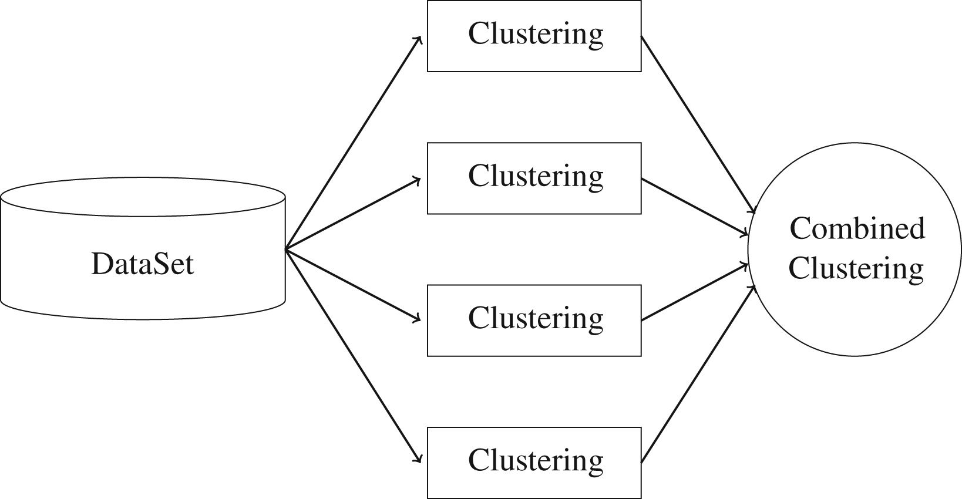
Combining multiple clusterings

Slide 5
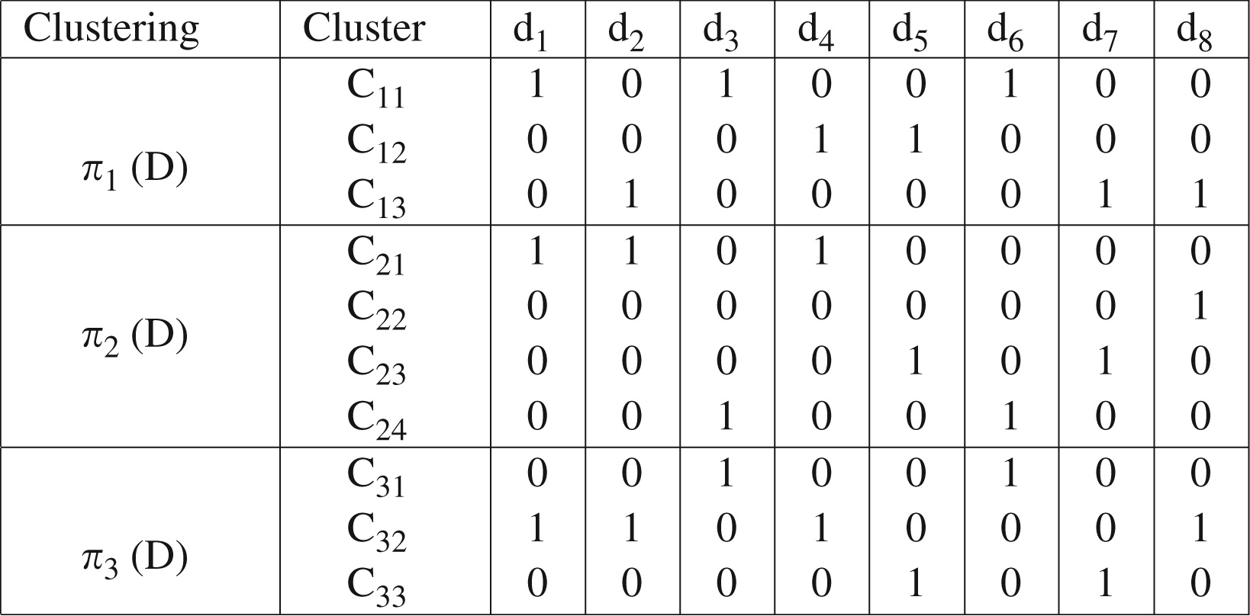
Example
Binary representation of multiple clusterings, Π

Slide 6
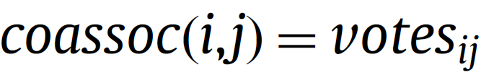
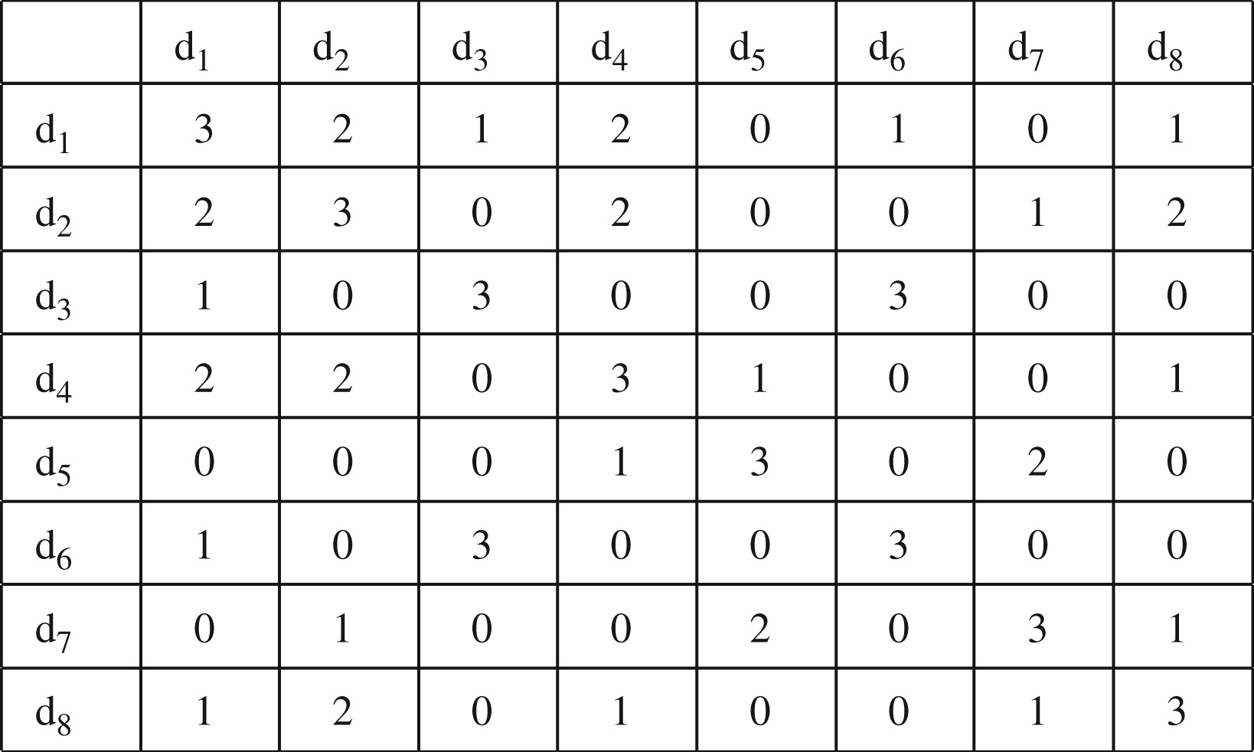

Example
A $\left|D\right|×\left|D\right|$co-association matrix

Slide 7


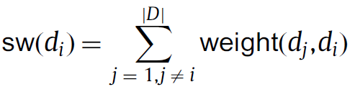
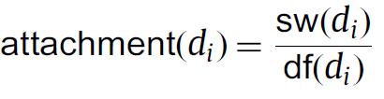
Combining Multiple Clusterings via Similarity Graph (COMUSA)
The degree of freedom of a vertex d_{i} is
The sum of weights of edges incident to a vertex di is the
The attachment of a vertex is

Slide 8
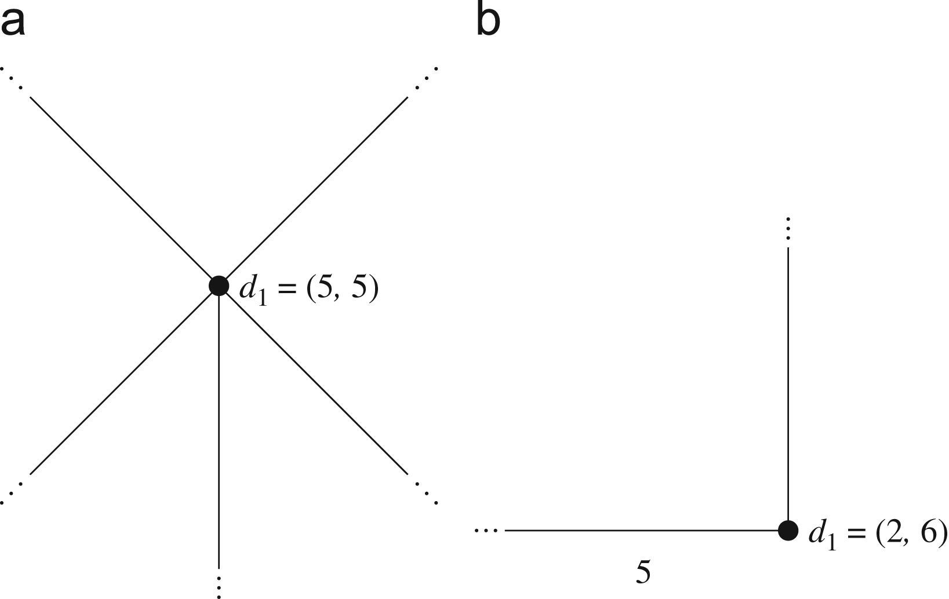
Combining Multiple Clusterings via Similarity Graph (COMUSA)
(a) df(d₁) = sw(d₁) = 5 and (b) df(d₁) = 2, sw(d₁) = 6

Slide 9
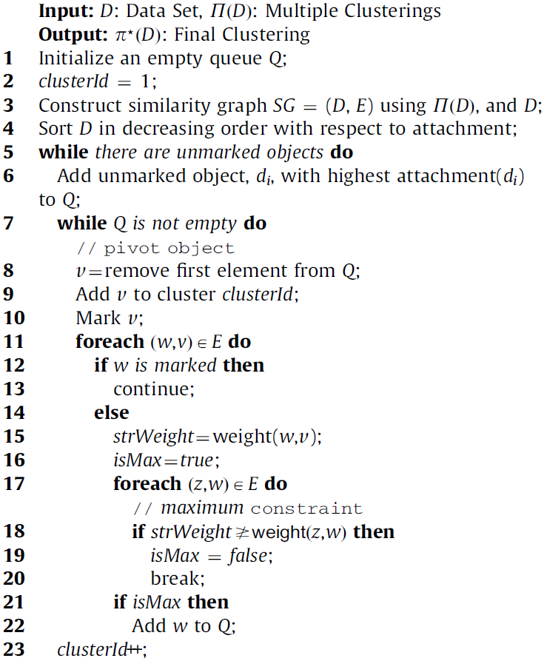

Slide 10
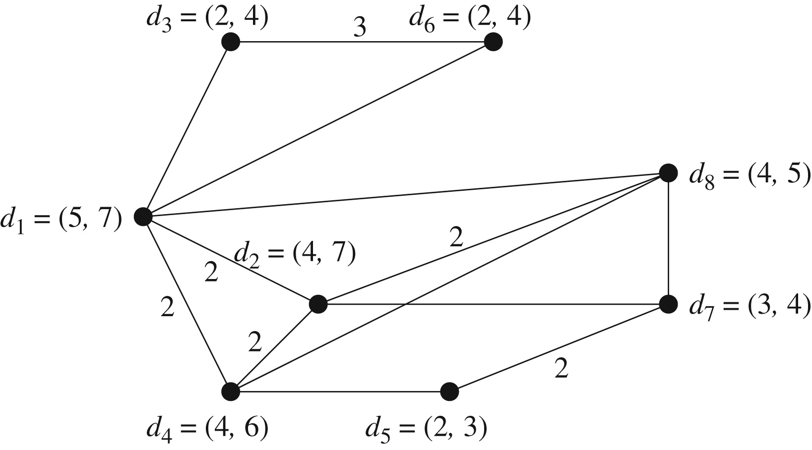
Combining Multiple Clusterings via Similarity Graph (COMUSA)
Similarity graph
Attachment values in decreasing order
Vertex | Attachment
d₃ | 2.00
d₆ | 2.00
d₂ | 1.75
d₄ | 1.50
d₅ | 1.50
d₁ | 1.40
d₇ | 1.33
d₈ | 1.25

Slide 11
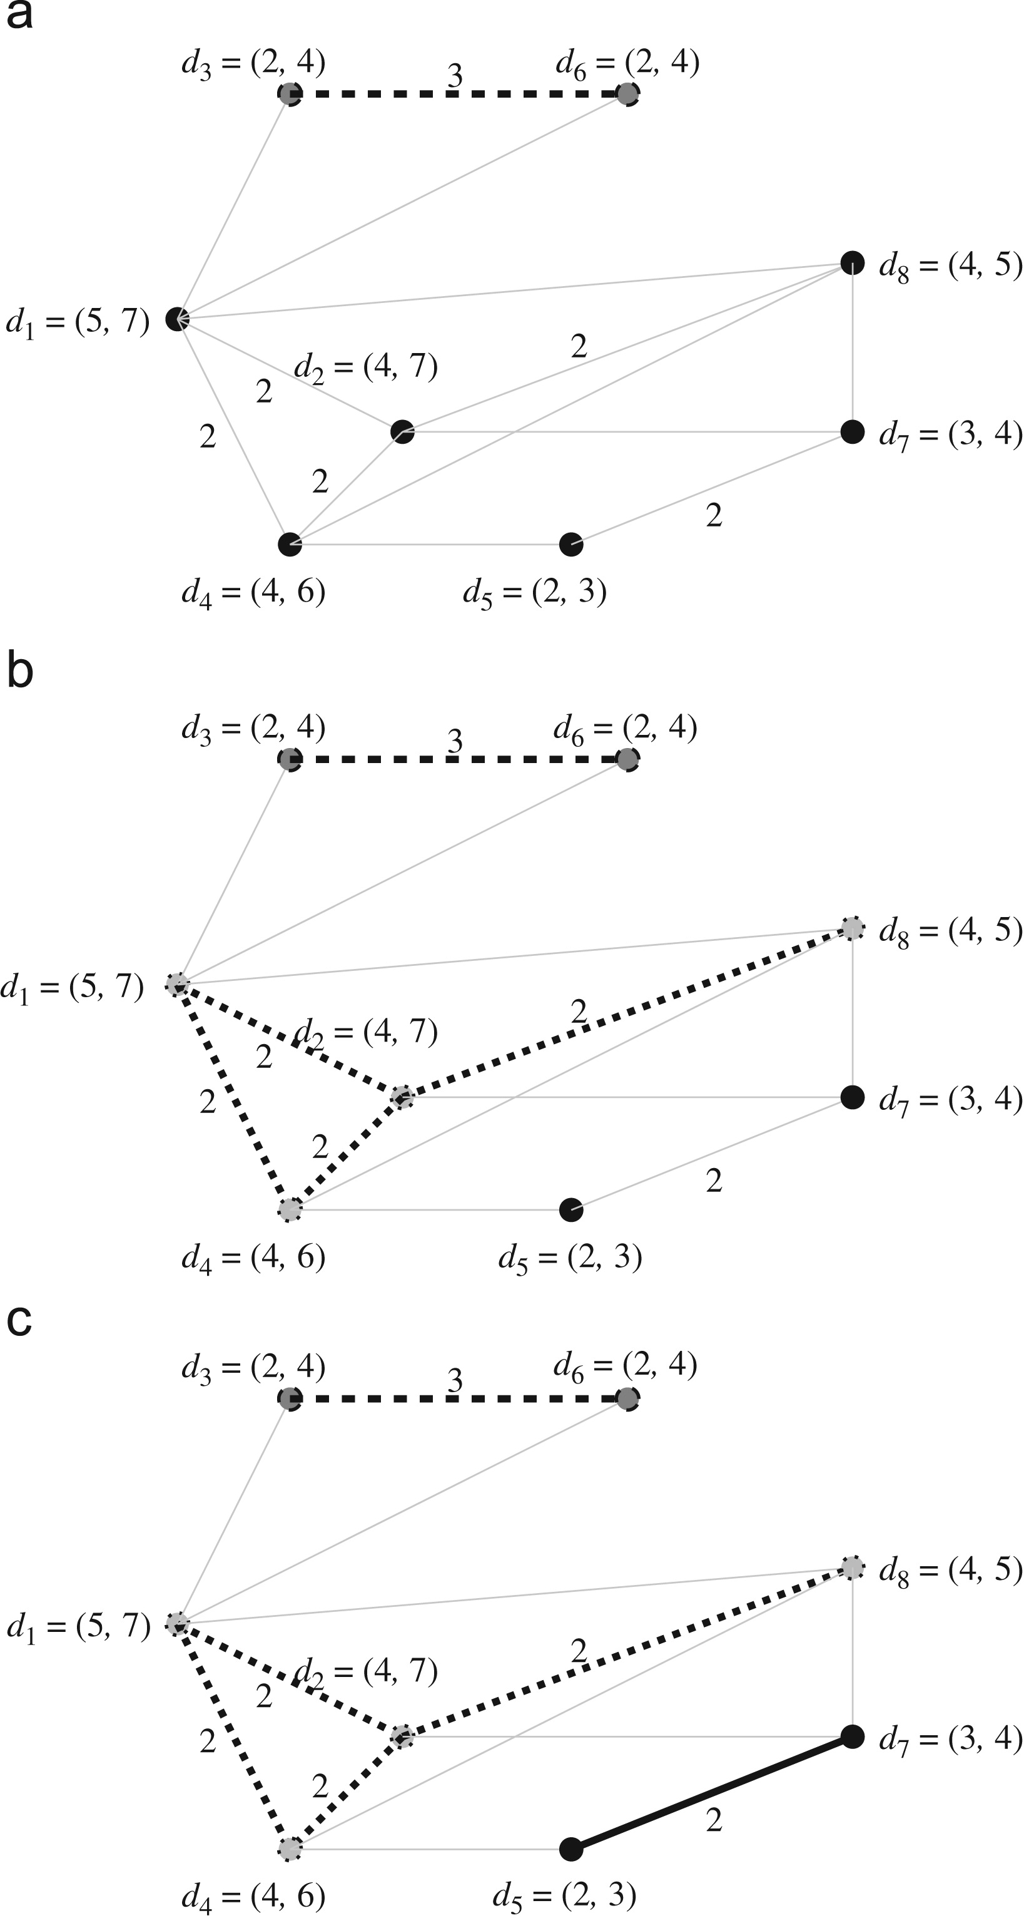
Combining Multiple Clusterings via Similarity Graph (COMUSA)

Slide 12
Combining Multiple Clusterings via Similarity Graph (COMUSA)

Slide 13
Combining Multiple Clusterings via Similarity Graph (COMUSA)

Slide 14
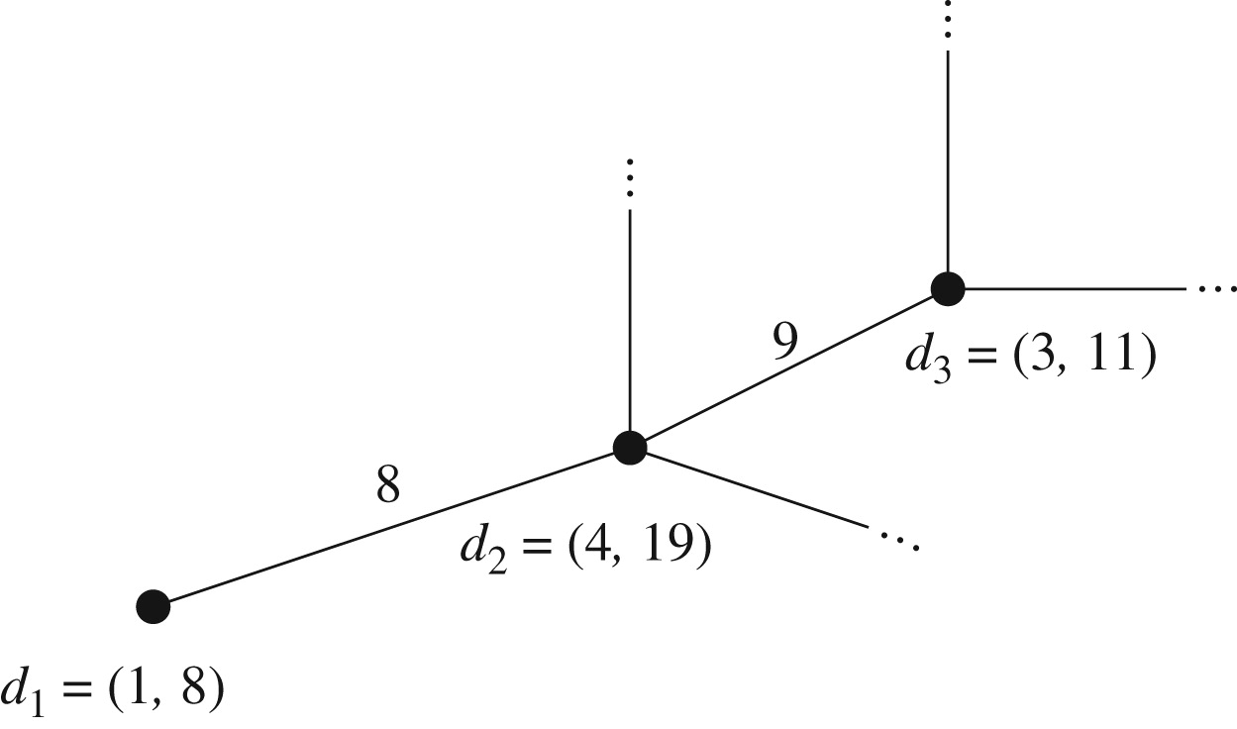

Relaxation
With a relaxation of 25%, weight(d1,d2)$×$1.25$≥$weight(d2,d3)

Slide 15
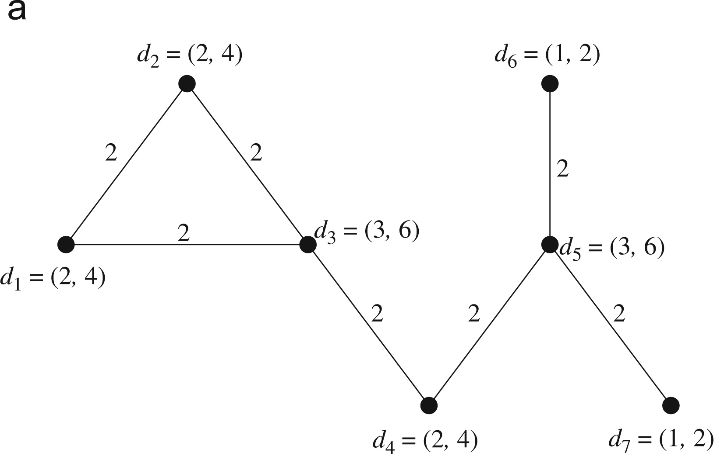
Example - 1
All the edge labels are 2
We end up with one big cluster having all the vertices.

Slide 16
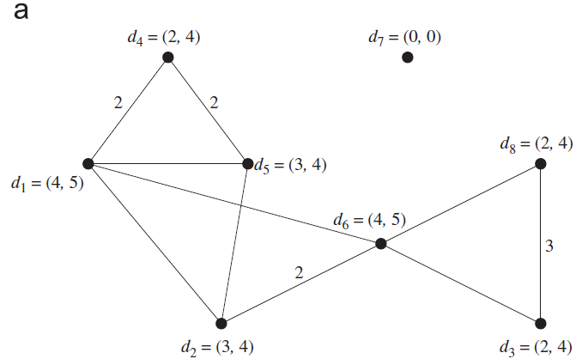
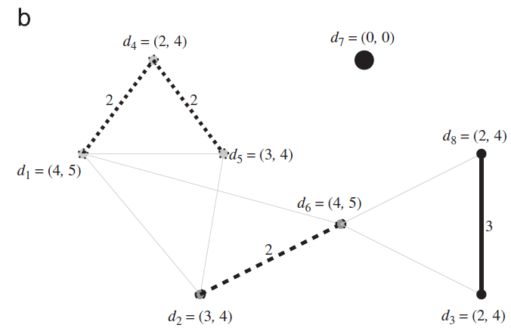
Example - 2

Slide 17
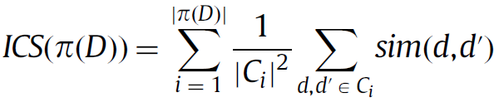
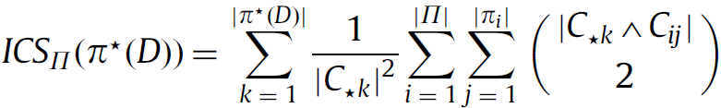
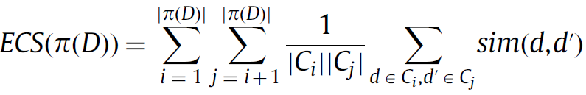
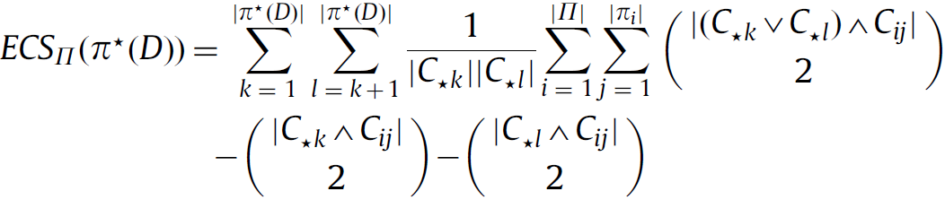
Experimental evaluations
Intra-cluster similarity is
Inter-cluster similarity is
validity function is

Slide 18


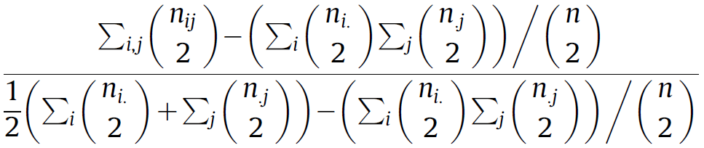
Experimental evaluations
Adjusted rand index (ARI)
represents classes.
represents a clusterings.
ARI =
Class/cluster | V₁ | v₂ | … | v_{p} | Sums
u₁ | n₁₁ | n₁₂ | … | n_{1p} | n_{1.}
u₂ | n₂₁ | n₂₂ | … | n_{2p} | n_{2.}
⋮ | ⋮ | ⋮ |  | ⋮
u_{r} | n_{r1} | n_{r2} | … | n_{rp} | n_{r.}
Sums | n_{.1} | n_{.2} |  | n_{.p} | n..=n

Slide 19
Experimental evaluations
INPUT | Number of clusterings | Number of clusters | Ensemble generation methods
1-Spiral, hand clustered | 2 | 3 | Manually
1-Spiral, k-means clustered | 4 | [2, 3] | k-means
2-Spiral | 2 | [2, 3] | Manually
2-Half rings | 3 | [2, 5] | k-means
2-Curve | 2 | [2, 8] | k-means, randomly, manually
2D2K | 3 | [2, 3] | k-means
8D5K | 3 | [3, 5] | k-means
Iris | 3 | [2, 3] | k-means
Glass | 4 | [6, 8] | k-means, randomly, manually
Breast Cancer | 5 | [2, 5] | k-means, randomly, manually
Image Segmentation | 10 | 7 | Randomly
Syn5K | 10 | 5 | Randomly

Slide 20
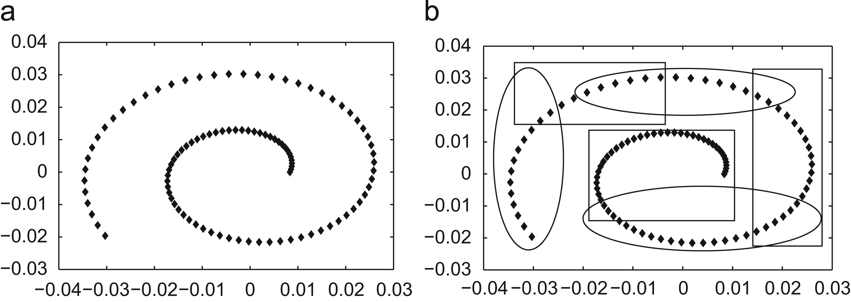
Experimental evaluations
INPUT | Relaxation (%) | ARI
1-Spiral, hand clustered | 0 | 1.0
1-Spiral, k-means clustered | 34 | 1.0

Slide 21
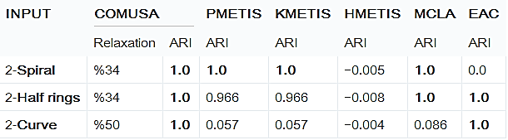
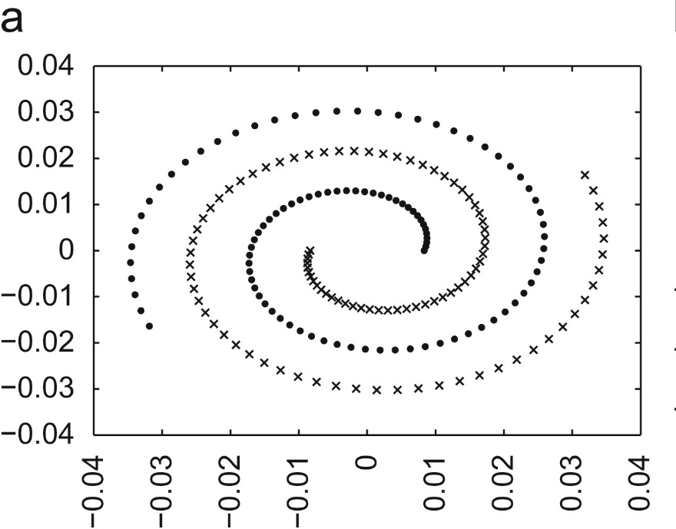
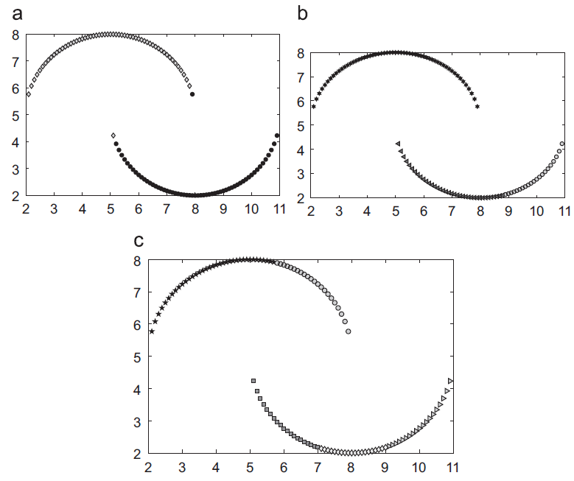


Slide 22
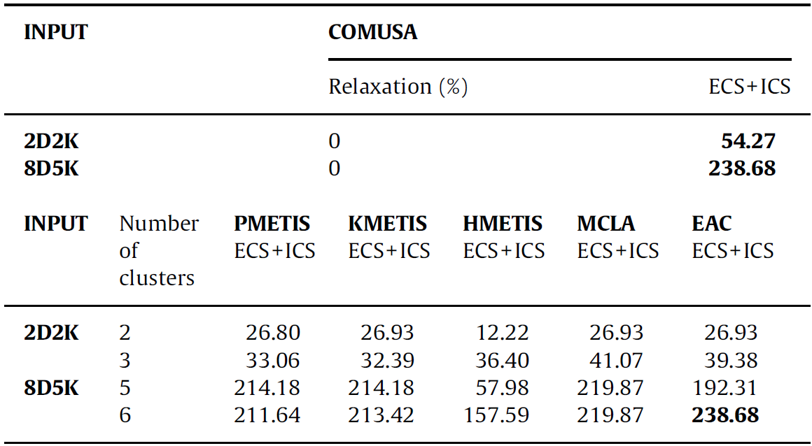
Experimental evaluations

Slide 23
Experimental evaluations
INPUT | COMUSA
 | Relaxation (%) | ARI
Iris | 0 | 0.676
 | 50 | 0.698
Glass | 0 | 0.308
 | 25 | 0.403
 | 34 | 0.964
Breast Cancer | 0 | 0.156
 | 17 | 0.301
 | 20 | 0.604
 | 25 | 1.0
Image Segmentation | 0 | 0.350
 | 12 | 0.932
 | 13 | 0.831
Syn5K | 0 | 0.301
 | 15 | 1.0
 | 25 | 0.999
INPUT | # of clusters | PMETISARI | KMETISARI | HMETISARI | MCLAARI | EACARI
Iris | 3 | 0.691 | 0.688 | 0.096 | 0.711 | 0.711
 | 4 | 0.412 | 0.368 | 0.036 | 0.662 | 0.690
Glass | 6 | 0.4740 | 0.4698 | 0.1568 | 0.9633 | 0.8041
 | 8 | 0.3835 | 0.4151 | 0.0063 | 0.6439 | 0.7862
 | 22 | 0.2026 | 0.1971 | 0.0654 | 0.2898 | 0.6404
 | 24 | 0.1892 | 0.1705 | 0.0615 | 0.2847 | 0.4292
Breast Cancer | 2 | 0.3597 | 0.3942 | 0.0024 | 0.5778 | 0.8322
 | 6 | 0.2174 | 0.2039 | 0.1311 | 0.2967 | 0.8981
 | 11 | 0.1189 | 0.1122 | 0.0684 | 0.3268 | 0.5463
 | 16 | 0.0836 | 0.0828 | 0.0188 | 0.4547 | 0.5316
Image Segmentation | 7 | 0.987 | 0.988 | 0.535 | 0.985 | 0.840
 | 9 | 0.633 | 0.639 | 0.352 | 0.938 | 0.837
 | 11 | 0.574 | 0.539 | 0.354 | 0.969 | 0.838
Syn5K | 3 | 0.488 | 0.480 | 0.317 | 0.611 | 0.482
 | 5 | 1.0 | 1.0 | 0.426 | 1.0 | 1.0
 | 7 | 0.578 | 0.556 | 0.607 | 0.953 | 0.999

Slide 24
Experimental evaluations
INPUT | COMUSA | PMETIS | KMETIS | HMETIS | MCLA | EAC
2-Spiral | 1.1 | 4.0 | 4.0 | 1.0 | 201.0 | 148.0
2-Half rings | 2.3 | 2.0 | 2.0 | 1.0 | 196.0 | 114.0
2-Curve | 1.1 | 2.0 | 3.0 | 3.0 | 203.0 | 150.0
2D2K | 25.1 | 48.5 | 46.0 | 2.0 | 197.5 | 1203.5
8D5K | 21.7 | 43.0 | 35.5 | 2.5 | 195.5 | 1207
Iris | 3.6 | 3.0 | 2.5 | 2.5 | 199.5 | 117.5
Glass | 1.3 | 5.5 | 7.3 | 34.3 | 198.5 | 149.5
Breast Cancer | 2.1 | 9.5 | 12 | 12 | 198.8 | 601
Image Segmentation | 7083.6 | 251.0 | 206.0 | 2 | 922.3 | 15466.3
Syn5K | 71769.0 | 1371.0 | 1159.0 | 6 | 372.3 | 30774.6

Slide 25
Conclusions
Extensive experimental evaluations on many real and artificial data sets demonstrate that COMUSA:
finds arbitrary shape clusters
is not affected by the cluster size
is not affected by noise and outliers
is not affected by the sparseness of the data set
is order independent
is deterministic
scales well

