Slide 1
Temporal significant wave height estimation from wind speed by perceptron Kalman filtering
Abdüsselam Altunkaynak, Mehmet Özger
Civil Engineering Faculty, Hydraulics Division, Istanbul Technical University, Maslak 34469, Istanbul, Turkey
Ocean Engineering 31 (2004) 1245–1255
Presenter: 許竣傑
2013/10/08

Slide 2
Abstract
Significant wave height estimates are necessary for many applications in coastal and offshore engineering and therefore various estimation models are proposed in the literature for this purpose. Unfortunately, most of these models provide simultaneous wave height estimations from wind speed measurements. However, in practical studies, the prediction of significant wave height is necessary from previous time interval measurements. This paper presents a dynamic significant wave height prediction procedure based on the perceptron Kalman filtering concepts. Past measurements of significant wave height and wind speed variables are used for training the adaptive model and it is then employed to predict the significant wave height amounts for future time intervals from the wind speed measurements only. The verification of the proposed model is achieved through the dynamic significant wave height and wind speed time series plots, observed versus predicted values scatter diagram and the classical linear significant wave height models. The application of the proposed model is presented for a station in USA

Slide 3


Kalman Filtering
K-1
k
K+1
預測值
最佳值
預測值
最佳值
測量值
測量值

Slide 4

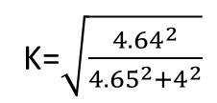



Example
房間的溫度
預測方法:與上一時刻相同, variance 4
測量方法:溫度計, variance 4
K-1
k
K+1
預測值:23
最佳值:23+k(25-23)=24.56
最佳值: 24.56+k(22-24.56)
variance $\sqrt{4^{2}+3^{2}}=5$
K=$\sqrt{\frac{5^{2}}{5^{2}+4^{2}}}=0.78$
K=$\sqrt{\frac{{4.64}^{2}}{{4.65}^{2}+4^{2}}}$
測量值:25
variance: (1-0.78) =$\frac{x^{2}}{5^{2}}$ , x=2.35
variance 4
預測值:24.56
variance $\sqrt{4^{2}+{2.35}^{2}}=4$.64
測量值:22
variance 4

Slide 5



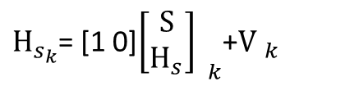
Perceptron Kalman Filtering
$H_{s_{k}}$= [1 0]${\left[\begin{matrix}S \\ H_{s}\end{matrix}\right] }_{k}$+${\text{V} }_{k}$

Slide 6
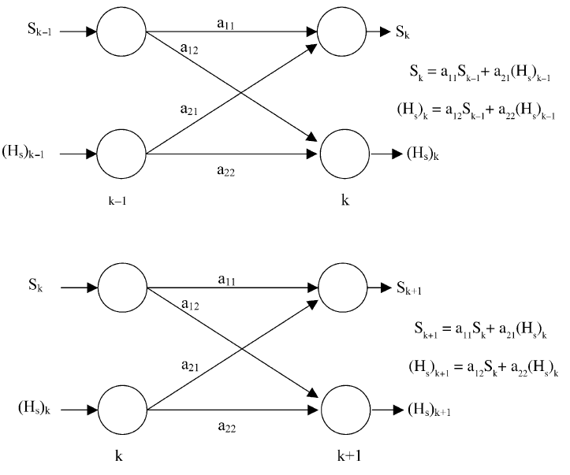
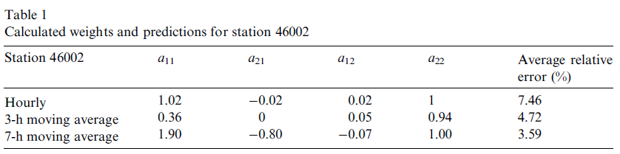





Perceptron
1 | 2 | 3 | 4 | 5 | … | 15
$$A_{1}$$
$$A_{2}$$
$$A_{3}$$
$$…$$
$$A_{13}$$

Slide 7
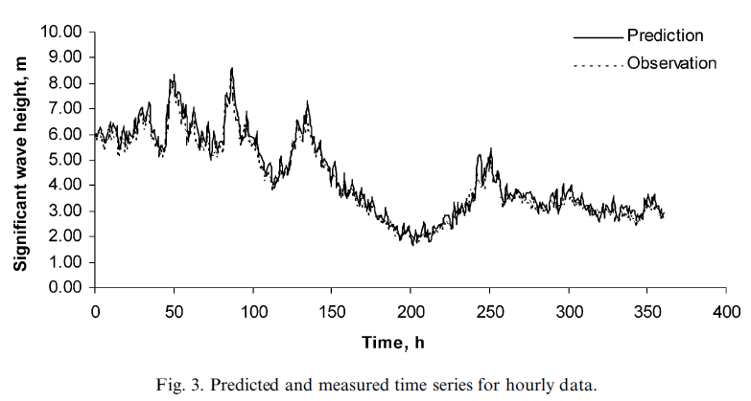

Slide 8
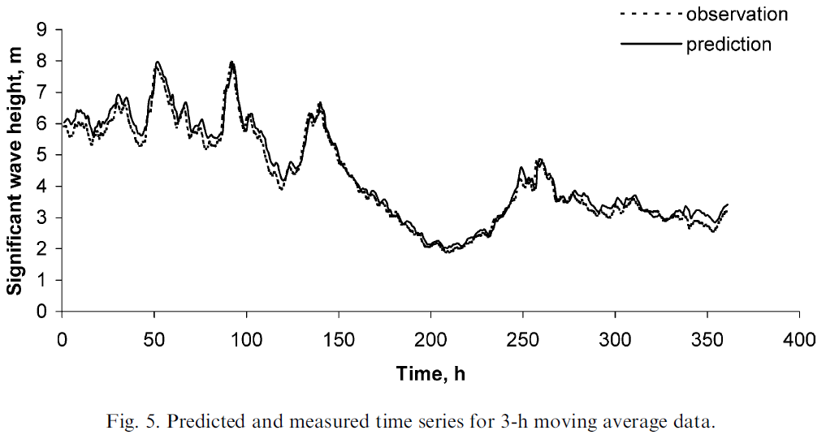

Slide 9
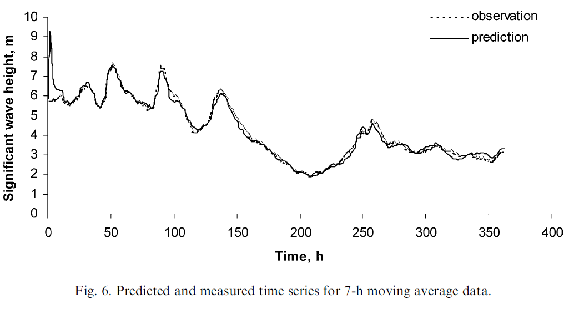

Slide 10
Thank You!

