Slide 1
TASSER_low-zsc: An approach to improve structure prediction using low z-score–ranked templates
Shashi B. Pandit and Jeffrey Skolnick PROTEINS: Structure, Function, and Bioinformatics, Vol. 78, pp.2769–2780, 2010
Presenter: Chun-Chieh Tai
Date: October 8, 2013

Slide 2
Abstract(1/2)
In a variety of threading methods, often poorly ranked (low z-score) templates have good alignments. Here, a new method, TASSER_low-zsc that identifies these low z-score-ranked templates to improve protein structure prediction accuracy, is described. The approach consists of clustering of threading templates by affinity propagation on the basis of structural similarity (thread_cluster) followed by TASSER modeling, with final models selected by using a TASSER_QA variant. To establish the generality of the approach, templates provided by two threading methods, SP(3) and SPARKS(2), are examined. The SP(3) and SPARKS(2) benchmark datasets consist of 351 and 357 medium/hard proteins (those with moderate to poor quality templates and/or alignments) of length < or =250 residues, respectively.
Notes:
有個方法叫TASSER, 是用template based來兜成結果的, 目前是使用z-score高的那些template, 但是作者發現有一些z-score低的卻好像對齊得很好(TM-score>=0.4), 所以本篇想要找出那些可能有用的低z-score的template. 但low z-score的可能很多 所以作者就開發了thread_cluster algorithm來過濾

Slide 3
Abstract(2/2)
For SP(3) medium and hard targets, using thread_cluster, the TM-scores of the best template improve by ~4 and 9% over the original set (without low z-score templates) respectively; after TASSER modeling/refinement and ranking, the best model improves by ~7 and 9% over the best model generated with the original template set. Moreover, TASSER_low-zsc generates 22% (43%) more foldable medium (hard) targets. Similar improvements are observed with low-ranked templates from SPARKS(2). The template clustering approach could be applied to other modeling methods that utilize multiple templates to improve structure prediction.

Slide 4
Introduction
TASSER: Threading/ASSEmbly/Refinement
Template-Based Modeling(TBM)
用其他的蛋白質的結構片段當成template來組合出目標蛋白質的結構
相反: de novo: 只看序列, 憑空捏出結構
Notes:
Threading: 將所求序列與已知蛋白質三維結構進行配對, 建構model
ASSEmbly: 組合
Refinement: 優化

Slide 5
TM-score
TM-score is an algorithm to calculate the structural similarity of two protein models.
TM-score has the value in (0,1]. Based on statistics, a TM-score <0.17 corresponds to a random similarity and a TM-score >0.5 generally corresponds to the same fold in SCOP/CATH
Notes:
TM-score是用來計算兩個蛋白質模型的結構相似性，TM-score越高，其相似度越高。The definition of TM-score is independent on the length of the proteins.

Slide 6
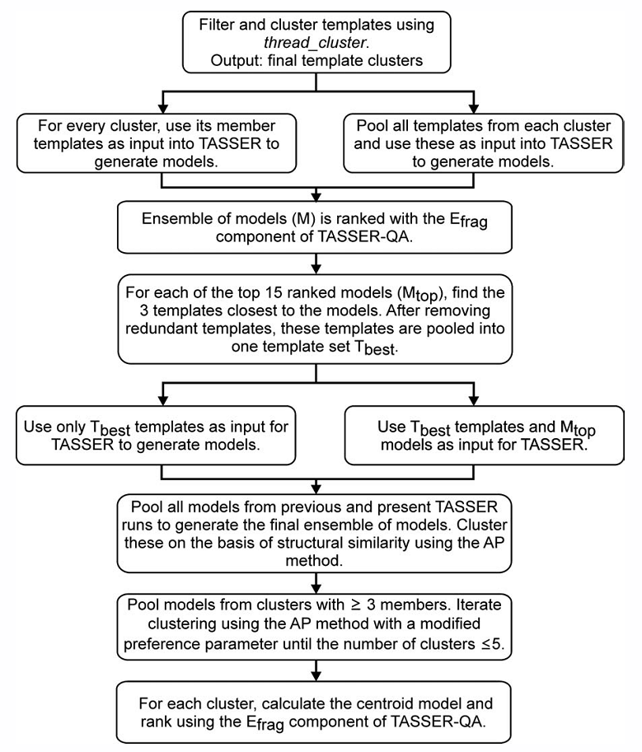
(a) filtering and clustering of templates via thread_cluster
(b) generation of an ensemble of models using TASSER
(c) model ranking
Notes:
選N個template 然後再套用affinity propagation 來分群, 分完就是final template cluster
每個cluster分別送到TASSER建model
模型的排名
----------------------------------
把選出來的再細選一次

Slide 7
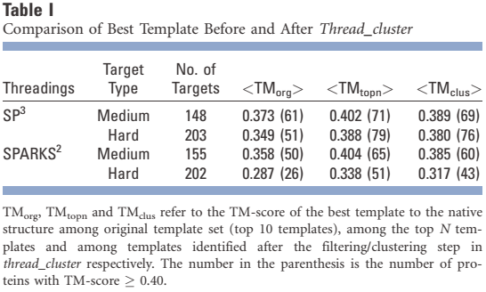
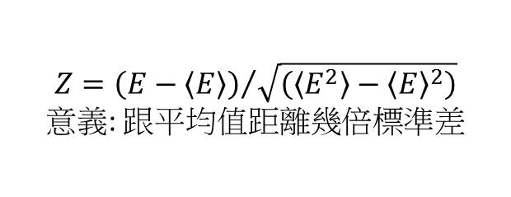
Thread_cluster
Input: 691 proteins (whole chains or domains) of length < or = 250 residues
Filtering: using z-score
SP³: hard<=4.5<medium<6.0<=easy
SPARKS²: hard<=4.0<medium<5.5<=easy
Clustering
Affinity Propagation
Output: final template clusters
$$Z={\left(E−\left\langle E\right\rangle \right)}/{\sqrt{\left(\left\langle E^{2}\right\rangle −{\left\langle E\right\rangle }^{2}\right)}}$$
意義: 跟平均值距離幾倍標準差
Notes:
SP³ & SPARKS²: 用來評分做出來的model的好壞的程式
SP和SPARKS都把target分成三類 easy, medium和hard:
easy是很好找答案(資料庫中有跟他很像的)
medium中等(資料庫中有主幹類似 但旁支不像的)
hard(資料庫中連主幹都沒有像的)
TMorg, TMtopn and TMclus各是 本來的方法 多選一些template的方法 以及 figure 1完整跑完的方法
最好tm-score(tm-score>=0.4的個數)

Slide 8
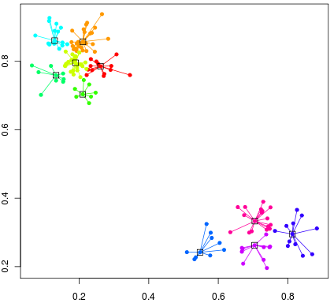
Affinity Propagation Algorithm
K-centers algorithm
從一些隨機取得的 "exemplars" (被當做 center 的 data points)開始，並且迭代調整更新每個集合以減少整體的 squared error 。
AP algorithm
同時考慮全部的資料點為可能的 exemplars
藉由點與點之間的遞迴地交換資訊 ─ "responsibility" & "availability"，讓各個節點能夠知道誰是最適合自己的 exemplar 以及自己有多大程度適合當 exemplar。
示意圖
Notes:
K-centers對於初始選擇的 exemplars 很敏感，所以通常需要更換初始選擇並且重跑許多次以獲得好的解答。
然而這樣做通常也只有在 clusters 的數目少且恰好初始時選的種子 (seeds) 夠好才會趨近好的解答。
值得注目的 affinity propagation clustering
http://thelightroad.blogspot.tw/2012/03/apcluster-affinity-propagation.html
http://www.psi.toronto.edu/index.php?q=affinity%20propagation

Slide 9
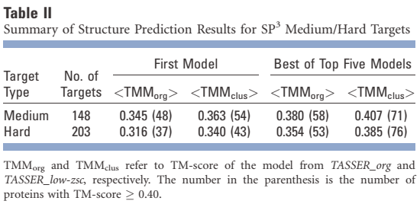
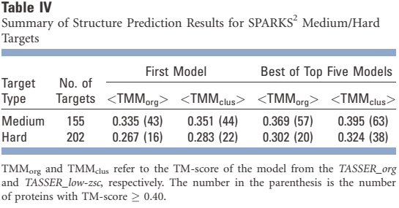
Notes:
TM Model
最好tm-score(tm-score>=0.4的個數)

Slide 10
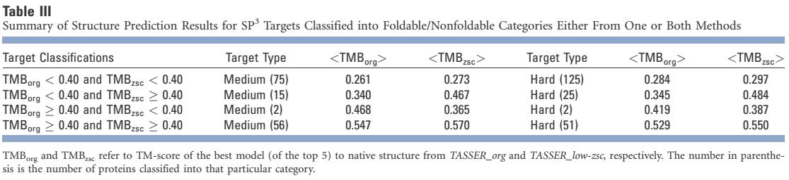
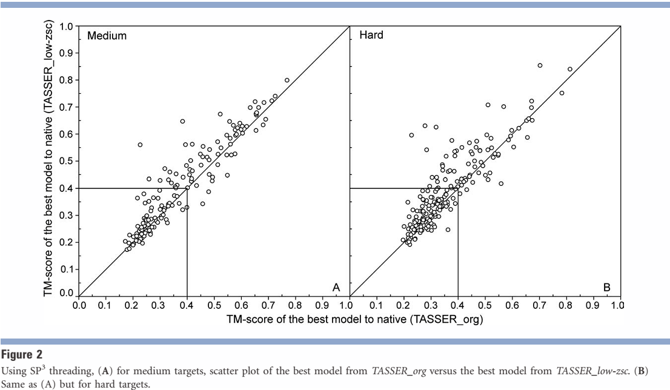
Notes:
TM Best
分數類似 但是zsc好一些 所以點在對角線上面一些

Slide 11
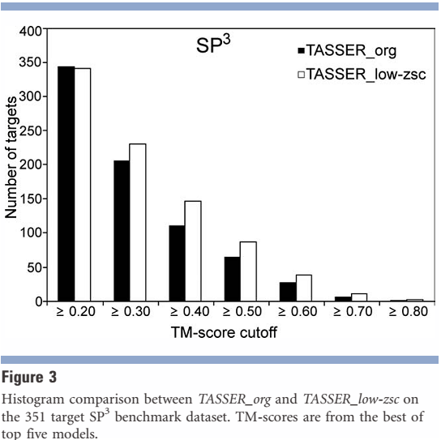
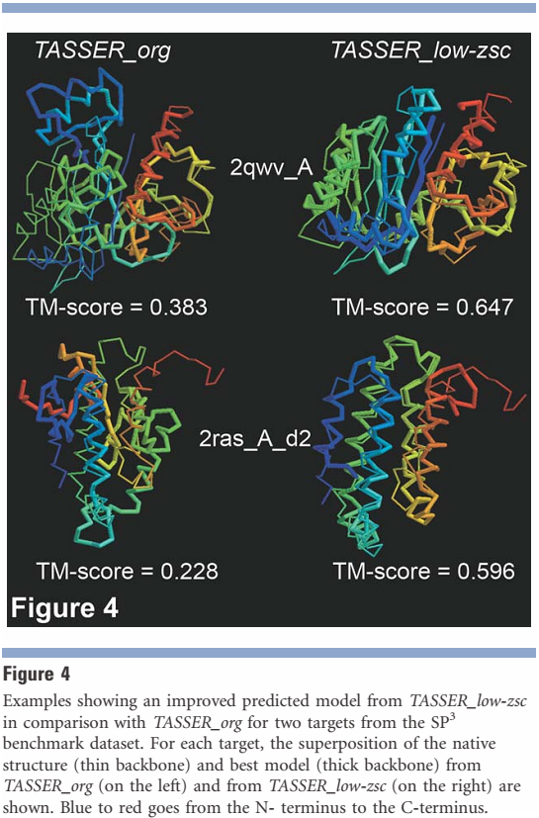

Slide 12
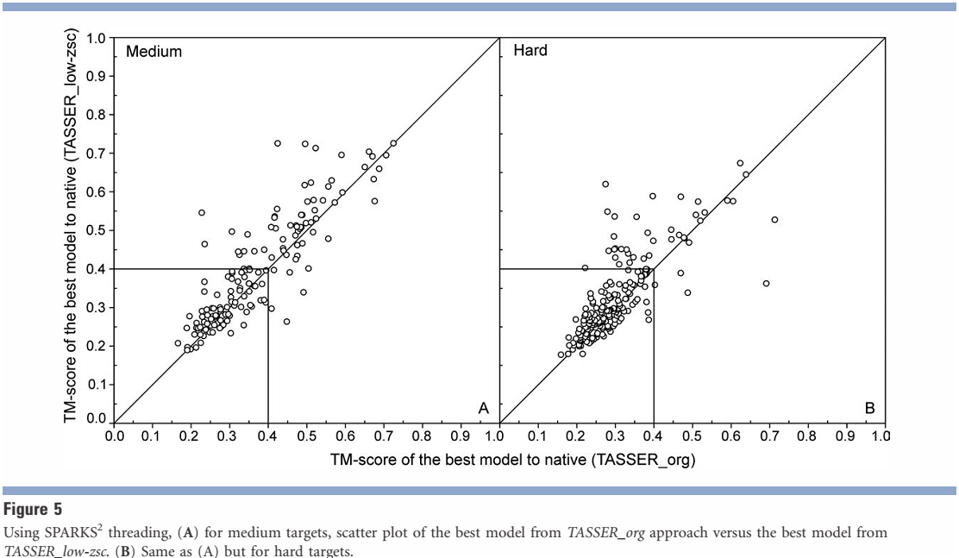

Slide 13
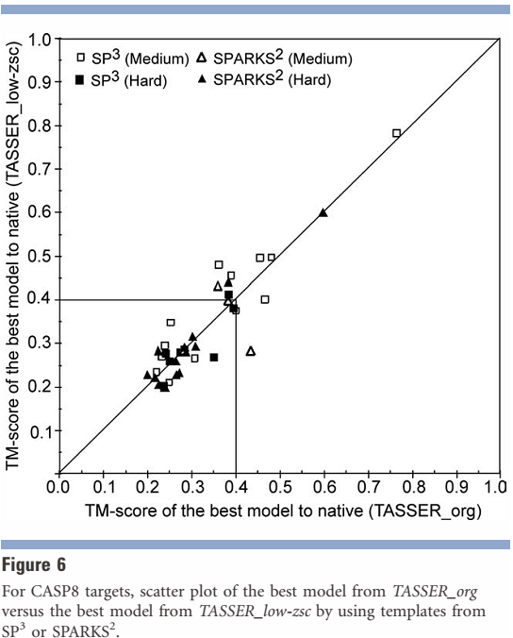
Notes:
改良原本TASSER沒有使用到的那些"low z-score的template" 使得TM-score的結果好一點點

Slide 14
Thanks for your listening.

