Slide 1
A linear time algorithm for max-min length triangulation of a convex polygon Information Processing Letters vol. 101 pp.203–208 (2007)
Shiyan Hu
Department of Computer and Information Science, Polytechnic University, Brooklyn, NY 11201, USA
Presentor：Hsin-Chuan Yuan

Slide 2
Abstract
We consider the following planar max-min length triangulation problem: given a set of n points in the Euclidean plane, find a triangulation such that the length of the shortest edge in the triangulation is maximized. In this paper, a linear time algorithm is proposed for computing the max-min length triangulation of a set of points in convex position.

Slide 3
Abstract
In addition, an O(nlogn) time algorithm is proposed for computing the max-min length k-set triangulation of a set of points in convex position, where we are to compute a set of k vertices such that the max-min length triangulation on them is minimized over all possible k-set. We further show that the graph version of max-min length triangulation is NP-complete, and some common heuristics such as greedy algorithm are in general not able to give a bounded-ratio approximation to the max-min length triangulation.

Slide 4
Triangulations
The minimum weight triangulation
The maximum weight triangulation
The min-max length triangulation

Slide 5



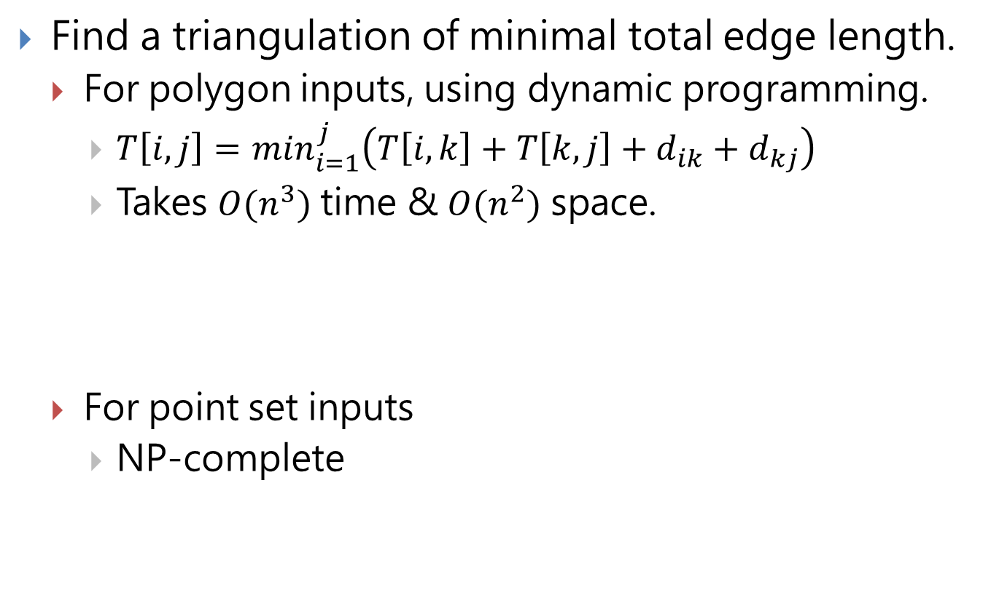
The minimum weight triangulation
Find a triangulation of minimal total edge length.
For polygon inputs, using dynamic programming.
$T\left[i,j\right]=\min_{i=1}^{j}\left(T\left[i,k\right]+T\left[k,j\right]+d_{ik}+d_{kj}\right)$
Takes $O(n^{3})$ time & $O(n^{2})$ space.
For point set inputs
NP-complete

Slide 6

The maximum weight triangulation
Find a triangulation of maximum total edge length.
For polygon inputs
Takes $O(n^{2})$ time

Slide 7

The min-max length triangulation
Find a triangulation such that the length of the longest edge is minimized.
Takes $O(n^{2})$ time

Slide 8
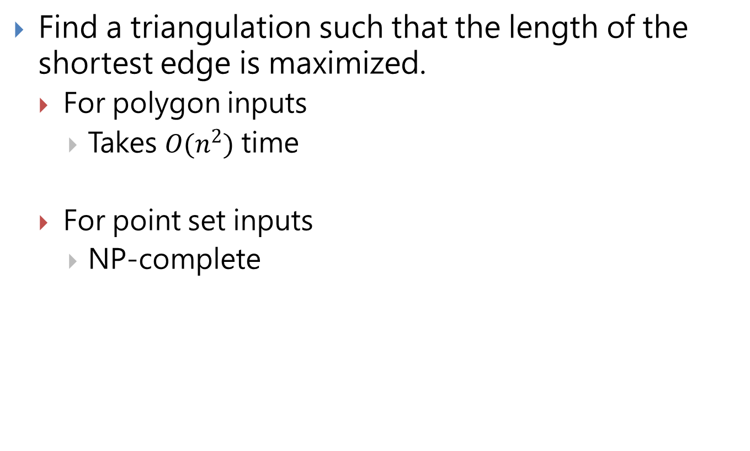
The max-min length triangulation
Find a triangulation such that the length of the shortest edge is maximized.
For polygon inputs
Takes $O(n^{2})$ time
For point set inputs
NP-complete

Slide 9
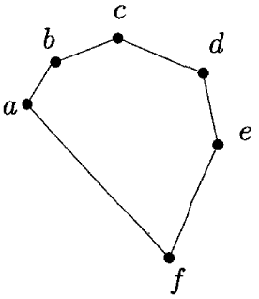
The max-min length triangulation for a convex polygon

Slide 10
The max-min length triangulation for a convex polygon

Slide 11
The max-min length triangulation for a convex polygon

Slide 12
The max-min length triangulation for a convex polygon

Slide 13
The max-min length triangulation for a convex polygon

Slide 14
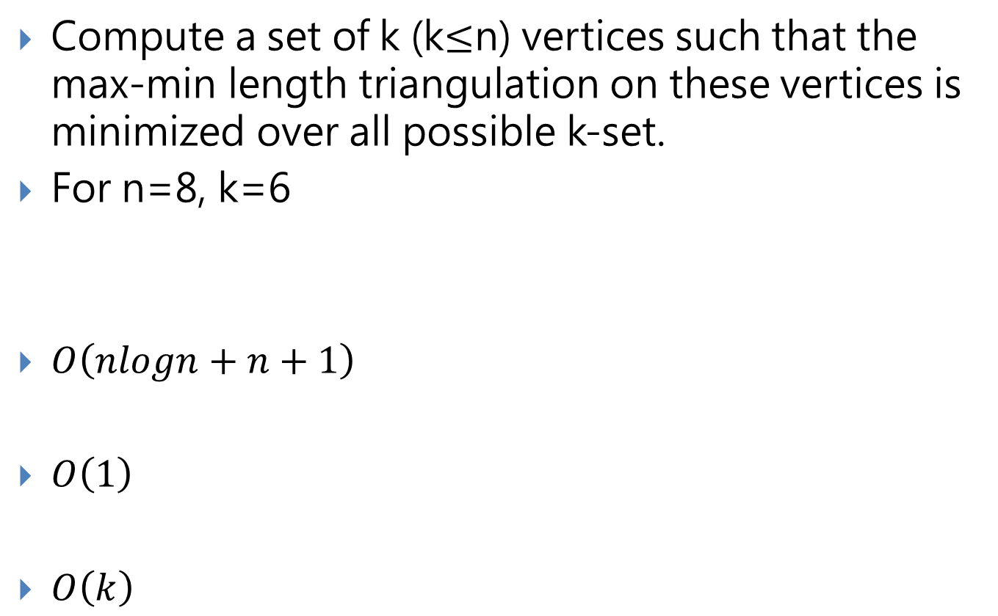
The max-min length k-set triangulation for a convex polygon
Compute a set of k (k$≤$n) vertices such that the max-min length triangulation on these vertices is minimized over all possible k-set.
For n=8, k=6
$O\left(nlogn+n+1\right)$
$O\left(1\right)$
$O\left(k\right)$

Slide 15
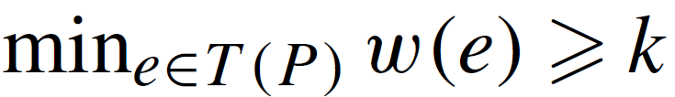
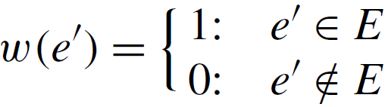
MMTG is NP-complete
Max-Min length Triangulation for undirected planar Graph problem (MMTG)
A complete graph G = (P,E) , w(e) = length
a positive number k, decide whether there is a triangulation T (P) in G such that
Let G’ = (P,E’) be the complete graph of P.

Slide 16
Conclusions
The work may help us better understand the nature of optimal triangulations.
Propose an optimal linear time algorithm for computing the max-min length triangulation of a convex polygon.
The max-min length k-set triangulation of a convex polygon can be computed in O(n log n) time.
The graph version of the max-min length triangulation problem is NP-complete.

