Slide 1
A Comparative Study on the Algorithms for a Generalized Josephus Problem
Author：Lei Wang, Xiaodong Wang Source：Applied Mathematics & Information Science; July 2013, Vol.7 Issue 4, p1451-1457
Presenter：郭冠呈 Date：2013/10/15

Slide 2
Abstract (1/2)
The classic Josephus problem can be described as follows: There are n objects, consecutively numbered from 1 through n, arranged in a circle. We are given a positive integer k. Beginning with a designated first object, we proceed around the circle, removing every kth object. After each object is removed, counting continues around the circle that remains. This process continues until all n objects have been removed. In a generalized Josephus problem, a number of lives l is introduced for the problem. Each object has l lives. The object is removed only when it has been selected l times.

Slide 3
Abstract (2/2)
In this paper we present a fast algorithm for generating the Josephus permutation for the generalized Josephus problem. Our new algorithm can also be applied to a more general case of the generalized Josephus problem where the lives for all objects can be different. The time and space complexities of new algorithms are O(lnlogk) and O(n) respectively. The computational experiments demonstrate that the achieved results are not only of theoretical interest, but also that the techniques developed may actually lead to considerably faster algorithms.

Slide 4
Josephus Problem
經典Josephus problem，有n個物件，將物件編號由1~n排列成一圈，給定一正整數k，從頭開始數起，數到k就移除該物件，接著重移除的物件之後開始數到k移除，以此類推，之後根據物件移除的順序可以生成Josephus permutation。
Ex: (n, k) = (6, 4) Josephus permutation = (4 2 1 3 6 5)

Slide 5
Variant of Josephus Problem
根據Josephus problem，賦予每個物件生命值l，每個物件被數到l 次之後才會被移除。
Ex: (n, k, l) = (6, 4, 2) Josephus permutation = (4 2 1 6 5 3)
經典Josephus problem可以看成生命值 l = 1。

Slide 6
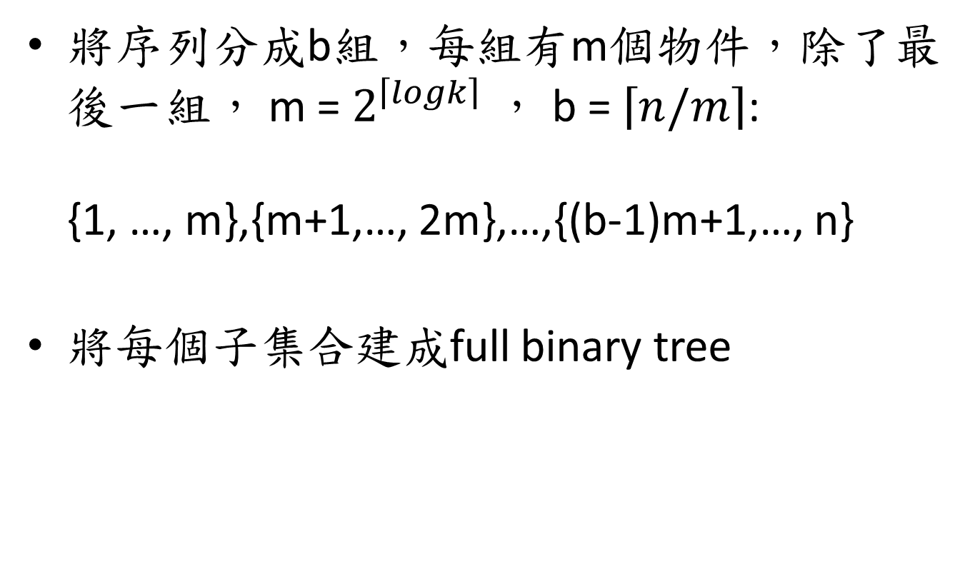
Data Structure of Algorithm
將序列分成b組，每組有m個物件，除了最後一組， m = $2^{\left\lceil logk\right\rceil }$ ， b = $\left\lceil n/m\right\rceil$: {1, …, m},{m+1,…, 2m},…,{(b-1)m+1,…, n}
將每個子集合建成full binary tree

Slide 7
Data Structure of Algorithm
Full binary tree 中，leaf 為物件，non-leaf儲存該節點subtree 中，沒有被移除的leaf數，即active leaf，用負號區分是leaf或是non-leaf。
(n,k,l) = (6, 4, 1)
4
2
2
2
-5
-6
-1
-2
-3
-4

Slide 8
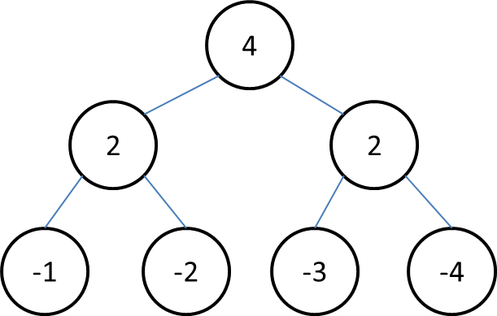
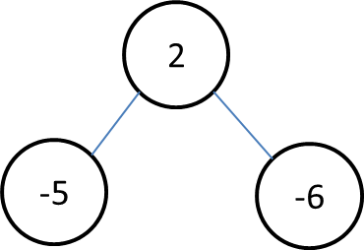
Data Structure of Algorithm
最後紀錄full binary tree之順序，tree連成circle。
Tree: 1 next: 1 prev: 2
Tree: 2 next: 1 prev: 1

Slide 9
Algorithm for Generating Hit Sequences
In this paper, they generate the hit sequences in three part.
Build the data structure
Find the hit object
Adjust the tree

Slide 10
Build the Data Structure
According to the data structure to build the tree of object.
Full binary tree can store easily in array.
Count the number of active leaf.

Slide 11
Find the Hit Object
Use the variable r to record the number of active objects to the right of currently hit node in the full binary tree.
Variable r is useful to find the next hit object.

Slide 12
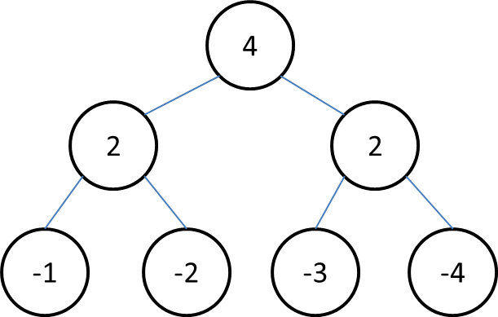

Find the Hit Object
Ex: (n, k, l) = (6, 4, 1), position in tree 1, has 4 active objects, initial r = 4.
Tree: 1 next: 1 prev: 2
Tree: 2 next: 1 prev: 1

Slide 13
Find the Hit Object
To hit the object, using the method likes binary search.
一開始 r = 0，k=4，r<k，將當前tree的leaf引入，使得r足夠數k次，記錄數k次剩餘的active object number next_r = r-k，藉由node上的active number，從右邊node開始找，先看node(2)，active number = 2，r-2 < k 表示減去node(2)的兩個leaf 還不足以數完k次 ，有hit object在 subtree中，以此類推，當遇到leaf表示找到hit object。
4
2
0
2
r – 2 = 2, 2 < k
1
2
-1
-2
-3
-4
r – 1 = 3, 3 < k It’s leaf. Found the hit object.
3
4
5
6

Slide 14
Find the Hit Object
當前的tree中的leaf不足k的情況
續前頁 r=2 < k，表示當前tree中沒有hit object，將下一個tree的leaf引入，tree2 的
下一個是tree1，r = r+3 = 5，r > k，hit object在tree1中，重複之前步驟，
找到hit object
r = r+3 = 5
3
r不足k
r – 2 < k
2
0
1
r – 1 = k 超過k次
2
0
1
2
-5
-6
-1
-2
-3
0
1
2
3
4
5
6
Tree: 2 next: 1 prev: 1
Leaf hit object
Tree: 1 next: 1 prev: 2

Slide 15
Adjust the tree
在找到hit object之後，將找到的object存入hit sequence中。
如果hit object的生命值沒了需要移除，要將tree的active number減去。
檢查當前tree前後的tree，剩餘的active object 是否能和當前tree的active object合成m個leaf的full binary tree。

Slide 16
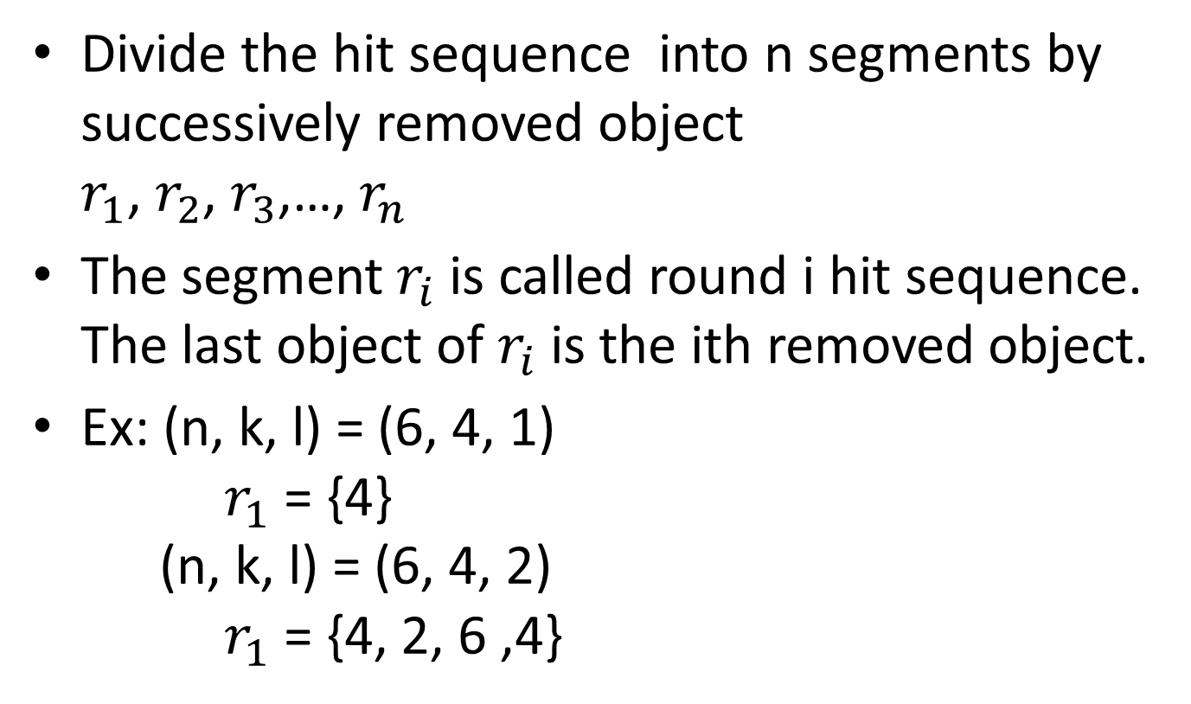
Improve the Algorithm
Divide the hit sequence into n segments by successively removed object $r_{1}$, $r_{2}$, $r_{3}$,…, $r_{n}$
The segment $r_{i}$ is called round i hit sequence. The last object of $r_{i}$ is the ith removed object.
Ex: (n, k, l) = (6, 4, 1) $r_{1}$ = {4} (n, k, l) = (6, 4, 2) $r_{1}$ = {4, 2, 6 ,4}

Slide 17
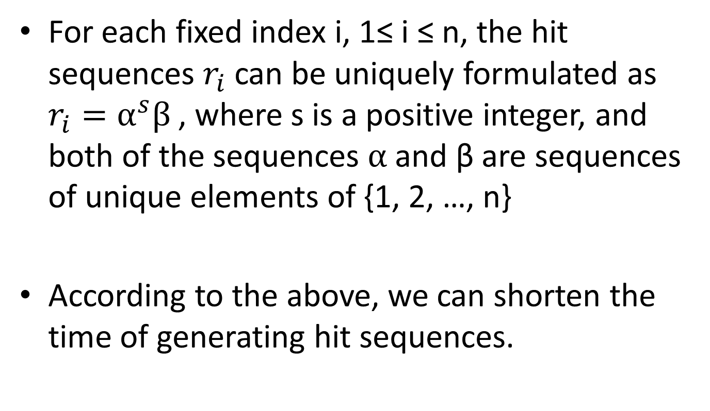
Improve the Algorithm
For each fixed index i, 1≤ i ≤ n, the hit sequences $r_{i}$ can be uniquely formulated as $r_{i}=α^{s}β$ , where s is a positive integer, and both of the sequences $α$ and β are sequences of unique elements of {1, 2, …, n}
According to the above, we can shorten the time of generating hit sequences.

Slide 18
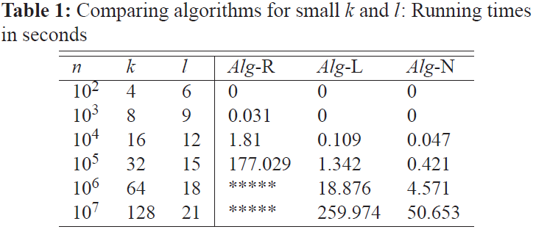
Computational Experiments

Slide 19
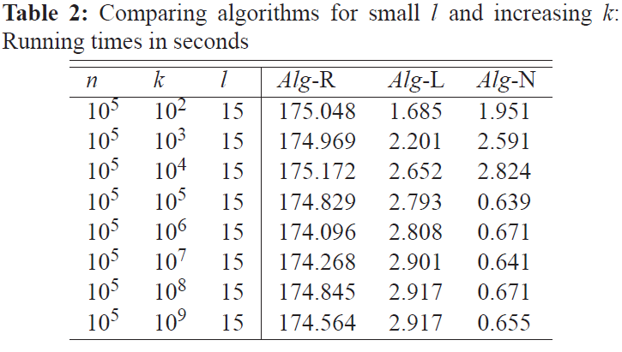
Computational Experiments

Slide 20
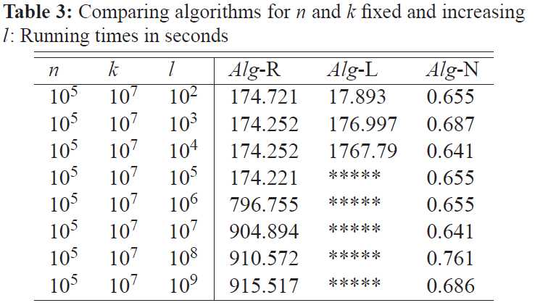
Computational Experiments

Slide 21
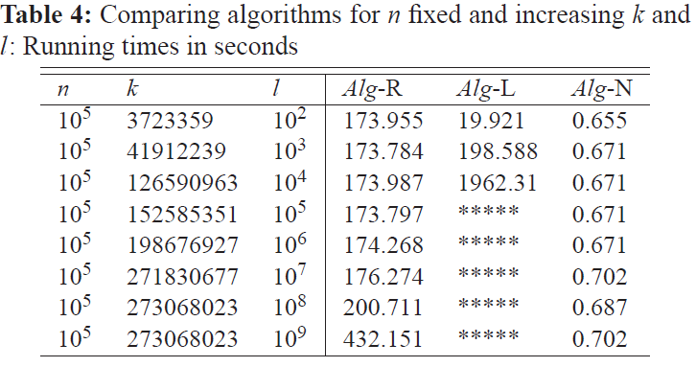
Computational Experiments

Slide 22
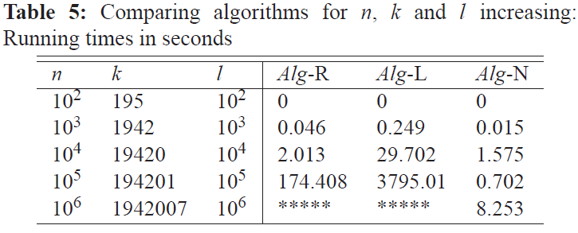
Computational Experiments

