Slide 1
Aggressive Assembly of Pyrosequencing Reads with Mates
Jason R. Miller, Arthur L. Delcher, Sergey Koren, Eli Venter, Brian P. Walenz, Anushka Brownley, Justin Johnson, Kelvin Li, Clark Mobarry and Granger Sutton Bioinformatics vol. 24 no. 24 2008, pages 2818–2824
Presentor: Yi-Pu Guo
2013-05-07

Slide 2
Abstract (1/2)
Motivation: DNA sequence reads from Sanger and pyrosequencing platforms differ in cost, accuracy, typical coverage, average read length and the variety of available paired-end protocols. Both read types can complement one another in a ‘hybrid’ approach to wholegenome shotgun sequencing projects, but assembly software must be modified to accommodate their different characteristics. This is true even of pyrosequencing mated and unmated read combinations. Without special modifications, assemblers tuned for homogeneous sequence data may perform poorly on hybrid data.

Slide 3
Abstract (2/2)
Results: Celera Assembler was modified for combinations of ABI 3730 and 454 FLX reads. The revised pipeline called CABOG (Celera Assembler with the Best Overlap Graph) is robust to homopolymer run length uncertainty, high read coverage and heterogeneous read lengths. In tests on four genomes, it generated the longest contigs among all assemblers tested. It exploited the mate constraints provided by paired-end reads from either platform to build larger contigs and scaffolds, which were validated by comparison to a finished reference sequence. A low rate of contig mis-assembly was detected in some CABOG assemblies, but this was reduced in the presence of sufficient mate pair data.

Slide 4
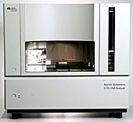
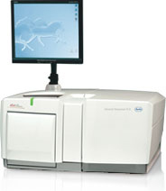
DNA Sequencing Methods
Dideoxy chain-termination method
Sanger method (桑格法)
454 pyrosequencing
454 Life Sciences Company
Shotgun sequencing
等等
ABI 3730 (Sanger method)
454 FLX pyrosequencing machine
Notes:
http://www.454.com/

Slide 5
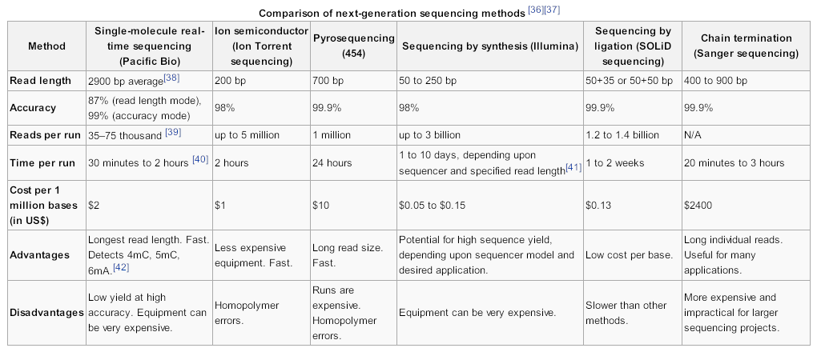
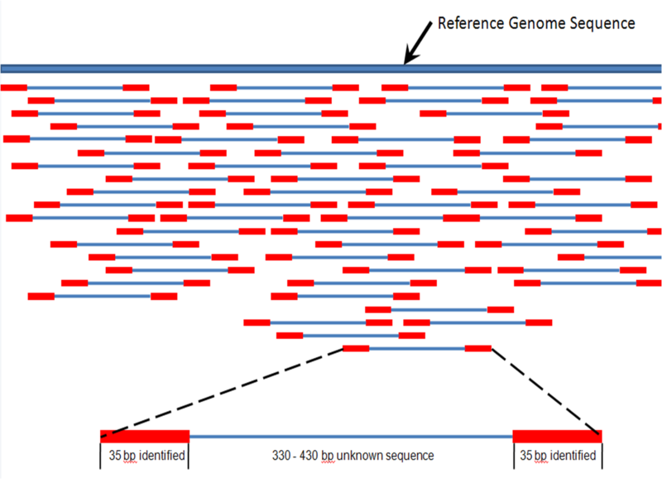
bp = base pair
sequencing platforms
↓ reads
assembly software
↓ whole sequence

Slide 6
Introduction
Hybrid sequencing
two or more sequencing platforms.
may require assembly software tuned for specific-read type combinations.
Modified Celera Assembler
CABOG (Celera Assembler with the Best Overlap Graph)
Notes:
pairwise overlap detection;
initial ungapped multiple sequence alignments called unitigs;
unitig consensus calculation;
combination of unitigs with mate constraints to form contigs and scaffolds, which are ungapped and gapped multiple sequence alignments, respectively;
and finally, scaffold consensus determination.

Slide 7
Algorithm
Overlap-based trimming
Compute for all read pairs local alignments, or partial overlaps that may not span the end of either read.
Anchors and overlaps
uses exact-match seeds to detect possibly overlapping reads quickly.
finds these seed matches in compressed sequence where consecutive instances of the same base are reduced to one base.

Slide 8
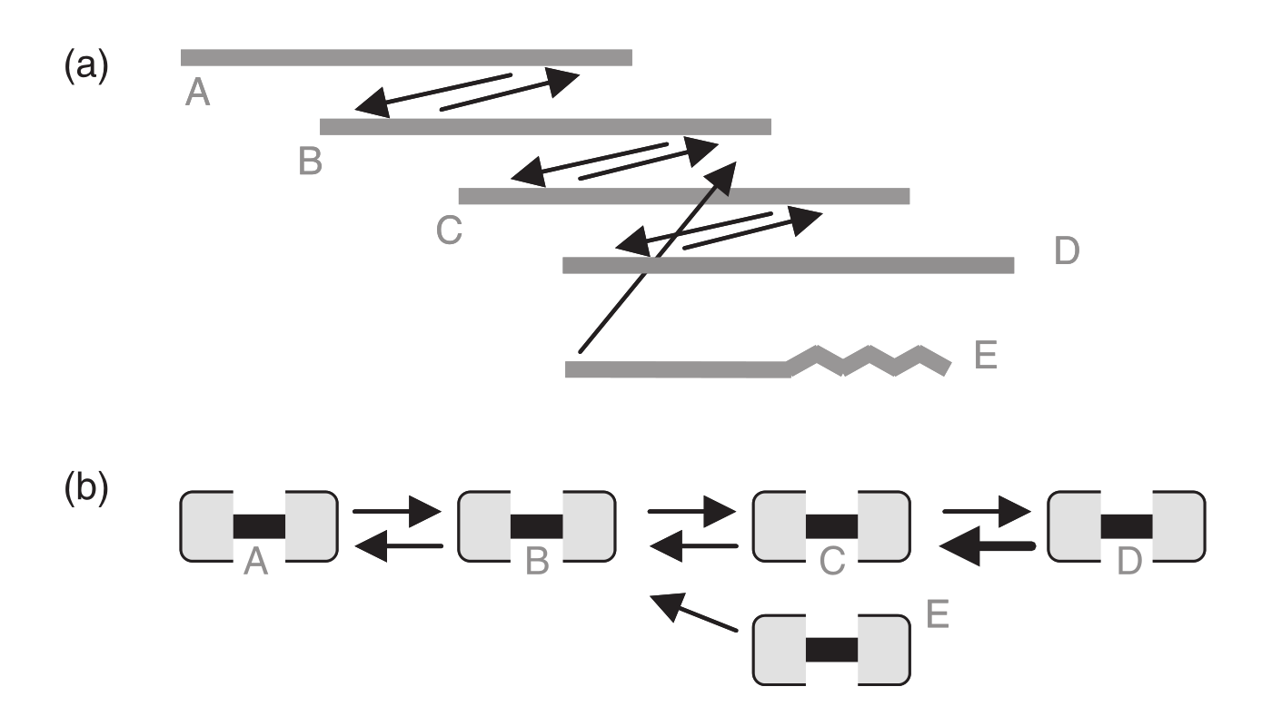
3. Best Overlap Graph (BOG)
multi-graph
one read has 2 ends (nodes)
undirected: best overlap
(in length, only one)
directed:
< 1.5% alignment error > 40 bp spanned

Slide 9
4. Unitig Construction
Score each read.
the number of other reads reachable from it along BOG paths.
Sort the reads by score.
Start at the next-highest scoring read R.
Follow paths and build a unitig from each path.
Skip R if R is already in a unitig.
4
4
4
4
3

Slide 10
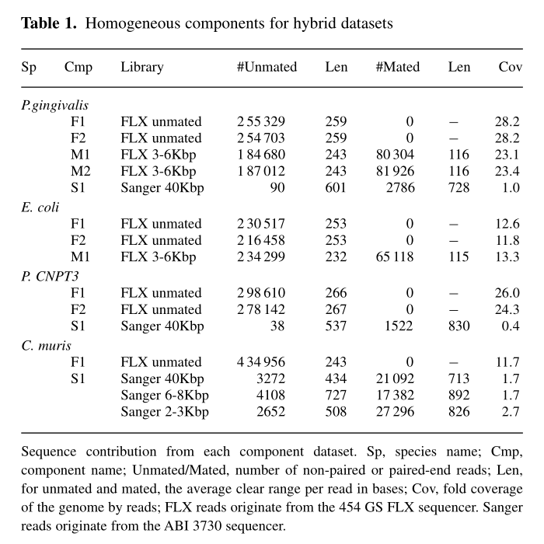
Dataset

Slide 11
Results
Compared with Newbler.
Contig analysis
Table 2, 3
Scaffold analysis
Table 4
Assembly correctness
Table 5

Slide 12
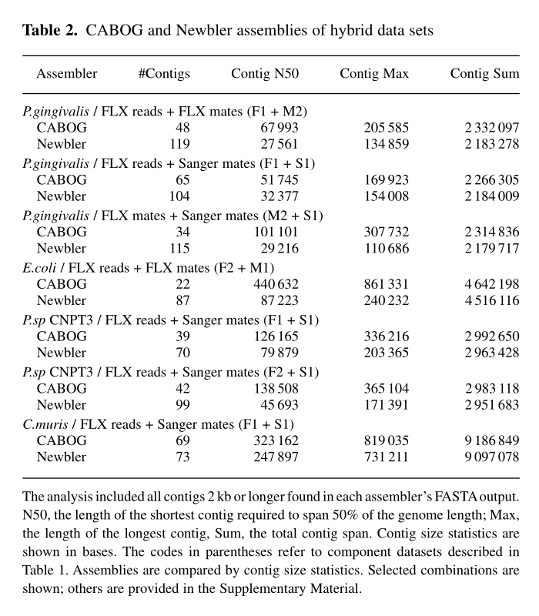

Slide 13
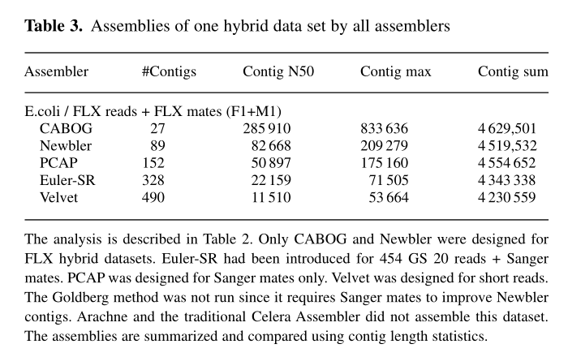

Slide 14
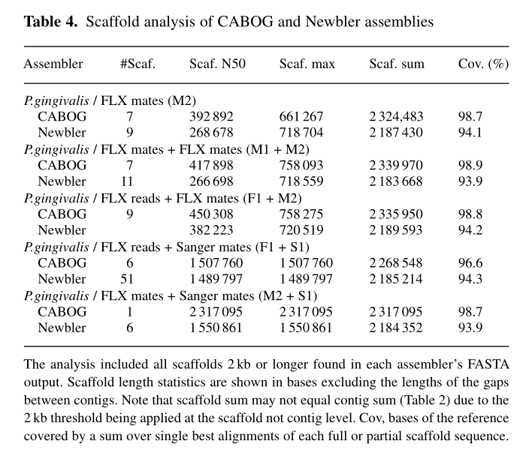

Slide 15
