Slide 1
Genome assembly reborn: recent computational challenges
Mihai Pop
Briefings in Bioinformatics, Volume 10, Issue 4, Pp. 354-366, 2009
Presenter: Che-Jui Hsu(許哲睿)
Date: 2013/5/7

Slide 2
Abstract
Research into genome assembly algorithms has experienced a resurgence due to new challenges created by the development of next generation sequencing technologies. Several genome assemblers have been published in recent years specifically targeted at the new sequence data; however, the ever-changing technological landscape leads to the need for continued research. In addition, the low cost of next generation sequencing data has led to an increased use of sequencing in new settings. For example, the new field of metagenomics relies on large-scale sequencing of entire microbial communities instead of isolate genomes, leading to new computational challenges. In this article, we outline the major algorithmic approaches for genome assembly and describe recent developments in this domain.

Slide 3
Genome assembly
Genome assembly: 將數個DNA segments重新組合回原本的genome
Original
A
C
B
D

Slide 4
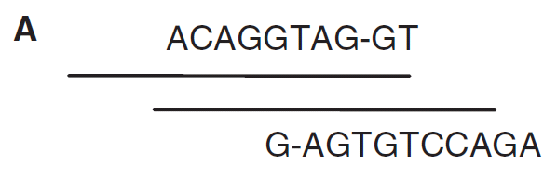
Greedy (1/3)
Greedy: Individual reads are joined together into contigs in an iterative fashion, starting with the reads that overlap best, and ending once no more reads or contigs can be joined.

Slide 5
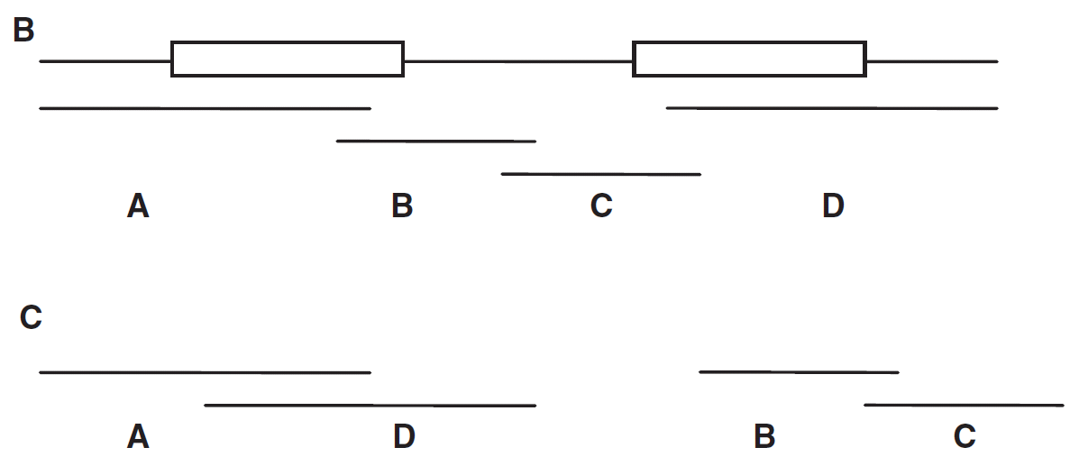
Greedy (2/3)

Slide 6
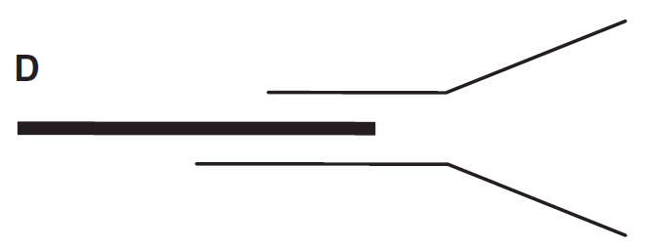
Greedy (3/3)
Variant: An unassembled read is chosen to start a contig, which is then repeatedly extended by identifying reads that overlap the contig on its 3’ end until no more extensions are possible. The process is repeated in the 5’ direction using the reverse complement of the contig sequence.

Slide 7
Overlap-layout-consensus (OLC) (1/2)
The reads are compared to each other to construct a list of pair-wise overlaps.
Construct an overlap graph: a graph containing each read as a node, and an edge connects two nodes if an overlap was identified between the corresponding reads.
Find a single path that traverses each node in the overlap graph exactly once. (Hamiltonian path)
Determining the DNA sequence that is implied by the arrangement of reads along the chosen path through the graph.

Slide 8
Overlap-layout-consensus (OLC) (2/2)
A
D
B
C

Slide 9
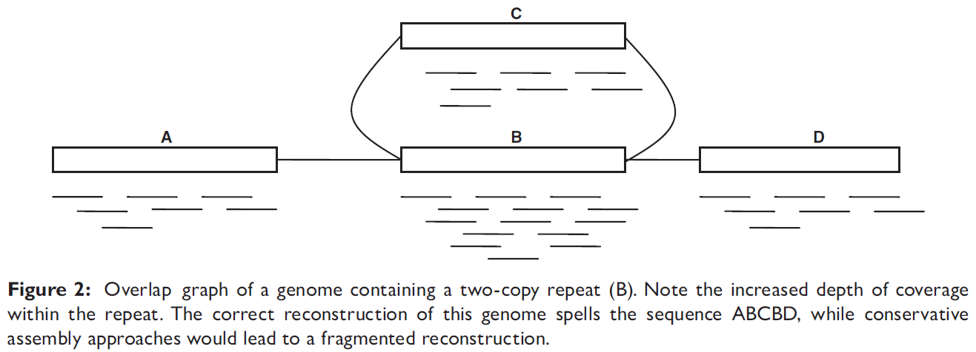
OLC V.S Greedy
OLC: ABCBD
Greedy: (ABC, D) or (ABD, C) or …..

Slide 10

Eulerian path (1/3)
Get the $k$-mer spectrum: a list of all oligomers of a given length $k$ present in the genome.

Slide 11

Eulerian path (2/3)
Construct a deBruijn graph: a graph ontaining as nodes the $k−1$ length prefixes and suffixes of the original $k$-mers, two nodes being linked by an edge if the adjacent $k−1$ -mers have an exact overlap of length $k−2$.

Slide 12
Eulerian path (3/3)
Finding a path through this graph that uses every edge in the graph. (Eulerian path)

Slide 13
Eulerian path V.S OLC
Advantage:
OLC不會記住overlaps的大小而Eulerian path會
Eulerian path比Hamiltonian path好解
Disadvantage:
Eulerian path求出來的解不一定唯一

