Slide 1
Quadratic Time Algorithms for Finding Common Intervals in Two and More Sequences Lecture Notes in Computer Science vol.3109, pp. 347-358, 2004
Thomas Schmidtª, and Jens Stoye^{b} ª International NRW Graduate School in Bioinformatics and Genome Research, Center of Biotechnology, Universitat Bielefeld, 33594 Bielefeld, Germany
^{b} Technische Fakultat, Universitat Bielefeld, 33594 Bielefeld, Germany
Presentor：Hsin-Chuan Yuan

Slide 2
Abstract
A popular approach in comparative genomics is to locate groups or clusters of orthologous genes in multiple genomes and to postulate functional association between the genes contained in such clusters. To this end, genomes are often represented as permutations of their genes, and common intervals, i.e. intervals containing the same set of genes, are interpreted as gene clusters. A disadvantage of modelling genomes as permutations is that paralogous copies of the same gene inside one genome can not be modelled.

Slide 3
Abstract
In this paper we consider a slightly modified model that allows paralogs, simply by representing genomes as sequences rather than permutations of genes. We define common intervals based on this model, and we present a simple algorithm that finds all common intervals of two sequences in Θ(n ²) time using Θ(n ²) space. Another, more complicated algorithm runs in O(n ²) time and uses only linear space. We also show how to extend the simple algorithm to more than two genomes, and we present results from the application of our algorithms to real data.

Slide 4
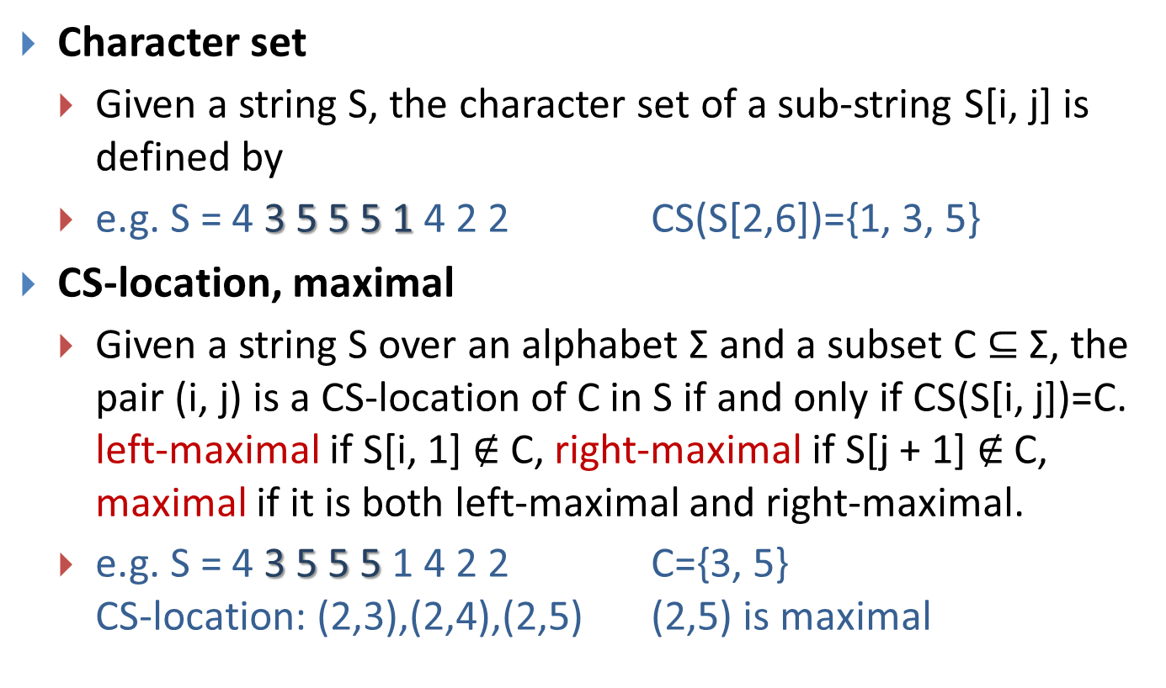
Basic Definitions
Character set
Given a string S, the character set of a sub-string S[i, j] is defined by
e.g. S = 4 3 5 5 5 1 4 2 2 CS(S[2,6])={1, 3, 5}
CS-location, maximal
Given a string S over an alphabet Σ and a subset C $⊆$ Σ, the pair (i, j) is a CS-location of C in S if and only if CS(S[i, j])=C. left-maximal if S[i, 1]$∉$C, right-maximal if S[j + 1]$∉$C, maximal if it is both left-maximal and right-maximal.
e.g. S = 4 3 5 5 51 4 2 2 C={3, 5} CS-location: (2,3),(2,4),(2,5) (2,5) is maximal

Slide 5
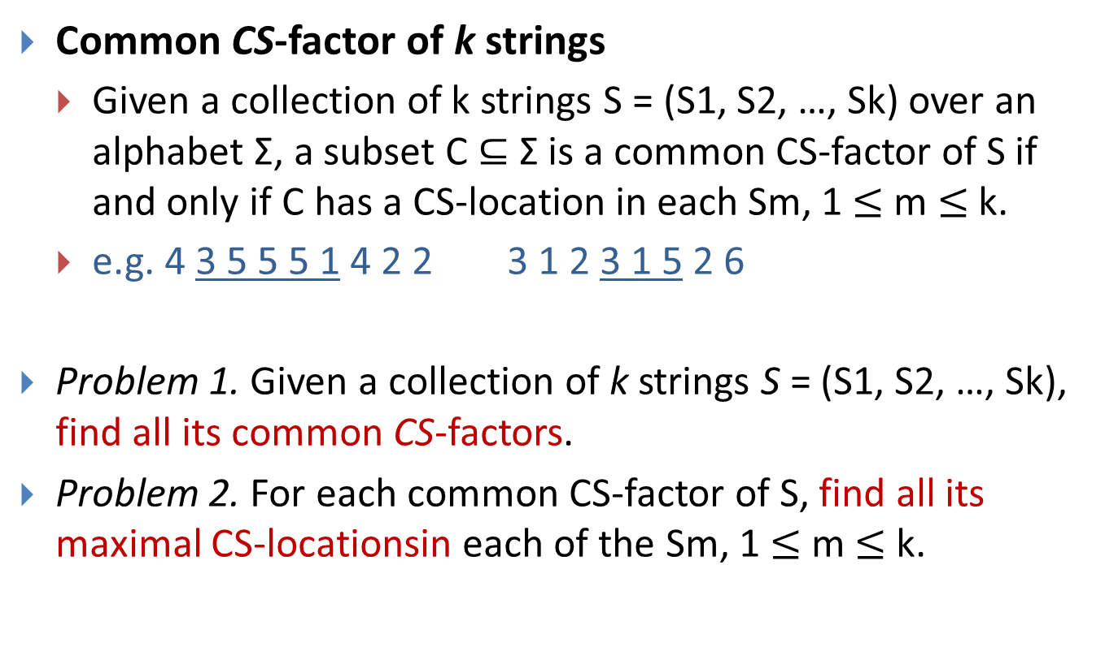
Basic Definitions
Common CS-factor of k strings
Given a collection of k strings S = (S1, S2, …, Sk) over an alphabet Σ, a subset C $⊆$ Σ is a common CS-factor of S if and only if C has a CS-location in each Sm, 1 $≤$m $≤$ k.
e.g. 4 3 5 5 5 1 4 2 2 3 1 2 3 1 5 2 6
Problem 1. Given a collection of k strings S = (S1, S2, …, Sk), find all its common CS-factors.
Problem 2. For each common CS-factor of S, find all its maximal CS-locationsineach of the Sm, 1 $≤$ m $≤$ k.

Slide 6
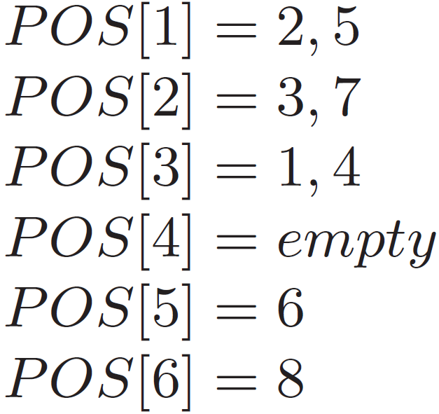
Pre-processing Step of Connecting Intervals (CI)
A list POS[c] that holds the positions of occurrence of c in sequence S1 in ascending order.
S1 = (3, 1, 2, 3, 1, 5, 2, 6) with Σ = {1, . . . , 6}

Slide 7
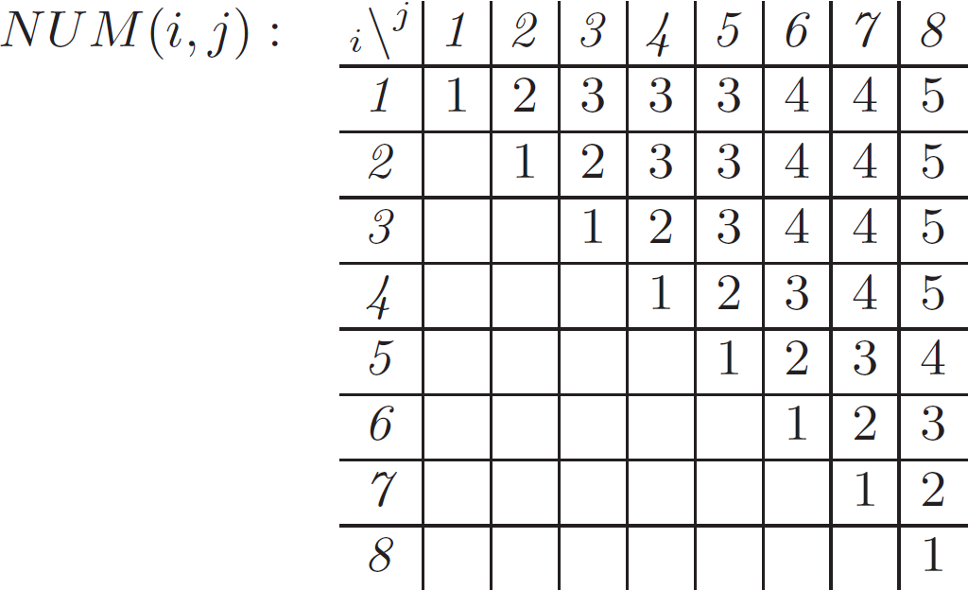

Pre-processing Step of Connecting Intervals (CI)
NUM(i, j) contains the number |CS(S1[i, j])|of different characters in the interval S1[I, j] for each 1 $≤$i$≤$ j $≤$|S1|.
S1 = (3, 1, 2, 3, 1, 5, 2, 6) with Σ = {1, . . . , 6}

Slide 8
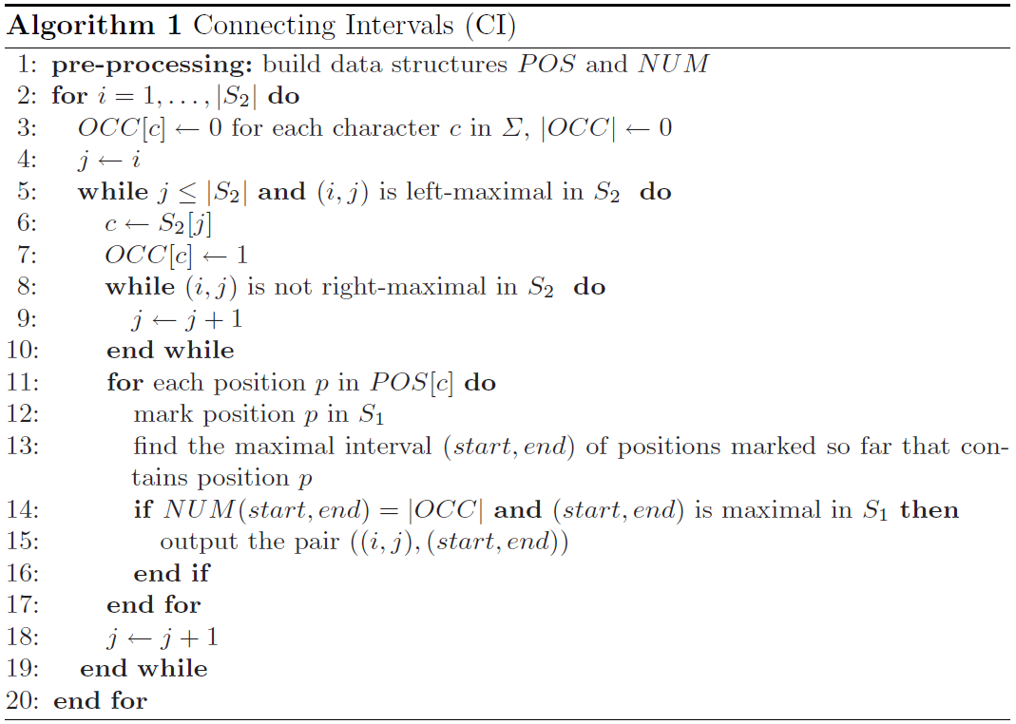
Connecting Intervals (CI)

Slide 9
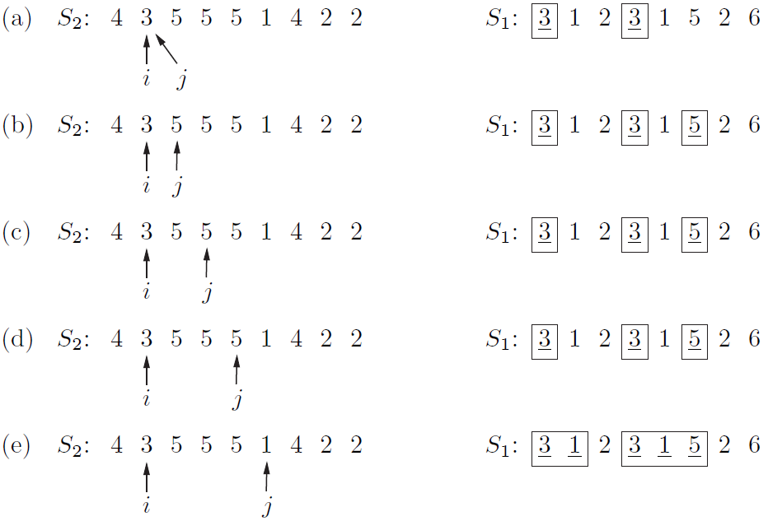
Connecting Intervals (CI)

Slide 10

Connecting Intervals (CI)
The price for this simplicity is paid in space consumption.
the pre-processing step consumes θ($n^{2}$) space and time.
Overall time and space complexity: θ($n^{2}$)

Slide 11
Generating Non-redundant Output
S1 = (1, 2, 3, 1, 2), S2 = (1, 2, 4, 1, 2, 5, 1, 2)
The original algorithm outputs :
((1, 2), (1, 2)), ((1, 2), (4, 5)), ((1, 2), (7, 8)), ((4, 5), (1, 2)), ((4, 5), (4, 5)), ((4, 5), (7, 8))
A non-redundant output :
S1 : (1, 2), (4, 5) - S2 : (1, 2), (4, 5), (7, 8)
Two additional tables LOC₁ and LOC₂, each of size |S1|x|S1|, are used to store lists of intervals.

Slide 12
Generating Non-redundant Output
Algorithm CI is applied to S1 as first and second input sequence.
e.g. For S1 = (1, 2, 3, 1, 2), CI yields common CS-factor ((1,2),(4,5)), then the CS-location (4,5) is appended to the list in LOC₁(1,2).
Algorithm CI is applied to S1 and S2, detecting the orthologous gene clusters.
e.g. For S2 = (1, 2, 4, 1, 2, 5, 1, 2), CI yields common CS-factors ((1,2),(1,2)), ((1,2),(4,5)), ((1,2),(7,8)), then the CS-location (1,2),(4,5),(7,8) is appended to LOC₂(1,2).
Finally, the output for each non-empty entry LOC₂(1,2) is: S1 : (1,2),LOC₁(1,2) - S2 : LOC₂(1,2).

Slide 13
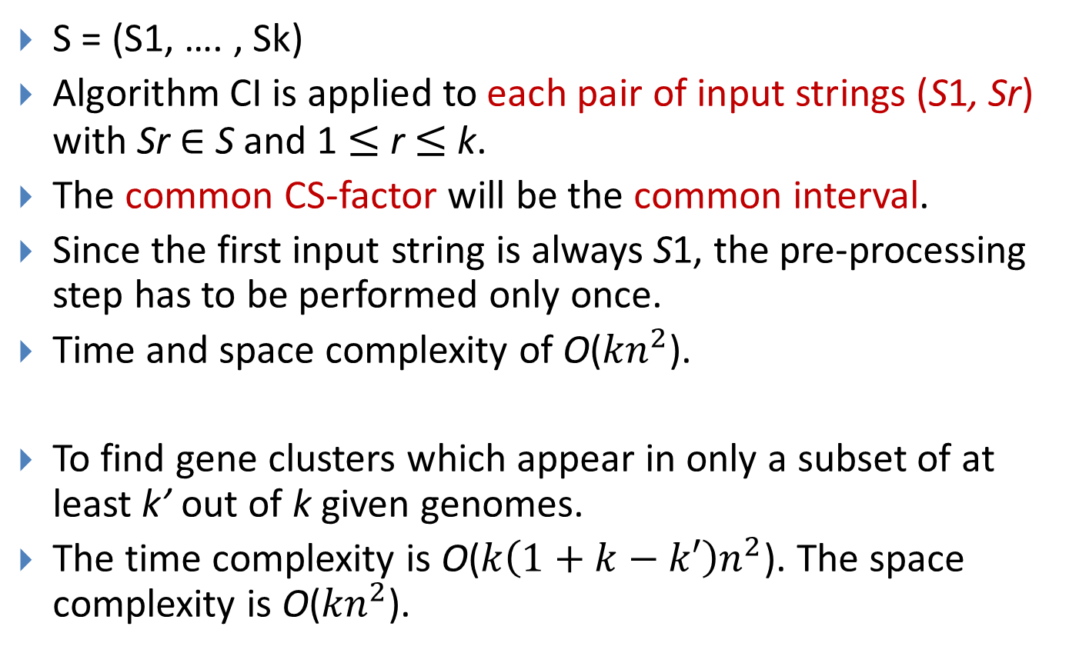
Multiple Genomes
S = (S1, …. ,Sk)
Algorithm CI is applied to each pair of input strings (S1,Sr) with Sr$∈$S and 1 $≤$ r $≤$ k.
The common CS-factor will be the common interval.
Since the first input string is always S1, the pre-processing step has to be performed only once.
Time and space complexity of O(${kn}^{2}$).
To find gene clusters which appear in only a subset of at least k’ out of k given genomes.
The time complexity is O(${k\left(1+k−k′\right)n}^{2}$). The space complexity is O(${kn}^{2}$).

Slide 14
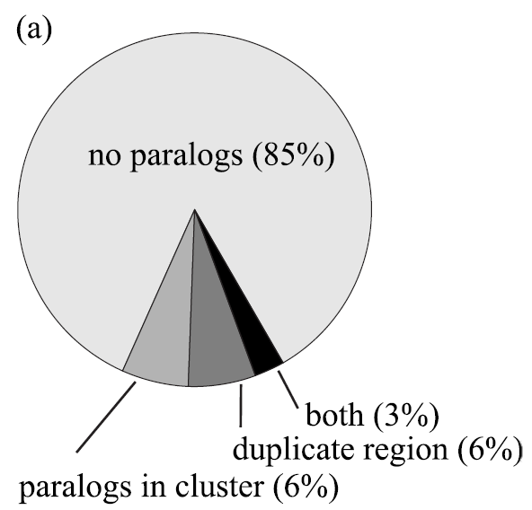
Experimental Results
We applied our algorithms to 5 bacterial genomes.
Algorithm CI reported 3428 gene clusters (which contains at least two different genes and has a CS-location in at least two sequences).
(a) distribution of cluster type.

Slide 15
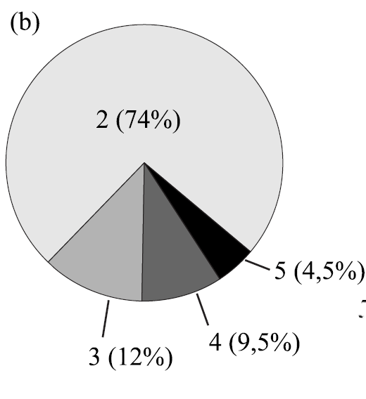
Experimental Results
We applied our algorithms to five bacterial genomes.
Algorithm CI reported 3428 gene clusters (which contains at least two different genes and has a CS-location in at least two sequences).
(b) number of genomes where a cluster is found.

Slide 16
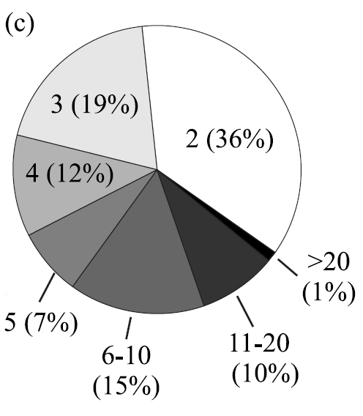
Experimental Results
We applied our algorithms to five bacterial genomes.
Algorithm CI reported 3428 gene clusters (which contains at least two different genes and has a CS-location in at least two sequences).
(c) distribution of cluster sizes.

Slide 17
Conclusions
To use gene clusters for functional prediction, it is necessary to use genomes with a sufficient evolutionary distance to avoid finding gene clusters that did not have enough time to diverge.
The evaluation of the cluster size provides the opportunity to reduce the time complexity to linear by setting a fixed maximum cluster size.

