Slide 1
Improved approximate common interval
Amihood Amir, Leszek Gasieniec, Riva Shalom
Information Processing Letters 103 (2007) 142–149
Presenter: 方鈞毅
Date: May 14, 2013

Slide 2
Intervals with the Same Character Set
Schmidt and Stoye give an O(n²) time algorithm that locates all intervals of two strings that share the same character set
O(Ln²) for L strings
S₁ = 121312
S₂ = 232321
{1,2} at S₁[1..2], S₁[5..6], S₂[5..6]
{1,2,3} at S₁[1..6], S₂[1..6]

Slide 3
Approximate Common Intervals Problem(ACI)
在容許部分錯誤之下,擁有更大區間
Input
S = {s₁ , s₂ ,..,s_{L}} with size n
int K (symmetric set difference )
Output
For every distinct character set (cs) in S, report all character sets cs’ (and intervals), occurring in S, such that 彼此的對稱差 ≤ K
對稱差 - 聯集扣掉交集

Slide 4
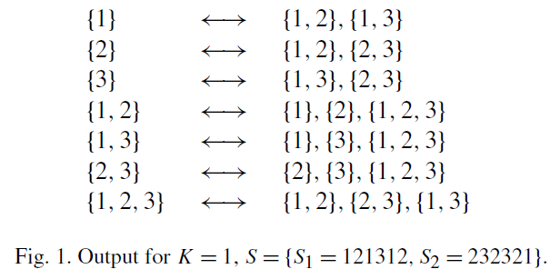
ACI example
cs cs’

Slide 5
作法
建圖
Node => distinct character sets(and its interval)
第一層為size為1 , 第二層的size為2,…由上而下
一層的 nodes count O(n – size + 1)
一個character set可能對應到多個intervals
S = 121312 {1}對應到S[1],S[3],S[5]
Edge => node間彼此的對稱差=1時，則相連
O(n*size) // (size+1, size)

Slide 6
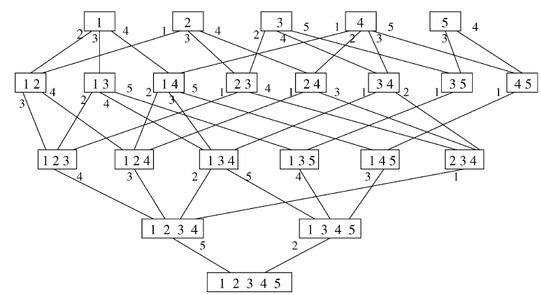

Slide 7
Character Sets
用 bit arrary 紀錄 character set (size = |∑|)
∑ = {1,2,3}
s₁ = 1123
 | 1 | 2 | 3
{1} | 1 | 0 | 0
{2} | 0 | 1 | 0
{3} | 0 | 0 | 1
{1,2} | 1 | 1 | 0
{2,3} | 0 | 1 | 1

Slide 8
Nodes
For a string find its distinct character sets
for size = 1 to |∑|
for y = 1 to (n-size+1)
{
…..find distinct character sets [y..y+size-1] and record its maximal intervals…
}
O(n|∑|) worst O(n²)
Sorted them(by layer) to get distinct character sets O(n² log n)//整合區間,character set

Slide 9
Edges
因為對稱差為1的只會出現在上下層，故逐一檢查，each layer的upper bond為O(n – size + 1)故cost O(n²) between layers
Here we consider this problem as an approximate dictionary matching problem, by Brodal Gasieniec algorithm cs_(f + 1)s form the dictionary, and all cs_f s are considered as query text O(n²)
All in all the procedure of constructing both V and E, including edges between all consecutive layers consumes O(n² log n)+ O(n³) = O(n³) time.

Slide 11
Graph have built
Now we can use DFS search with depth(k)
node, which was visted is the answer
O(Ln³)

