Slide 1
GAGE: A critical evaluation of genome assemblies and assembly algorithms
Steven L. Salzberg, Adam M. Phillippy, Aleksey Zimin, Daniela Puiu, Tanja Magoc, Sergey Koren, Todd J. Treangen, Michael C. Schatz, Arthur L. Delcher, Michael Roberts, Guillaume Marcxais, Mihai Pop, and James A. Yorke
Genome Res 2012, 22:557-567
Date:2013/5/7
Presenter: Cheng-Han Lee

Slide 2
Abstract
New sequencing technology has dramatically altered the landscape of whole-genome sequencing, allowing scientists to initiate numerous projects to decode the genomes of previously unsequenced organisms. The lowest-cost technology can generate deep coverage of most species, including mammals, in just a few days. The sequence data generated by one of these projects consist of millions or billions of short DNA sequences (reads) that range from 50 to 150 nt in length. These sequences must then be assembled de novo before most genome analyses can begin. Unfortunately, genome assembly remains a very difficult problem, made more difficult by shorter reads and unreliable long-range linking information. In this study, we evaluated several of the leading de novo assembly algorithms on four different short-read data sets, all generated by Illumina sequencers. Our results describe the relative performance of the different assemblers as well as other significant differences in assembly difficulty that appear to be inherent in the genomes themselves. Three overarching conclusions are apparent: first, that data quality, rather than the assembler itself, has a dramatic effect on the quality of an assembled genome; second, that the degree of contiguity of an assembly varies enormously among different assemblers and different genomes; and third, that the correctness of an assembly also varies widely and is not well correlated with statistics on contiguity. To enable others to replicate our results, all of our data and methods are freely available, as are all assemblers used in this study.

Slide 3
Backgroud Knowledge
DNA
Reads
Contigs
Scaffolds

Slide 4
N50
50 指的是50%
Contigs/Scaffolds排序後由最長的開始累加，直到長度超過總長的50%。跨越50%門檻值的長度即為N50的值。
EX: Contigs: 200K, 160K, 140K, 80K, 60K, 50K, 30K, 20K, 10K
Total length = 750K
(200+160+140)K > 750K*50% --> N50 = 140K
是一種評估重組過後序列好壞的參考(越長越好)

Slide 5

GAGE
http://gage.cbcb.umd.edu/

Slide 6
Assemblers
• ABySS
• ALLPATHS-LG
• Bambus2
• CABOG
• MSR-CA
• SGA
• SOAPdenovo
• Velvet

Slide 7
Data
Staphylococcus aureus (金黃色葡萄球菌)
Rhodobacter sphaeroides (某種菌類)
Human (chromosome 14)
Bombus impatiens (a species of bee)

Slide 8
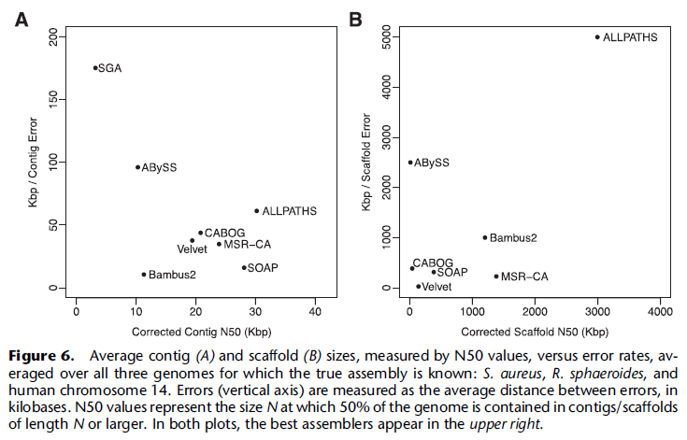

Slide 9
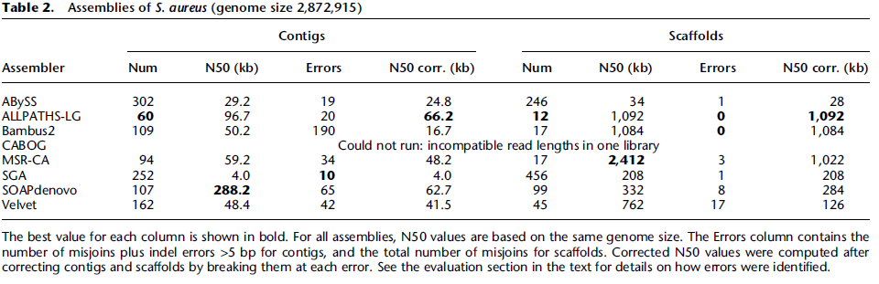
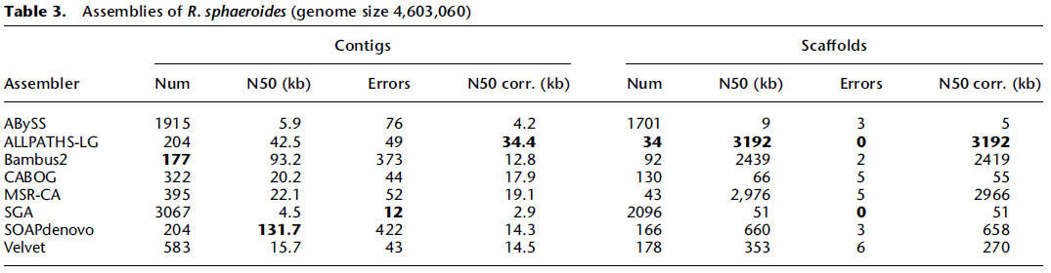
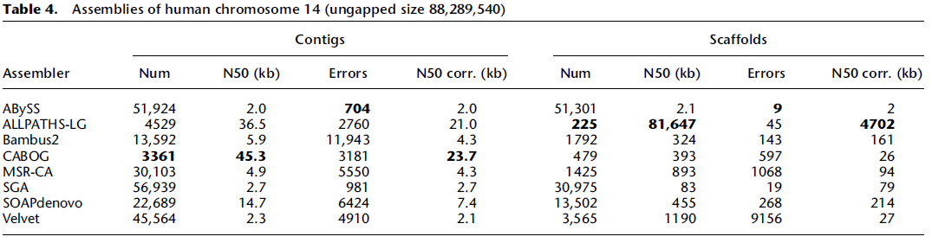
Notes:
http://en.wikipedia.org/wiki/Rhodobacter_sphaeroides

Slide 10
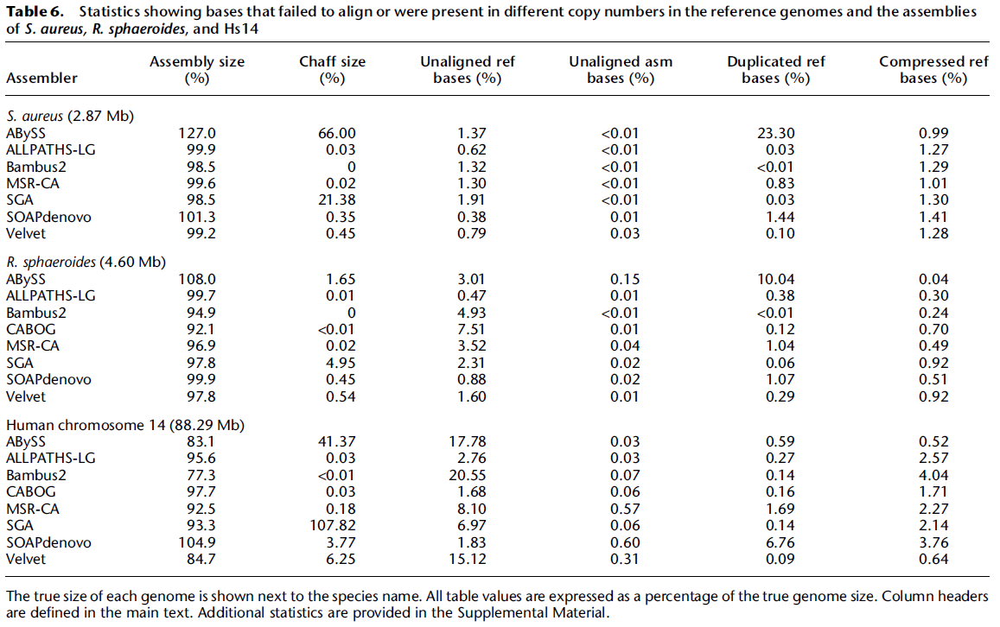
Notes:
Chaff: <200pb

Slide 11
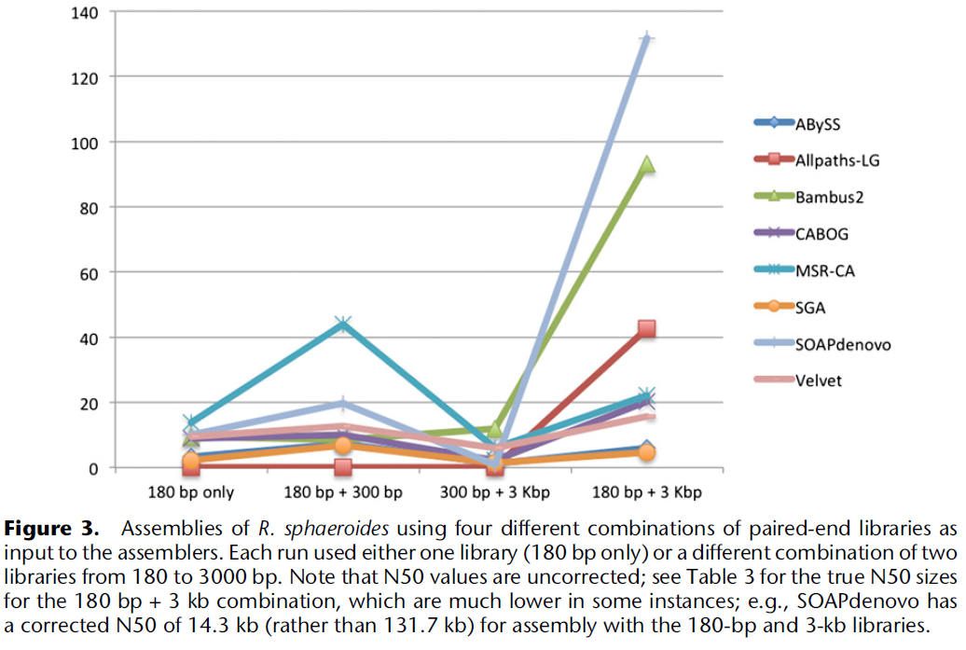

Slide 12
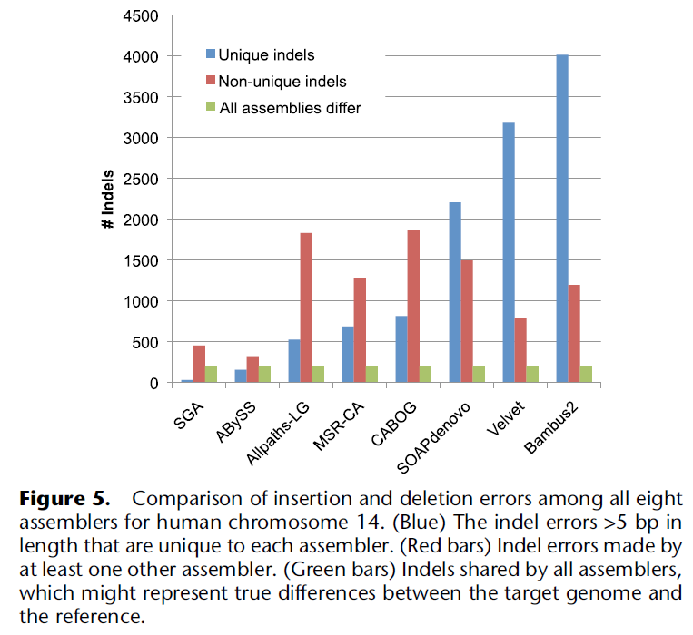

Slide 13
THE END

