Slide 1
Computing Common Intervals of K Permutations, with Applications to Modular Decomposition of Graphs
Anne Bergeron¹, Cedric Chauve¹, Fabien de Montgolfier²,
and Mathieu Raffinot³
Proc. 13th Annual European Symposium on Algorithms, in Lecture Notes in Comput. Sci
LNCS 3669, pp. 779–790, 2005.
Presenter: 許竣傑
2013/5/14

Slide 2
Abstract
We introduce a new way to compute common intervals of K permutations based on a very simple and general notion of generators of common intervals. This formalism leads to simple and efficient algorithms to compute the set of all common intervals of K permutations, that can contain a quadratic number of intervals, as well as a linear space basis of this set of common intervals. Finally, we show how our results on permutations can be used for computing the modular decomposition of graphs in linear time.

Slide 3
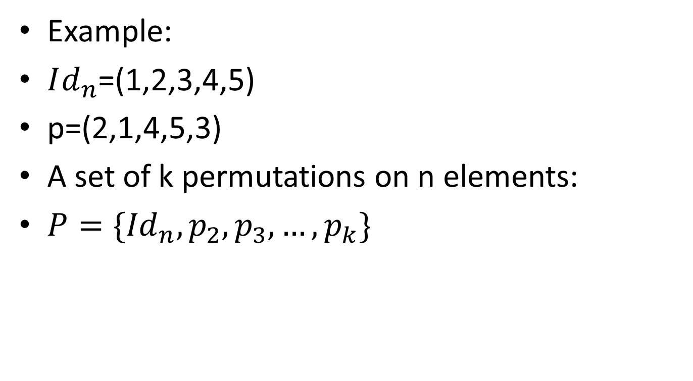
K Permutations
Example:
$Id_{n}$=(1,2,3,4,5)
p=(2,1,4,5,3)
A set of k permutations on n elements:
$P=\{{Id}_{n},p_{2},p_{3},…,p_{k}\}$

Slide 4
Common Intervals and Generators
Interval: (i,j)…(i,i+1,i+2,…,j)
Common interval:
(1,2,3,4,5,6,7,8,9)
(1,4,7,5,9,6,2,3,8)
=> (1,9),(2,3)

Slide 5
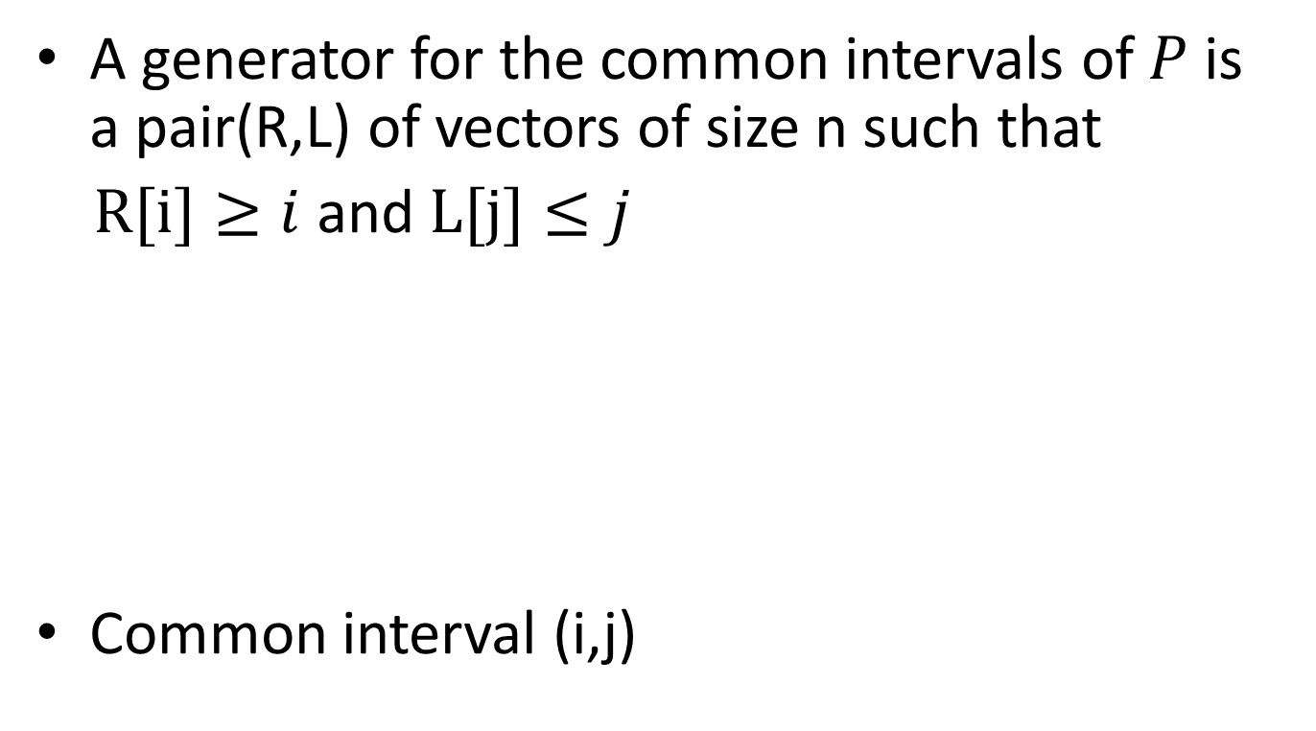
Common Intervals and Generators
A generator for the common intervals of $P$ is a pair(R,L) of vectors of size n such that
$R[i]≥i$ and $L[j]≤j$
Common interval (i,j)
i
j
R[i]
p1
L[j]
p2

Slide 6
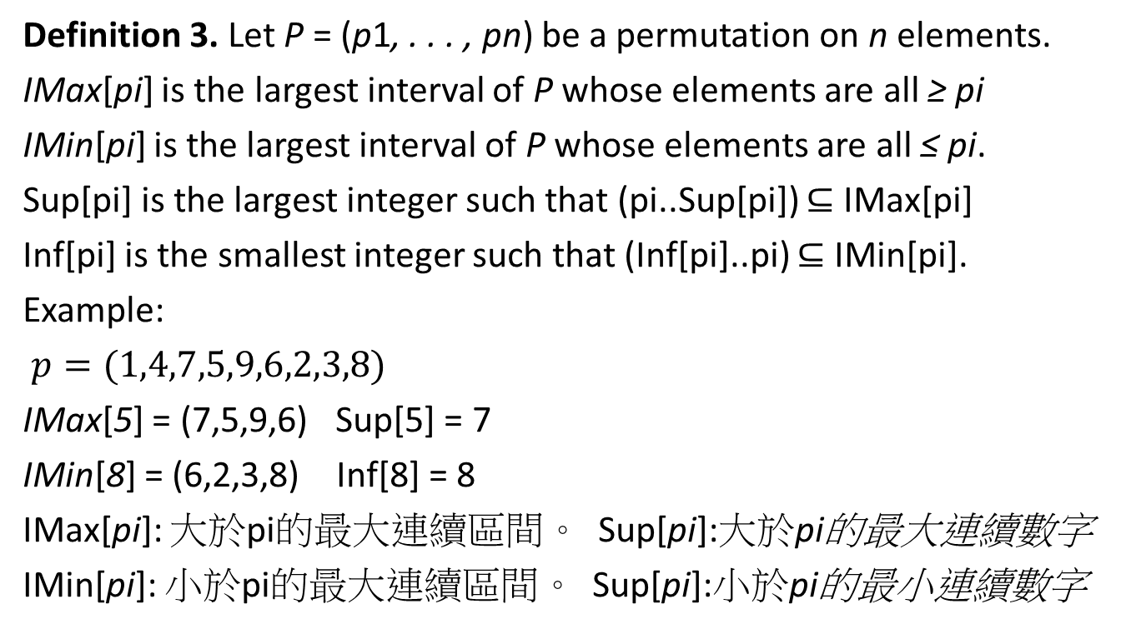
Common Intervals and Generators
Definition 3. Let P = (p1, . . . , pn) be a permutation on n elements.
IMax[pi] is the largest interval of P whose elements are all ≥ pi
IMin[pi] is the largest interval of P whose elements are all ≤ pi.
Sup[pi] is the largest integer such that (pi..Sup[pi]) ⊆ IMax[pi]
Inf[pi] is the smallest integer such that (Inf[pi]..pi) ⊆ IMin[pi].
Example:
$p=(1,4,7,5,9,6,2,3,8)$
IMax[5] = (7,5,9,6) Sup[5] = 7
IMin[8] = (6,2,3,8) Inf[8] = 8
IMax[pi]: 大於pi的最大連續區間。 Sup[pi]:大於pi的最大連續數字
IMin[pi]: 小於pi的最大連續區間。 Sup[pi]:小於pi的最小連續數字

Slide 7
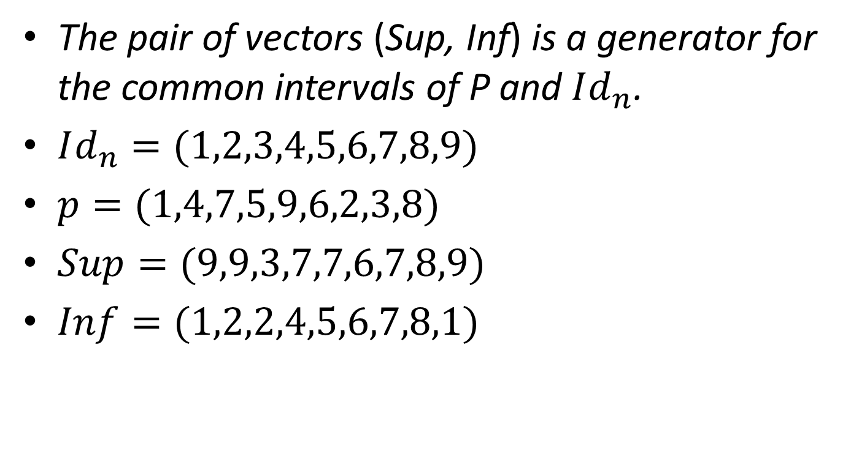
Common Intervals and Generators
The pair of vectors (Sup, Inf) is a generator for the commonintervals of P and$Id_{n}$.
$Id_{n}=(1,2,3,4,5,6,7,8,9)$
$p=(1,4,7,5,9,6,2,3,8)$
$Sup=(9,9,3,7,7,6,7,8,9)$
$Inf=(1,2,2,4,5,6,7,8,1)$

Slide 8

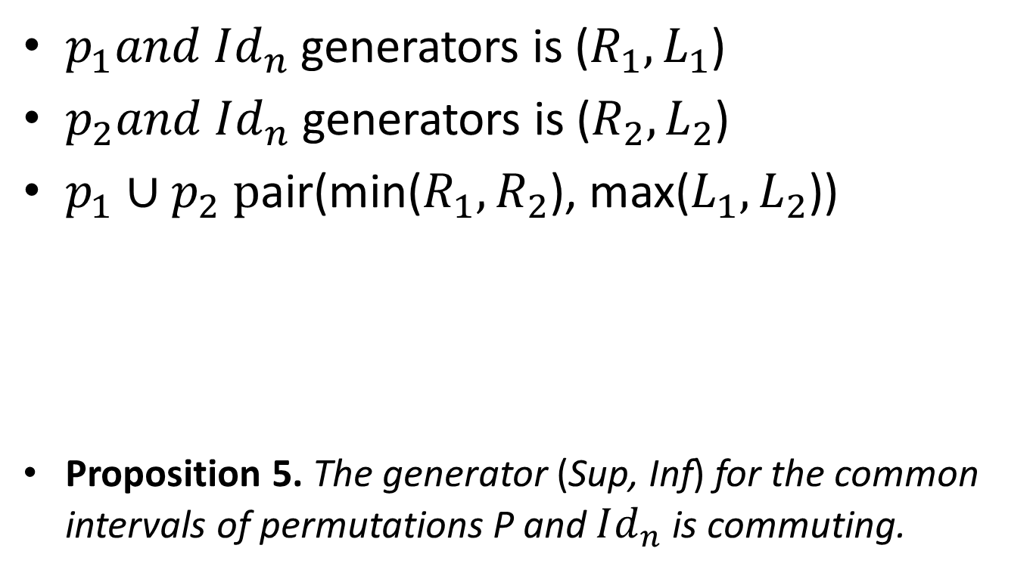



Common Intervals and Generators
$p_{1}and Id_{n}$generators is ($R_{1},L_{1}$)
$p_{2}and Id_{n}$generators is ($R_{2},L_{2}$)
$p_{1}∪p_{2} \text{p}\text{air}\text{(}$min($R_{1},R_{2}$), max($L_{1},L_{2}$))
Proposition 5. The generator (Sup, Inf) for the common intervals of permutations P and $Id_{n}$ is commuting.
$$L_{1}$$
$$L_{2}$$
$$R_{1}$$
$$R_{2}$$

Slide 9
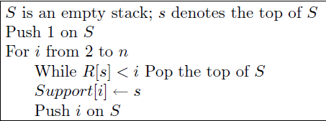





Common Intervals of K Permutations in Optimal Time
$Support\left[i\right]$:下一個$i^{′}$值比$i$小，且R[$i^{′}$] 大於i
$Support$=( ,1,2,2,4,5,5,2,2)
$$i^{′′}$$
$$i^{′}$$
$$i$$
R[$i^{′}$]

Slide 10
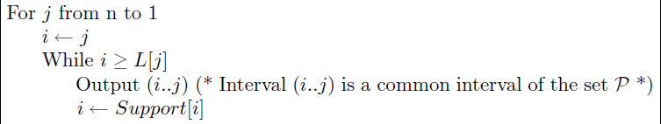







Common Intervals of K Permutations in Optimal Time
$$L[j]$$
$$i^{′}$$
$$i$$
$$j$$
$$1$$
$$n$$
R[$i^{′}$]
(i,j) is a common interval, ∵R[$i^{′}$]$≥i$∴($i^{′}$,j) is also a common interval
$$\left(i^{′},R\left[i^{′}\right]\right) be finded when j moved to R\left[i^{′}\right]$$

Slide 11
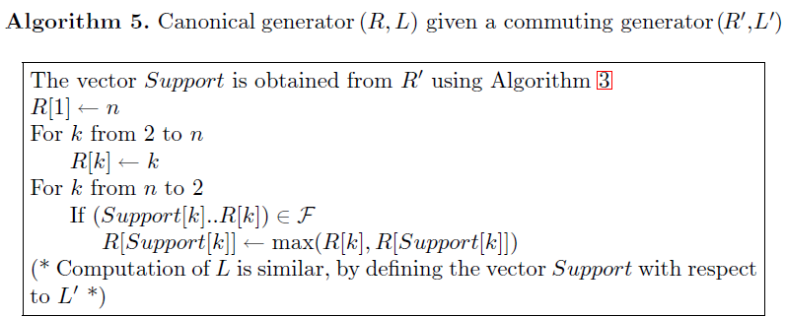
Modular Decomposition
R[i]
R[support[i]]
Support[i]
i

Slide 12
Modular Decomposition
Linear-time decomposition algorithms have been discovered [6,13] but remain rather complex. Simpler algorithms work in two steps: computing a factorizing permutation, and then building a tree representation on it. The first step was published in [9]. In this paper, we simplify the second step.

Slide 13
Thank You!

