Slide 1
Identifying almost identical files using context triggered piecewise hashing
Jesse Kornblum
Digital Investigation 3S (2006) S91–S97
Presenter: Che-Jui Hsu(許哲睿)
Date: 2013/6/25

Slide 2
Abstract
Homologous files share identical sets of bits in the same order. Because such files are not completely identical, traditional techniques such as cryptographic hashing cannot be used to identify them. This paper introduces a new technique for constructing hash signatures by combining a number of traditional hashes whose boundaries are determined by the context of the input. These signatures can be used to identify modified versions of known files even if data has been inserted, modified, or deleted in the new files. The description of this method is followed by a brief analysis of its performance and some sample applications to computer forensics.

Slide 3
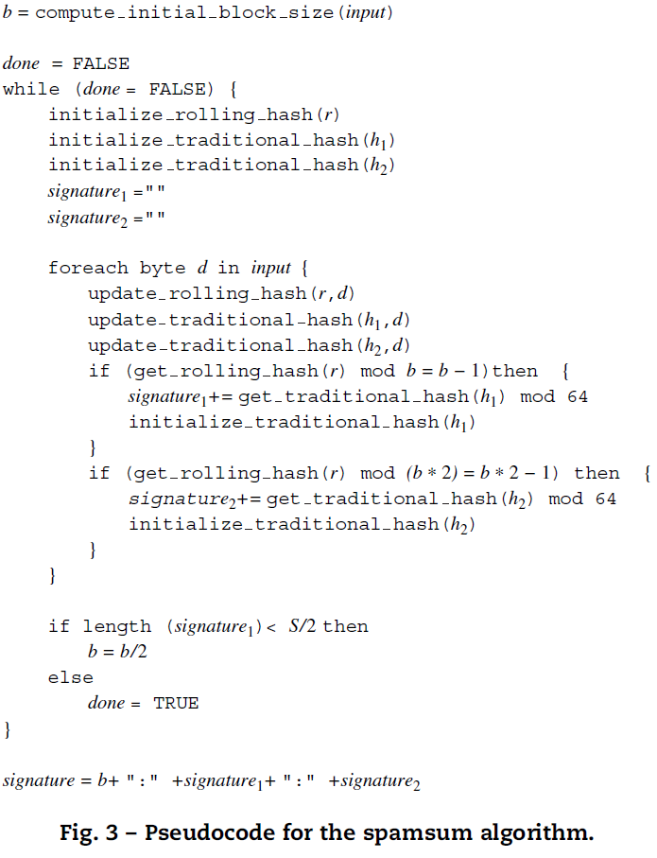
The spamsum algorithm (1/3)

Slide 4
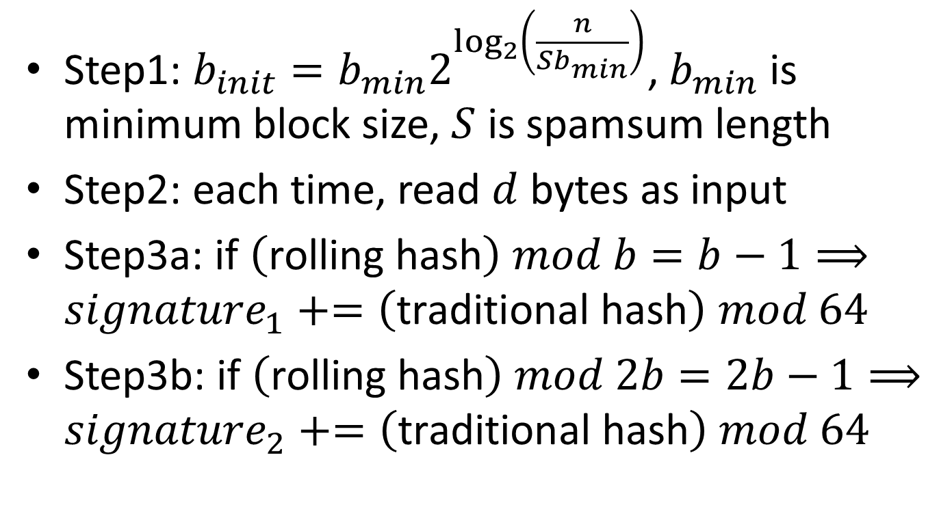
The spamsum algorithm (2/3)
Step1: $b_{init}=b_{min}2^{\log_{2}\left(\frac{n}{Sb_{min}}\right)}$, $b_{min}$ is minimum block size, $S$ is spamsum length
Step2: each time, read $d$ bytes as input
Step3a: $\text{if} \left(\text{rolling} \text{hash}\right) mod b=b−1⟹{signature}_{1}+=\left(\text{traditional} \text{hash}\right) mod 64$
Step3b: $\text{if} \left(\text{rolling} \text{hash}\right) mod 2b=2b−1⟹{signature}_{2}+=\left(\text{traditional} \text{hash}\right) mod 64$

Slide 5
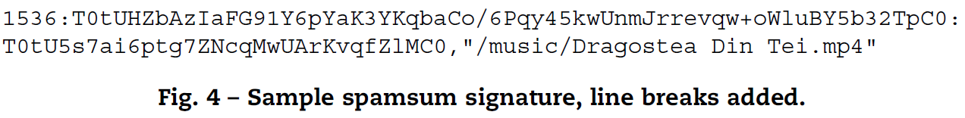

The spamsum algorithm (3/3)
Step4: if $length\left({signature}_{1}\right)<S/2⟹b=b/2$ and go to Step2 (重跑一次)
Step5: $signature=b:{signature}_{1}:{signature}_{2}$

Slide 6
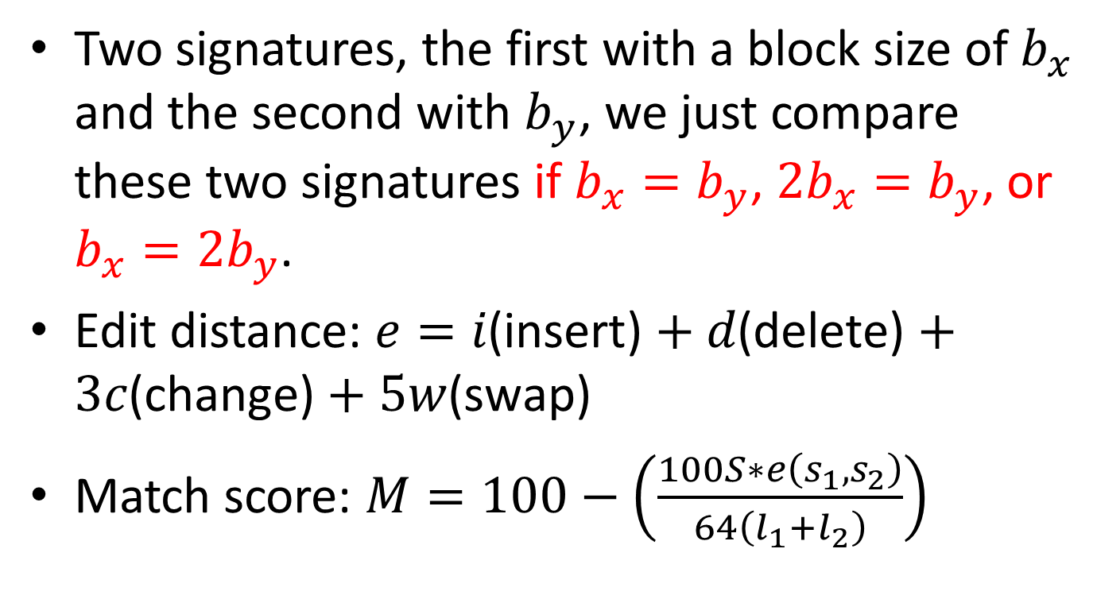
Comparing spamsum signatures (1/3)
Two signatures, the first with a block size of $b_{x}$ and the second with $b_{y}$, we just compare these two signatures if $b_{x}=b_{y}$, $2b_{x}=b_{y}$, or $b_{x}=2b_{y}$.
Edit distance: $e=i\text{(}\text{insert}\text{)}+d\text{(}\text{delete}\text{)}+3c\text{(}\text{change}\text{)}+5w\text{(}\text{swap}\text{)}$
Match score: $M=100−\left(\frac{100S∗e\left(s_{1},s_{2}\right)}{64\left(l_{1}+l_{2}\right)}\right)$

Slide 7
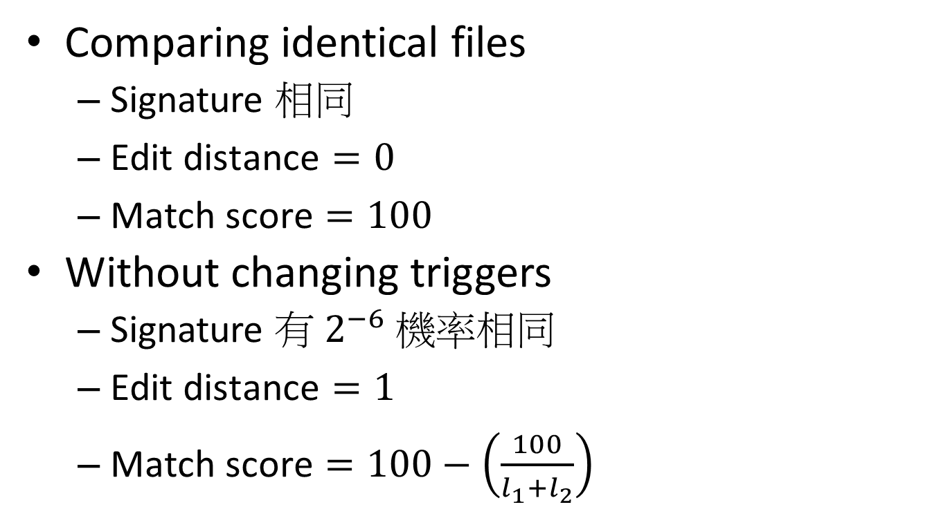
Comparing spamsum signatures (2/3)
Comparing identical files
Signature 相同
$\text{Edit} \text{distance}=0$
$\text{Match} \text{score}=100$
Without changing triggers
Signature 有 $2^{−6}$ 機率相同
$\text{Edit} \text{distance}=1$
$\text{Match} \text{score}=100−\left(\frac{100}{l_{1}+l_{2}}\right)$

Slide 8
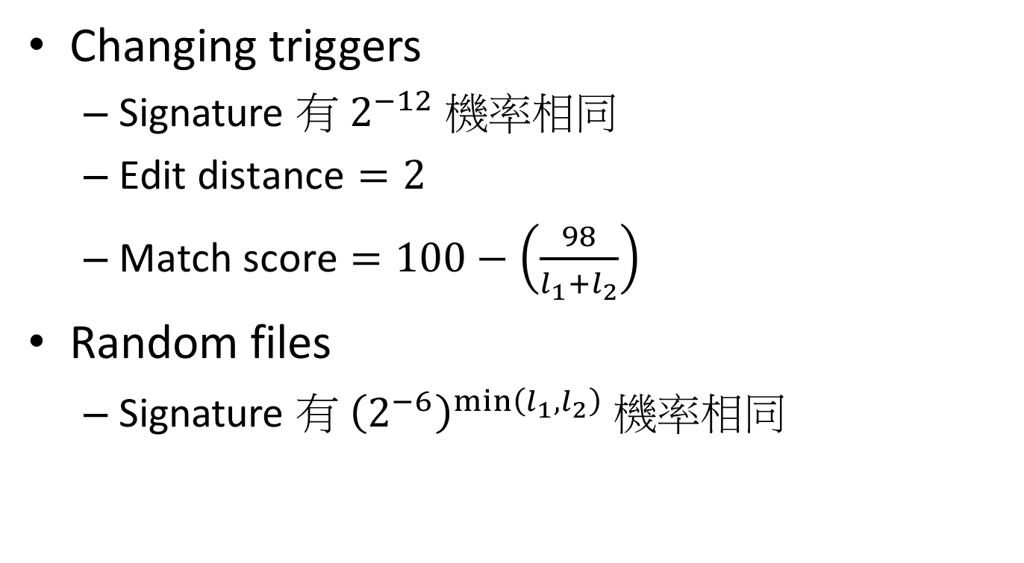
Comparing spamsum signatures (3/3)
Changing triggers
Signature 有 $2^{−12}$ 機率相同
$\text{Edit} \text{distance}=2$
$\text{Match} \text{score}=100−\left(\frac{98}{l_{1}+l_{2}}\right)$
Random files
Signature 有 ${\left(2^{−6}\right)}^{\min\left(l_{1},l_{2}\right)}$ 機率相同

Slide 9
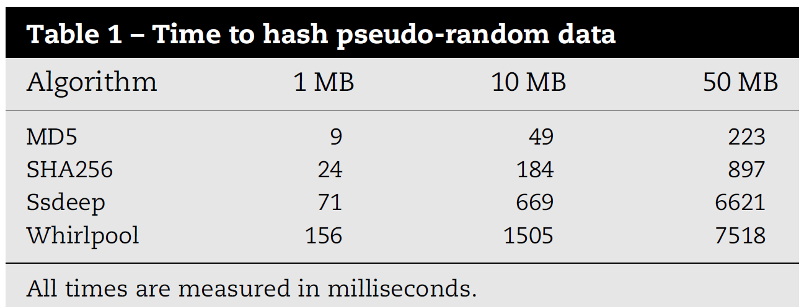
Performance issues (1/2)

Slide 10
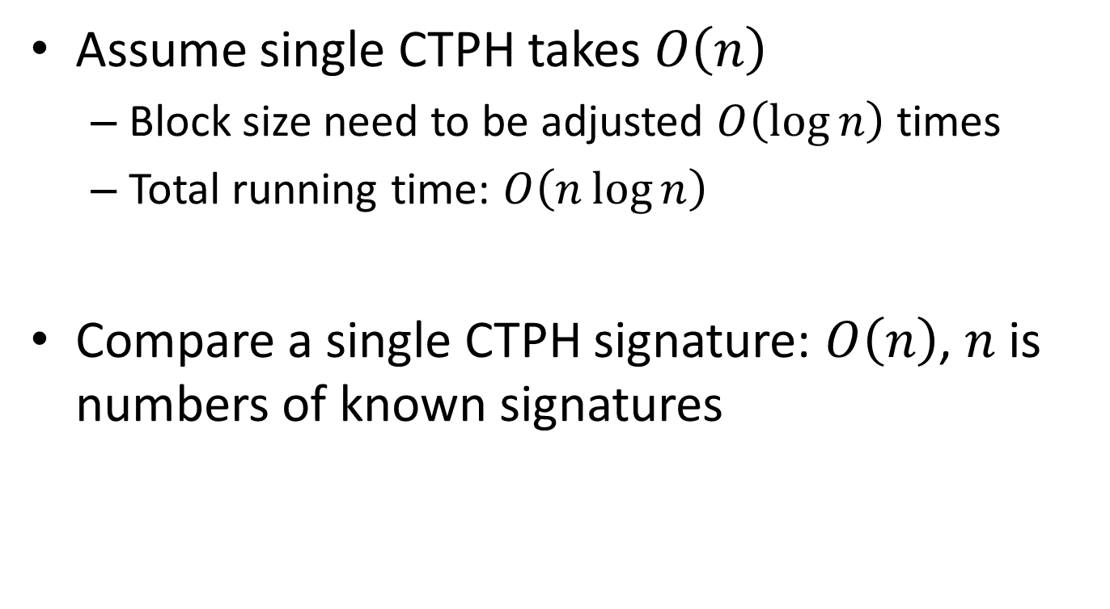
Performance issues (2/2)
Assume single CTPH takes $O\left(n\right)$
Block size need to be adjusted $O\left(\log{n}\right)$ times
Total running time: $O\left(n\log{n}\right)$
Compare a single CTPH signature: $O\left(n\right)$, $n$ is numbers of known signatures

Slide 11
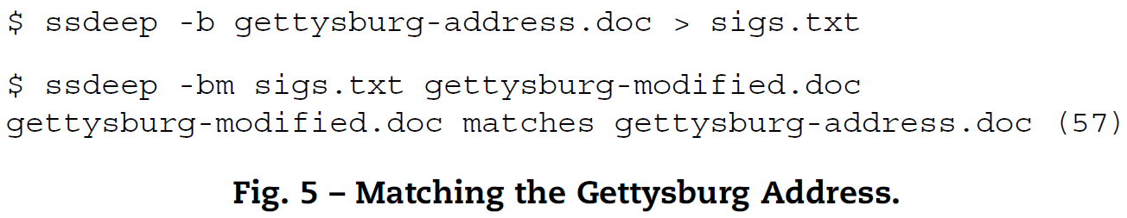
Applications (1/3)
Altered document matching
文章開頭加新段落
文章內容單字修改
文章部分字體顏色改為紅色
文章結尾加上眾多贅句 (I AM THE LIZARD KING!)

Slide 12
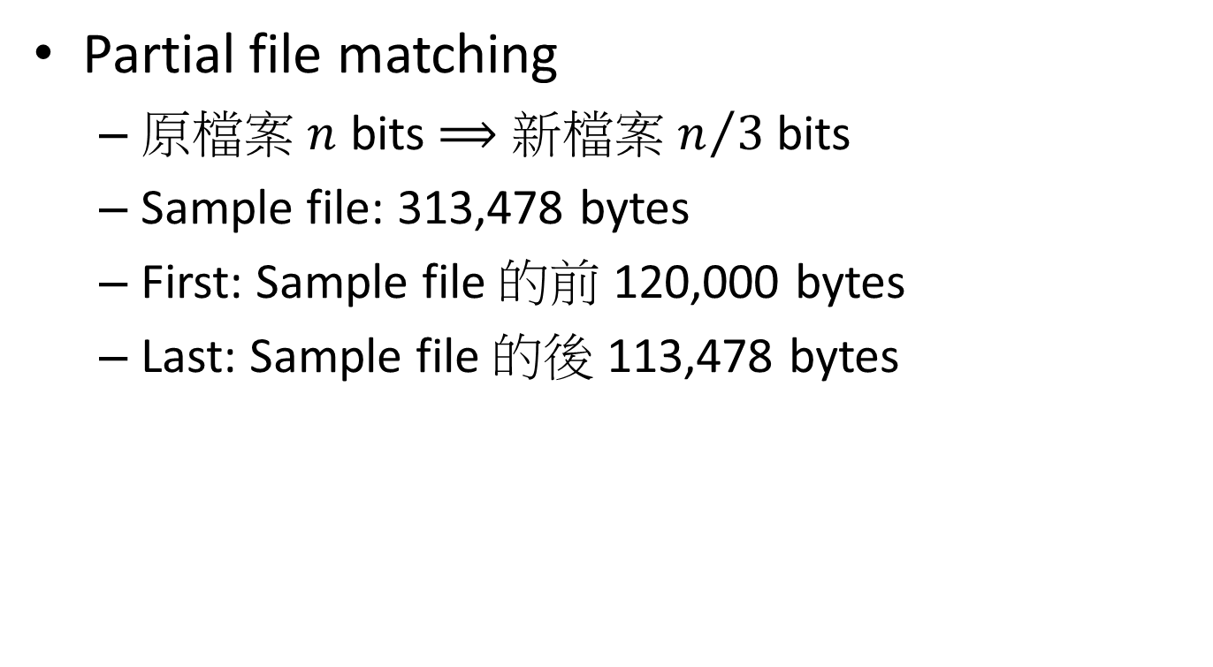
Applications (2/3)
Partial file matching
原檔案 $n$ bits $⟹$ 新檔案 $n/3$ bits
Sample file: 313,478 bytes
First: Sample file 的前 120,000 bytes
Last: Sample file 的後 113,478 bytes

Slide 13
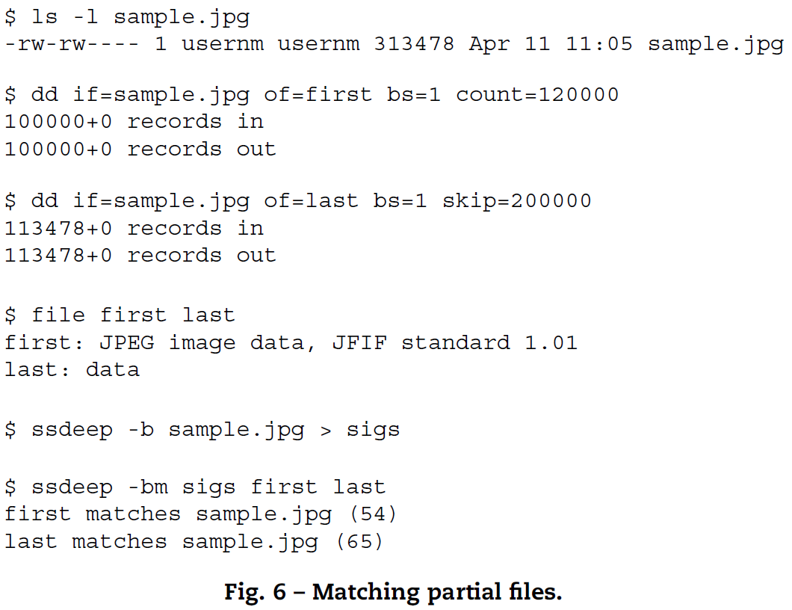
Applications (3/3)

