Slide 1
A hybrid stock selection model using genetic algorithms and support vector regression
Applied Soft Computing 12 (2012) 807–818
Chien-Feng Huang (黃健峯)
Presenter: Cheng-Han Lee
Date:2013/6/25

Slide 2
Abstract
In the areas of investment research and applications, feasible quantitative models include methodologies stemming from soft computing for prediction of financial time series, multi-objective optimization of investment return and risk reduction, as well as selection of investment instruments for portfolio management based on asset ranking using a variety of input variables and historical data, etc. Among all these, stock selection has long been identified as a challenging and important task. This line of research is highly contingent upon reliable stock ranking for successful portfolio construction. Recent advances in machine learning and data mining are leading to significant opportunities to solve these problems more effectively.

Slide 3
Abstract
In this study, we aim at developing a methodology for effective stock selection using support vector regression (SVR) as well as genetic algorithms (GAs). We first employ the SVR method to generate surrogates for actual stock returns that in turn serve to provide reliable rankings of stocks. Top-ranked stocks can thus be selected to form a portfolio. On top of this model, the GA is employed for the optimization of model parameters, and feature selection to acquire optimal subsets of input variables to the SVR model. We will show that the investment returns provided by our proposed methodology significantly outperform the benchmark. Based upon these promising results, we expect this hybrid GA–SVR methodology to advance the research in soft computing for finance and provide an effective solution to stock selection in practice.

Slide 4
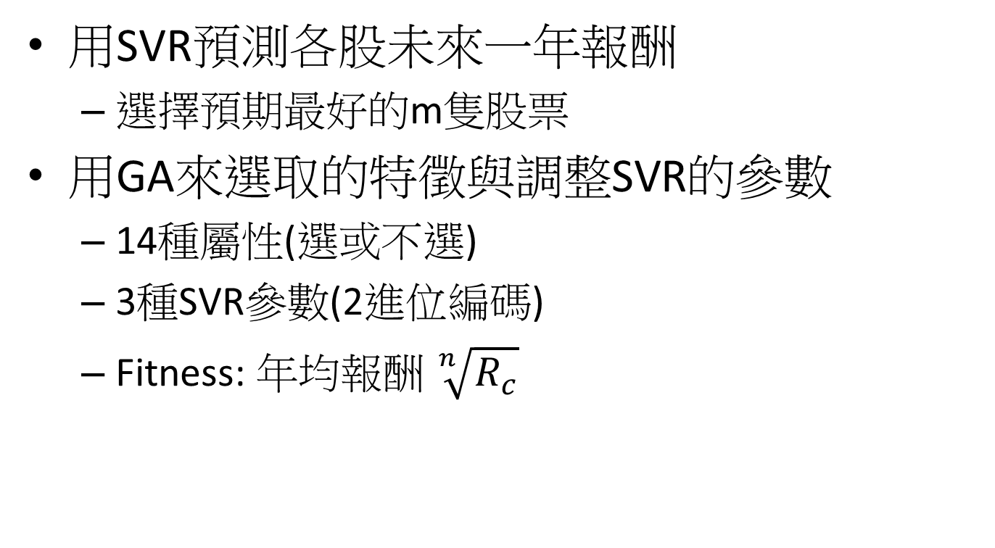
簡單來說就是
用SVR預測各股未來一年報酬
選擇預期最好的m隻股票
用GA來選取的特徵與調整SVR的參數
14種屬性(選或不選)
3種SVR參數(2進位編碼)
Fitness: 年均報酬 $\sqrt[n]{R_{c}}$

Slide 5
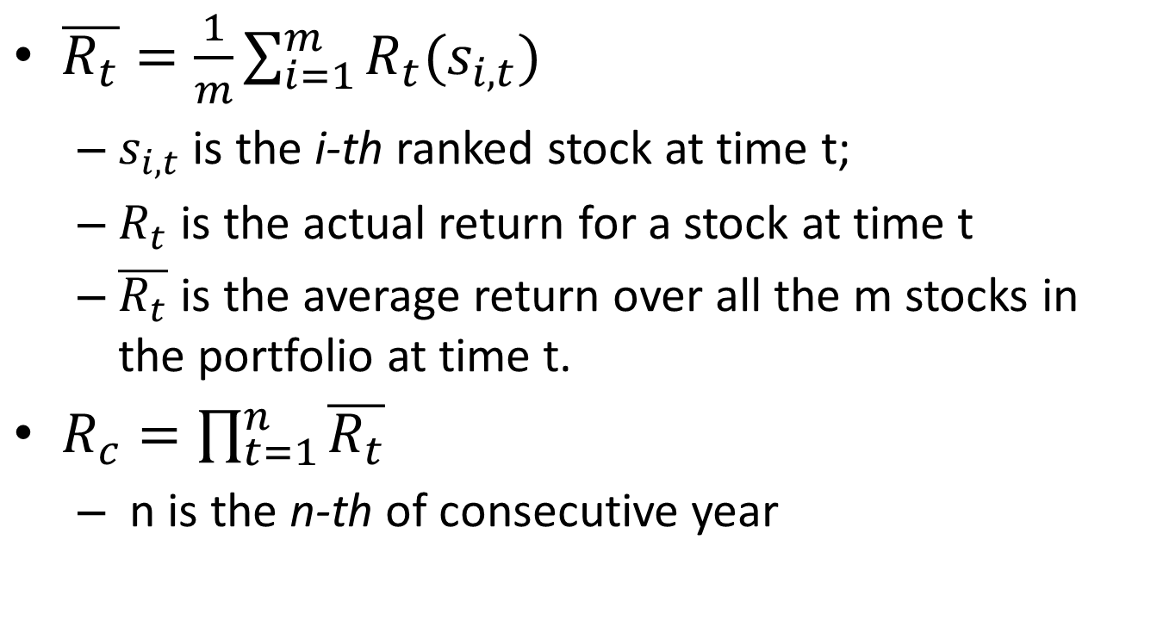
$\overline{R_{t}}=\frac{1}{m}\sum_{i=1}^{m}{R_{t}(s_{i,t})}$
$s_{i,t}$ is the i-th ranked stock at time t;
$R_{t}$ is the actual return for a stock at time t
$\overline{R_{t}}$ is the average return over all the m stocks in the portfolio at time t.
$R_{c}=\prod_{t=1}^{n}{\overline{R_{t}}}$
n is the n-thof consecutive year

Slide 6
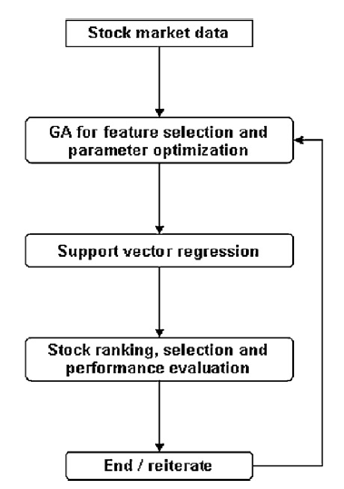
Flow chart

Slide 7
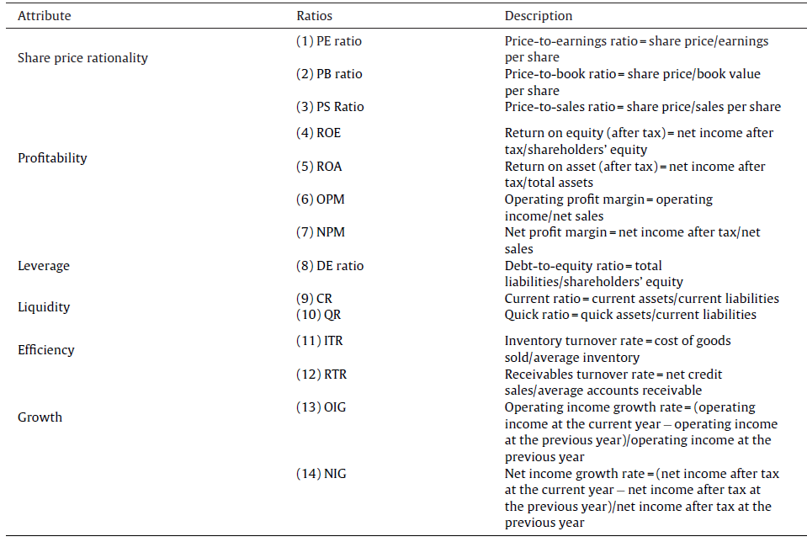
Attributes

Slide 8
Empirical results
200 largest market capitalizations listed in the Taiwan Stock Exchange. (TEJ)
Every original attribute is scaled into the range of [−1, 1] by subtracting the mean, and dividing the result by the standard deviation

Slide 9
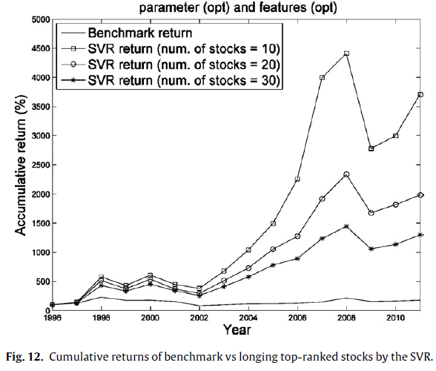

Slide 10
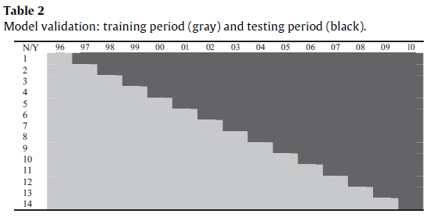
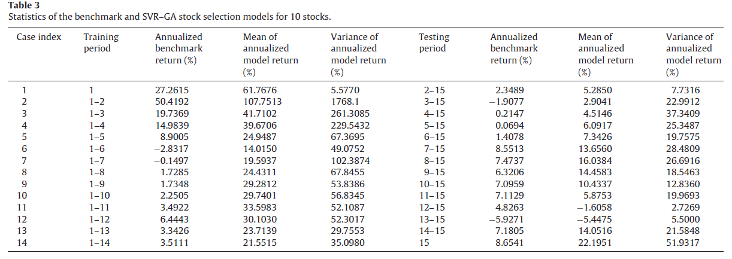
*
*
*
*
*
*
*
*
*
*
*
*
*

Slide 11
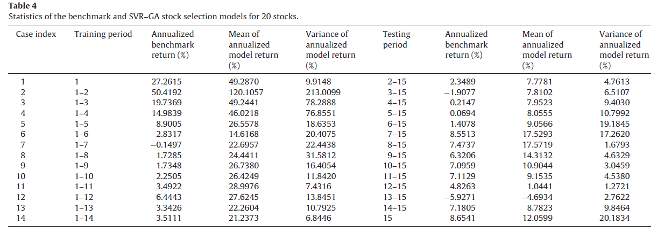
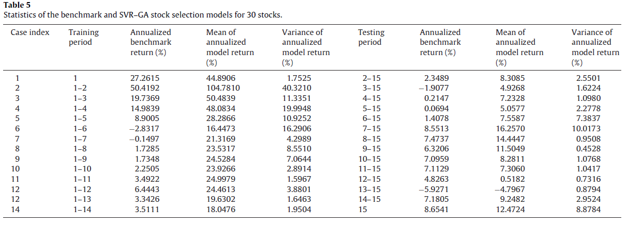
*
*
*
*
*
*
*
*
*
*
*
*
*
*
*
*
*
*
*
*
*
*
*
*
*
*
*
*

Slide 12
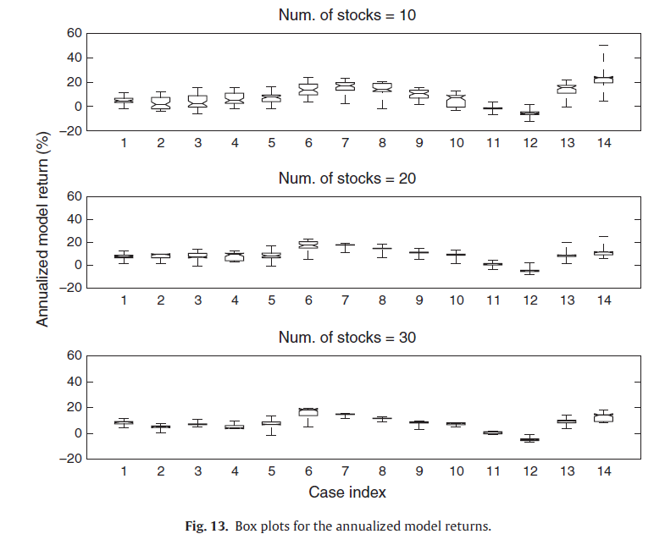

Slide 13
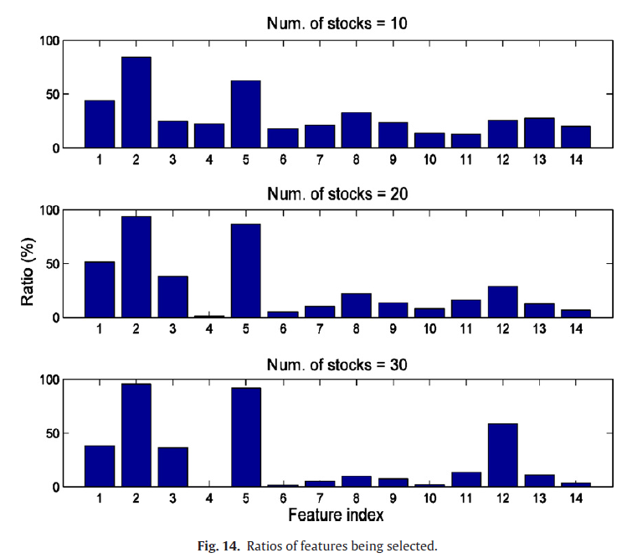

Slide 14
THE END

