Slide 1
Center Particle Swarm Optimization
Yu Liu(劉宇), Zheng Qin(覃征), Zhewen Shi(史哲文), Jiang Lu
Neurocomputing 70 (2007) 672-679
Presenter: 許竣傑
2013/6/25

Slide 2
Abstract
Center particle swarm optimization algorithm (CenterPSO) is proposed where a center particle is incorporated into linearly decreasing weight particle swarm optimization (LDWPSO). Unlike other ordinary particles in LDWPSO, the center particle has no explicit velocity, and is set to the center of the swarm at every iteration. Other aspects of the center particle are the same as that of the ordinary particle, such as fitness evaluation and competition for the best particle of the swarm. Because the center of the swarm is a promising position, the center particle generally gets good fitness value.

Slide 3
Abstract
More importantly, due to frequent appearance as the best particle of swarm, it often attracts other particles and guides the search direction of the whole swarm. CenterPSO and LDWPSO are extensively compared on three well-known benchmark functions with 10, 20, 30 dimensions. Experimental results show that CenterPSO achieves not only better solutions but also faster convergence. Furthermore, CenterPSO and LDWPSO are compared as neural network training algorithms. The results show that CenterPSO achieves better performance than LDWPSO.

Slide 4
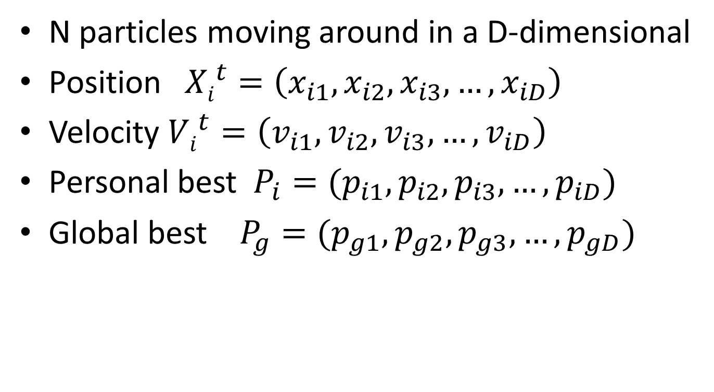
Linearly Decreasing Weight Particle Swarm Optimization(LDWPSO)
N particles moving around in a D-dimensional
Position${Xi}^{t}=\left(x_{i1},x_{i2},x_{i3},…,x_{iD}\right)$
Velocity ${Vi}^{t}=\left(v_{i1},v_{i2},v_{i3},…,v_{iD}\right)$
Personal best $P_{i}=(p_{i1},p_{i2},p_{i3},…,p_{iD})$
Global best $P_{g}=(p_{g1},p_{g2},p_{g3},…,p_{gD})$

Slide 5
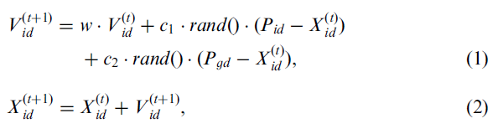

Linearly Decreasing Weight Particle Swarm Optimization(LDWPSO)
Xmin $≤X≤$Xmax
w: 0.9 to 0.4
Rand(): (0,1)

Slide 6
Linearly Decreasing Weight Particle Swarm Optimization(LDWPSO)
10
w
5
c1
p_{i}
x_{i}
0
c2
P_{g}
-5
-10
-10
-5
0
5
10

Slide 7
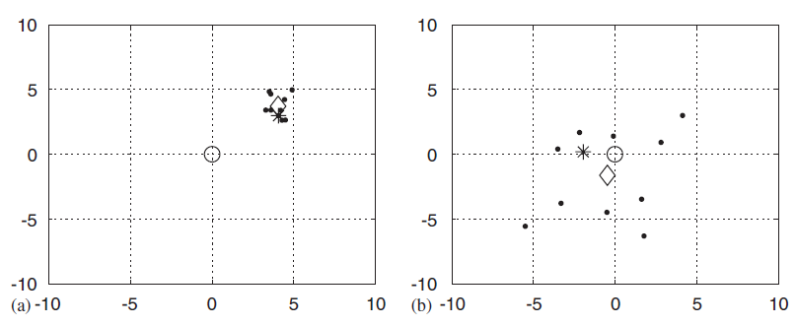
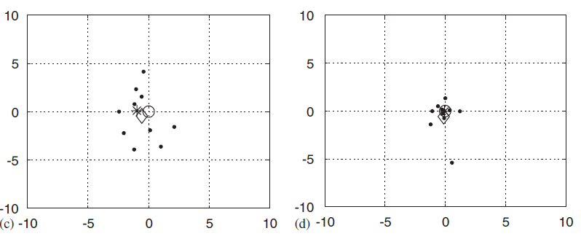
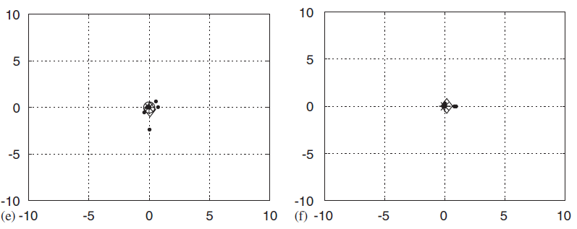
first
10
40
60
80
100

Slide 8
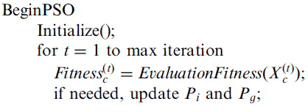

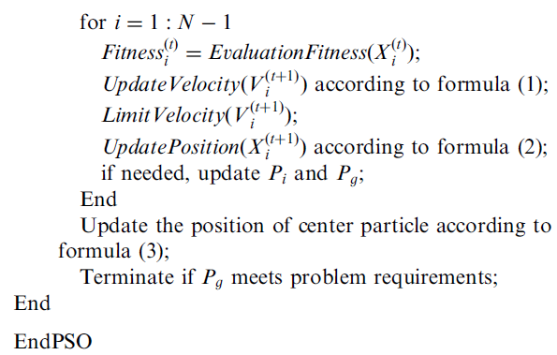
Center Particle Swarm Optimization (CenterPSO)

Slide 9
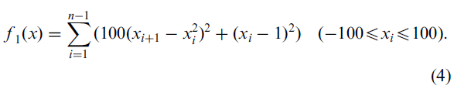

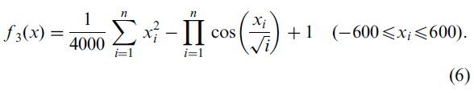
Experiments
Rosenbrock function
Rastrigrin function:
Griewank function

Slide 10
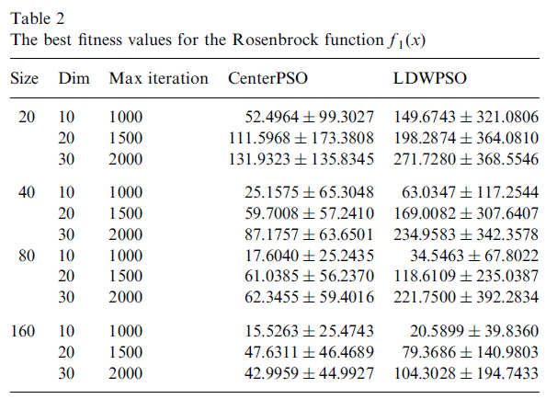
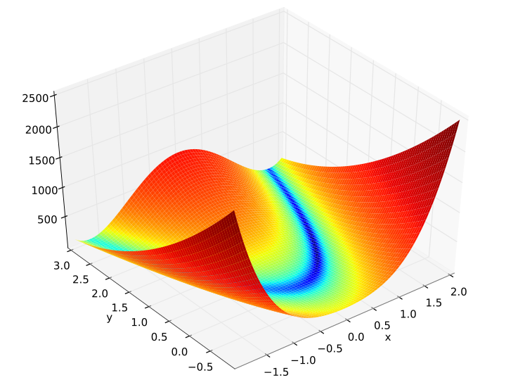
Experiments

Slide 11
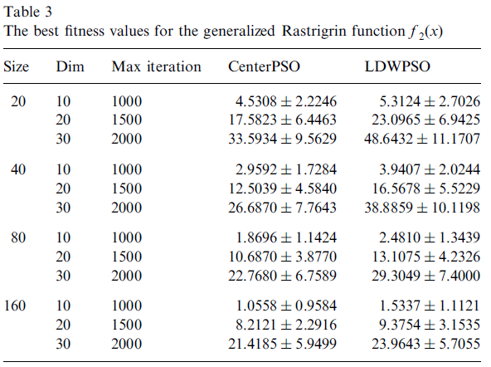
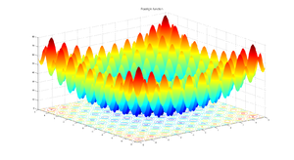
Experiments

Slide 12
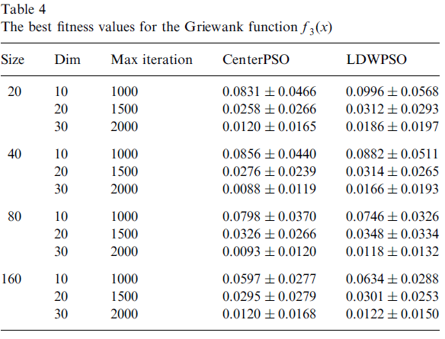
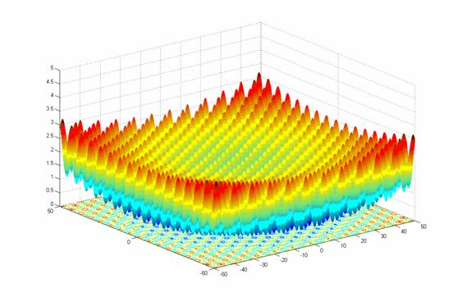
Experiments

Slide 13
Thank You!

