Slide 1
Approximate Common Intervals in Multiple Genome Comparison
Annie Chateau, Pierre Riou, Eric Rivals
LIRMM, UMR 5506 CNRS, Université Montpellier 2, Montpellier, France
2011 IEEE International Conference on Bioinformatics and Biomedicine
REPORTER : Cing-Yao Chen 2013/7/2

Slide 2
Abstract
We consider the problem of inferring approximate common intervals of multiple genomes. Genomes are modelled as sequences of homologous genes families identifiers, and approximate common intervals represent conserved regions possibly showing rearrangements, as well as repetitions, or insertions/deletions. This problem is already known, but existing approaches are not incremental and somehow limited to special cases. We adopt a simple, classical graph-based approach, where the vertices of the graph represent the exact common intervals of the sequences (i.e., regions containing the same gene set), and where edges link vertices that differ by less than δ elements (with δ being parameter). With this model, approximate gene clusters are maximal cliques of the graph: computing them can exploit known and well designed algorithms. For a proof of concept, we applied the method to several datasets of bacterial genomes and compared the two maximal cliques algorithms, a static and a dynamic one. While being quite flexible, this approach opens the way to a combinatorial characterization of genomic rearrangements in terms of graph substructures.

Slide 3
DEFINITION

Slide 4
Definition 1 : Character Set
Given a sequence w of size |w|, its character set C(w) is defined by C(w) := {w[i] : 1 ≤ i ≤ |w|}.
w = { 1 , 3 ,2 , 2 , 3, 4}
C(w) = { 1 , 2 , 3 , 4}

Slide 5
Definition 2 : Left- And Right-Maximality
Let w be sequence. A substring w[a, b] of w is left-maximal
If w[a-1] ∉ C(w[a,b])
EX:
w = {a,v,f,s,c,e,a,d,v}
w[2,6] is left-maximal , right-maximal
w[2,7] is NOT left-maximal

Slide 6
Definition 3 : Location
A location of a set of characters C on a sequence w is an interval [a, b] such that C(w[a, b]) = C.
w = {a, c, b, a, k, b, k, c, a}
C = {b, k}
Location of C = [a, b] = [5, 6] or [6, 7] or [5, 7]
C’ = {a, b, c}
Location of C’ = [a, b] = [1, 3] or [2, 4] or [1, 4]

Slide 7
Definition 4 : Exact Common Interval of p Sequences
A common interval of p sequences is a set E of substrings from p ≤ k sequences among S₁, ..., S_{k} such that for all the pairs (w₁, w₂) ∈ E², C(w₁) = C(w₂). A common interval is maximal if it contains only maximal substrings.
In all what follows, we only consider maximal common intervals.
EX: k = 3
S₁ = {a, c, c, b, k, b}
S₂ = {a, c, a, a, a, c}
S₃ = {c, c, a, b, k, b}
P = 3
E = {{a, c}, {a, c, c}, {a, c}, {c, a}, {c, a, a}, {a, c, a}, {a, a, c}, {c, a, a, a}, {a, c, a, a}, {a, a, a, c}, {a, c, a, a, a}, {c, a, a, a, c}, {a, c, a, a, a, c}, {c, a}, {c, c, a}}

Slide 8
Distance
d(A,B) = max{ |A\B|, |B\A|}.

Slide 9
Definition 5 : Approximate common interval
Given an integer δ > 0, a δ-approximate common interval of p sequences is a set E of substrings from p ≤ k sequences among S₁, ..., S_{k} such that for all the pairs (w₁, w₂) ∈ E2, d(C(w₁), C(w₂)) < δ.

Slide 10
Definition 6 : δ-graph
Given an integer δ,
a minimum character set size s,
a quorum parameter q and
a set-distance d
the δ-graph of k sequences is the graph whose vertices are the character sets corresponding to substrings of size at least s that are located on at least q genomes.
An edge links two vertices A and B if d(A,B) < δ.
Notes:
• s is the minimum size of considered character
sets, eliminating substrings with non-intersecting
character sets;
• q indicates the minimum number of sequences that
must be concerned by the locations of a given
character set.

Slide 11
Definition 6 : δ-graph
δ = 1
S = 2
q = 3
S₁ = {a, c, c, b, k, b}
S₂ = {a, c, a, a, a, c}
S₃ = {c, c, a, b, k, b}
E = {{a, c}, {a, c, c}, {a, c}, {c, a}, {c, a, a}, {a, c, a}, {a, a, c}, {c, a, a, a}, {a, c, a, a}, {a, a, a, c}, {a, c, a, a, a}, {c, a, a, a, c}, {a, c, a, a, a, c}, {c, a}, {c, c, a}}

Slide 12
Definition 6 : δ-graph
Note that, if q = 1, the approximate common intervals are the cliques of this graph.
However, if q > 1, the equivalence is no longer true, but we gain in computation time and flexibility.

Slide 13
Definition 7 : Connected Cluster
Given k sequences S₁, ..., S_{k}, and three integers s, q and δ, a connected cluster of these sequences is a set E of substrings from S₁, ..., S_{k} such that the set {C(w) : w ∈ E} is a connected component of the δ-graph of S₁, ..., S_{k} .
This notion enlarges the notion of clique, and it may prove biologically relevant. With connected clusters, we can for instance analyze rearrangement events.

Slide 14
METHOD

Slide 15
METHOD
1. extracts the genome representations from Hogenom files .
Note. Hogenom is a database
2. builds the δ-graph for the k genomes .
3. computes its cliques and maximal connected components (CC).
4. allows a general visualization of the entire graph or detailed view of its CC.

Slide 16
Construct of the Graph
The processing of each sequence is done in two distinct steps.
1. The genomes are first processed to detect substrings that are maximal with respect to their character set.
2. Each maximal substring is then processed by calling a second algorithm with the character set and the location as input.
Theorem 1: The algorithm described in the previous paragraphs builds the δ-graph in O(k²n⁵) time and O(k²n⁴) space.

Slide 17
Computation of the Maximal cliques in the graph
Static
Dynamic
MACE
K. Makino and T. Uno. New algorithms for enumerating all maximal cliques.
O(k³n⁶)

Slide 18
RESULT

Slide 19
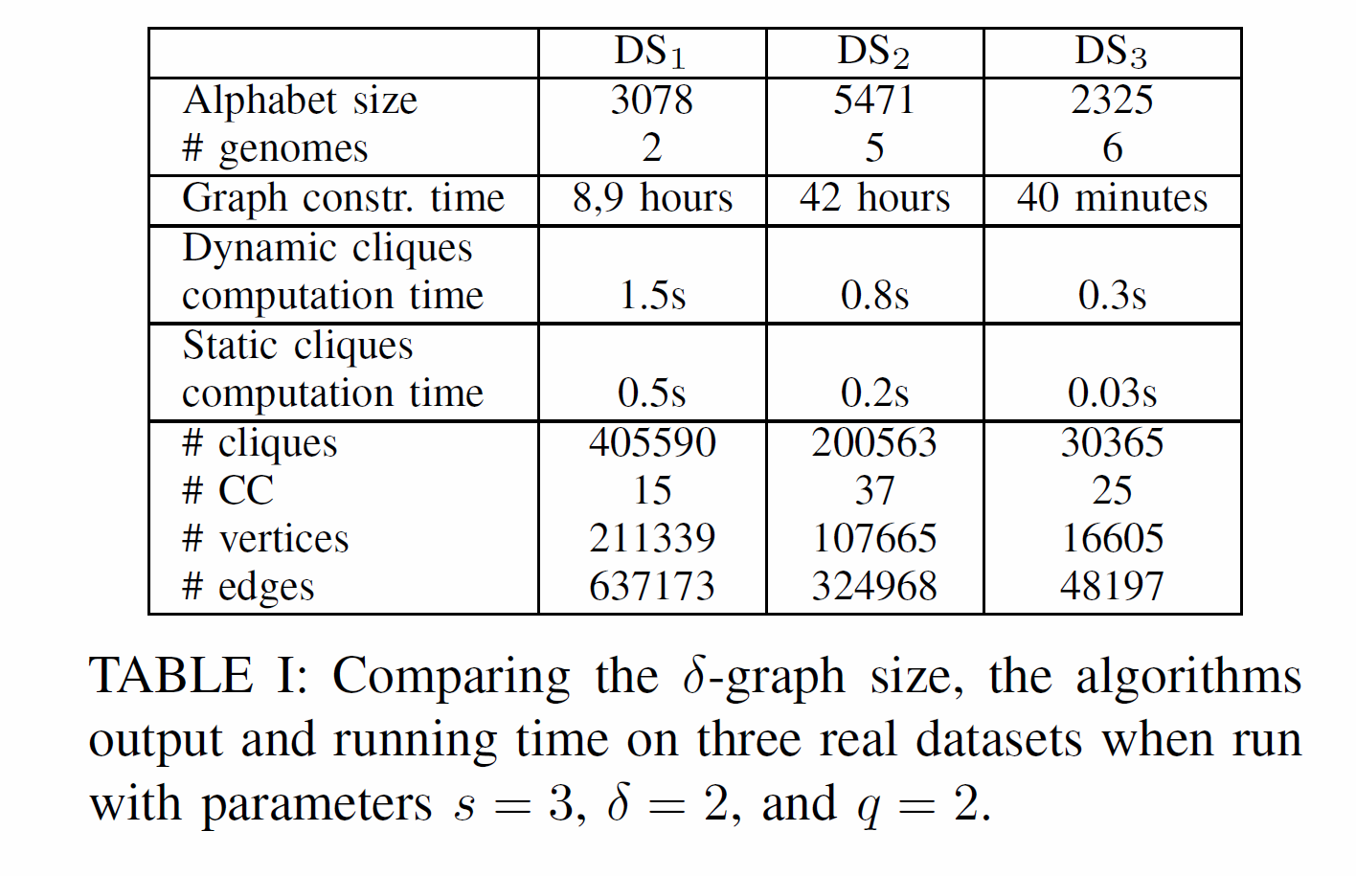
RESULT

