Slide 1
Multiple Trajectory Search for Large Scale Global Optimization
Lin-Yu Tseng(曾怜玉) and Chun Chen
2008 IEEE Congress on Evolutionary Computation (CEC 2008)
講者:方鈞毅

Slide 2
Abstract
In this paper, the multiple trajectory search (MTS) is presented for large scale global optimization. The MTS uses multiple agents to search the solution space concurrently. Each agent does an iterated local search using one of three candidate local search methods. By choosing a local search method that best fits the landscape of a solution’s neighborhood, an agent may find its way to a local optimum or the global optimum. We applied the MTS to the seven benchmark problems designed for the CEC 2008 Special Session and Competition on Large Scale Global Optimization.

Slide 3
Multiple Trajectory Search (MTS)
It was presented to solve the large scale global optimization problem.
Typical examples of global optimization applications include:
Protein structure prediction
Traveling salesman problem (minimize the path length)
Chemical engineering
Worst case analysis
Mathematical problems (e.g., the Kepler conjecture)

Slide 4
Global Optimization Problem
Problem definition:
Minimize F(X)
Subject to L ≤ X ≤ U
Where X = (x₁, x₂, x₃, .., x_{n})
F(X) is the objective function.
L = (l₁, l₂, l₃, .., l_{n}), U = (u₁, u₂, u₃, .., u_{n})
Feasible solution X satisfies l_{i} ≤ x_{i} ≤ u_{i} , i = 1 to n

Slide 5
Multiple Trajectory Search (MTS)
Steps
產生 M 個initial solutions by simulated orthogonal array SOA_{M×N} ； search range初始值為(upper bond - low bond)/2
除第一代外，每一代只對部分較好的解，執行local search(solution, search range), local search將會修改search range，並將較好的解做為下一次疊代的候選。
執行step2，直到到達指定次數。

Slide 6


Orthogonal Array (OA)
Orthogonal Array(OA)
OA(n, k, q, t)
n: 實驗次數
k: factors
q: level of a factor
t: strength
滿足
同一行中的每個element出現的次數相同。
任選t行，任何level的組合的出現次數要一樣。
組合被均勻的分佈在整個可能的組合空間中。

Slide 7
Simulated Orthogonal Array (SOA)
只須滿足第一項即:
同一行中的每個element出現的次數相同。
做法:
任選一未填滿的行，將elemnt作亂序排列，再一一放入，重複以上動作，直到沒空行。
MTS initial solutions:
SOA上的M列，即為M個initial solutions
目的: 使initial solutions

Slide 8
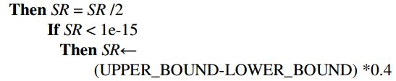
Local Search
這裡提出三種local search，在執行MTS時會先計算哪種search分數較高，而使用；
Local search1: 從第一維開始，減去SR，較好則保留，退化則恢復原值，再加上SR/2，同樣較好保留，退化則恢復原值，重複直到第n維的值。
若SR經過一輪(1至n維)無法再有改進，則:

Slide 9
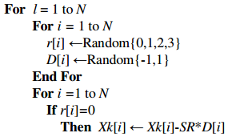
Local Search
Local search2:與Local search1相似，從第一維開始，每個維度有1/4的機會，要做增刪SR，較好則保留，退化則恢復原值，再加減SR/2，同樣較好保留，退化則恢復原值，重複直到第n維的值。

Slide 10


Local Search
Local Search3:從第一維開始，計算X₁ , Y₁, X₂ 是否較佳，與分數評算

Slide 11
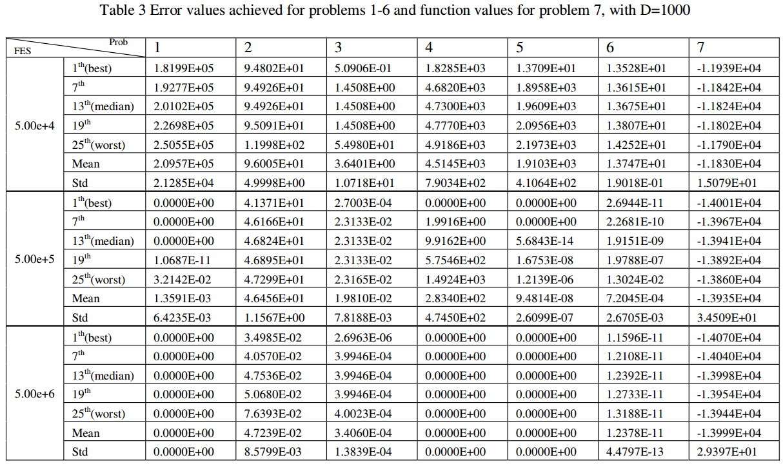
The function error value (f(x)-f(x*))

Slide 12
