Slide 1
RTED: A Robust Algorithm for the Tree Edit Distance
Mateusz Pawlik and Nikolaus Augsten Free University of Bozen-Bolzano Bolzano, Italy
The Proceedings of the VLDB Endowment (PVLDB) Volume 5 Issue 4, December 2011 Pages 334-345
Presenter: Yi-Pu Guo 2013-07-02

Slide 2
Abstract (1/2)
We consider the classical tree edit distance between ordered labeled trees, which is defined as the minimum-cost sequence of node edit operations that transform one tree into another. The state-of-the-art solutions for the tree edit distance are not satisfactory. The main competitors in the field either have optimal worst-case complexity, but the worst case happens frequently, or they are very efficient for some tree shapes, but degenerate for others. This leads to unpredictable and often infeasible runtimes. There is no obvious way to choose between the algorithms.

Slide 3
Abstract (2/2)
In this paper we present RTED, a robust tree edit distance algorithm. The asymptotic complexity of RTED is smaller or equal to the complexity of the best competitors for any input instance, i.e., RTED is both efficient and worst-case optimal. We introduce the class of LRH (Left-Right-Heavy) algorithms, which includes RTED and the fastest tree edit distance algorithms presented in literature. We prove that RTED outperforms all previously proposed LRH algorithms in terms of runtime complexity. In our experiments on synthetic and real world data we empirically evaluate our solution and compare it to the state-of-the-art.

Slide 4
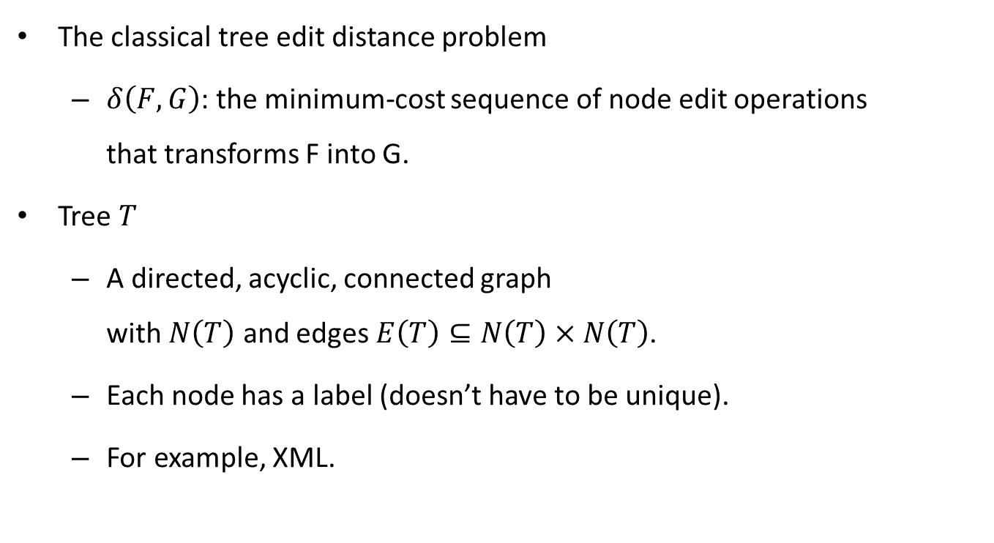
The Problem to Solve
The classical tree edit distance problem
$δ\left(F,G\right)$: the minimum-cost sequence of node edit operations that transforms F into G.
Tree $T$
A directed, acyclic, connected graph with $N\left(T\right)$ and edges $E\left(T\right)⊆N\left(T\right)×N\left(T\right)$.
Each node has a label (doesn’t have to be unique).
For example, XML.
T, G 看來甚至可以是 forest。

Slide 5
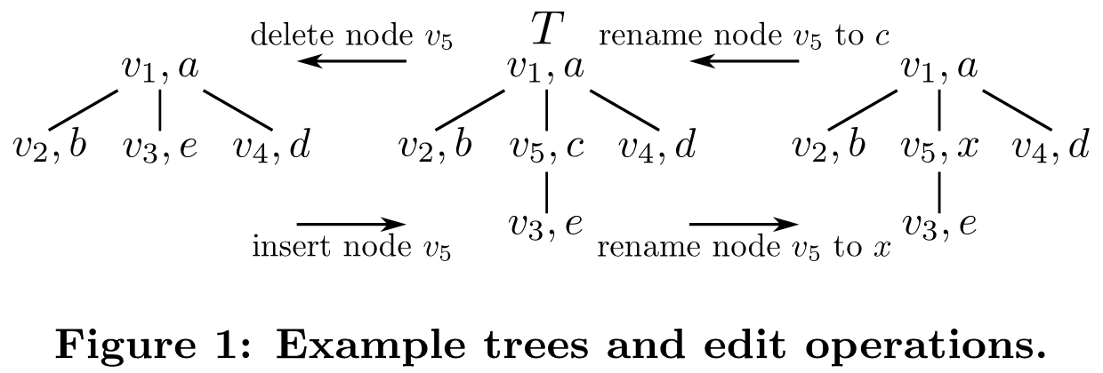

The Standard Edit Operations
Delete (cost $c_{d}\left(υ\right)$)
Insert (cost $c_{i}\left(υ\right)$)
Rename (cost $c_{r}\left(υ,ω\right)$)

Slide 6
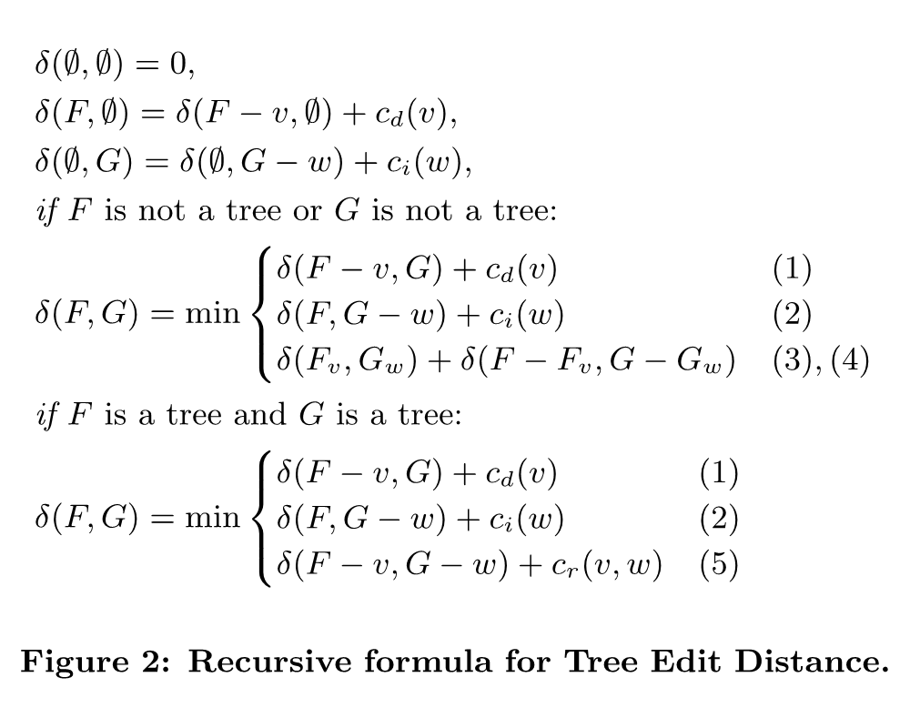
Recursive Formula for TED
The fastest algorithms are DP implementations of the recursive solution.

Slide 7
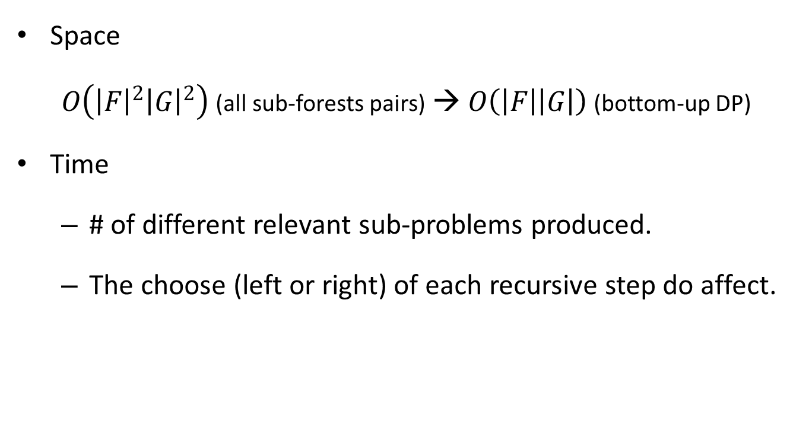
Space & Time Complexity
Space
$O\left({\left|F\right|}^{2}{\left|G\right|}^{2}\right)$ (all sub-forests pairs) → $O\left(\left|F\right|\left|G\right|\right)$ (bottom-up DP)
Time
# of different relevant sub-problems produced.
The choose (left or right) of each recursive step do affect.

Slide 8
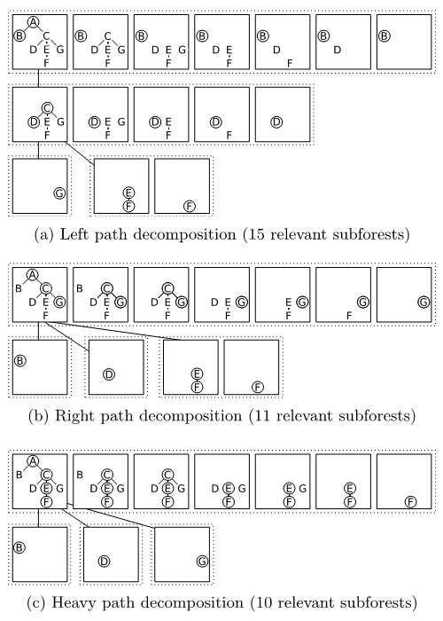
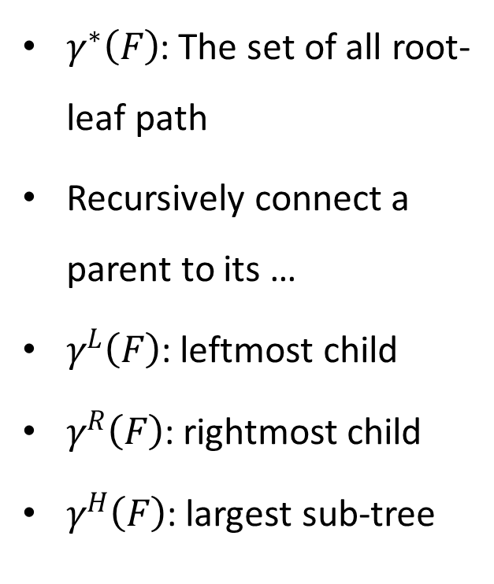
Root-leaf Path
$γ^{∗}\left(F\right)$: The set of all root-leaf path
Recursively connect a parent to its …
$γ^{L}\left(F\right)$: leftmost child
$γ^{R}\left(F\right)$: rightmost child
$γ^{H}\left(F\right)$: largest sub-tree

Slide 9
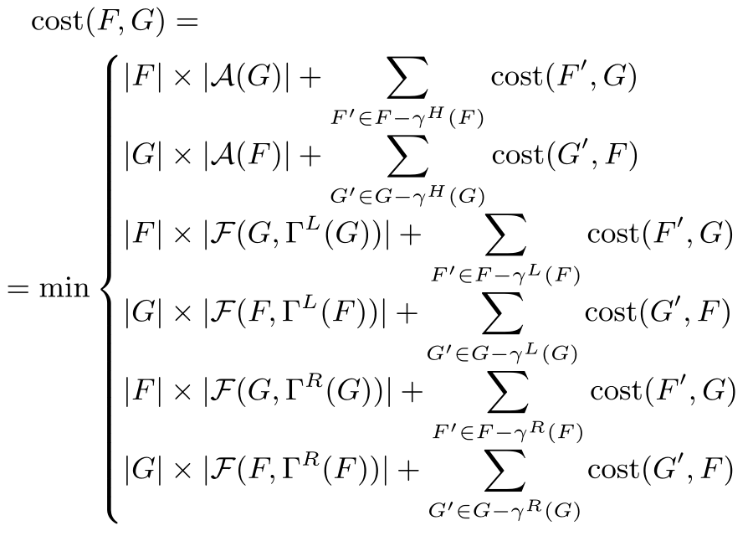
RTED
The optimal LRH strategy for finding the optimal strategy.

Slide 10
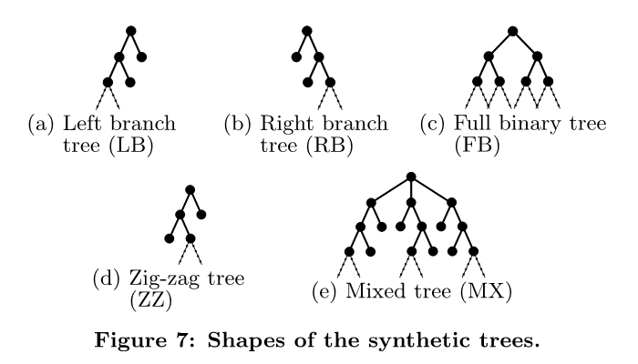
Dataset
Synthetic data
6 different shapes
depth < 15, fanout < 6
Real world data
SwissPort
XML protein sequence database
50,000 flat trees, depth ≤ 4, fanout ≤ 346, avg size = 187
TreeBank
XML representation of natural language syntax trees
56,385 small and deep trees, avg size = 68, avg depth = 10.4
TreeFam
16,138 phylogenetic trees of animal genes
depth < 158 (avg = 14), avg fanout = 2, avg size = 95

Slide 11
Compared with
Zhang-L
Left paths only
Zhang-R
Right paths only
Klein-H
Heavy paths only
Demain-H
The worst case optimal solution

Slide 12
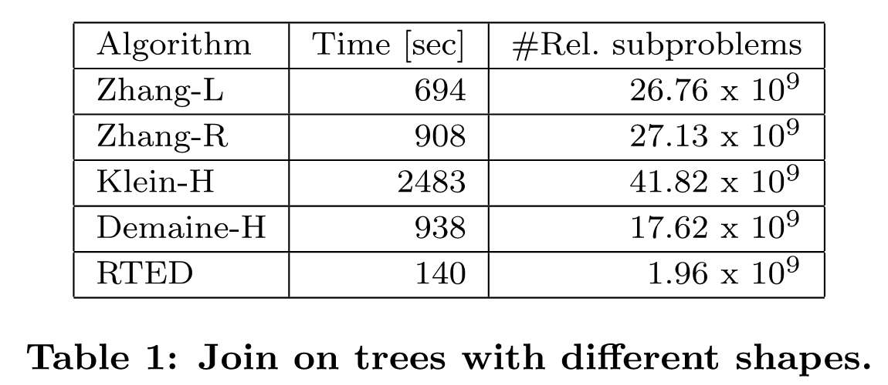
Result

Slide 13
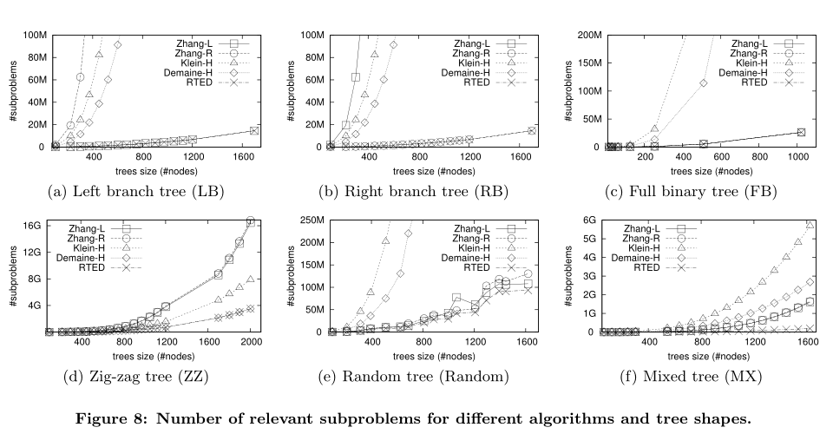

Slide 14
